Slide 1
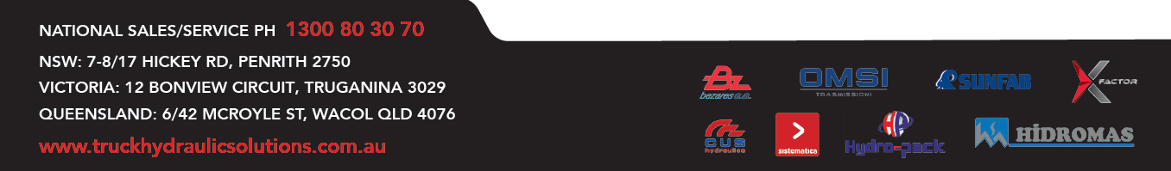
Truck Hydraulic Solutions Product Overview

Slide 2
COMPANY HISTORY
THS was founded by Ronnie Heeps in 2010
Mathew Hayter joined the business as partner in 2019 and established THS Melbourne
In 2020 THS Brisbane was opened
All three states have company owned workshops
Service providers based in WA, NT and SA
2024 THS moves to import majority of products

Slide 3
INDUSTRIES WE SERVE
TRUCK HOUSES
TILT TRAY MANUFACTURERS
VAC TRUCK MANUFACTURERS
TRUCK BODY BUILDERS
RESELLERS
FLEET OWNERS
TRUCK RENTAL
CRANE SUPPLIERS
WASTE EQUIPMENT INSTALLERS

Slide 4

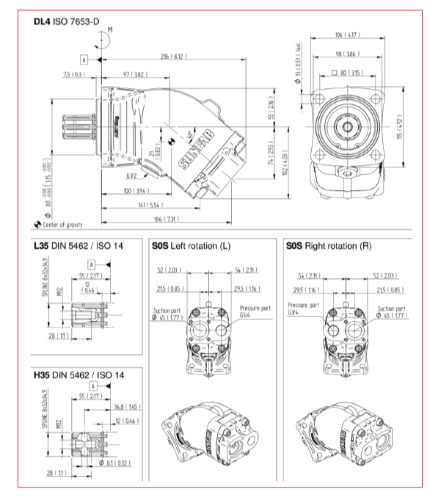
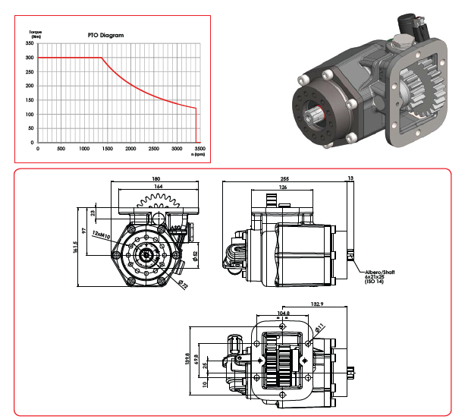
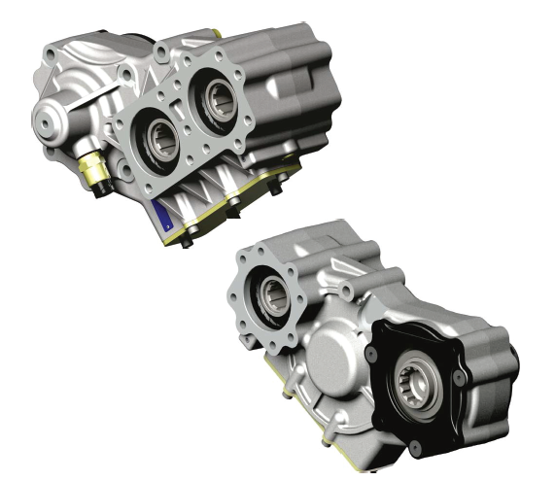
PTO & PUMPS
BEZARES
SUNFAB

Slide 5


HEAVY DUTY PTOs

Slide 6
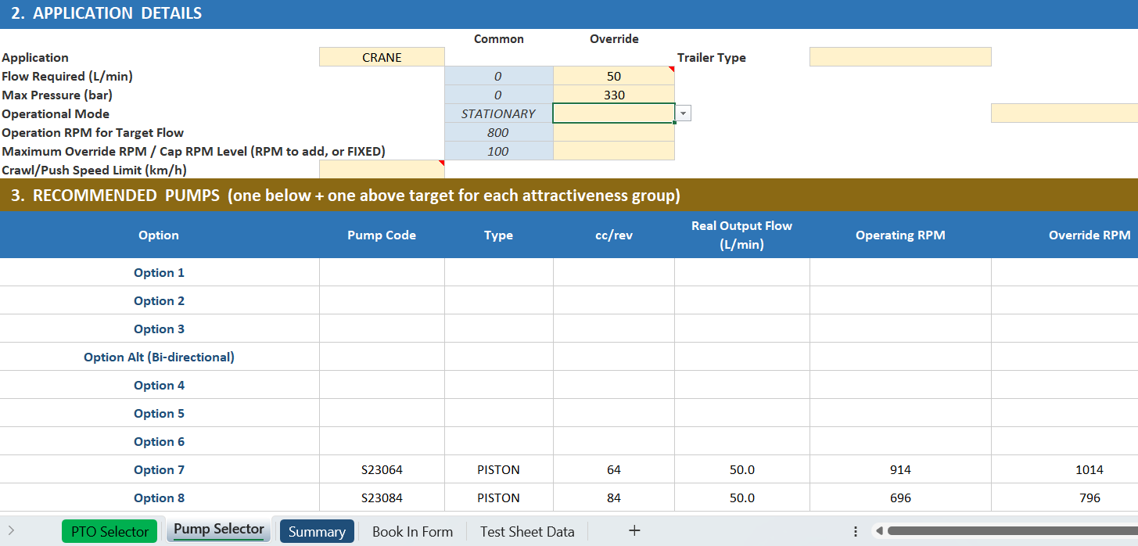
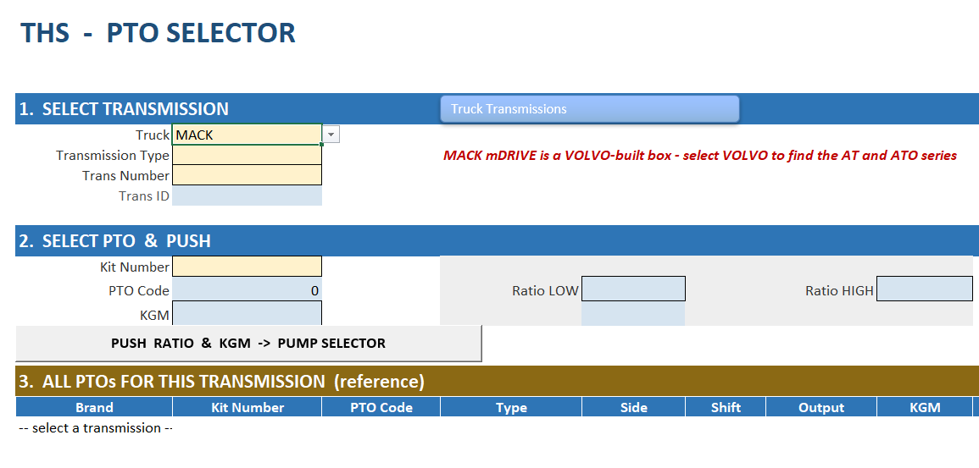
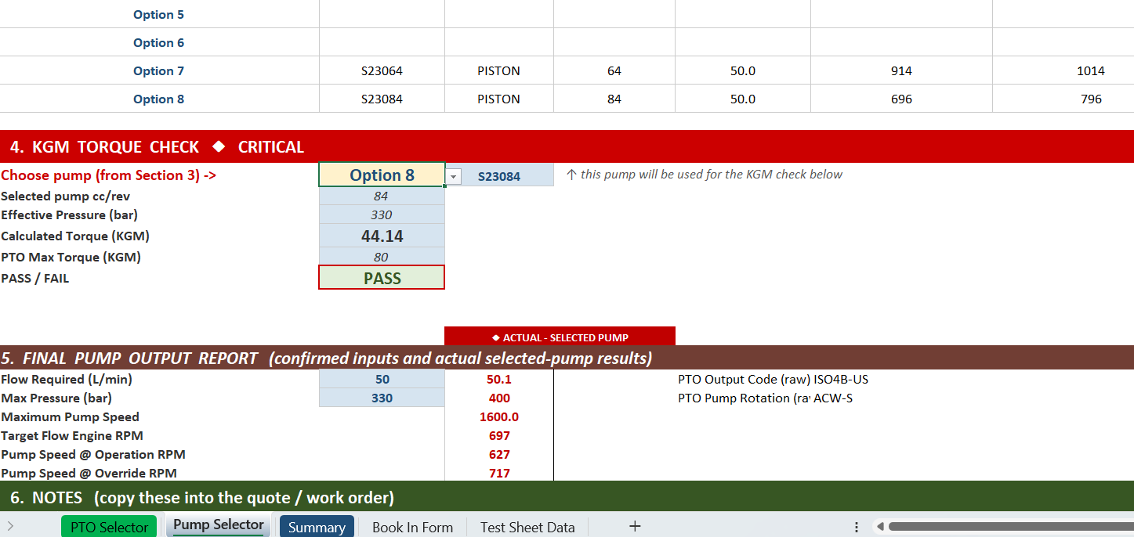
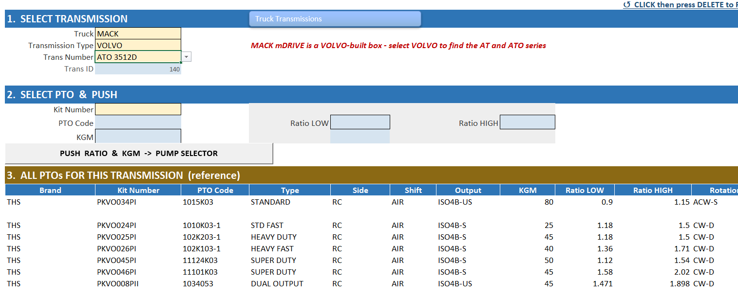
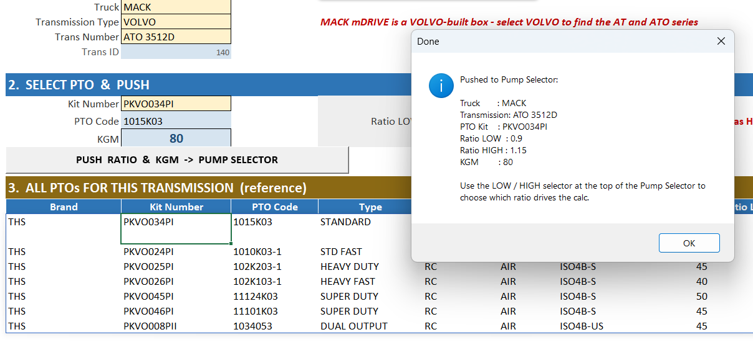
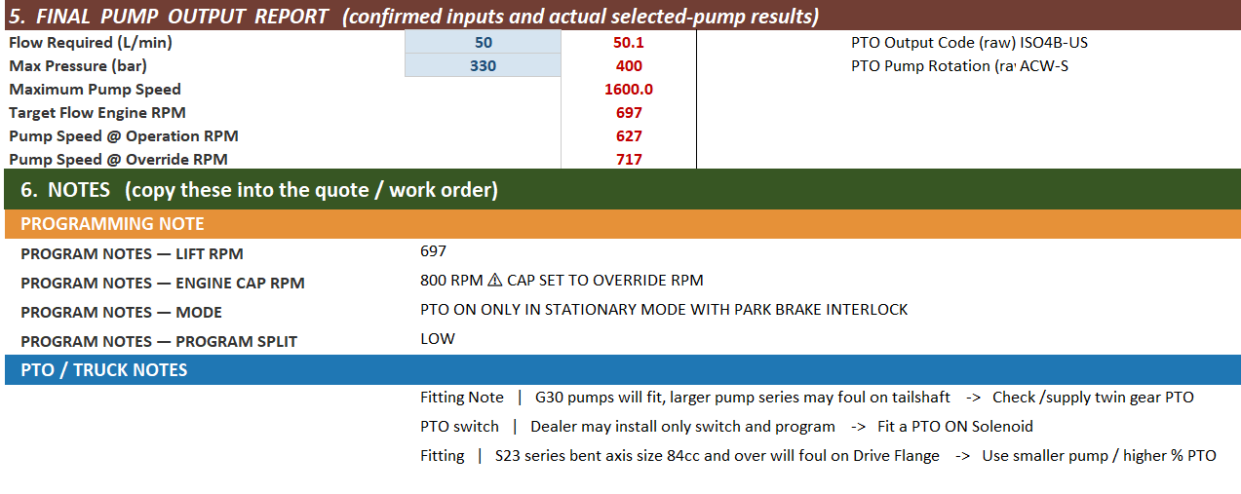
PTO SELECTION

Slide 7
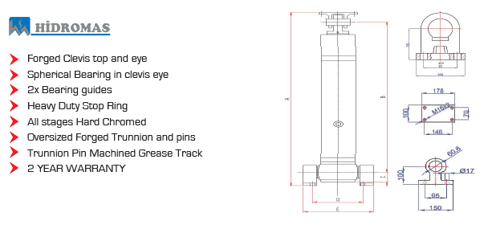
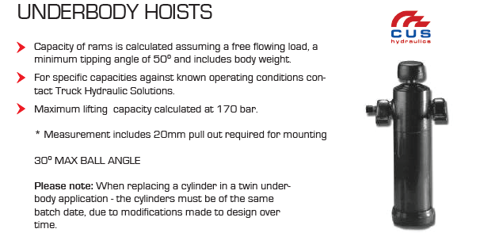
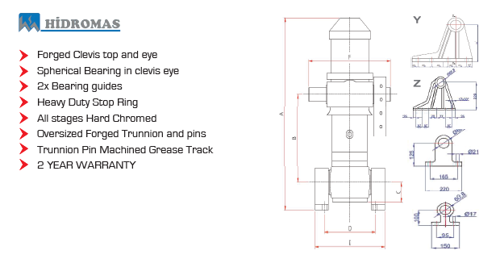
HOISTS

Slide 8
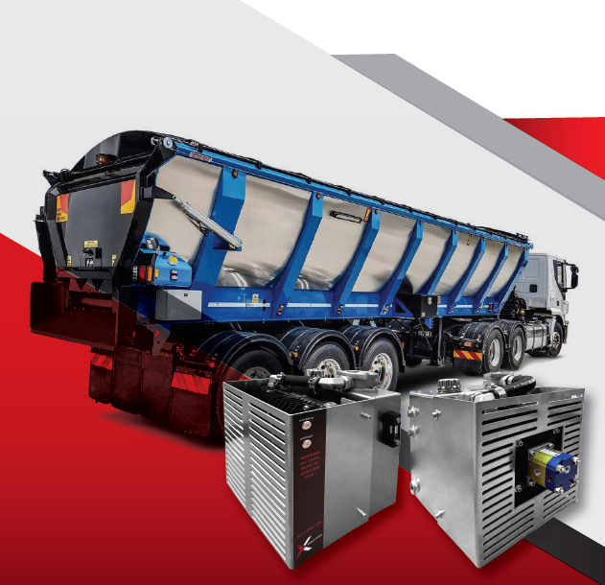
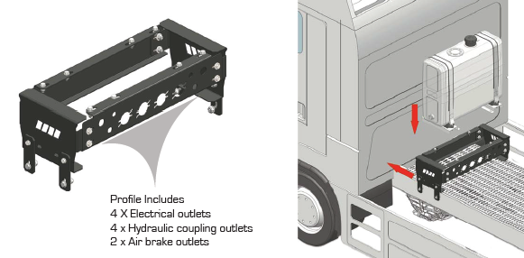
TANKS & COOLERS

Slide 9



VALVES

Slide 10






CONTROLS & REMOTES

Slide 11

DC POWERPACKS

Slide 12
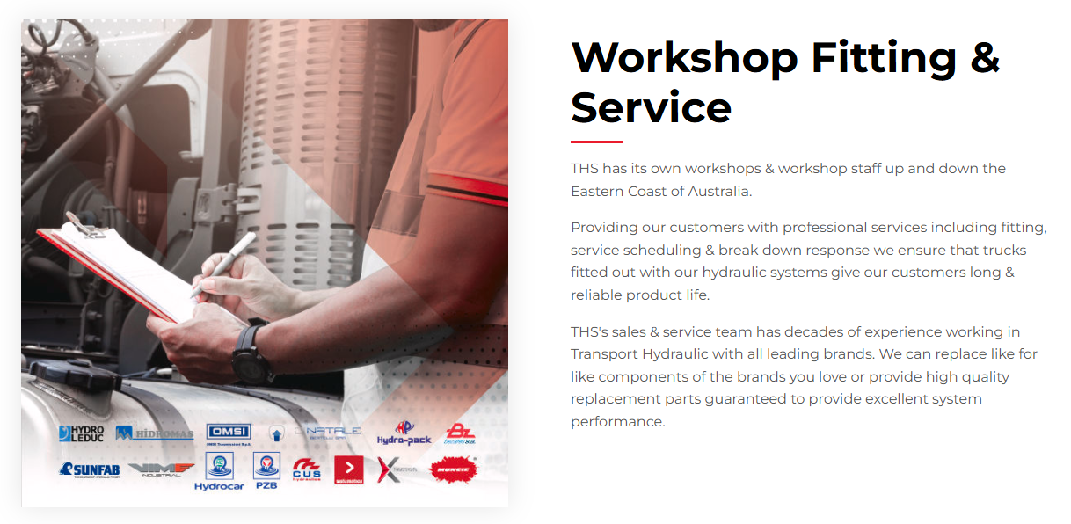
WORKSHOPS

Slide 13
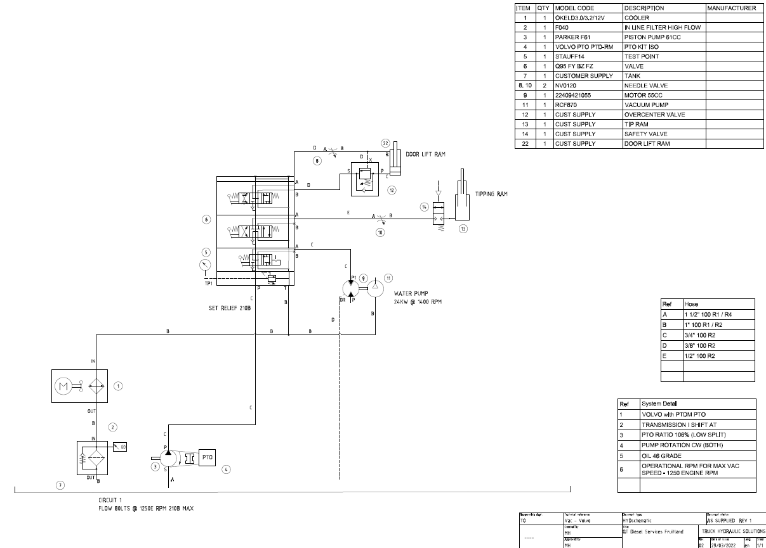
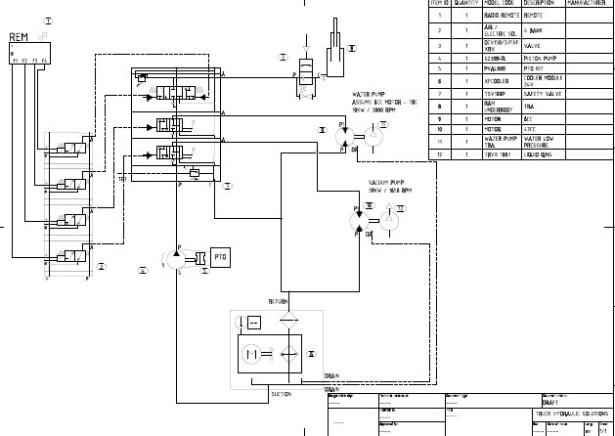
SYSTEM DESIGN

