Slide 1
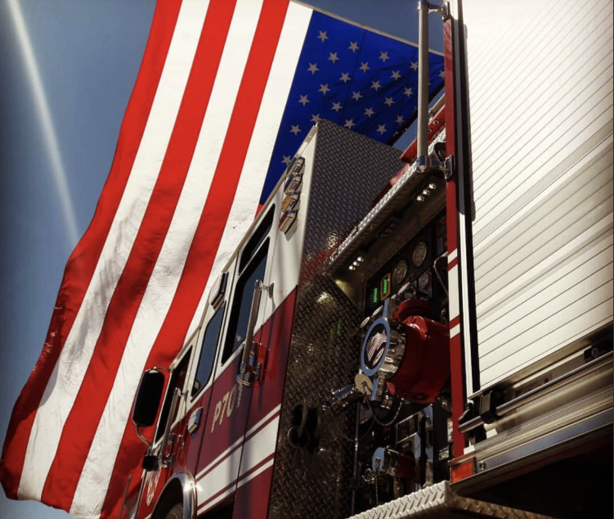

EL PASO COUNTY E.S.D. #2
2025 – 2026
ANNUAL BUDGET PRESENTATION

Slide 2
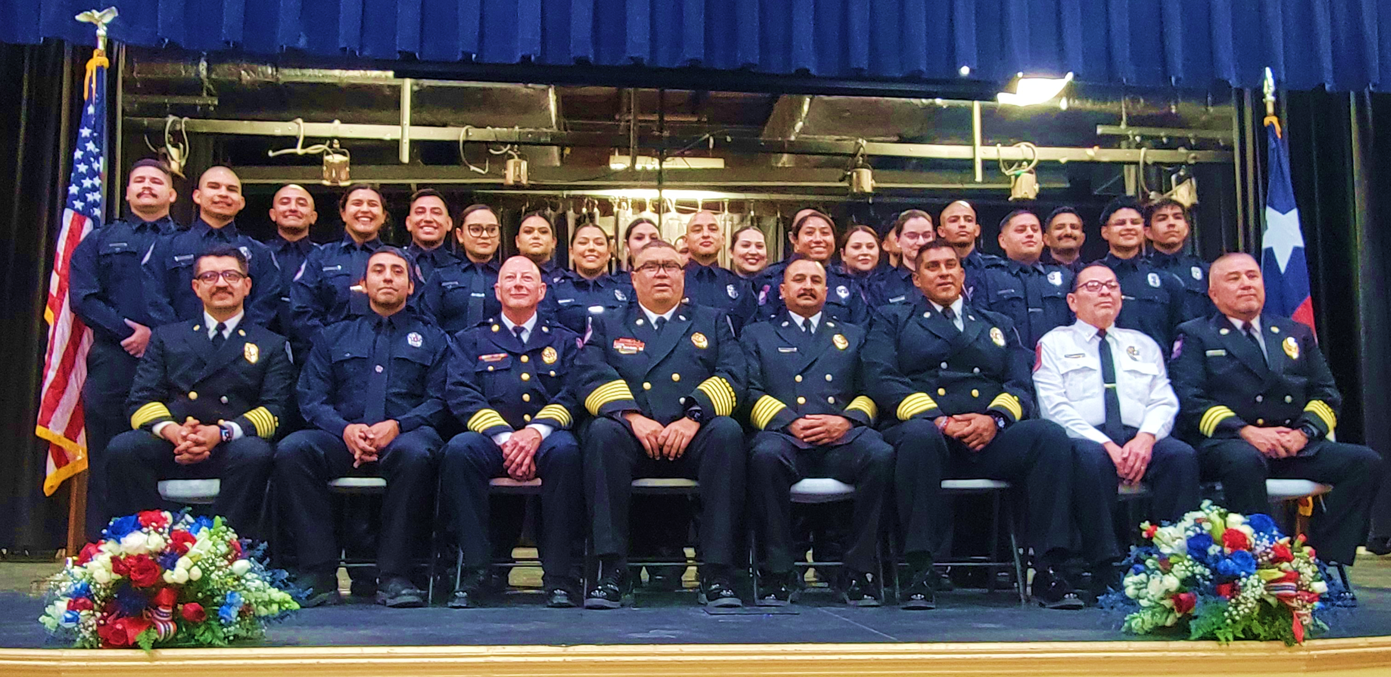
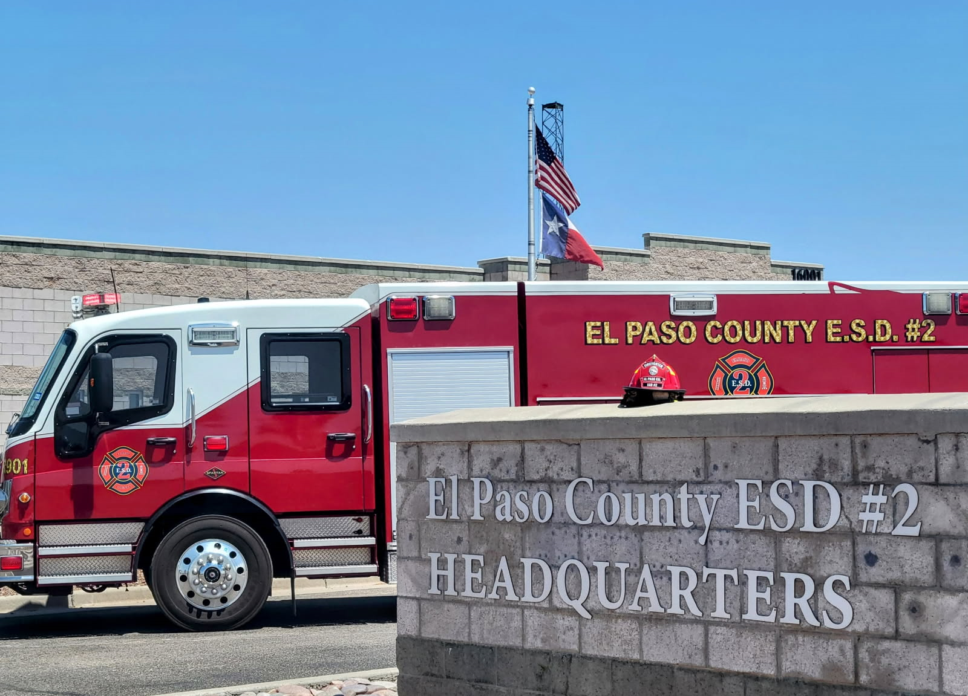
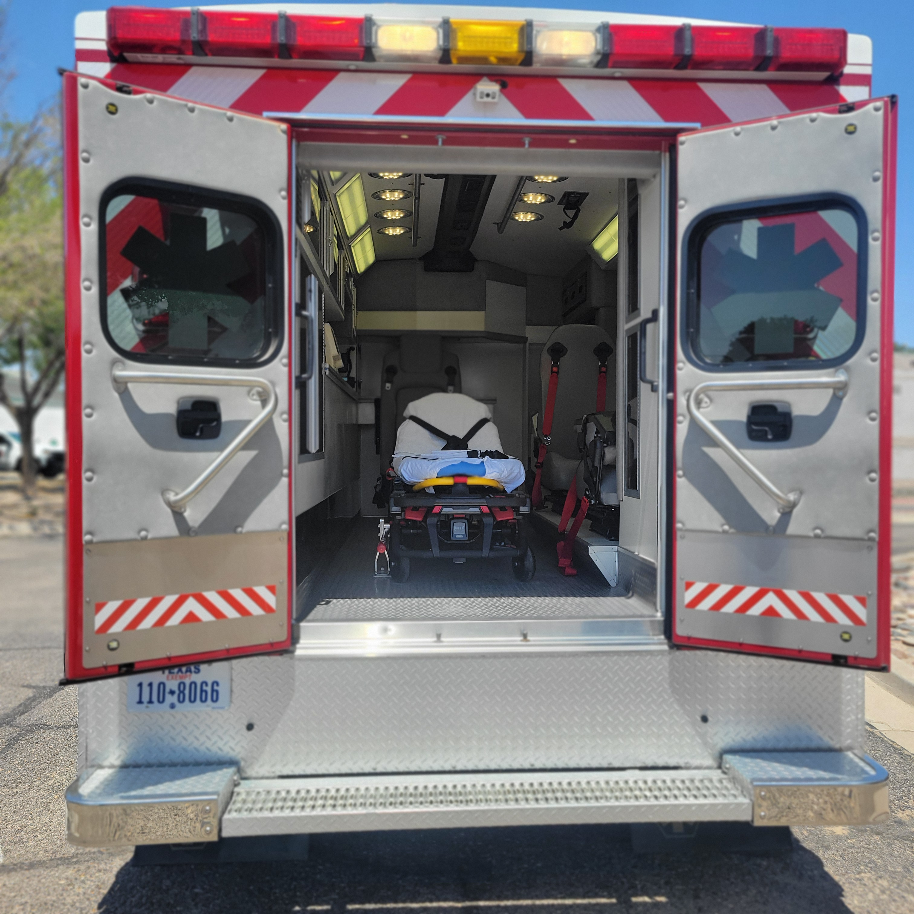
E.S.D. #2 Highlights
E.S.D. #2 has completed these forecasted special projects:
Training room remodel for our west side fire station
Kitchen remodel for our Montana Vista fire station
Certified 44 Volunteer Firefighters
Certified two paid paramedics
Added a second paid night shift to the Socorro & San Elizario fire stations, and we are currently working on adding night shift to Clint and Fabens
E.S.D. #2 is currently working on completing these special projects:
Working on the architectural design for the second fire station in Socorro
Four to attend the El Paso Sheriff's Academy
Activation of the E.S.D. 2 ambulance

Slide 3
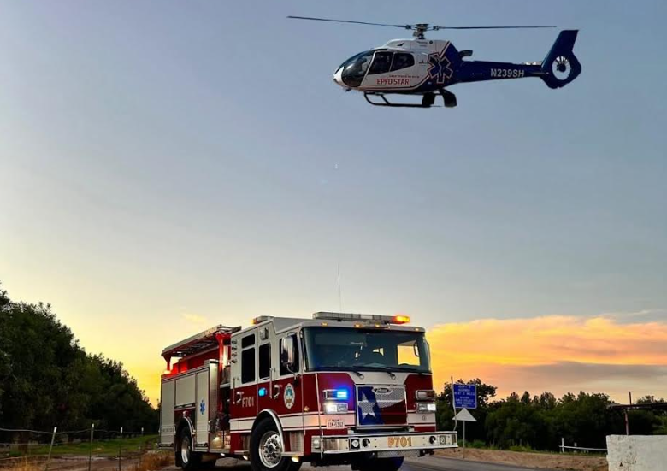

911 CALL
OVERVIEW
6 YEAR COMPARISON

Slide 4
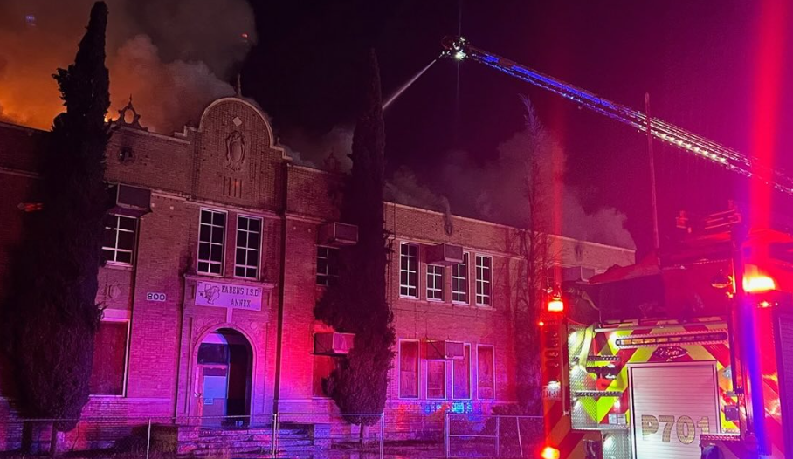
Response Time
2025 07m:51s
2023 07m:40s
2020 08m:11s
2021 08m:02s
2024 07m:59s
2022 08m:0s
6 YEAR COMPARISON

Slide 5
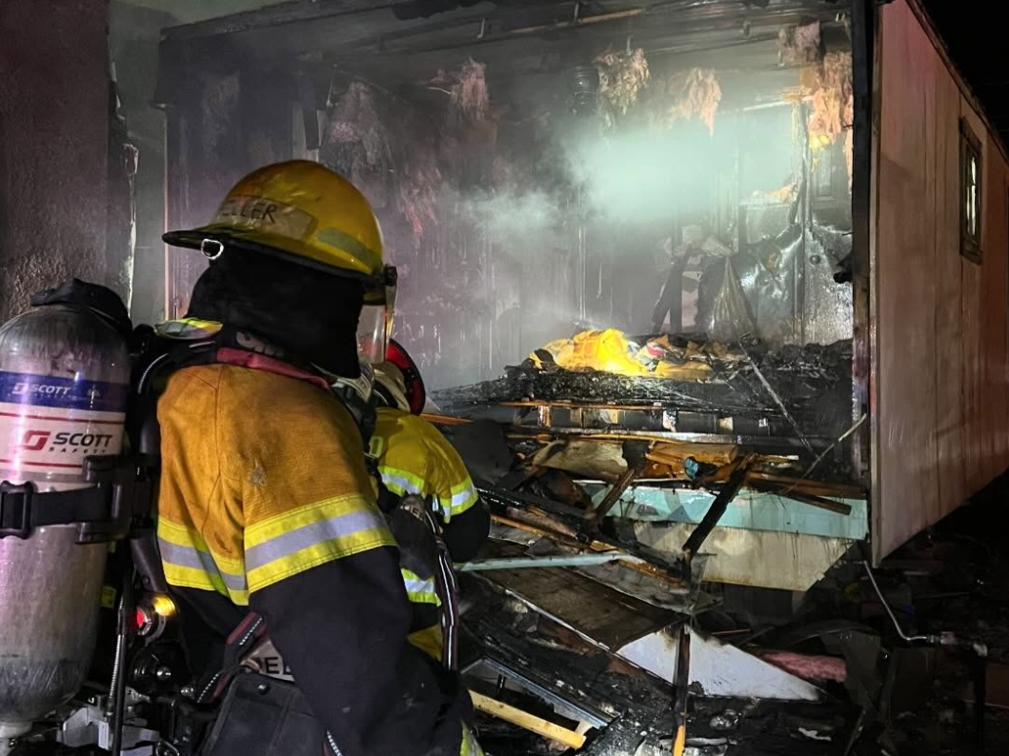
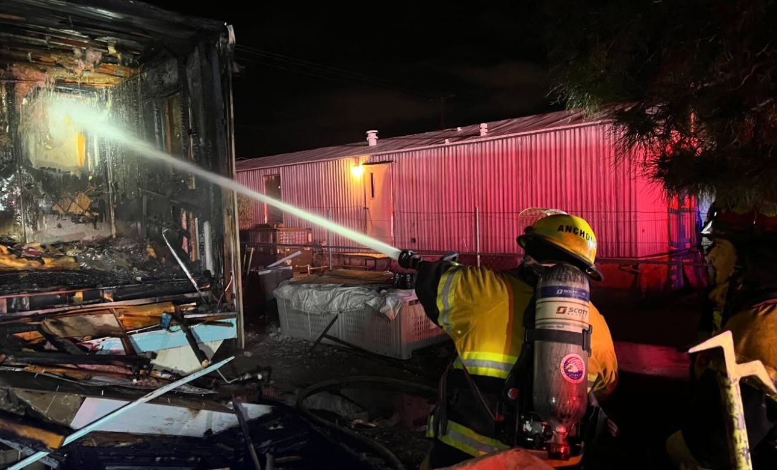
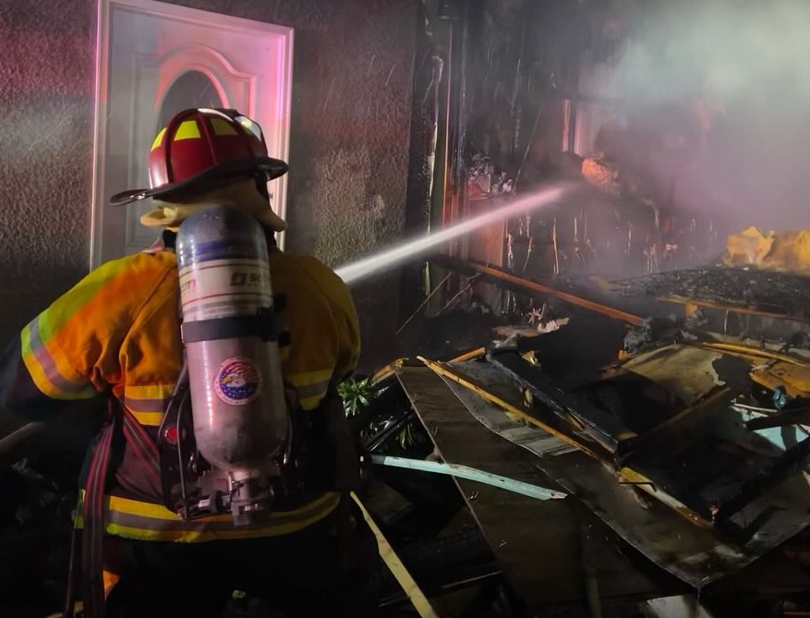
Fire Breakdown
6 YEAR COMPARISON
 | 2025 | 2024 | 2023 | 2022 | 2021 | 2020
Bush Fire | 95 | 123 | 122 | 127 | 146 | 166
Overpressure | 6 | 6 | 0 | 0 | 9 | 0
Rubbish Fire | 151 | 185 | 77 | 81 | 145 | 218
Structure Fire | 138 | 123 | 54 | 74 | 154 | 145
Vehicle Fire | 6 | 52 | 31 | 53 | 81 | 88

Slide 6
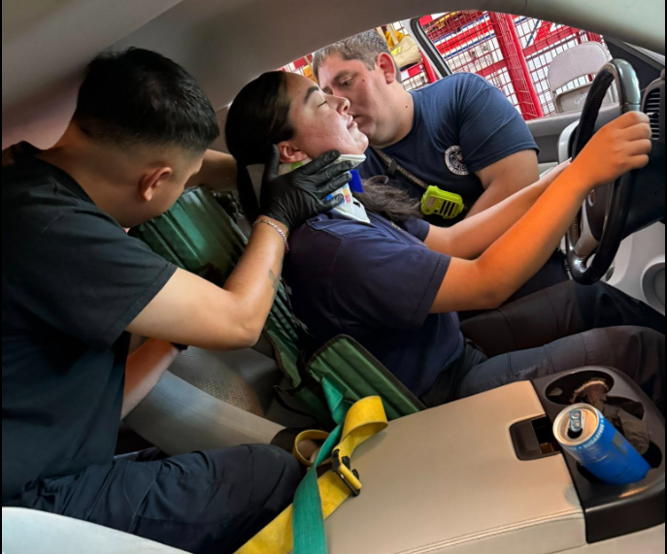
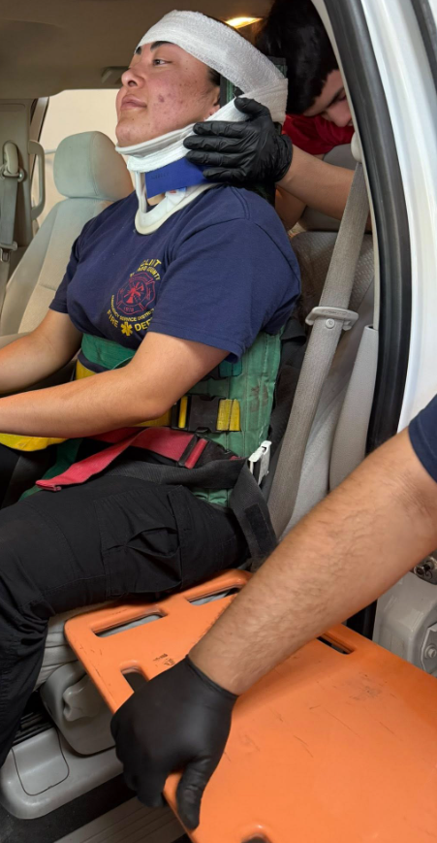
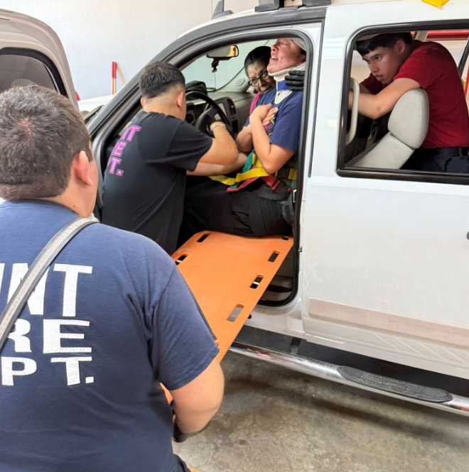
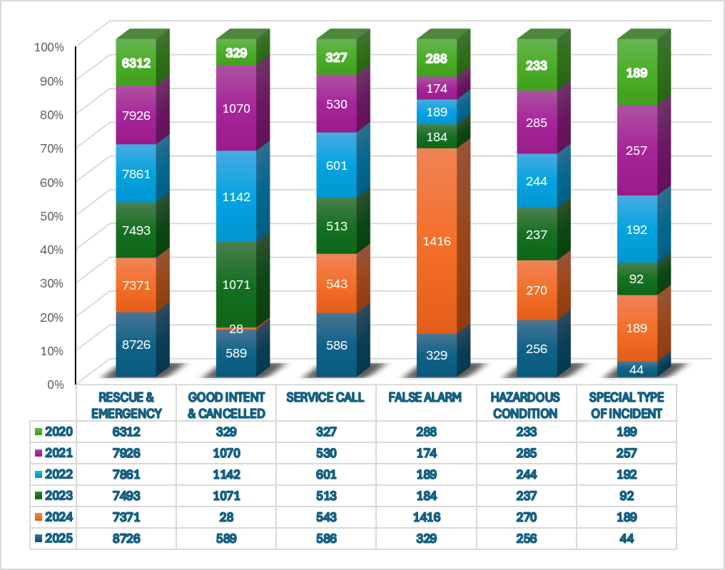
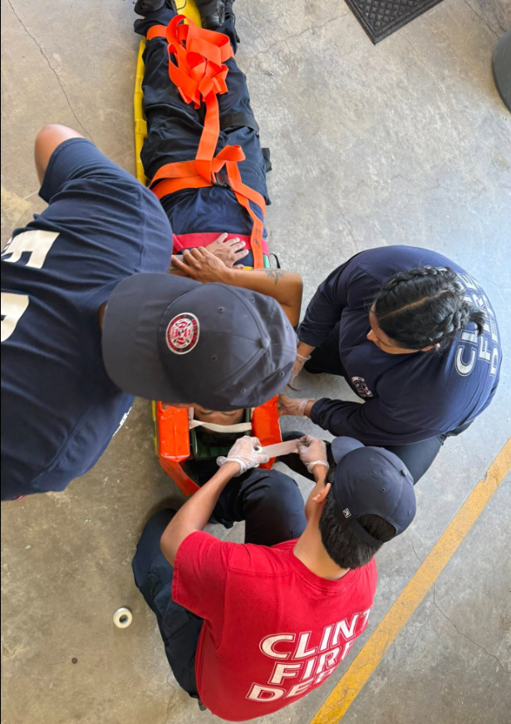
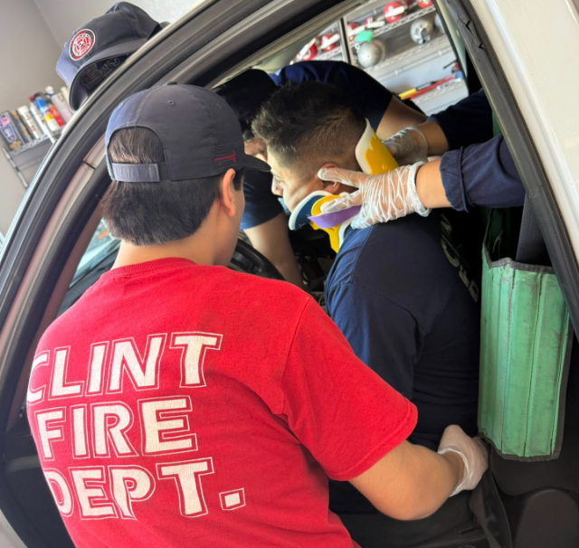
6 YEAR COMPARISON
Medical Breakdown

Slide 7
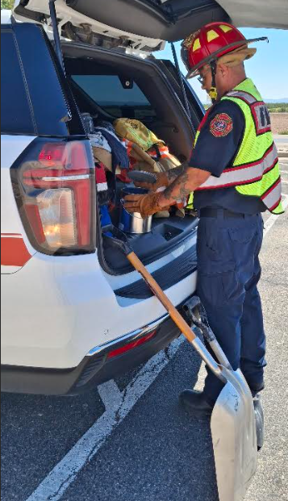
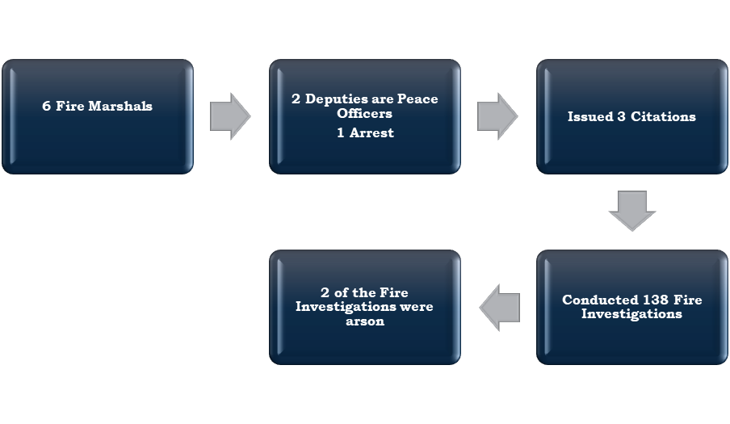
Fire Marshals

Slide 8
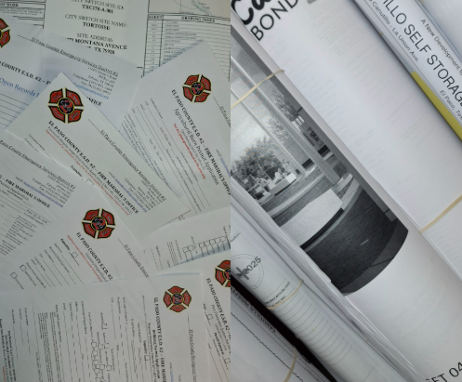
Construction
Permits
January 1, 2025 - June 30, 2025
333 permits issued
2023
269 permits
2020
240 permits
2021
254 permits
2024
488 permits
2022
379 permits
6 YEAR COMPARISON

Slide 9
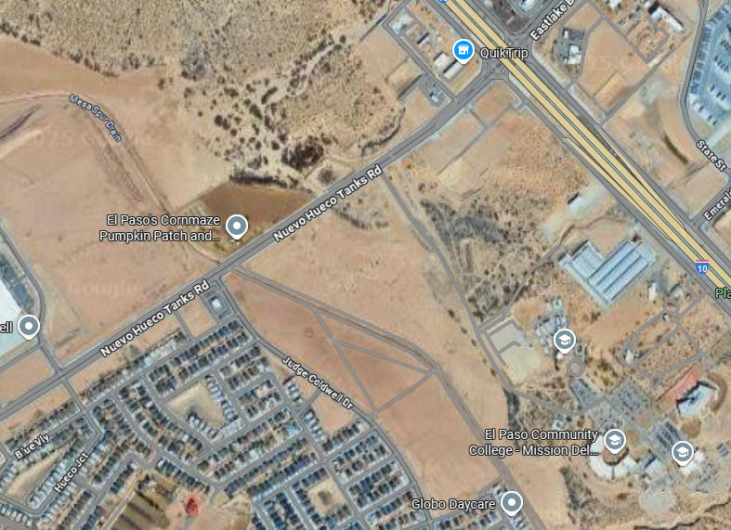
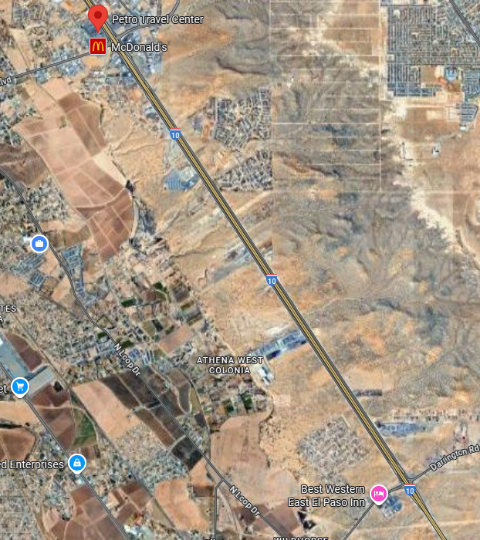
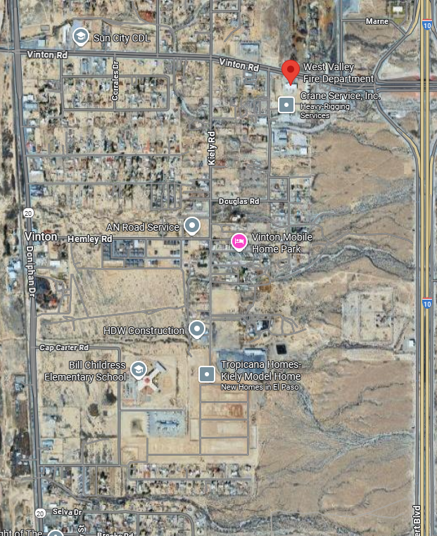
















Socorro
Clint
District Growth​
Ay Cocula
Home 2 Suites
Socorro Logistics Bldg. 1 & 2
Jack in the Box
Urgent Care
Dunkin
Mini Concrete
Thor Industries
Speedway Logistics Bldg. 1 & 2
Holiday Inn Express
Glamp the World
Kasco Structures
Sonic
Virtu Apartments
Canutillo

Slide 10
Budget Breakdown
Total Budget:
$22,579,037

Slide 11
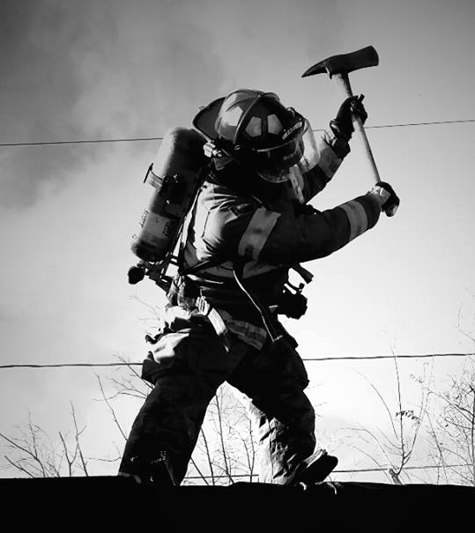
Budget Overview
El Paso County ESD #2’s Board of Commissioners has adopted a budget of $22,579,037 for the 25/26 Fiscal Year. This is an increase of $8,305,548, or 58.19% over the 24/25 Fiscal Year budget.
Personnel
The Personnel category reflects an increase of $666,509, or 13.63% for the upcoming fiscal year, driven by employee pay scale adjustments and the planned addition of six firefighter positions and two lieutenant positions.
Debt Service
The Debt Service category increased by $571,039, or 32%, due to the new loan for the construction of the second Socorro Fire Station and two fire trucks.

Slide 12
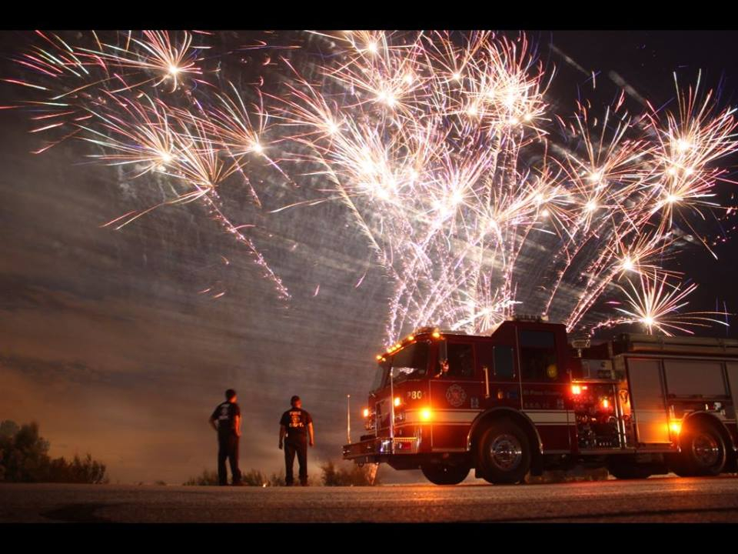
Budget Overview, continued.
Operations
The Operations category increased by $611,753 or 9.95% for the upcoming fiscal year, primarily due to higher operating costs, including increases in utilities, fuel, equipment maintenance, and contracted services.
Capital Projects
This category increased by 6,456,246, or 449%. This increase reflects funding for the construction of the new fire station in Socorro, as well as the purchase of two new fire trucks.

Slide 13
Budget Recap
  Total Budget: $22,579,037, a 58.19% increase from FY 24/25
  Property Tax $6,754,973
  Sales Tax $5,089,822
  Fund Balance $12,690,412
  Code Enforcement $367,500
  Adopted Tax Rate $0.087138/$100
      I&S Tax Rate: $0.029651
      M&O Tax Rate:$0.057487
Reserve Balance estimated at $2,323,671, or 19% of Operating Budget
This budget reflects the District’s commitment to:
Strengthening emergency response through expanded personnel.
Addressing rising insurance and operational costs.
Investing in critical infrastructure with the new Socorro Fire Station.
Summary of Changes | FY 25-26 | FY 24-25 | Difference | Percentage
Total Budget | $22,579,037 | $14,273,489 | $8,305,549 | 58.19%
Total Adopted Tax Rate (per $100 of value) | $0.087138 | $0.078856 | $0.008282 | 10.50%
I&S Rate | $0.029651 | $0.024744 | $0.004907 | 19.83%
M&O Rate | $0.057487 | $0.054112 | $0.003375 | 6.24%
Average homestead taxable value | $172,550 | $160,206 | $12,344 | 7.71%
Tax on average homestead | $150 | $126 | $24 | 19.02%

Slide 14
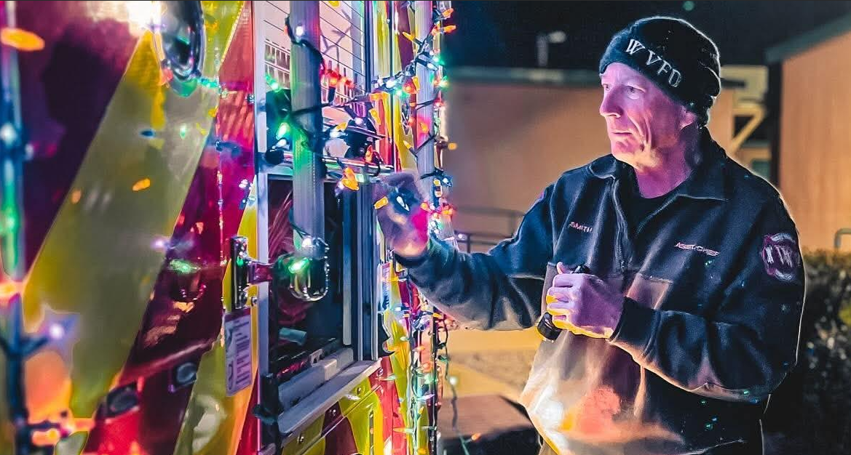
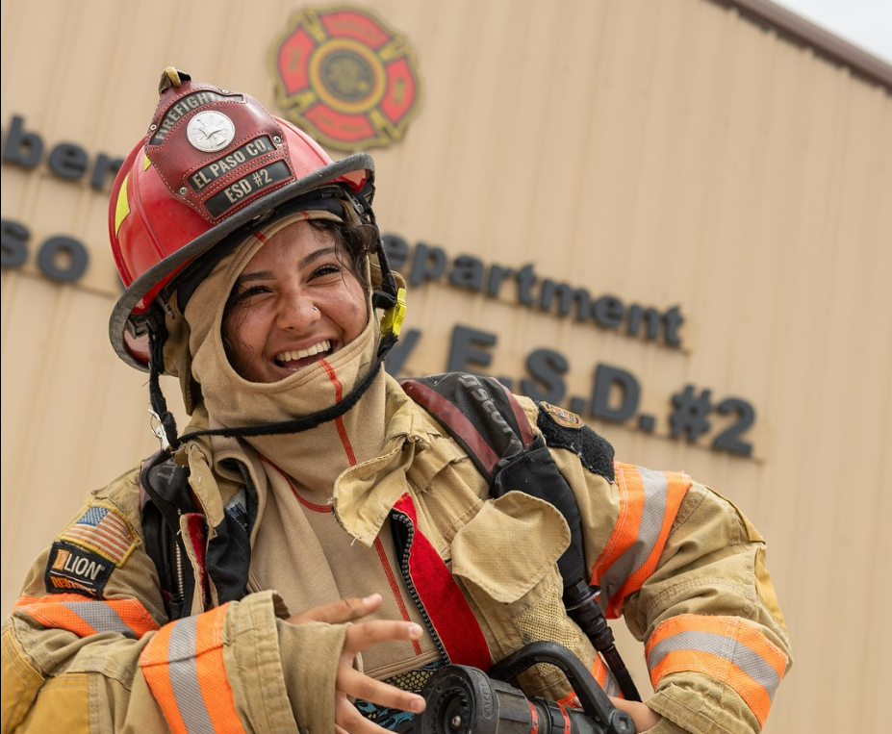
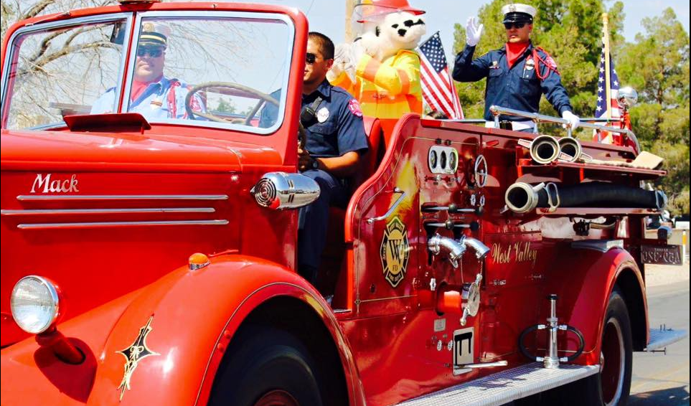
Thank you.

