Slide 1
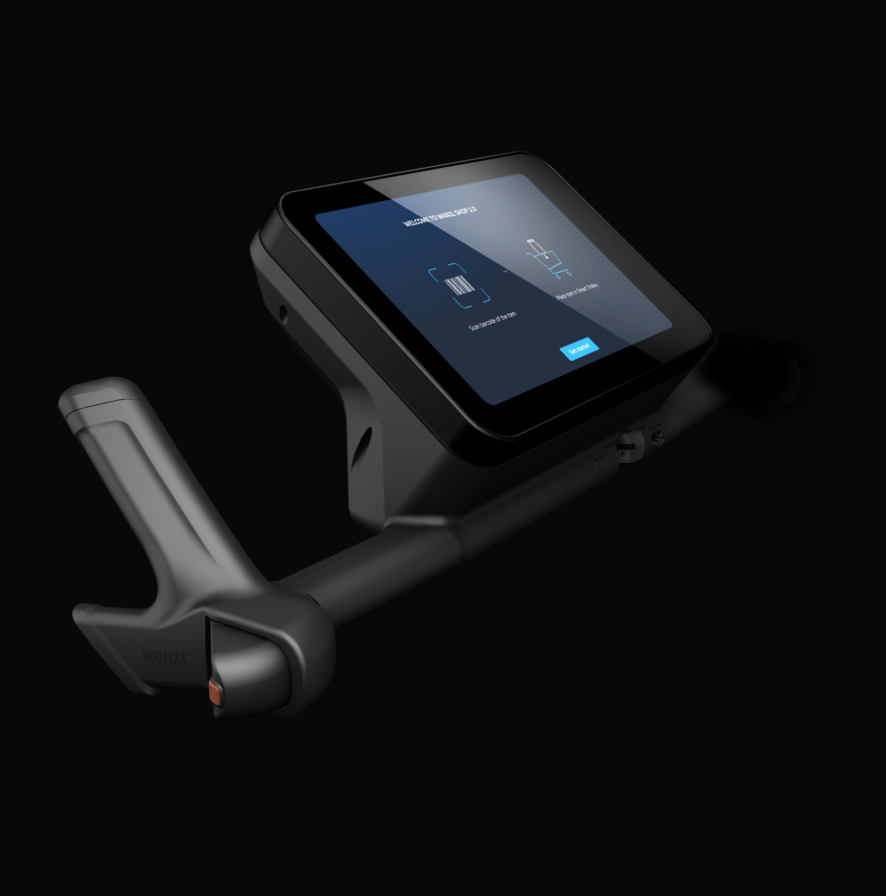
Smart Trolley by Wanzl
for internal use only
FastLaner

Slide 2
Hardware Overview
for internal use only
FastLaner

Slide 3
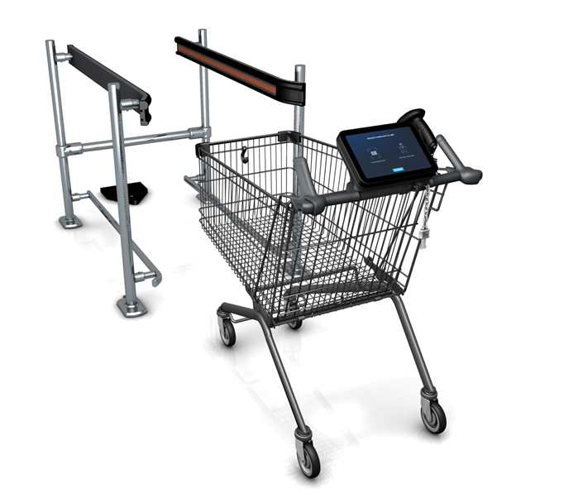
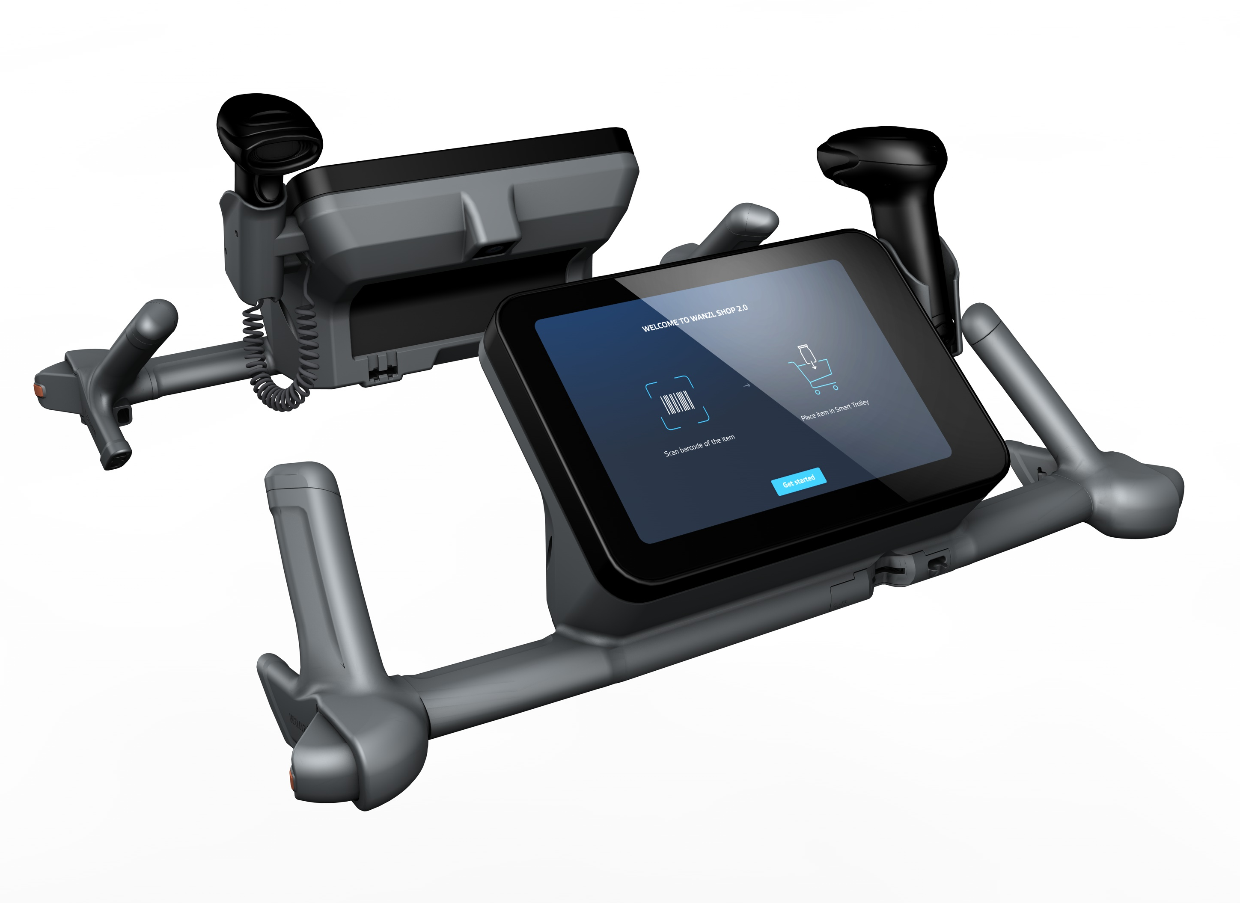
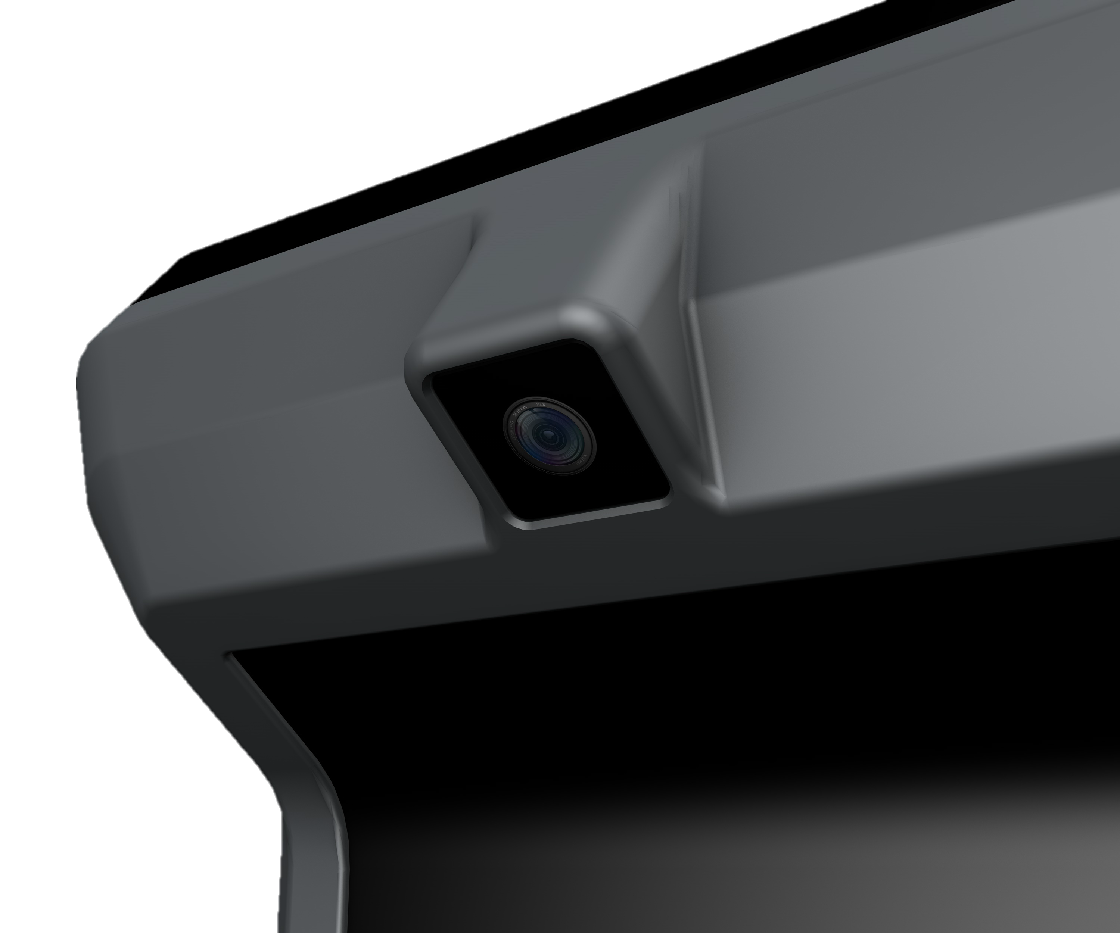
FastLaner: Wanzl’s Smart Trolley
Product overview
Notes:
4 Verschieden Module

Slide 4
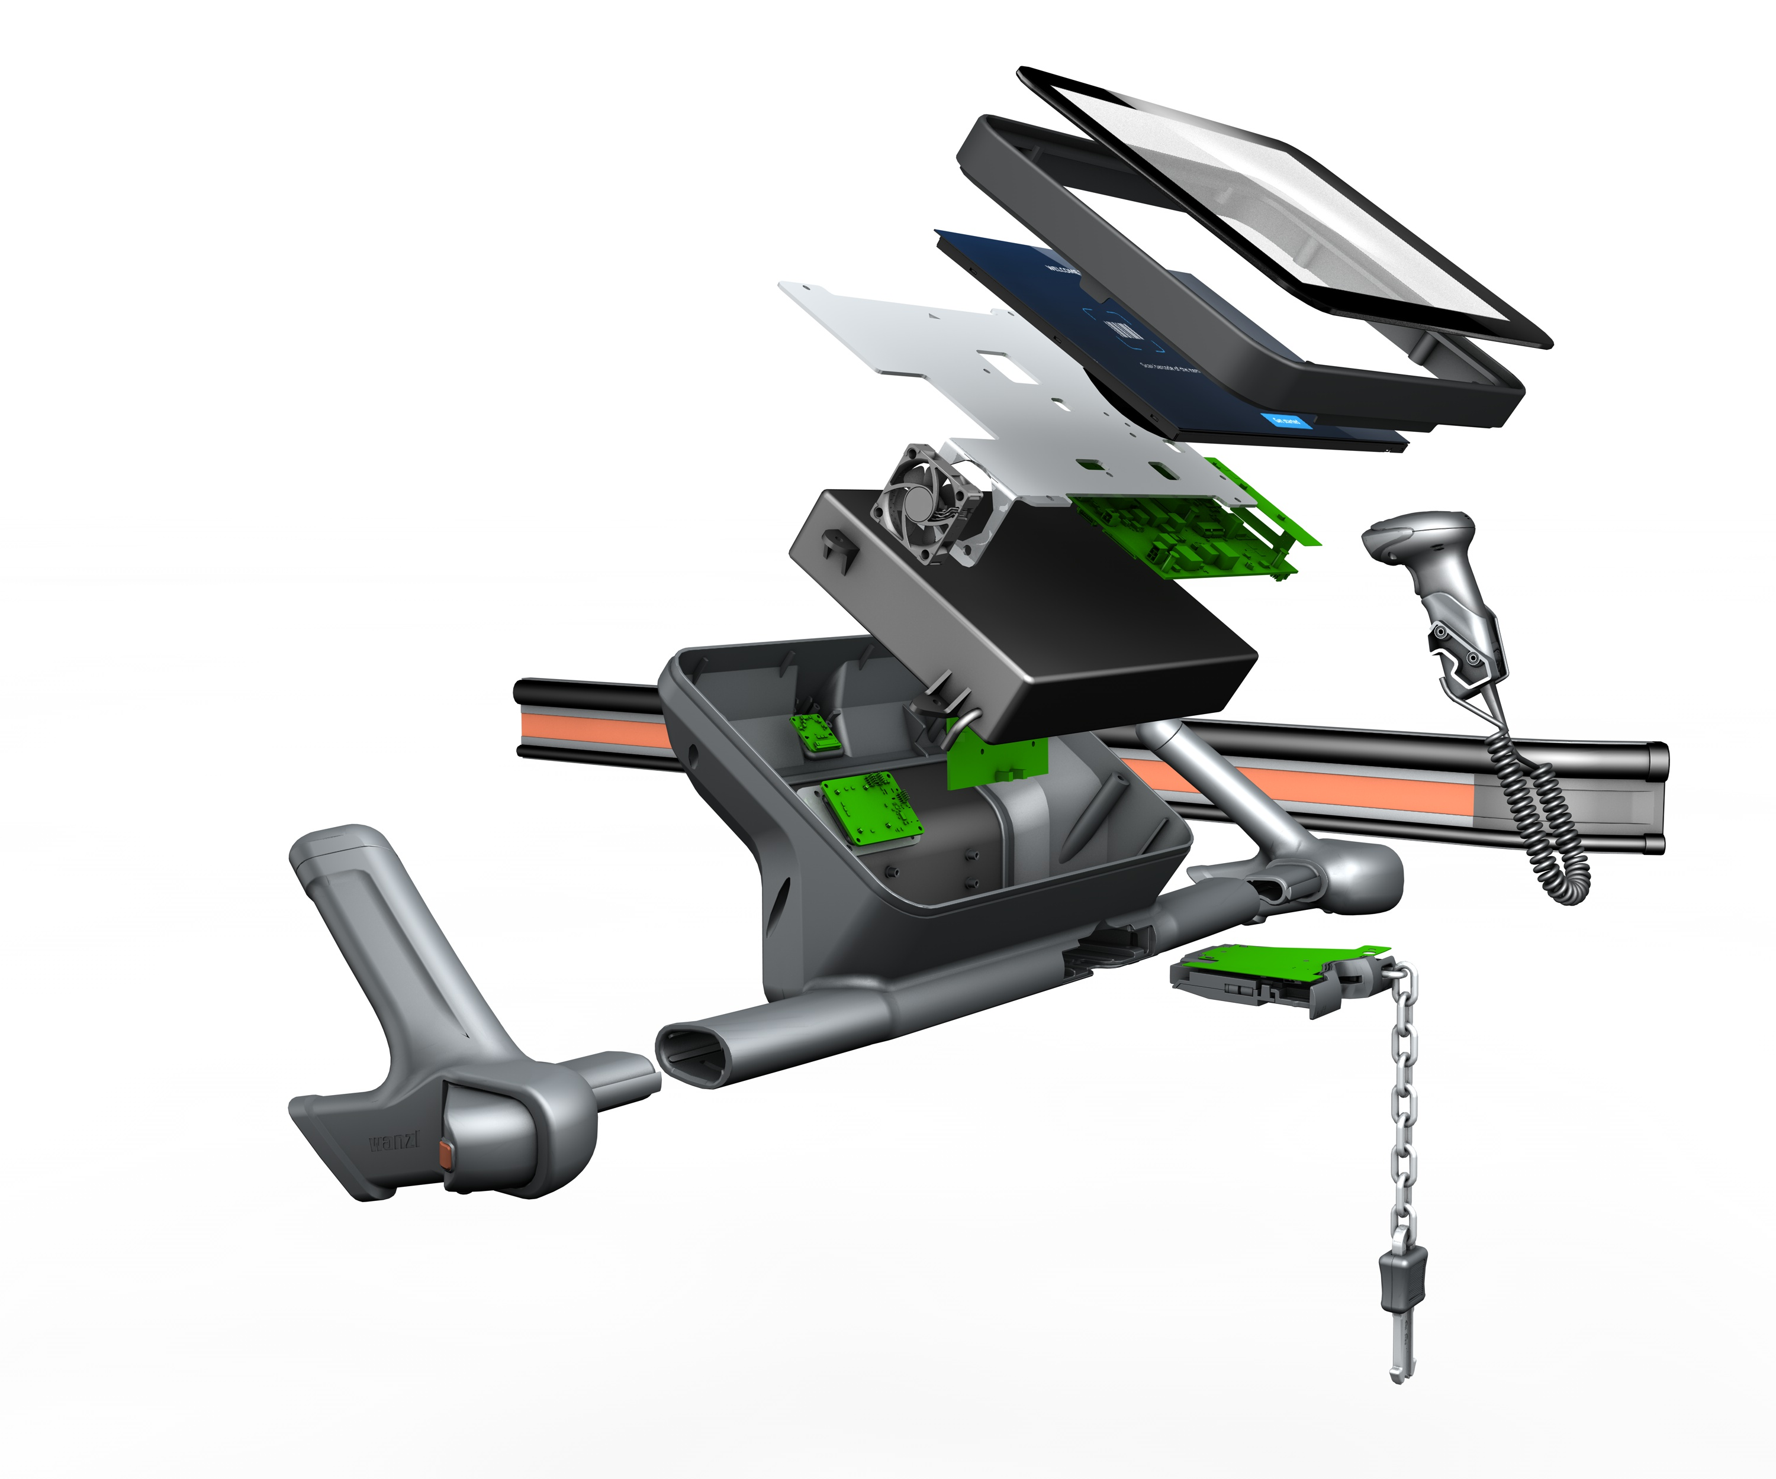
Display unit, charging contacts and Hybridloc as part of the FastLaner
Product overview – Interior
Fan
Quiet fan for optimal heat distribution
Display unit with cover glass
10.1" touchscreen with 1280X800 pixels Brightness sensor Scratch-resistant, frosted glass
Battery with Power Management System
Operating time for one day Safe cell chemistry (lithium iron phosphate) 230Wh, 24 V
Board with heat conduction plate
Android 14 i.MX 8 M Plus processor incl. HAILO chip WIFI, NFC, BLE, GPS, UWB Sheet metal for efficient heat dissipation Speakers for audio feedback
Camera sensor with AI board
Camera sensor for theft prevention Additional AI board
Hand-held scanner
Wired Cino Scanner Flexible scanning through scanner handling
Charging Contacts
Intuitive, wireless charging via sliding contacts Automated charging process when returning the cart
Hybridloc
Trolley removal by coin or smartphone Easy integration with Retailer App
Notes:
4 Verschieden Module

Slide 5
Software Application Overview
for internal use only
FastLaner

Slide 6












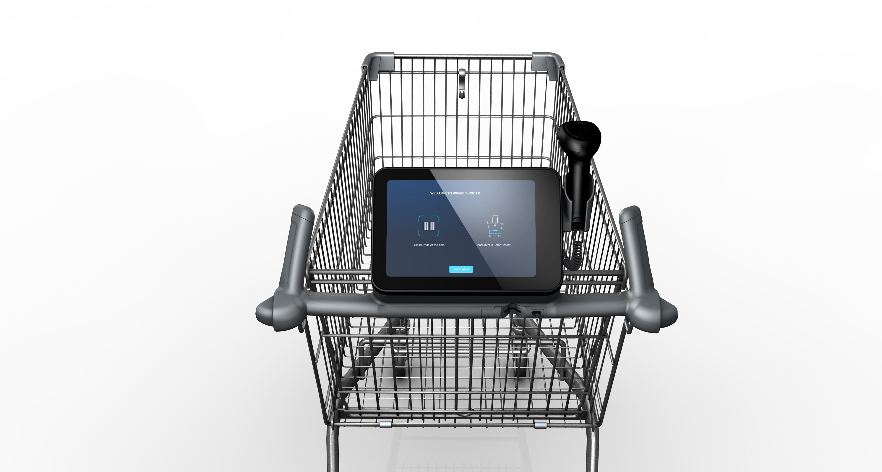
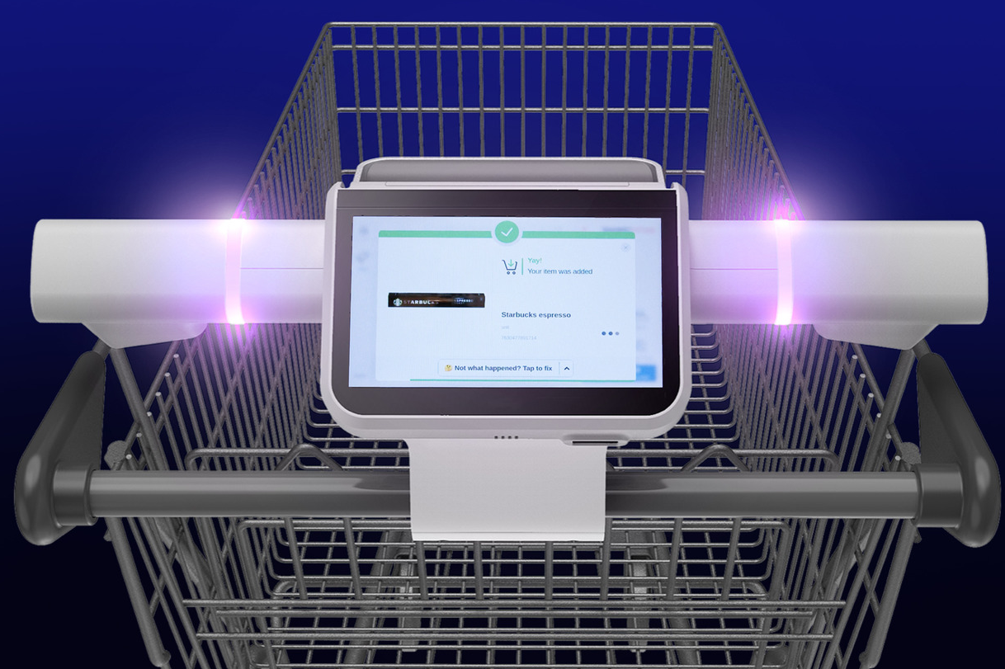
Wanzl offers a platform for the integration of existing customer solutions and enables standardization
Comparison of the Wanzl business model with other providers
With the Wanzl FastLaner platform, our customers can integrate their apps directly and have full access to all the hardware functions of the trolley via an interface.
For market competitors, the focus is very often on the sale of POS SW licenses/SAAS, which often leads to enormous integration efforts on the customer side: e.g. merchandise management, payment providers, onboarding customers what already exists in the existing apps
Retailer App / POS Provider / Third Party Apps
Retailer ERP
Dashboard / Fleet Management
Dashboard / Fleet Management
Dashboard / Flottenmanagement
https://cdn.informaconnect.com/platform/files/public/2024-08/background/Marmon_-Shopic.jpg?VersionId=4rsh8LN_BNRoqKZXfYMYb6Xfii.xwatR

Slide 7
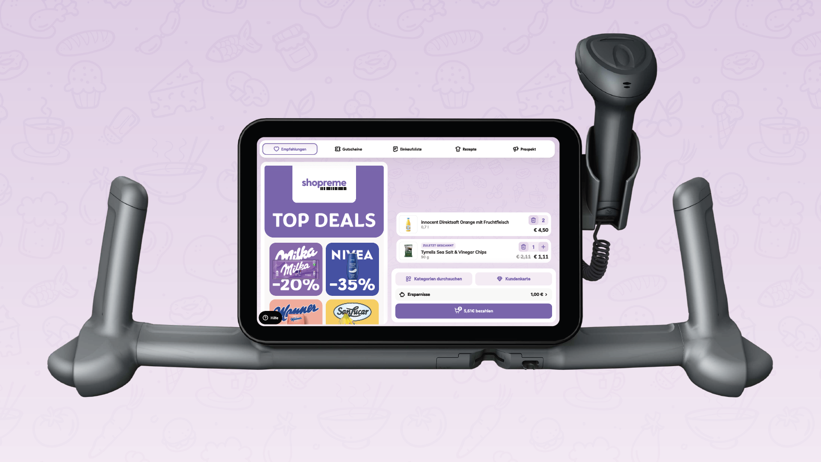





Wanzl’s successful integration of first POS providers like Shopreme
Product overview – POS provider integration
Use Cases
Product scanning
Retail Media
Couponing
NFC Payment on the Display Unit
Staff notifications on Zebra devices (age check, manual rescan, etc.)

Slide 8
Example Customer Journey
for internal use only
FastLaner

Slide 9


Customer Journey with Shopreme
Start & Identification
Shopping & Adding Products
Age Verification
Payment & Exit

Slide 10

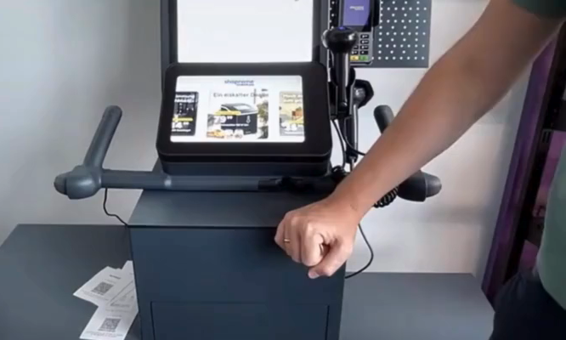
Customer Journey with Shopreme
Unlocking trolley
Mechanical unlocking of the trolley
Unlock trolley with display unit Two options
Identify with customer card and click on button to unlock the trolley
Hold Smartphone at the NFC position of the display unit to unlock
Customer Card
Start & Identification
Shopping & Adding Products
Age Verification
Scanning of customer cards with the handscanner is possible
Personalized content is possible, e.g.: 'Hello Chris, enjoy your shopping!'
Payment & Exit

Slide 11
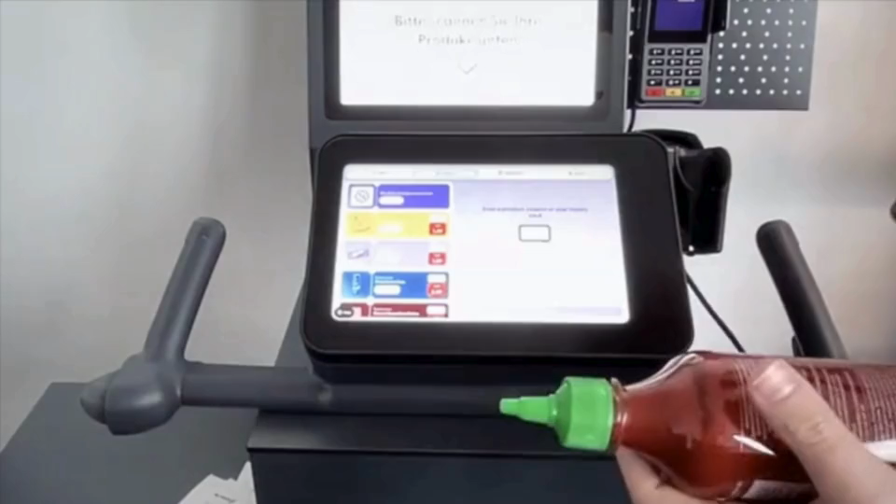
Customer Journey with Shopreme
Scanning of regular products
Scanning of products with the handscanner
Manual adding of loose goods via menu (for items without barcodes)
Start & Identification
Shopping & Adding Products
Age Verification
Payment & Exit

Slide 12
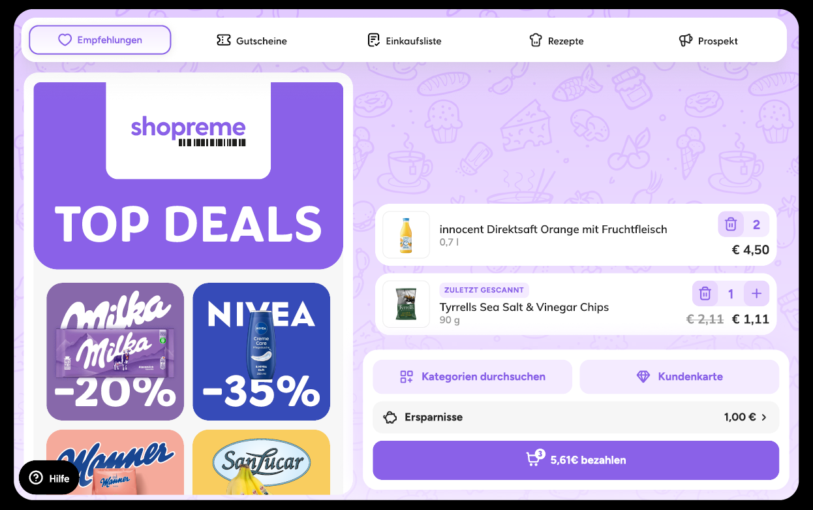
Customer Journey with Shopreme
Retail Media, Loyalty and Coupons
The screen space allows the integration of multiple customer-facing elements:
Retail media campaigns to support revenue generation
Loyalty program integration
Scanning of paper coupons
Start & Identification
Shopping & Adding Products
Age Verification
Payment & Exit

Slide 13
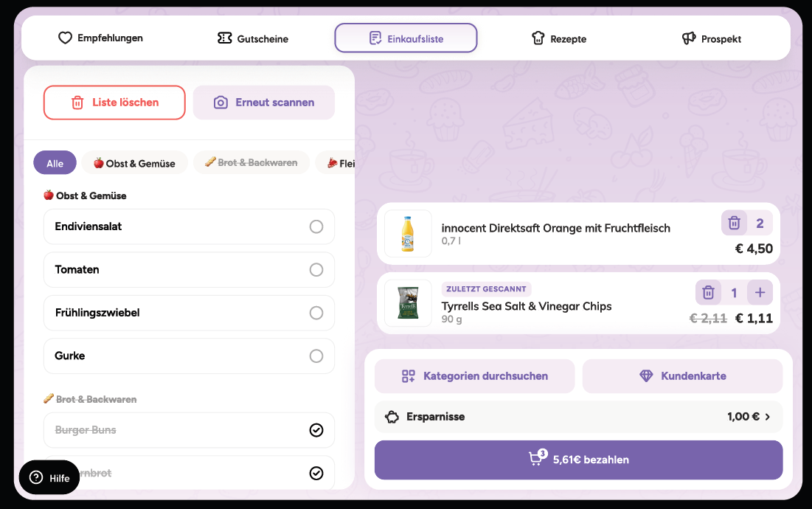
Customer Journey with Shopreme
Additional features
Shopping list transfer Handwritten shopping lists can be digitised and transferred to the trolley
Personalised recommendations Display of targeted ads based on current trolley contents or in-store location.
Recipe integration: Add products to the shopping list directly from suggested recipes
Start & Identification
Shopping & Adding Products
Age Verification
Payment & Exit

Slide 14
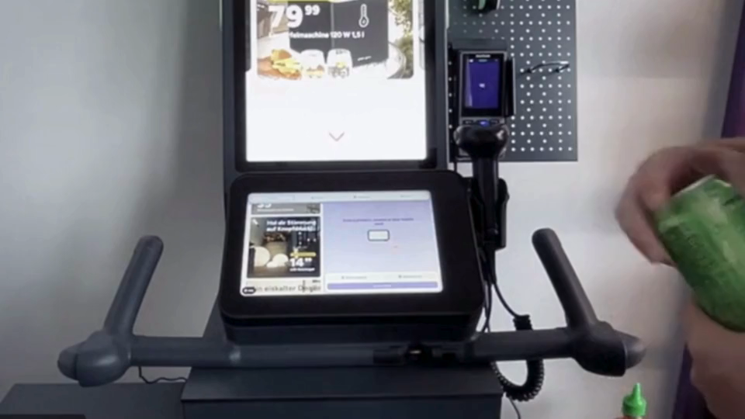
Customer Journey with Shopreme
Age Verification
Age-restricted product scan triggers a notification on the staff’s handheld device
Staff verifies and approves the customer’s age during checkout
Customer can proceed with payment after approval
Start & Identification
Shopping & Adding Products
Age Verification
Payment & Exit

Slide 15
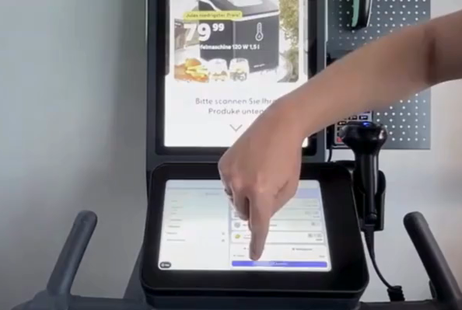
Customer Journey with Shopreme
Payment
Three available checkout methods for flexible user experience
Cashier payment
SCO payment Scan a QR code to transfer the digital cart to a self-checkout terminal for payment.
NFC Payment at Trolley Pay directly at the trolley via NFC and scan the digital receipt with a smartphone.
Start & Identification
Shopping & Adding Products
Age Verification
Payment & Exit

Slide 16
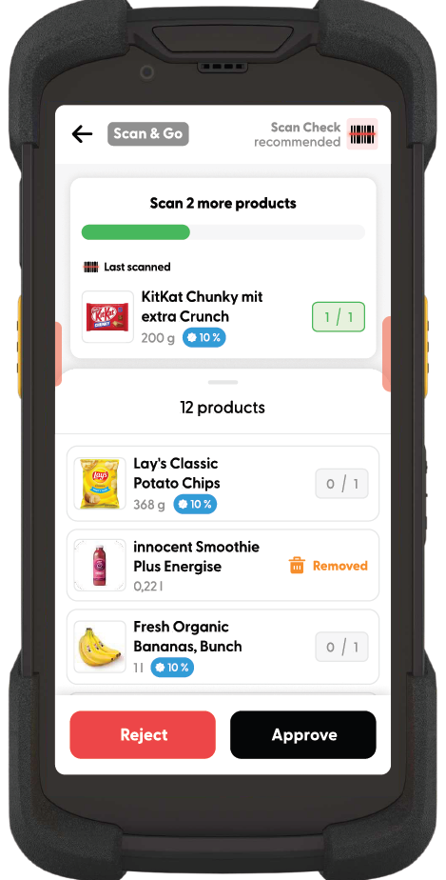




Monitor & manage FastLaner operations in real-time
Shopreme Supervisor App
Real-time overview of all active shopping carts
Partial or full basket verification
Notifications for required actions (e.g. age verification)
Random trolley checks

Slide 17
Support
for internal use only
FastLaner

Slide 18
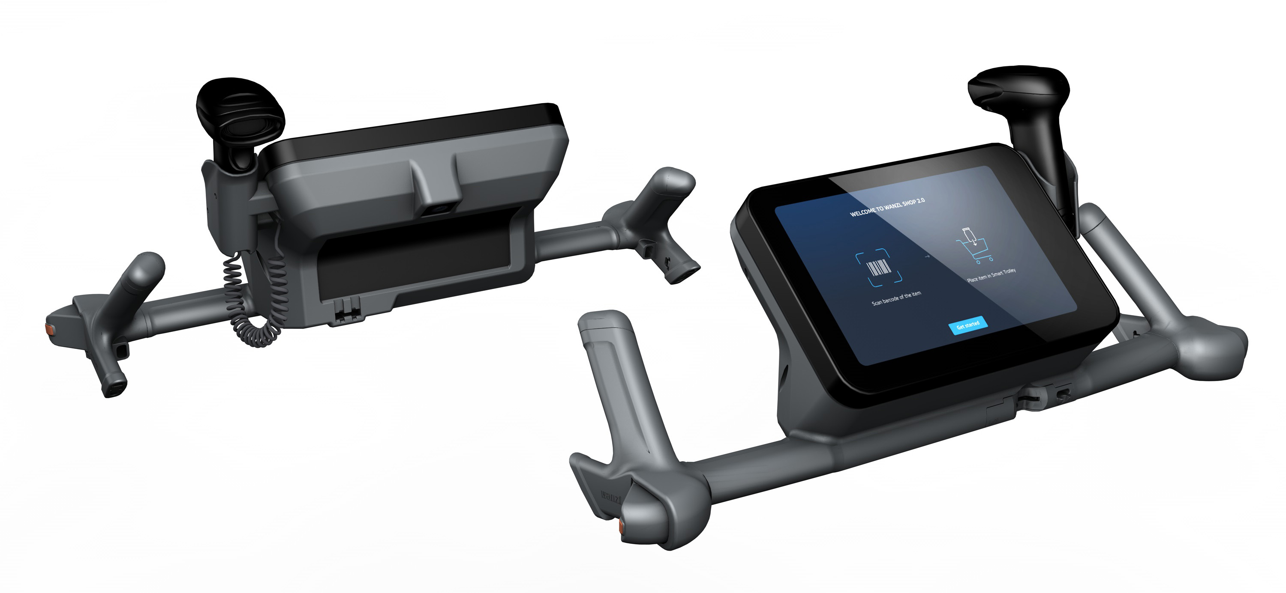

We support our customers during the migration to the FastLaner platform
Joint Development
Milestone 1:
Kick-Off
Milestone 2:
App migrated
Milestone 3:
Learnings from the pilot phase
Wanzl Project Team
1x Project Manager
1x Application Engineer
(1x SW-Engineer)
Agile Apporach
Project Team meeting every 2 weeks
Feedback
Meeting every 2 weeks
Project Kick-Off
Definition of goals
Providing the development kit
Implementation (Duration max. 2 months)
Development and migration of the retailer app
Definition of relevant use cases, e.g. theft prevention
Providing reference implementations
Pilot (Duration max. 6 months)
Installation in 1-2 test markets
Optimizations and bug fixing
Development-Kit
Fully functional display unit with charging option
Access to our devices management for easy deployment
Documentation in the Standard (https://www.asyncapi.com/)

Slide 19
Development Roadmap
for internal use only
FastLaner

Slide 20
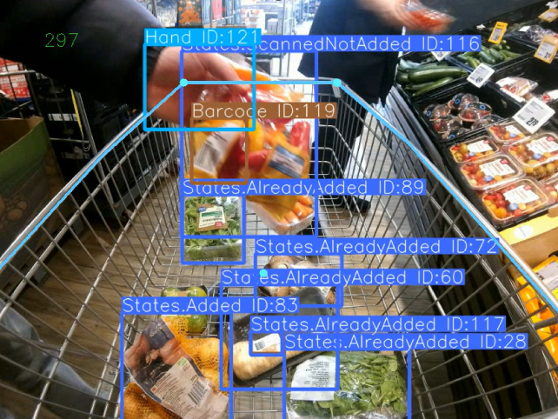




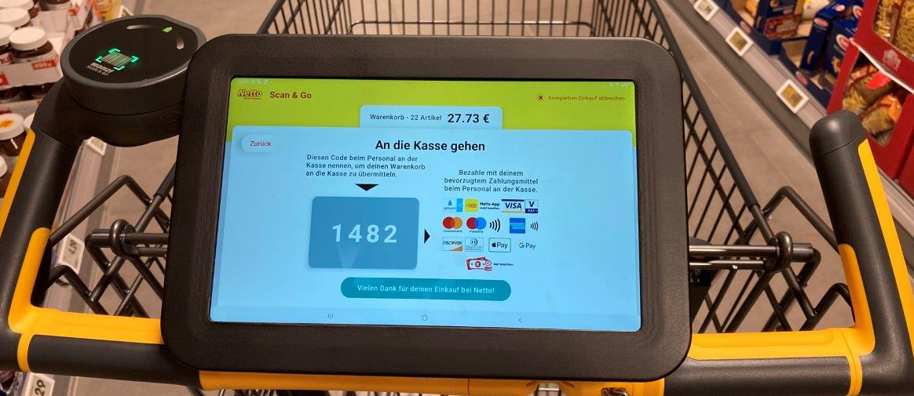

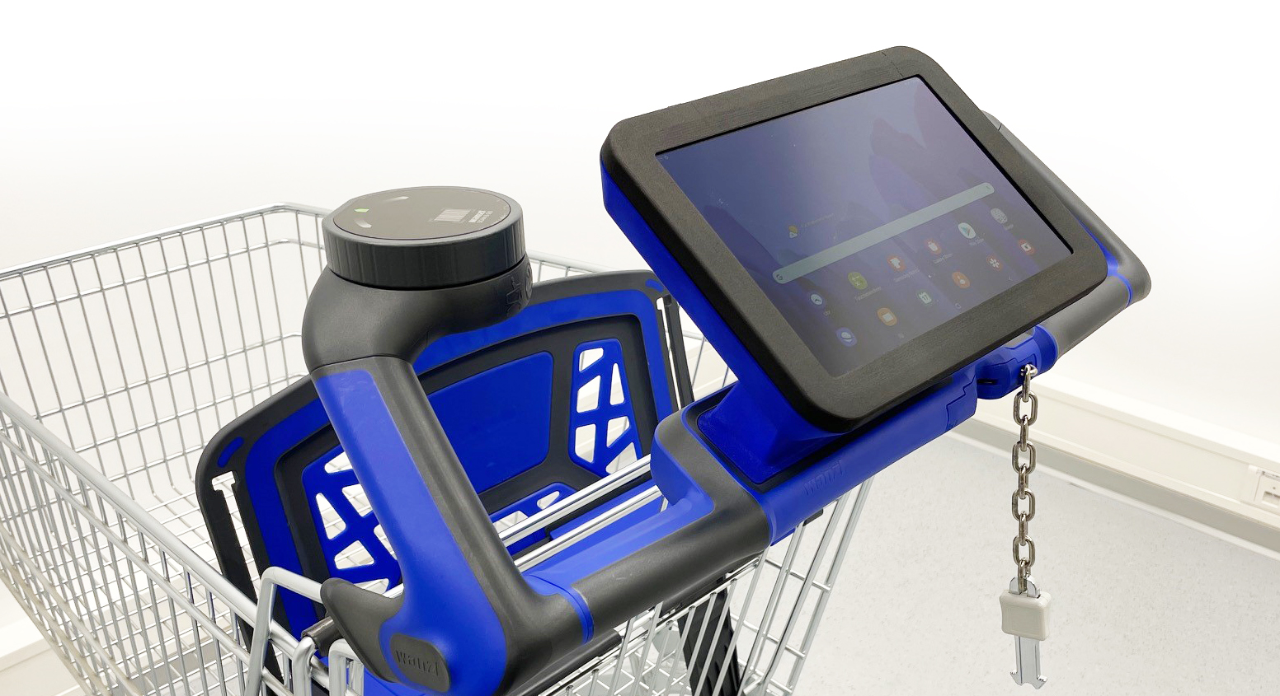
From Prototype, Pre-Series to Series
Next steps for the fastlaner
SEP 2025
Series development
Integration of POS providers (Shopreme, Gebit)
Integration of AI features
Q4 2025
Q1 2026
Past
Teststart at V-Markt Munich
→ Learning for series development improvements
Prototyp & Pre-Series
Testing with customers

Slide 21
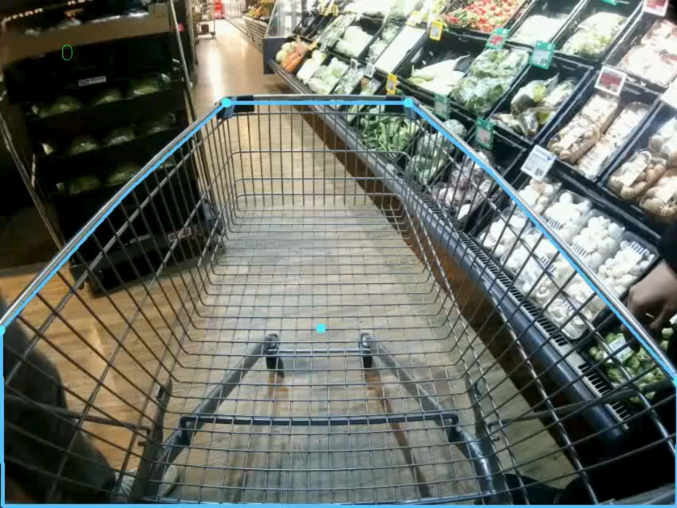
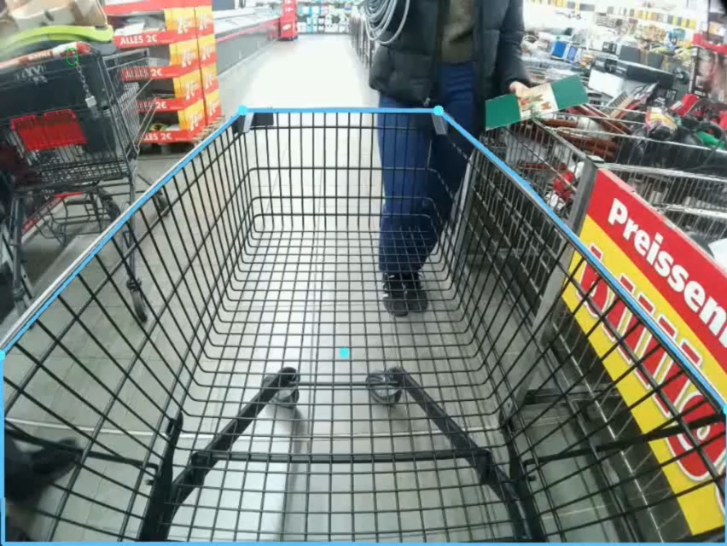
In the next software update a camera-based AI technology can be available for theft prevention
Product overview – AI theft prevention

Slide 22
Market Info
for internal use only
FastLaner

Slide 23
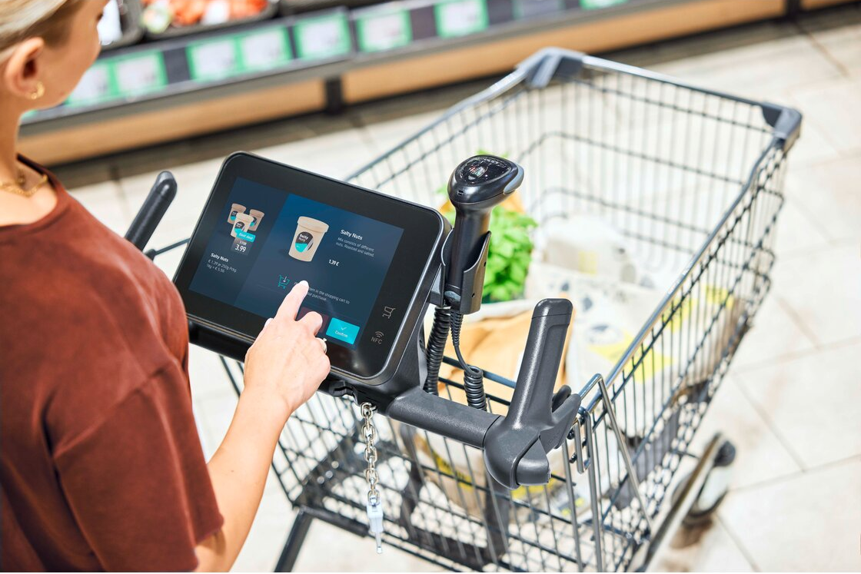
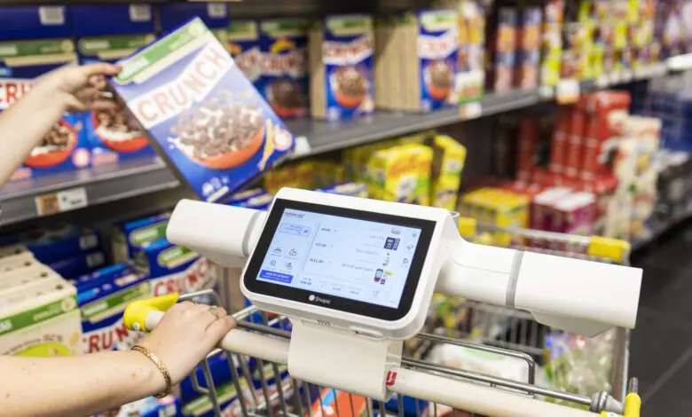
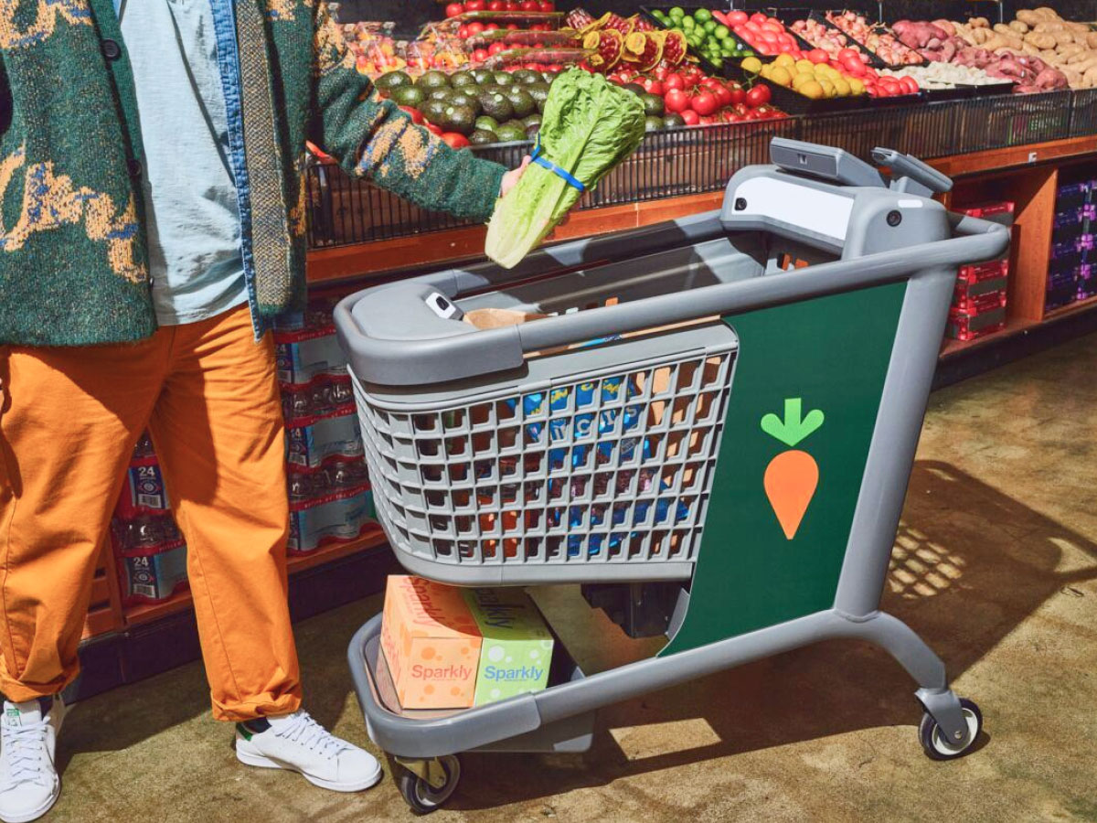
Main differences of the smart trolley solutions
Wanzl, Shopic and Caper AI (Instacart)
 | Wanzl (Germany) | Shopic (Isreal) | Instacart (Caper AI) (USA)
Hardware | Retrofit Display Unit | Clip-on Device | Full integrated Smart Trolley
Outdoor | Yes | No | Yes
Charging Station | Charging rail | Charging Wall | Block contacts
POS UI | Retailer App | Shopic App | Instacart App
Fraud detection | Camera | Camera | Camera with weighing
Price per Cart | Subscription. No Capital outlay. | Profit Share Model on Sales | £5-10K

Slide 24
Thank you

