Slide 1

Nastl december 2024 Virtual fly-in congressional and election review
Allen D. Freemyer
allen@adfpc.com

Slide 2
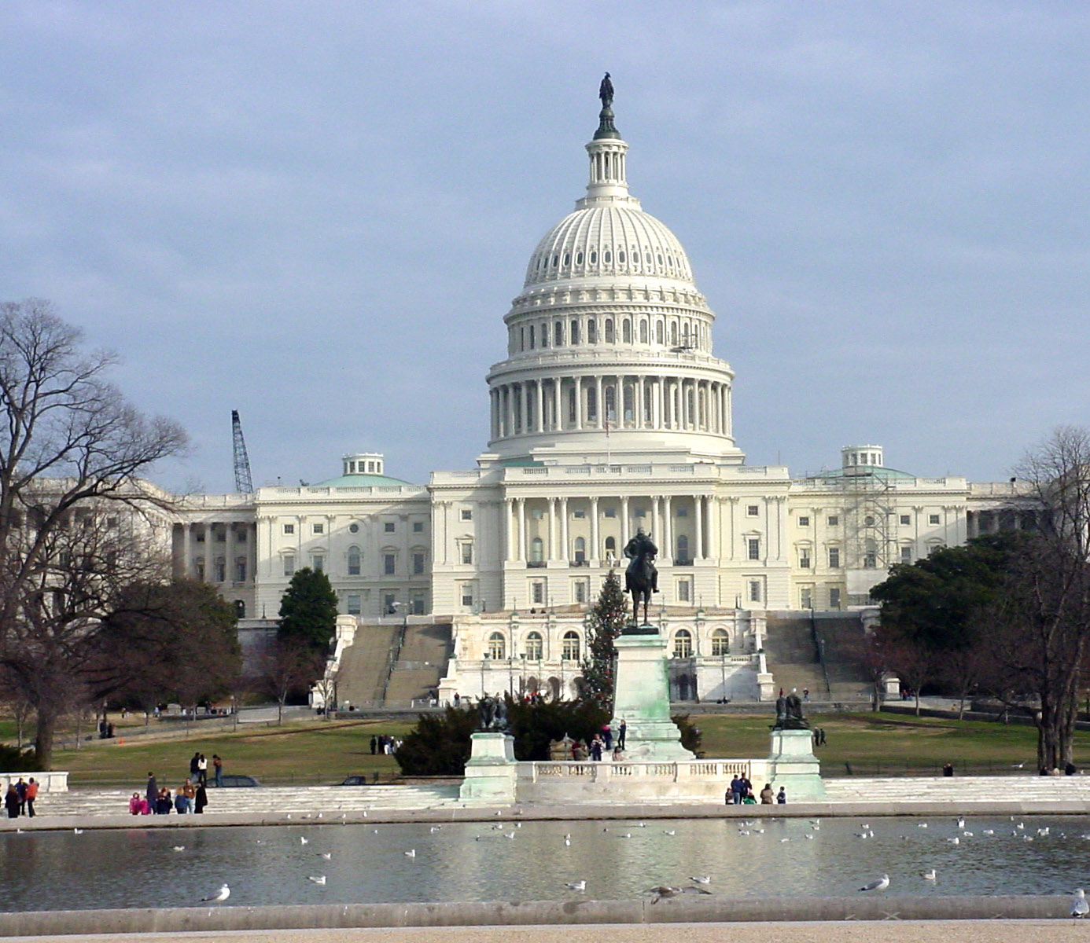
2024 Election
President
Senate
House
Administration Changes
Lame Duck
Regulatory Agenda
119th Congress

Slide 3
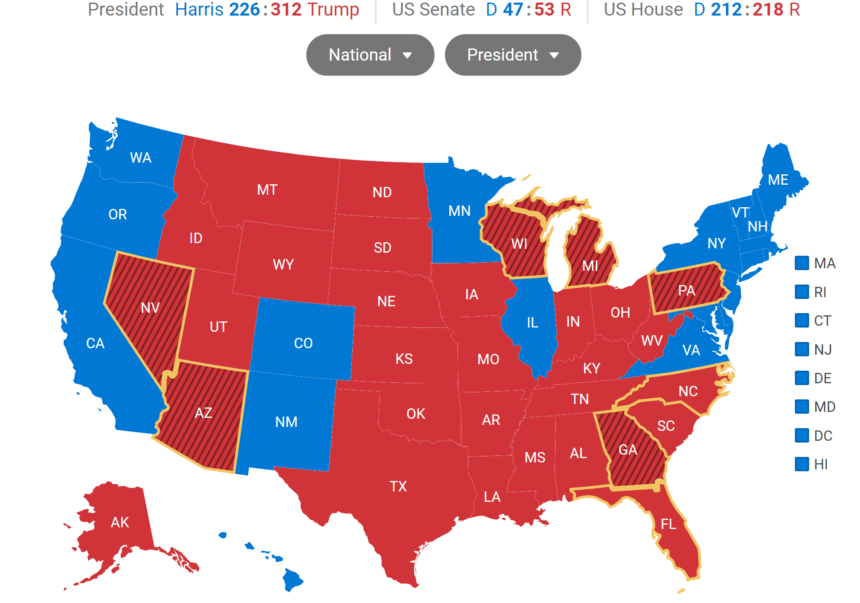
Trump Victory

Slide 4
Mandate?
Trump 2024 =49.9%
Trump 312 Electoral College Votes
Harris 226 Electoral College Votes
153 Million Ballots Cast in 2024
158 Million Ballots Cast in 2020
Flipped Senate Control to Republican Majority
Retained House Republican Majority
Election Year | Candidate | Percentage of Votes (%)
2008 | Barack Obama | 52.9%
2012 | Barack Obama | 51.1%
2020 | Joe Biden | 51.3%

Slide 5
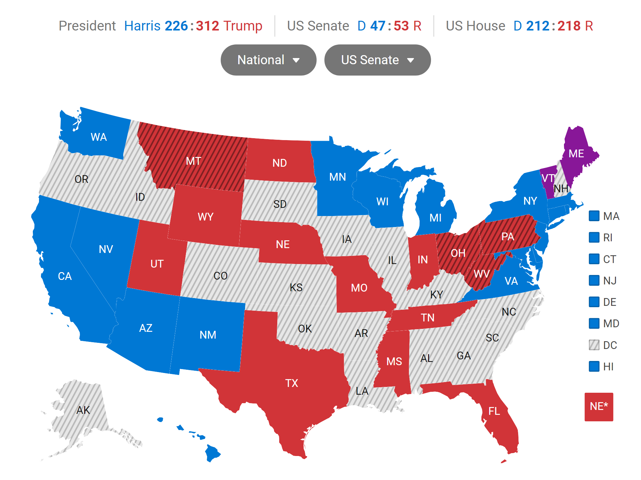
US Senate

Slide 6
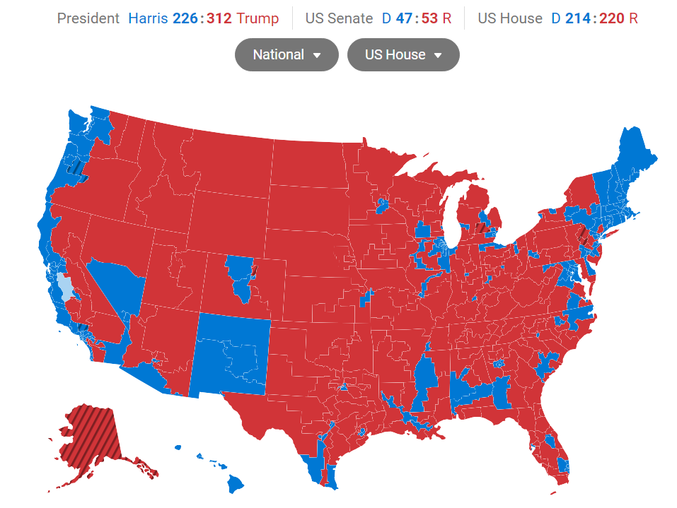
US House of Representatives—220 R-215 D

Slide 7
Senate Leadership
John Thune R-SD—Majority Leader
John Barrasso R-WY—Majority Whip
Tom Cotton R-AR—Republican Conference Chair
Chuck Schumer D-NY—Minority Leader and Conference Chair
Dick Durbin D-IL—Minority Whip

Slide 8
House Leadership
Mike Johnson R-LA—Speaker
Steve Scalise R-LA—Majority Leader
Tom Emmer R-MN—Majority Whip
Hakeem Jeffries D-NY—Minority Leader
Katherine Clark D-MA—Minority Whip

Slide 9
Key Committee Leadership—Senate--projected
Energy and Natural Resources:
  Mike Lee R-UT Chairman
  Martin Heinrich D-NM Ranking Member
Environment and Public Works:
  Shelly Moore Capito R-WV Chairwoman
  Sheldon Whitehouse D-RI
Indian Affairs:
  Lisa Murkowski R-AK Chairwoman
  Brian Schatz D-HI Chairman
Agriculture, Nutrition, and Forestry:
  John Boozman R-AR Chairman
  Amy Klobuchar D-MN Ranking Member
Appropriations:
  Susan Collins R-ME Chairwoman
  Patty Murray D-WA
  Interior Subcommittee
    Lisa Murkowski R-AK Chairwoman
    Jeff Merkley D-OR Ranking Member

Slide 10
Key Committee Leadership—House--projected
Natural Resources:
  Bruce Westerman R-AR Chairman
  Raul Grijalva D-AZ dropped out of race for Ranking Member. Jared Huffman is likely to win the race for ranking Member.
Energy and Commerce:
  Bob Latta R-OH or Brett Guthrie R-KY in race for Chairman
  Frank Pallone D-NJ Ranking Member
Appropriations:
  Tom Cole R-OK Chairman
  Rosa DeLauro D-CT Ranking Member
Agriculture:
  Glenn Thompson R-PA Chairman
  David Scott D-GA Ranking Member

Slide 11
Trump Administration Nominees
Department of Interior—Doug Burgum Governor North Dakota
National Energy Council—Doug Burgum--will provide Burgum a seat on the National Security Council
  First elected North Dakota governor in 2016, Burgum briefly ran against Trump in the 2024 GOP primaries. A tech executive and investor by trade, Burgum previously ran Great Plains Software, remaining at the company after it was acquired by Microsoft. Last year, Forbes estimated his net worth at least $100 million. Seen as a solutions-oriented Governor. As Governor, Burgum was a strong proponent of an all-of-the-above energy policy. He also supported the use of carbon capture technologies to reduce carbon emissions while continuing to use fossil fuels. In 2021, he declared North Dakota would achieve carbon neutrality by 2030 “without a single mandate,” instead favoring carbon capture and storage technology.
  He is expected to play an outsized role in the Trump Administration's energy policy. The President-elect also announced that Governor Burgum will head a newly created National Energy Council. The Council is a multi-agency effort to boost U.S. energy production and eliminate regulations and red tape that slow development in the U.S., a core policy plank from the Trump campaign. According to the announcement, the Council will oversee the path to U.S. energy dominance.
Department of Agriculture—Brooke L. Rollins, the CEO of the America First Policy Institute and a senior aide during first Trump administration. Rollins was director of the Domestic Policy Council in Trump’s first term, director of the Office of American Innovation, and a presidential assistant for strategic initiatives. She founded the pro-Trump America First Policy Institute think tank and America First Works, an advocacy group, four years ago. She’s a native of Texas and was a policy director for GOP Gov. Rick Perry, who was Trump’s first Energy Secretary.

Slide 12
Trump Nominees Continued…
EPA—Lee Zeldin R-NY
  Trump cited his “very strong legal background” and calling him “a true fighter for America First policies” in a statement. Zeldin—a Trump ally who ran for New York governor two years ago—“will ensure fair and swift deregulatory decisions that will be enacted in a way to unleash the power of American business while at the same time maintaining the highest environmental standards,” the statement said. Expect his leadership to focus on reversing Biden’s regulatory agenda in regard to clean air (NAAQS), clean water (WOTUS), and promote domestic energy production.
Department of Energy—Chris Wright, CEO, Liberty Energy
  CEO of oilfield services group, Liberty Energy. Wright has argued against climate change’s role in causing extreme weather events, saying in a video posted to LinkedIn last year “there is no climate crisis, and we’re not in the midst of an energy transition either.” He later disputed he was “[fighting] climate science,” despite saying the claims he made were “correct.”
  Wright is known for his affinity for innovation in energy space. He is on the Board of Directors of Oklo Inc., a next-generation small modular nuclear reactor company, and EMX Royalty Corp., a global mining royalties company.
  Wright also serves on the board of several nonprofit organizations, including ACE Scholarships, and as a founding board member of the Bettering Human Lives Foundation. He holds an undergraduate degree in Mechanical Engineering at Massachusetts Institute of Technology (MIT) and did graduate work in Electrical Engineering at UC Berkeley and MIT.

Slide 13
Congressional Review Act
The Congressional Review Act (CRA) allows Congress to review and potentially overturn new federal regulations issued by government agencies.
1. Submission of Rules: Federal agencies must submit a report on each new rule to both houses of Congress and the Government Accountability Office (GAO) before the rule can take effect.
2. Congressional Review: Congress has 60 legislative days to review the rule. During this period, any member of Congress can introduce a joint resolution of disapproval.
3. Expedited Process: The CRA provides an expedited process for considering the resolution in the Senate. If the committee to which the resolution is referred does not act within 20 calendar days, it can be discharged from further consideration by a written petition of 30 Senators.
4. Presidential Approval: If both houses of Congress pass the joint resolution, it is sent to the President for approval. If the President signs the resolution, the rule is nullified. If the President vetoes it, Congress can override the veto with a two-thirds majority in both houses.
5. Prohibition on Reissuing: Once a rule is overturned, the CRA prohibits the reissuing of the same or substantially similar rule unless specifically authorized by a new law.
The CRA has been used to overturn a total of 20 rules since its enactment in 1996.
Look-back date is August 1, 2024, and any regulations finalized after that date are subject to the CRA next Congress.

Slide 14
Regulatory Rollback—the primary mission of incoming Trump Administration
BLM Conservation Landscape Rule
USFS Old Growth Climate Resilience**
EPA NAAQS Rule
Sage Grouse Rule**
** subject to CRA reversal
Tribal Reserved Water Rights
NEPA Phase I and Phase II (now in question due to DC Circuit decision)
ESA Listing and Delisting
Mineral Withdrawals (Superior National Forest)
Lock in Loper WOTUS decision in Regulation
Interagency Working Group Study

Slide 15
Lame Duck Congress
Fund the Federal Government—Continuing Resolution Expected
Authorize the US Military
Emergency Supplemental
200-bill public lands package
Farm Bill?--unlikely
Judges, judges, judges…..
Or will Republicans take their ball and go home?

Slide 16
119th Congress
Margins for Republicans are thin and Trump nominations complicating Republican strategy.
Budget Reconciliation Process—streamlined process that allows simple majority to enact budgetary and policy initiatives.
  Congress likely to grab unspent post Covid era Federal funds to pay for Republican priorities
  Extension of 2017 Trump tax cuts
  Opportunity to open areas for development such as ANWR, Gulf of Mexico leasing, etc.
  Congress could use budget reconciliation to reverse mineral withdrawals such as the Powder River Basin
Confirmation of Nominees will consume much of the Senate’s agenda in Q1-Q3
Fund the Government for FY 2025
Farm Bill

Slide 17
Allen D. Freemyer allen@adfpc.com
Questions?
Comments?
December 4, 2024

