Slide 1
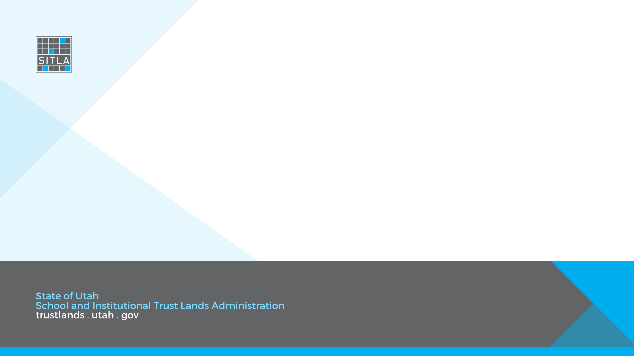
STATE LAW EXCHANGE PROVISIONS

Slide 2
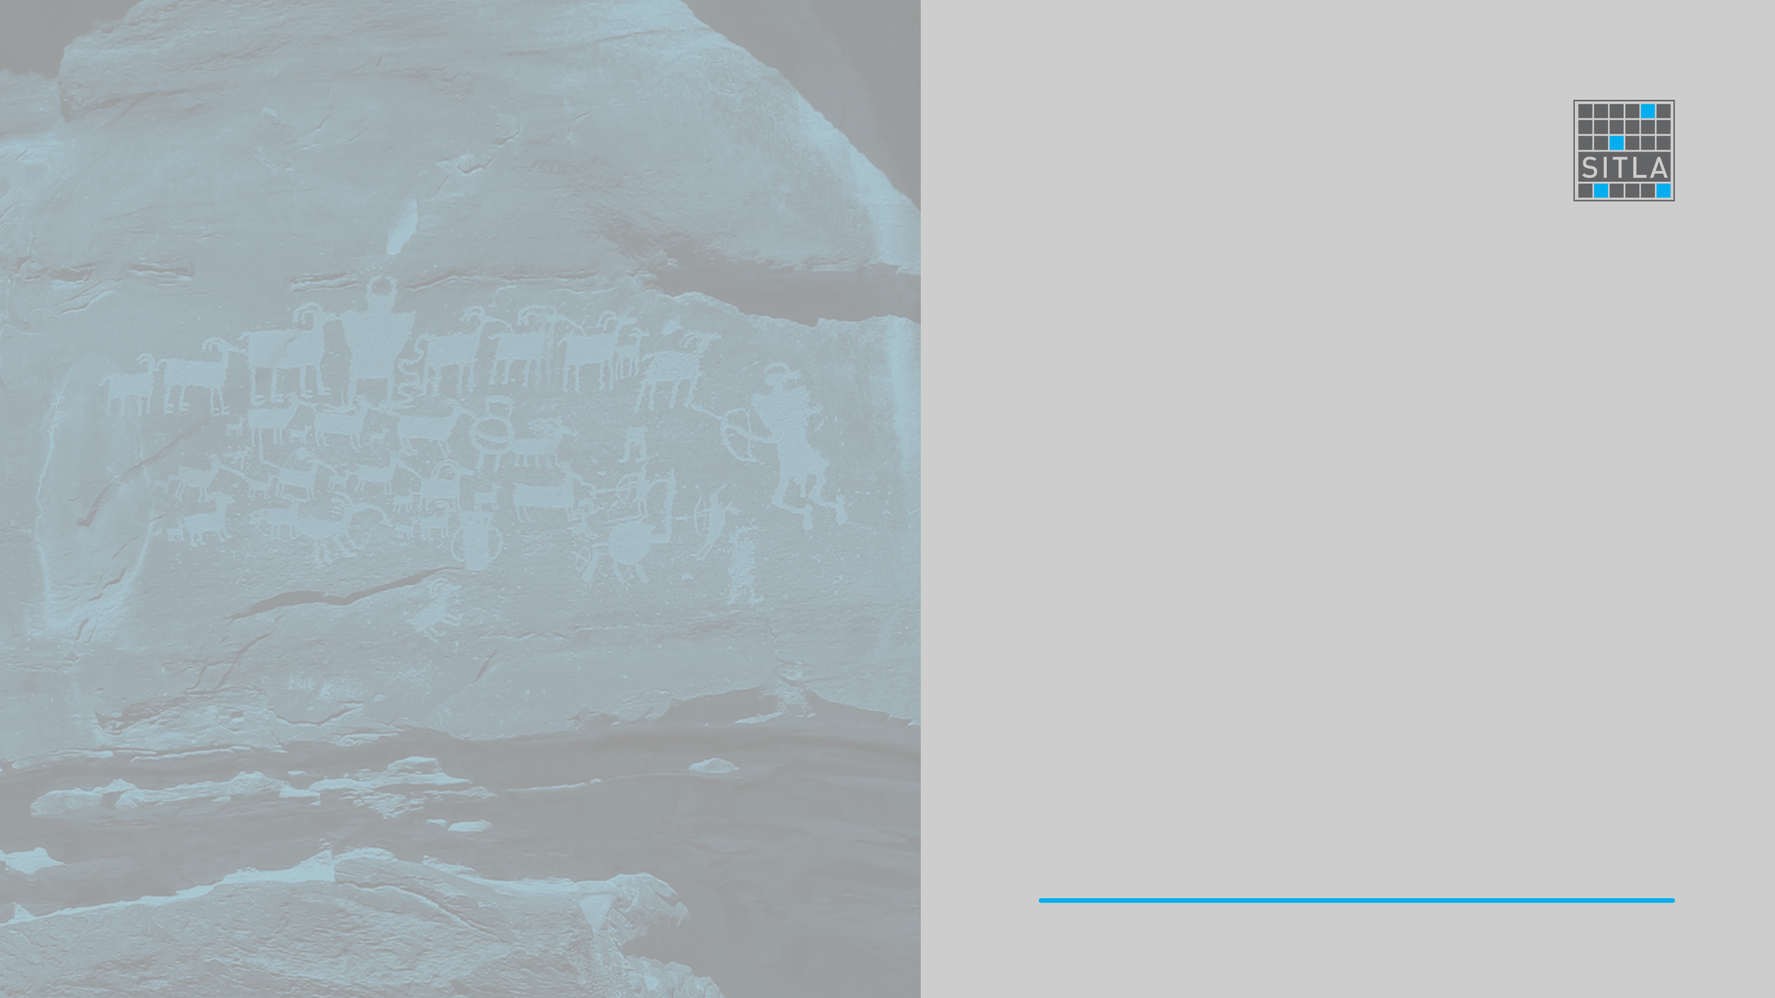
Legislative approval requirement
  Any land exchange with the federal government of over 500 acres must be approved by the legislature.
  Such approval may be granted by the entire legislature during the general session or by the (Joint) Legislative Management Committee during the interim.

Slide 3

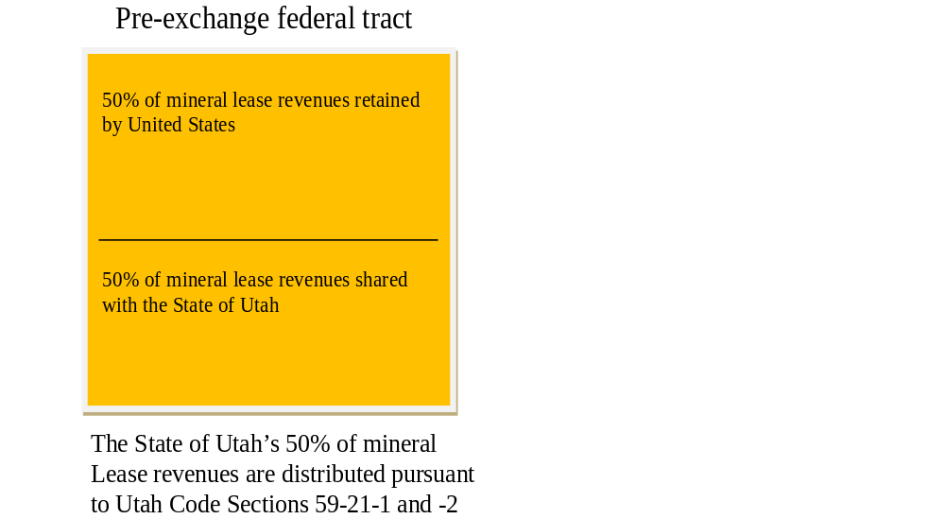
The Land Exchange Distribution Account (LEDA)
  When federal land is leased pursuant to the Mineral Leasing Act (MLA), the State in which the federal land is situated receives 50% of the lease revenue. See 30 U.S.C. § 191.
  In Utah, the State’s half is placed in the Mineral Lease Account of the General Fund and is distributed per a formula set forth in statute, much of it flowing to counties impacted by mineral development
  Utah negotiates a 50% discount on federal land acquired via exchange where MLA minerals determine valuation (in such cases the State is in effect already a 50% owner of the tract)

Slide 4

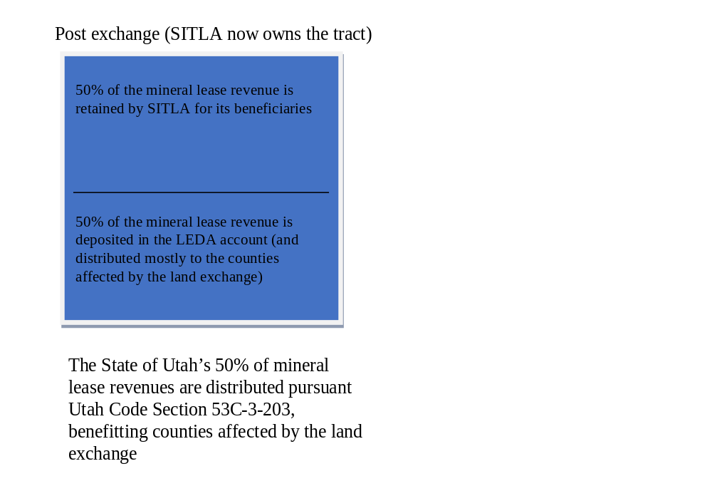
  In such a circumstance, when SITLA receives mineral lease revenue, it retains 50% for its beneficiaries and deposits the remaining half in the Land Exchange Distribution Account (LEDA).
  The LEDA funds are then distributed per a formula that compensates both the county that ‘lost’ SITLA land in the exchange as well as the county in which the acquired federal land is situated.
  The LEDA program makes certain mineral tracts more affordable and helps secure the support of counties affected by exchanges.

Slide 5
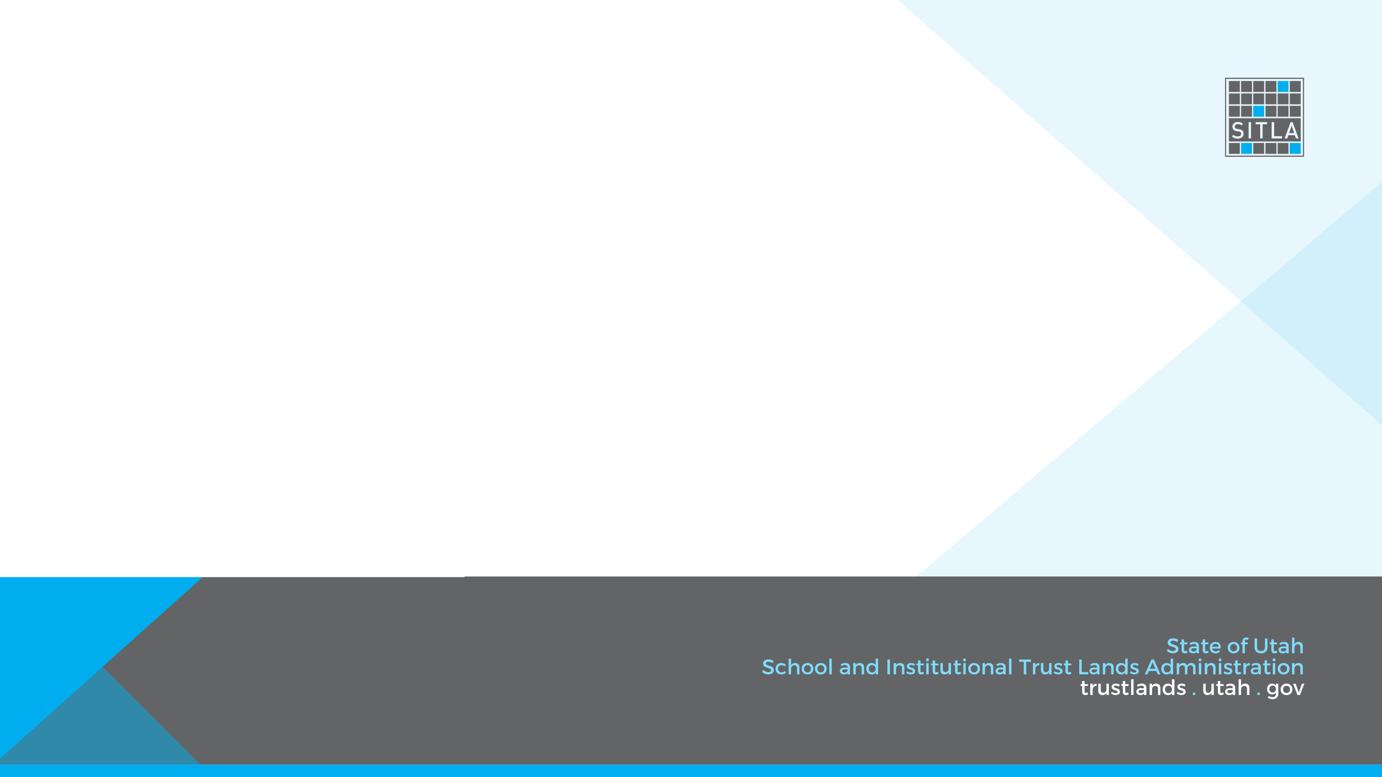
Other states...
Questions.

