Slide 1

Bipartisan Infrastructure Law:
Legacy Pollution Remediation & Reclamation Program
July 2022
Notes:
A few slides to provide an overview of the OW Program under BIL

Slide 2
What is the Legacy Pollution Remediation & Reclamation Program?
IIJA/BIL/Energy Communities Revitalization Program - ECRP
Orphaned Well Site Plugging, Remediation, & Restoration (40601)
  $4.677 billion total (OEPC & BLM)
Abandoned Coal Mine Reclamation (40701)
  $11.3 billion (OSMRE)
Abandoned Hardrock Mine Reclamation Section (40704)
  Establishes a program to address physical safety & contamination at abandoned hardrock (non-coal) mines
  Authorizes $3.0 billion (50/50 Feds/States&Tribes)
  No appropriations provided in BIL
  FY22 budget provides start-up funding (OEPC)

Slide 3
What is the Orphaned Well Program?
Title VI – Methane Reduction Infrastructure
  Section 40601: Orphaned Well Site Plugging, Remediation, & Restoration
    $4.677 billion total
    Expires 9/30/2030
    1. State and Tribal Grant Program – OEPC
      $4.3 billion for State and private lands [91.4%]
      $150 million for work on Tribal lands [3.2%]
    2. Federal Program – BLM/OEPC
    BLM, NPS, FWS, BSEE, USFS
      $250 million

Slide 4
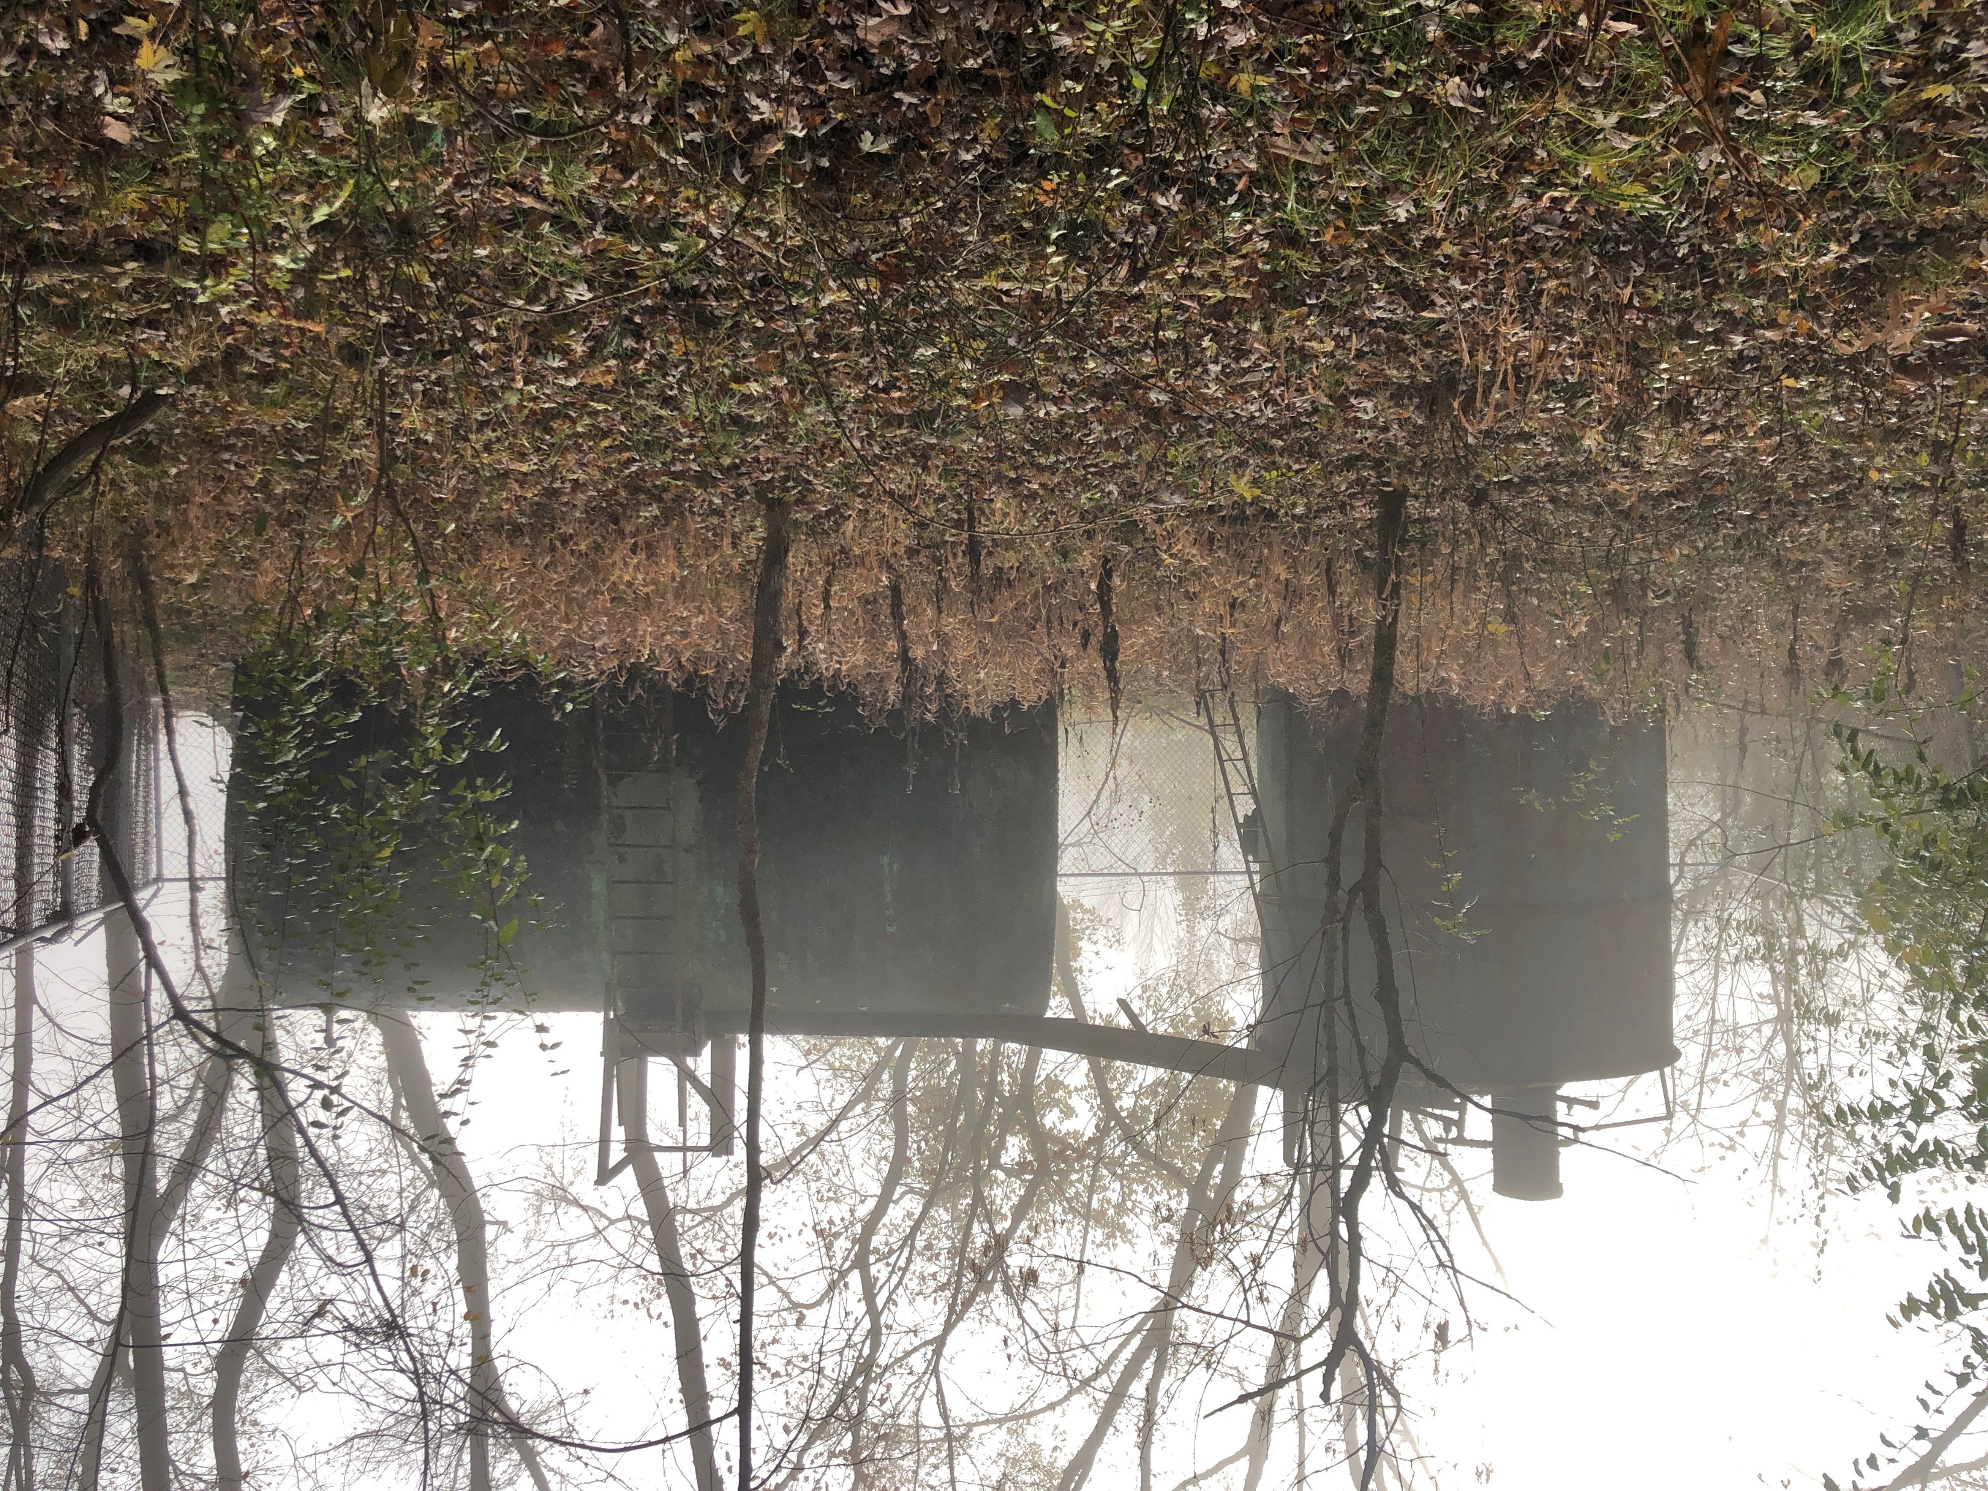
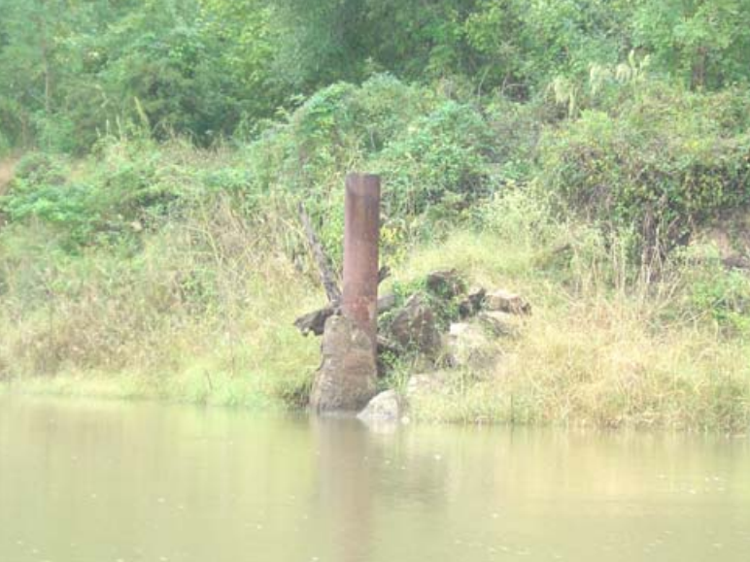
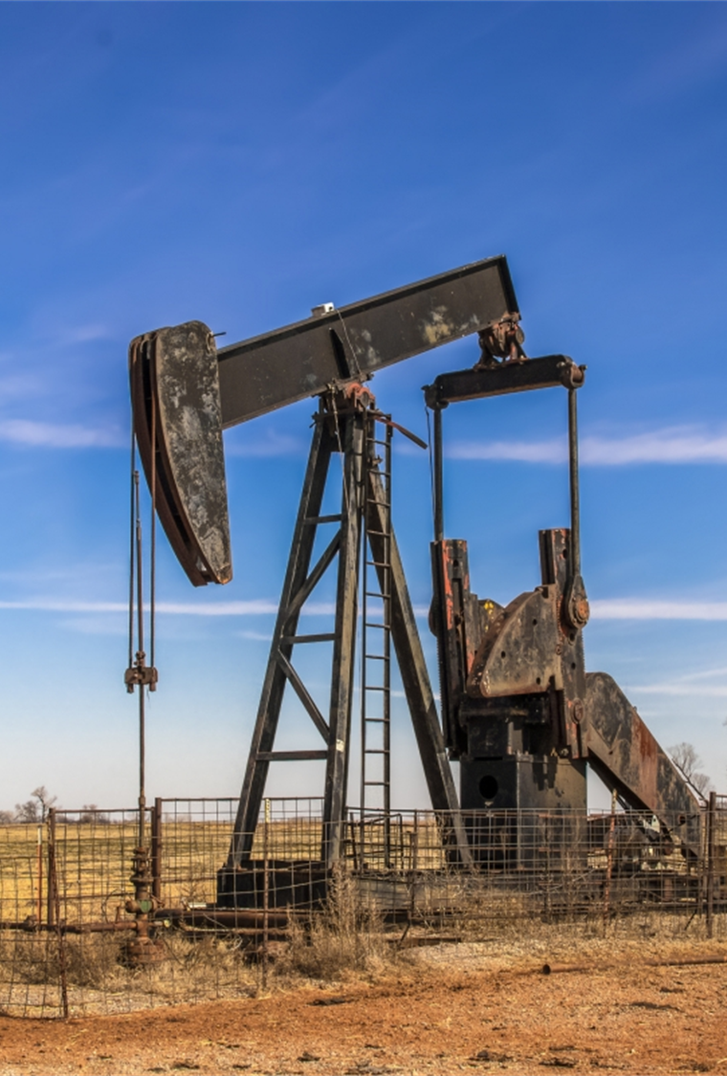
What is the ECRP?
Benefits of properly closing orphaned wells:
~2.5M – 4M orphaned wells nationwide
Reduce methane & other GHG emissions
Cleanup surface water & groundwater contamination
Remove health & safety hazards
Restore habitat
Create jobs, particularly in disproportionately burdened communities

Slide 5
Definitions – Orphaned Well
  with respect to Federal land or Tribal land = a well…
    that is not used for an authorized purpose, such as production, injection, or monitoring; and
    for which no operator can be located;
    the operator of which is unable—
      to plug the well; and
      to remediate and reclaim the well site; or
      that is within the National Petroleum Reserve AK
  with respect to State or private land –
    has the meaning given the term by the applicable State; or
    if that State uses different terminology, has the meaning given another term used by the State to describe a well eligible for plugging, remediation, and reclamation by the State.

Slide 6
Definitions – Documented, Undocumented
Terms not defined in BIL
IOGCC definitions (emphasis added):
    Documented - a well for which the regulatory agency has a drilling report, completion report, inspection report, or other record establishing the existence of the well.
      BIL - $4.677 DOI
    Undocumented – a well that is entirely unknown to the agency or a well of which the agency has some evidence, but which requires further records research or field investigation for verification.
      BIL - $30M DOE

Slide 7
Eligible Uses of Funds
Plug, remediate, & reclaim orphaned wells
Identify and characterize undocumented orphaned wells
Rank orphaned wells based on factors including, public health / safety, potential environmental harm, & other land use priorities
Make information available on a public website
Measure and track –
  emissions of methane and other gases associated with orphaned wells
  contamination of groundwater or surface water
Remediate soil & restore native species habitat that has been degraded due to the presence of orphaned wells & associated pipelines, facilities, infrastructure
Remediate land adjacent to orphaned wells and decommission or remove associated pipelines, facilities, infrastructure
Identify and address any disproportionate burden of adverse human health or environmental effects of orphaned wells on communities of color, low-income communities, and Tribal & indigenous communities

Slide 8
State Grants
Initial Grant ($775M)
  Small-scale: up to $5M (capacity)
  Large-scale: up to $25M
    Lg-scale app deadline 5/13/22
    Awards in August
Formula Grant ($2B)
  Job losses in O&G industry
  # documented orphaned wells
  Cost of plugging, reclamation, etc
    State NOI deadline 12/31/21
    State eligibility published 1/31/22
    Draft guidance under internal review
    Apps to begin ~August/Sept 2022 (60 days)
Performance Grants ($1.5B)
  Matching Grants
  Regulatory Improvements Grants
    No sooner than 180 days > Initial Grant

Slide 9
Tribal Well Options
Direct Grant
  5 years to obligate
  May be Competitive, Formula, or other
or
In Lieu of a Grant
  Request that DOI perform P&A on behalf of the Tribe
  OEPC & IESC
*****
    Tribal listening sessions Feb 8-10, 2022
    Draft guidance under internal review
    Listening sessions late July
    Apps to begin ~ Aug/Sept (60 days)
Notes:
2 CFR 200 applies

Slide 10
Federal Program
Federal Land = USDOI & USDA
  BLM
  NPS
  FWS
  BSEE/BOEM
  FS
Technical Working Group (BLM & OEPC)
  Matrix, Methane, GW/SW, EJ subgroups
FY22 projects awaiting funds (~$30M)

Slide 11
Annual Report to Congress
Updated inventory of wells located on Federal, Tribal, State & private lands that are—
  orphaned wells (OW) or
  at risk of becoming OW
Estimate of the quantities of—
  methane & other gasses emitted from OW
  emissions reduced as a result of plugging, remediating, and reclaiming OW
# jobs created, jobs saved through the plugging, remediation, & reclamation of OW
Acreage of habitat restored, with a description of the purposes for which that land is likely to be used

Slide 12
Contacts & Resources
DOI Infrastructure Site
  www.doi.gov/priorities/investing-americas-infrastructure
State & Tribal Grants Program
  Orphanedwells@ios.doi.gov
  www.doi.gov/oepc/legacy-pollution-remediation-and-reclamation
Federal Well Program
  Orphanedwells@blm.gov
  www.blm.gov/programs/energy-and-minerals/oil-and-gas/federal-orphaned-well-program

