Slide 1

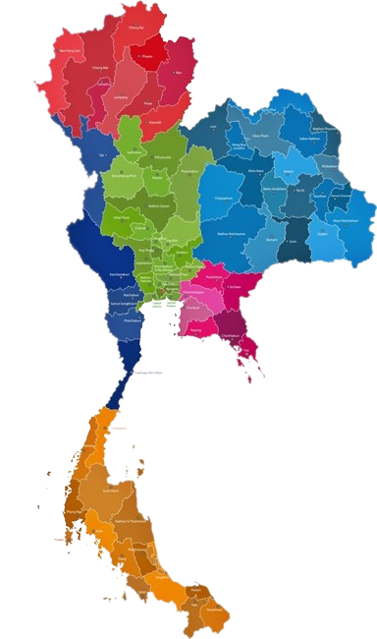
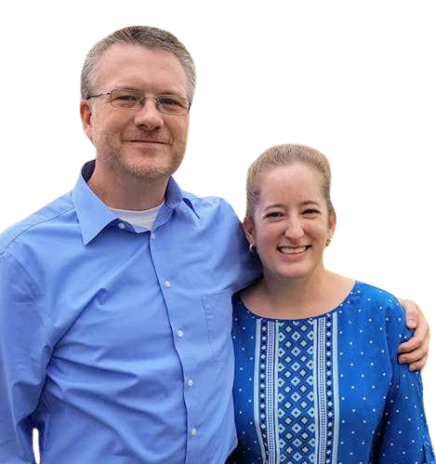




The Teer Family
Rusty & Susan
Sent by: Victory Baptist Church – Madison, MS
Serving in Southeast Asia & North/Northeast Thailand
Ministry Focus:
Gospel Outreach through English Classes through public schools & at personal home Monday - Thursday
English & Sports Camps
Christmas/Holiday Outreach
Prayer Requests & Needs:
Gospel plant/water/harvest & student/teacher salvations
Interns (summer & annual) & teachers (full & part-time)
Summer Camps (5 schools x 3 weeks)
Political unrest/tensions
Parent’s health
Brorusty
Mission: SE Asia
@youthwake
brorusty@gmail.com
https://missionsea.blogspot.com/

