Slide 1
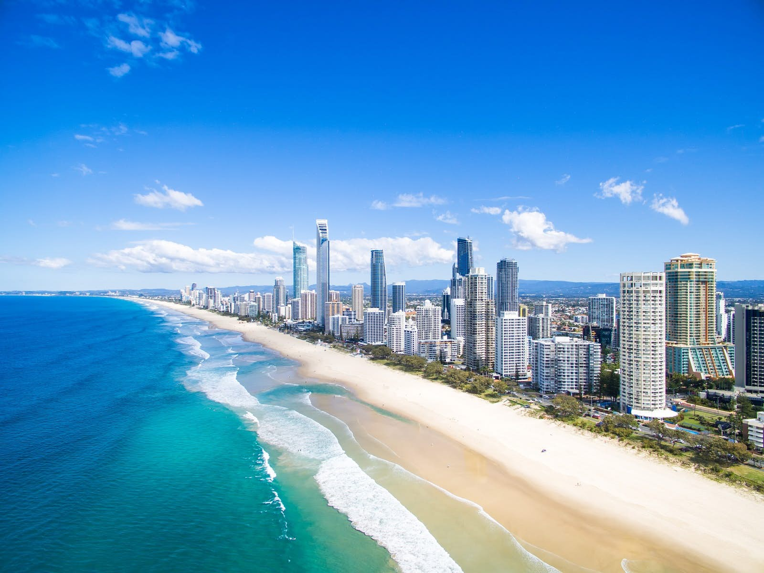
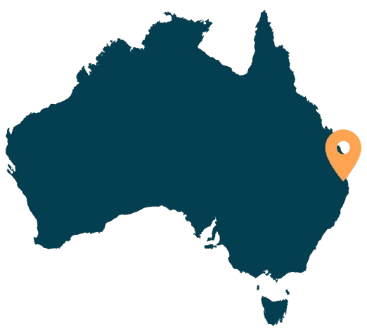
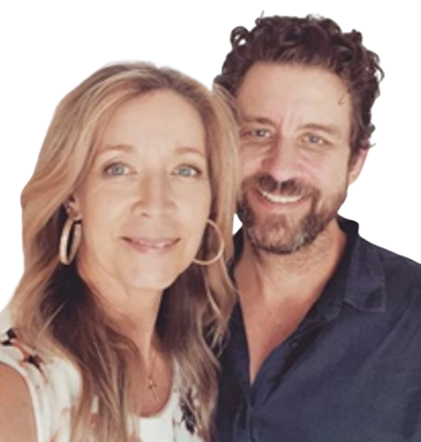



The Miller Family
Chris & Christine
Children: Kaitlyn & Samuel
Sent by: East Somerset Baptist Church
Sommerset, KY
Serving in Gold Coast, Australia
Ministry Focus:
Gold Coast of Australia, population 732,000.
30,000 unit housing development within ½ mile of church.
Pastor Hinterland BC since 2003.
Prayer Requests & Needs:
Development of ministries to reach the new community under construction.
Improvement to online presence & outreach.
Financial independence of Hinterland Baptist Church
HinterlandBaptistChurch
@hinterlandbaptistchurch1706
https://hinterlandbaptist.com

