Slide 1

Community Energy for West Earlham & Bowthorpe
Opportunities through Pride in Place
Livvy Hanks, Our Power Community Energy CIC

Slide 2
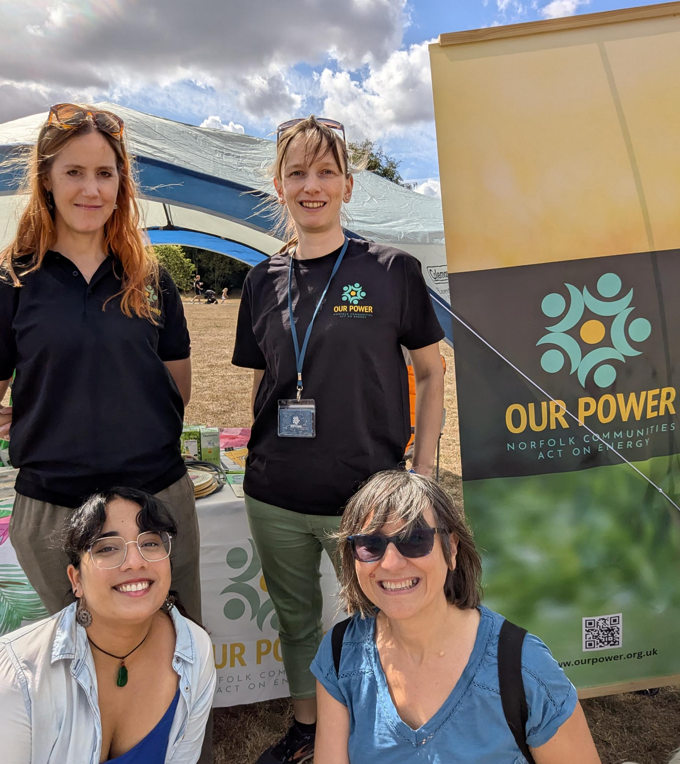
About Our Power
Working for a fairer, more resilient and
people-powered energy system in Norwich
Community interest company – funded by a mixture of contracts and grants
We do drop-in ‘energy cafés’ , workshops and home visits – get in touch if interested!
Working with the city council on a possible solar project
Also exploring possibilities for solar on other local buildings.

Slide 3
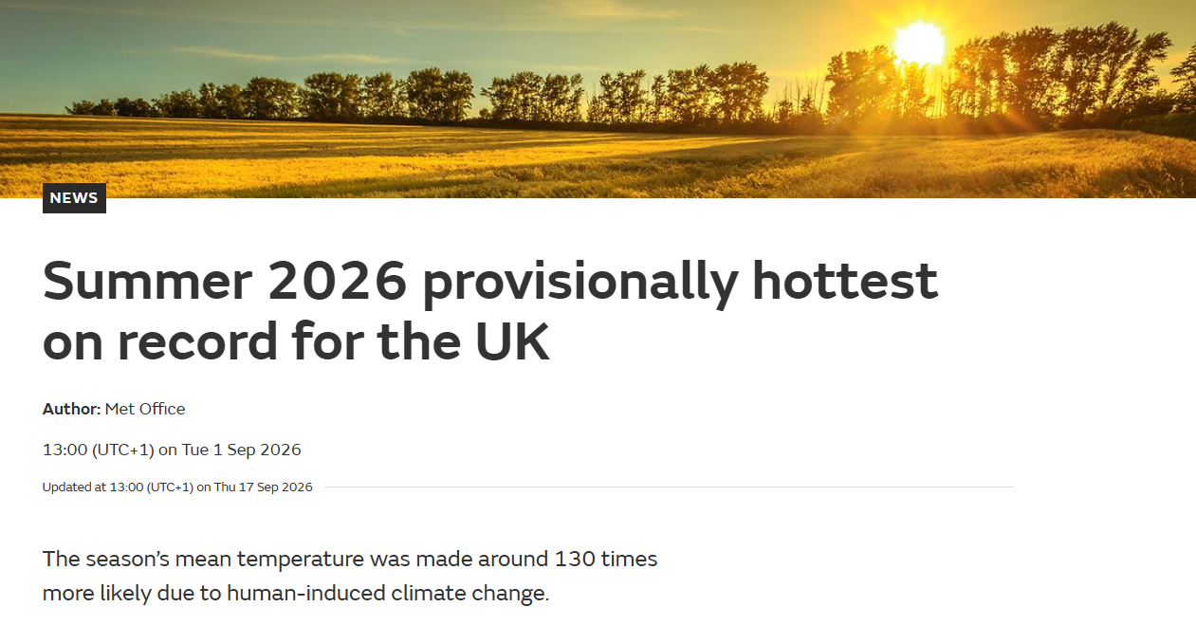

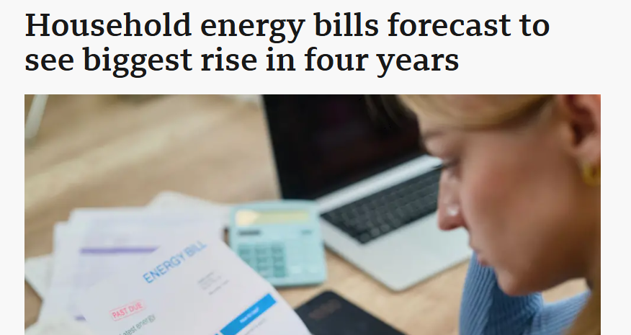
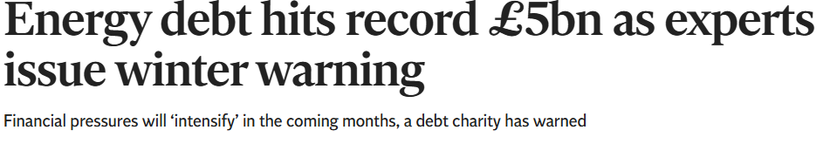
Our energy system isn’t working for us…

Slide 4
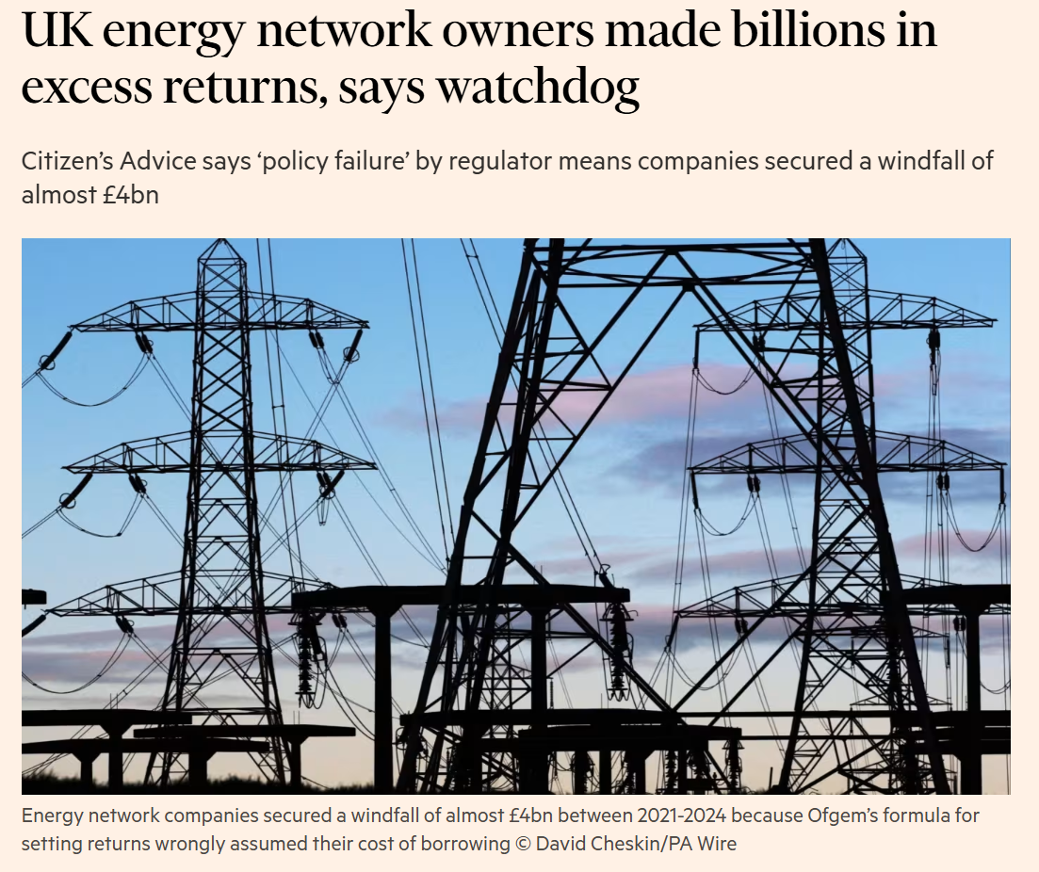
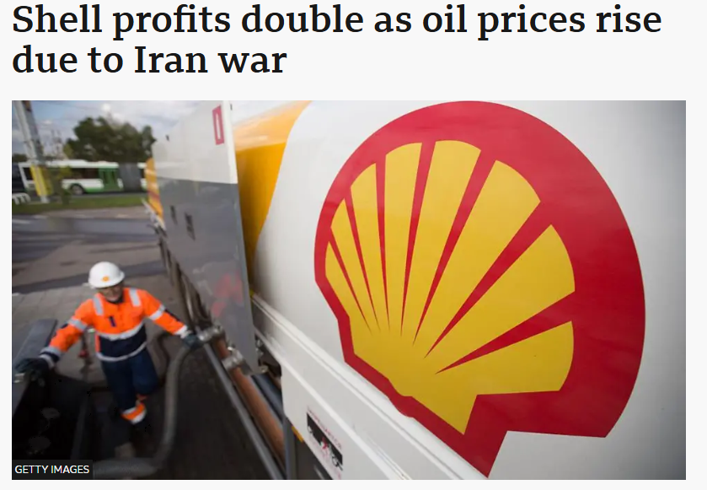
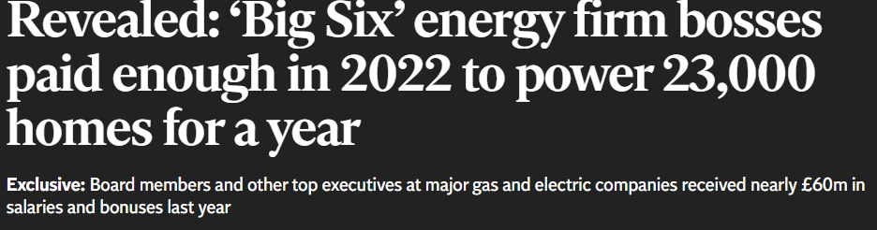
…but it is working for a few people

Slide 5
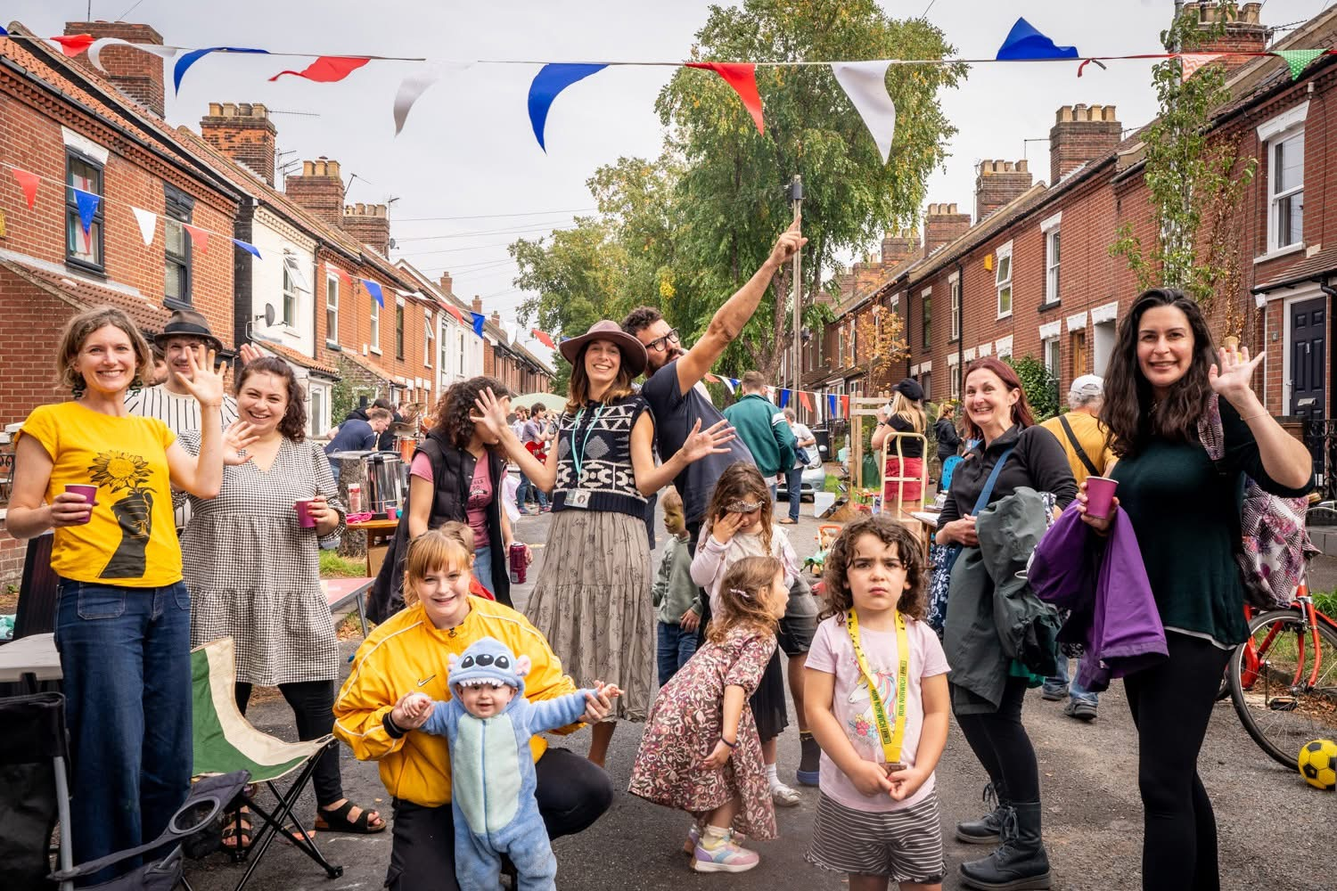
What is community energy?
"Community energy is about people and communities taking democratic control over their energy future, by understanding, generating, using, owning and saving energy in their communities, as well as working together across regions and nationally."
- Community Energy England
Often involves community ownership, but can include other community-led projects.
Well suited to renewable energy (it’s a lot harder to set up your own gas power station…).
Can help with the transition away from fossil fuels – and ensure everyone benefits.

Slide 6
How it works
A community energy group finds a potential site, conducts some basic research and approaches the owner.
The group works with installers to survey the site, design the system and obtain the necessary permissions.
The group raises money through a community share offer which anyone can invest in.
The group owns the installation and sells electricity to the building user (or others) at a lower price than they were paying elsewhere.
Income is used to cover operating costs and pay interest to investors. Any surplus funds community projects.

Slide 7
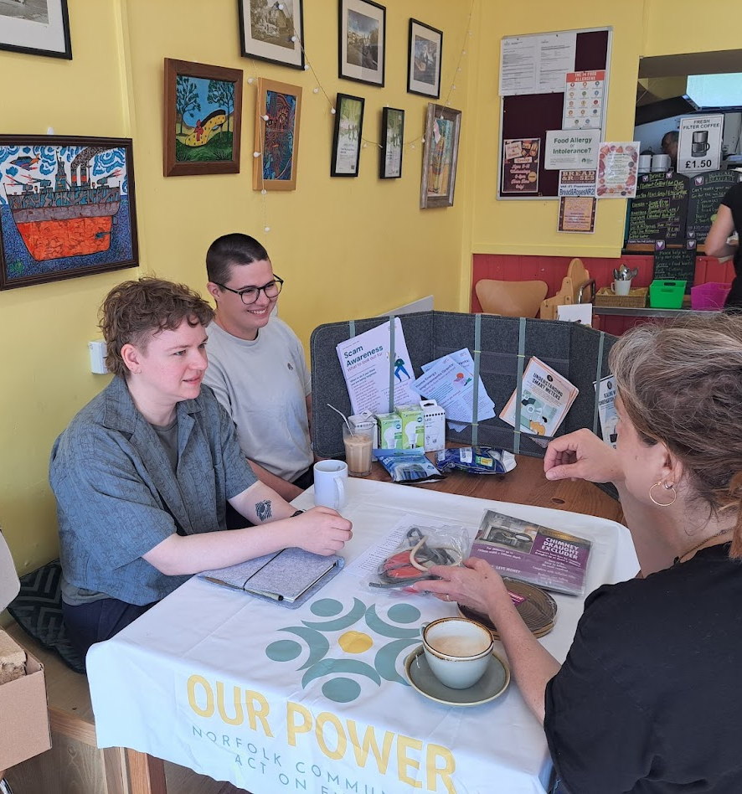
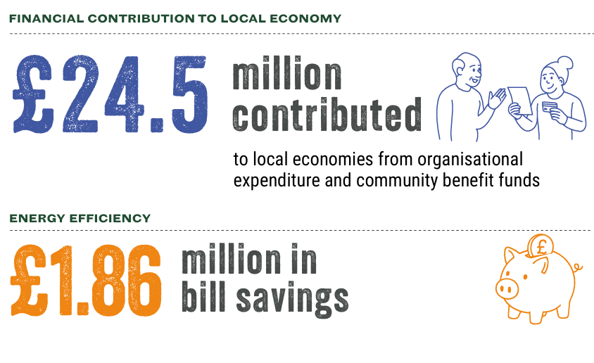
Benefits of community energy
Community energy is good for local economies and communities as well as the planet:
It's cheaper and more secure – no shareholder profits and no volatile international market
It keeps money in local economies, builds local skills and funds community projects
It brings communities together
It's accountable to the community it serves
Figures for 2024. From the Community Energy England 'State of the Sector' report.

Slide 8
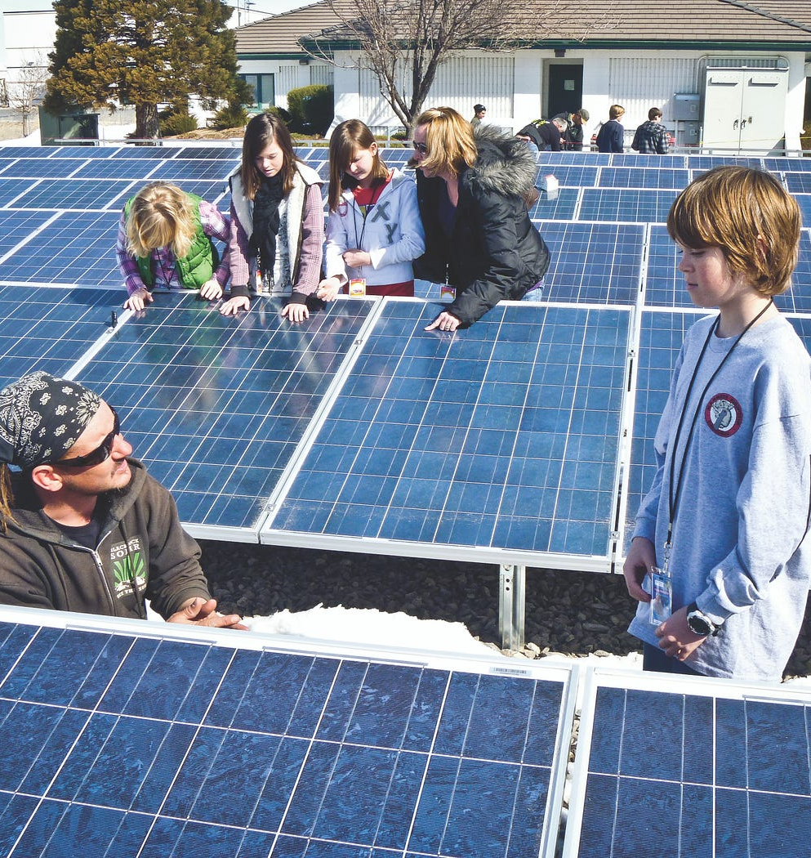
Rooftop solar
Most tried-and-tested model of community energy – but most projects relied on subsidies which no longer exist
Cost of panels has fallen, cost of electricity has risen → viable projects are now possible again
Usually on roofs of buildings with high electricity usage e.g. swimming pool, care home, hospital
Need around 70% on-site usage – the rest can be sold to the grid.
Photo: Jessica Reeder. Licensed under Creative Commons

Slide 9
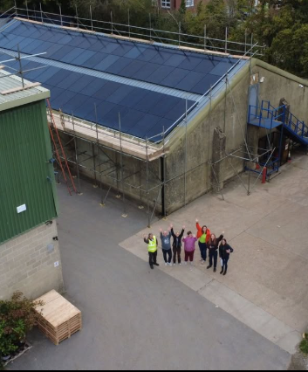
Case study:
Energise South Downs
First three solar installations completed in 2025 – on a sailing club, a swimming pool and a warehouse
Community share issue raised £300,000 in 10 days – investments from £50 to £30,000
Expects to pay interest of up to 5.5% as well as putting money into a community benefit fund.
Photo: Energise South Downs

Slide 10
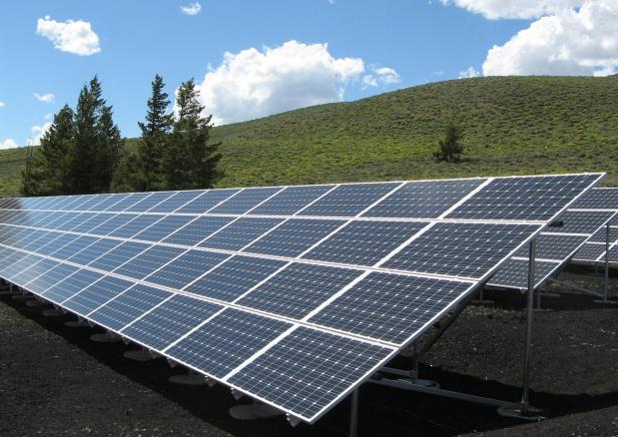
Ground-mounted solar
Needs at least 4 hectares (10 acres – about 6 football pitches)
Needs planning permission and a grid connection
(this is often a barrier)
Can be combined with other uses like grazing animals or planting wildflowers
Can sell to an energy company, or directly to a user.

Slide 11
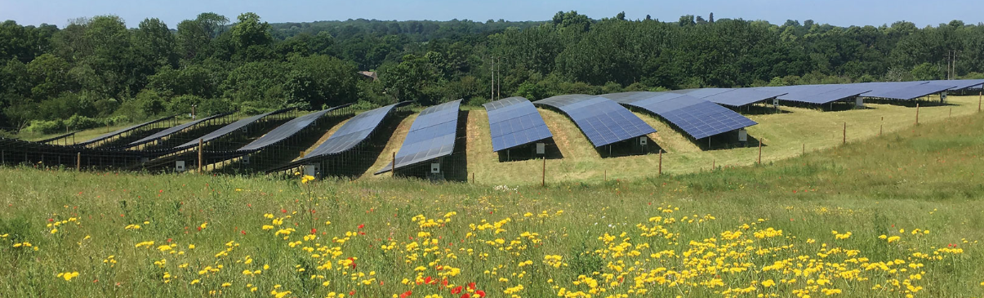
Case study: Southill Solar
Photo: Southill Community Energy
4.5MW solar farm in Oxfordshire
Cost £4.5m - £1.35m raised through community shares, with the rest coming from loans and government grants
Enough power for about 1,500 homes
Site also includes a wildflower meadow and an orchard.

Slide 12
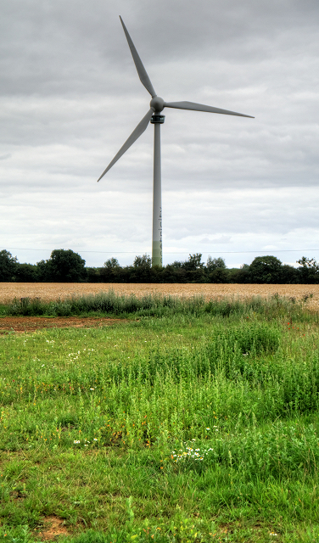
Wind power
Britain has a target to double onshore wind capacity by 2030
More than 60% of people would support a community-owned wind turbine in their area (compared to 37% for privately owned)
1MW is the minimum scale, but economics are better with a 4MW turbine
Capital cost around £4.5m for 4MW
No opportunities very close to PiP area
Onshore wind was pretty much banned in England for a decade, so there aren’t many recent examples. However…
Photo: David Dixon. Licensed under Creative Commons

Slide 13
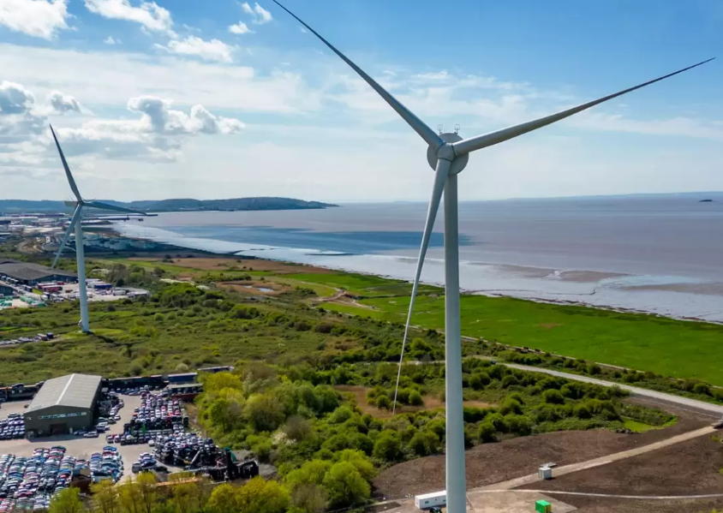
Case study: Ambition Lawrence Weston
Housing estate in Bristol owns the biggest onshore wind turbine in England at 150m tall and 4.2MW capacity
Took 7 years from idea to operation
Cost £5.5m. Expects to contribute £100,000 a year to local projects once loans are paid off
Photo: Ambition Community Energy

Slide 14
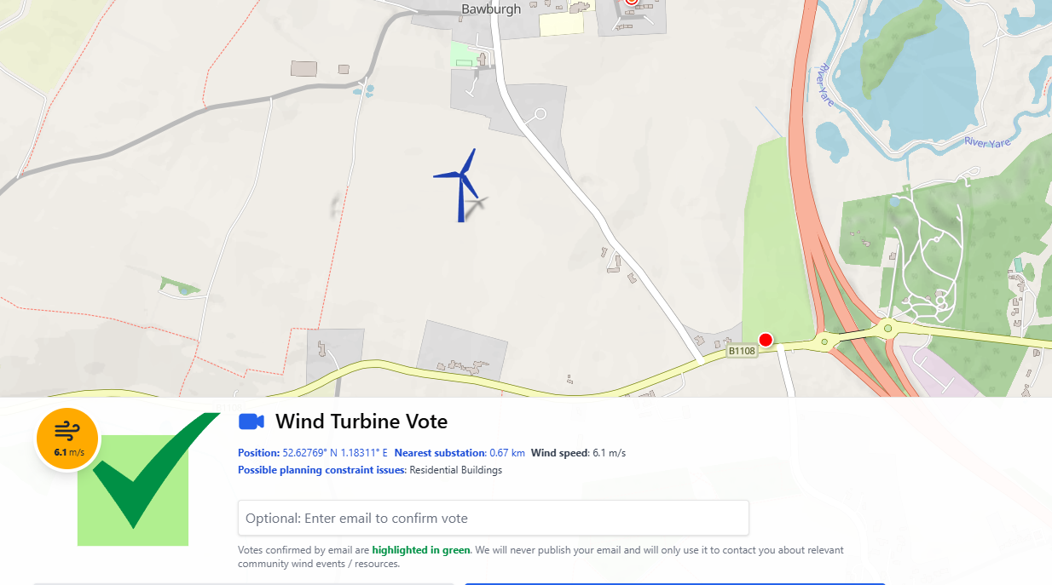
VoteWind.org

Slide 15
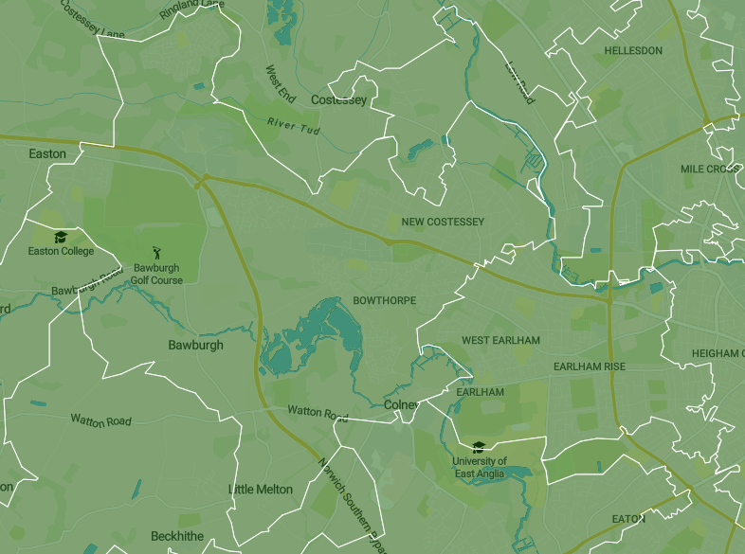
Who buys the electricity?
There are three main options:
Sell to an on-site user (probably won’t cover 100% of generation)
Sell to the grid – via an agreement with an energy supplier
Sell to local homes or businesses – this has previously been almost impossible but is getting easier.
You can avoid some grid costs if you can show that a local customer is using electricity at the same time your site is generating it.
Domestic users must be in the same primary substation area as the site.

Slide 16
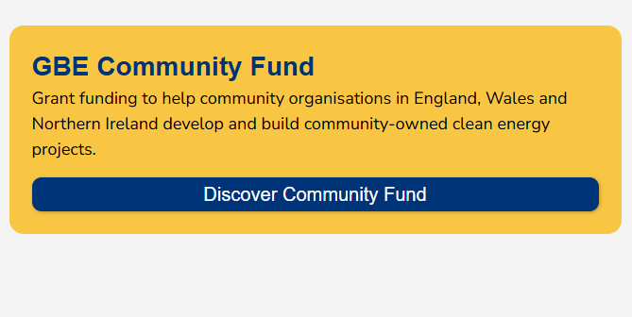

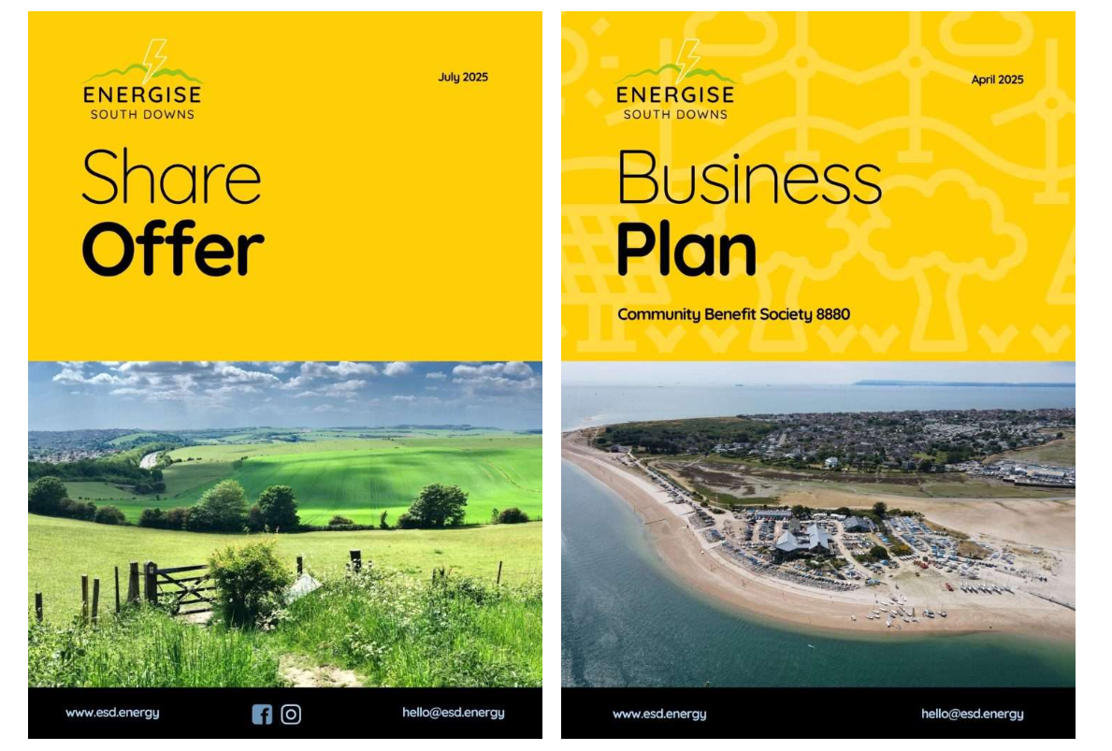
How to raise the money
Needs a business case – but grant funding can help with initial costs
Community share offer – £100k-£1.5m
Grants e.g. GB Energy Community Fund
Would Pride in Place wholly fund a small installation e.g. on a community building,
with air source heating and cooling? (Not exactly community energy but could inspire other projects)
Or could PiP pay for project development costs for a larger project?
Loans – e.g. Triodos Bank, Younity

Slide 17
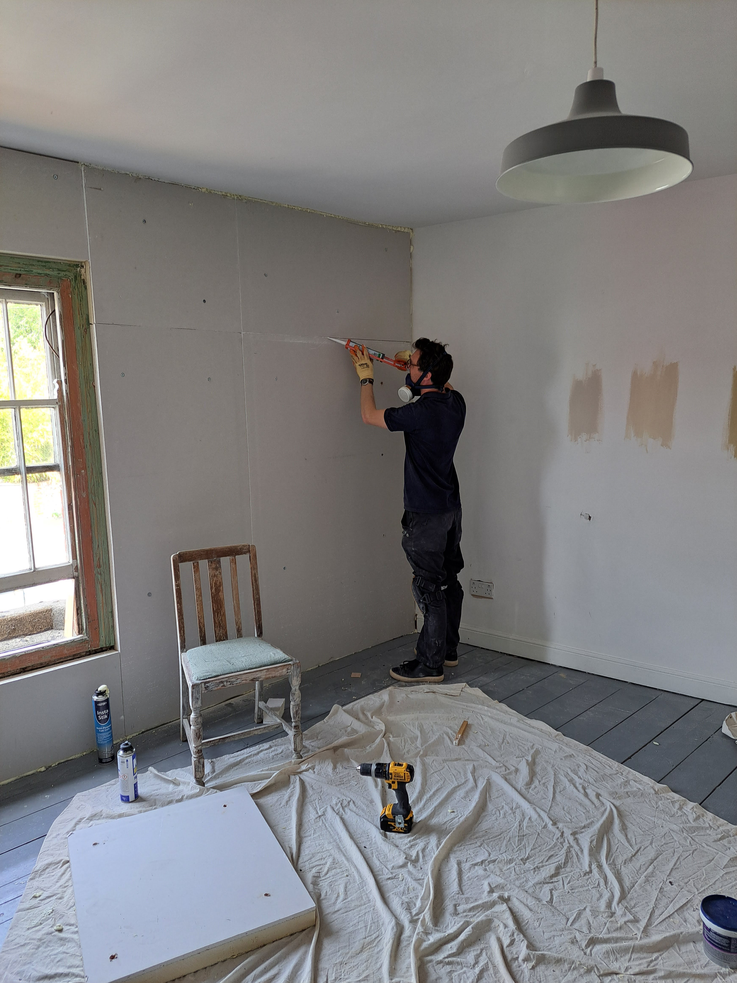
Retrofitting: what and why
Upgrading homes so they waste less energy
Insulation, windows and doors, heat pumps, solar, ventilation
Can make homes healthier, more comfortable and cheaper to run
Can reduce housing-related illnesses including respiratory illnesses and depression
Huge need across the UK – but cost, low trust, and confusing information are key barriers
Potential for skilled jobs – advisors, surveyors and installers.

Slide 18
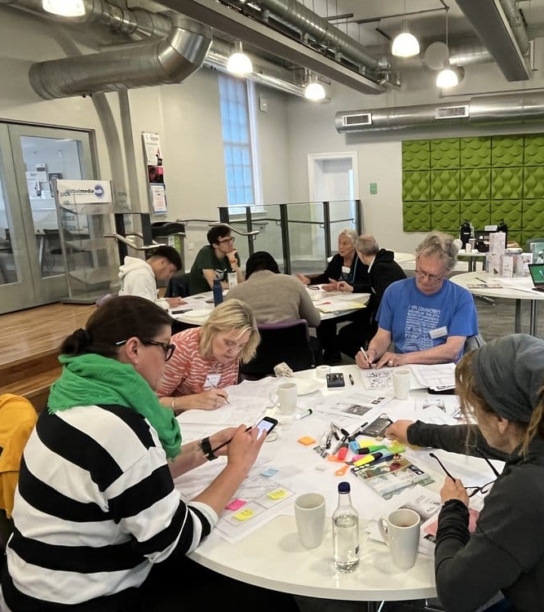
Community-led retrofit
A more community-led approach to retrofit asks: how can we work together to make our whole neighbourhood fit for the future?
Civic Square in Birmingham set up a Neighbourhood Trade School for people to share all kinds of skills and knowledge needed to build more resilient neighbourhoods.
B4Box provides multi-trade skills apprenticeships to people in Greater Manchester. It works with a social housing provider to guarantee work for trainees.
The Portland Inn Project in Stoke-on-Trent involved the community in bringing a derelict pub back into use as a community cultural space.

Slide 19
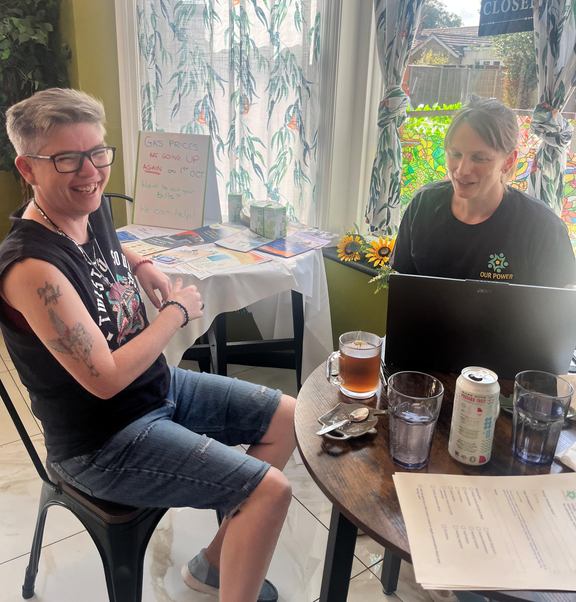
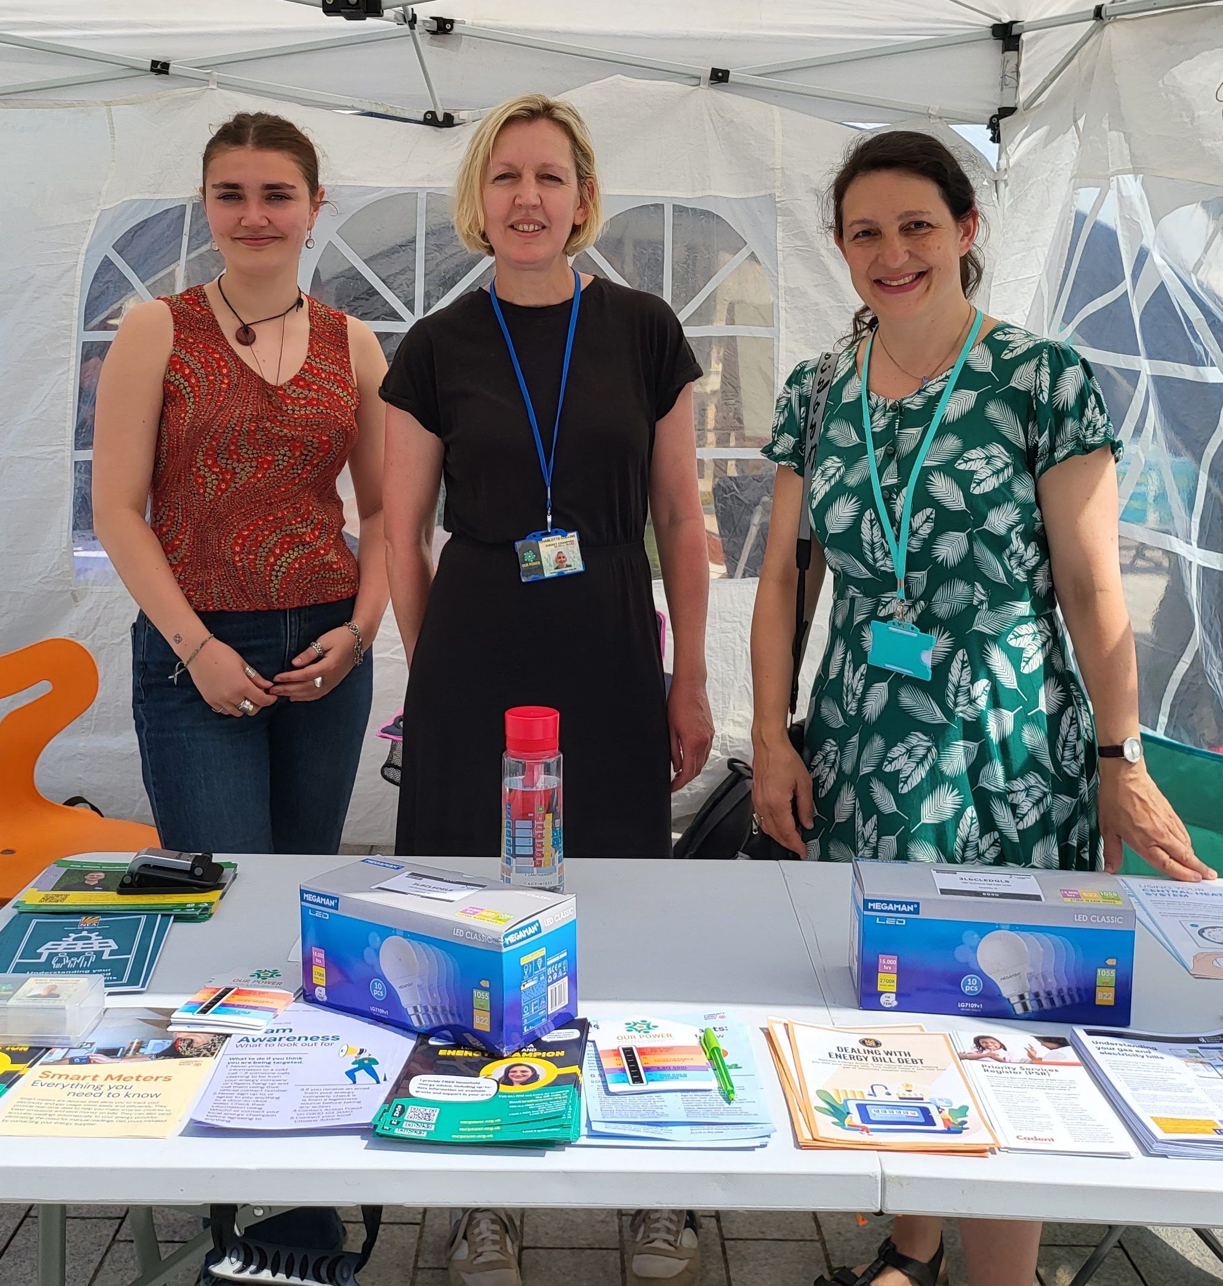
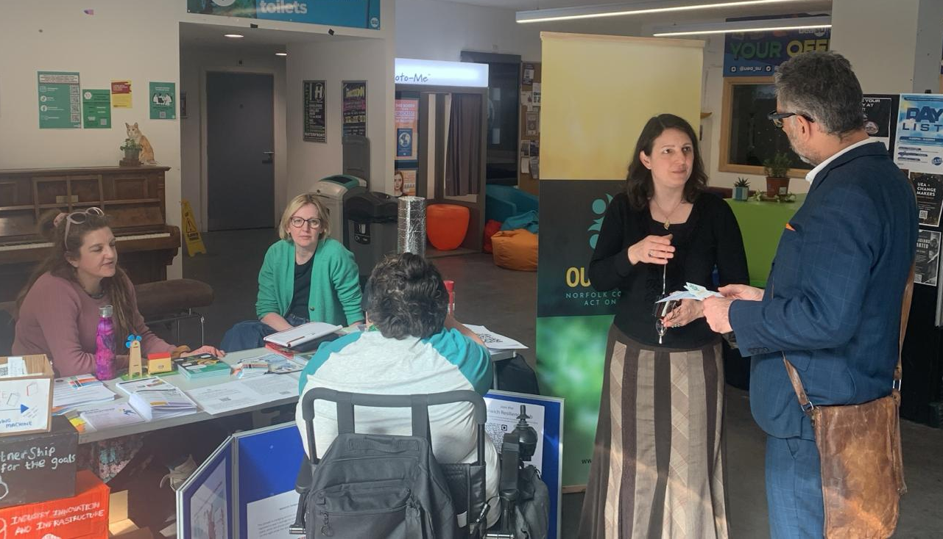
Energy champions
Local people are the most trusted source of information.
Our Power has trained volunteers who give energy advice in community venues, helping people save money or keep warm.
Can also run workshops and thermal imaging surveys.
PiP could expand this model and involve more people from West Earlham & Bowthorpe.

Slide 20
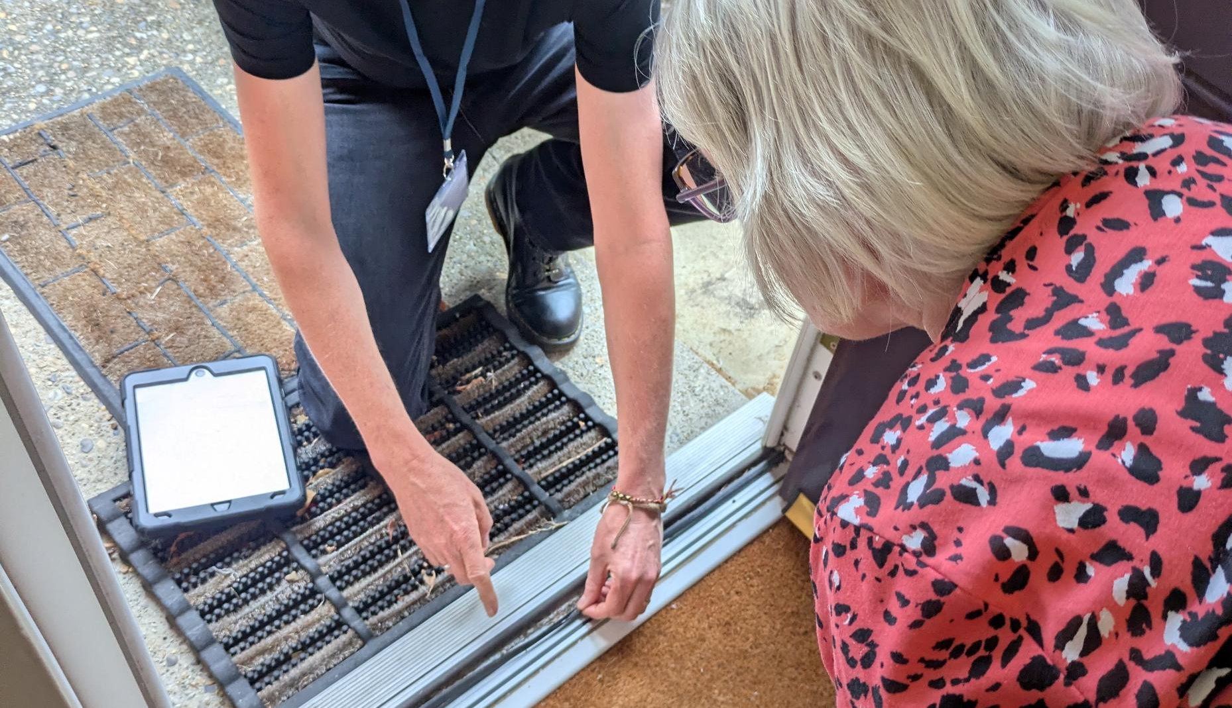
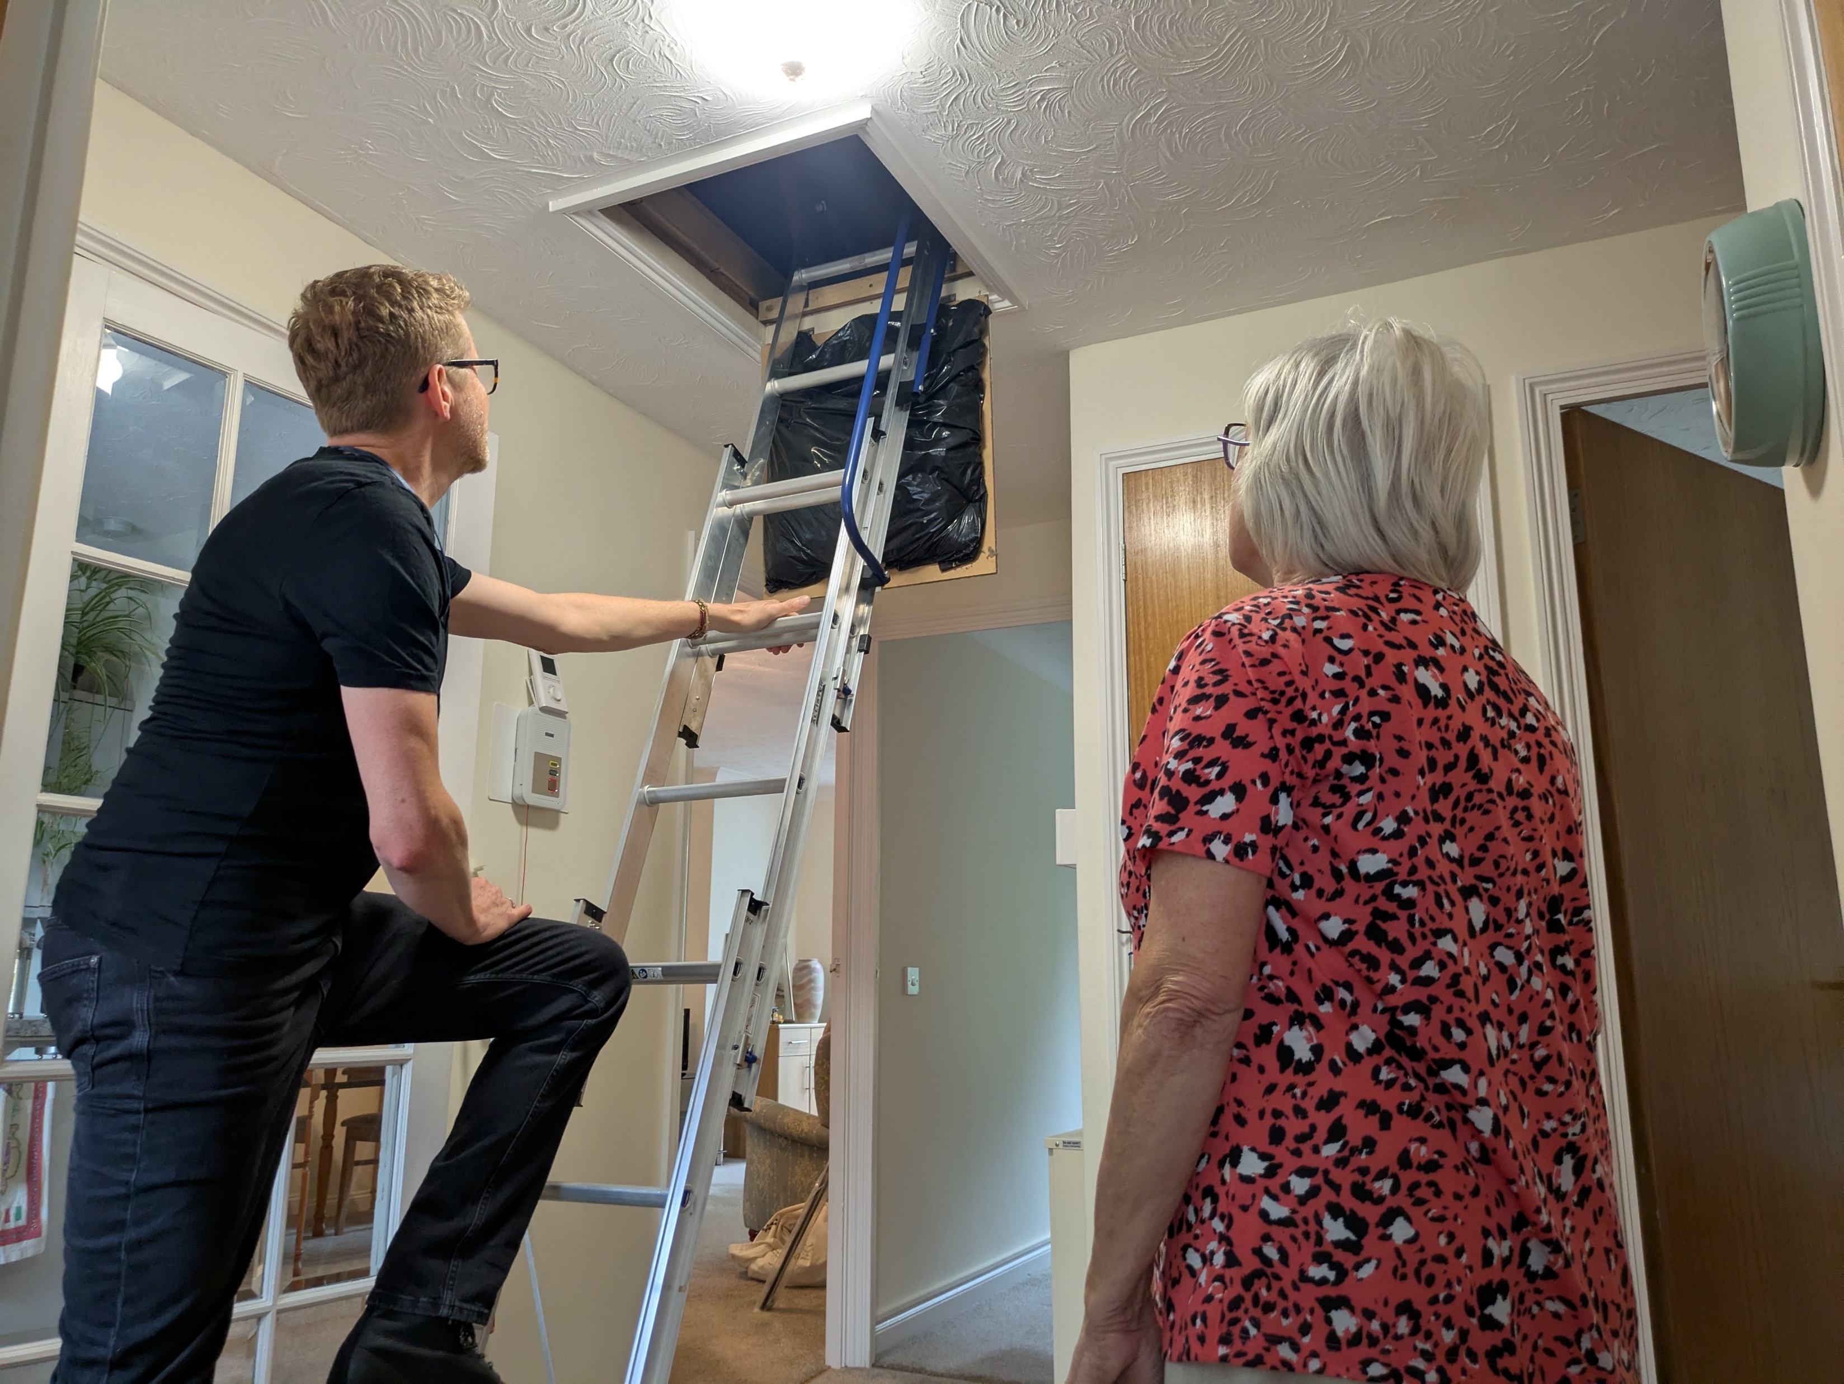
Healthy homes
Retrofit is hard to fund – low financial return on investment.
Could be seen as a health project but better evidence is needed.
PiP could fund some home upgrades and work with researchers to assess health impacts.
Works well with 10-year timescale – can assess long-term impacts.

Slide 21
Next steps
Decide what you want to achieve
Get people excited about it!
For an energy generation project:
Build local support for the general principle before settling on a specific site.
Identify one or more possible sites.
If the electricity won’t mostly be used on site, think about who might buy it.
Do a basic desktop feasibility assessment to see if the sites are likely to be viable.
Approach the site owner.
For a large project, talk to UK Power Networks early on.

Slide 22
How Our Power can help
We could support an energy generation project by:
Hosting a project within our organisation
Managing the entire project on behalf of a new entity set up by the PiP programme
Undertaking specific elements of the project such as initial feasibility work, finding installers, or running a community share offer.
We could also support different kinds of energy-related projects, e.g.:
Delivering an energy advice project in collaboration with local volunteers
Running workshops on community energy, community-led retrofit, or relevant DIY skills such as draughtproofing
Doing project design and project management for a retrofit project.

Slide 23
Thank you!
We hope to see you soon…
livvy@ourpower.org.uk
https://ourpower.org.uk/
To book a home visit: energyhelp@ourpower.org.uk

