Slide 1
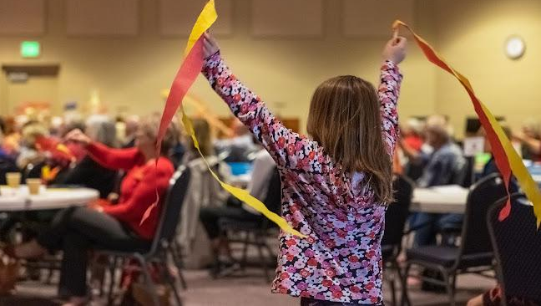
Congregational Vitality Assessment Report
Lutheran Church of the Resurrection

Slide 2
OUR PARTNERSHIP
PARTICIPANT DATA
DEMOGRAPHICS
PROGRAM PERCEPTIONS
TABLE OF CONTENTS
PARTICIPANT
EXPERIENCES
CONGREGATIONAL
DATA
CONCLUSIONS
‹#›

Slide 3
Convergence understands that institutional religion is changing. We serve at the leading edge of that change, generating present and future possibilities within an organization's intended areas of influence. In short, we are a 501c3 organization working with those moving from "organized religion" to "organizing religion" in service to a more just and generous world.
In our 14+ years, we have worked with hundreds of congregations, judicatories, denominations, non-profit organizations, foundations, and thousands of faith leaders.
For over a decade, we have provided online courses, as well as in-person & virtual leadership training events to support our consulting work. We facilitate mediation, Futures Labs, and national thought leadership summits. We provide consulting & leadership coaching in the United States, Canada, and the UK.
ABOUT CONVERGENCE
WHO
WE ARE
‹#›

Slide 4
OUR PARTNERSHIP
Convergence partnered with Lutheran Church of the Resurrection in 2024-2025 for Assessment and Consultation services. This report contains the data from your church assessment, an analysis of the data, and creative thinking about what the church could consider as they determine their future.
‹#›

Slide 5
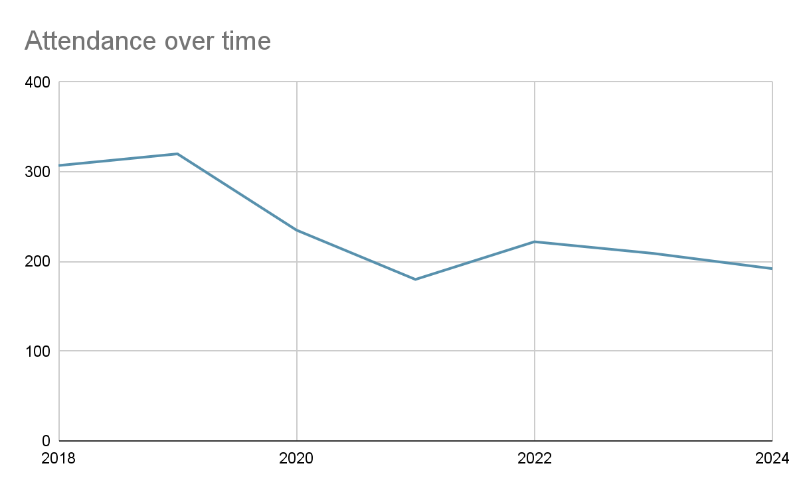
CHURCH DATA
Lutheran Church of the Resurrection has approximately 650 people who participate or support the church in some way. The church has 2 worship services each week, which have had an average of 192 people in attendance face to face in recent months. The leader survey reports around 200 in online attendance, while the Youtube channel with worship videos has 355 subscribers and the 1/12/2025 worship services had 100 views as of the Friday following. The weekly attendance is around 137 at the traditional service and 55 at the contemporary. Attendance has fluctuated between 180 and 222 in the post-pandemic years. Worship attendance before the pandemic was approximately 310 per week.
‹#›

Slide 6
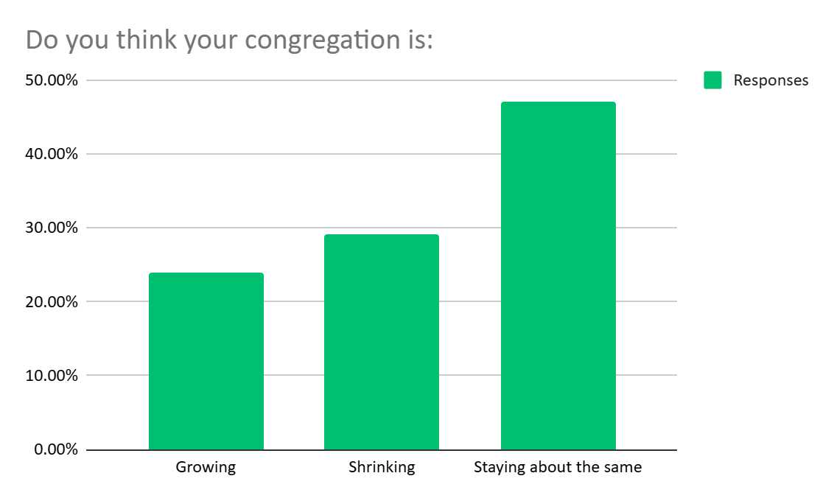
DATA
162 people responded to your congregational survey.
Lutheran Church of the Resurrection had an average of 23 visitors in worship in 2023. This was down slightly from an average of 30 per year pre-pandemic. In 2023, the church gained 58 new participants.
However, in 2024 the numbers of visitors and new members declined. There were 6 visitors per week in 2024 on average. 12 people joined the church in 2024.
When asked, “Do you think your congregation is growing, shrinking, or staying about the same:” 47% perceived the congregation as staying about the same size, 29% perceived it as shrinking, and 24% perceived it as growing.
‹#›

Slide 7
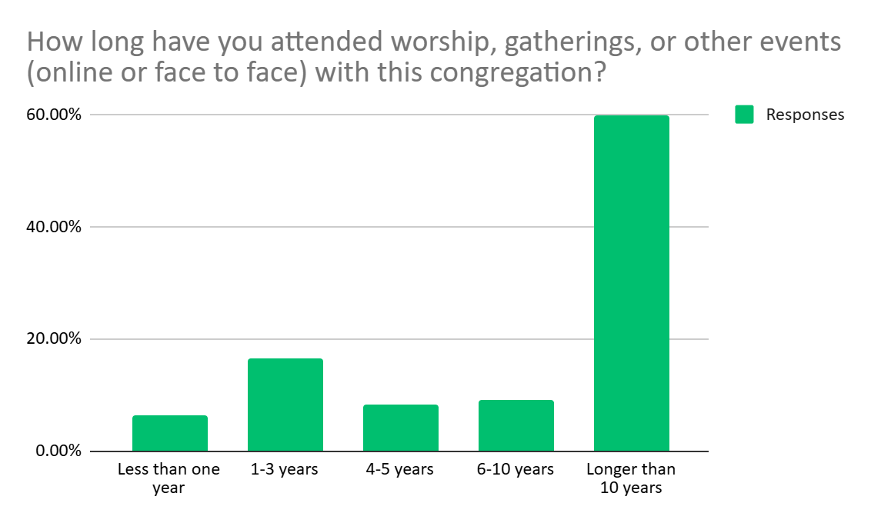
CHURCH DATA
The survey respondents indicated that most (60%) had been part of the church for over 10 years. 9% had participated for 6-10 years, 8% for 4-5 years, and 36 began participation in the last 3 years.
Most survey respondents (90%) report participating in worship at least monthly over the last six months. While 63% have participated both face to face and online at some point, 36% said they have only participated face to face. In the past year, 92% participated most often face to face, while 5% most often participated online.
‹#›

Slide 8
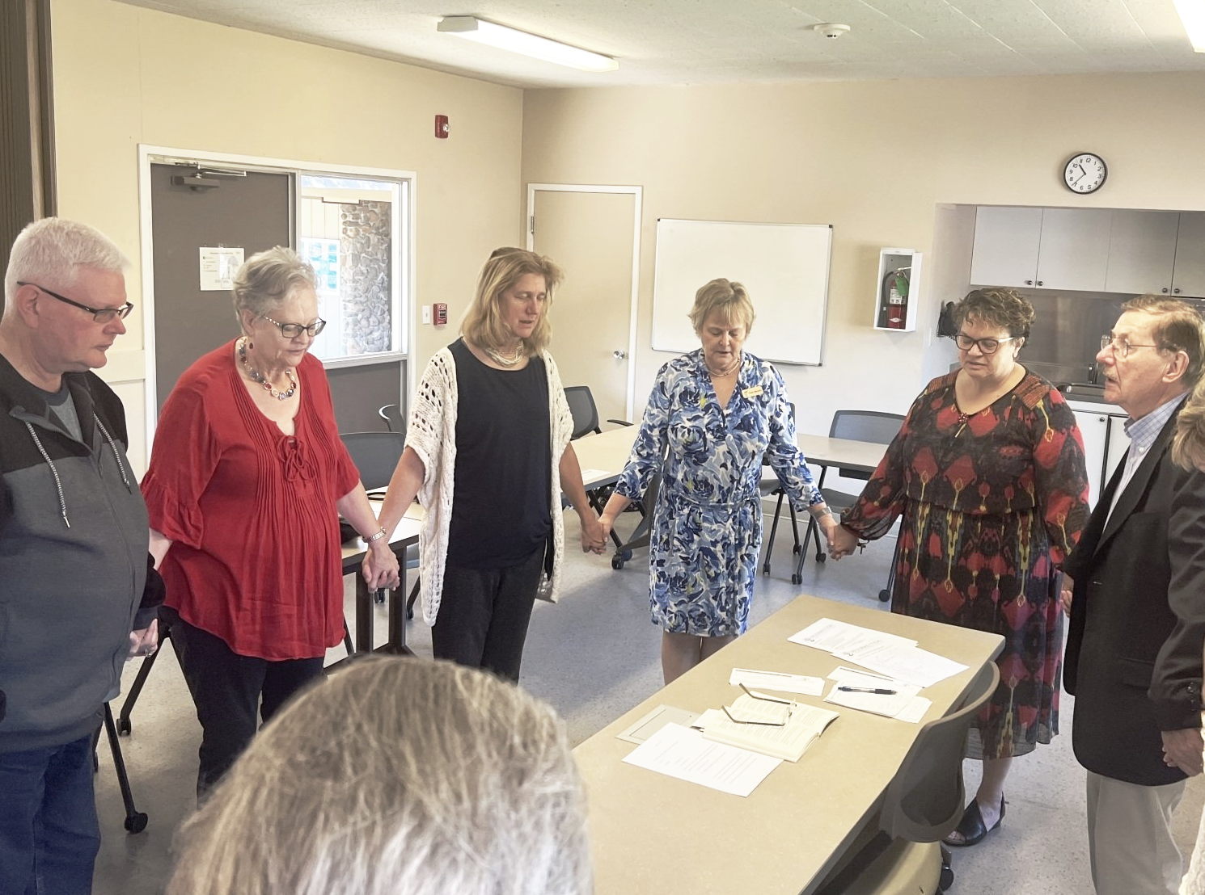
DATA
The church also holds about 45 non-worship activities per month, with an average of 100 people per month participating in at least one non-worship activity. Activities include:
Midweek Bible Study
Peacemakers Quilting
Grief support
Mens Happy Hour
Womens Night Out
Choir rehearsal
Band rehearsal
Gathering Inn
Youth group
Confirmation
Sunday School
AA
Boy Scouts
‹#›
Insert Church Name Here

Slide 9
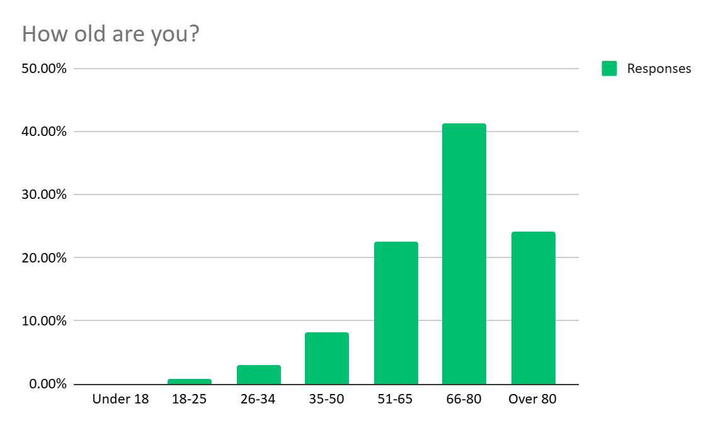
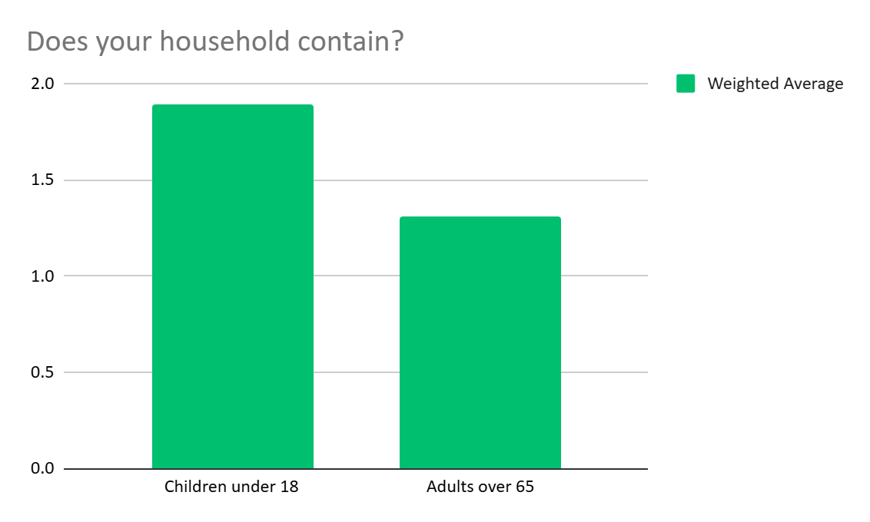
DATA
Among congregational survey respondents, 0% were under 18, 35% working-age adults, and 65% over 65.
11% of respondent households contain children, and 69% of respondent households contain adults over 65.
Your leader survey reports that 5% of the
congregation are under 18, and these
young people are not represented in the
survey data. It would be worth convening
a focus group of children and youth to
ask them some of the questions we have
asked here.
‹#›

Slide 10
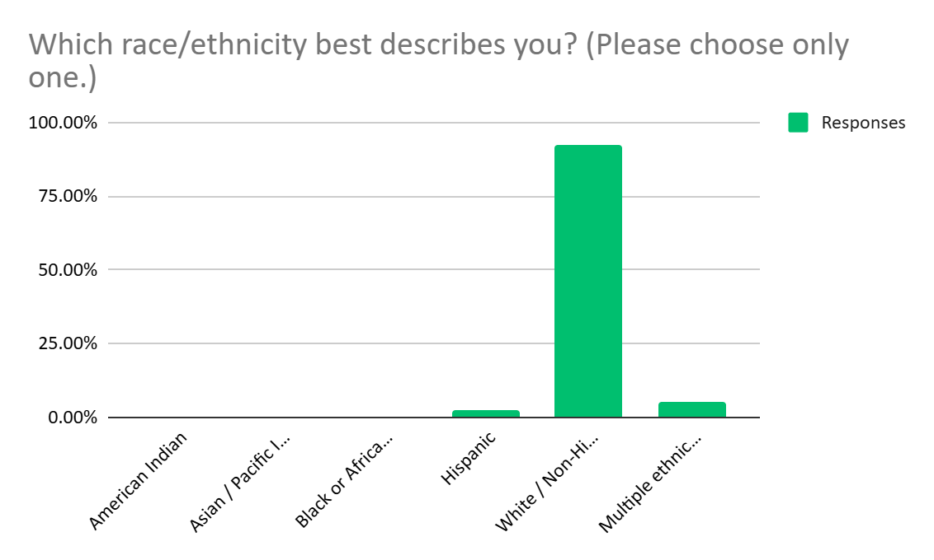
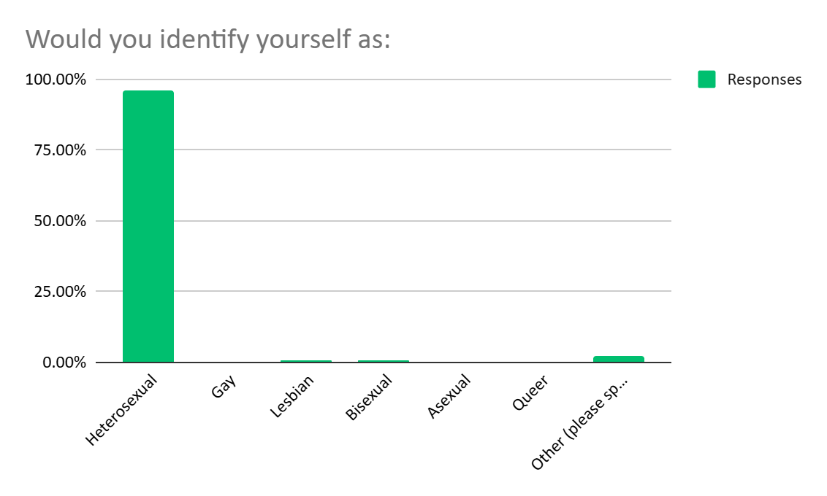
DATA
The 130 congregation members responding to the demographic question on race report identifying as 92% White/Caucasian, 2% Hispanic/non-White, and 5% Multiple ethnicity/Other. The leader survey indicated similar racial diversity.
On the survey, 96% of 128 respondents identified as heterosexual with the remainder being comments that did not indicate an identity.
‹#›

Slide 11
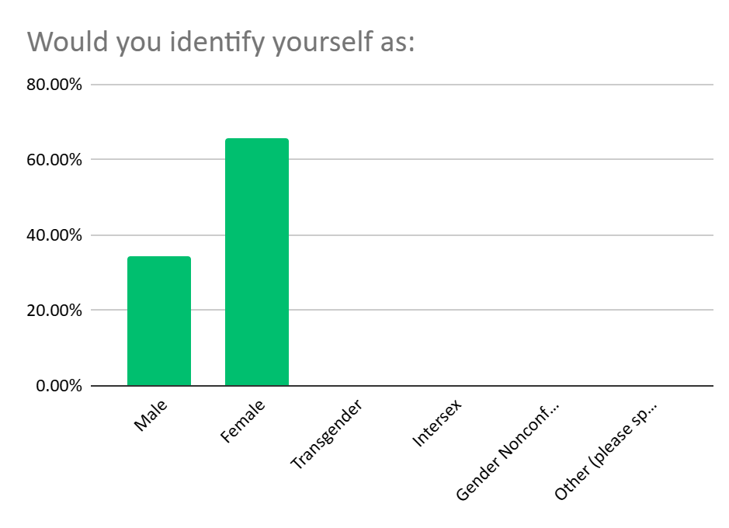
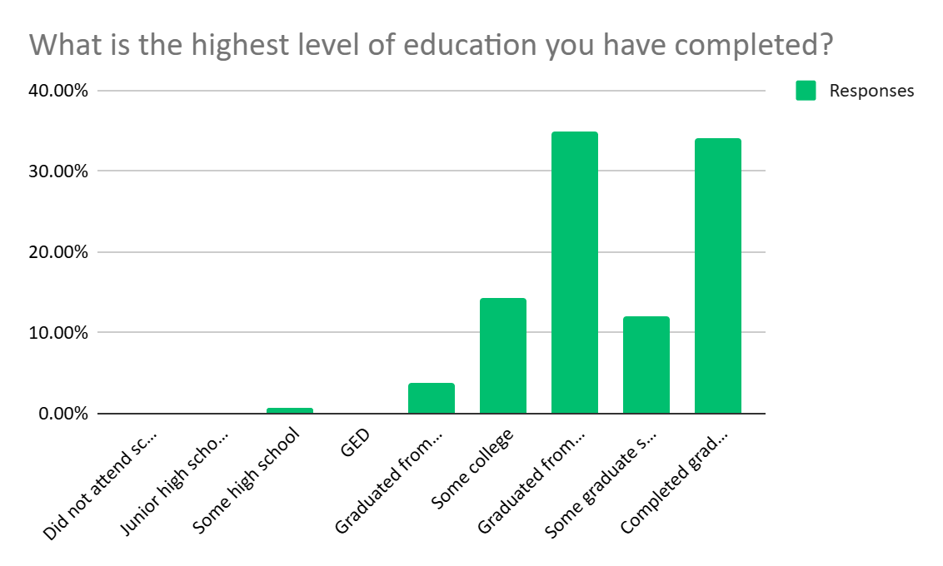
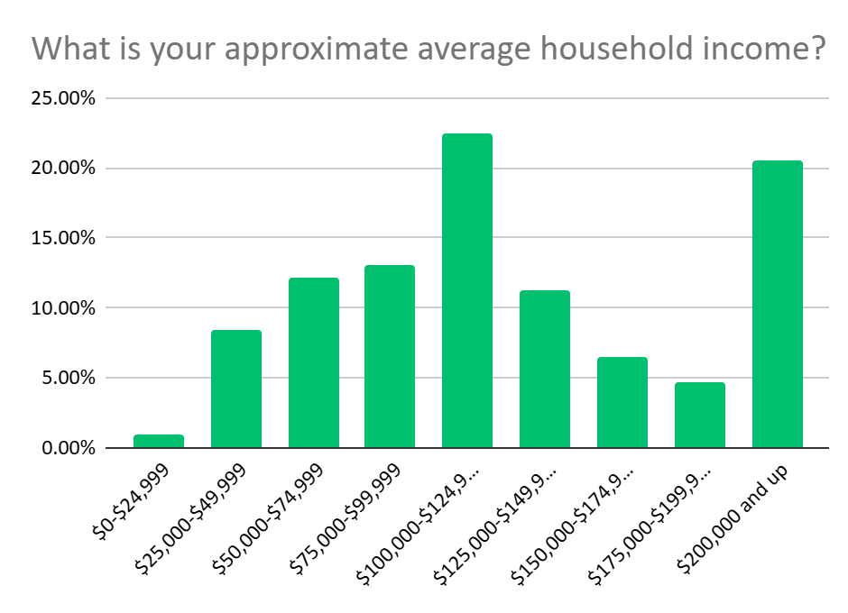
DATA
Respondents identified as 34% male and 66% female, with none identifying as transgender, intersex, or gender nonconforming.
17% of 130 respondents identify as a person with a disability or other chronic condition.
95% of respondents have attended at least some college. 46% have attended or completed graduate school.
45% of respondents report household incomes between $100,000 and $200,000 per year, 35% below $100,000 per year, and 21% report incomes above $200,000.
‹#›

Slide 12
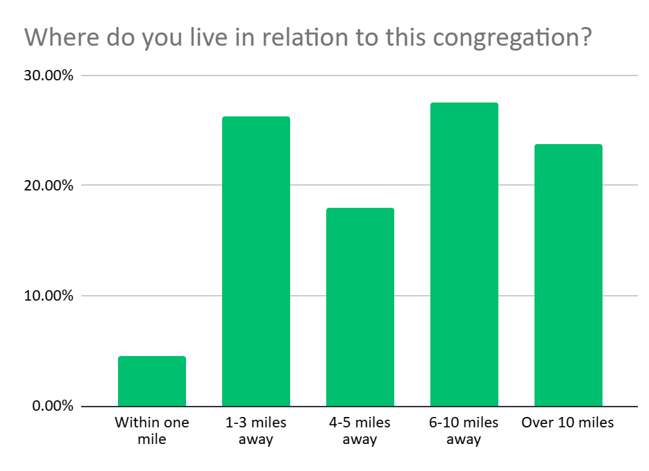
DATA
The majority of survey respondents, or 69% live 4+ miles away from the church, with 30% living within 3 miles of the church. 24% live over 10 miles away. Your congregation is very geographically dispersed.
The zip code plot of your survey respondents stretches far beyond Granite Bay.
‹#›

Slide 13
CONGREGATIONAL PERCEPTIONS
Survey respondents were positive in their perceptions of the congregation and its situation. Over 90% of respondents felt the church:
Has a clear mission and purpose
Holds strong beliefs and values
Is spiritually vital and alive
Engages all the senses in worship
Has worship that makes me think
Is working for social justice
Is a source of learning for adults
Supports vibrant ministries through the financial and time investments of its members
Supports members in developing spiritual practices
Empowers members to do ministry in ways that reflect their gifts, callings and passions
Has a building and parking that are easy for newcomers to find
‹#›

Slide 14
CONGREGATIONAL PERCEPTIONS
Over 80% thought the church:
Has worship that calls me to action
Has worship that inspires awe
Is a source of learning for youth and children
Successfully engages people of all ages
Builds relationships among members
Is like a close-knit family
This last one can be a good and a bad thing. Being too close knit can feel cliquish and close out newcomers, while being very distant from one another can prevent relationships from growing among your members.
Over 79% of respondents are excited about where the church is headed. This is down slightly from 90% who report that they felt that way in 2019.
‹#›

Slide 15
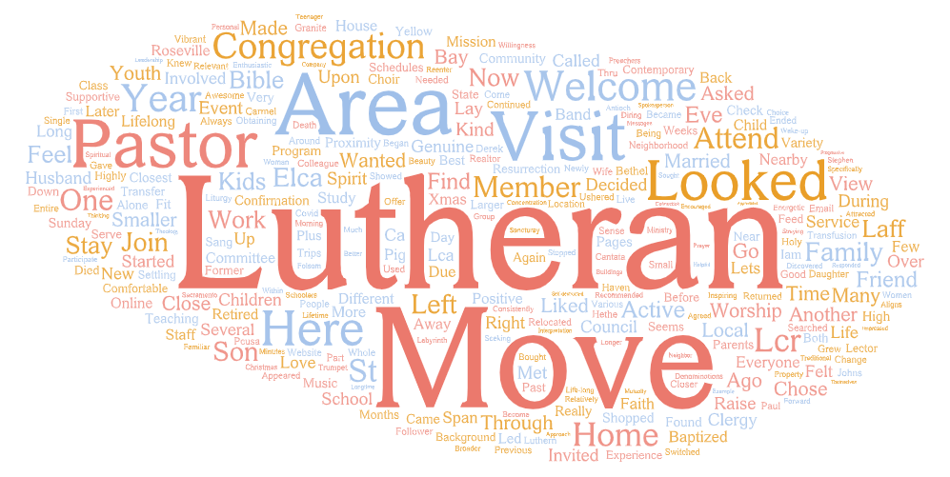
DATA
When asked, “How did you come to be involved with this church?,” your members responded with these words:
Common themes included moving to the area and looking for a Lutheran congregation. Surprisingly for a church in 2024, your denomination was mentioned as a top reason people became involved (35 respondents). Denominational identity is becoming less important to many, but for your church, it may still be a significant attractor, so don’t hide that light under a bushel!
‹#›

Slide 16
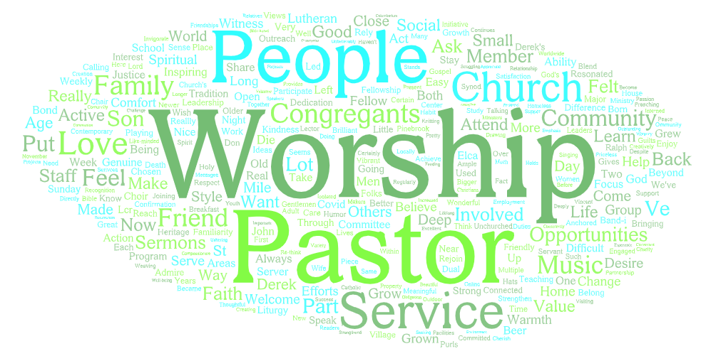
DATA
When asked, “What keeps you involved with this church?,” your members responded with these words:
Themes included the worship service, the pastor, and the people.
‹#›

Slide 17
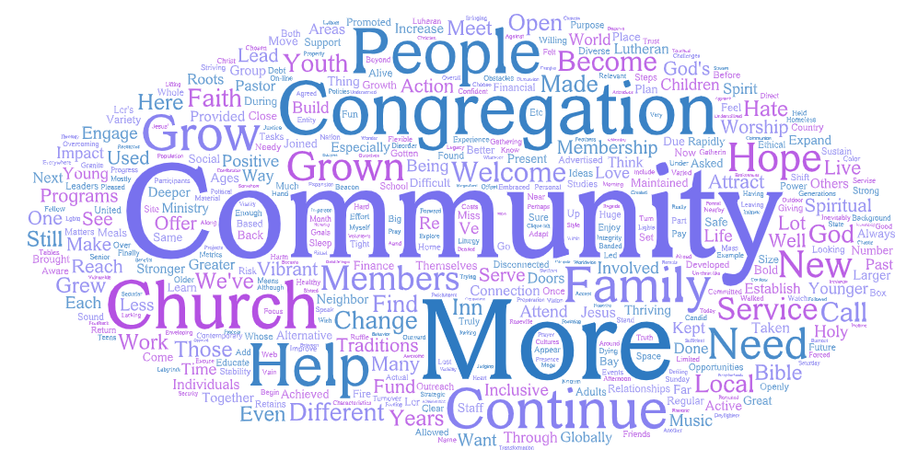
DATA
When asked, “When you think about the next 2 years of this church, what do you hope you'll be able to say about what you all have done together as a congregation?,” your members responded with these words:
There was a strong impulse to engage more people in the life of the congregation and have more engagement/impact helping others in the community. However, there was not a unified vision present in the comments beyond numerical growth.
‹#›

Slide 18
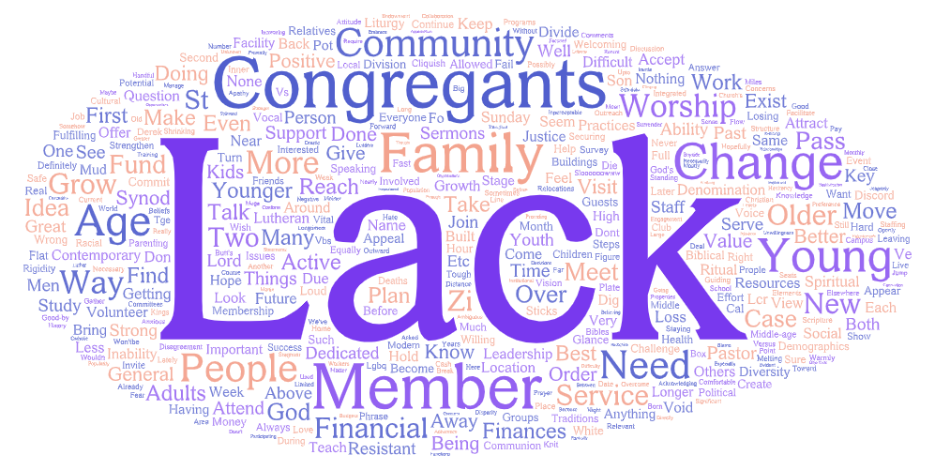
DATA
When asked, “What do you see or sense could hold you back as a congregation?,” your members responded with these words:
Themes mentioned in the comments included:
Lack of more people/congregants
Lack of younger people and families
Issues with change
Lack of volunteers
Divides between congregants
‹#›

Slide 19
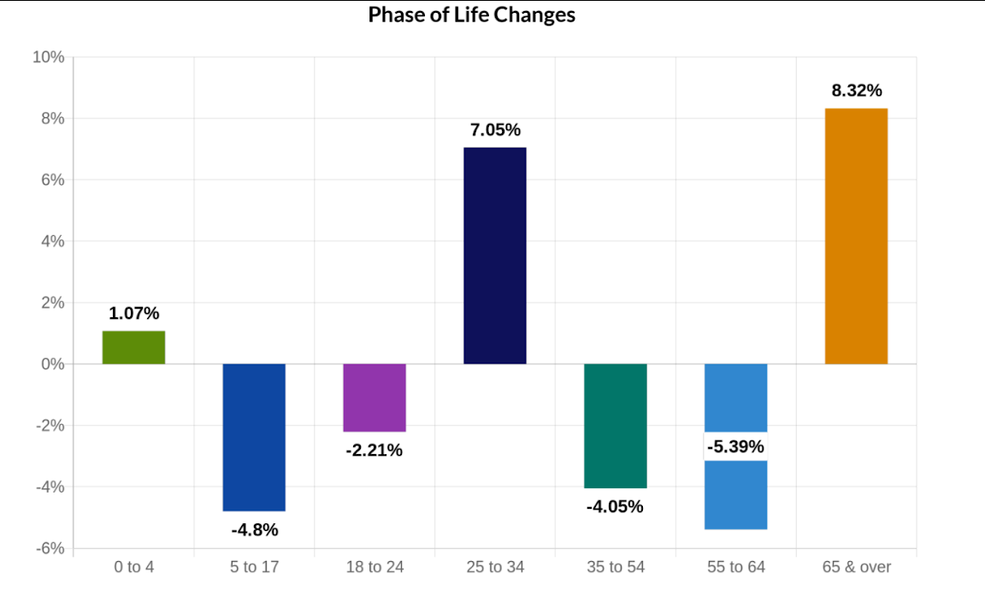
YOUR NEIGHBORHOOD
The population in the area immediately around your church building (2.5 mile radius) is declining slowly while the larger area (7 mile radius) and state as a whole are growing.
In your neighborhood, the population is getting older and the fastest growing age group is 65 and over.
However, there are two other
growing age groups - adults
aged 25-34 and children
under 4. This indicates a
minor baby boom that may
be occurring among some
young couples in your area.
‹#›

Slide 20
YOUR NEIGHBORHOOD
Your neighbors are predominantly white, highly educated, high-income white collar workers or retirees and their children who are still living at home.
Your congregation echoes the demographics of your community in almost every way, except that there is more racial diversity in your area than in your congregation. There is even greater racial diversity when the radius is widened to 7 miles from your congregation.
‹#›

Slide 21
The largest demographic segments in your area include 50% of households which contain well-resourced older adults described as Booming with Confidence and 25.32% of households which contain couples and families with significant wealth described as Power Elite. When all of the older adult segments are combined, we see that 54% of your neighbors are in their older years. There are also some smaller segments of families in your area (Flourishing Families - 8% of households, Promising Families - 2% of households).
‹#›

Slide 22
NEIGHBORHOOD PERCEPTIONS
While your neighbors do not have many very strong religious beliefs, they have similar values to those of your congregation. They very strongly believe that God is love and that they have a relationship with God. They very strongly believe that Jesus was both divine and human, that people in the church do not behave as Jesus would, and that belief in Jesus doesn’t require participation in a church.
On social issues, they believe in strong families where children are taught moral standards, the necessity of tolerance, America’s moral responsibility to be a force for good, and that they have great hope for the future of their local community.
Your neighbors are not very likely to have a religious preference or participate in a congregation. Only 40% are involved with a congregation. 3.5% identify as Lutheran, but this does not mean they attend a Lutheran church. The largest segments in your area are Catholic (24%), None/No preference (16%), and Baptist (14%).
‹#›

Slide 23
NEIGHBORHOOD PERCEPTIONS
For those who do not participate in a religious congregation, the top reasons were:
Religion too focused on money
Don’t trust religious leaders
Religious people too judgmental
Don’t trust organized religion
Disillusionment with religion
Among those who might consider participating in a religious congregation, they are looking for warm and friendly encounters and quality sermons. They may also be interested in traditional worship, opportunities for relationship with others, and holiday programs.
‹#›

Slide 24
NEIGHBORHOOD NEEDS
Your neighbors’ biggest life concerns include:
ongoing impact of COVID-19
social and political tensions/discord
health crisis/illness
finances
illegal immigration
racism/racial injustice
fear of the future or the unknown
personal health problems
children’s education
losing weight/diet
‹#›

Slide 25
NEIGHBORHOOD INTERVIEWS
Resurrection leaders conducted 21 community interviews with local leaders and neighbors. Interviewees included:
Pat Murphy, Pinebrook Community Social Club Director - local Mobile home park (250 homes)
Father Brian Crawford, Pastor, St. Joseph Marcello Parish
Mary Tess Mayall, Blue Line Art Gallery
Peter Cardin, Head Librarian
Vince Dutto
Barbara Gillogly, counselor for elderly and caregivers
Susan Bushnell, Bushnell Nursery
Leigh Mrizek
Lieutenant Chris Ciampa, Captain Doug Blake, Roseville Police Department
Sean O'Brien, Dry Creek Conservancy
Ann Bowler,
Kris Johnson
Randy Blair, member and past lay leader, Bayside/Adventure Christian schools
Joe Patterson, State Assemblyman, past Mayor of Rocklin
Brenda Pieper
Michelle Larsh
Dale Carlsen
Regina Banks, JD, Director of Lutheran Office of Public Policy for California for 7 years, in seminary
Ed Morgado & Beth Gonzalez, Placer People of Faith Together
Kally Kedinger-Cecil, county planner with Placer County
‹#›

Slide 26
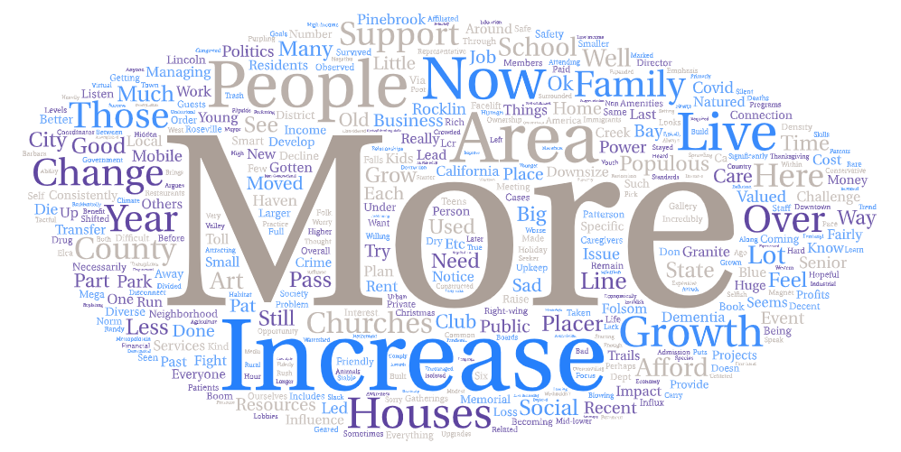
NEIGHBORHOOD INTERVIEWS
When asked, “How have you observed the community changing over the past few years?” interviewees responded with these words:’’
Many noted the growth of your community, both in terms of residents as well as in terms of usage of art galleries, libraries, and public services. This can be a strength and a challenge. Some feel it is less of a community feeling with all the growth. Another person mentioned that there is no “downtown” in Granite Bay to feel like a community gathering place. There is a sense of political divisions. More people increases threats to natural resources but also a greater number of people willing to care for natural resources. There can be a shortage of resources and housing for lower income and aging residents. The increasing population has brought some additional diversity in the schools, however, lower income families face a lack of affordable housing in the area.
‹#›

Slide 27
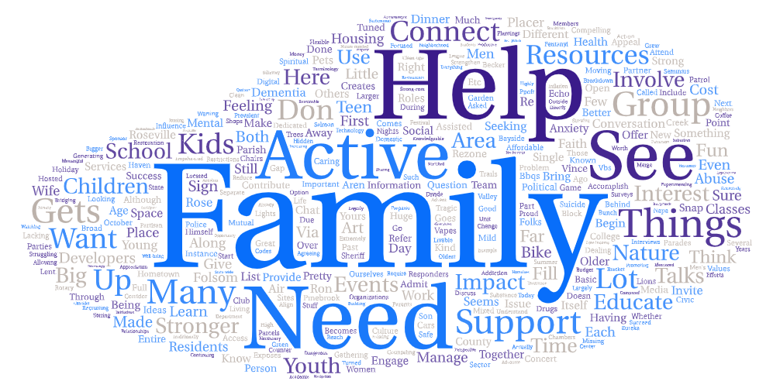
NEIGHBORHOOD INTERVIEWS
To address these needs, interviewees had the following ideas to make your community stronger.
They saw a need for activities and services for families across income levels. This could include arts and culture events, information about safe and affordable youth/family programs, mental health support for youth, times for families to connect without technology, ways to help protect local nature, advocating for parks/natural spaces, and supporting affordable housing. Providing similar programs and advocacy for senior adults was also suggested. Interviewees also suggested partnerships and mergers as a way to maximize impact as civic/religious organizations get smaller. An organization called Bridging the Divide was mentioned as a way to work together in spite of political differences.
‹#›

Slide 28
NEIGHBORHOOD INTERVIEWS
Suggestions for specific actions the church could take included:
providing volunteers for local organizations
sharing facilities to meet community needs - for families, government, and civic orgs.
addressing the needs of aging adults outside the congregation
hosting support groups for families dealing with mental health, addiction, domestic abuse
partnering with local schools
connecting to restorative justice/peer support initiatives
assisting the homeless and advocating for their needs including Housing First
hosting Bridging the Divide to address political polarization
hosting public meetings
supporting efforts for parks/trails
promoting the ELCA’s values of inclusivity and justice
work with PPOFT on joint efforts with other people of faith
participate in county-level visioning, advocacy
‹#›

Slide 29
COMMUNICATIONS
Lutheran Church of the Resurrection communicates regularly using email, a website, and Facebook or other social media. Most participants hear about church announcements and events by email, with announcements at gatherings and word of mouth also frequent sources of information.
The website is up to date and engaging. The photos and videos make your church seem warm and approachable. The only change needed might be to have the church address directly below the Worship Schedule, to make it clear where you all meet for worship.
Your Facebook page is up to date. Most posts are worship videos. The song lyrics and quote from a member are engaging. More images of church people doing things together, and thumbnails for worship that have photos rather than the tree graphic, could make it feel more representative of your community. Your Instagram is more lively but somewhat out of date with top posts still about Christmas. For many newcomers, social media is the way they understand who you are, so it is worth making sure your spirit is evident here.
The Ministry This Week document is text heavy. Ways to get involved are prioritized, which is excellent. More photos and a few less words could bring this document to life and increase engagement.
The Newsletter is traditional and text heavy. A shift to more photos and less text could make this communication more engaging and encourage greater participation. Putting a short list of ways to get involved (PJ drive, Connect and Grow events , Book Club) on the front page of the newsletter will help as many people won’t read below the fold.
‹#›

Slide 30
EXTERNAL ENGAGEMENT
Lutheran Church of the Resurrection is an engaged congregation! Your leader survey indicates the top priorities for the church in the community are:
Homelessness
Food Insecurity
Elder Care
The church is measuring impact in these areas through relationships with local nonprofits and the number of people fed.
The pastor reports approximately 100 members took part in some action in recent years relating to these three priorities, but that more took part in the years before the pandemic.
In recent years, the congregation has engaged in:
87 provisions of support for priority issues
8 sermons preached on justice issues
5 opportunities for education around priority issues for adults
2 opportunities for education around priority issues for youth/children
4 public actions (vigils, protests, press conferences)
giving 10% of the budget to external organizations
12 collaborations with other congregations or organizations on priority issues
2 opportunities provided for children/youth to take action
engaging with 25 community partners
‹#›

Slide 31
EXTERNAL ENGAGEMENT
Survey respondents are volunteering either in church or their community quite frequently, with 101 survey respondents reporting a total of almost 6800 hours spent volunteering in church settings and activities during the last 12 months. Some reported only 1-2 hours while a couple reported over 400! 92 survey respondents reported a total of over 8900 hours spent volunteering in the community outside of church programming. Some reported only an hour while one person reported over 1500 hours.
41 survey respondents reported from 1 to dozens of contacts with elected officials in the past 12 months, for a total of over 300 contacts just from your congregation! 38 survey respondents attended at least one educational or advocacy event on issues that impact your community. Many were learning constantly about such issues, for a total of over 370 connections with such events.
‹#›

Slide 32
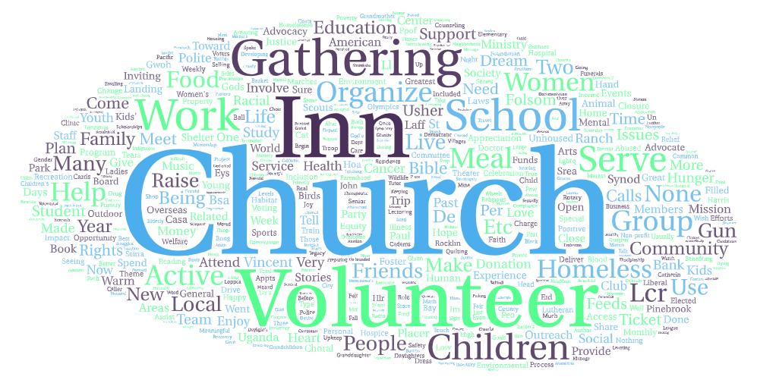
EXTERNAL ENGAGEMENT
Meaningful experiences in serving church and community reported by survey respondents involved:
Frequently mentioned were church, Gathering Inn, schools and children, meals, and homelessness.
However, only 57% of respondents believe that your work is changing the surrounding community. 92% of respondents believed the church is working for social justice, 80% perceived the church as working with other organizations in the community for common goals, and 60% believed local people are in the church building on a regular basis.
Several non-church organizations that bring community members into the building (Sharing space, not partners): AA, Gathering Inn, Folsom Lake HOA, Mankind
‹#›

Slide 33
CONFLICT SKILLS
Conflict is not a pressing issue for your congregation. Just 27% of survey respondents reported church conflict during the past two years, 67% of those people said the conflict was minor, and less than 10 survey respondents indicated some serious or major conflicts during that period. This indicates that any heated conflicts were limited and primarily known only to a small segment, possibly leadership, and while disagreements were known, most of your congregation thought they were easily reconciled or tackled by working together. Echoing this interpretation, 90% felt the church embraces differences of opinion and belief and 79% believe the church deals with disagreements and conflicts openly rather than hushed up or hidden behind closed doors.
SPIRITUAL LIFE
Growing and renewing a church requires a deep engagement with spiritual practices. Lutheran Church of the Resurrection regularly promotes group Bible study and exploring timely topics in light of faith. The church occasionally promotes religious practices such as individual Bible study and individual or group prayer practices. The church does not promote family devotions, talking with your family about faith, or fasting. Members who responded to the survey indicate a high level of participation in individual prayer, meditation, or devotions, with 79% doing so weekly or almost weekly or even more often and 95% doing so at least occasionally. The next most common practice was exploring timely topics in light of faith which was practiced regularly by 44% of respondents. Individual spiritual/Bible study was practiced regularly by 41% of respondents, family meditation and devotions were practiced regularly by 40%, and group meditation and devotions were practiced regularly by 37%.
‹#›

Slide 34
FINANCES AND FACILITIES
For 2024-2025, your proposed budget is $956,000 with estimated income of $857,960 in contributions, $24,000 in mortgage support, $72,500 in facilities use, and $1800 in other income.
For 2023-2024, the proposed budget was $1,032,325. Estimated income was to be $945,500 in contributions, $85,000 in facilities use, and $1825 in other income. The projected actual budget as of the 2024 annual meeting, however, was $928,920, due to a reduction in projected giving to only $820,000.
For 2022-2023, the budget was $991,525. Estimated income was to be $921,500 in contributions, $70,000 in facilities use, and the remainder in other income. However, as of the 2023 annual meeting, contributions were projected to fall short of this at $890,500 for the year, leaving the total budget at $959,845.
The church endowment balances over time were as follows:
‹#›

Slide 35
FINANCES AND FACILITIES
The Legacy Fund is structured to generate gifts continually, for years to come, by using only the income from investments for grants to support the needs of our church, community, and world. The Foundation Fund is used to provide funding for children and youth ministries. The Resurrection Life Fund was established in 2022 and is a perpetual fund that uses realized gains in investments to help supplement the general spending plan of your church.
Among survey respondents, 44% see the finances in some or serious difficulty. 42% describe your finances as “tight, but we manage.” Only 14% see the church’s finances as in good condition. This is a decline from five years ago, when 60% would have perceived the church’s finances as good or excellent, and only 12% in difficult condition. The pastor’s survey echoes this trend and identifies the current finances as in some difficulty now and good 5 years ago.
Going back to the period when respondents reported perceiving the finances as good or excellent, in 2018-2019, the annual budget was $1,018,410 with tithes and offerings of $849,000. Other income for that year was $40,000 and the value of investments/endowments was $540,000.
‹#›

Slide 36
FINANCES AND FACILITIES
The precipitating event for this sense of scarcity seems to be a drop in giving by approximately $100,000 during the pandemic. Your financial lay leaders may have a sense of why this occurred. It parallels somewhat the drops in attendance you experienced but is much steeper.
Your endowment balances in 2019 totaled $604,816 and currently total $540,967 as of 12/30/2024. While totals have fluctuated in recent years, there has not been a precipitous decline in these funds. Addressing any restrictions that prevent using endowment funding for ministry needs might be needed if those restrictions are impacting sustainability.
A majority, or 76% of your survey respondents report giving financially at least monthly. Another 20% are giving in other frequencies but are regularly giving.
Your average monthly giving is $75,000. When divided by the ~600 adults connected with your church, this is around $125 per person per month. This is slightly lower than the national average of $188 per person per month. If each of the ~600 adults associated with your church donated $25 more per month, you would have an additional $180,000 per year, putting your annual giving in line with pre-pandemic levels.
‹#›

Slide 37
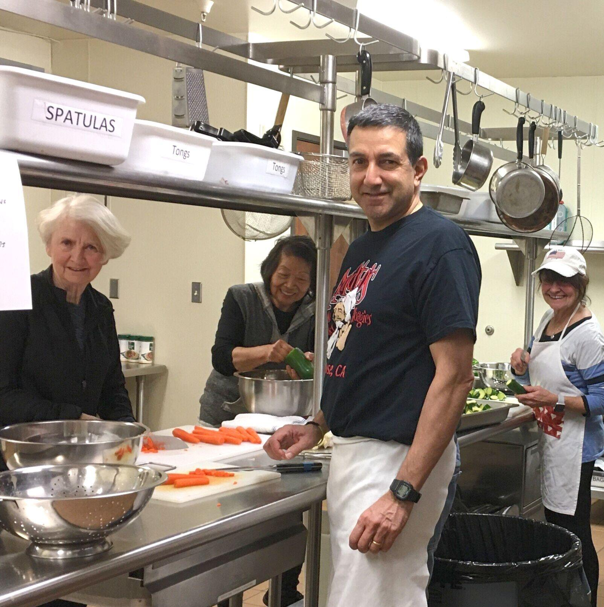
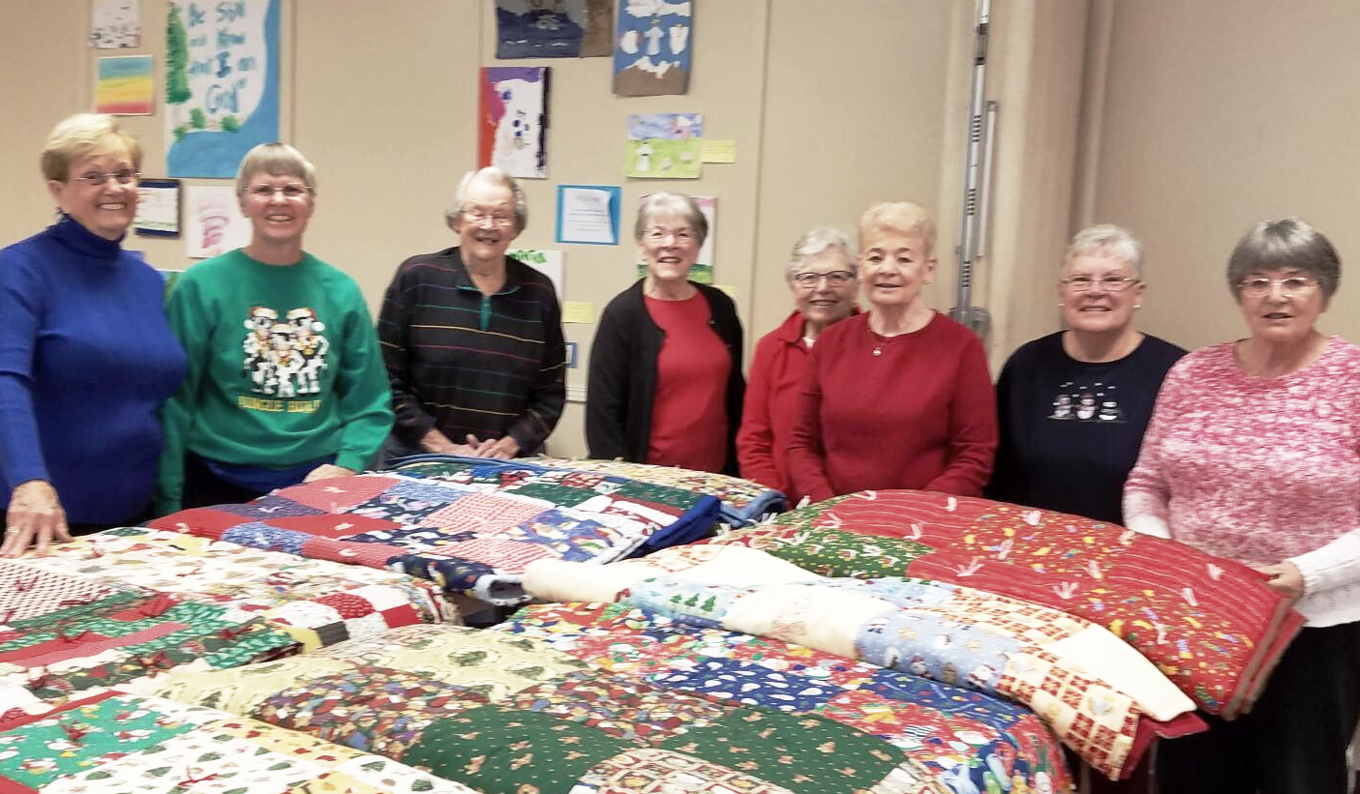
FINANCES AND FACILITIES
Lutheran Church of the Resurrection has facilities that respondents identify as the right size for your ministries, although the leader survey suggests they may be too big for your current congregational size. The facilities are in adequate to excellent condition according to the congregational survey, although the leader survey suggests they may be in need of repairs. Deferred maintenance is common in churches, but your members do not seem aware of any problems. This is no reason to delay further, though, as problems with buildings tend to get bigger over time.
Photos on your social media show attractive and well maintained spaces, but of course can’t get in all the nooks and crannies, especially after a period where many might be empty most of the time. Continue to be attentive to your space. Make sure it is clean, well-repaired, smells good (ask a stranger to come and tell you the truth, we develop a tolerance to smells over time), and is clearly marked as to restrooms, elevators, and other necessary spaces.
It may also be time to explore ways to make your building work more for your congregation’s mission than against it. You are sitting on an amazing property asset that could be leveraged for community impact in several ways.
‹#›

Slide 38
CONGREGATIONAL WELCOME
In terms of congregational welcome, 98% of respondents at least somewhat agree the church wants more members, 86% say the church wants to be racially and culturally diverse, 93% feel the church is welcoming to people of all races, and 89% feel the church is welcoming to people of all sexualities, and genders. 96% feel the church is welcoming and accessible to those with disabilities. However, only 61% of church members say they make it a point to speak to any new people present in worship.
Among newer participants, only 69% feel the church wants to be diverse, and only 87% believe the church is welcoming to people of all races. The percentage that see the church as welcoming to people of all sexualities and genders is lower as well (85% vs. 89%). This is an area that will need addressing if you are to make newcomers feel truly welcome.
Additionally, only 68% of survey respondents report it is easy for new people to join existing church groups. Interestingly, newer people were more likely to say it is easy for new people to join, with 78% agreeing.
The growing edges seem to be in welcoming people on first encounters and in your skills at welcoming more diverse newcomers. While your desire to be welcoming is evident, your people may need encouragement to say hello to any new faces you encounter, as well as some additional training and support to truly welcome those who look different from the people already in your pews.
‹#›

Slide 39
Openness to Change
In areas relating to openness to change, survey respondents indicated:
85% felt the church is always ready to try something new
83% felt the church invites all members into visioning and decision-making
82% felt the church helps members make their ideas for ministry a reality
79% of respondents believe the church loves the enthusiasm of people with new ideas.
72% felt the church regularly does new things in worship
However, only:
69% felt the members of the church are willing to change in order to achieve shared goals
68% felt the church embraces change
64% felt new ideas are always welcome at the church
55% felt the church prides itself on an embrace of change and constant adaptation.
53% felt members are always willing to try something new at church
49% felt they frequently talk about change during worship and other activities.
Change skills were seen by 14 survey respondents as something that could hold back your congregation.
‹#›

Slide 40
Openness to Change
Additionally, 57% felt putting a new idea into action takes a long time at your church, and 77% felt the church is more comfortable when things remain the same.
Among newer participants, a lower percentage (59%) felt that the church members are willing to change and a lower percentage (48%) felt that members are always willing to try something new.
There is no way for a church to grow without change. We all love the comfort of the worship and spiritual practices to which we have become accustomed. Yet, holding those too tightly leaves no room for new people or new energy. At minimum, new people will bring their own new ideas and feel less than welcome if those ideas are shot down at every turn. So you have a choice: change and grow or stay the same and hold steady as existing members are no longer able to participate due to age or joining the heavenly choir.
‹#›

Slide 41
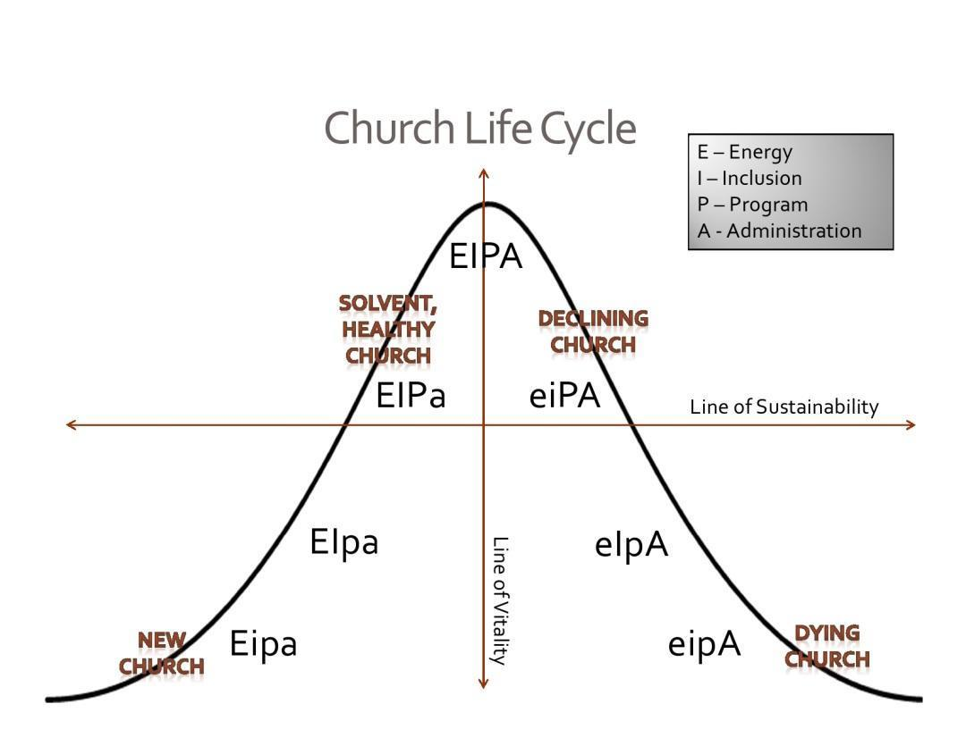
‹#›

Slide 42
Recommendations:
Focus on spiritual not numerical growth –
Your people long for numerical and generational growth. Yet numerical growth on its own is not a compelling purpose that new people will feel moved to support. Why do you want more people? Is it simply to maintain the institution? To take over the work of management and administration? Or is there a greater purpose to your work together? What will you add to the lives of new people if they join you? What impact will you have on Granite Bay?
2025 is a whole new reality. Doing relationship building now looks different than in the past. Offering spiritual experiences will look different too. What will you do to create spiritual and relationship experiences in the lives of people within and outside your congregation? How will you go to them and meet them where they are?
Naming and proclaiming this vision/purpose will improve investment of time and energy as well as morale. It will also be a clear invitation for others who share that vision/purpose to join you. (This needs to be specific and measurable, but not in terms of bodies in pews. How will you evaluate and celebrate your impact on people’s lives?)
‹#›

Slide 43
Recommendations:
Engage newer voices –
As you work to define that vision/purpose for the next 2 years, you will need to ensure that newer voices are present in this process. It is hard to see in our data how your current church life is incorporating newer voices, their needs, and their new ideas. What do the 70 people who joined the church in the last 2 years dream for your church and community? What do they need in order to have deep relationships and spiritual experiences? What do their friends and peers outside the church need? How can you help meet those needs? We recommend focus groups of newer people, younger adults, and children and youth to capture their insights.
‹#›

Slide 44
Recommendations:
Aligning and streamlining –
It now takes many newcomers to replace the funding, attendance, and volunteering of a mid-century church member. This is the 21st century reality. You can not expect that simply gaining new people will save you from exhaustion and burnout. Streamlining your governance and aligning all church energies toward your purpose will be necessary to alleviate the issue of weary lay leadership. Help those that are burned out to exit their roles gracefully. If there is no one to fill those roles, you may need to ask if the church should include lay labor roles that none of your participants find life-giving. If a role is necessary, it might mean paid workers filling those roles rather than burning out people who are not called to them. Alignment requires a radically different approach to governance, workflows, and programming that is focused on the best ways to achieve your congregation’s mission/purpose.
‹#›

Slide 45
Recommendations:
Build Change Readiness –
Change is going to happen whether we like it or not. God is in the change just as God is in the stillness. While we may be weary of change, we can’t try to hold our churches as places where no change happens to soothe our weary souls. If we do, we will cause congregational decline which is a change most of us don’t want to see! You will need to intentionally develop your change skills, especially among your older and long-time members. There is no way to truly listen to what God is calling your church to become without an openness to doing things in new ways. The best way to build your change skills is to practice change. Change something or try something new every week in worship. Be explicit about why you are doing this - change is built into any spiritual journey, and finding God in change is something we all need to practice.
‹#›

Slide 46
Recommendations:
Increase Sustainability –
You are facing reduced financial resources due to decreased giving. One way to address this is by increasing giving in your congregation. If each of the ~600 adults associated with your church donated $25 more per month, you would have an additional $180,000 per year, putting your annual giving in line with pre-pandemic levels. To gain additional giving, you will need to make a clear and compelling case for how that money will make a difference in more than just institutional preservation. It may also be time to explore ways to make your building work more for your congregation’s mission than against it. You are sitting on an amazing property asset that could be leveraged for community impact in several ways. However, your space could possibly be shared with more businesses and community groups with strategic outreach. Many congregations have found it helpful to spin the building off into its own 501c3 to become an arts facility, a coworking space, or center for community and justice or something of that nature. This has the benefit of taking property management out of the church workload and placing it in the hands of the building nonprofit’s board or trustees. You also have land attached to your facilities. Congregations have also worked with developers to turn land into housing or offices with a lifetime leaseback of some of the space for congregational activities.
‹#›

Slide 47
THANK YOU

