Slide 1
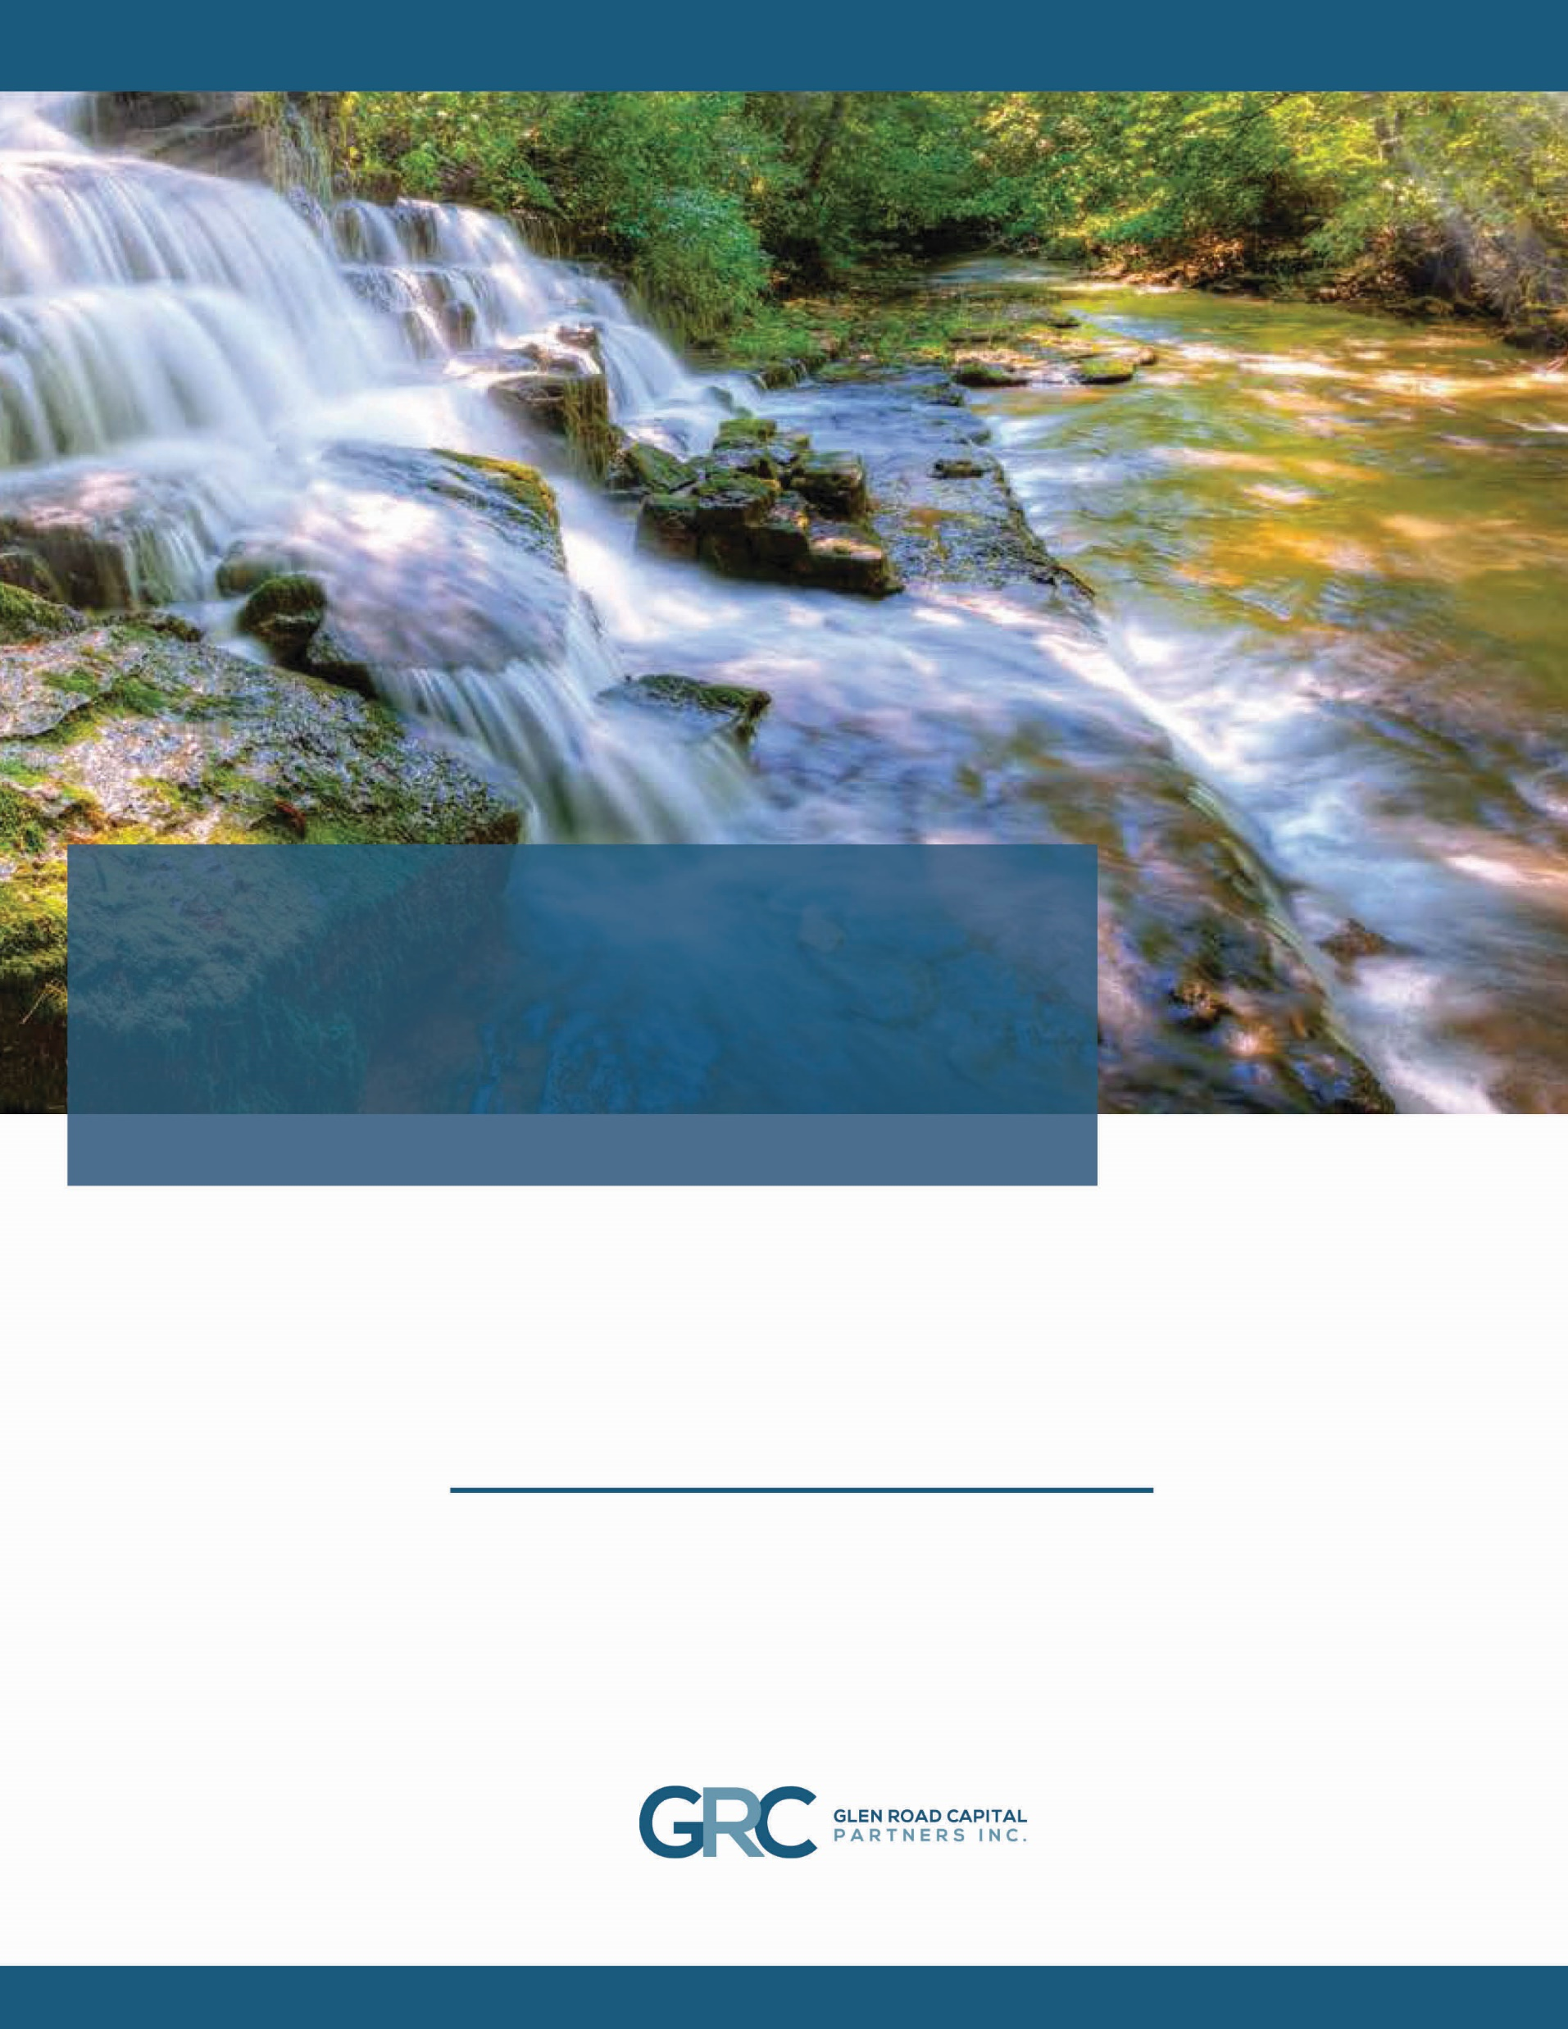
Revenue Stream Investing
- The Glen Road Investment Model -
Glen Road Fund No. 1 LP and Glen Road Trust
Glen Road Capital Partners Inc. (“GRC”) offers an innovative investment alternative
- Revenue Stream Investing -
for Canadians looking to diversify their investment portfolio.

Slide 2



WHAT SETS US APART
OUR INVESTORS ARE OUR PRIORITY
Revenue Stream Investing provides investors the opportunity to have debt-like security and quarterly distributions.
THE INVESTOR GETS PAID FIRST
STEADIER RETURNS
GRC does not earn any fees until our investors have exceeded their 7.5 % annualized preferred (base) return.
Profits over the 7.5% return are shared between Glen Road and investors.
Our investment approach is designed to deliver a regular revenue stream to our investors.
NON-CORRELATED ALTERNATIVE INVESTMENT
Investor returns are not subject to the volatility of the stock market.
GLEN ROAD FUND NO. 1 LP
INVESTMENT OPPORTUNITY
Glen Road Fund No. 1 (the “Fund”) is the platform GRC created to launch the Revenue Stream Investing Model. The Fund invests in top line revenue streams of privately held, small and mid-size businesses. In exchange for GRC’s upfront investment, the first money in from the business – the top line revenue – is paid to the Fund before expenses or existing debt.
This investor-centric model provides the following distribution opportunity to Fund Investors:
PREFERRED RETURN (paid quarterly): Investors receive a preferred annual return of 7.5% on their invested capital.
PROFIT SHARING (paid semi-annually): Profits above the 7.5% Preferred Return are split 50/50 between investors and GRC.
The Fund targets a 10% return for investors.
EXAMPLE:
The following example demonstrates how the Revenue Stream Investing Model works.
Distribution of Investor Returns:
Preferred Return:
Investors receive a Preferred Return of 7.5% on invested capital of $1,000,000.
Calculation:
$1,000,000 @ 7.5% = $75,000
Scenario: GRC provides $1,000,000 to Target Co.
Target Co’s Performance – Year 1
Target Co.’s Revenue: 1st Year Royalty Payment to GRC ($): | $3,000,000 $166,667
Investment Returns
Fund Gross Revenue from Royalty: Administrative Costs*: Net Glen Road Fund Income: | $166,667 $3,000 $163,667
Profit Sharing:
Profits above the 7.5% Preferred Return are split between investors and GRC.
Calculation:
$163,667 - $75,000 = $88,667
Split 50/50 = $44,333 for Investors
Distribution of Investment Returns
Preferred Return to Investors – 7.5%: Profit Sharing – Investor Portion: Total Return to Investors ($): Investor Return on Invested Capital (%): | $75,000 $44,333 $119,333 11.9%
Total Investor Return: 11.9%
Preferred Return + Profit Sharing = Total Investor Return
Calculation:
$75,000 + $44,333 = $119,333
*Administrative Costs: a nominal amount covering such costs as audit fees, bank charges and insurance.

Slide 3
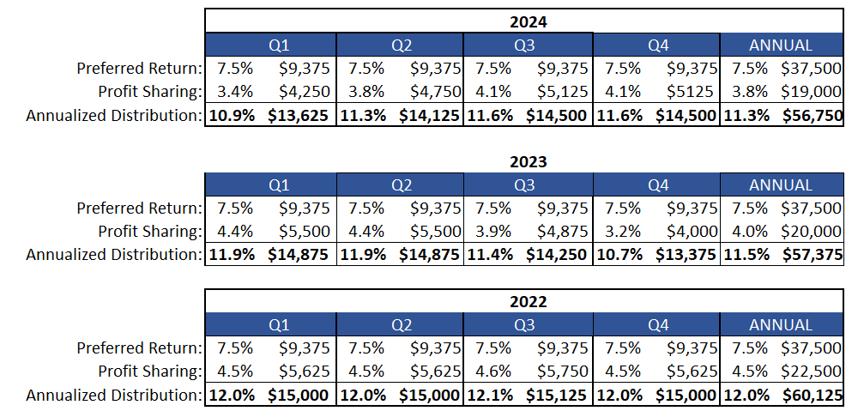
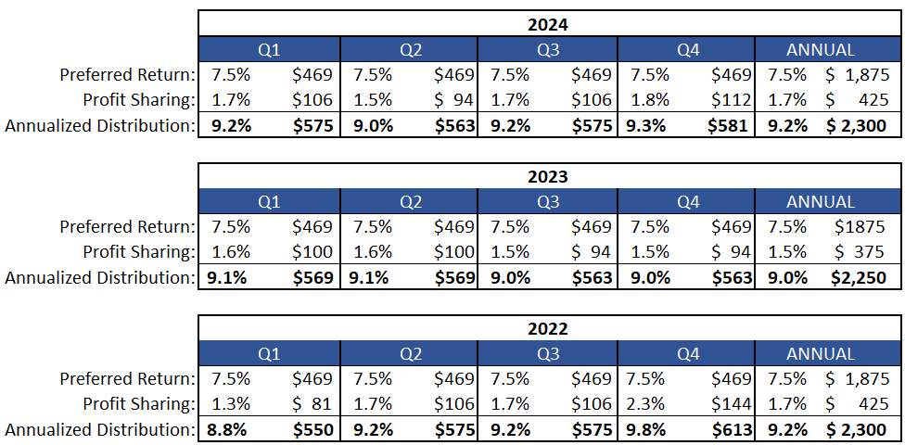
INVESTMENT OPTIONS
GLEN ROAD FUND AND GLEN ROAD TRUST
There are two ways investors can participate in the Fund:
For investments of $500,000 or greater: Investors can participate directly in the Fund, or
For investments under $500,000: GRC launched Glen Road Trust (“Trust”)* to allow investors to participate indirectly in the Fund through the purchase of Trust units.
*Eligible for Registered Plans: Investments in the Trust are qualified investments under the Income Tax Act, including RRSPs, RRIFs, TFSAs, RDSPs and RESPs.
OUR TRACK RECORD
GLEN ROAD THREE YEAR PERFORMANCE
The following two scenarios demonstrate how Glen Road’s investments have performed to date:
SCENARIO I: Glen Road Fund No.1 - Return for a $500,000 Investment
GLEN ROAD FUND NO.1 LP
FOR 2024: The Fund, once again, EXCEEDED GRC’s target return of 10% with investors realizing an annualized return of 11.3%. FOR 2023: Another strong year, with an average return of 11.5%. FOR 2022: At the end of 2022, investors realized an annual return of 12.0%.
SCENARIO I: Glen Road Trust - Return for a $25,000 Investment
GLEN ROAD TRUST*
FOR 2024: Average annual return, this year is 9.2%. FOR 2023: For the year ending December 31, 2023, Glen Road has tracked an average return of 11.0%. FOR 2022: At the end of 2022, investors realized an annualized return of 11.1%.
* NOTE: The cost of the Trust structure is borne by the Trust unit holders, resulting in a slightly lower rate of return than the Fund.

Slide 4
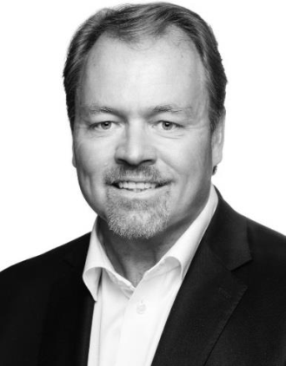
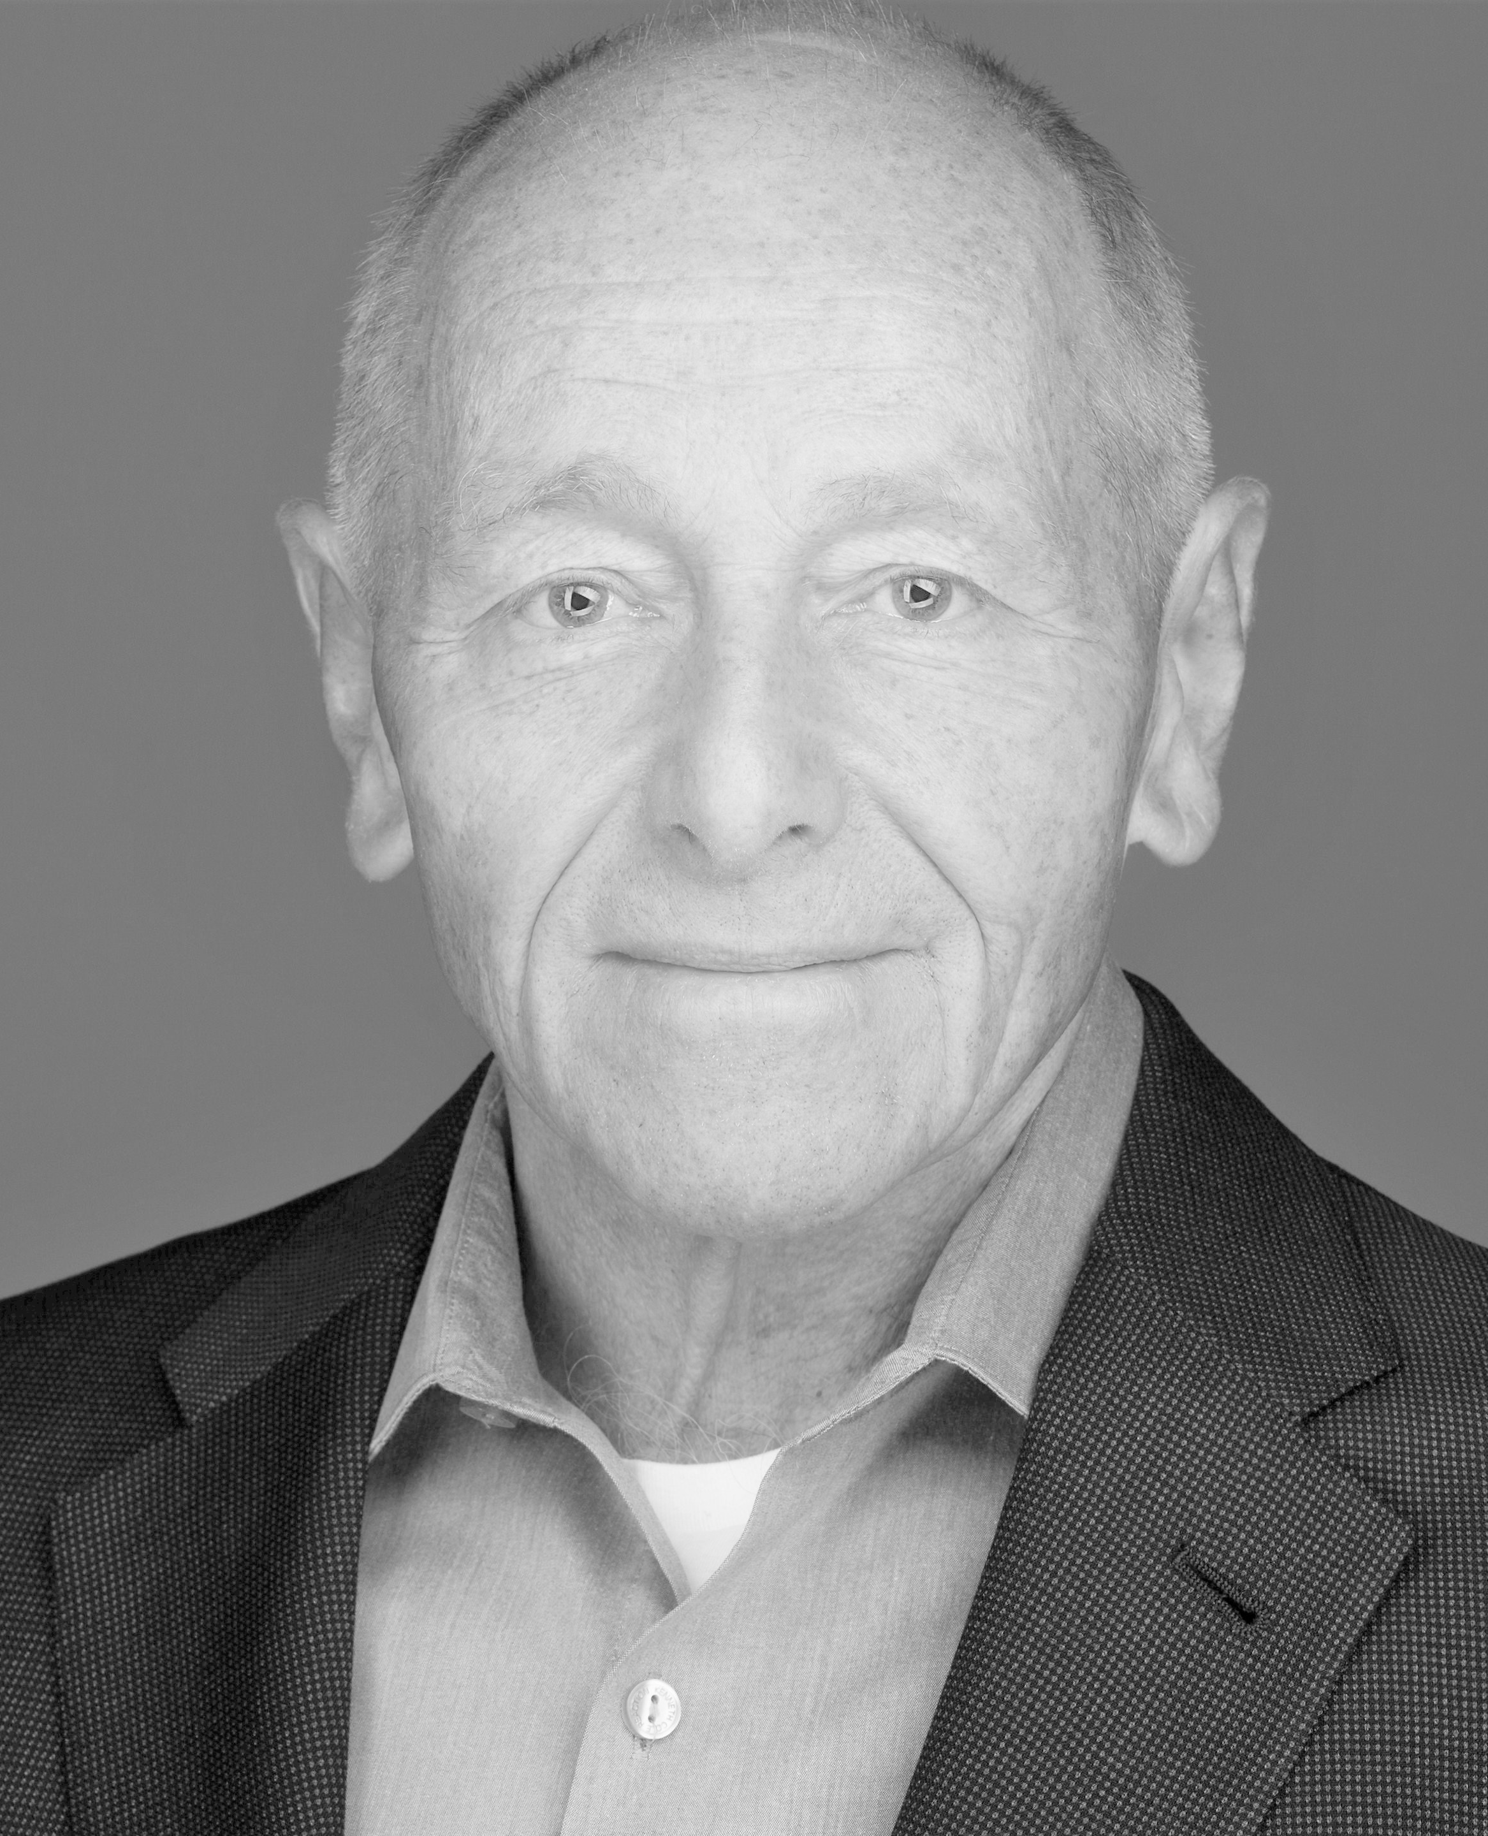
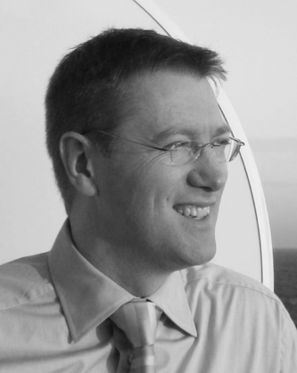
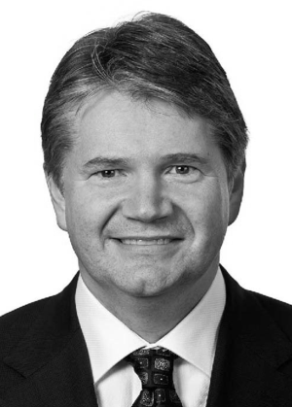
THE GLEN ROAD TEAM
STEVE MEEHAN, Co-Founder of the Fund and Trustee of Glen Road Trust
Steve has been in the financial industry for over 20 years, during which time he co-founded and was the Chief Executive Officer of Investment Planning Counsel Inc. (IPC). During Steve’s tenure, IPC grew from two small offices with approximately 30 Advisors to a fully integrated wealth management organization which, at the time of Steve’s departure, had $18 billion in assets under administration and $3 billion in assets under management. IPC was sold to IGM Financial in 2004, a member of the Power Financial group of companies. After IPC’s sale, Steve carried on as CEO and continued to guide the growth of the company. He left IPC at the end of 2010 to pursue his interests in venture capital and philanthropy and joined Bellwether Investment Management as its chairman in October 2011.
CHRISTOPHER DINGLE LL.B., Co-Founder of the Fund and Trustee of Glen Road Trust
Mr. Dingle is a graduate of Osgoode Hall Law School with over 30 years of business experience in the real estate and financial services industries. He was CEO of RealFund, Canada’s first Real Estate Investment Trust (REIT). He was also a founding director and President of IPC Financial Network Inc., a consolidator of mutual fund broker/dealers that attracted over seven hundred financial planners across Canada. Mr. Dingle was a director of the Canadian Institute of Public Real Estate Companies (CIPREC) and served on boards of private and publicly listed companies including Royal LePage Ltd., Delta Hotels Ltd., RealFund, IPC Financial Network Inc. and Lorne Park Capital Partners Inc.
KELLY KLATIK, Independent Trustee
Currently acting as managing director of Cypress Hills Partners, Mr. Klatik has over 23 years of experience as a strategist, financier and operator, predominantly in the investment banking/management and alternative asset sectors. He holds an Institute of Corporate Directors designation (ICD.D). Mr. Klatik received a Bachelor of Commerce in Accounting from the University of Saskatchewan, an MBA from Royal Roads University and earned the Institute of Corporate Directors designation (ICD.D) from Rotman School of Business.
DAVID FEATHER, Independent Trustee
Mr. Feather has over 30 years of experience in the investment management industry. He is currently Chairman of Russell Investments Canada Ltd., where he served as President and CEO from 2010 to 2017. Previously he was with Mackenzie Financial Corporation from 1991 to 2010 and was Executive Vice President of the corporation and President of Mackenzie Financial Services from 2002 to 2010. He is Vice-Chairman of The Peter Cundill Foundation (Bermuda) and is a member of the Board of Governors at McMaster University.
IS THIS INVESTMENT STRATEGY RIGHT FOR YOU?
If you think Glen Road’s Revenue Stream Investing approach is right for you, contact your financial advisor or you can get in touch with us directly at: info@glenroad.ca
To learn more about REVENUE STREAM INVESTING, watch our video on Glen Road’s website: www.glenroad.ca
The marketing materials relate to the offering memorandum of Glen Road Trust dated March 23, 2022 (the “Offering Memorandum”), as updated and amended from time to time, which are incorporated by reference in such Offering Memorandum.
This document does not provide disclosure of all information required for an investor to make an informed investment decision. Glen Road Fund (the “Fund”) and Glen Road Trust (the “Trust”) have prepared Offering Memorandums for delivery to prospective investors, which contain important information relating to the securities described in these marketing materials, including the terms, conditions and risks of an investment in securities of the Fund and Trust, and certain rights that you may have. A copy of the Offering Memorandum is required to be delivered to you at the same time or before you sign the agreement to purchase the securities described in this document pursuant to the Fund and Trust Offering Memorandum and has been or will be filed with securities regulatory authorities in each of the jurisdictions where a distribution has occurred or will occur pursuant to the Offering Memorandum. If you did not receive a copy of the relevant Offering Memorandum, please contact us to obtain one. Investors should review the Offering Memorandum with their professional advisor, especially the risk factors relating to the securities offered, before making an investment decision. This brochure contains disclosures that constitute forward-looking statements under securities law.

