Slide 1
ROOF RESTORATION PROPOSAL
Restoring Your Roof —
the Right Way, the First Time
A proposal to repair, seal, and protect your roof with the Expandothane waterproofing system — built to last, built to move fast.
Presented by Tim Laughery, RenewPro
Prepared for the Board of Directors

Slide 2
!
The Situation Today
Why the roof can't just be left as-is
The roof is currently protected by a layer of spray foam.
THE ROOT CAUSE
Exposed Foam
Has No Shell
Birds landing on the roof are pecking at the exposed foam, breaking down its surface over time.
The damaged areas are spreading, and left alone, they will only get worse.
Spray foam alone is soft and unprotected. Without a hard, sealed outer layer, it stays vulnerable to birds, weather, and everyday wear — which is exactly what's happening now.
Once the foam's surface is compromised, the roof's waterproofing is at risk.
RenewPro | Roof Restoration Proposal
2

Slide 3
Two Paths Forward
How the Board's two options actually compare
X
Remove & Re-Foam
✓
Restore with Expandothane
Strip the existing roof and start over
Seal, protect, and warranty the roof in place
–
Full tear-off of the existing roof system
✓
Installed directly over the sound, existing roof structure
–
Significant disruption to residents and building operations while the roof is stripped bare
✓
Seals seams, gaps, and damaged spots — no full tear-off required
–
The new foam is exposed again, unprotected — the same bird damage risk returns
✓
Finished with a super-hard topcoat that stands up to birds, sun, and salt air
–
Same problem, same timeline, likely again in a few years
✓
Backed by a 20-year system warranty
RenewPro | Roof Restoration Proposal
3

Slide 4
What Is Expandothane?
A sealed, waterproof system — not just another foam roof
THE SYSTEM, LAYER BY LAYER
Expandothane is a fast-curing, flexible waterproofing membrane. It's sprayed directly onto the roof, where it expands to fill and seal seams, gaps, and damaged spots — then cures in seconds, not hours.
Aliphatic Polyurea Topcoat
Hard, UV-stable protective shell
On top of it goes an aliphatic polyurea topcoat — an extremely hard, UV-stable finish that shields the membrane below and gives the whole system its long-term durability.
Expandothane Base Membrane
Seals seams, gaps & damage
Existing Roof Structure
Sound deck / foam substrate
Together, the two layers form one complete, warrantied system — installed once and built to perform for two decades.
RenewPro | Roof Restoration Proposal
4

Slide 5
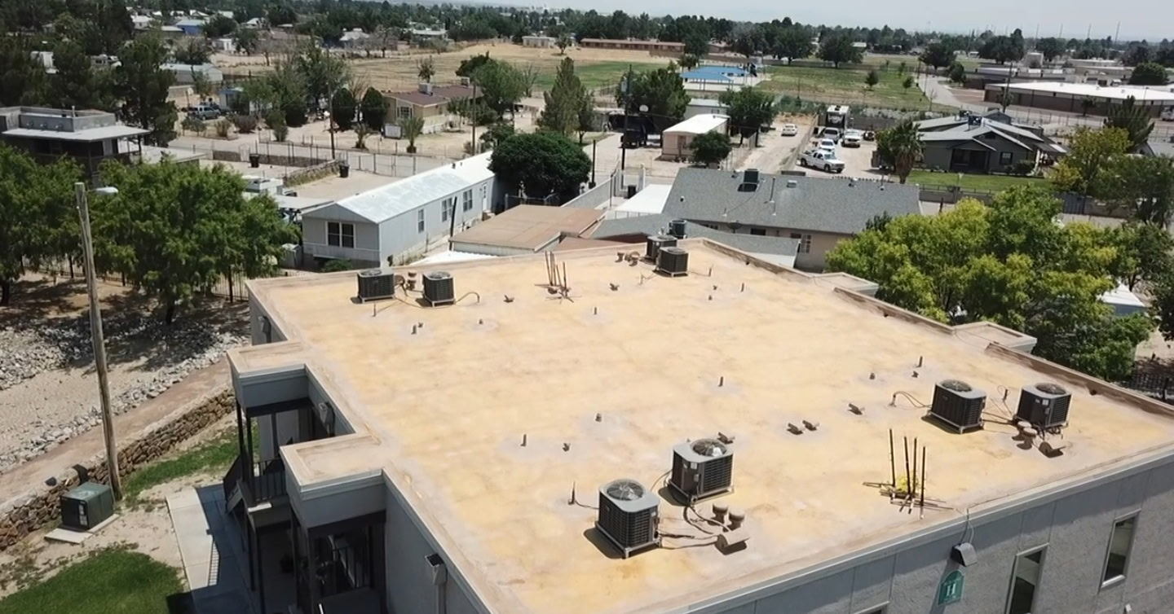
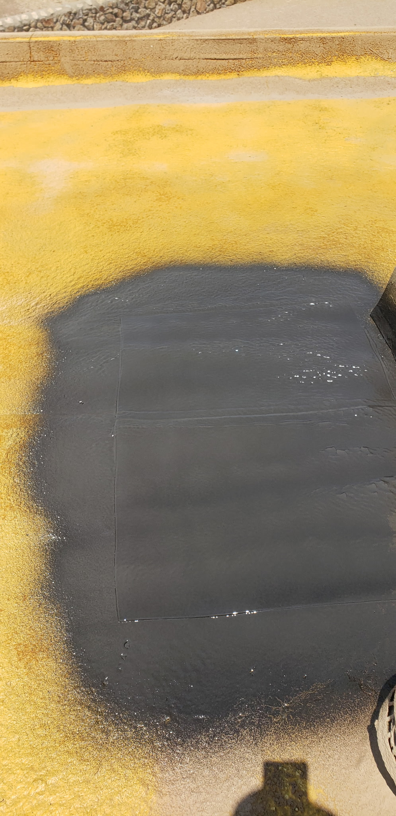
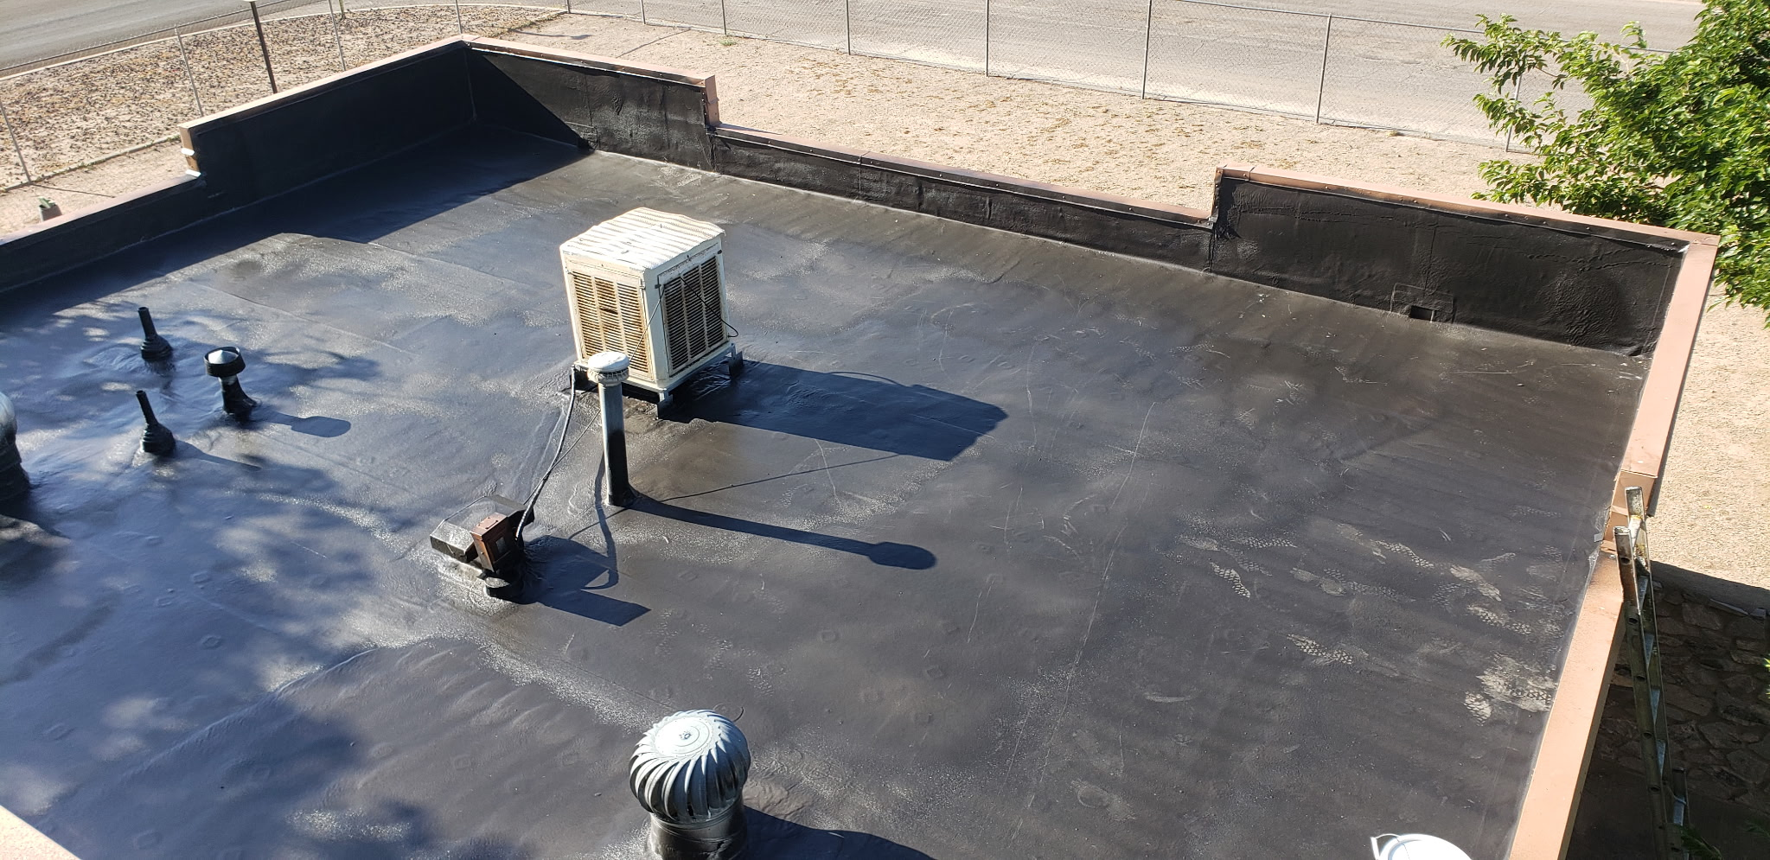
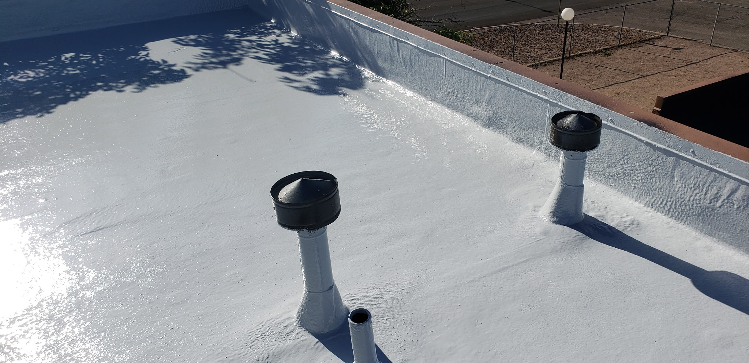
A Real Installation, Start to Finish
This is the exact system proposed for your roof — already completed and performing on another property
1
Before: Existing Foam Roof
2
Test Patch: Expandothane Applied
3
Full Base Coat Applied
4
Complete System: Topcoat Applied
RenewPro | Roof Restoration Proposal
5

Slide 6
Why It Outperforms a New Foam Roof
Four reasons roofing teams choose Expandothane over foam alone
Cures in Seconds
Crews apply and move on fast — there's no long open-air cure window for weather to interfere with.
1
Seals Everything
It expands into seams, gaps, and the exact spots the birds have damaged, closing them completely.
2
Impact & Hail Resistant
Tested to resist cracking under impact — a real plus in Florida's storm and hail exposure.
3
Works Over What's Already There
No need to strip the roof down to bare deck — it's designed to be applied over sound existing structure.
4
RenewPro | Roof Restoration Proposal
6

Slide 7
The Topcoat Makes the Difference
Aliphatic polyurea: the hard shell that stops the cycle of damage
Cures to an extremely hard, dense finish — far tougher than exposed foam.
A SUPER-HARD
SHIELD
Built to withstand sun, salt air, and coastal weather without breaking down.
on top of a flexible, sealed membrane below
Holds its color and gloss over time, instead of yellowing or degrading.
A hard, sealed surface gives birds nothing soft to peck apart the way the old foam offered.
RenewPro | Roof Restoration Proposal
7

Slide 8
Minimal Disruption to Your Residents
Life at the building keeps moving while the work happens overhead
Rooftop work only — no interior access needed for units
⏱
Measured in Days —
Not Weeks
Fast-cure application means crews are on and off the roof quickly
No hauling away debris from an entire old roof system
Compared to a full tear-off and re-foam of the entire roof, restoring in place is a far shorter project window.
Normal building life continues below while the crew works above
RenewPro | Roof Restoration Proposal
8

Slide 9
What the Process Looks Like
So the Board and residents know exactly what to expect, start to finish
1
Inspect & Assess
2
Repair as Needed
3
Clean the Surface
Walk the roof and document bird-damaged areas, seams, and any ponding before work begins.
Deteriorated foam is removed and repaired only where it's actually damaged.
The roof is pressure-washed and left to fully dry — a critical step before coating.
4
Test Adhesion
5
Apply Expandothane
6
Apply the Topcoat
A quick adhesion check confirms the surface is ready for the system.
The base membrane is sprayed on, sealing seams and gaps as it cures in seconds.
The hard aliphatic polyurea finish goes on last, completing the warrantied system.
RenewPro | Roof Restoration Proposal
9

Slide 10
BUILT TO LAST
20
✓
One installation, two decades of protection
✓
Backed by SprayEZ Equipment & Coatings
YEAR SYSTEM WARRANTY
✓
Peace of mind for the Board and every resident
Covering the complete Expandothane roofing system when installed by an authorized applicator.
RenewPro | Roof Restoration Proposal
10

Slide 11
Why This Is the Right Choice for Your Building
Bringing it all together for the Board
Solves the Real Problem
Faster, Less Disruptive
Addresses the bird damage directly instead of setting up the same failure again in a few years.
Installed in place, over sound structure — far less impact on residents than a full tear-off.
Built for This Coast
20 Years of Protection
A super-hard topcoat designed to hold up to sun, salt air, and Florida storms.
One warrantied project, two decades of coverage for the building.
RenewPro | Roof Restoration Proposal
11

Slide 12
Next Steps
Moving forward together
1
Board review and discussion
2
Schedule a full roof walk-through and assessment
3
Finalize project scope and installation timeline
4
Move forward with an authorized Expandothane installation
QUESTIONS?
Tim Laughery
RenewPro
RenewPro | Roof Restoration Proposal
12

