Slide 1
Mentorship Matters:
Improving Bus Operator Retention and
Reducing Absenteeism Through Peer Support
Iowa Public Transit Association
Altoona, Iowa
June 18, 2026

Slide 2
Maurice Beard, Senior Workforce Development Advisor, Transit Workforce Center
Valerie Campo, Mentor Program Coordinator, Champaign-Urbana Mass Transit District

Slide 3
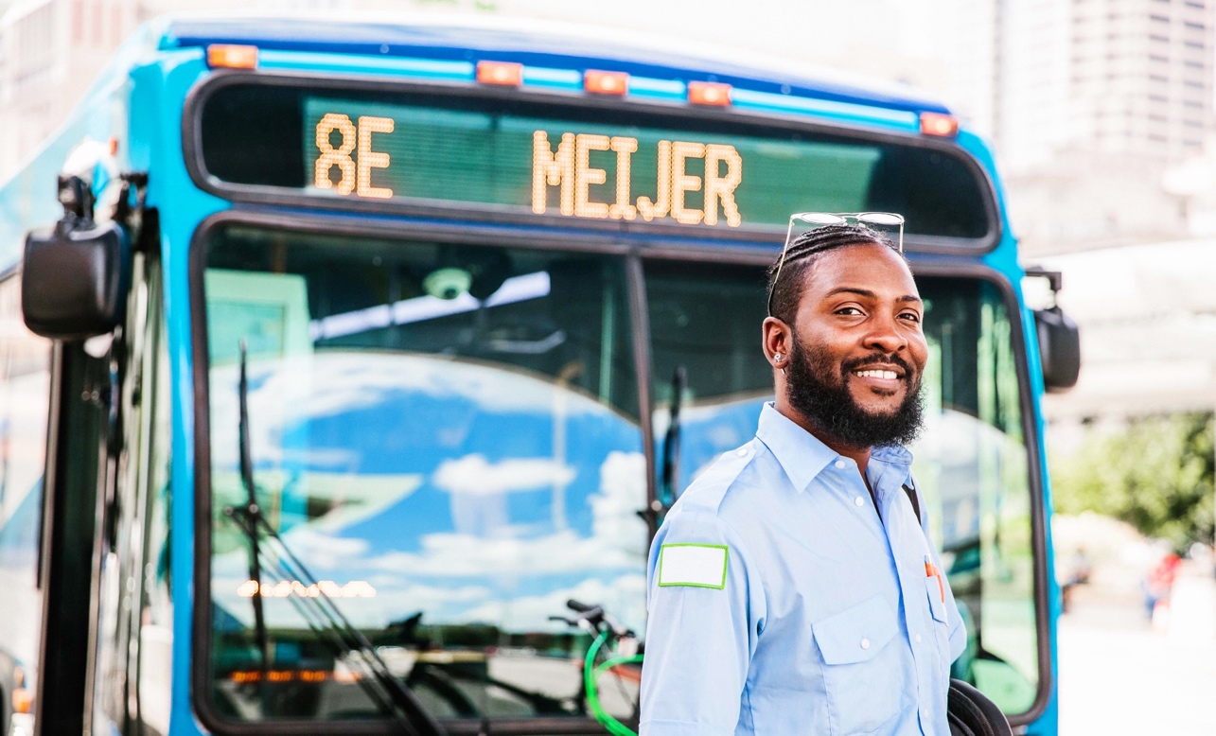
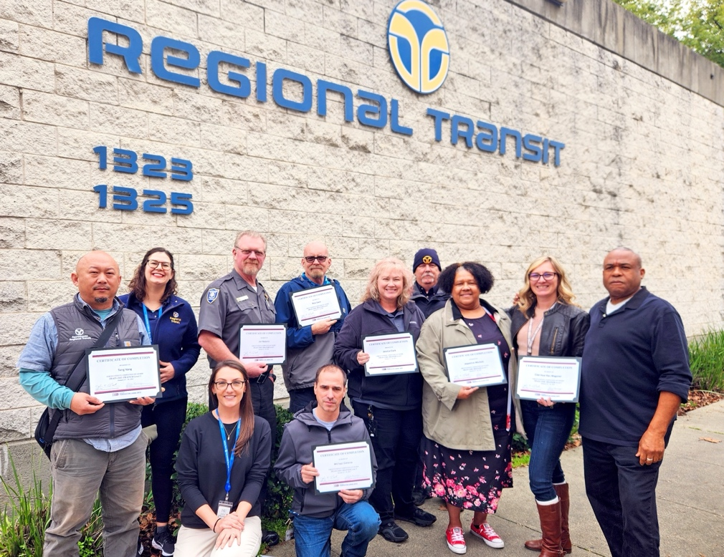
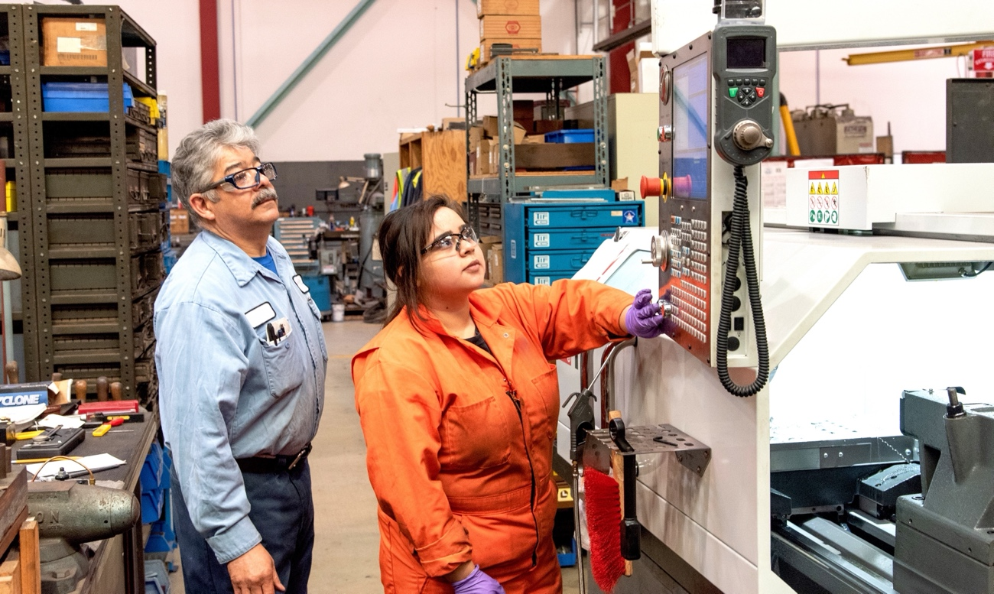
Transit Workforce Center – Mission
The Transit Workforce Center (TWC) is the Federal Transit Administration’s national technical assistance center for transit workforce development.
Operated by the International Transportation Learning Center (ITLC),
TWC supports the workforce development needs of urban, suburban, tribal, and rural public transportation entities across the country.
Notes:
ITLC has been around for two and a half decades, starting out by supporting labor management partnerships in public transportation, which led to the development of established career pathways, national training standards and curricula, and apprenticeships and mentorship.
A couple of years ago, the Federal Transit Administration selected ITLC to operate the Transit Workforce Center, which is FTA’s first national technical assistance center for transit workforce development.
So if you’re a transit agency, please send any technical assistance requests to us with our TWC hats on; but as ITLC we work on transportation workforce development more broadly.

Slide 4











TWC Services
Targeted
Technical Assistance
Registered Apprenticeship
(ATTAIN)
Transit Workforce Data Dashboard
Trainer and Mentor Development
Resource Center
Transit Core Competencies
Curriculum (TC3)
Funding Information
National Transit Frontline Worker Recruitment Campaign
Recruit • Hire • Develop • Retain
Fleet Transition and New Technologies

Slide 5



The Workforce Challenge
Transit agencies face an urgent operator retention crisis that threatens service delivery.
247K
53.3
71.5%
projected bus driver
openings by 2033
median age of transit
bus operators
of operators are
over age 45
Turnover is highest in the first 3 years — mentorship targets this critical window.
Source: Bureau of Labor Statistics, Transit Workforce Center (2023)

Slide 6
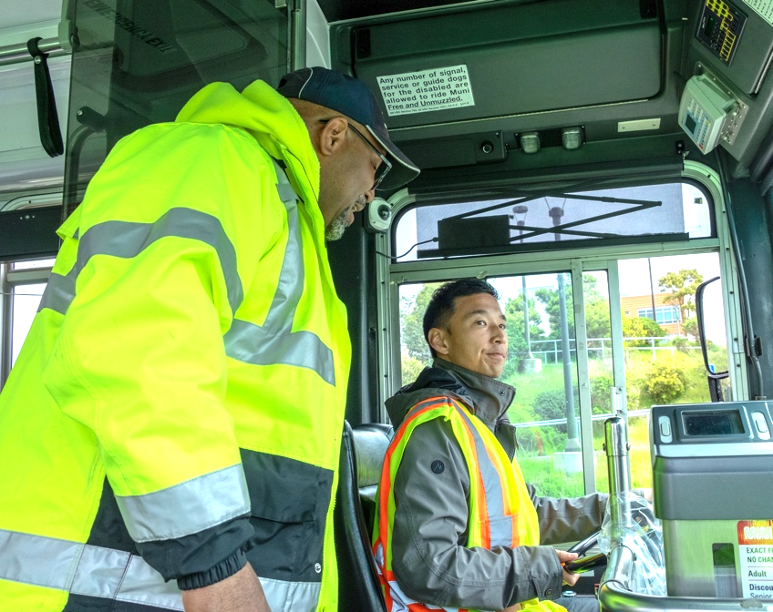

What is Operator Mentorship?
A structured peer support system pairing experienced operators with new hires during their critical first year.
Pairing Experience with Commitment
Operator mentorship programs pair seasoned
coach operators with new hires for hands-on skill
development, coaching, and peer support during
their critical first year.
Ride-along training with experienced mentors
Guidance on navigating the challenges of real-world operations
Regular check-ins and periodic mentor meetings
Emotional support during onboarding
Most successful when run management works collaboratively with the frontline workforce.

Slide 7




Safety and Performance Gains
Mentored operators demonstrate measurably better safety records and fewer workplace incidents.
Fewer Accidents
Lower Violations
VTA reports improved accident metrics among mentored operators
Metro Transit mentees: 0.08 violations/
hire vs. 0.12 for non-participants
Better Customer Service
Fewer Grievances
Reduced customer complaints as new operators learn best practices early
Programs at VTA showed improved grievance metrics across participating operators
Sources: Transit Workforce Center, VTA, Metro Transit (2023)

Slide 8
Proven Retention Impact
95%
50% → 90%
VTA peer-to-peer program worker retention (APTA)
→
80%
+15%
Retention increase for new hires in first year (VTA)
VTA Retention Rate After Mentoring
“If an operator makes it past year one,
the likelihood of staying increases dramatically.”
Source: Madison Metro Transit / UW-Madison Research (2026)

Slide 9
Attendance and Compliance
10%
lower unexcused
absence rate
33%
fewer recorded
violations per hire
Data: Metro Transit, Minneapolis (2018-2019)

Slide 10
Success Stories
VTA
(San Jose, CA)
Metro Transit (Minneapolis)
CENTRO
(Syracuse, NY)
Since 2008
Since 2018
First in NY State
Retention rose from 80% to 95%. Mentoring cited as biggest factor. Workers earn college credit through Mission College partnership.
531 mentees, 108 mentors. Lower absence rates and recorded violations among participants.
ATU Local 580 partnership. Teaching operators that the job is about safety, riders, and community — not just driving.
Sources: Transit Workforce Center, APTA, ATU International

Slide 11
SMALL AGENCIES,
BIG IMPACT
Mentorship programs are not just for large metros —
small agencies are leading the way

Slide 12



Why Mentorship Matters for Small Fleets
Small and rural transit agencies face unique workforce challenges that make mentorship even more critical.
Every Operator Counts
In smaller organizations, losing even one operator can significantly impact service delivery.
Rural Coverage Gaps
Operators may serve vast geographic areas — peer support reduces isolation and burnout.
Increased Resources
Especially for smaller-staffed organizations, structured mentorship is a force multiplier.
96% of transit agencies report workforce shortages, hitting small agencies hardest — APTA 2025

Slide 13




Small and Mid-Sized Agencies Leading the Way
STAR Transit
Lane Transit District
Terrell, TX | 85 employees
Lane County, OR | 200 operators
Guiding Star Mentor Program
First-in-Oregon Apprenticeship
Three regional mentors divide mentorship by geography. Launched March 2026 with TWC/ITLC collaboration. Largest agency in North Central TX without sales tax funding.
8 inaugural apprentices paired with trained mentors for 18-month program. Certified by Oregon Bureau of Labor & Industries. Next cohort starts July 2026.
TARTA
CATS
Toledo, OH
Baton Rouge, LA
M-PACT Mentorship Program
Joint Apprenticeship Pilot
Mentorship Program Advancing Career Trajectories. Joint partnership with ATU Local 697. Presented to board June 2024 with dedicated Workforce Development Manager.
First-in-Louisiana labor/management operator pilot with ATU Local 1546. 6-12 month program pathway to state apprenticeship registration.
Sources: STAR Transit, Lane Transit District, TARTA, ATU International (2024-2026)

Slide 14






Key Benefits
Increased Retention
Improved
Safety
Reduced Absenteeism
Keep operators beyond the critical first year
Fewer accidents and
recorded violations
10% lower unexcused
absence rates
Higher
Morale
Better Performance
Knowledge Transfer
Stronger sense of community and belonging
Improved customer service and compliance
Preserve institutional
expertise across generations

Slide 15

Implementation Roadmap
01
02
03
04
05
Form Committee
Define Criteria & Recruit
Train Mentors
Launch & Pair
Track & Measure
Equal labor and management
Prep and training for effective mentorship
Match mentors with new operators; begin ride-alongs
Monitor retention, attendance, safety, and satisfaction
Years of experience, clean record, strong communication

Slide 16

Program Branding and Recognition
Successful programs invest in identity and recognition to attract volunteer mentors and build pride.
Brand Identity
Create a catchy program name, logo, and promotional materials
Mentor Recognition
Uniform patches, certificates, awards ceremonies
Visibility
Feature mentors in agency newsletters, social media, and events
Career Advancement
Mentoring experience as a steppingstone to leadership roles
“The greatest thing you can do as a mentor is passing on your knowledge to make it better for others.”

Slide 17

INVEST IN
YOUR OPERATORS.
INVEST IN YOUR FUTURE.
Mentorship programs are proven, cost-effective tools to retain operators, improve safety, and build a resilient workforce for the future.
Form a committee
Begin mentor recruitment
Set baseline metrics
Contact us to begin building your mentorship program today.

Slide 18
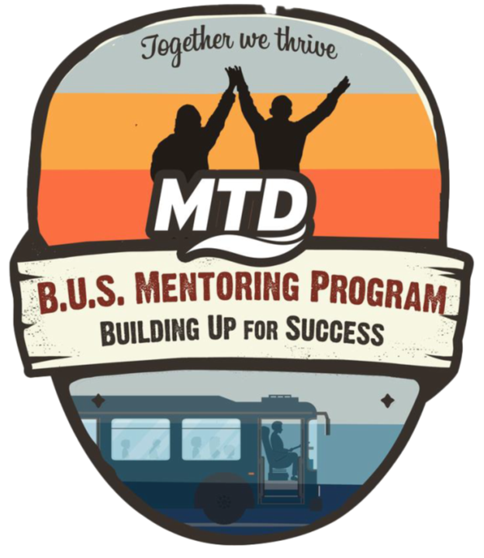
Changing the Route, Not the Destination:
ModernizIng Mentoring at MTD
What We Learned, What We Changed, and Why It’s Worked Better for Everyone

Slide 19

MTD at a Glance
Our Motto is, “Helping you thrive!”
Provide 12 million+ rides per year
267 Operators (fixed-route & paratransit)
26 routes (fixed and on-demand)
Operate 118 fixed‑route buses (plus 10 spares) + paratransit
$1.00 Single-ride fare
  $60.00 Annual Passes
High‑frequency service (10-15 minute service on UIUC campus routes) for Champaign–Urbana–Savoy
Nationally recognized for innovation

Slide 20

How Our Mentoring Program Began
We Started With a Traditional 1:1 Model
Launched to support new operators during their first year
Paired each mentee with one mentor
Goal: consistency, connection, and skill transfer
Early success depended heavily on individual mentor dedication

Slide 21

Why Our 1:1 Model Failed
The Reality Behind Our 33 Mentors
• Of 33 selected mentors, only one-third consistently performed the duties
• The rest disengaged due to:
o Shift differences
o Too much paperwork
o Lack of connection with assigned mentee
o Wanting to “try something new” but not sustain it
• Result: inconsistent support, uneven experiences, and mentor burnout
• The structure—not the people—was the problem
This Photo by Unknown Author is licensed under CC BY-SA

Slide 22

Our Coordinated Coaching Team
A Three-Person Team Built for OUR Transit Reality
• Mentor Program Coordinator (Yours truly!)
• Two Operator Mentors with rotating mentoring days
o One daytime (Nafisah)
o One evening (Kayla)
• Team approach ensures coverage across shifts and schedules
• Everyone shares responsibility for every mentee

Slide 23

Our Contact Schedule
Consistent, Predictable, Human Support
• Daily contact for first 10 days
• Weekly contact for next 10 weeks
• Bi weekly contact through 6 months
• Monthly contact until 1 year
• Ensures no mentee “falls through the cracks”
• Builds trust, confidence, and retention

Slide 24

Why the Coordinated Coaching Team Works
Coverage, Consistency, Culture
Mentees receive support from multiple strengths, not one person
Eliminates single‑point failure
Reduces burnout and increases accountability
Creates a shared culture of support
Works regardless of shift patterns or hiring surges

Slide 25

Why Any Agency Can Use This Model
Scalable for Small, Medium, or Large Systems
• Small agencies: team of 2–3 mentors
• Large agencies: specialized mentor roles
• Works with any shift structure
• Focus is on coverage, not headcount
• Strength mapping reveals how to build the right mix

Slide 26
Activity: Mentor Strength Mapping
See Your Strengths — And Your Gaps
• Identify 3–5 mentors at your agency
• Place each mentor under the strengths they bring
• Look for:
o Clusters
o Gaps
o Overloaded individuals
o Underutilized strengths
• Shows how a team model may be more resilient than 1:1 for your agency

Slide 27

A Better Path for Operators — And for Us
The Results of Rerouting: Stronger Operators, Stronger Teams
Our goal never changed: confident, supported operators
The 1:1 model couldn’t get us there
The Coordinated Coaching Team did
Consistency, coverage, and culture made the difference
Any agency can adapt this model — no matter the size
When the route doesn’t work, redesign the map

Slide 28

Thank You for Joining Us on This Route
Your time and attention mean a lot to us
Supporting operators is a shared journey
We’re all working toward the same destination
Questions? Reflections?
Let’s talk!

Slide 29

Questions, Reflections, and Shared Experiences
What stood out to you?
What challenges are you seeing in your own systems?
Where do you see opportunities to support operators differently?
Let’s learn from each other.

Slide 30
MENTOR TRAINING

Slide 31



Who Makes A Great Mentor?
Selecting the right mentors is the foundation of program success. Criteria should be transparent and jointly developed.
Experience
Clean Record
Significant years of service as a coach operator with deep route knowledge
No recent incidents, violations, or unexplained absences
Communication
Commitment
Confidentiality rules, chain of command, when to escalate issues
Genuine desire to support new operators and volunteer time
Professionalism
Cultural Fit
Adherence to agency policies, strong customer service ethic
Shared experiences or demographics can strengthen mentor-mentee bonds
Selection process: Advertise → Collect applications → Interview → Notify selected mentors
Notes:
What type of people do you want to train?

Slide 32




Mentor Training In Practice
Introduction to Mentoring
Communication Skills
What mentorship means in transit,
roles vs. supervision, program goals
Active listening, giving constructive feedback, motivational techniques
Boundaries & Ethics
Practical Strategies
Patient, approachable, and skilled at explaining complex situations
Ride-along best practices, handling difficult conversations, stress management
Health & Wellness
Role Playing & Review
Work-life balance guidance, recognizing burnout, support resources
Hands-on scenarios, group debriefs, commitment to action plans
Notes:
What type of people do you want to train?

Slide 33

TWC Mentor Development Program
8-Hour Training Program
Developed by the Transit Workforce Center, this program equips mentors with practical tools for effective peer support.
Understanding the mentor role and responsibilities
Adult learning styles and communication techniques
Setting appropriate boundaries with mentees
Role-playing exercises and facilitated discussion
Tailored to local and occupational contexts
Source: Transit Workforce Center (transitworkforce.org)

Slide 34

Ride-Alongs
Learning Behind the Wheel
Ride-alongs are where classroom learning meets real-world operations. Mentors join new operators in service to observe, coach, and build confidence.
Route Navigation
Tips for challenging stops, passenger loading zones
Customer Interaction
De-escalation, ADA compliance, service etiquette
Safety Practices
Mentee witnesses the job in real-time
Performance Tips
Time management, schedule adherence, self-care
Mentors are typically compensated with overtime pay for ride-along sessions.

Slide 35

Key Program Components
12-18 Month
Duration
Designated
Coordinator
Regular
Check-Ins
Pilot Phase
Mentoring spans the critical first-year period and beyond
A program coordinator manages mentor assignments and logistics
Structured contact at agreed-upon intervals between mentor and mentee
Start with a small cohort to refine processes before scaling

Slide 36
MENTORSHIP CAN
BE A BASE FOR
REGISTERED APPRENTICESHIP

Slide 37
Mentorship VS. Registered Apprenticeship
 | Mentorship | Registered Apprenticeship
Focus | Personal effectiveness, peer support, workplace culture | Occupation-specific skills plus mentorship foundations
Duration | 12-18 months typical | 1+ year minimum (DOL requirement)
Credential | Internal program completion | Nationally-recognized journeyworker card
Structure | Ride-alongs, meetings, informal coaching | Structured OJT hours + classroom instruction
Oversight | Agency/union-managed | Registered with DOL or State Apprenticeship Agency
Wages | Standard operator pay | Progressive wage increases as skills grow
Education | Optional | Required related technical instruction
Both strategies are complementary — mentorship is often the first step toward a full apprenticeship program.

Slide 38




The ATTAIN Network
American Transit Training and Apprenticeship Innovators Network
Peer Exchange
Technical Assistance
Connect with agencies and unions already running apprenticeship programs
Free support from TWC to develop, register, and enhance programs
Webinars & Events
Occupational Frameworks
Regular learning events focused on specific occupational groups
DOL-approved frameworks for bus operations, maintenance, and more
50+ registered apprenticeship programs | 30+ transit agencies | From 5 programs in 2010 to 50+ today
Join at transitworkforce.org/attain

Slide 39
Apprenticeship Growth and Impact
27,418
90%
150%
registered apprentices
in transportation (2025)
employment retention
after completion
average ROI
for employers
10% increase over 5 years
Apprenticeship.gov
Ivy Tech / DOL data

Slide 40
Getting Started As A Small Agency
1
Contact TWC for Free Support
The Transit Workforce Center provides free technical assistance to agencies of all sizes — including help designing, launching, and registering mentorship programs.
2
Join the ATTAIN Network
Connect with peer agencies already running programs. ATTAIN provides occupational frameworks, webinars, and a community of practice for mentorship.
3
Consider starting with a pilot
Begin with 2-3 mentors and a single cohort. STAR Transit launched with just three regional mentors covering their entire service area.
4
Partner with Your Union (if applicable)
Joint labor-management programs are the most successful.
5
Track Outcomes from Day One
Measure retention, attendance, and safety from the start. Early data builds the case for continued investment and future expansion.

Slide 41
Q&A Session
Q A
&

Slide 42
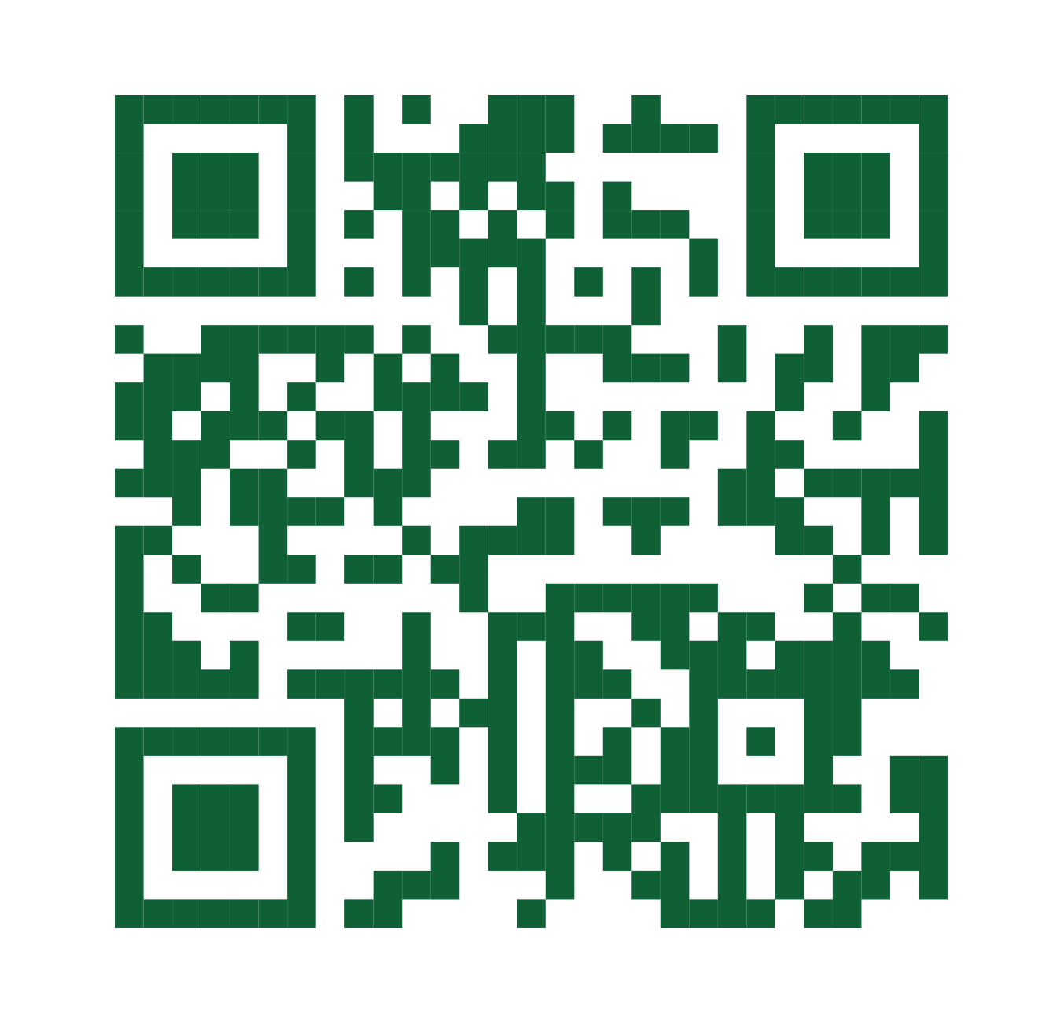
THANK YOU!
Maurice Beard
Senior Workforce
Development Advisor
mbeard@transportcenter.org
www.transitworkforce.org

