Slide 1
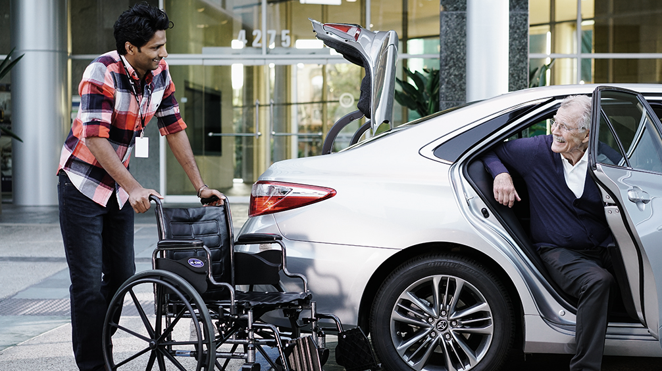


Iowa NEMT Overview

Slide 2
What We’ll Cover Today
Welcome and Introductions
About
MTM Health
MTM Health
in Iowa
The Future of NEMT
Q&A and Comments

Slide 3
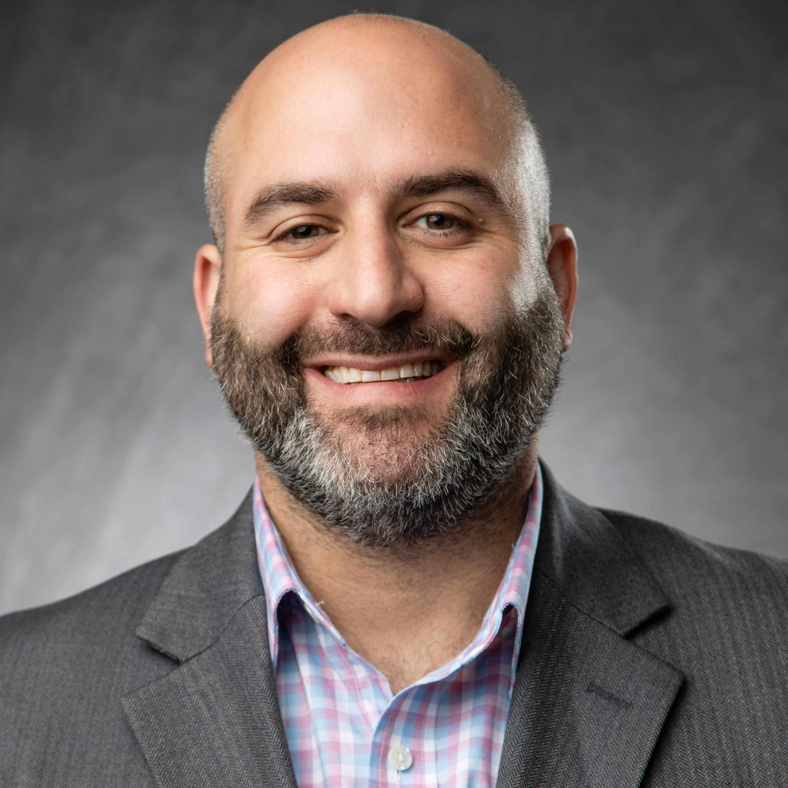




Welcome and Introductions
Justin Berger
Iowa
Program Director
Molly Heuton
Manager,
Transportation
Cassie Carder
Vendor Account
Manager
Alyssa Young
Vendor Account
Manager
Stacey Powell
Vendor Account
Manager

Slide 4
About MTM Health:
Our History and Who We Are Today

Slide 5

Our History and Founding
Founded in 1995 as Medical Transportation Management by
Peg and Lynn Griswold
Started in a one-room office with a solid vision: solve healthcare access barriers through innovative NEMT brokerage, leveraging existing providers instead
of owning fleets
Pioneered brokered NEMT model
for Medicaid/Medicare

Slide 6

30 Years of
Transformative Growth
Rebranded to MTM Health in
2025 to reflect our expanded
mission beyond transportation
to comprehensive health access solutions
From two employees to a
national NEMT leader via organic growth and strategic acquisitions
Now, we operate in all 50 states, D.C., and Puerto Rico

Slide 7
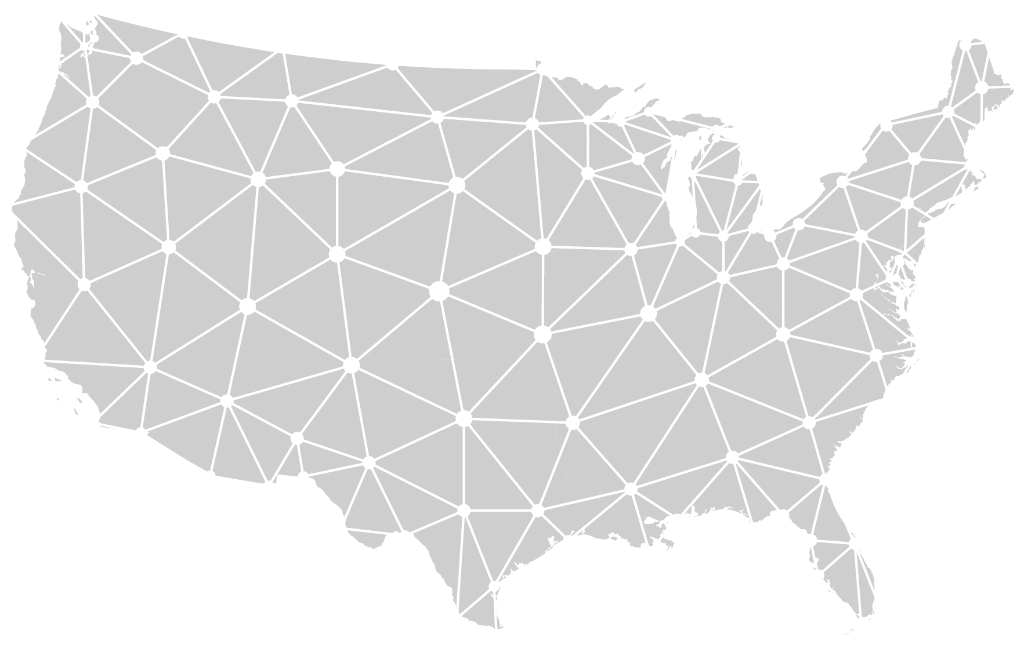

Current Scale and Impact
Largest privately-owned NEMT company in the industry
Partners with state governments, MCOs, and health plans – as well as a robust network of transportation providers
Our focus: improve health outcomes, reduce missed appointments, and lower healthcare costs
50
States +
DC and Puerto Rico
25M
Members Covered
35M
Annual
Trips
28M
Annual
Calls

Slide 8
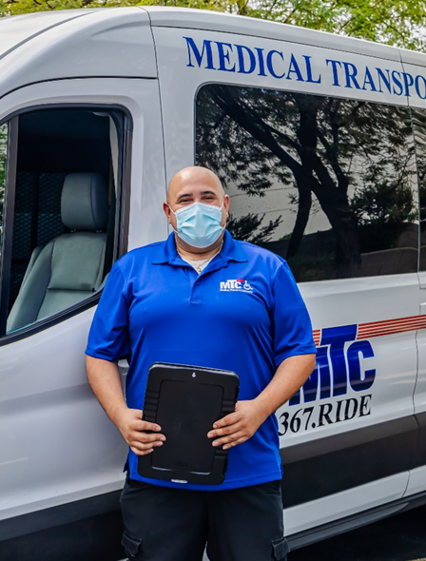
Our Commitment to
Providers
You are the backbone of our network
and operations
We rely on you to deliver safe, timely rides
to members nationwide
Our goal: mutual growth, where strong
performers thrive and grow with us

Slide 9
MTM Health in Iowa:
A History of Service Excellence

Slide 10
MTM Health in Iowa
1.3M+
Annual
Trip Legs
126
Credentialed Providers
95%+
Member Satisfaction
400K+
Annual Calls Answered
98%
On-Time Performance

Slide 11
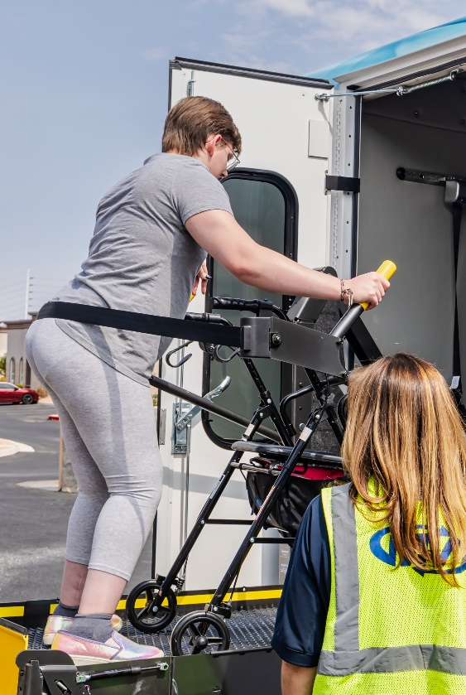
Public Transit Partnerships
We partner with transit agencies in Iowa to facilitate approved NEMT and Waiver trips
User-friendly credentialing portal to allow providers visibility to monitor and maintain credentialing requirements
MTM Health will set transportation at the requested mode for up to 45 days during the assessment period
If denied, member must use GMR or fixed route

Slide 12
The Future of NEMT:
Opportunities for Strong Providers

Slide 13
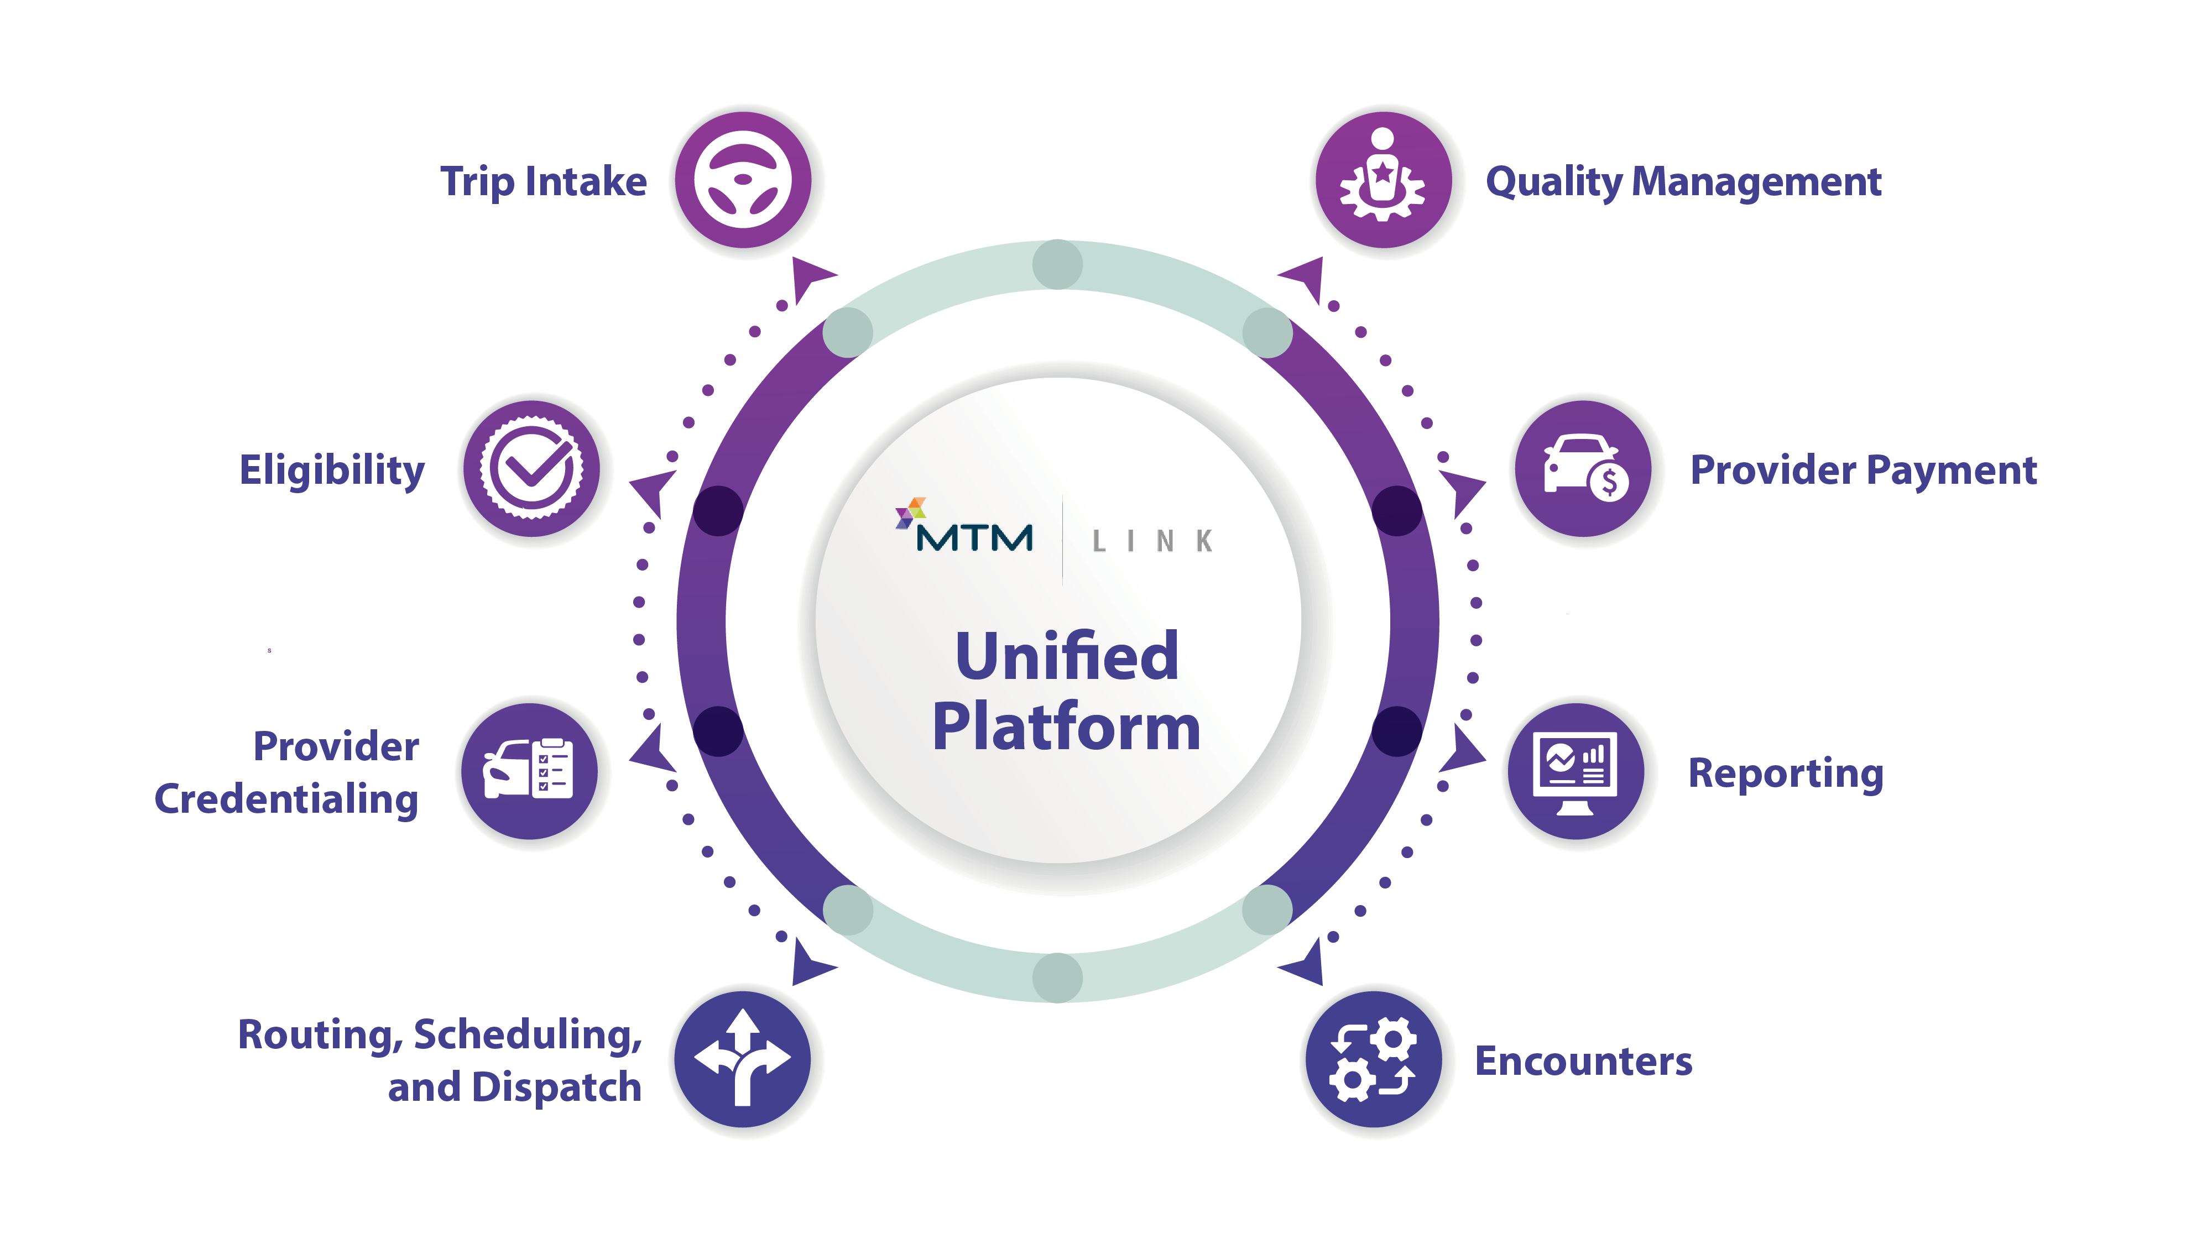
Technology to Reduce Burden on You
Industry shifting toward
tech-enabled efficiency
MTM Link platform: core tool
to make coordination with
MTM Health simpler and faster
Designed specifically to ease administrative load on providers

Slide 14
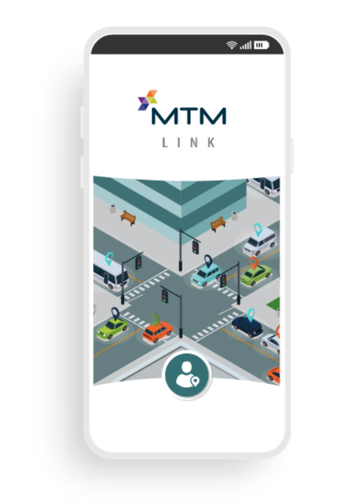
Key MTM Link Features for Providers
Simple and functional Driver App
Quick routing for short-notice trips
GPS data and timestamps
Claims monitoring and updates
Marketplace to "shop" for additional trips/opportunities
Easy credential management
APIs with 30+ third-party RSD platforms

Slide 15
AI Enhancements and
Provider Ranking
Example Provider Ranking:
AI-powered tools to
support daily operations
New provider ranking algorithm rewards strong performance
Reliability
Safety
Timeliness
Better performance = more trips and growth opportunities
Alpha Transport
Bravo Limo
Charlie Transit
Delta Shuttles
Echo Movers
Foxtrot Cars

Slide 16

The Role of Traditional
Providers
Huge ongoing need for human-driven, traditional NEMT services
Autonomous options (if/when viable) will complement, not replace, providers
Safety remains paramount;
tech must prove reliable for vulnerable passengers

Slide 17

What This All Means for You
Strong-performing transportation providers will see significant growth opportunities with MTM Health
We’re invested in your success: more trips, better tools, and a shared future
Focus on safety, reliability, and data (GPS, timestamps, cameras) positions you for success

Slide 18
Q&A and Audience Comment
Thank you for your partnership and dedication to providing high quality NEMT services!

