Slide 1
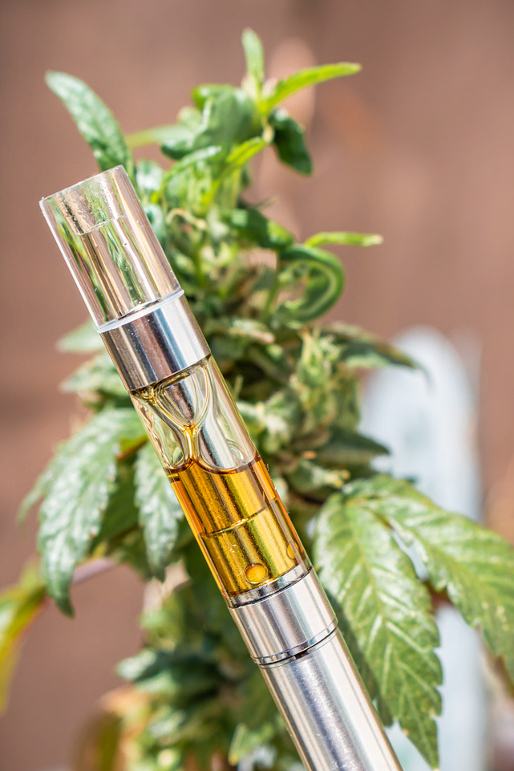
USDOT-FTA D&A Testing: Addressing Today’s Key Challenges
i
Sean K. Oswald, Chief of Operations
RLS & Associates, Inc.
Notes:
The Preferred fonts throughout the template are:
Headers: Franklin Gothic Heavy (48pt or 36Pt)
Major Titles: Franklin Gothic Demi (24 pt)
Standard Text: Franklin Gothic Book (24 pt)
Accessibility Notes:
Remember to add Alt Text/ Captions to photos that are representative of what is happening in the image.
You can right click on the image and choose ‘View Alt Text”, or go to Review -> Check Accessibility -> Alt Text to add or have PPT generate Alt text

Slide 2
Common Findings
Notes:
Accessibility Notes:
Remember to add Alt Text/ Captions to photos that are representative of what is happening in the image.
You can right click on the image and choose ‘View Alt Text”, or go to Review -> Check Accessibility -> Alt Text to add or have PPT generate Alt text
If you add jpgs/images of graphs or tables make sure the captions describe the graph/ table in detail. Include percentages, numbers and comparisons.
Best practice is to copy or import tables and graphs as Excel or Microsoft objects
Avoid using Smart Objects unless necessary, they require alt text just like images and can be difficult to edit
For text, make sure your color contrast passes the WCAG AA and that your text is no smaller than 16pts if possible. A contrast checker can be found at WebAIM: Contrast Checker

Slide 3
Common Findings: Policy Applicability
Must Identify the Authority for Each Provision
  CLEARLY identify & delineate between provisions required by USDOT vs. those required locally by the employer
  Typically accomplished through a font difference
  Example: “Any provision set forth in this policy which are not included under USDOT/USDOT Agency rules, regulations, and/or laws and which are under the sole authority of the [EMPLOYER] are underlined.”
Can’t contradict the USDOT regulations
Can’t suggest/infer a local violation is DOT violation
Notes:
The bullets shown are representative to show that you must use different bullet types for each level of bullets. Also bulleted text is meant to be short and concise versus using long sentences or paragraphs in a slide format. (there may be certain exceptions for detailed technical information that needs to be conveyed. However whenever possible keep the text in the slide as minimal as possible and use the speaker notes section here for the details. When slides are shared, the speaker notes will be viewable by the reader.
Accessibility Notes:
Remember to add Alt Text/ Captions to photos that are representative of what is happening in the image.
You can right click on the image and choose ‘View Alt Text”, or go to Review -> Check Accessibility -> Alt Text to add or have PPT generate Alt text
If you add jpgs/images of graphs or tables make sure the captions describe the graph/ table in detail. Include percentages, numbers and comparisons.
Best practice is to copy or import tables and graphs as Excel or Microsoft objects
Avoid using Smart Objects unless necessary, they require alt text just like images and can be difficult to edit
For text, make sure your color contrast passes the WCAG AA and that your text is no smaller than 16pts if possible. A contrast checker can be found at WebAIM: Contrast Checker

Slide 4
Common Findings: Policy – Out of Date
Policy = Living Document
Remove/Generalize Provisions Likely to Change
Seek Expert Review
It will NEVER be “finished”
It will ALWAYS need updating
Lab cut-off levels (remove)
Random testing percentages (generalize)
Get your policy reviewed REGULARLY
FTA
State DOT
Others?
Notes:
The bullets shown are representative to show that you must use different bullet types for each level of bullets. Also bulleted text is meant to be short and concise versus using long sentences or paragraphs in a slide format. (there may be certain exceptions for detailed technical information that needs to be conveyed. However whenever possible keep the text in the slide as minimal as possible and use the speaker notes section here for the details. When slides are shared, the speaker notes will be viewable by the reader.
Accessibility Notes:
Remember to add Alt Text/ Captions to photos that are representative of what is happening in the image.
You can right click on the image and choose ‘View Alt Text”, or go to Review -> Check Accessibility -> Alt Text to add or have PPT generate Alt text
If you add jpgs/images of graphs or tables make sure the captions describe the graph/ table in detail. Include percentages, numbers and comparisons.
Best practice is to copy or import tables and graphs as Excel or Microsoft objects
Avoid using Smart Objects unless necessary, they require alt text just like images and can be difficult to edit
For text, make sure your color contrast passes the WCAG AA and that your text is no smaller than 16pts if possible. A contrast checker can be found at WebAIM: Contrast Checker

Slide 5

Common Findings: Policy Consequences
Zero Tolerance vs. 2nd Chance
  Determination to terminate or not is 100% EMPLOYER decision (not mandated by USDOT-FTA regulations
  Each employer must make the decision, list in policy, be consistent
YOU MUST ALWAYS FOLLOW YOUR POLICY!!
Notes:
The bullets shown are representative to show that you must use different bullet types for each level of bullets. Also bulleted text is meant to be short and concise versus using long sentences or paragraphs in a slide format. (there may be certain exceptions for detailed technical information that needs to be conveyed. However whenever possible keep the text in the slide as minimal as possible and use the speaker notes section here for the details. When slides are shared, the speaker notes will be viewable by the reader.
Accessibility Notes:
Remember to add Alt Text/ Captions to photos that are representative of what is happening in the image.
You can right click on the image and choose ‘View Alt Text”, or go to Review -> Check Accessibility -> Alt Text to add or have PPT generate Alt text
If you add jpgs/images of graphs or tables make sure the captions describe the graph/ table in detail. Include percentages, numbers and comparisons.
Best practice is to copy or import tables and graphs as Excel or Microsoft objects
Avoid using Smart Objects unless necessary, they require alt text just like images and can be difficult to edit
For text, make sure your color contrast passes the WCAG AA and that your text is no smaller than 16pts if possible. A contrast checker can be found at WebAIM: Contrast Checker

Slide 6
Common Findings: Policy General
Removing EE from SS Functions
Generic / Undefined Language
Governing Authority Approval
0.04 vs. 0.02
0.04 = Violation
  SAP Referral
  RTD Process
0.02 = No Violation
  No SAP Referral
  No RTD
“Fail” vs. “Refusal” vs. “Positive” vs. “Pass”, etc.
Lab cut-off levels (remove)
Random test % (generalize)
Must approve EVERY TIME* policy is revised
Current EEs must acknowledge changes
Notes:
The bullets shown are representative to show that you must use different bullet types for each level of bullets. Also bulleted text is meant to be short and concise versus using long sentences or paragraphs in a slide format. (there may be certain exceptions for detailed technical information that needs to be conveyed. However whenever possible keep the text in the slide as minimal as possible and use the speaker notes section here for the details. When slides are shared, the speaker notes will be viewable by the reader.
Accessibility Notes:
Remember to add Alt Text/ Captions to photos that are representative of what is happening in the image.
You can right click on the image and choose ‘View Alt Text”, or go to Review -> Check Accessibility -> Alt Text to add or have PPT generate Alt text
If you add jpgs/images of graphs or tables make sure the captions describe the graph/ table in detail. Include percentages, numbers and comparisons.
Best practice is to copy or import tables and graphs as Excel or Microsoft objects
Avoid using Smart Objects unless necessary, they require alt text just like images and can be difficult to edit
For text, make sure your color contrast passes the WCAG AA and that your text is no smaller than 16pts if possible. A contrast checker can be found at WebAIM: Contrast Checker

Slide 7




Common Findings: Policy Resources
RESOURCES
FTA Policy Review Checklist
FTA D&A Policy Builder
FTA D&A Project Office
State DOT

Slide 8
Common Findings: Pre-Employment
Previous DOT Employer D&A Check
Conditional based on employment history
Positive P.E. Test Question
Must do for ALL applicants
FTA DOESN’T USE “FMCSA CLEARINGHOUSE”
Only asking verbally is not a best practice
VERY specific wording
SAMPLE FORM FROM FTA
“Two Branches – Same Tree”
Notes:
https://transit-safety.fta.dot.gov/DrugAndAlcohol/Tools/DAPMForms/Forms/Pre-Employment%20Notification%20and%20Acknowledgement%20Form.docx

Slide 9
Common Findings: Pre-Employment
Previous USDOT Employer DA Check
Getting Info. Back
Record Retention
Written release from applicant required
Standard form
At least 2 years
No “Blanket Releases”
All DOT employers, not just TRANSIT
You must receive response from previous employer(s)
If no response – You must show “good faith effort”
Must maintain information at least 3 years
Even if you don’t hire individual
Notes:
https://transit-safety.fta.dot.gov/DrugAndAlcohol/Tools/DAPMForms/Forms/Previous%20Employer%20Release%20of%20Information%20Form.docx

Slide 10
Common Findings: Post-Accident Testing
FTA Thresholds
Decision to Test
Who To Test?
Human fatality
Bodily injury w/immediate transportation away from scene to medical facility
Any vehicle incurs disabling damage
**rail car, trolley car, trolley bus, or vessel removed from service
Made by employer AT TIME OF ACCIDENT
Decision not reversed based on facts learned later on
MUST DOCUMENT DECISION
  Standard form
Fatal Accident
  Transit operator
  Any other SS EE who could’ve contributed
Non-Fatal Accident
  Same as a fatal accident UNLESS employee’s performance can be completely discounted
Notes:
https://transit-safety.fta.dot.gov/DrugAndAlcohol/Tools/DAPMForms/Forms/Previous%20Employer%20Release%20of%20Information%20Form.docx
https://transit-safety.fta.dot.gov/DrugAndAlcohol/Tools/DAPMForms/Forms/Post%20Accident%20Decision%20Making%20Form%20-%202025.docx

Slide 11
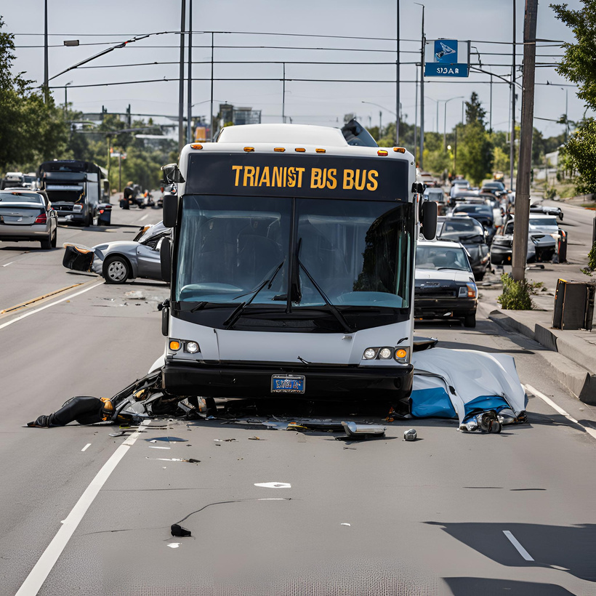
Common Findings: Post-Accident Testing
Factors that DON’T impact decision to test
  Testing just to be safe
  Dollar damage
  Preventability
  Reasonable Suspicion Implications
  Citation vs. No Citation
Notes:
The bullets shown are representative to show that you must use different bullet types for each level of bullets. Also bulleted text is meant to be short and concise versus using long sentences or paragraphs in a slide format. (there may be certain exceptions for detailed technical information that needs to be conveyed. However whenever possible keep the text in the slide as minimal as possible and use the speaker notes section here for the details. When slides are shared, the speaker notes will be viewable by the reader.
Accessibility Notes:
Remember to add Alt Text/ Captions to photos that are representative of what is happening in the image.
You can right click on the image and choose ‘View Alt Text”, or go to Review -> Check Accessibility -> Alt Text to add or have PPT generate Alt text
If you add jpgs/images of graphs or tables make sure the captions describe the graph/ table in detail. Include percentages, numbers and comparisons.
Best practice is to copy or import tables and graphs as Excel or Microsoft objects
Avoid using Smart Objects unless necessary, they require alt text just like images and can be difficult to edit
For text, make sure your color contrast passes the WCAG AA and that your text is no smaller than 16pts if possible. A contrast checker can be found at WebAIM: Contrast Checker

Slide 12
Common Findings: Random Testing
Unpredictable Testing!
What Makes Random Testing “Random”?
Tools Available
Deterrence / Detection
Unannounced / Unpredictable
Must spread throughout times of day, days of week, testing period, year
No “Batch” Testing
Don’t just send EEs “whenever”
Whenever = Convenient
Convenient = Predictable
Predictable =
Low Deterrence / Detection
Best practice is for DAPM to use tracker to visually represent testing patterns
FTA’s Tool
Create your own
Notes:
https://transit-safety.fta.dot.gov/DrugAndAlcohol/Tools/DAPMForms/Forms/Previous%20Employer%20Release%20of%20Information%20Form.docx

Slide 13
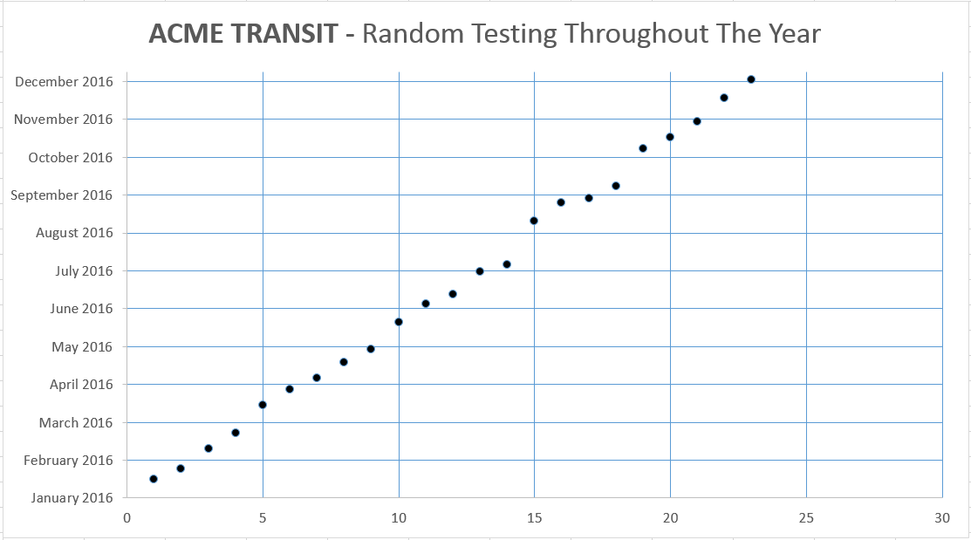
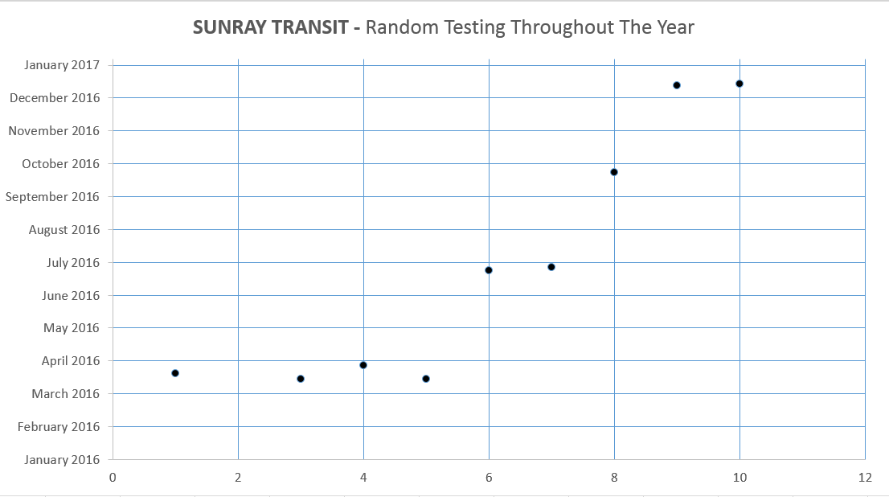

Slide 14
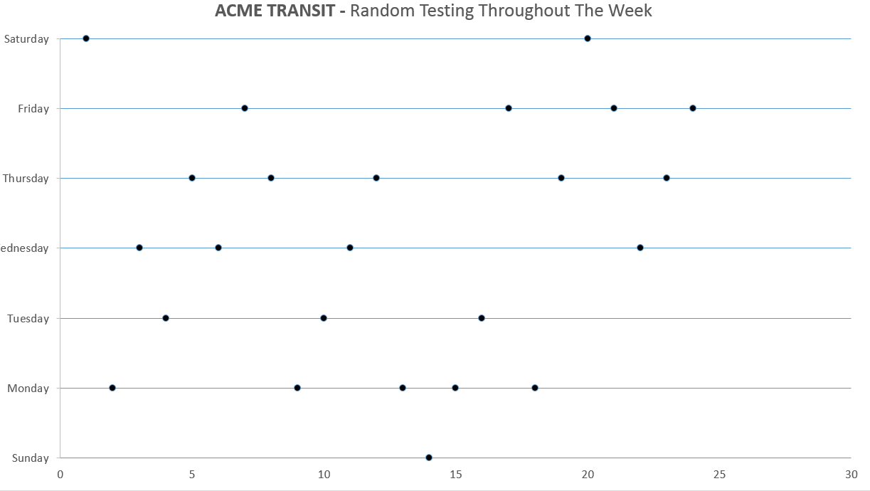
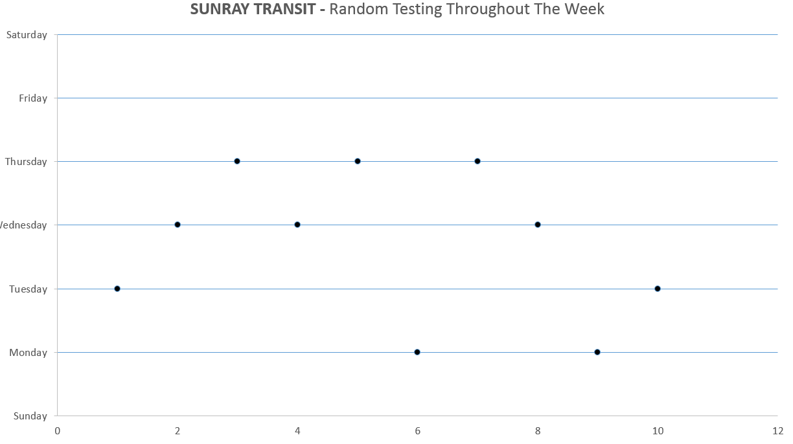

Slide 15
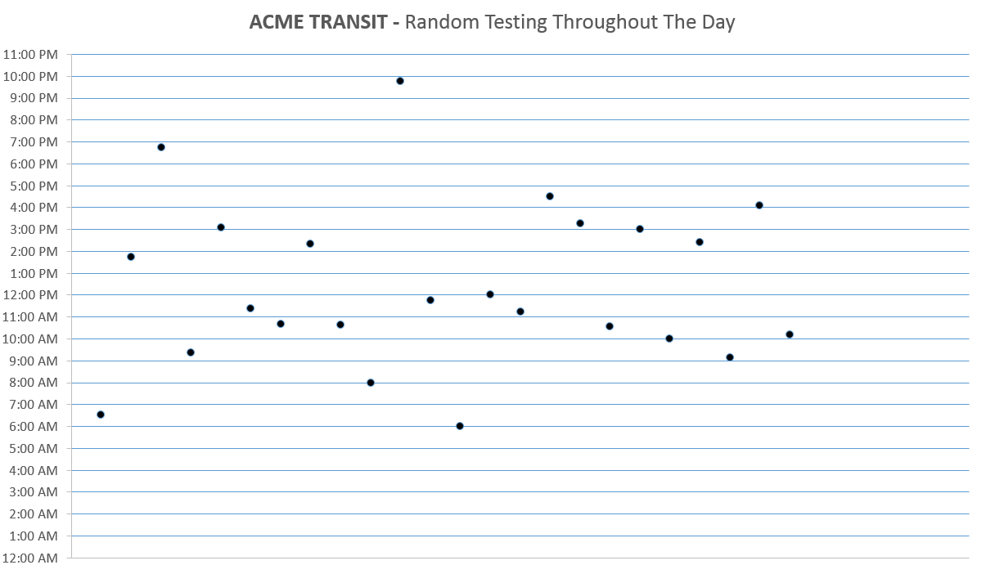
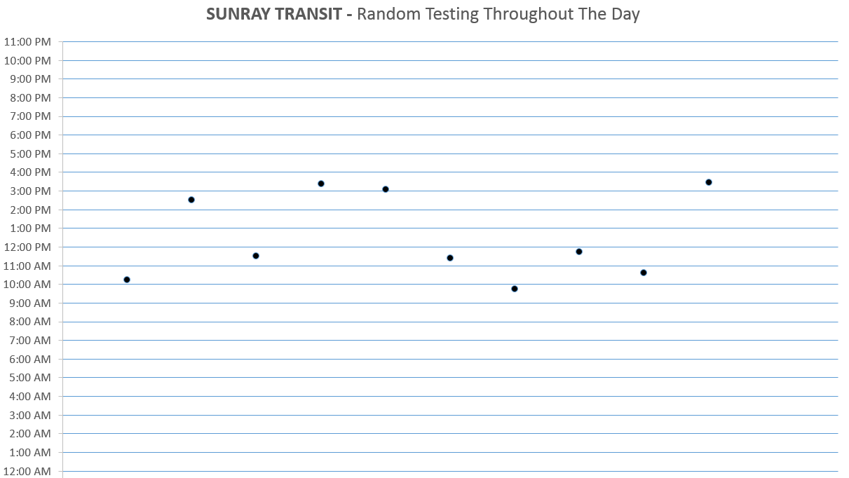
11:00 PM CLOSE
5:00 AM
OPEN
11:00 PM CLOSE
5:00 AM
OPEN

Slide 16
Marijuana Legalization
Continued Impacts on Transit Operations
Notes:
Accessibility Notes:
Remember to add Alt Text/ Captions to photos that are representative of what is happening in the image.
You can right click on the image and choose ‘View Alt Text”, or go to Review -> Check Accessibility -> Alt Text to add or have PPT generate Alt text
If you add jpgs/images of graphs or tables make sure the captions describe the graph/ table in detail. Include percentages, numbers and comparisons.
Best practice is to copy or import tables and graphs as Excel or Microsoft objects
Avoid using Smart Objects unless necessary, they require alt text just like images and can be difficult to edit
For text, make sure your color contrast passes the WCAG AA and that your text is no smaller than 16pts if possible. A contrast checker can be found at WebAIM: Contrast Checker

Slide 17
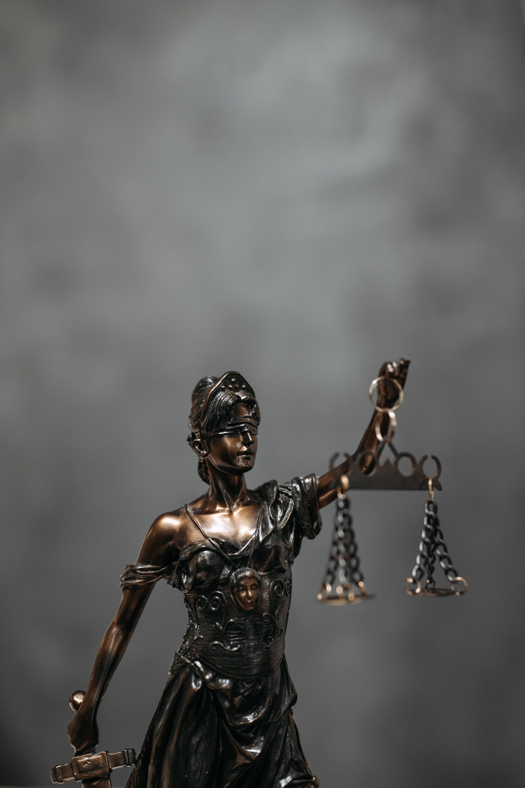
Federal vs. State
THC is still Federally illegal
  USDOT Test is a Federal Test
  THC use prohibited AT ALL TIMES for SS employees
“Prescription” / Medical recommendation for Marijuana
  Will NOT save anyone from a USDOT positive test result
  ** Some MROs don’t even know this!
Term - “Safety-Sensitive”
  Defined by USDOT/USDOT-Agency ONLY
Notes:
The bullets shown are representative to show that you must use different bullet types for each level of bullets. Also bulleted text is meant to be short and concise versus using long sentences or paragraphs in a slide format. (there may be certain exceptions for detailed technical information that needs to be conveyed. However whenever possible keep the text in the slide as minimal as possible and use the speaker notes section here for the details. When slides are shared, the speaker notes will be viewable by the reader.
Accessibility Notes:
Remember to add Alt Text/ Captions to photos that are representative of what is happening in the image.
You can right click on the image and choose ‘View Alt Text”, or go to Review -> Check Accessibility -> Alt Text to add or have PPT generate Alt text
If you add jpgs/images of graphs or tables make sure the captions describe the graph/ table in detail. Include percentages, numbers and comparisons.
Best practice is to copy or import tables and graphs as Excel or Microsoft objects
Avoid using Smart Objects unless necessary, they require alt text just like images and can be difficult to edit
For text, make sure your color contrast passes the WCAG AA and that your text is no smaller than 16pts if possible. A contrast checker can be found at WebAIM: Contrast Checker

Slide 18
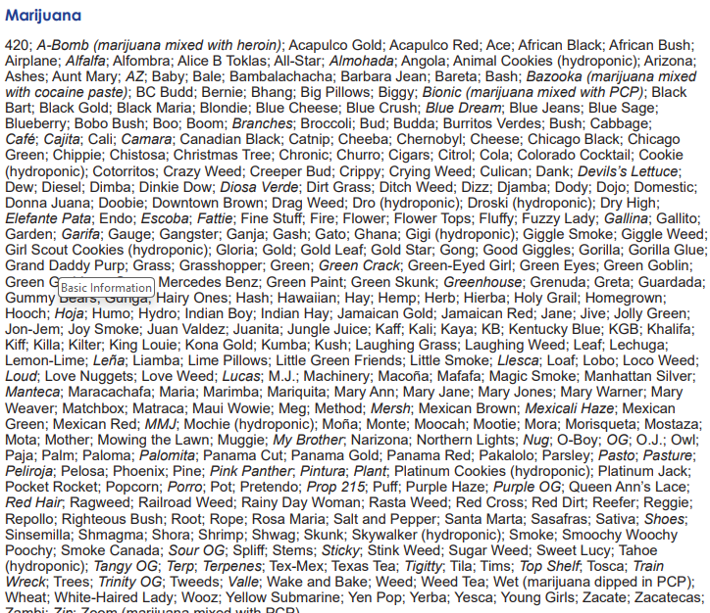
Notes:
The bullets shown are representative to show that you must use different bullet types for each level of bullets. Also bulleted text is meant to be short and concise versus using long sentences or paragraphs in a slide format. (there may be certain exceptions for detailed technical information that needs to be conveyed. However whenever possible keep the text in the slide as minimal as possible and use the speaker notes section here for the details. When slides are shared, the speaker notes will be viewable by the reader.
Accessibility Notes:
Remember to add Alt Text/ Captions to photos that are representative of what is happening in the image.
You can right click on the image and choose ‘View Alt Text”, or go to Review -> Check Accessibility -> Alt Text to add or have PPT generate Alt text
If you add jpgs/images of graphs or tables make sure the captions describe the graph/ table in detail. Include percentages, numbers and comparisons.
Best practice is to copy or import tables and graphs as Excel or Microsoft objects
Avoid using Smart Objects unless necessary, they require alt text just like images and can be difficult to edit
For text, make sure your color contrast passes the WCAG AA and that your text is no smaller than 16pts if possible. A contrast checker can be found at WebAIM: Contrast Checker

Slide 19
Basic Information – Common Names
Cannabis, Marijuana, Weed
Names Differ
Curious Observation
On and on and on and on …
Commercial industry continues to lean toward “Cannabis”
Demographic Differences
Geographic Differences
Product Type(s)
Increase in legalization = Decrease in “whacky names”
Notes:
The bullets shown are representative to show that you must use different bullet types for each level of bullets. Also bulleted text is meant to be short and concise versus using long sentences or paragraphs in a slide format. (there may be certain exceptions for detailed technical information that needs to be conveyed. However whenever possible keep the text in the slide as minimal as possible and use the speaker notes section here for the details. When slides are shared, the speaker notes will be viewable by the reader.
Accessibility Notes:
Remember to add Alt Text/ Captions to photos that are representative of what is happening in the image.
You can right click on the image and choose ‘View Alt Text”, or go to Review -> Check Accessibility -> Alt Text to add or have PPT generate Alt text
If you add jpgs/images of graphs or tables make sure the captions describe the graph/ table in detail. Include percentages, numbers and comparisons.
Best practice is to copy or import tables and graphs as Excel or Microsoft objects
Avoid using Smart Objects unless necessary, they require alt text just like images and can be difficult to edit
For text, make sure your color contrast passes the WCAG AA and that your text is no smaller than 16pts if possible. A contrast checker can be found at WebAIM: Contrast Checker

Slide 20
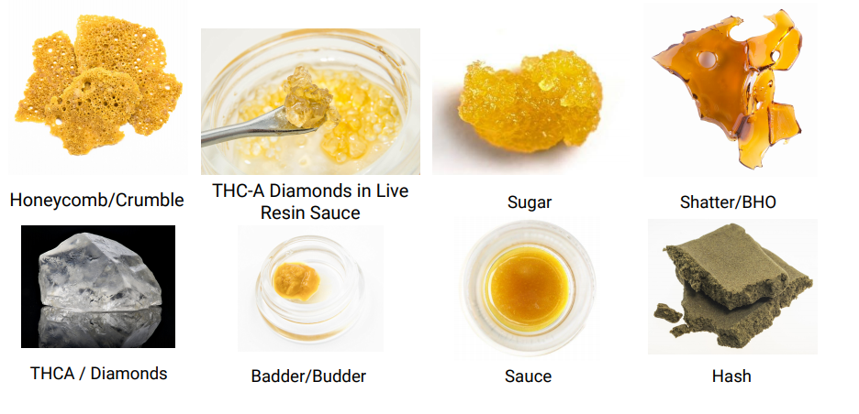
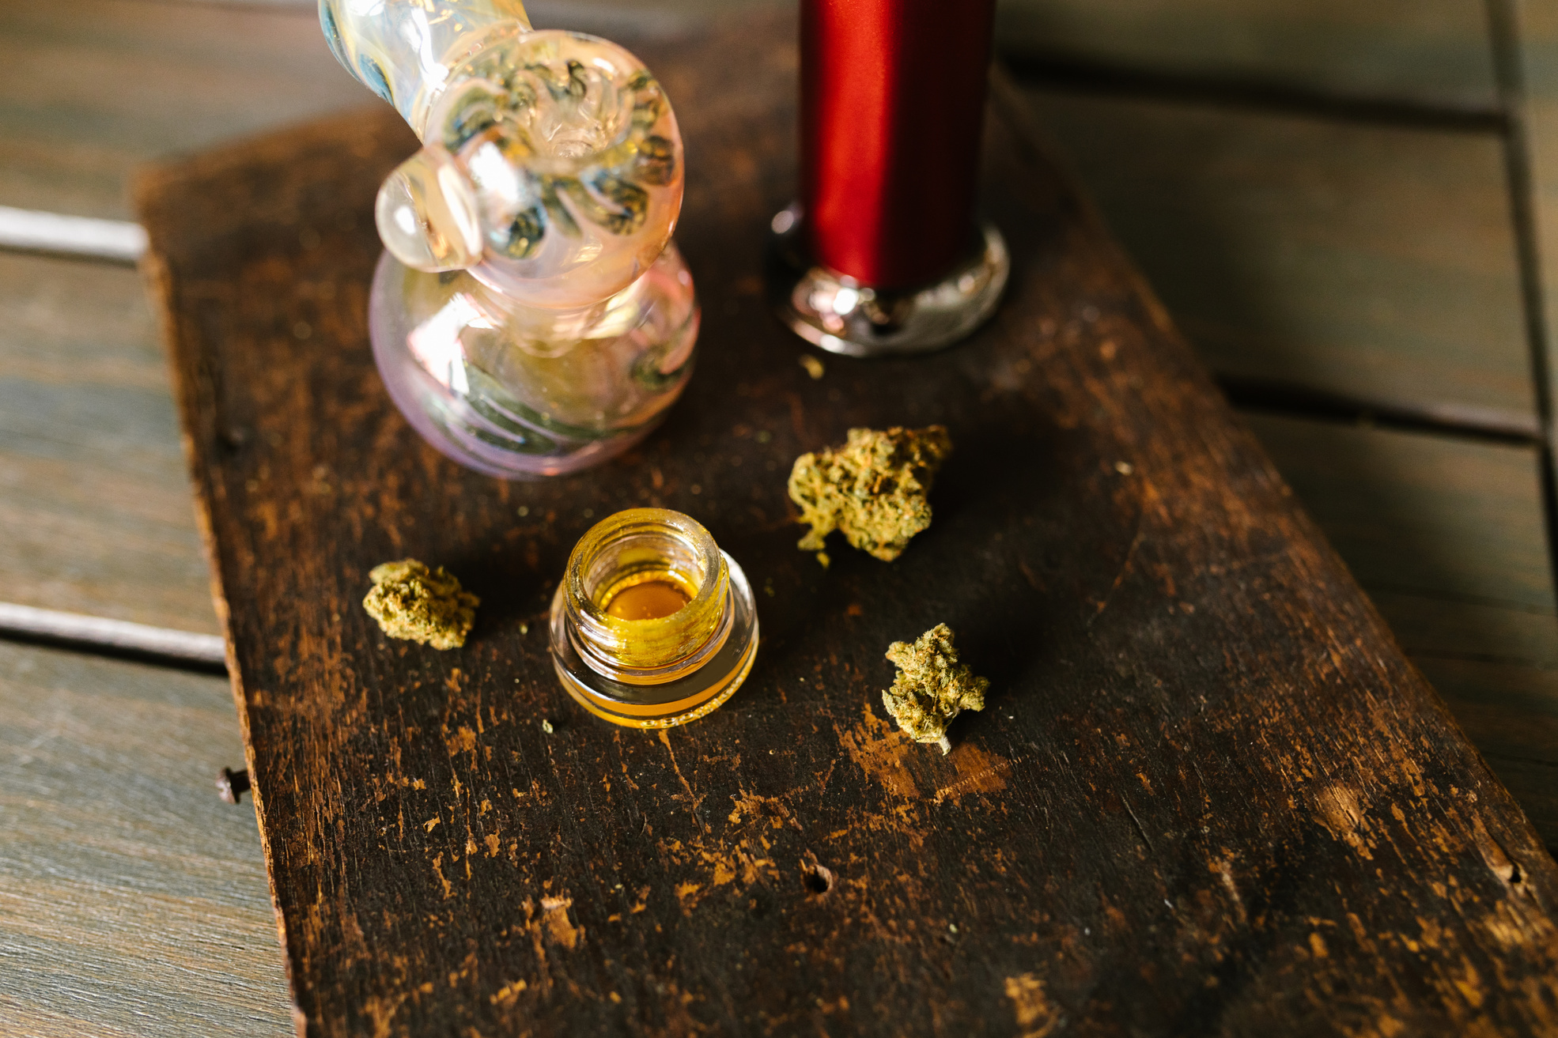
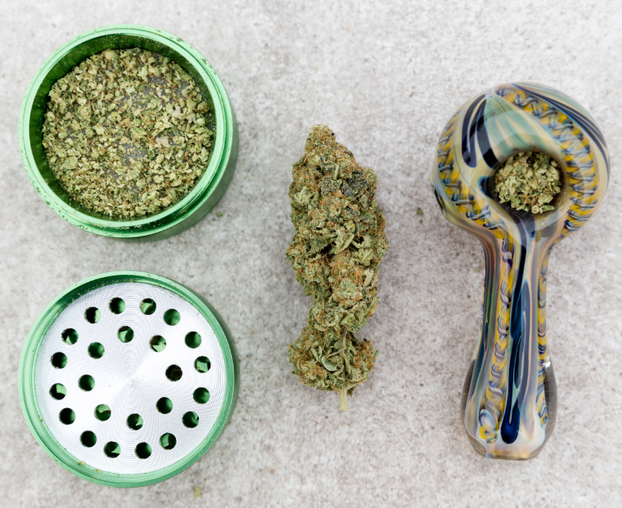
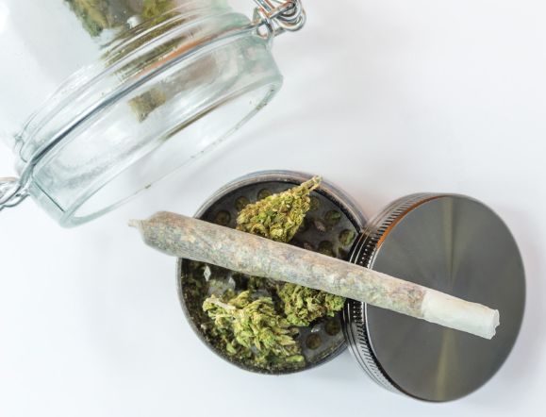

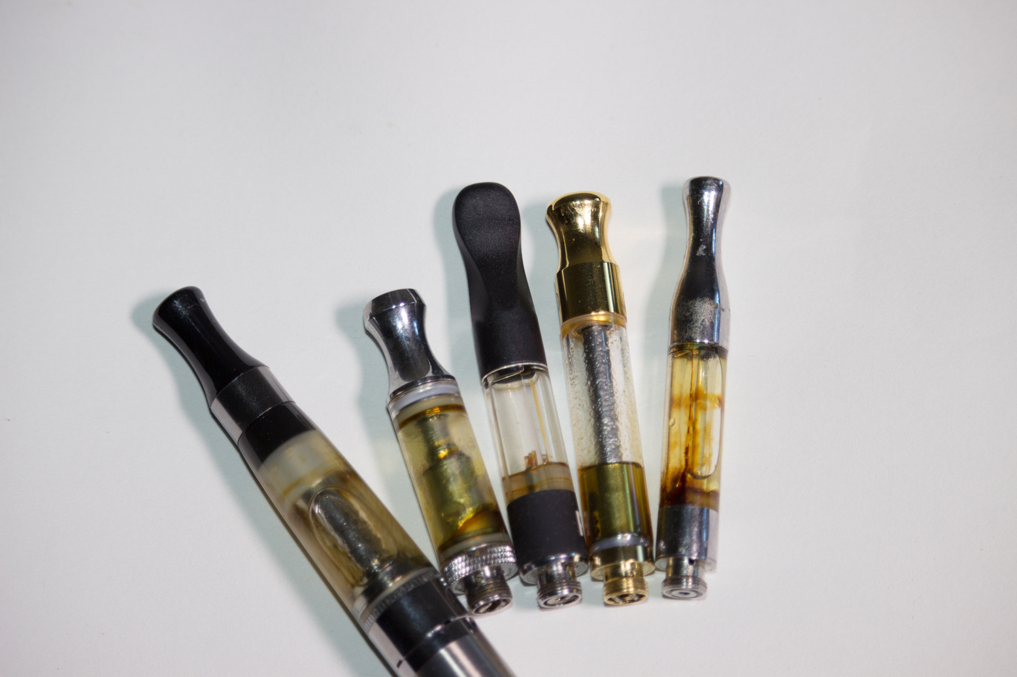
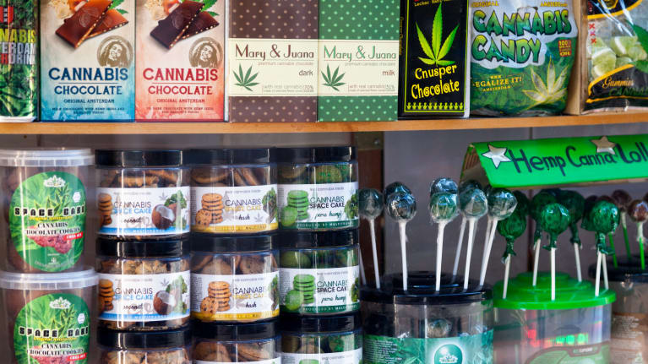
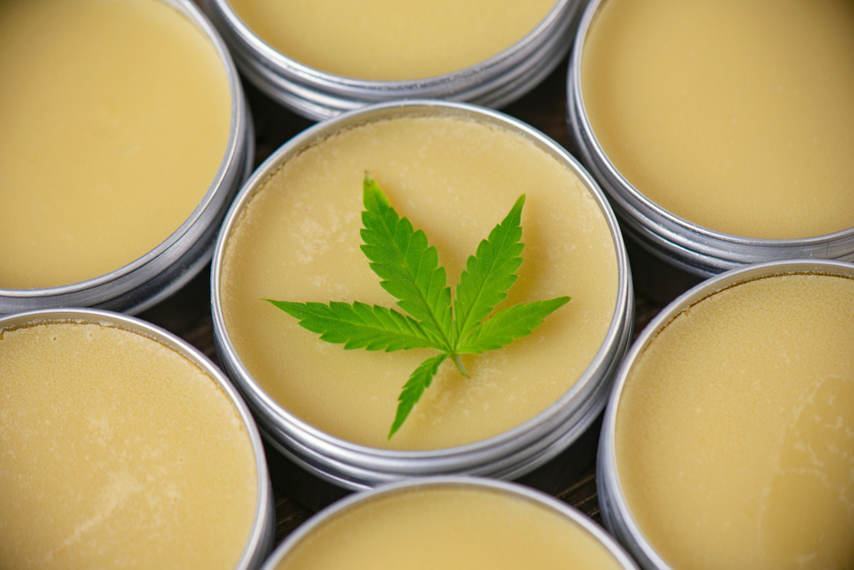
Pictures of various marijuana products
Notes:
Accessibility Notes:
Remember to add Alt Text/ Captions to photos that are representative of what is happening in the image.
You can right click on the image and choose ‘View Alt Text”, or go to Review -> Check Accessibility -> Alt Text to add or have PPT generate Alt text
If you add jpgs/images of graphs or tables make sure the captions describe the graph/ table in detail. Include percentages, numbers and comparisons.
Best practice is to copy or import tables and graphs as Excel or Microsoft objects
Avoid using Smart Objects unless necessary, they require alt text just like images and can be difficult to edit
For text, make sure your color contrast passes the WCAG AA and that your text is no smaller than 16pts if possible. A contrast checker can be found at WebAIM: Contrast Checker

Slide 21
Hemp vs Marijuana – A Legal Distinction
2018 Farm Bill
Hemp
Marijuana
Hemp removed from definition of “Marijuana”
Hemp removed from CSA Schedule I
Any cannabis plant, or derivative thereof that:
  Does not contain more than 0.3% delta-9 THC
Federally legal ONLY if produced consistent with 2018 Farm Bill
Trending Example:
  “hemp derived” THC Delta 9 Drinks
Anything* that isn’t “hemp”
Federally illegal
CSA Schedule I
Notes:
hemp and low-dose THC beverages
are nonalcoholic beverages infused with delta-9 THC derived from hemp, distinguishing them from traditional marijuana products. The 2018 Farm Bill legalized hemp and its derivatives, provided they contain no more than 0.3% THC on a dry weight basis. This legal gray area has led to a surge in products that can deliver psychoactive effects while being marketed alongside or as alternatives to alcohol.
Delta-9 THC is a psychoactive cannabinoid naturally found in cannabis. It is the primary intoxicating compound in state-regulated marijuana markets. The 2018 federal Farm Bill defined hemp as any cannabis plant or derivative with no more than 0.3% delta-9 THC on a dry-weight basis. The 0.3% THC threshold for hemp, which was intended to measure the THC concentration of the plant around the time of harvest, is being used in certain jurisdictions as the standard for THC concentration (on a wet-weight basis) in consumable hemp products. This can result in highly intoxicating beverages available in the marketplace.
U.S. Congress is debating whether to regulate intoxicating hemp products that many argue it unintentionally established by passing the 2018 Farm Bill. Unless or until the federal government steps in, expect more states to enact laws and regulations addressing THC-infused beverages.
California: The California Department of Alcoholic Beverage Control (ABC) has taken a strict stance on hemp beverages containing THC. On October 3, 2024, the ABC issued an industry advisory stating that alcohol licensed businesses may not carry, market, offer for sale, or sell any industrial hemp products intended for human consumption (including food, beverages, and dietary supplements) that contain a detectable amount of total THC or other intoxicating cannabinoids. Any businesses that do not comply will subject the licensee to disciplinary action. To date, the ABC has already begun enforcement efforts. Recently, ABC agents have been reported visiting licensed locations across the state and seizing hundreds of products from several licensees, removing them from shelves and preventing them from being sold.
Massachusetts: On May 30, 2024, the Massachusetts Alcoholic Beverages Control Commission (ABCC) issued an advisory in connection with the joint notice issued by the Massachusetts Department of Public Health (MDPH) and the Massachusetts Department of Agricultural Resources (MDAR) regarding the sale of beverages and food with hemp-derived cannabinoid extracts (CBD) or THC. The ABCC made clear that it is unlawful to manufacture and/or sell food or beverages containing CBD and/or THC. This applies to alcoholic and nonalcoholic beverages. Under the advisory, the ABCC directed that products need to be removed immediately, and anyone found in violation faces potential revocation or suspension of its license. The joint notice and advisory each make clear that they only apply to hemp-derived CBD and THC products and are separate from marijuana products regulated by the Massachusetts Cannabis Control Commission.
Minnesota: In contrast to California and Massachusetts, Minnesota explicitly allows the sale of hemp and low-dose THC beverages and provides a clear legal framework for businesses and consumers alike. Beverages can be sold in stores that register with the state prior to sale.
Missouri: In August 2024, an executive order was entered banning intoxicating hemp products in the state. The order threatened penalties for any establishment with a Missouri liquor license or that sells food products if they sold hemp-derived THC beverages. The ban also extended to companies producing these beverages in the state. The hemp industry quickly challenged the order by arguing that it was an overreach, and as a result, the regulators went back and limited the scope of the ban. Instead of embargoing products because they contained hemp-THC, regulators have focused on identifying “misbranded” products.
New Jersey: Recently, Senate Bill No. 3235 was signed temporarily banning the unlicensed sale of hemp products in New Jersey. The bill bans the sale of any hemp product containing more than 0.3% THC, including delta-9 THC. The bill also mandates that the products are regulated by the New Jersey Cannabis Regulatory Commission (NJCRC) and that manufacturers and retailers of these products must obtain a license from the NJCRC. Initially, the bill required that all intoxicating hemp products be pulled from store shelves until the NJCRC established new regulations. However, a federal judge recently issued a temporary reprieve, allowing these products to remain on shelves while the court reviews the case.
https://www.gmlaw.com/news/states-are-increasingly-regulating-hemp-derived-thc-infused-beverages/
https://www.alcohollawadvisor.com/2024/10/navigating-the-buzz-how-state-agencies-are-addressing-confusion-around-hemp-and-low-dose-thc-beverages/

Slide 22
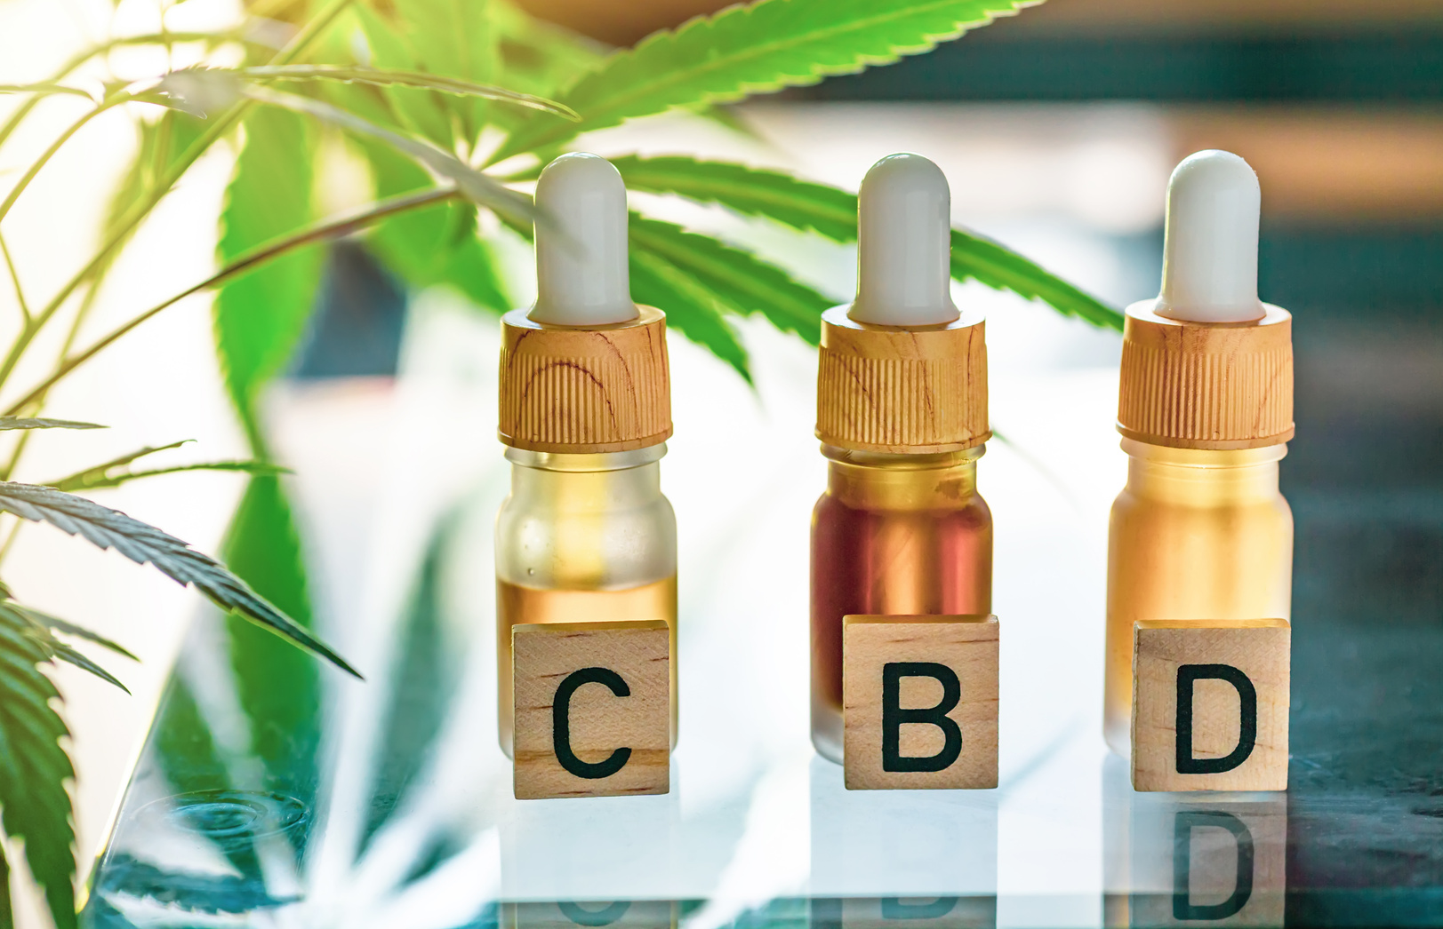
Cannabidiol (CBD) – What Is It?
Derived from cannabis plant
  Hemp derived to meet 2018 Farm Bill
  Could still be derived from non-hemp plant
It is not THC
  But may still contain THC
Many forms
  Oil is most popular
Often touted as “non-intoxicating/non-psychoactive”
Medical Uses
  Heavily studied
  Most significant and reliable research showing effectiveness for epilepsy
  But evidence shows many medical uses beyond epilepsy
  “Treat the symptoms” vs. “treat the issue”
Notes:
The bullets shown are representative to show that you must use different bullet types for each level of bullets. Also bulleted text is meant to be short and concise versus using long sentences or paragraphs in a slide format. (there may be certain exceptions for detailed technical information that needs to be conveyed. However whenever possible keep the text in the slide as minimal as possible and use the speaker notes section here for the details. When slides are shared, the speaker notes will be viewable by the reader.
Accessibility Notes:
Remember to add Alt Text/ Captions to photos that are representative of what is happening in the image.
You can right click on the image and choose ‘View Alt Text”, or go to Review -> Check Accessibility -> Alt Text to add or have PPT generate Alt text
If you add jpgs/images of graphs or tables make sure the captions describe the graph/ table in detail. Include percentages, numbers and comparisons.
Best practice is to copy or import tables and graphs as Excel or Microsoft objects
Avoid using Smart Objects unless necessary, they require alt text just like images and can be difficult to edit
For text, make sure your color contrast passes the WCAG AA and that your text is no smaller than 16pts if possible. A contrast checker can be found at WebAIM: Contrast Checker

Slide 23
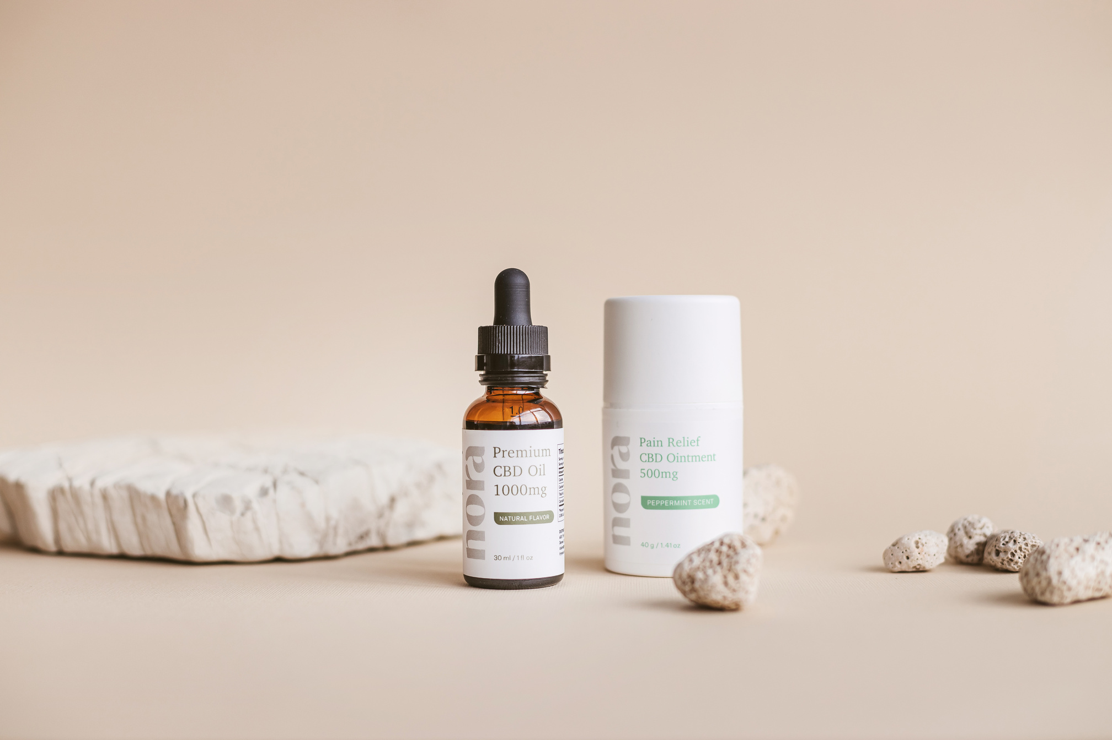
Cannabidiol (CBD) – What Is It?
“Research CBD” vs “Commercial CBD”
  Lots of claims from marketers
  Lack of consistent oversight/quality control
…. It is not a panacea
Who is verifying veracity of claims?
  FDA historically focused only on unsubstantiated claims of “curing” serious disease
Notes:
The bullets shown are representative to show that you must use different bullet types for each level of bullets. Also bulleted text is meant to be short and concise versus using long sentences or paragraphs in a slide format. (there may be certain exceptions for detailed technical information that needs to be conveyed. However whenever possible keep the text in the slide as minimal as possible and use the speaker notes section here for the details. When slides are shared, the speaker notes will be viewable by the reader.
Accessibility Notes:
Remember to add Alt Text/ Captions to photos that are representative of what is happening in the image.
You can right click on the image and choose ‘View Alt Text”, or go to Review -> Check Accessibility -> Alt Text to add or have PPT generate Alt text
If you add jpgs/images of graphs or tables make sure the captions describe the graph/ table in detail. Include percentages, numbers and comparisons.
Best practice is to copy or import tables and graphs as Excel or Microsoft objects
Avoid using Smart Objects unless necessary, they require alt text just like images and can be difficult to edit
For text, make sure your color contrast passes the WCAG AA and that your text is no smaller than 16pts if possible. A contrast checker can be found at WebAIM: Contrast Checker

Slide 24
CBD – “Will a USDOT Drug Test Find CBD?”
Technical Answer = NO
  USDOT tests for THC, not CBD
Perhaps a better question is to ask….
“So…. If I use CBD, will I test positive for THC?”
  Possible – Likelihood varies
  Some CBD products have high levels of THC
  Other products have 0.3% THC
  … How much CBD product do you use?
  … for how LONG
BOTTOM LINE
  Use of marijuana is prohibited at ALL times under USDOT – FTA
  If THC is found at/above cutoff levels, USDOT test will always be POSITIVE
  Source of THC is 100% irrelevant
Notes:
The bullets shown are representative to show that you must use different bullet types for each level of bullets. Also bulleted text is meant to be short and concise versus using long sentences or paragraphs in a slide format. (there may be certain exceptions for detailed technical information that needs to be conveyed. However whenever possible keep the text in the slide as minimal as possible and use the speaker notes section here for the details. When slides are shared, the speaker notes will be viewable by the reader.
Accessibility Notes:
Remember to add Alt Text/ Captions to photos that are representative of what is happening in the image.
You can right click on the image and choose ‘View Alt Text”, or go to Review -> Check Accessibility -> Alt Text to add or have PPT generate Alt text
If you add jpgs/images of graphs or tables make sure the captions describe the graph/ table in detail. Include percentages, numbers and comparisons.
Best practice is to copy or import tables and graphs as Excel or Microsoft objects
Avoid using Smart Objects unless necessary, they require alt text just like images and can be difficult to edit
For text, make sure your color contrast passes the WCAG AA and that your text is no smaller than 16pts if possible. A contrast checker can be found at WebAIM: Contrast Checker

Slide 25
Recreational vs. Medical vs. Decriminalized
Recreational
Medical
Decriminalized
What does “recreational” marijuana mean?
How many states have passed recreational marijuana laws?
  24, plus D.C., Guam, Northern Mariana Islands, USVI
What does “medical” marijuana mean?
How many states of passed recreational marijuana laws?
  38, plus Puerto Rico
What does “decriminalized” marijuana mean?
What about if Marijuana is “De-scheduled”? ….
  What does THAT even mean?
  CSA
  Big implications
  Status unknown

Slide 26
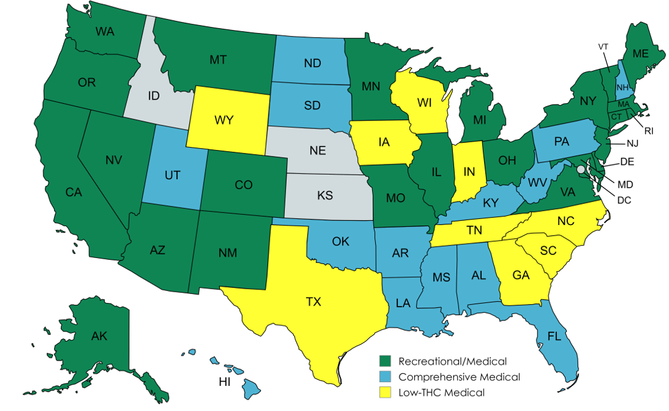
Recreational vs. Medical vs. Decriminalized
Notes:
Accessibility Notes:
Remember to add Alt Text/ Captions to photos that are representative of what is happening in the image.
You can right click on the image and choose ‘View Alt Text”, or go to Review -> Check Accessibility -> Alt Text to add or have PPT generate Alt text
If you add jpgs/images of graphs or tables make sure the captions describe the graph/ table in detail. Include percentages, numbers and comparisons.
Best practice is to copy or import tables and graphs as Excel or Microsoft objects
Avoid using Smart Objects unless necessary, they require alt text just like images and can be difficult to edit
For text, make sure your color contrast passes the WCAG AA and that your text is no smaller than 16pts if possible. A contrast checker can be found at WebAIM: Contrast Checker

Slide 27
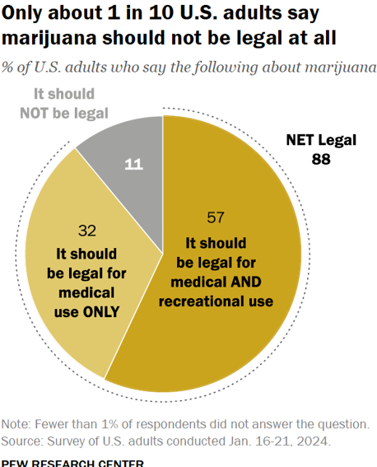
Public Opinion Trends – Legalizing Marijuana
Only ~1 in 10 U.S. adults say marijuana should not be legal at all
~32% say marijuana should be legal for medical use only
~57% say marijuana should be legal for both medical and recreational use
Notes:
The bullets shown are representative to show that you must use different bullet types for each level of bullets. Also bulleted text is meant to be short and concise versus using long sentences or paragraphs in a slide format. (there may be certain exceptions for detailed technical information that needs to be conveyed. However whenever possible keep the text in the slide as minimal as possible and use the speaker notes section here for the details. When slides are shared, the speaker notes will be viewable by the reader.
Accessibility Notes:
Remember to add Alt Text/ Captions to photos that are representative of what is happening in the image.
You can right click on the image and choose ‘View Alt Text”, or go to Review -> Check Accessibility -> Alt Text to add or have PPT generate Alt text
If you add jpgs/images of graphs or tables make sure the captions describe the graph/ table in detail. Include percentages, numbers and comparisons.
Best practice is to copy or import tables and graphs as Excel or Microsoft objects
Avoid using Smart Objects unless necessary, they require alt text just like images and can be difficult to edit
For text, make sure your color contrast passes the WCAG AA and that your text is no smaller than 16pts if possible. A contrast checker can be found at WebAIM: Contrast Checker

Slide 28
Percentage of Americans Living in a:
State w/ Recreational Marijuana | 54%
State w/ Either Recreational or Medical Marijuana | 74%
County w/ At Least 1 Cannabis Dispensary | 79%
Notes:
Table columns width may need to be adjusted when using more or fewer columns than shown. Text size may also need to be adjusted when changing the number of columns.
Accessibility Notes:
Remember to add Alt Text/ Captions to photos that are representative of what is happening in the image.
You can right click on the image and choose ‘View Alt Text”, or go to Review -> Check Accessibility -> Alt Text to add or have PPT generate Alt text
If you add jpgs/images of graphs or tables make sure the captions describe the graph/ table in detail. Include percentages, numbers and comparisons.
Best practice is to copy or import tables and graphs as Excel or Microsoft objects
Avoid using Smart Objects unless necessary, they require alt text just like images and can be difficult to edit
For text, make sure your color contrast passes the WCAG AA and that your text is no smaller than 16pts if possible. A contrast checker can be found at WebAIM: Contrast Checker

Slide 29


Presence vs. Impairment
 | ALCOHOL TEST | DRUG TEST
Presence
Impairment
Oral fluid drug testing will NOT change this!
Notes:
Accessibility Notes:
Remember to add Alt Text/ Captions to photos that are representative of what is happening in the image.
You can right click on the image and choose ‘View Alt Text”, or go to Review -> Check Accessibility -> Alt Text to add or have PPT generate Alt text
If you add jpgs/images of graphs or tables make sure the captions describe the graph/ table in detail. Include percentages, numbers and comparisons.
Best practice is to copy or import tables and graphs as Excel or Microsoft objects
Avoid using Smart Objects unless necessary, they require alt text just like images and can be difficult to edit
For text, make sure your color contrast passes the WCAG AA and that your text is no smaller than 16pts if possible. A contrast checker can be found at WebAIM: Contrast Checker

Slide 30

Presence vs. Impairment
USDOT tests for presence of drugs
  NOT IMPAIRMENT
  Make this UBUNDANTLY clear in your policies and in your employee training
  Employees have a responsibility to avoid inadvertent ingestion
Notes:
The bullets shown are representative to show that you must use different bullet types for each level of bullets. Also bulleted text is meant to be short and concise versus using long sentences or paragraphs in a slide format. (there may be certain exceptions for detailed technical information that needs to be conveyed. However whenever possible keep the text in the slide as minimal as possible and use the speaker notes section here for the details. When slides are shared, the speaker notes will be viewable by the reader.
Accessibility Notes:
Remember to add Alt Text/ Captions to photos that are representative of what is happening in the image.
You can right click on the image and choose ‘View Alt Text”, or go to Review -> Check Accessibility -> Alt Text to add or have PPT generate Alt text
If you add jpgs/images of graphs or tables make sure the captions describe the graph/ table in detail. Include percentages, numbers and comparisons.
Best practice is to copy or import tables and graphs as Excel or Microsoft objects
Avoid using Smart Objects unless necessary, they require alt text just like images and can be difficult to edit
For text, make sure your color contrast passes the WCAG AA and that your text is no smaller than 16pts if possible. A contrast checker can be found at WebAIM: Contrast Checker

Slide 31

Employer Policy Choices
Zero Tolerance vs. 2nd Chance
  Driver shortages
  Shift in understanding of addiction issues
  State employment laws
  No matter what… MUST FOLLOW YOUR POLICY!
THC positive tests
  Difference discipline for THC vs. other drugs?
  Medical vs. Recreational?
  Union negotiation point?
Notes:
The bullets shown are representative to show that you must use different bullet types for each level of bullets. Also bulleted text is meant to be short and concise versus using long sentences or paragraphs in a slide format. (there may be certain exceptions for detailed technical information that needs to be conveyed. However whenever possible keep the text in the slide as minimal as possible and use the speaker notes section here for the details. When slides are shared, the speaker notes will be viewable by the reader.
Accessibility Notes:
Remember to add Alt Text/ Captions to photos that are representative of what is happening in the image.
You can right click on the image and choose ‘View Alt Text”, or go to Review -> Check Accessibility -> Alt Text to add or have PPT generate Alt text
If you add jpgs/images of graphs or tables make sure the captions describe the graph/ table in detail. Include percentages, numbers and comparisons.
Best practice is to copy or import tables and graphs as Excel or Microsoft objects
Avoid using Smart Objects unless necessary, they require alt text just like images and can be difficult to edit
For text, make sure your color contrast passes the WCAG AA and that your text is no smaller than 16pts if possible. A contrast checker can be found at WebAIM: Contrast Checker

Slide 32

Passive Exposure
“Can someone test positive for THC from secondhand smoke (aka Passive Exposure)?”
  Yes, but unlikely
  Even with today’s increased THC levels
  USDOT tests have “cutoff” levels that are established (in part) for this reason
Notes:
The bullets shown are representative to show that you must use different bullet types for each level of bullets. Also bulleted text is meant to be short and concise versus using long sentences or paragraphs in a slide format. (there may be certain exceptions for detailed technical information that needs to be conveyed. However whenever possible keep the text in the slide as minimal as possible and use the speaker notes section here for the details. When slides are shared, the speaker notes will be viewable by the reader.
Accessibility Notes:
Remember to add Alt Text/ Captions to photos that are representative of what is happening in the image.
You can right click on the image and choose ‘View Alt Text”, or go to Review -> Check Accessibility -> Alt Text to add or have PPT generate Alt text
If you add jpgs/images of graphs or tables make sure the captions describe the graph/ table in detail. Include percentages, numbers and comparisons.
Best practice is to copy or import tables and graphs as Excel or Microsoft objects
Avoid using Smart Objects unless necessary, they require alt text just like images and can be difficult to edit
For text, make sure your color contrast passes the WCAG AA and that your text is no smaller than 16pts if possible. A contrast checker can be found at WebAIM: Contrast Checker

Slide 33

Workplace Training
Make sure your training is covering:
  State marijuana laws and associated impacts
  THC vs CBD; Hemp Derived THC infused products
    Federal, State, Employer, Personal Health
  Drug testing: Impairment vs. Presence
  Passive Exposures
  Passenger Trips/Possession on Transit Vehicles
ENHANCE YOUR REASONABLE SUSPICION TRAINING!!!!!!
  Don’t just do it for the “Check in the box”
  Seek new training for refresher classes
  Focus on “fitness for duty” & safety issues
Notes:
The bullets shown are representative to show that you must use different bullet types for each level of bullets. Also bulleted text is meant to be short and concise versus using long sentences or paragraphs in a slide format. (there may be certain exceptions for detailed technical information that needs to be conveyed. However whenever possible keep the text in the slide as minimal as possible and use the speaker notes section here for the details. When slides are shared, the speaker notes will be viewable by the reader.
Accessibility Notes:
Remember to add Alt Text/ Captions to photos that are representative of what is happening in the image.
You can right click on the image and choose ‘View Alt Text”, or go to Review -> Check Accessibility -> Alt Text to add or have PPT generate Alt text
If you add jpgs/images of graphs or tables make sure the captions describe the graph/ table in detail. Include percentages, numbers and comparisons.
Best practice is to copy or import tables and graphs as Excel or Microsoft objects
Avoid using Smart Objects unless necessary, they require alt text just like images and can be difficult to edit
For text, make sure your color contrast passes the WCAG AA and that your text is no smaller than 16pts if possible. A contrast checker can be found at WebAIM: Contrast Checker

Slide 34

Federal Resources
DOT “Medical Marijuana” Notice
DOT “Recreational Marijuana” Notice
DOT “CBD” Notice
FTA Drug & Alcohol Newsletters (By Topic)
  Issue #77 – DOT does not authorize the use of marijuana
  Issue #75 – State/Local legislation; CBD is not regulated & may generate THC positive
  Issue #55 – Rise of use of marijuana by safety-sensitive employees
  Issue #52 – Keynote speaker stresses DOT’s position on marijuana
  Issue #51 – Marijuana Class I appeal
  Issue #49 – USDOT stance on medical marijuana
Notes:
The bullets shown are representative to show that you must use different bullet types for each level of bullets. Also bulleted text is meant to be short and concise versus using long sentences or paragraphs in a slide format. (there may be certain exceptions for detailed technical information that needs to be conveyed. However whenever possible keep the text in the slide as minimal as possible and use the speaker notes section here for the details. When slides are shared, the speaker notes will be viewable by the reader.
Accessibility Notes:
Remember to add Alt Text/ Captions to photos that are representative of what is happening in the image.
You can right click on the image and choose ‘View Alt Text”, or go to Review -> Check Accessibility -> Alt Text to add or have PPT generate Alt text
If you add jpgs/images of graphs or tables make sure the captions describe the graph/ table in detail. Include percentages, numbers and comparisons.
Best practice is to copy or import tables and graphs as Excel or Microsoft objects
Avoid using Smart Objects unless necessary, they require alt text just like images and can be difficult to edit
For text, make sure your color contrast passes the WCAG AA and that your text is no smaller than 16pts if possible. A contrast checker can be found at WebAIM: Contrast Checker

Slide 35
Oral Fluid Drug Testing
Where Do We Stand?
Notes:
Accessibility Notes:
Remember to add Alt Text/ Captions to photos that are representative of what is happening in the image.
You can right click on the image and choose ‘View Alt Text”, or go to Review -> Check Accessibility -> Alt Text to add or have PPT generate Alt text
If you add jpgs/images of graphs or tables make sure the captions describe the graph/ table in detail. Include percentages, numbers and comparisons.
Best practice is to copy or import tables and graphs as Excel or Microsoft objects
Avoid using Smart Objects unless necessary, they require alt text just like images and can be difficult to edit
For text, make sure your color contrast passes the WCAG AA and that your text is no smaller than 16pts if possible. A contrast checker can be found at WebAIM: Contrast Checker

Slide 36
Oral Fluid Drug Testing: Part 40 Update
The What
The Why
The When
49 CFR Part 40 is USDOT’s D&A regulation covering testing procedures
“OTETA” requires DOT is to align with DHHS drug testing rules
DHHS published updated final rule for oral fluid testing in 2019
Part 40 had to be updated to align with DHHS changes
Feb 2022 – USDOT issued NPRM
May 02, 2023 – Final rule (Part 40) published in Federal Register
June 1, 2023 – Effective date for all changes
Legal Quagmire

Slide 37
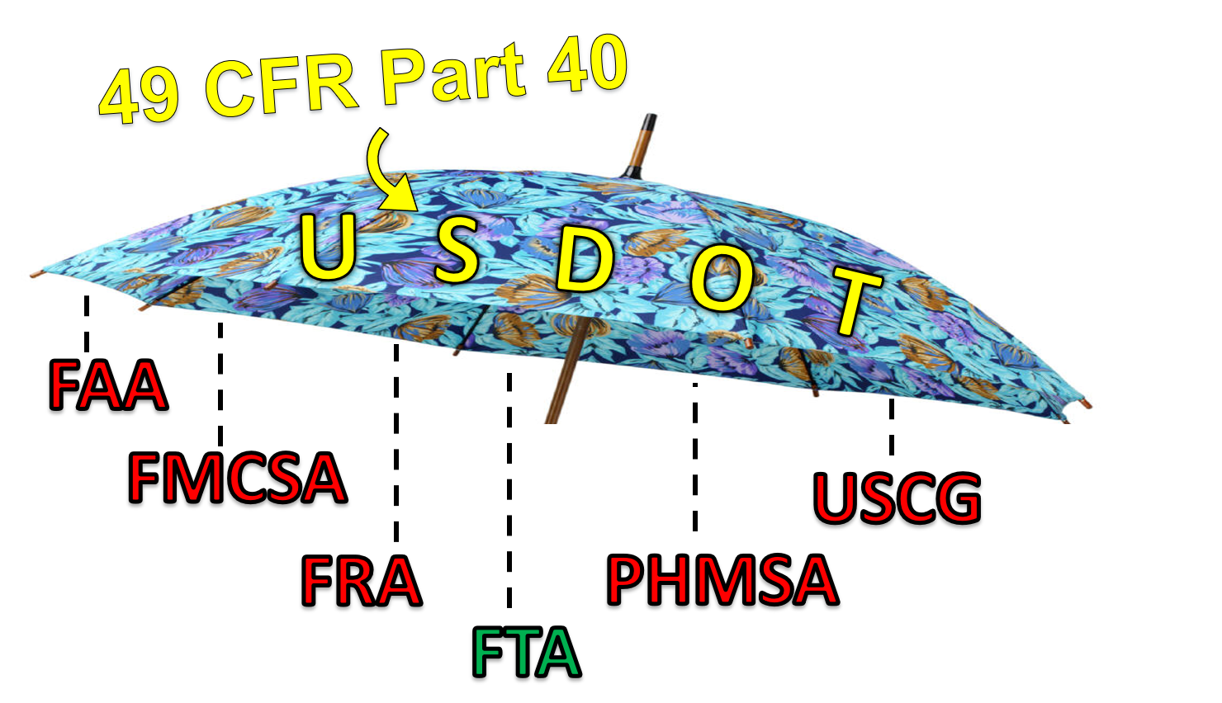

Slide 38
Oral Fluid Drug Testing: Part 40 Update
The Headline
Can You Start Oral Fluid Testing?
Highlights
ORAL FLUID DRUG TESTING
Permitted as alternative* to urine drug testing
Time to result likely won’t be much different than urine tests
NO!
DHHS must first approve 2 labs
Why 2 labs?
…. We’re all still waiting
Employer chooses test specimen type
Employers will want to establish a “standing order”
All oral fluid collections are considered “directly observed”

Slide 39
Oral Fluid Drug Testing: Part 40 Update
What Does This Mean For Employers?
What Does This Mean For Employers?
What Does This Mean for EMPLOYEES?
Decide which specimen type(s) you want to utilize once available
Tests requiring “subsequent collections” like shy bladder, dry mouth, temp out of range, etc.
Collectors will need to obtain training specific to oral fluid collections
Employer should retain copies of training certificates
Vital for DERs/DAPMs to be immediately available to collectors during test
May be subject to either urine or oral fluid collection in future
Some tests can start as one specimen type and switch to another
Make it clear that it is employer’s decision

Slide 40
Can You Train Transit Staff to Be Collectors?
Pros | Cons
Ease of scheduling | Conflicts of interest
Gets EEs back to duty faster | Lack of interest/comfort from staff to be collectors
Quality control | Invasion of privacy
Ease of access | Lack of professional experience
Less wait time | EE turnover in collector position
Less predictable testing patterns | Staff burden / retention concerns
May by only option for remote areas | Insurance & other employment implications
 | Union challenges

Slide 41
Thank you!
Sean K. Oswald, RLS & Associates, Inc.
Chief of Operations | Director of Drug & Alcohol Initiatives
937-299-5007
soswald@rlsandassoc.com

