Slide 1

You’re Not Alone: Where to Turn for System Support
Suzanne Watson, Executive Director, Western Iowa Services Collaborative
May 2, 2026

Slide 2
Overview
Disability Services System
DAP Service Overview
Disability Access Points
Questions

Slide 3
Disability Services System
Annie Uetz

Slide 4
Disability Services: Disability Access Points
Service Navigation
Short-Term Options Counseling and Services
Caregiver Support
Service Coordination of LTSS

Slide 5
Key Transition Areas of Focus
Warm hand offs for Service Coordination of LTSS
Provider Communication and Training
Engagement and outreach to community and stakeholders about existing and transitioning network
Supporting a shift to statewide consistency for accessing services

Slide 6
DAP Service Overview

Slide 7
Navigation: No-wrong door
Reliable and Trusted Information and Referral
Connection to Services and Resources through warm hand-offs
Person-centered Decision-making support

Slide 8
Short-term Services and Supports
Time-limited activities
Support people to live in the home and community of their choice
Integrated manner and offering support to their families and caregivers as needed toward this purpose

Slide 9
Short-Term Services & Supports
Individual Assessment and Evaluation
Transportation
Respite
Peer and Parent Support
Time-limited Rental Assistance
Home and Vehicle Modifications
Adaptive Equipment
Other Basic Needs

Slide 10
Service Coordination of Safety Net LTSS
Longer term support and coordination
Support people to live in the home and community of their choice
Support return to community and facility diversion

Slide 11
Safety-Net Long-Term Services & Supports
Supported Community Living (SCL)
Day Habilitation
Facility-Based Residential Programs
Medical Services and Supplies
Personal Emergency Response Systems
Supported Employment
Respite
Prevocational Services

Slide 12
Disability Access Points

Slide 13

Where Help Meets Hope

Slide 14
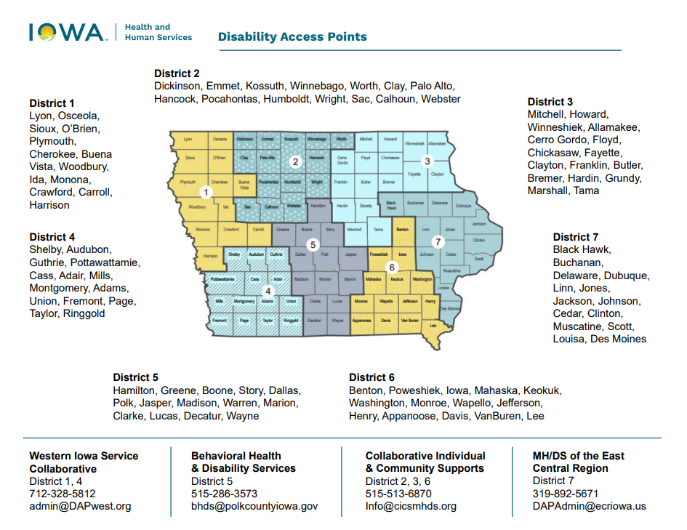
Disability Access Point Map

Slide 15
Don’t Know Where to Start?
That’s ok. Simply email at information@iowacompass.org or call 1-800-779-2001. Team members at Iowa Compass will help answer your questions and connect you with available services.

Slide 16
District 1
Suzanne Watson
Western Iowa Services Collaborative

Slide 17

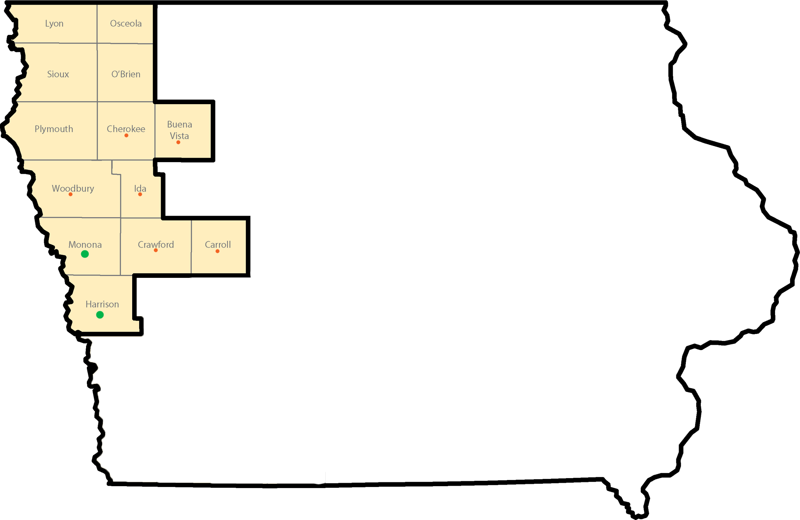
District 1 – Western Iowa Services Collaborative

Slide 18
District 1 Community Access Locations
PottIA.Gov/DAPwest
Location | Address | Date/Hours
Pride Group HCBS office | 218 W Bluffs St. Cherokee, IA | 1st Friday 9:00 am to 1:00 pm
Connections AAA | 2301 Pierce St. Sioux City, IA | 2nd Monday & 3rd Thursday 9:00 am to 2:00 pm
WESCO | 415 South 11th St. Denison, IA | 3rd Thursday 9:00 am to 1:00 pm
Missouri Valley Elementary School | Missouri Valley, IA 602 N 9th St. | Last Wednesday 9:00 am to 1:00 pm
Updated Locations posted: pottia.gov/DAPwest

Slide 19
District 1 Community Access Locations
PottIA.Gov/DAPwest
Location | Address | Date/Hours
LeMars Public Library | 46 First St. SW LeMars, IA | 1st Friday 9:00 am to 1:00 pm
Storm Lake Public Library | 609 Cayuga St. Storm Lake, IA | 2nd Tuesday 9:00 am to 12:30 pm
Burgess Health Center | 1600 Diamond St. Onawa, IA | Last Friday 9:00 am to 12:00 pm
Burgess Wellness Center | 111 South 5th St. Mapleton, IA | Last Friday 1:00 pm to 3:30 pm
Updated Locations posted: pottia.gov/DAPwest

Slide 20
District 1 Disability Service Advisory Council
Six of Thirteen Counties Represented
Buena Vista
Crawford - 2
Harrison
O’Brien
Plymouth - 2
Woodbury - 2
Shaping policy
Improving communication
Ensuring real community needs are discussed
Nine Members
6 - Caregivers of Individuals with Lived-Experience
3 – Disability Service providers

Slide 21
District 2
Russell Wood
Collaborative Individual and Community Supports

Slide 22
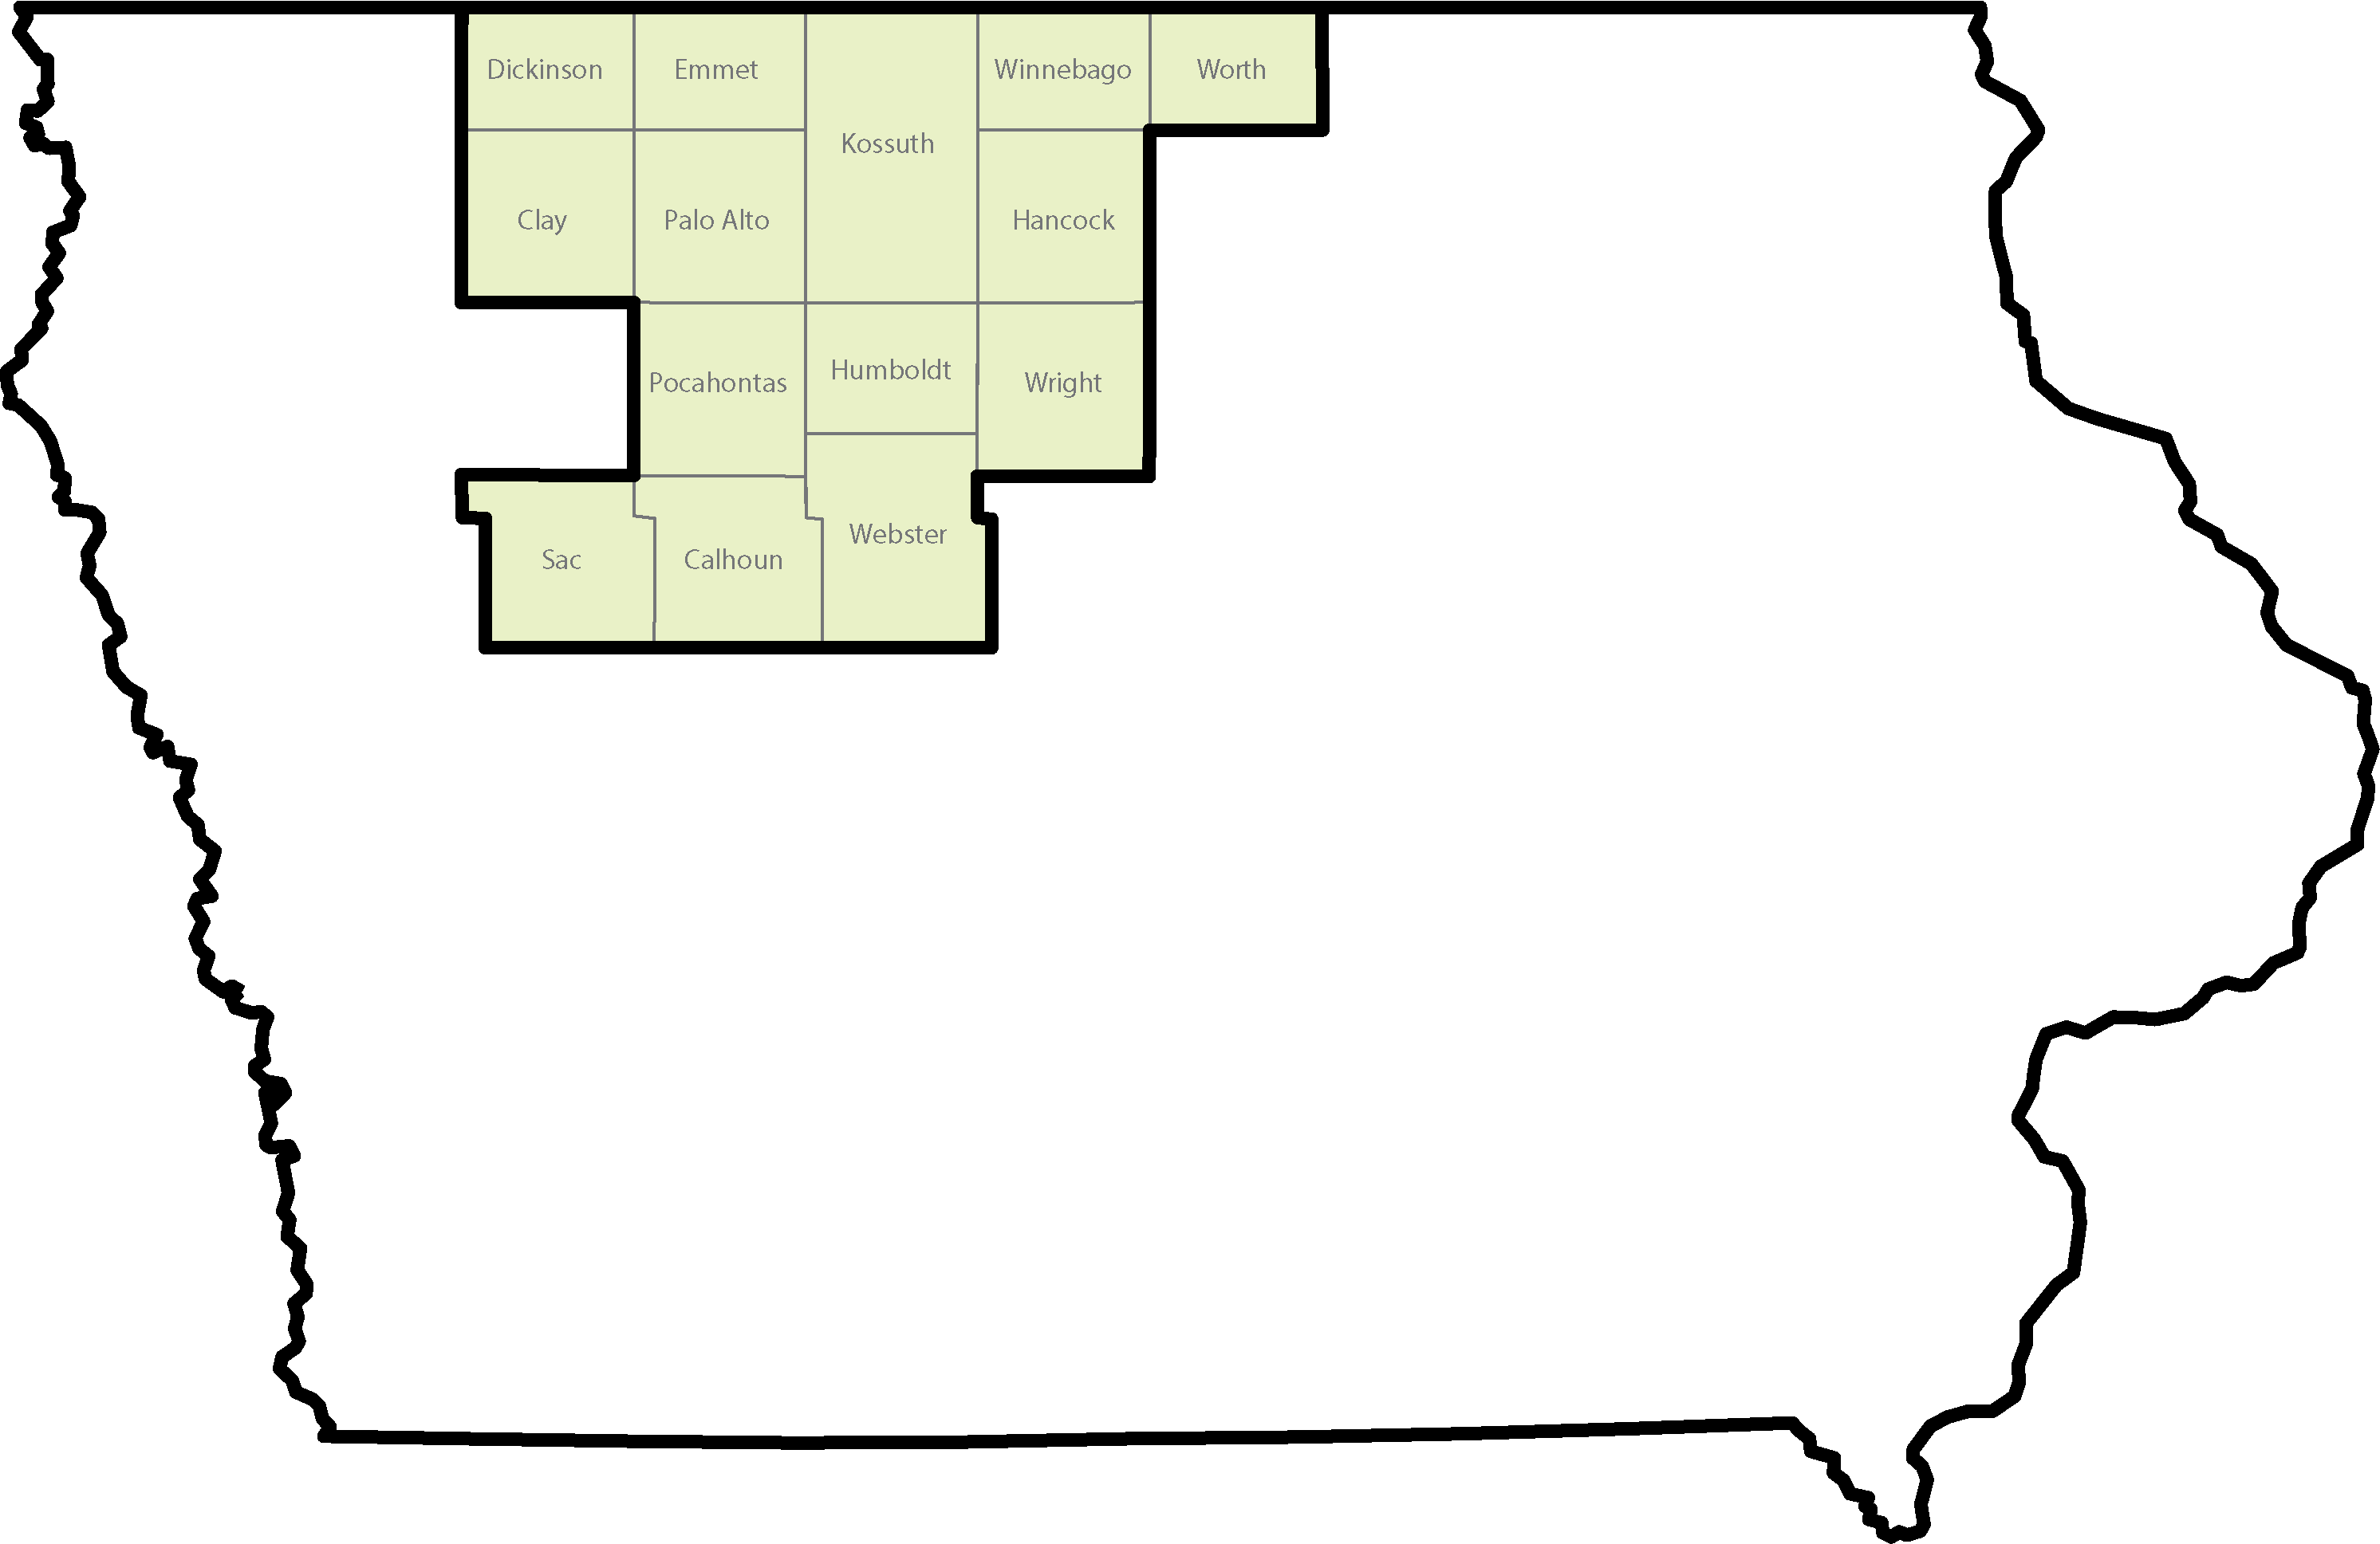

District 2 Collaborative Individual & Community Services ADRC DAP

Slide 23
District 2 Office Locations
Hours may vary depending on meetings with clients
info@cicsmhds.org
Location | Address | Days
Prairie Ridge 515-416-6904 | 117 East Call Street Algona | 3rd Wednesday of the month
Wright County Connections 515-955-1719 | 215 N Main St. Clarion | 4th Friday of the month
Humboldt Co. Courthouse 515-416-6904 | 203 Main St. Dakota City | 2nd Thursday of the month
Emmetsburg Public Library 515-766-4332 | 707 N Superior St. Emmetsburg | 1st Friday of the month
Estherville Public Library 515-766-4332 | 613 Central Ave. Estherville | 1st Thursday of the month
Prairie Ridge 515-663-2941 | 138 N Clark St. Forest City | 2nd Wednesday of the month
Elderbridge AAA 515-416-6904 | 308 Central Ave., Ste. C Fort Dodge | Monday-Friday, except for 2nd Thursday and 3rd Wednesday

Slide 24
District 2 Office Locations
Hours may vary depending on meetings with clients
info@cicsmhds.org
Location | Address | Days
Duncan Heights 515-663-2948 | 236 State St. Garner | 1st Tuesday of the month
Worth County Public Health 515-663-2941 | 95 9th St. N Northwood | 3rd Thursday of the month
City Hall 515-955-1719 | 100 E Elm Ave. Pocahontas | 1st Friday of the month
Annex Building 515-955-1719 | 515 Court St. Rockwell City | 1st and 3rd Tuesdays of the month
Sac Public Library 515-955-1719 | 1001 W Main St. Sac City | 4th Monday of the month
Elderbridge AAA 515-766-4322 | 714 10th Ave. E Spencer | Monday-Friday except for 1st week of the month
Spirit Lake Public Library 515-766-4322 | 702 16th St. Spirit Lake | 1st Tuesday of the month

Slide 25
District 2 Disability Service Advisory Council
Nine of Fourteen
Counties Represented
Calhoun
Clay
Dickinson
Hancock
Humboldt
Kossuth
Webster
Winnebago
Worth
Nine Members
Individuals with Lived-Experience
Caregivers
Providers
Shaping policy
Improving communication
Ensuring real community needs are discussed

Slide 26
District 3
Russell Wood
Collaborative Individual & Community Supports

Slide 27
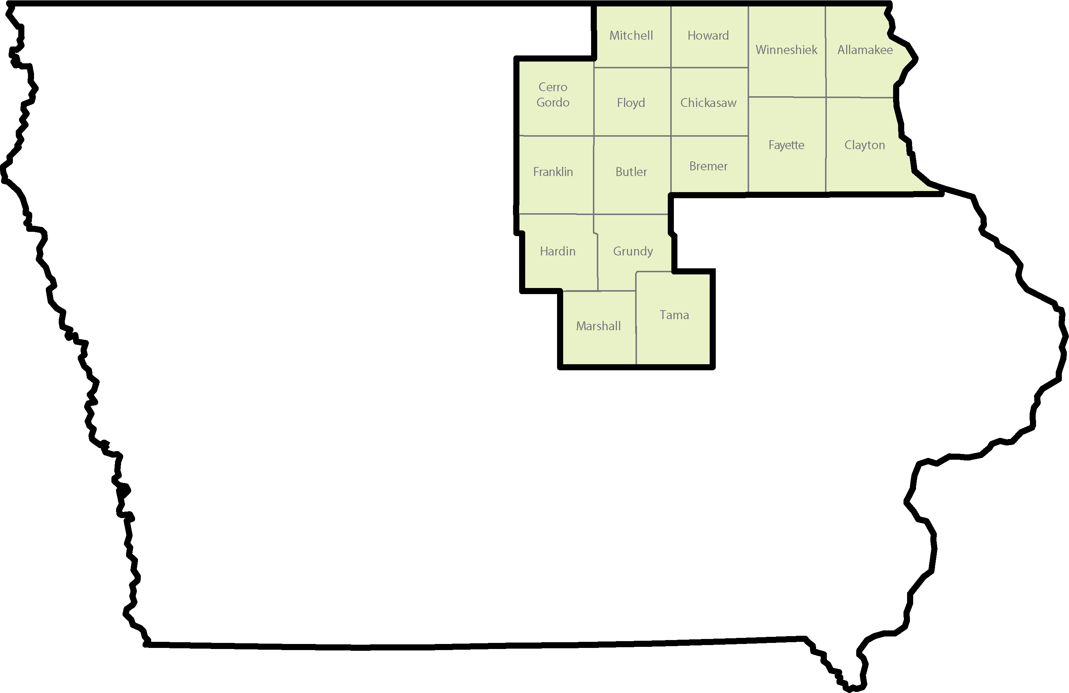
District 3 Collaborative Individual & Community Services ADRC DAP

Slide 28
District 3 Office Locations
Hours may vary depending on meetings with clients
info@cicsmhds.org
Location | Address | Days
Pathways 515-416-6399 | 315 N Main St. Allison | 1st Thursday of the month
Floyd County Courthouse 515-663-2948 | 101 S Main St. Charles City | Fridays
Howard Co. Public Service 641-715-7731 | 205 2nd St. E Cresco | 1st Monday of the month
NEI3A 641-715-7731 | 915 Short St., Ste. 169 Decorah | Monday-Friday except 1st Mon., 2nd Wed., 3rd Thursday
Clayton Co. General Relief 641-715-7731 | 600 Gunder Rd., Ste. 6 Elkader | 3rd Thursday of the month
Annex Building 641-754-6390 | 706 H Ave., Ste. 2 Grundy Center | 2nd Thursday of the month
Community Resource Center 515-416-6399 | 123 1st Ave. SW Hampton | Monday-Friday except 1st Tue., Wed, and Thursday
Friendship Club 515-416-6399 | 602 S. Oak St. Iowa Falls | 1st Tuesday of the month

Slide 29
District 3 Office Locations
Hours may vary depending on meetings with clients
info@cicsmhds.org
Location | Address | Days
Prairie Ridge 641-754-6390 | 9 N 4th Ave. Marshalltown | Monday, Wednesday, Thursday, Friday except 2nd Thursday
Elderbridge AAA 515-663-2941 or 515-663-2948 | 1190 Briarstone Dr. Mason City | Monday-Thursday
Heritage Center 515-663-2948 | 2275 S Linn Ave. New Hampton | 2nd and 4th Thursday
Oelwein VA 641-715-7731 | 901 N Frederick Ave. Oelwein | 4th Tuesday of the month
Mitchell Co. Public Health 515-663-2941 | 415 Pleasant St. Osage | Fridays
Prairie Ridge 641-754-6390 | 413 McClellan St. Tama | Tuesdays
MOSAIC 641-715-7731 | 17 Allamakee St. Waukon | 2nd Wednesday of the month
Pathways 515-416-6399 | 111 10th St. Waverly | 1st Wednesday of the month

Slide 30
District 3 Disability Service Advisory Council
Nine Members
Individuals with Lived-Experience
Caregivers
Providers
Six of Sixteen
Counties Represented
Bremer
Cerro Gordo
Fayette
Franklin
Marshall
Tama
Shaping policy
Improving communication
Ensuring real community needs are discussed

Slide 31
District 4
Suzanne Watson
Western Iowa Services Collaborative

Slide 32
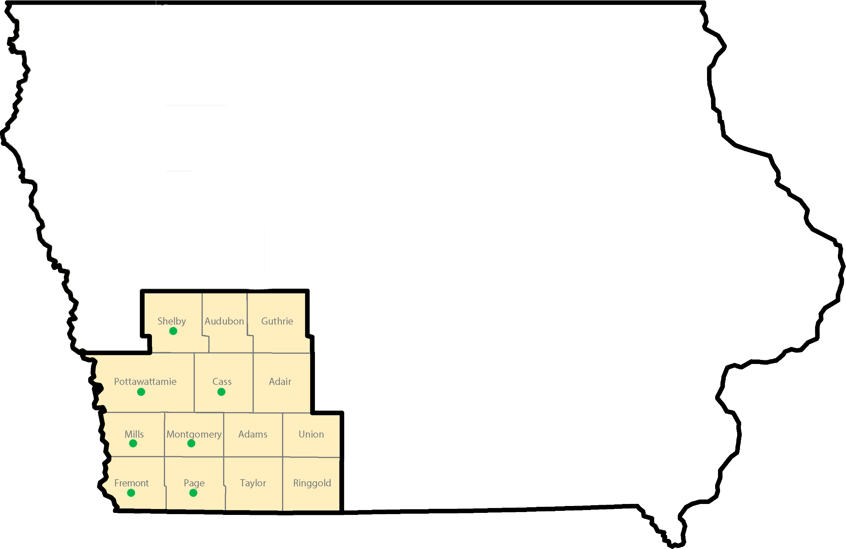
District 4 – Western Iowa Services Collaborative

Slide 33
District 4 Community Access Locations
PottIA.Gov/DAPwest
Location | Address | Date/Hours
Firefly Lakin Human Services Campus | 830 N. 14th St. Ste. 201 Council Bluffs, IA | Every Thursday 9:00 am – 3:30 pm
Public Library | 400 Willow Ave. Council Bluffs, IA | 2nd and 4th Tuesday 9:30 am – 3:30 pm
Waubonsie Mental Health Center | 216 W. Division St. Clarinda, IA | 2nd and 4th Thursday 9:30 am – 3:00 pm
Cass County Public Health | 1408 East 10th St. Atlantic, IA | 1st and 3rd Thursday 9 am – 3:30 pm
The Gathering Place (NAMI) | 202 S. 2nd St. Neola, IA | 1st and 3 Wednesday 9:00 am – 3:00 pm

Slide 34
District 4 Community Access Locations
PottIA.Gov/DAPwest
Location | Address | Date/Hours
Innovative Industries | 215 N Walnut St. Creston, IA | 2nd and 4th Tuesday 9:00 am – 3:30 pm
Gibson Memorial Library | 200 W Howard Creston, IA | 2nd and 4th Thursday 12:00 pm– 4:00 pm
Glenwood Public Library | 109 N Vine Glenwood, IA | 2nd Tuesday 10:00 am – 3:30 pm
Heartland Family Service | 719 Market St. Harlan, IA | 1st and 3rd Wednesday 9 am – 2:00 pm
Shenandoah Public Library | 201 S. Elm St. Shenandoah, IA | 3rd Thursday 1:00 pm – 3:30 pm

Slide 35
District 4 Disability Service Advisory Council
Eight of Fourteen Counties Represented
Adams - 2
Cass
Guthrie
Montgomery
Page
Pottawattamie
Shelby
Union
Nine Members
4 – Caregivers
1 - Individual with Lived-Experience
3 – Disability Service providers
1 – Elected Official
Shaping policy
Improving communication
Ensuring real community needs are discussed

Slide 36
District 5
Annie Uetz
Polk County Behavioral Health & Disability Services

Slide 37
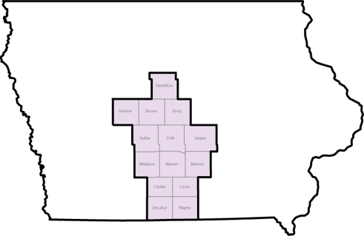
District 5 Behavioral Health & Disability Services ADRC DAP

Slide 38
District 5 Drop-in Hours
bhds@polkcountyiowa.gov
Location | Address | Hours
Behavioral Health & Disability Services 515-286-3573 | Polk County River Place 2309 Euclid Avenue Des Moines | 9:00 am to 4:00 pm Monday - Friday
Community Support Advocates 515-288-0803 | 1516 Valley West Drive West Des Moines | 9:00 am to 4:00 pm Monday - Friday
WeLift | 106 East 2nd Avenue Indianola | 10:00 am to 2:00 pm 4th Monday of the Month
Ames Public Library | 515 Douglas Avenue 2nd Floor Study Room Ames | 1:00 pm to 3:00 pm 2nd Thursday of the Month 10:00 am to 12:00 pm 4th Thursday of the Month
Decatur County Public Health | 207 NE Idaho Street Leon | 10:30 am to 12:00 pm 3rd Thursday of the Month

Slide 39
District 5 Disability Service Advisory Council
Five of Fourteen Counties Represented
Story
Marion
Warren
Dallas
Polk
Shaping policy
Improving communication
Ensuring real community needs are discussed
Nine Members
Individuals with Lived-Experience
Caregivers

Slide 40
District 6
Russell Wood
Collaborative Individual and Community Supports

Slide 41
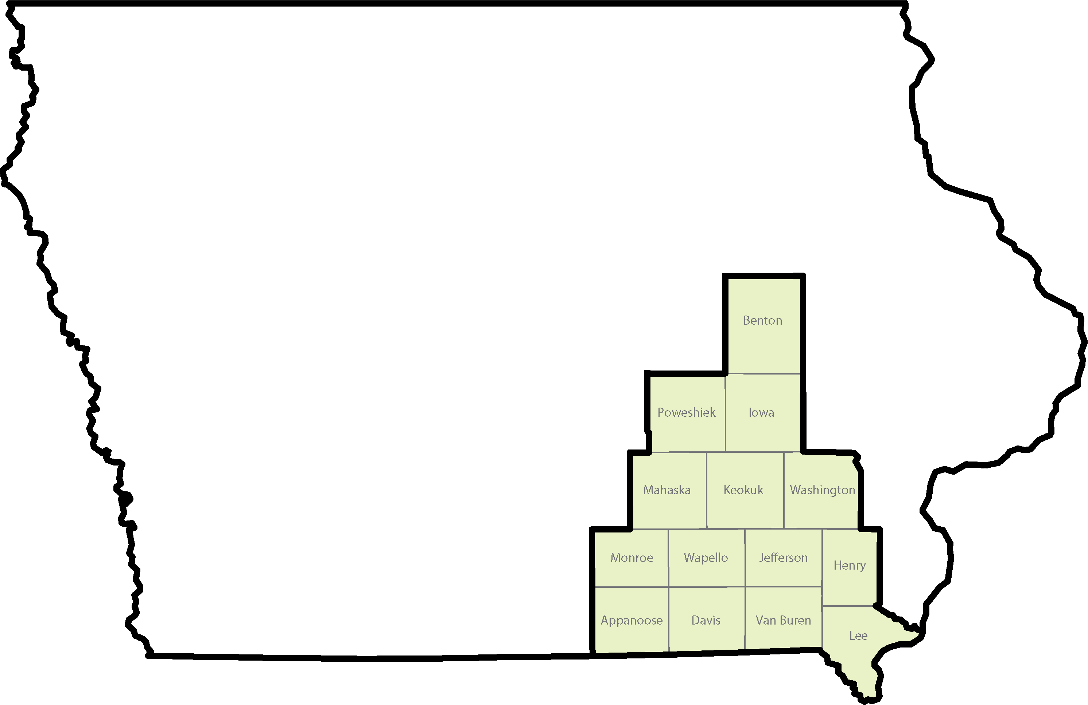
District 6 Collaborative Individual & Community Services ADRC DAP

Slide 42
District 6 Office Locations
Hours may vary depending on meetings with clients
info@cicsmhds.org
Location | Address | Days
Southern Iowa Mental Health Center 515-961-1075 | 105 S Clinton St. Albia | 1st Monday of the month
Southern Iowa Mental Health Center 515-961-1075 | 712 S West St., Ste. #4 Bloomfield | 3rd Tuesday of the month
Southern Iowa Mental Health Center 515-961-1075 | 717 N 18th St., Unit #7 Centerville | Wednesdays
Fairfield Public Library 641-450-7160 | 104 W Adams Ave. Fairfield | Tuesdays
Elevate 641-658-9352 | 615 8th St. Ft. Madison | Monday-Friday except 4th Monday
Capstone Behavioral Health 641-236-9199 | 200 4th Ave. W Grinnell | Mondays, Wednesdays, Fridays
Southern Iowa Mental Health Center 641-658-9352 | 807 1st St. Keosauqua | 4th Monday of the month

Slide 43
District 6 Office Locations
Hours may vary depending on meetings with clients
info@cicsmhds.org
Location | Address | Days
Marengo Public Library 515-236-9199 | 235 E Hilton St. Marengo | 4th Wednesday of the month
Mt. Pleasant Public Library 641-450-7160 | 307 E Monroe St. Mt. Pleasant | Mondays and Fridays
Mahaska Co. Courthouse Annex 515-236-9199 | 301 1st Ave. E Oskaloosa | 2nd Tuesday of the month
Southern Iowa Mental Health Center 515-961-1075 | 1527 Albia Rd. Ottumwa | Mondays, Fridays, Tuesdays (1st, 2nd, 4th), Thursdays (2nd, 3rd, 4th)
Keokuk Co. Courthouse Boardroom 515-236-9199 | 101 S Main St. Sigourney | 3rd Friday of the month
Benton Co. HHS Conference Room 641-236-9199 | 811 D Ave., Ste. 20 Vinton | Tuesdays and Thursdays
Washington Public Library 641-450-7160 | 115 W Washington St. Washington | Wednesdays and Thursdays

Slide 44
District 6 Disability Service Advisory Council
Six Members
Still accepting applications.
Caregivers
Providers
Five of Fourteen
Counties Represented
Henry
Lee
Marion
Monroe
Wapello
Shaping policy
Improving communication
Ensuring real community needs are discussed

Slide 45
District 7
Julie Davison
Eastern Iowa Disability Alliance

Slide 46
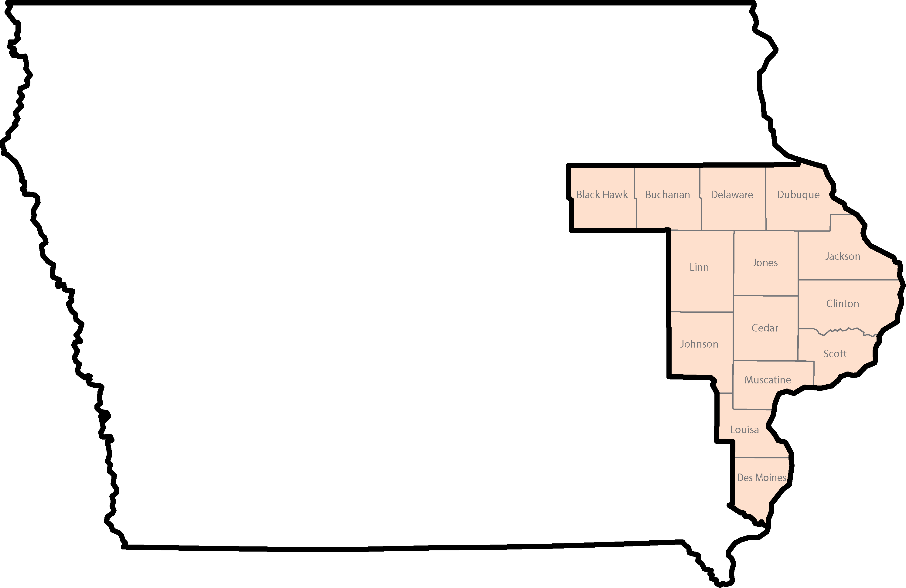
District 7 Behavioral Health & Disability Services ADRC DAP

Slide 47
District 7 Walk-in Hours
DAPIntake@ecriowa.us
Location | Address | Hours
Northeast Iowa Area Agency on Aging 319-325-5908 | 201 Tower Park Dr. #100 Waterloo | Monday - 12:00 pm to 3:00 pm Thursday – 9:00 am to 12:00 pm
Buchanan County Courthouse 319-327-0357 | 210 5th Avenue NE Independence | Wednesday - 9:00 am to 3:00 pm
Delaware County Community Services 319-327-0357 | 601 Grant Street Manchester | 2nd and 4th Tuesday of the Month 8:30 am to 12:00 pm
Hills & Dales 319-325-8247 319-325-6208 | 1660 Embassy West Drive Suite #250 Dubuque | Monday – 8:30 am to 11:30 am Wednesday 12:30 pm to 3:30 pm
Anamosa Public Library 319-325-8247 | 600 E 1st Street Anamosa | 3rd Monday of the Month 12:00 pm to 2:30 pm
Monticello Public Library 319-325-8247 | 205 E Grand Street Monticello | 2nd Thursday of the Month 12:00 pm to 2:30 pm
Linn County Community Services 319-892-5671 | 1240 26th Ave Ct SW Cedar Rapids | Monday - 8:00 am to 12:00 pm Tuesday - 12:00 pm to 4:30 pm Thursday - 12:00 pm to 4:30 pm

Slide 48
District 7 Walk-in Hours
DAPIntake@ecriowa.us
Location | Address | Hours
Columbus Junction Public Library 319-430-6662 | 232 2nd Street Columbus Junction | 1st and 3rd Monday of the Month 9:00 am to 1:00 pm
Burlington Public Library 319-430-6662 | 210 Court Street Burlington | Wednesday 9:00 am to 12:00 pm
Muscatine County 319-430-6662 | 313 Iowa Ave Muscatine | Thursday - 8:00 am to 12:00 pm
Bridgeview CMHC 319-325-5897 | 1320 19th Ave NW Clinton | Tuesday - 8:00 am to 12:00 pm
Johnson County Health & Human Services 319-530-1974 319-310-5564 | 855 S Dubuque Street Iowa City | Tuesday – 9:30 am to 1:30 pm Thursday – 1:30 pm to 4:30 pm
Milestones 319-330-3640 | 4440 Brady Street Bldg 1 Davenport | Tuesday–8:00 am to 12:00 pm Wednesday–8:00 am to 12:00 pm
Cedar County Courthouse 319-325-5897 | 400 Cedar Street Tipton | 1st and 3rd Thursday of the Month 8:00 am to 12:00 pm
Jackson County Annex 319-325-6208 | 311 W Platt Street Maquoketa | 1st Tuesday of the Month 9:00 am to 11:30 am 3rd Tuesday of the Month 12:30 pm to 3:00 pm

Slide 49
District 7 Disability Service Advisory Council
Nine of Fourteen Counties Represented
Jackson
Dubuque
Des Moines
Black Hawk
Johnson
Linn
Scott
Clinton
Muscatine
Shaping policy
Improving communication
Ensuring real community needs are discussed
Nine Members
Individuals with Lived-Experience
Caregivers
Providers and other Stakeholders

Slide 50

Questions

