Slide 1
AI at the Swedish Medical Products Agency
Samuel Fransson
Data Scientist
AI-Unit, Swedish Medical Products Agency
Notes:
A demonstration of very practical and tangible implementations of AI

Slide 2
Disclosure
Opinions expressed should be regarded personal

Slide 3
Why AI at the agency?
Regulatory responsibility for AI in:
Medical devices
Development, production, usage and follow up of pharmaceuticals
Intelligent support or automatisation of internal processes
Regulatory science
AI unit for AI-related matters and development
Cross-agency collaboration
Competence: Physicians, engineers, computer scientists, medical physicists

Slide 4
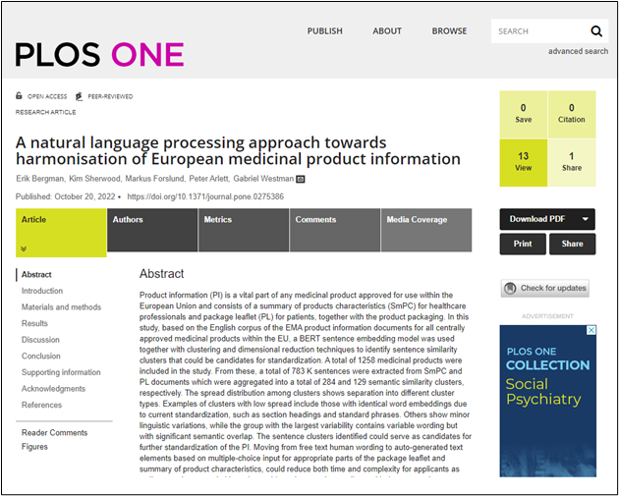
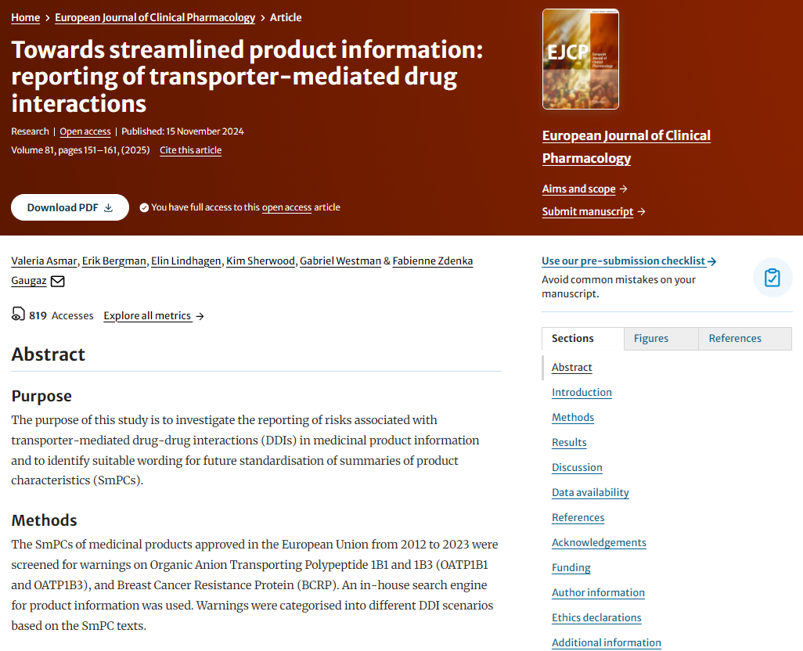
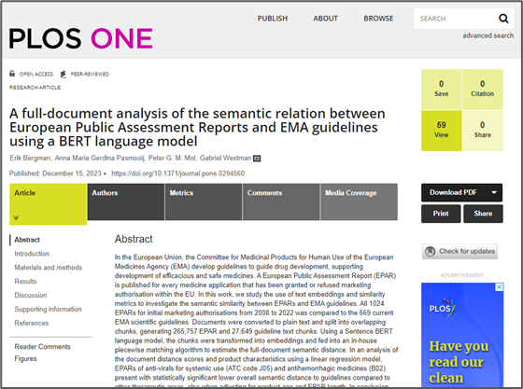
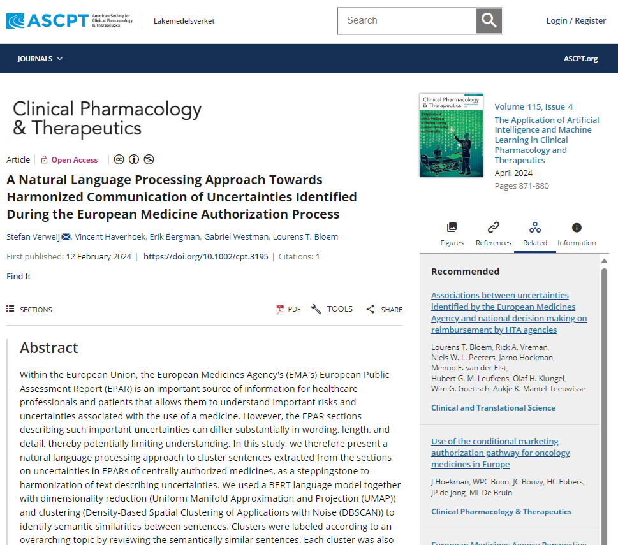
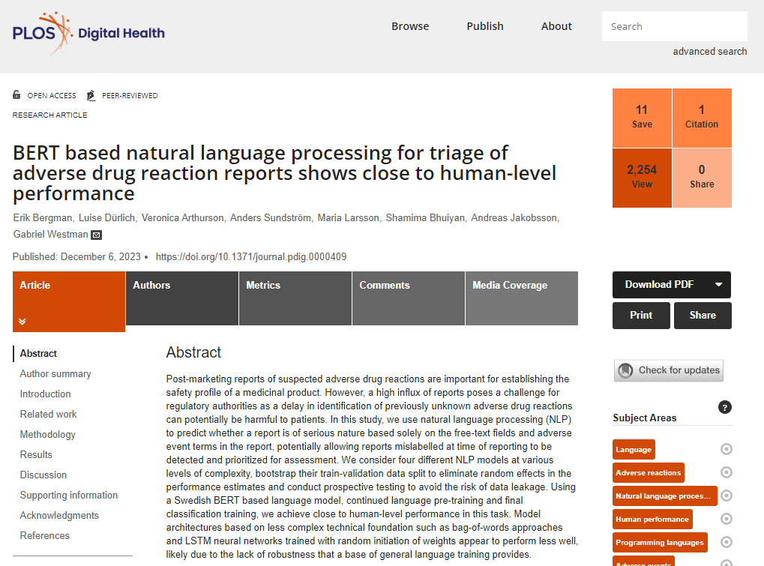
Scientific publications 2022-2024

Slide 5
Internal development

Slide 6
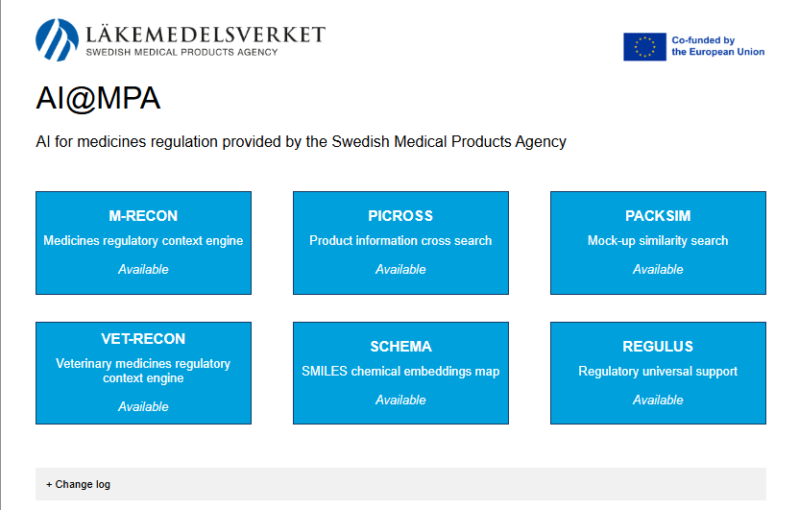
AI@MPA toolbox
AI-toolbox for regulatory support in the pharmaceutical area
PICROSS – product information cross search
M-RECON – medicines regulatory context engine
PACKSIM – package similarity search
VET-RECON – veterinary regulatory context engine
SCHEMA – SMILES chemical embeddings map
REGULUS – regulatory universal support

Slide 7
AI@MPA toolbox – Our users
Sweden | MPA |  | France | ANSM
Finland | FIMEA |  | Croatia | HALMED
Belgium | FAGG/AFMPS |  | Greece | EOF
Germany | PEI, BfArM |  | Spain | AEMPS
Netherlands | MEB |  | Czech Republic | SÚKL
Latvia | SAM |  | Denmark | DKMA
Norway | NOMA |  | Malta | Medicines Authority
Austria | AGES |  | EU | EMA
Cyprus | Ministry of Health |  | Iceland | IMA
Ireland | HPRA |  | Italy | AIFA
Portugal | INFARMED |  | Slovenia | JAZMP

Slide 8
PICROSS – product information cross search
Product information for all centrally approved pharmaceuticals, tokenized on sentence level
All text is processed by a language model generating semantic vector representations -> 1.16 million vectors indexed towards respective product, document type and section
Allows for both exact and semantic search
Notes:
Why: Towards harmonization of expressions

Slide 9
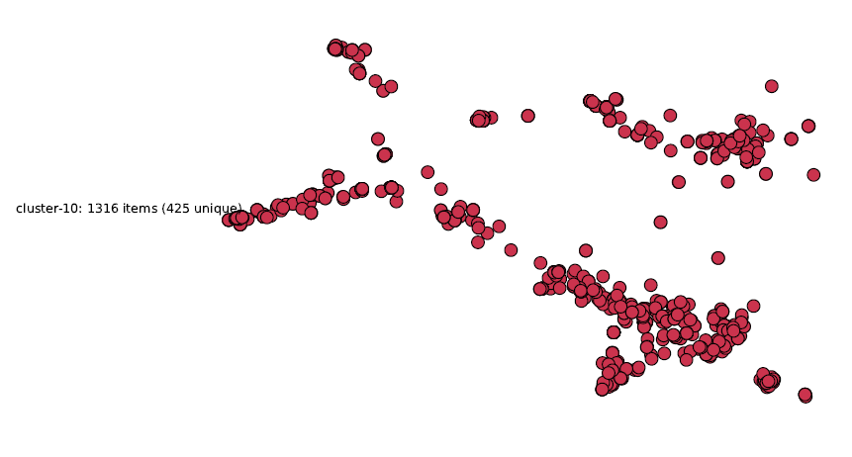
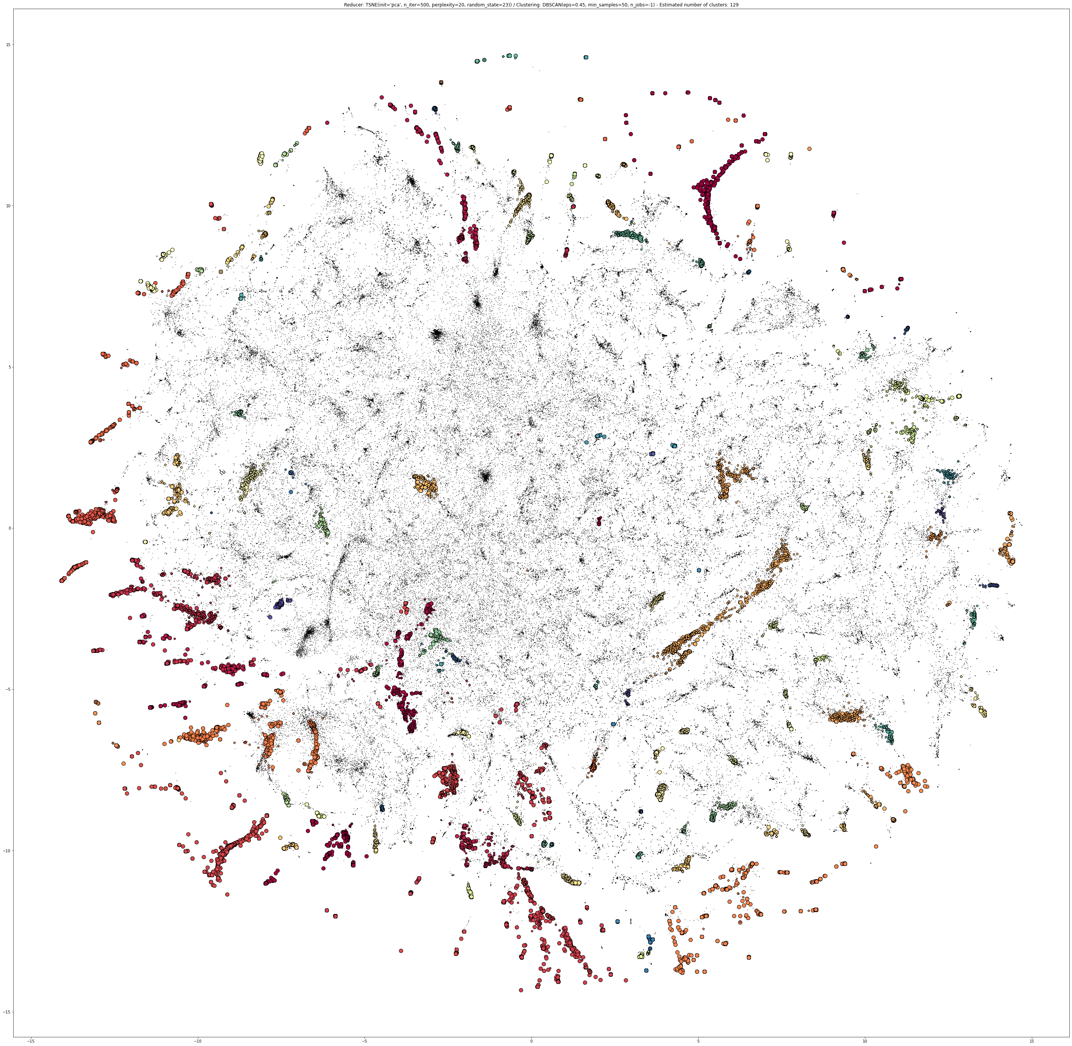
(n=281) Do not take a double dose to make up for a forgotten dose. (n=89) Do not take a double dose to make up for a forgotten tablet. (n=34) Do not use a double dose to make up for a forgotten dose. (n=24) If you miss a dose, take it as soon as you remember. (n=18) If you forget to take a dose, take it as soon as you remember. (n=17) Do not inject a double dose to make up for a forgotten dose. (n=16) Then take your next dose at the usual time. (n=15) Do not take a double dose to make up for forgotten individual doses. (n=15) Then take the next dose as usual. (n=15) If you forget for more than 12 hours, simply take the next single dose at the usual time.

Slide 10
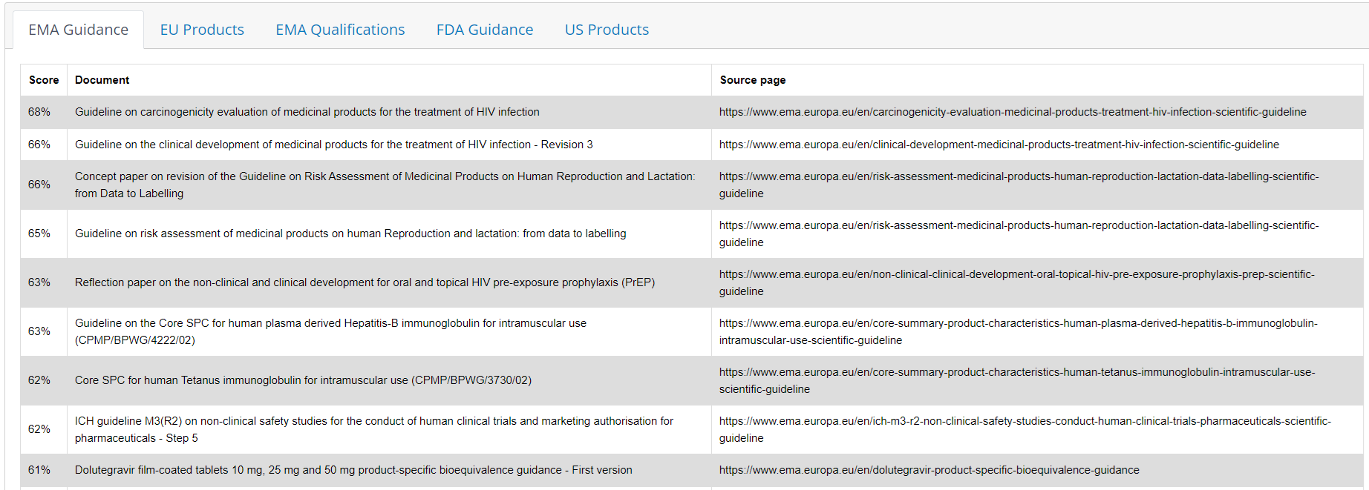
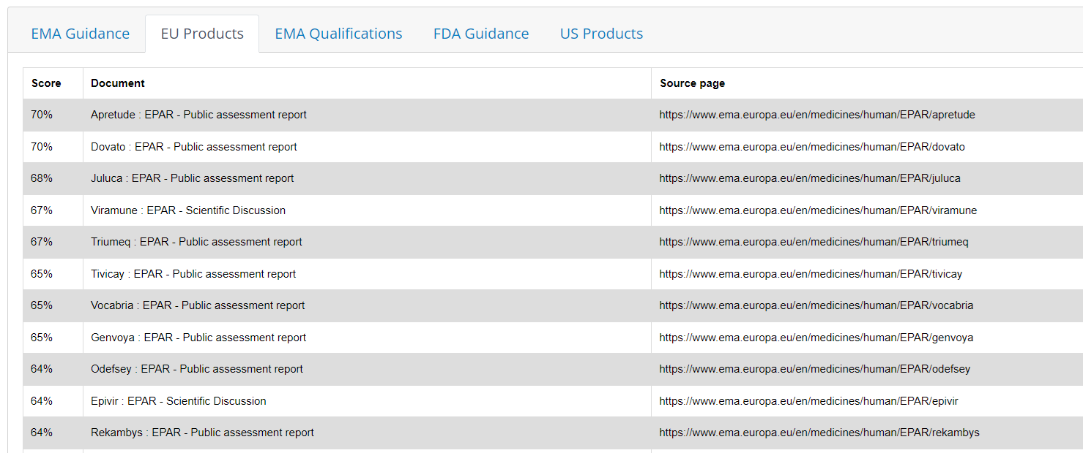
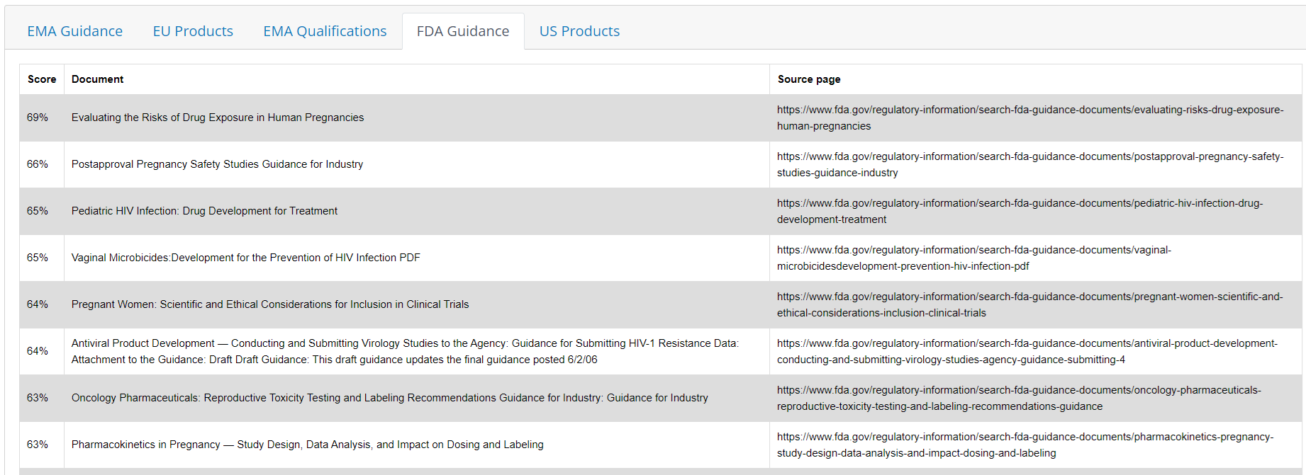
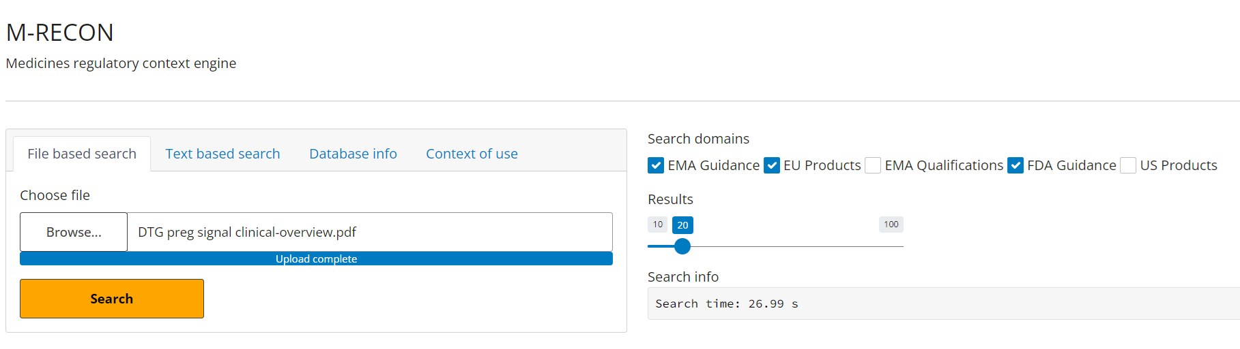
M-RECON – medicines regulatory context engine
Notes:
Why: Find the relevant regulatory documents for an investigation

Slide 11
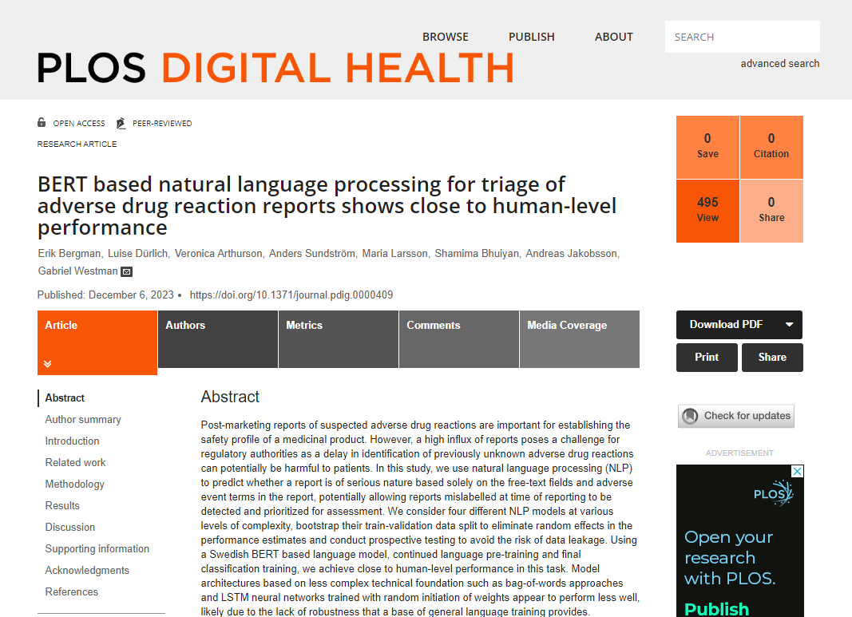
PhaVAI - AI for triage of adverse event reports
Explosive increase in the number of adverse event reports in conjunction with the covid vaccine campaign
Goal – to reduce the time to analysis of reports describing serious drug reactions
Training of language models to analyze free text in adverse event reports and estimate degree of seriousness

Slide 12
PACKSIM - computer vision to avoid mixup
Goal – to avoid mixing up drug packages by ascerting that drug packages are not similar to each other
A convolutional network (CNN) transforms images (N × M × N_{color depth}) to an N_{E}-dimensional vector – a so called embedding
EfficientNet
pretrained
image model
Specific training with augmented packaging graphics
Image search via vector database

Slide 13
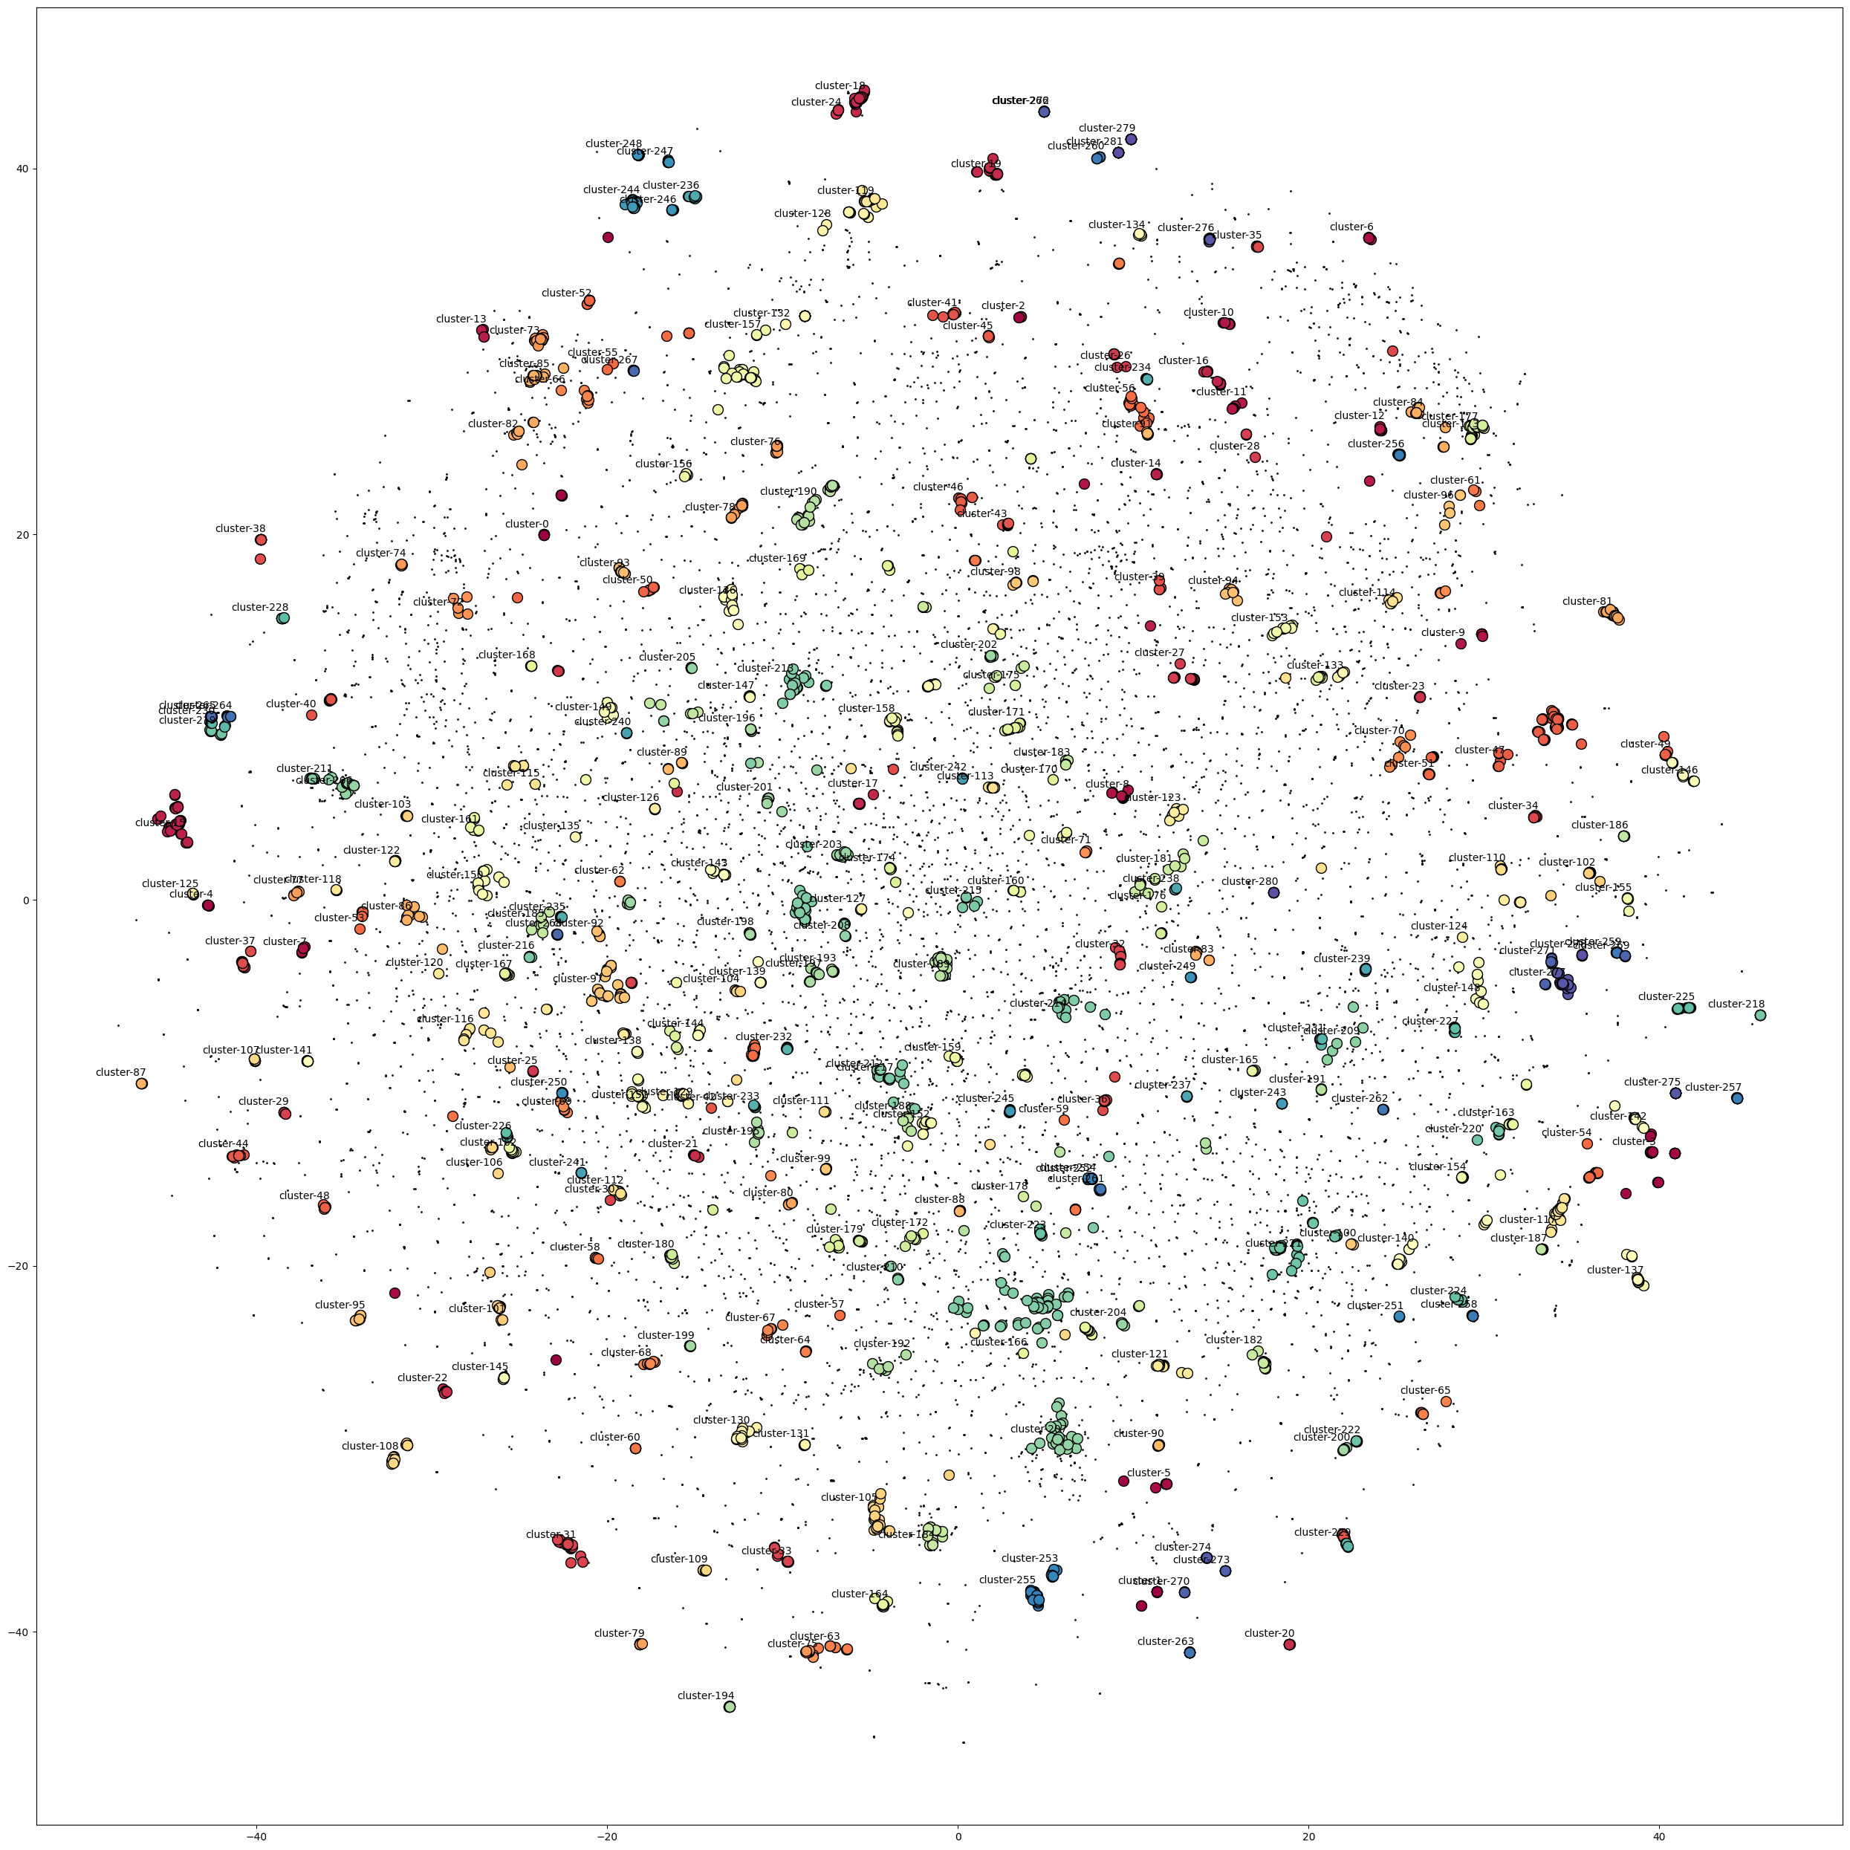
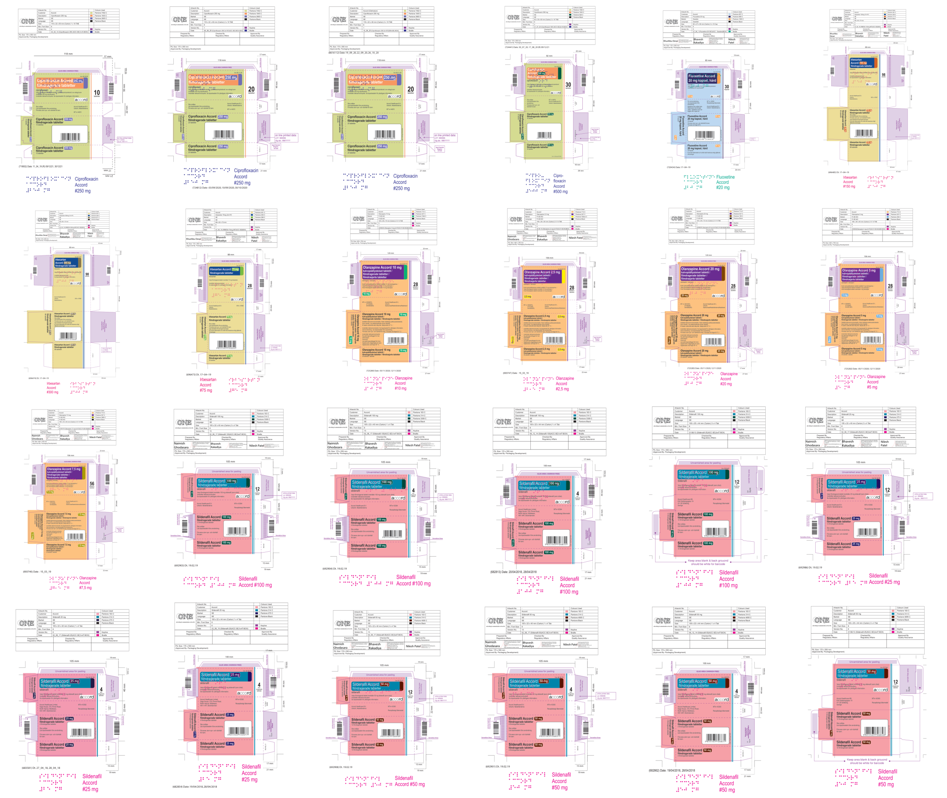
PACKSIM - results
Notes:
Working with scientific evaluation and publication

Slide 14
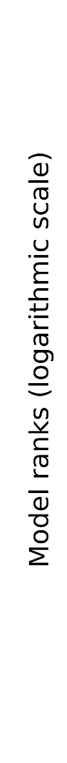
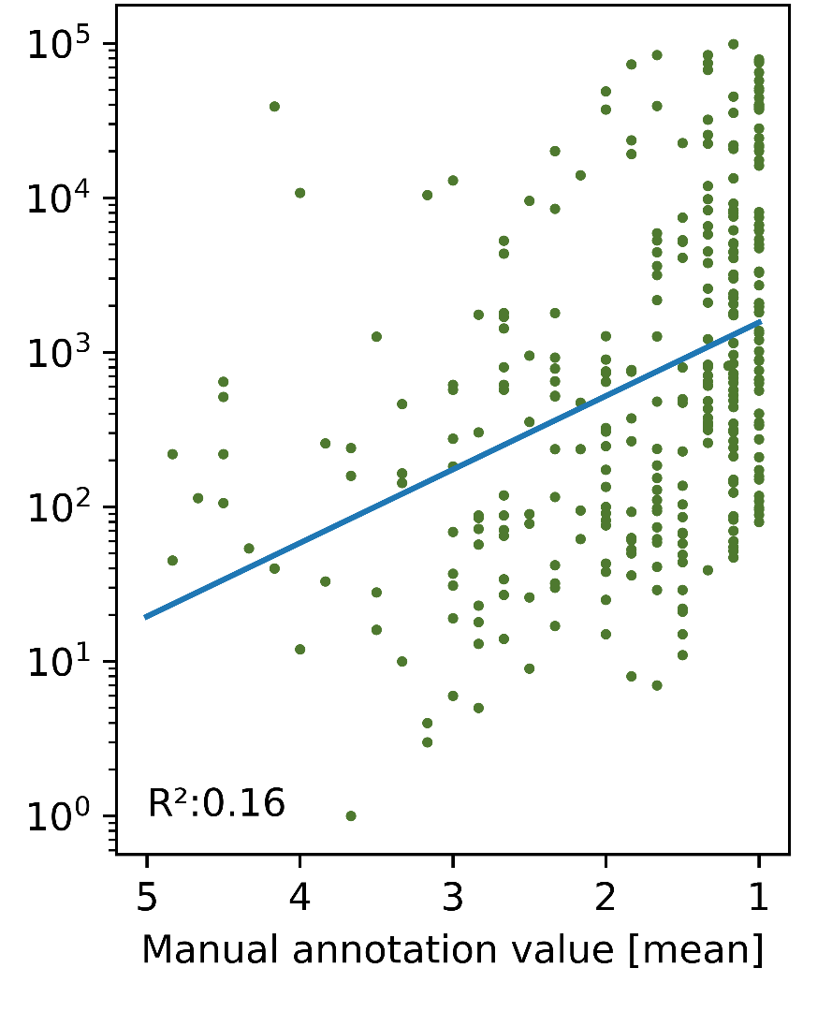
PACKSIM - results
Ongoing scientific evaluation
Manual annotation of similarity between pairs of
authority employees
Scale 1 (no similarity) to 5 (highest risk of mix-up)
Similarity between pairs also from distance in
vector space from model
Ranked in descending order
Correlation between human and machine

Slide 15
SCHEMA – semantic chemical embeddings map
Proximity search of molecules with QSAR approach
Database with 600K substances vectorized with a pretrained chemical language model
We are talking SMILES (Simplified Molecular Input Line Entry Specification), an ASCII-based molecular representation
Metadata from several sources (PubChem, Tox21, BIKT)
Distance in vector space encodes substance structure similarity
Notes:
QSAR – Quantitative Structure Activity Relationship, entails a correlation between the structure appearance and the structures properties
BIKT is the national database of adverse event frequencies of pharmaceuticals

Slide 16
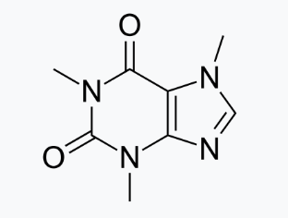
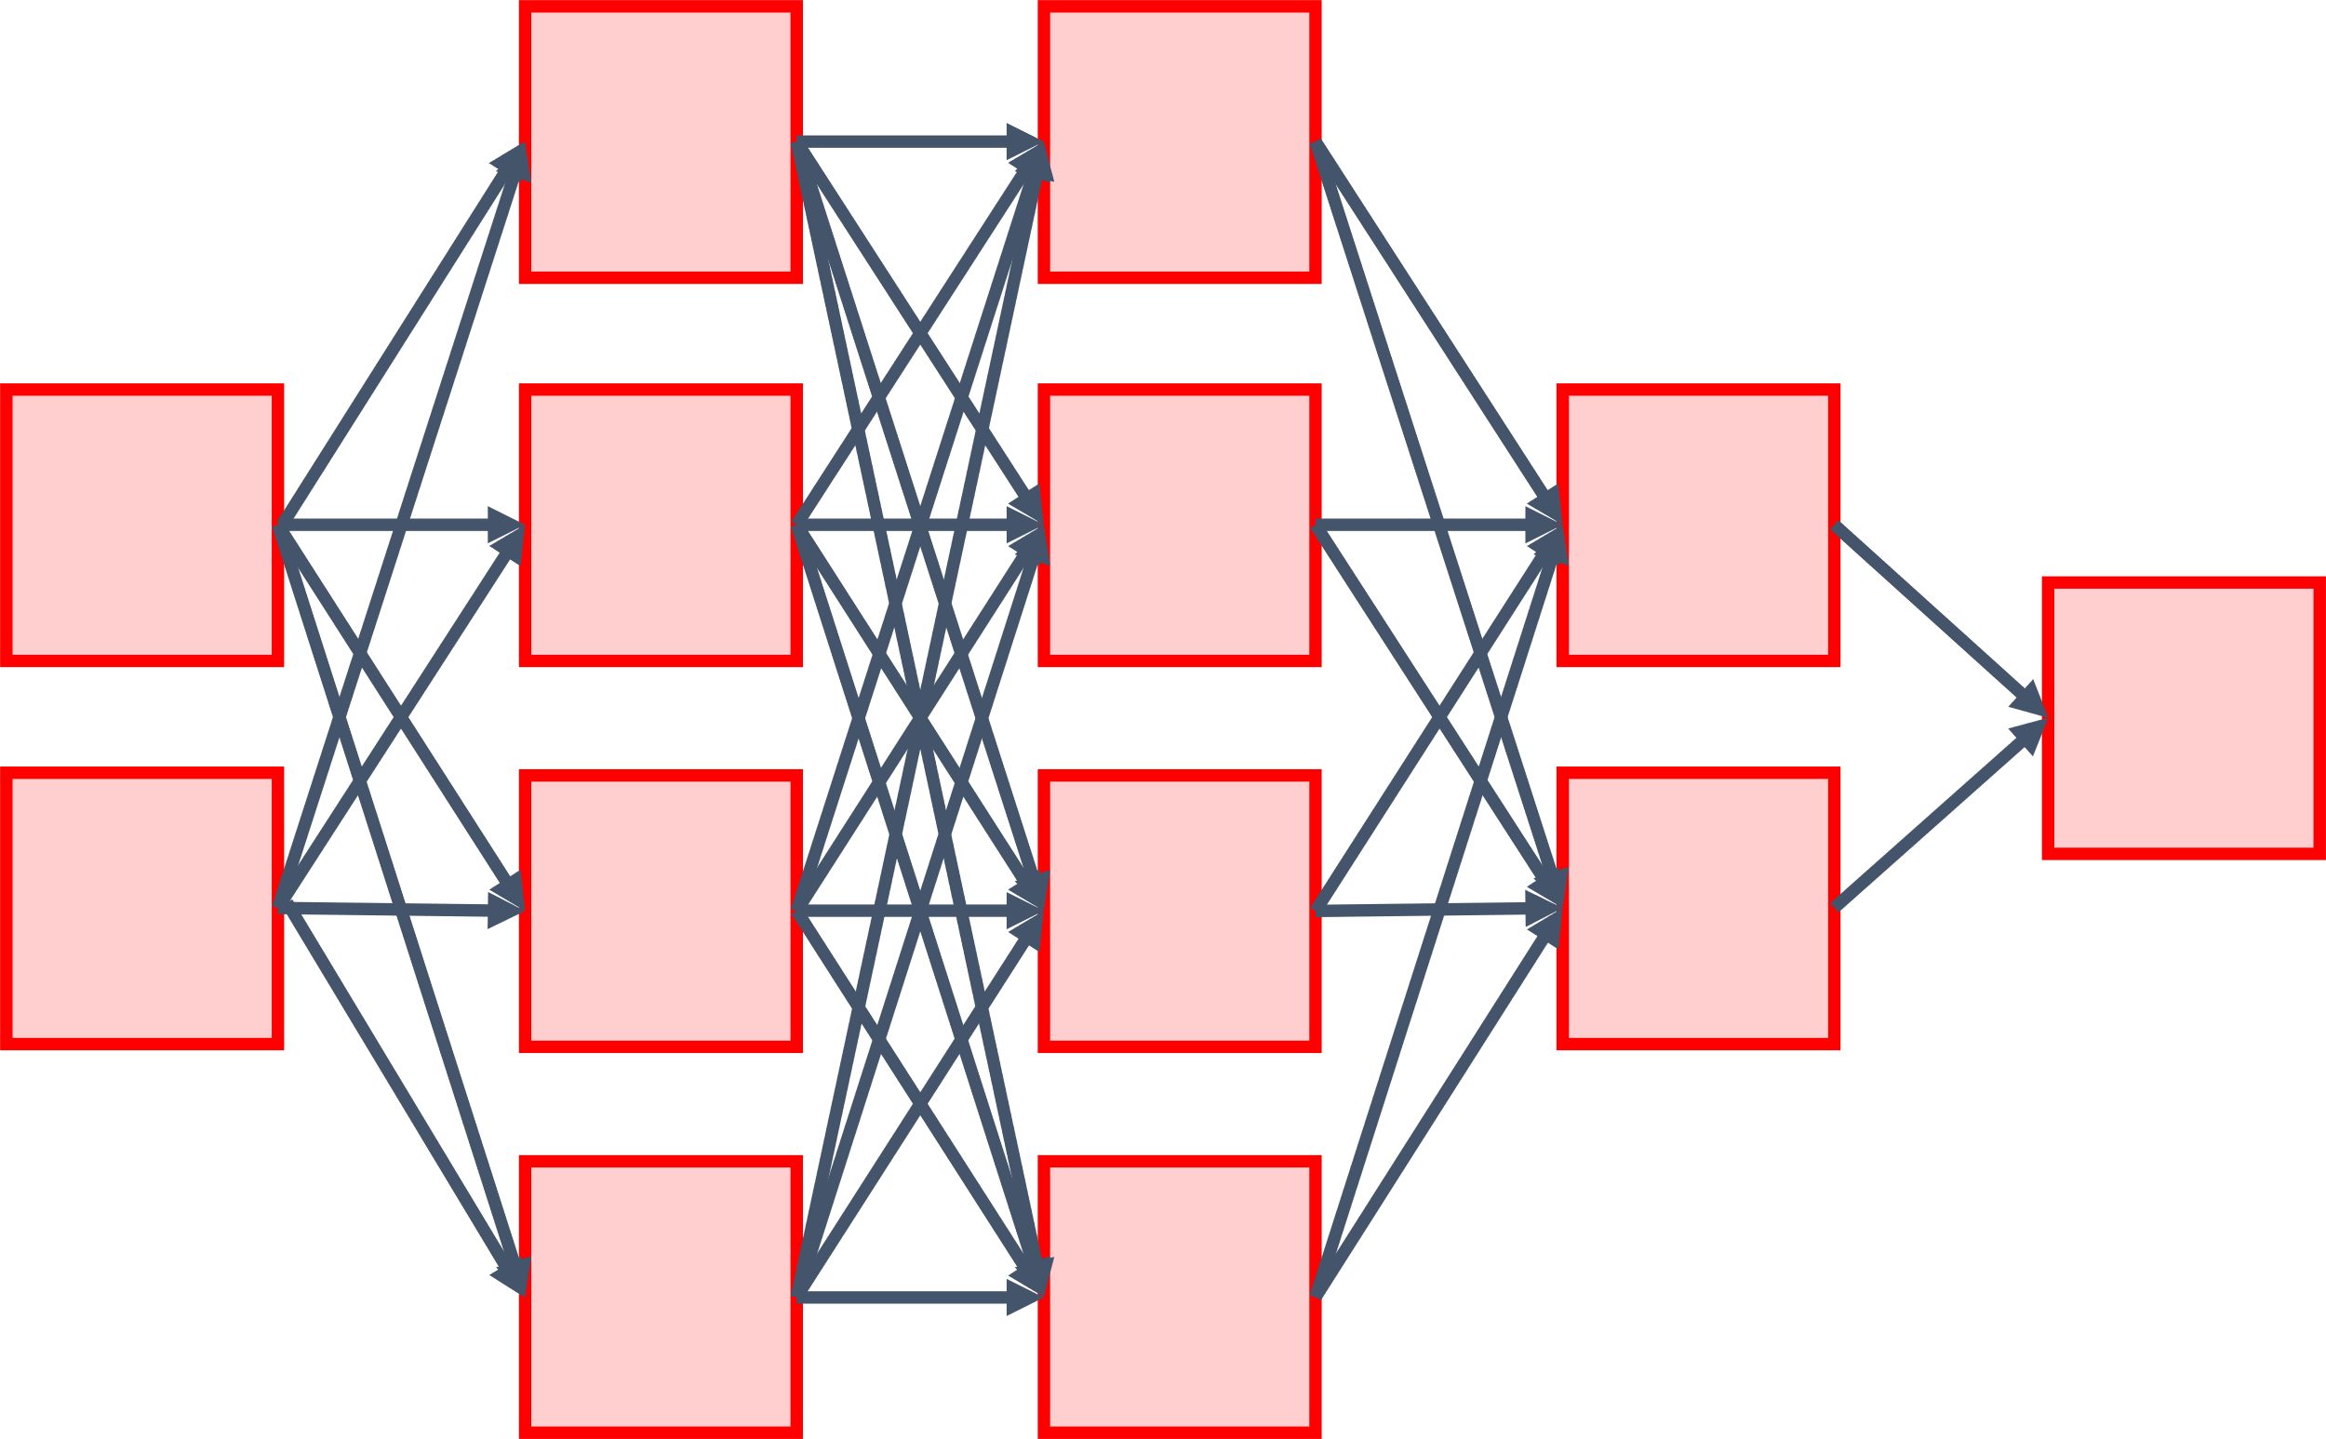
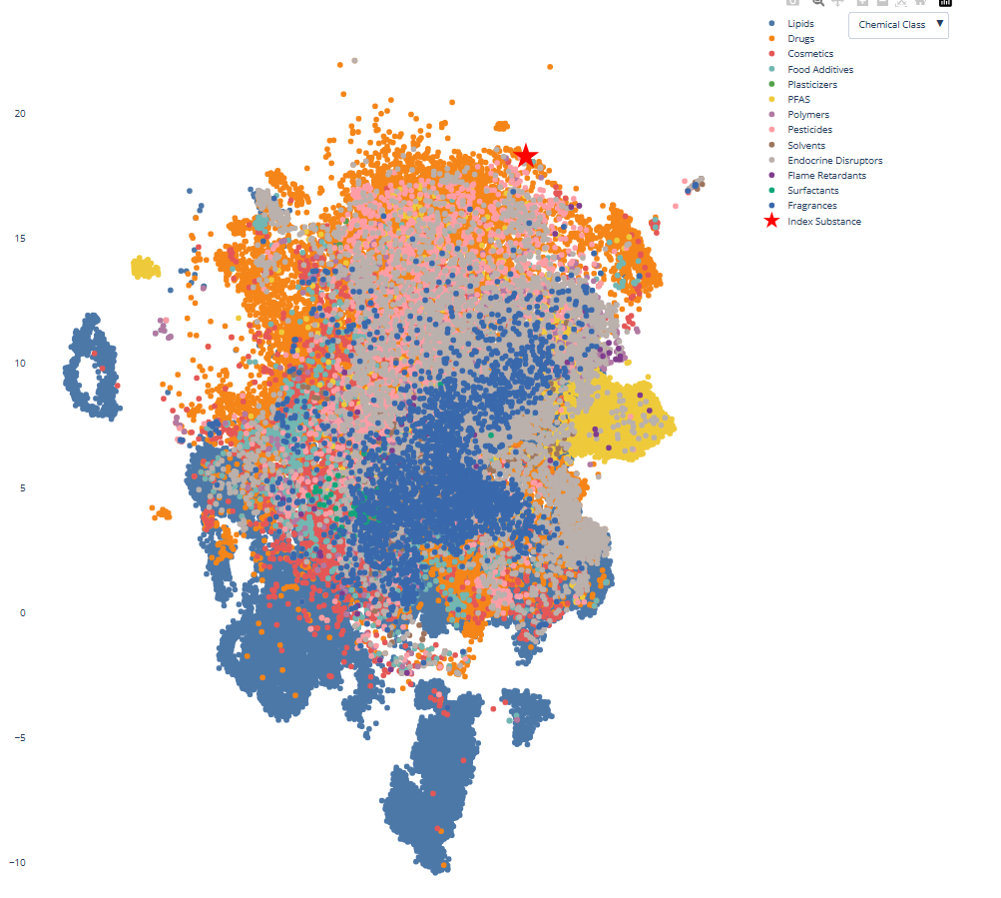
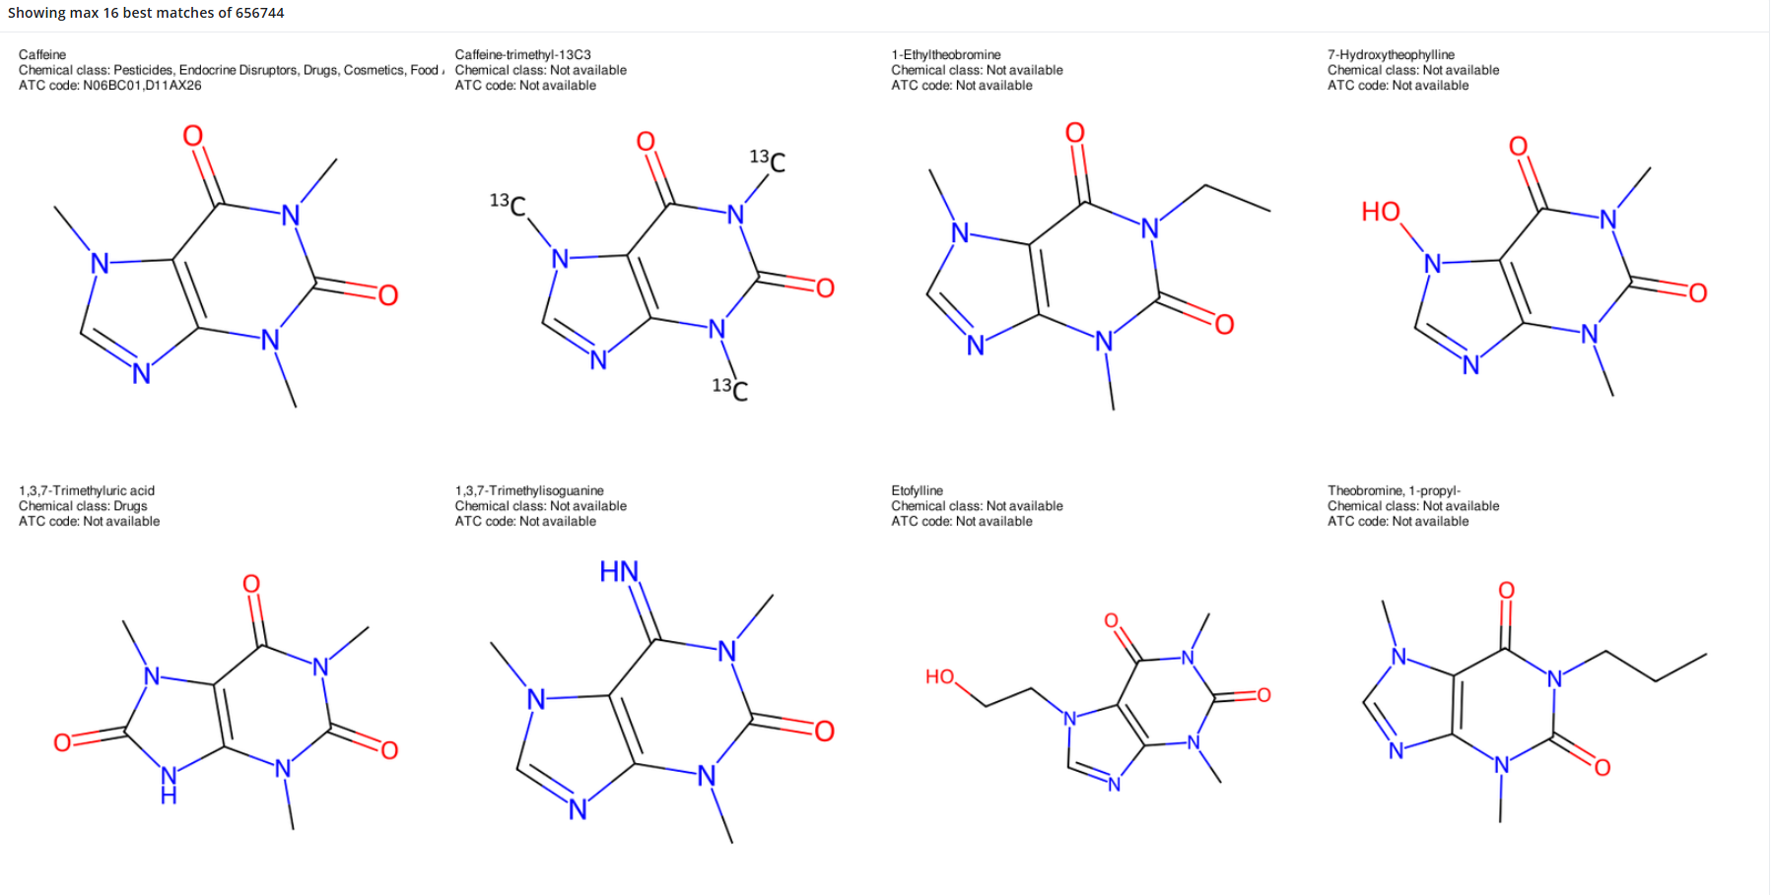
SCHEMA – how it works
Distance to all vectors
in database
Molecular representation input
(image, .sdf-file, other)
SMILES representation
Embedding vector
768x1
768x1
768x1
CN1C=NC2=C1C(=O)N(C(=O)N2C)C
768x1
768x1
768x1
768x1
768x1
768x1
Top n shortest distances
Placement of substance in vector space
…
Notes:
Utilizing two different AI-models. First, a CNN-transformer based model translates an input image to a SMILES representation. Then, a transformer model encodes the SMILES representation into an embedding space.

Slide 17
REGULUS – regulatory universal support
Locally developed and internally hosted AI-assistant ad modum Chat-GPT that can support the agencies employees through drafting with the purpose of:
Answer questions from one or several documents
Extract, summarize and translate text from different sources (text, images, audio)
Compare content and analyze compliance
Three separate assistant modules based on a set of open weights language models
Notes:
Internal hosting, i.e. everything, including the large language models.
Currently we are emplying variant of the llama models. However, the system architecture allows for effortless switching between models.
Note that we are (currently) not training nor emplying bespoke models from which training data could have been internal documents and sensitive information.
All models employed are open source and off the shelf.

Slide 18
REGULUS – regulatory universal support
Modular system with information architecture allowing for direct transferability of concept and installation to other agencies
Based on open weights models
Interchangeability
No fine-tuning
Text extraction from several sources, including audio transcription
Regulatory documents in database
Retrieval Augmented Generation (RAG) concept
In-text citation in answers
Notes:
SF

Slide 19
REGULUS – regulatory universal support
Structured introduction at the MPA since 2025-03-10
Secure information environment
”Single user pod”-architecture
User data automatically deleted at session termination
Allows handling of sensitive information
No information is saved or shared
Regulus EU accessible since july 2025
Available from AI@MPA toolbox
Notes:
SF

Slide 20
Upcoming projects
RADAR
Raw data augmented review
Visualization and processing of clinical raw data without explicit coding
SOCIR
Source Confirmed Information Retrieval
Answering clinical questions with source conformation
VERA
Chat-based extraction of eCTDs (electronic common technical document)
Notes:
eCTD – an interface and international specification for the pharmaceutical industry to transfer regulatory information to regulatory agencies

Slide 21
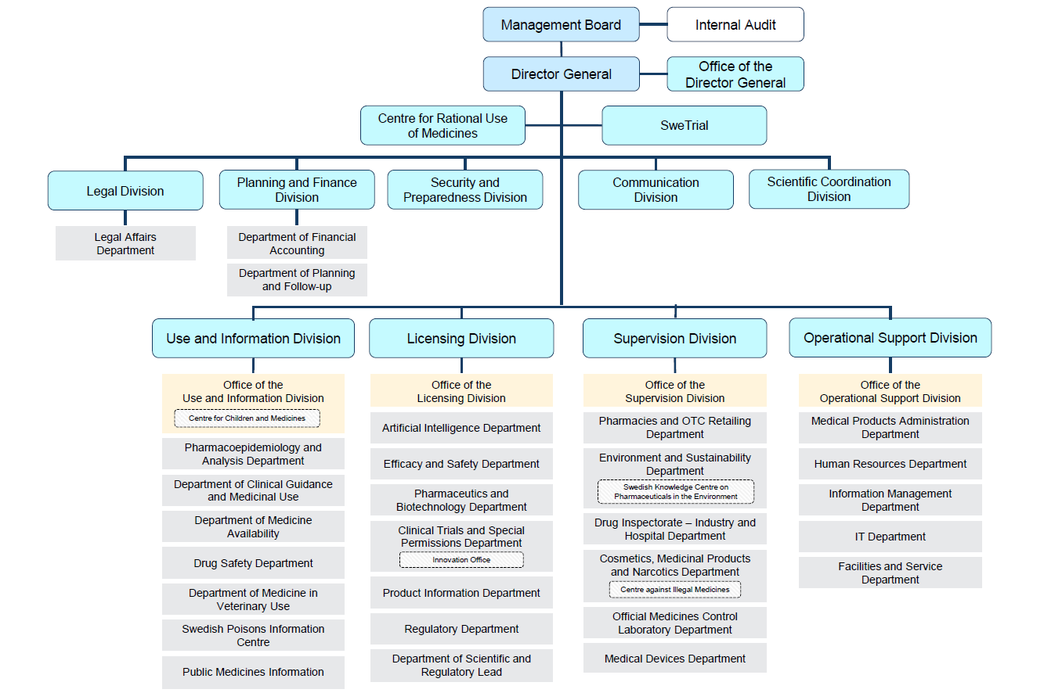
Notes:
Many units with broad scope. Especially for general systems, each unit has to find their own questions and method to work with AI and quality assure the results.

Slide 22
Quality Assurance
Requires neverending educational efforts
Network of AI-ambassadors and superusers for effective utilization
Collaborative effort
System based risks assessments
Routines for quality assurance of generated outputs
Outputs may include hallucinations, factual errors and/or missing important information
Outputs should be clearly marked as generated by AI until finalization of quality review

Slide 23
Practical implications
Idea
What is necessary?
Idea:
Idea
System:
Idea
Infrastructure, hardware
Dedicated developers
Soft values
Long term planning
Adaptation to user needs
Education and training
Life cycle management
…
System
PoC:
Idea
Laptop
Basic python
PoC
Notes:
Personal opinions I might very well be stating the obvious with some clichés here, but it's worth repeating.
There can be a vast difference between having a working proof of concept in an isolated environment and having a system architecture that can be utilized at an organizational level. It is NOT reasonable to assume that just because it's relatively easy to download a model from HuggingFace or Ollama to your personal laptop, it is also relatively easy to scale it up to the organizational level.

Slide 24
Regulations

Slide 25
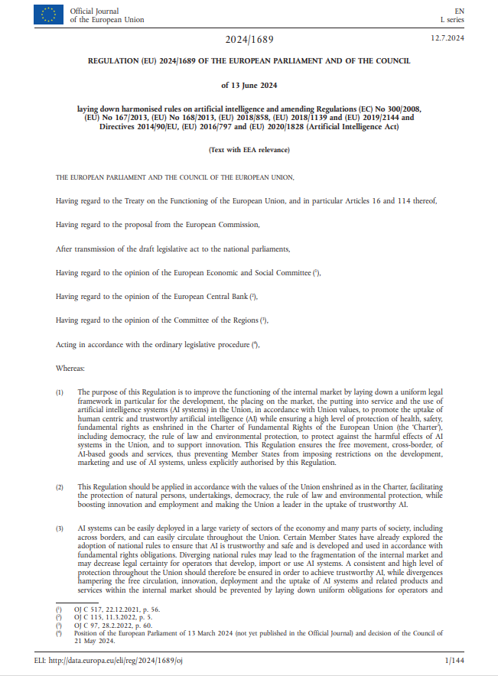
AI Act
Ongoing implementation
Complementary to other regulations
MDR
IVDR
…
Risk based assessment
Many (or all) MDP high risk
Notes:
MDP – Medical Device Product

Slide 26
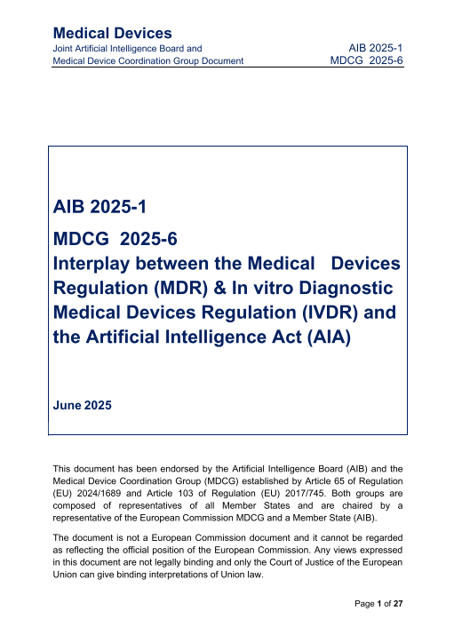
MDCG 2025-6
On the interplay effect between MDR and AI-act
From the Medical Device Coordination Group (MDCG)
With the aim to adress the most frequent questions from manufacturers
Aimed at manufacturers of medical devices, notified bodies, and national competent authorities

Slide 27
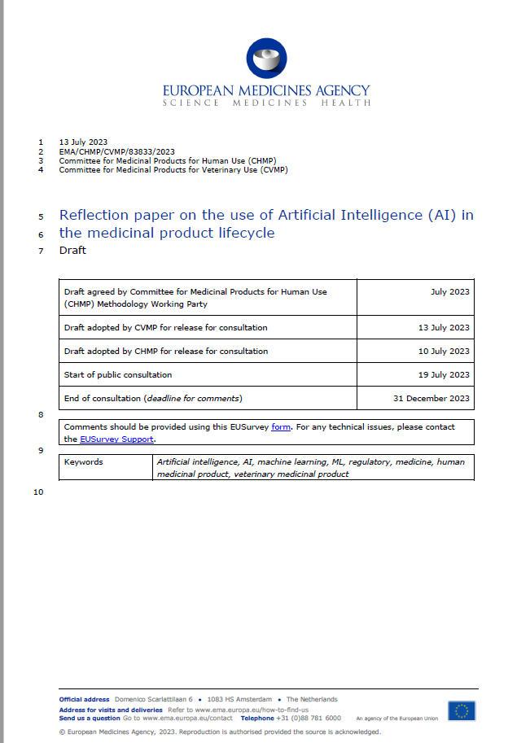
EMA reflection paper on AI
Published september 2024
Describes how artificial intelligence and machine learning can be used in the context of developing, using and follow of up pharmaceuticals

Slide 28

Guidance regarding AI in swedish healthcare sector
Published september 2023
Attempt to bridge the gap between manufacturers and users of AI-containing medical products
Focus on what is possible rather than so called ”what ifs”
Updated version upcoming

Slide 29
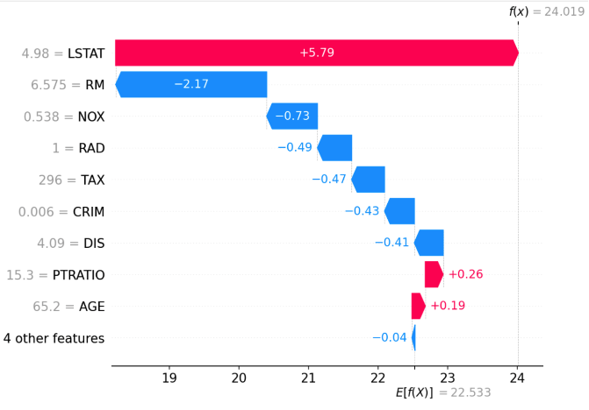
Transparency and explainability
Everything else equal, transparent models are to be preferred above black box-models
Usage of black box-models should be motivated by higher performance and/or robustness, but requires a more thorough validation
Usage of so called explainable AI (xAI) may increase safety by providing both local and global explanations to model behaviour

Slide 30
AI-unit
Gabriel Westman (scientific leader)
Erik Bergman
Luise Dürlich
Seamus Doyle
Victor Lindeman
Samuel Fransson
Notes:
Last but not least, the highly diverse work being done — ranging from the development and deployment of local chat modules, to research and development in the regulatory domain, to interpersonal communication for broad adoption — requires an equally strong and diverse team.

Slide 31
Thanks for your attention!
Contact: samuel.fransson@lakemedelsverket.se

