Slide 1


Welcome to Saturn Class
Early Years Foundation Stage. EYFS
Parents Meeting

Slide 2
This PPT:
To help you to understand the curriculum that your child will be covering in the Reception Year.
To understand how children learn in order to cover the requirements of the Early Years Foundation Stage.
To identify the key ways in which you can help your child at home and in school.

Slide 3
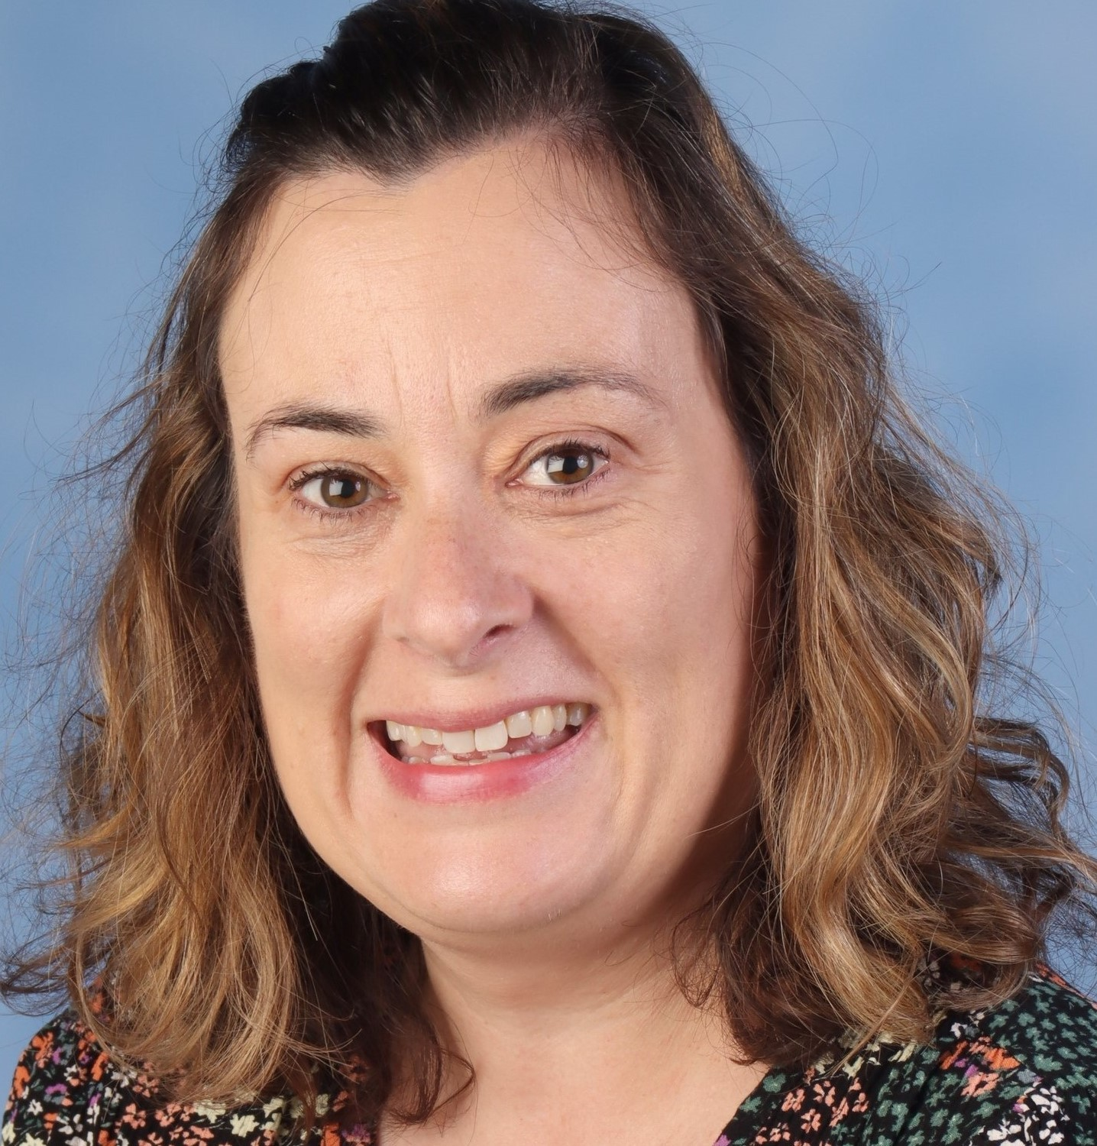
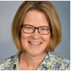
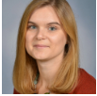


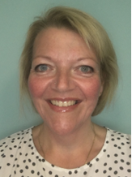
The Staff
Mrs Peel -Teacher 5 days
Mrs Smither – TA
Mrs Lodge - SENCO
Mrs Beasley – Executive Deputy Headteacher
Mrs Howe - Executive Headteacher
Mrs Raven de Burca – School Business Manager
There are other staff and volunteers that may spend time in our class

Slide 4
Where can you find more information?
School website:
The Village Saints Partnership (demat.org.uk)
Class Dojo: When you have filled in a consent form you will receive an email invite to join our Class Dojo page.
We will use Dojo portfolio to show you your childs learning throughout the year, you will also be able to add any learning they do at home here too.

Slide 5
Paperwork
Please make sure all registration forms are completed and handed in to the school office before the end of term.
 Please ensure we have multiple and up-to-date emergency
contact numbers and let us know if this changes.
 If there is a change to the usual pick-up arrangements
and someone different is picking up your child please let the office know.
 Please notify us of any health conditions- asthma, allergies
Please book a home visit/ Zoom call today and give permission if you would like me to visit nursery.

Slide 6

We use Class Dojo to communicate with parents in various ways:
Information is shared on class pages e.g. trips, homework, events etc.
Even if you have another child on Dojo, you need to connect to Saturn class page, so you don’t miss class information.
We also share whole school information on the whole school Dojo page.
We will use Dojo portfolio to show you your child learning throughout the year, you will also be able to add any learning they do at home here too.
Please contact the school office if you experience any difficulties with Class Dojo.

Slide 7
What is the Early Years Foundation Stage?
The Early Years Foundation Stage (E.Y.F.S.) is the stage of education for children from birth to the end of the Reception year.
It is based on the recognition that children learn best through play and active learning.
New EYFS framework (2021) means we don’t have to record as much as we previously had.
Notes:
We no longer need to record all of the children’s learning all of the time – teacher knowledge

Slide 8
There are seven areas of learning and development. All areas are connected to one another and are equally important.
Communication and language – Listening, attention, understanding and speaking
Physical development – Gross motor skills and fine motor skills
Personal, Social and Emotional Development – Self regulation, managing self and building relationships
Literacy – Comprehension, word reading, writing
Mathematics – Number and numerical patterns
Understanding the World – Past & present, people, culture & communities, the natural world
Expressive Art and Design – Creating with materials, being imaginative and expressive

Slide 9
Learning in EYFS
We plan the environment and resources to inspire play linked to the Early Learning Goals.
We observe children and use what we learn to plan the environment.
We follow the children's interests and inspirations.
We should be busy playing to learn and practice our skills.
We have a Knowledge rich curriculum that is taught to be remembered.

Slide 10
The Early Learning Goals
Each of the areas of development lead to an Early Learning Goal that we hope your child will be able to achieve by the END of the Reception Year.
We look for children developing these skills in child-initiated activities and independently.
what-to-expect-in-the-eyfs-d99a9272.pdf (cdn-website.com) document uploaded to website contains the Early Learning Goal statements for each area and some ideas to help you to support your child to achieve them by the end of the academic year.

Slide 11
What do we do?
Communication and language development involves giving children opportunities to experience a rich language environment; to develop their confidence and skills in expressing themselves; and to speak and listen in a range of situations mostly through play.
• Physical development involves providing opportunities for young children to be active and interactive; and to develop their co-ordination, control, and movement. Children must also be helped to understand the importance of physical activity, and to make healthy choices in relation to food.
• Personal, social and emotional development involves helping children to develop a positive sense of themselves, and others; to form positive relationships and develop respect for others; to develop social skills and learn how to manage their feelings; to understand appropriate behaviour in groups; and to have confidence in their own abilities.

Slide 12
What do we do? Cont.
• Literacy development involves encouraging children to link sounds and letters and to begin to read and write. Children must be given access to a wide range of reading materials (books, poems, and other written materials) to ignite their interest.
• Mathematics involves providing children with opportunities to develop and improve their skills in counting, understanding and using numbers, calculating simple addition and subtraction problems; and to describe shapes, spaces, and measures.
• Understanding the world involves guiding children to make sense of their physical world and their community through opportunities to explore, observe and find out about people, places, technology and the environment.
• Expressive arts and design involves enabling children to explore and play with a wide range of media and materials, as well as providing opportunities and encouragement for sharing their thoughts, ideas and feelings through a variety of activities in art, music, movement, dance, role-play, and design and technology.

Slide 13
Our Topics
Autumn 1: All about me
Autumn 2: Transport
Spring 1: Space
Spring 2: Growing and Changing
Summer 1: Kings and Queens
Summer 2: Stories from the Past

Slide 14
The first few weeks
We will find out what the children
already know and can do
and use this information to help us develop an understanding of your child and their learning and development.
Please complete your ‘All about me’ booklet which you can find in your welcome pack and return it at the next session. This will give us some very important insights into your child's world! It helps us to plan learning opportunities that may interest them.

Slide 15
How we teach:
Playful adults
Model
commentate
Pose questions
Set challenges

Slide 16
How we learn:
First hand
Messy
Creative
Child led

Slide 17
A Typical day in Saturn Class
8.40 - 8:45 – Children say goodbye to parents and are led into their class from the playground by their teacher. We hang up our coats and put our lunch boxes and book bags away. Then we do the register.
8:45 – 9:00 – Early morning tasks
9:00 – 9:30 – Phonics
9.30 – 9.45 - Snack time
10:00 – 11.15 - Child initiated playful learning.
11:15 – 11:45 – Maths
11:45 – 12:00 – Wash hands ready for lunchtime sing a song/story/maths meeting
12:00 – 1:00 – Lunch time
1:00 – 1:30 – Drawing Club
1:30 – 2:30 – Child initiated playful learning
2:30 - 2.45 - Guided Learning such as Topic, RE, PSHE.
3:00 - 3:15 – Story & home time

Slide 18
Book Bags
We encourage children to have a book bag to carry books, work and letters in.
We will give your child a folder which will contain your child's reading book, reading record, library book and phonics learning, please can these be in school everyday.
Please check your child's book bag everyday for homework and any letters or invitations from the school.
We will visit the library once a week to change our books, we usually do this on a Thursday. We encourage the children to bring their library books everyday so that the children can read and share them. The library van also visits and children can borrow books with their library card.

Slide 19
Snack time and Lunch time.
Children up to the age of 7 are entitled to a piece of fruit daily which is funded by the government. Children are welcome to bring a snack from home. As a school we encourage children to eat as healthily as possible and request that snacks are fruit or vegetables.
Children up to the age of 7 are also entitled to a free school lunch – we have a lot of choice on our menu – pasta, hot school meal, packed lunch, jacket potato.
As much as possible home packed lunches need to consist of healthy and nutritious food with tasty treats such as sweets, chocolate, crisps, biscuits and cakes kept to an absolute minimum. Lunches can be book by yourself on the my child at school app.
Water is extremely important for busy children. Well hydrated children are ready and more able to learn successfully. Children will need a school bottle which we will send home for a wash and a refill at the end of the day. Please only put water in water bottles – our ants love squash and juice.
Notes:
Please can we encourage you to book lunches –especially for the first few weeks as it will help us when settling the children in.

Slide 20
Reading – How can you help?
https://sounds-write.co.uk/help-your-child-to-read-and-write/
We have a daily Sounds Write session where children learn and practice reading and writing with an adult. These books will also be shared with you to practice at home too.
Use the Free Course: Take the free Sounds-Write online course to understand how to help your children.
Encourage Sounding Out: Do not encourage guessing from pictures. Ask children to "say the sounds and read the word".
Practice with Decodable Books: Use the books sent home, which are specifically designed to match the sounds the child is learning. We hope that you will listen to your child with their reading book. We like reading books to be read at least 3 times, for accuracy, speed and comprehension. We change books once a week and we encourage children to spend time looking at other books too.
Word Building: Ask children to arrange letters to build words, saying the sounds as they go.
Use the App: Sounds-Write iPad App, which helps practice skills like blending and segmenting.

Slide 21
Homework
Each week your child will receive phonics homework consisting of sounds and words to learn linked to the phonics teaching at school.
Children will also have a homework grid with things you can do at home with your child linked to our topic for each half term. Most of this will be play based ideas. We love to see the child's hard work on dojo.

Slide 22
Learning is fun!
Please remember that children learn so much through play. We try to bring important learning to their play rather than dragging them away from play to ‘learn’.

Slide 23
Medical Matters
Head lice are common! Please check regularly and treat as recommended.
As much as possible we would prefer the administration of medicines to be carried out by parents or carers. (e.g. medicines 3 times a day taken before school, after school and after tea).
We can only administer medicines prescribed by a doctor or nurse.

Slide 24
Attendance
If your child is unwell or unable to attend school, you must phone the school and inform us in the morning.
Please inform us of any known absences or medical appointments as soon as you can. Please do this through the school office.
We recommend arranging appointments outside of the school day and around registration time at 9am and 1pm.

Slide 25
Other matters…
Please name all clothing, footwear and belongings. Be aware that pen fades and washes out.
We like to learn outside and, at times, in very messy ways. We would appreciate a set of spare clothes in a carrier bag in the children’s book bags. It would also be helpful to include a set of waterproofs and wellington boots. Sunhats and named suncream in warm months.
We love celebrating children's birthdays! And for this special occasion we do allow the special birthday person to bring in small treats like cakes/sweets to take home.
On PE days children need to come dressed in PE kit, we will inform you at the beginning of term which day this will be. Earrings have to be covered over if within the 6 weeks or removed. We cannot do this at school.
Notes:
New EYFS nutrition guidance

Slide 26
Uniform
Boys uniform
Black shoes (no backless shoes and no boots), grey or black socks.
Purple All Saints Academy sweatshirts or purple ‘V’ or round neck pullover.
White shirt or a plain white polo shirt.
Grey or black long trousers.
Girl's uniform
Black ‘flat’ shoes (No backless shoes and no boots), grey, black or white socks.
Purple All Saints Academy sweatshirt or purple ‘V’ or round neck pullover or purple cardigan.
White blouse or a plain white polo shirt.
Grey or black skirt/pinafore dress or grey or black tailored trousers.
All Saints Academy | Birds of Dereham

Slide 27
Uniform
PE Kit:
Plain black shorts
Black Trainers
White t-shirt (school printed purple ones are available from birds)
Jogging bottoms or tracksuit (black or dark blue with no hoodies).
NB: Plimsolls are not part of our PE Kit

Slide 28
And Finally…
If you have any worries or concerns, please message either of us via Class Dojo or contact the school office 01366 501050 office@allsaintsacademy.Norfolk.sch.uk

Slide 29
Useful Websites
www.pinterest.com Under the education section Parents, T.As and Teachers from around the world post really fun and interesting learning activities and ideas
www.phonicsplay.co.uk Great phonics games to support reading.
http://www.earlylearninghq.org.uk/ Good information and resources
http://www.education.gov.uk/schools/teachingandlearning/curriculum/a0068102/early-years-foundation-stage-eyfs
What to expect, when? - Foundation Years - what to expect when – a parents guide
http://www.bbc.co.uk/schools/websites/eyfs/ and http://www.bbc.co.uk/schools/ Great activities, videos, songs and information

