Slide 1

Delta Head Start
End of Year
2024-2025
Outcomes Report
Delta Community Action, Inc.
Head Start/Early Head Start Program
Lindsay, OK
Serving McClain, Garvin, and Stephens Counties

Slide 2
Educational Outcomes
The results outlined and discussed in this section address the 6 Central Domains of the Head Start Early Learning Outcomes Framework through the 38 Learning Objectives of Teaching Strategies Gold.

Slide 3
Curriculums
Creative Curriculum
Conscious Discipline
Ready Rosie
IMIL

Slide 4

Assessment Tool
  This assessment is completed by teachers on each individual child three times a year. It measures a child’s growth in each of the 38 objectives for learning and their indicators. These objectives are aligned with the Head Start Early Learning Outcomes Framework and the Oklahoma Early Learning Guidelines. This also enables teachers to see student movement toward School Readiness goals.

Slide 5
Gender Data Summary

Slide 6
Language Data Summary
Other Languages Spoken

Slide 7
Ethnicity Data Summary

Slide 8
Head Start Demographics

Slide 9
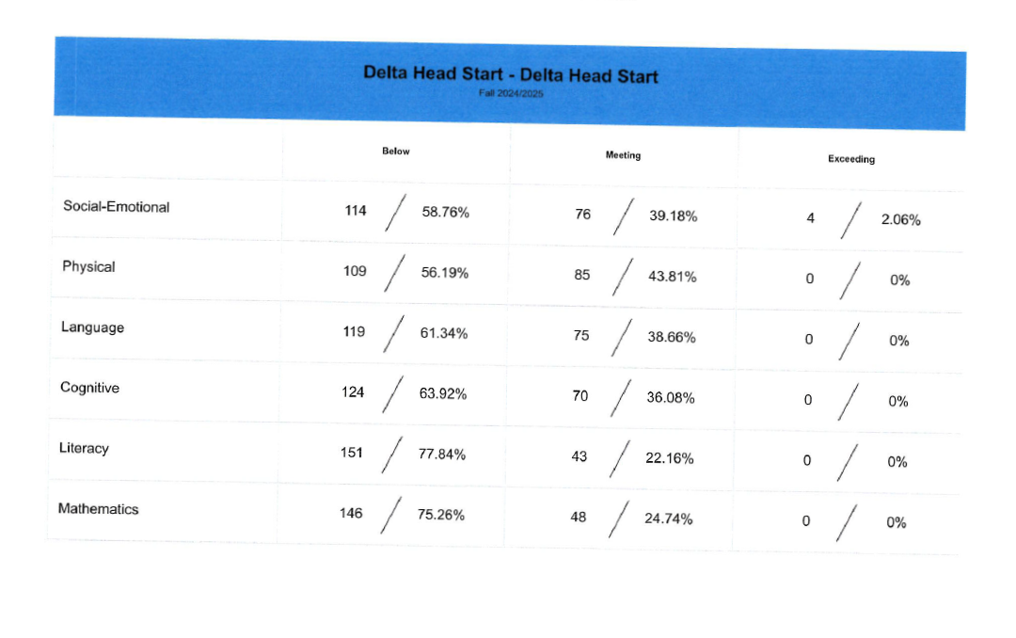

Slide 10
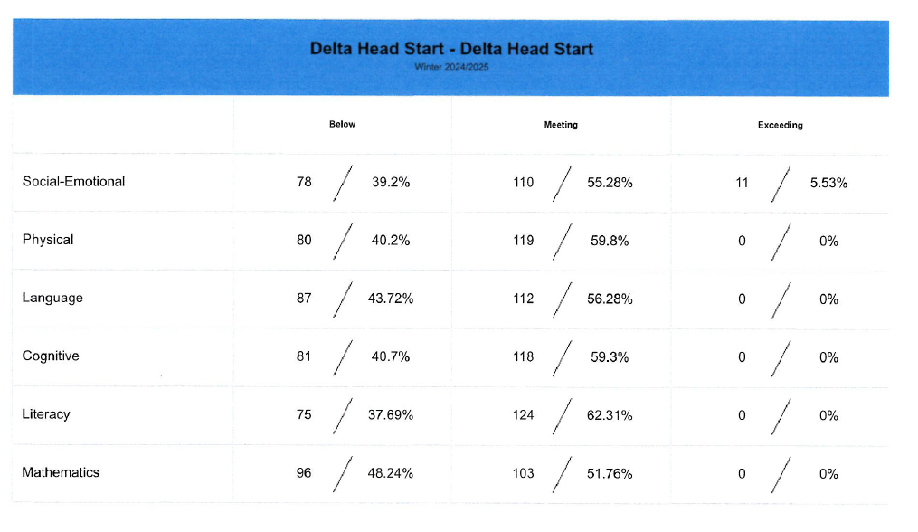

Slide 11
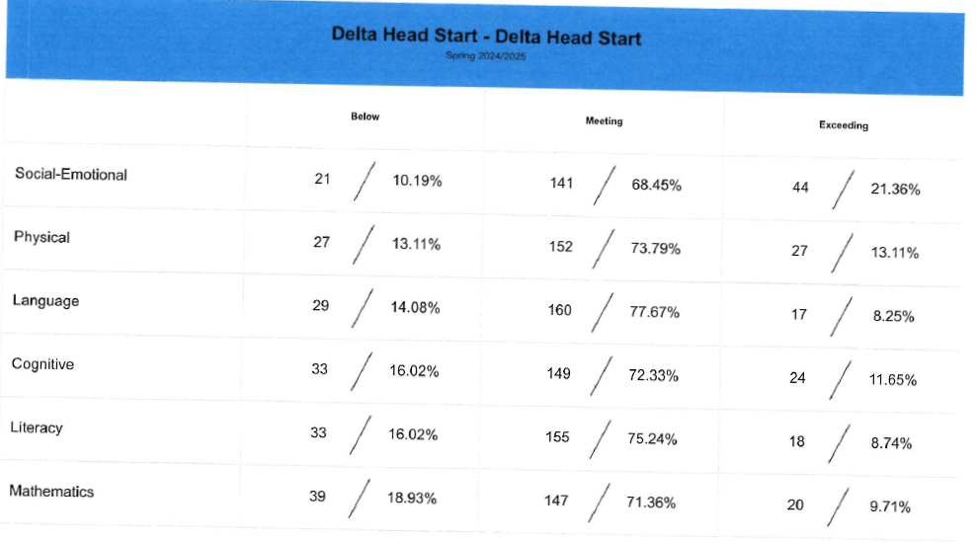

Slide 12
Meeting/Exceeding
Data Summary
Domains | Fall | Winter | Spring | % Change
Social-Emotional | 46% | 65% | 90% | 44%
Physical | 55% | 73% | 87% | 32%
Language | 46% | 68% | 86% | 40%
Cognitive | 41% | 68% | 84% | 43%
Literacy | 36% | 59% | 84% | 48%
Mathematics | 26% | 52% | 81% | 55%

Slide 13
Summary of Information
Teaching Strategies Gold is the assessment tool of the Creative Curriculum we use to measure educational outcome data. Our mid year data analysis revealed in the Summary Results Chart displays children steadily progressed in each domain. Based on current data the largest amount of growth occurred in the Mathematics domain with a 55% growth increase followed by a 48% growth in the Literacy domain, 44% in the Social Emotional domain, 40% in the Language domain%, and 32% in the Physical domain since the beginning of the school year. It is important to note although the least amount of growth based on percentage occurred in the Physical domain, 39.18% of children were meeting or exceeding in the physical domain at the start of the school year and current data indicates 59.8% of children are meeting or exceeding in this domain at the mid year point. This indicates teachers are being purposeful in their lesson planning to ensure all domains are being taught and individualization is taking place. Currently, data indicates we are meeting school readiness goals, strategic planning goals, as well as ensuring children will be ready for Kindergarten.
“Teaching Children and Reaching Families”

