Slide 1

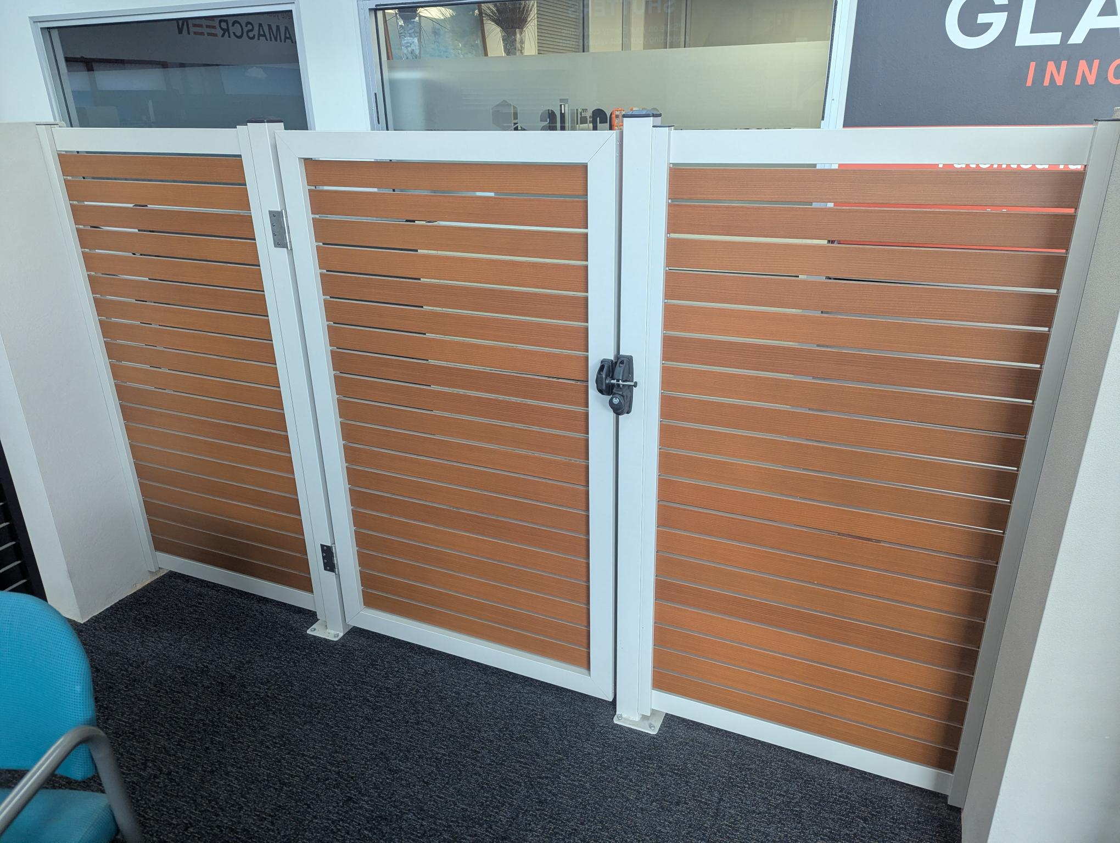

2026-10 SHAUN LANE
Glamascreen®
Shaun Lane 2026-08
Made-to-Measure
M2M
Name:
Address:
Phone:
Email:
1.
Use the next page to plan your Glamascreen fence and gates.
Provide ‘tight’ measurements (to the millimeter).
2.
Take pictures of the installation area.
⃞ Location Front
⃞ Location Rear
⃞ Post Locations
⃞ Connections to Walls
Be clear where transitions are between soil, concrete, walls, and raised garden beds.
3.
Send us your plan and pictures to sales@alucom.com.au.
We’ll respond with your estimate as quickly as we can.
Plan
Photograh & Annotate
Quote
Site Notes:
Glamascreen® Estimate
Example
Plan
830mm
B
970mm
B
830mm
Elevation
830mm
970mm
830mm
Rear View
!
Example Only
Images are not to scale
The individual circumstances of your site and construction will effect the final price. Subject to site inspection.
Please submit full plan details to sales@alucom.com.au for a full quote.
Alucom | Security Doors & Screens
156 Gladstone Street, Fyshwick | alucom.com.au | 02 6280 7465

Slide 2
2026-10 SHAUN LANE
Glamascreen®
Shaun Lane 2026-08
Made-to-Measure
M2M
Name:
Address:
Size & Style
Locks
8 / 25 mm | Gaps
mm | Height
 | Frame Colour
 | Slats Colour
 | Single-Sided Lock
 | Double-Sided Lock (standard)
 | D-Latch
Frames & Slats
Black
Monument
Installed or DIY
Woodland Grey
 | Supply Only for DIY
 | Installed
Dune
Slats Only
Primrose
Western Red Cedar
!
Custom Colour
Bush Cherry
Installation is subject to site inspection.
1.
G
In-Ground
2.
Existing wall
3.
B
Bolt Down
Fence Panel
Single Gate
A
Above-Ground
Posts
Walls & Fence
Gates
E
Existing
Double Gate
Glamascreen® Estimate
Alucom | Security Doors & Screens
156 Gladstone Street, Fyshwick | alucom.com.au | 02 6280 7465

