Slide 1

Private Wealth Solutions: Creating more impactful client relationships through your offering
Advisory services offered through CreativeOne Wealth LLC, a Registered Investment Adviser. For financial professional use only. Not to be distributed or shown to clients.

Slide 2





Private Wealth Solutions
A collection of strategies and products designed to help
advisors attract and service High Net Worth (HNW) clients.
Enhance ability to better service and scale current book of business.
Deep bench of solutions used individually or in concert to meet client needs.
Access to private markets.
Tax sensitive optionality and customization.

Slide 3

Private Wealth Solutions
55ip: Tax Transition and Tax Loss Harvesting
C1W UMA Suite: UMA-SMA-High Net Worth portfolios
Aperio: Direct Indexing
Custom Equity & Fixed Income SMAs through BlackRock and Zacks
SpiderRock:
Options overlay strategies
BlackRock Private Investment Fund (BPIF)
Goldman Sachs & Charles Schwab: Securities-Backed Lending
Greater Horizons: Charitable Giving and Donor-Advised Funds

Slide 4


What is the Opportunity?
High net Worth (HNW)
Ultra High net Worth (UHNW)
Mass affluent
An individual or HH with at least $500,000
in liquid assets
An individual or HH with at least
$1 million
in liquid assets
An individual or HH with at least
$30 million
in liquid assets

Slide 5
55ip
Tax loss harvesting, transition and distribution overlay
  Minimum Investment: $50k
  Additional Paperwork: One strategy per account, must update tax lot methodology to HCLOT (High Cost)
  Pricing: Standard admin, no additional fee for tax overlay tech.
  NOTE: Only available on C1W models and at Schwab. This is ideal for non-qualified accounts.

Slide 6
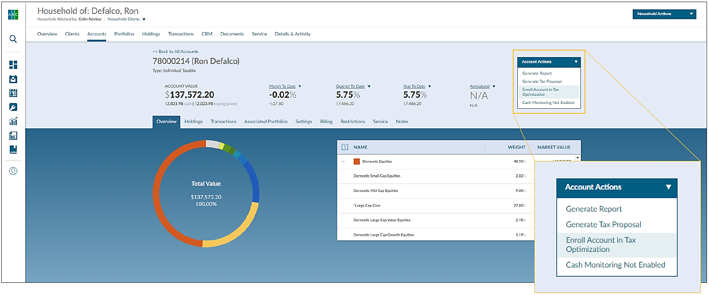
Ease of Integration on the C1W Platform
Notes:
I assume this one is a screen shot from the actual system, so I didn’t want to recreate it. Let me know if you want it build out instead.

Slide 7
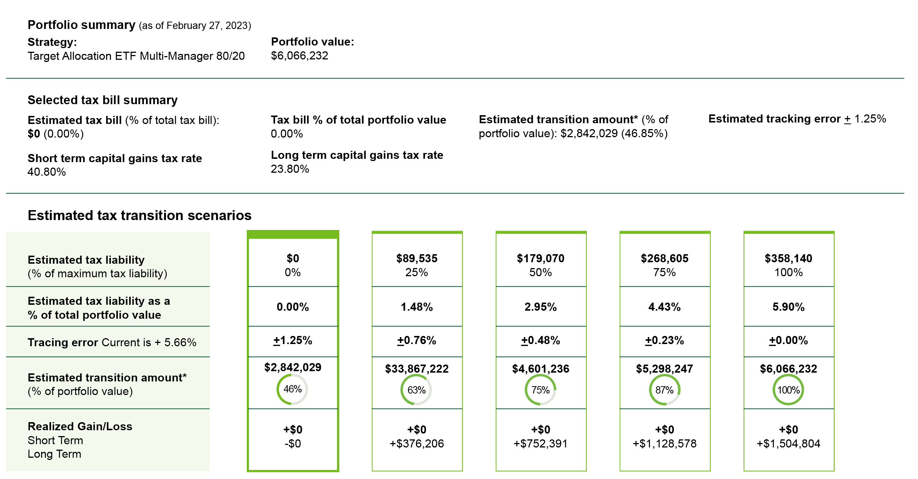
55ip

Slide 8
CreativeOne Wealth UMA:
Multi-Asset, Multi-Manger risk-based model of models.
  • Minimum Investment: $100k (Mass Affluent), $500k - $2mm (HNW)
  • Additional Paperwork: None
  • Pricing: Standard admin + Category
  • Ongoing communication: Quarterly marketing update by model and by each asset manager that is part of the UMA strategies

Slide 9
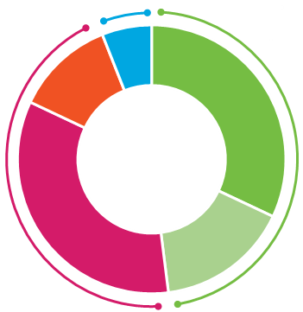
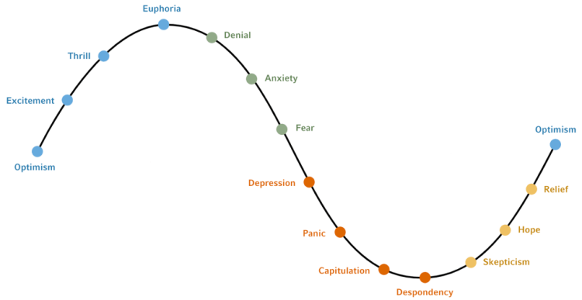
Holistic investment solutions for your HNW clients
SIMPLE YET POWERFUL
LONG-TERM INVESTMENT
SCALABLE
Multi-manager portfolios have a unique blend of strategies hand selected by our due diligence team.
Portfolios are diversified and actively managed and intended to be held over various market cycles.
An ecosystem of support, from due diligence to quality content, so you can spend more time with clients.

Slide 10
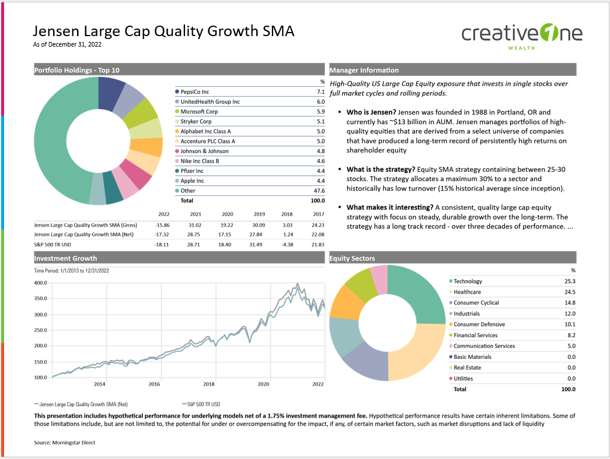
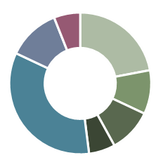
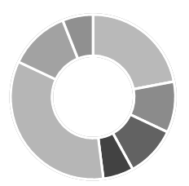
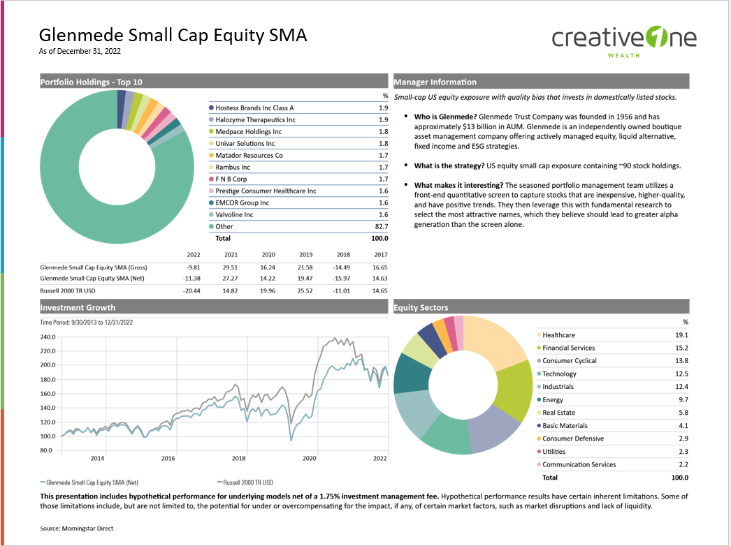
You select the portfolio – we do the rest
You select a portfolio that aligns with your client needs
We provide initial & ongoing investment management
You benefit from relevant content and commentary
A spectrum of Portfolios across:
Minimum “bite size”
Risk profiles
Tax preferences
Underlying vehicles (stock, ETF)
Portfolios navigate market cycles with:
Active engagement with the asset managers within the portfolio
Adjust mix of asset classes and asset managers in response to evolving market environments
Marketing material to support client conversations beyond initial pitch
Monthly market commentary
Quarterly portfolio updates

Slide 11
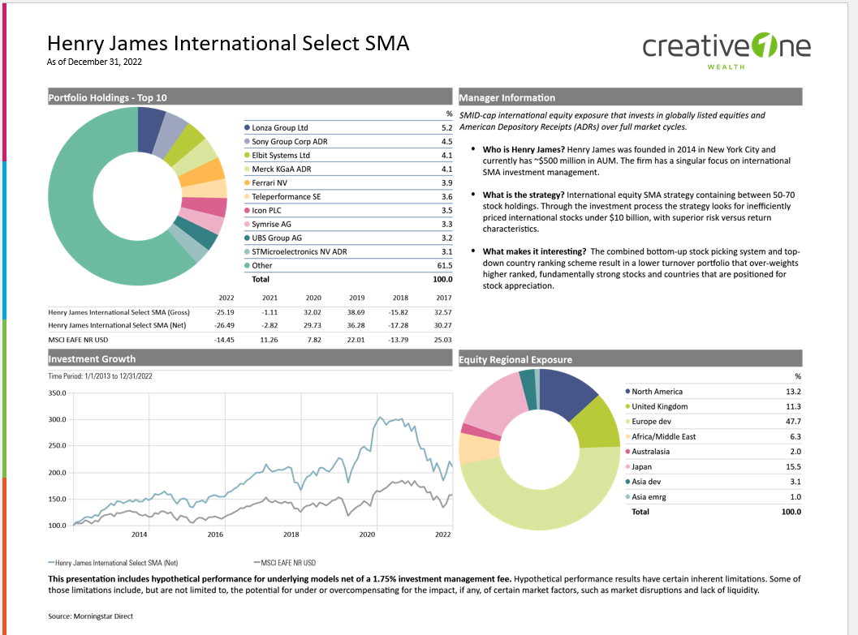
You receive relevant content & commentary for that portfolio
Almost 50% of Clients say they “wish” Advisor contacted them more
That increases almost 60% for older and higher value clients (+60 and >$500k AUM)
Quarterly Portfolio Updates
Overlay page on entire UMA with commentary from due diligence team
Top model or SMA holdings
250-word customized commentary from Portfolio Manager
Gross and Net performance charts
Sub-sector, style or positioning look-through

Slide 12
Aperio
Direct indexing, tax loss harvesting and transition service
  • Minimum Investment: $1mm (for only the equity portion of a client’s allocation)
  • Additional Paperwork: Yes, this would be in a standalone account
  • Pricing: Standard admin + 22bps
  • Ongoing communication: Updated tax information and reporting
  • Note: Securities only for transition purposes. No fixed income, ETFs, or mutual funds. This is ideal for non-qualified accounts.
Advisory services offered through CreativeOne Wealth LLC, a Registered Investment Adviser.
For financial professional use only. Not to be distributed or shown to clients

Slide 13
Greater flexibility, better possible outcomes
OVERVIEW
Five core benefits of an Aperio personalized, tax-optimized SMA
1
2
3
Core equity exposure
Seek pre-tax returns similar to the index with minimal tracking error.
Tax alpha
Aim to increase after-tax returns with advanced tax-loss harvesting.
In-kind transitions
Fund a new SMA while seeking to minimize unnecessary tax costs.
4
5
Personalization
Tailor a portfolio to each investor’s needs, preferences and personal values.
Future flexibility
Make tax-efficient strategy changes, deposits, and withdrawals.

Slide 14
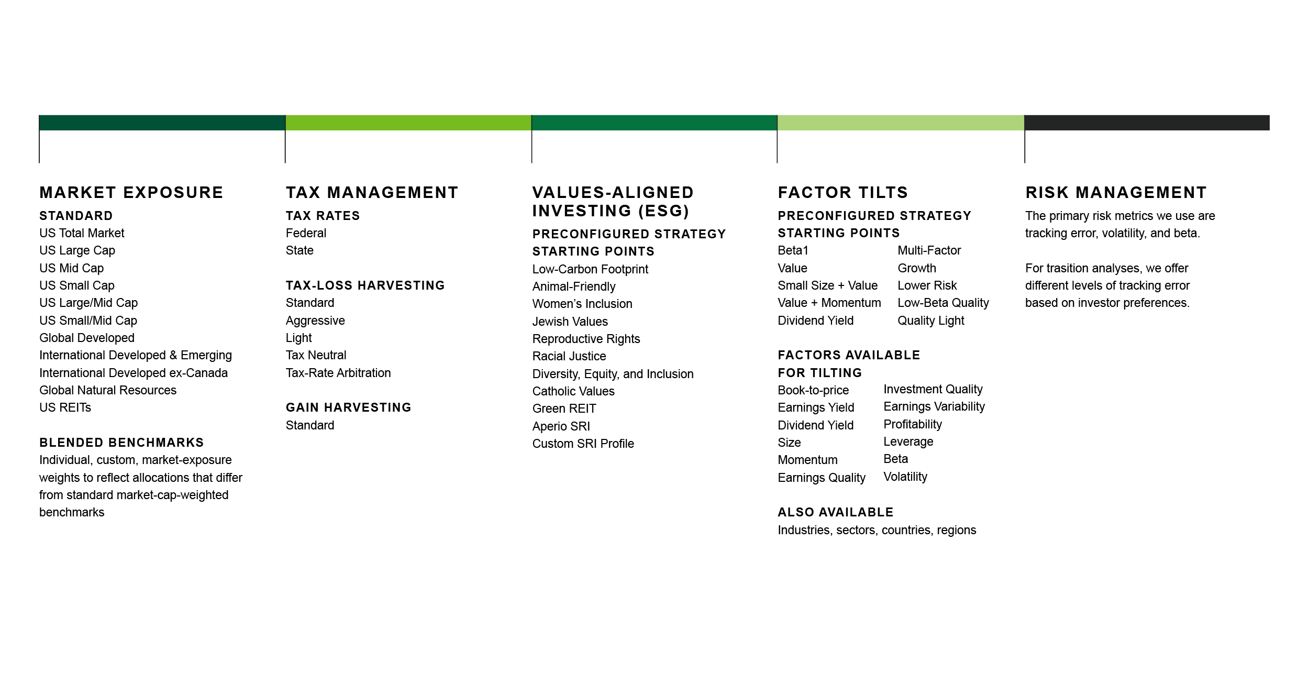
Thoughtful, precise personalization
OVERVIEW
Aperio portfolios are personalized and optimized around five dimensions.

Slide 15
Zacks Custom SMA:
Custom equity and/or fixed income portfolios
  • Minimum Investment: $250k for equity or equity/FI and $100k for FI only
  • Additional Paperwork: Yes, this would be in a standalone account
  • Will take embedded positions and offer ongoing tax loss harvesting
  • Can customize and blend Equity and FI in one account (rather than two separate accounts) – the minimum increases to $500k in this instance
  • Pricing: Standard admin + Zacks SMA fee (15 bps for FI and 30 bps for Equity)
Advisory services offered through CreativeOne Wealth LLC, a Registered Investment Adviser.
For financial professional use only. Not to be distributed or shown to clients

Slide 16
Zacks Custom SMA
TOP ADVANTAGES: AT A GLANCE
Custom strategies for asset allocation, fixed income and tax strategy
One-to-one process with an experienced Portfolio Manager
Access to investment strategies ranked in the top 8% of Morningstar’s performance rankings

Slide 17
We provide a one-to-one process of evaluating personal requirements, tailoring a custom solution and adapting to evolving needs
STEP 1
Your goals and Requirements
STEP 2
Your Custom Allocation and Tax Strategy
Identifying personal requirements such as tax, risk, liquidity and protection
Custom designing your investment strategy according to your needs and goals
HOW IT WORKS: AT A GLANCE
STEP 4
Quarterly Meetings
STEP 3
Implementation and Ongoing Service
Implementation, periodic rebalancing and quarterly review meetings

Slide 18
BlackRock SMA:
Custom fixed income portfolios
  • Minimum Investment: $1mm (Typical HH of $2mm plus)
  • Additional Paperwork: Yes, this would be in a standalone account
  • Pricing: Standard admin + Black Rock SMA fee (15 – 30bps)
Advisory services offered through CreativeOne Wealth LLC, a Registered Investment Adviser.
For financial professional use only. Not to be distributed or shown to clients

Slide 19
SMAs provide clients unique benefits
THE BENEFITS OF SMAS
Different from pooled vehicles, SMAs provide broad-market exposure through the direct ownership of securities which allows you to address your clients’ specific needs.
Benefits of owning individual securities include:
CUSTOMIZATION
TAX-EFFICIENT CAPABILITIES
GREATER FEE TRANSPARENCY
Personalization at the individual security level, including sector and industry restrictions and ESG screens.
Portfolios tailored to specific client objectives and liquidity needs.
Portfolios can be adjusted based on individual tax situations.
Customize municipal portfolios by state.
In-kind transitions to help avoid capital gains.
Often a lower-cost option than mutual funds.
Simple fee conversation with clients – wrap fee.
Potential for tiered pricing and relationship discounts.
For financial professional use only. Not to be shown or distributed to clients.

Slide 20
SpiderRock
Options overlay strategy
  • Minimum Investment: $250k
  • Additional Paperwork: Yes, this would be in a standalone account
  • Pricing: Standard admin + 36 – 85 bps
Advisory services offered through CreativeOne Wealth LLC, a Registered Investment Adviser.
For financial professional use only. Not to be distributed or shown to clients

Slide 21

SpiderRock makes it easy
GET TO KNOW SRA
Founded in 2013, SRA expertly delivers actively managed, customized option overlay strategies.
Designed for you
Easy to use
Full service
Option overlays work with existing holdings
Customization delivered at scale through powerful technology
Fully integrated with all major custodians including Schwab, Fidelity and TD
Daily account liquidity and full transparency
Custom proposals, performance reporting and operational support
Partnership on education and implementation
Having a partner with the experience, the knowledge and the tools make it easier to use option strategies effectively.

Slide 22
SRA evaluates each client’s portfolio and goals
Develop a custom options overlay strategy aimed at achieving the desired investing outcome, including:
Concentrated stock risk management
Strategies that target customized concentrated stock risk management, including tax-neutral liquidation.
Downside protection
Strategies that target downside protection for your current portfolio, ranging from a modest buffer to a defined floor.
Income generation
Strategies that target income generation from options premium.

Slide 23
BlackRock Private Investment Fund (BPIF)
Private Investment Fund
  Minimum Investment: $25,000 (must be accredited)
  Additional Paperwork: Yes, subscription docs.
  Pricing: Standard admin
  Ongoing communication: Circulation of updated fact sheets
  NOTE: Quarterly subscription & liquidation. 7% guaranteed liquid. Must be accredited investor.
Advisory services offered through CreativeOne Wealth LLC, a Registered Investment Adviser.
For financial professional use only. Not to be distributed or shown to clients

Slide 24
Private markets unleashed
Better opportunities meets easier access for accredited investors
The case for private markets
Looking back, looking forward
Liquidity: get the right balance
Unshackle your portfolio manager – trade daily liquidity for periodic liquidity
Private equity
It’s increasingly where wealth is created
Privates made simple
Listed and unlisted closed-end funds-say goodbye to lock-ups and onerous tax reporting
Private credit
As banks have stepped back, the direct
lending opportunities has emerged
Allocate to patient capital
Take a planning approach to how you invest:
your “later” money should be patient money
Private markets for the advisor’s practice
Private markets to unleash your practice
Your HNW clients may seek out private markets: understand why

Slide 25
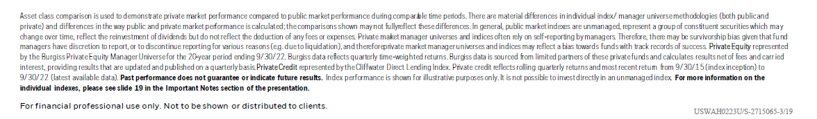
Looking back: the case for private markets
THE CASE FOR PRIVATE MARKETS
Private equity
Private credit
Annualized return of private equity manager universe and global equities
Annualized return of private
credit and U.S. bonds
14.8%
8.1%
8.4%
0.5%
Private equity
MSCI World
Private credit
U.S. Agg
Two premiums drive the outperformance
Liquidity premium
Expectation of higher return, in exchange for less liquidity and lower frequency of trading.
Complexity premium
Compensation associated with negotiating, structuring and underwriting private deals.

Slide 26
Schwab & Goldman (Securities Backed Lending):
Securities backed lending program
  • Minimum Investment: $75,000
  • Additional Paperwork: Yes
  • Pricing: SOFR plus spread, reset monthly
Advisory services offered through CreativeOne Wealth LLC, a Registered Investment Adviser.
For financial professional use only. Not to be distributed or shown to clients

Slide 27
Greater Horizons
Charitable giving and donor-advised funds
Give: Give cash, stock, property, or other assets to your donor-advised fund. Contributions are tax deductible.
Grow: Your charitable dollars are invested and grow tax-free.
Grant: When you are ready, designate where your donor-advised fund grants will go to support your favorite charities.
Advisory services offered through CreativeOne Wealth LLC, a Registered Investment Adviser.
For financial professional use only. Not to be distributed or shown to clients

Slide 28
For educational purposes only.
This information is designed to provide a general overview with regard to the subject matter covered and is not state specific. The authors,
publisher and host are not providing legal, accounting or specific advice for your situation. This presentation was prepared exclusively for
information and discussion purposes, and is not meant to be, nor shall it be construed as, an attempt to define all information that may be
material to you.
All information including opinions or facts expressed herein are current as of the date appearing in this presentation and is subject to change without notice. All information has been obtained from sources believed to be reliable. No representation, warranty, or undertaking, express or implied, is given as to the accuracy or completeness of the information or opinions contained in this presentation. The information and opinions in this presentation do not constitute investment advice. For Professional Use Only.
©2022 CreativeOne Wealth, LLC Investment advisory Services offered through CreativeOne Wealth, LLC a Registered Investment Adviser.

