Slide 1
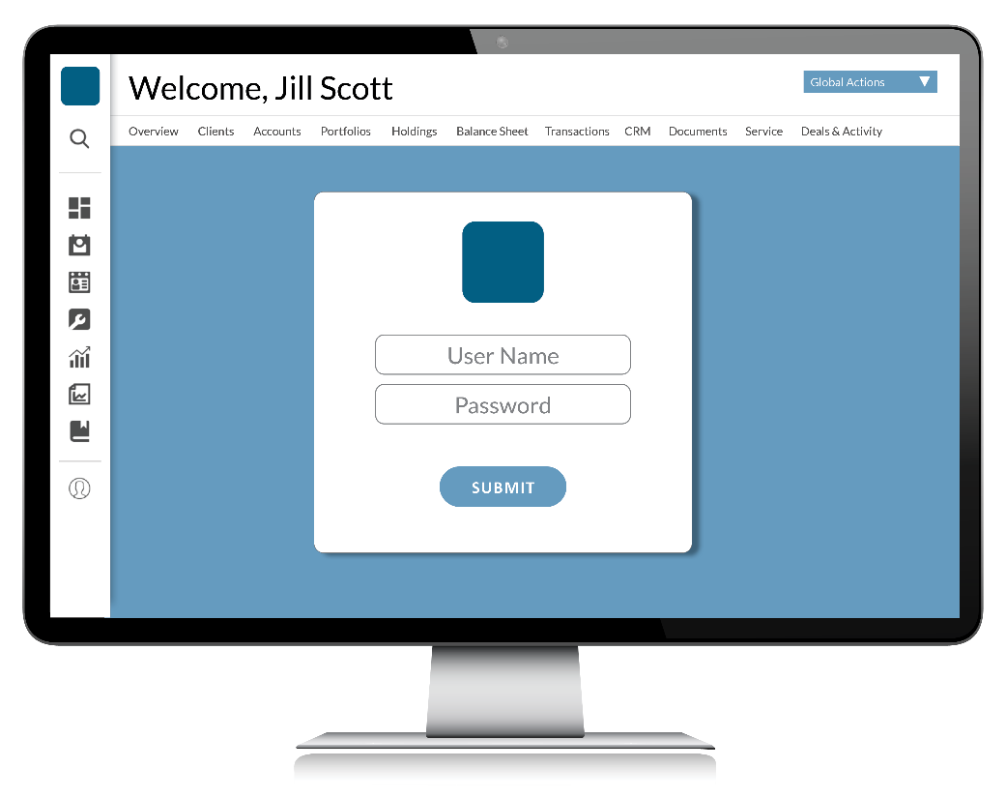
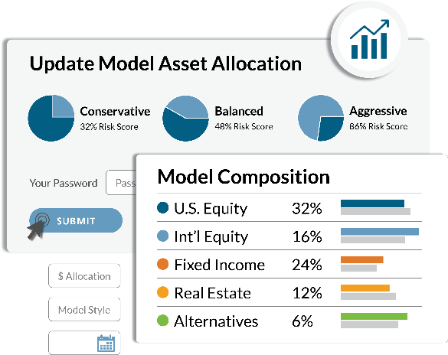
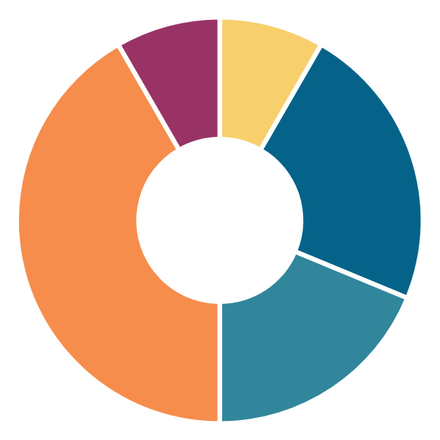
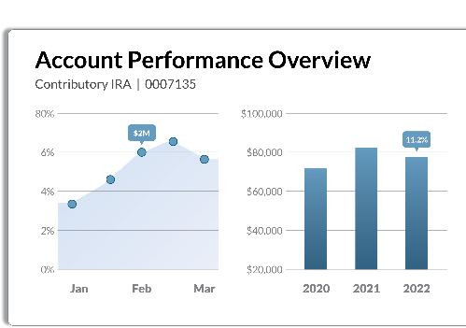
GeoWealth CreativeOne
Multi-Manager Portfolios
NOT FOR FURTHER DISTRIBUTION.
© 2024 Private & Confidential. GeoWealth, LLC.
Investment Advisory Services Provided by GeoWealth Management, LLC.

Slide 2
Agenda
GeoWealth CreativeOne Multi-Manager Portfolios
Overview
The GeoWealth Investment Solutions team
The UMA structure
UMAs across the risk spectrum
Deeper dive
The underlying models
Where to find the UMAs on the platform
Marketing collateral

Slide 3
Multi-manager Investment Solutions
Simple yet comprehensive
multi-manager investment solutions
Today’s clients have high expectations when it comes to investment management. Your firm can team up with GeoWealth to design a suite of investment portfolios to help you meet those needs with one comprehensive solution.
Our investment portfolios offer:
A suite of simple, yet powerful investment portfolios across client risk profiles
Access to institutional asset managers - both big brand and boutique
Smart and concise market and portfolio manager commentary
★
★
★
These multi-manager unified managed accounts (UMAs) are designed to meet individual client risk profiles and goals over the long-term.

Slide 4
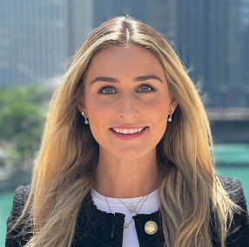
GeoWealth Investment Solutions team
Seven dedicated investment employees with two CFAs, two Masters in Mathematics, one MBA
Experienced in all aspects of investment solutions, including asset allocation, portfolio implementation, manager selection, due diligence, research, and thought leadership.
Team Leadership
Jen Wing, MBA Head of Investment Solutions
15 years’ experience
Patrick Krulik, CFA Chief Investment Officer
20 years’ experience
Ivo Ivanov, CFA, CIPM Head of Investment Research
25 years’ experience
Dedicated Investment Team
Josh Smith
Portfolio Manager Associate
Stoyan Iliev
Investment Research Associate
Charles Staples
Investment Solutions Manager
Lindsey Repp Client Portfolio Manager

Slide 5
The UMA Structure
Zero IM Fee Models:
Allocate to: Proprietary ETFs, Mutual funds
Model Overlay Fee: 0 bps
IM Fee Models:
Allocate to: Third Party ETFs, Mutual Funds
Model Overlay Fee: 20-30 bps
Stocks Models:
Allocate to: Stocks or ADRs
Model Overlay Fee: 25-50 bps
First Trust Moderate ETF Model
 | First Trust Large Cap Value ETF
 | First Trust NASDAQ Tech ETF
 | First Trust Long Duration ETF
 | First Trust TCW Opportunistic ETF
Franklin Templeton Core Multi-Manager 50/50
 | Clearbridge Large Cap Growth ETF
 | iShares Core S&P 500 ETF
 | T Rowe Price Overseas Stock MF
 | Brandywine Global Bond MF
Jensen Quality Growth SMA
 | Apple
 | Automatic Data Processing Ord
 | Broadridge Financial Solutions
 | Home Depot
A
B
C
Unified Managed Accounts (UMAs):
Any mix of Manufacturer, Strategist, and/or Separately Managed Accounts
Each model or SMA makes up a separate sleeve in the UMA
Unified Managed Account (UMA)
 | Model A | First Trust Moderate ETF Model
 | Model B | Franklin Templeton Core Multi-Manager 50/50
 | Model C | Jensen Quality Growth SMA

Slide 6
Mass-Affluent UMA Suite
Illustrative UMA Offering
Mass-Affluent UMA Suite
KEY STATISTICS:
As of June 2023 and subject to change.
*Bonus UMA
MASS AFFLUENT:
6
$100k Minimum client investment
6 UMAs Consisting of 5 different investment managers
~20 Underlying ETFs
5
4
Aggressive
Diversified Equity
3
Growth
Balanced
2
Moderately Conservative
5 Underlying Models + 1 Bonus Model
 | Large Cap US Equity ETF Model
 | International Equity ETF Model
 | Core Fixed Income ETF Model
 | Tactical Fixed Income ETF Model
 | Alternatives ETF Model
 | Thematic Equity ETF Model
1
Conservative
*Bonus Model

Slide 7
High Net Worth (HNW) Suite
Illustrative UMA Offering
High Net Worth (HNW) Suite
KEY STATISTICS:
As of June 2023 and subject to change.
HNW (SMA):
$500k-$2mm Minimum client investment
5 UMAs Consisting of 7 different investment managers
~20 Underlying ETFs
~170 Individual Stocks
5
4
3
Aggressive
Growth
Balanced
2
Moderately Conservative
7 Underlying Models
 | Large Cap US Equity Stock Model
 | International Equity Stock Model
 | Small Cap US Equity Stock Model
 | Emerging Markets Equity ETF Model
 | Core Fixed Income ETF Model
 | Tactical Fixed Income ETF Model
 | Alternatives ETF Model
1
Conservative

Slide 8
The Underlying Components
Best in-class strategies from boutique and big brand asset managers
MASS AFFLUENT UMA SUITE:
5 Underlying ETF Models + 1 Bonus ETF Model
HNW (SMA) SUITE:
3 Underlying SMA Models + 4 Underlying ETF Models
EQUITY
 | Large Cap Core Equity | Main Management Active Sector Rotation Model
 | International Equity | GeoWealth International Equity ETF Model
FIXED INCOME
 | Core Fixed Income | PIMCO Taxable Fixed Income: Enhanced Core ETF Model
 | Tactical Fixed Income | Dorsey Wright Tactical Fixed Income Model
ALTERNATIVES
 | Alternatives | First Trust Alternatives Strategic Focus ETF Model
THEMATIC
 | Thematic Equity | Global X Equity Thematic Disruptors ETF Model
EQUITY
 | Large Cap Core Equity | Jensen Quality Growth SMA
 | International Equity | HJIM International Select SMA (optional)
 | Small Cap Equity | Glenmede Small Cap Diversified SMA
 | Emerging Markets | GeoWealth Emerging Markets ETF Model
FIXED INCOME
 | Core Fixed Income | PIMCO Taxable Fixed Income: Enhanced Core ETF Model
 | Tactical Fixed Income | Dorsey Wright Tactical Fixed Income ETF Model
ALTERNATIVE
 | Alternatives | First Trust Alternatives Strategic Focus ETF Model

Slide 9
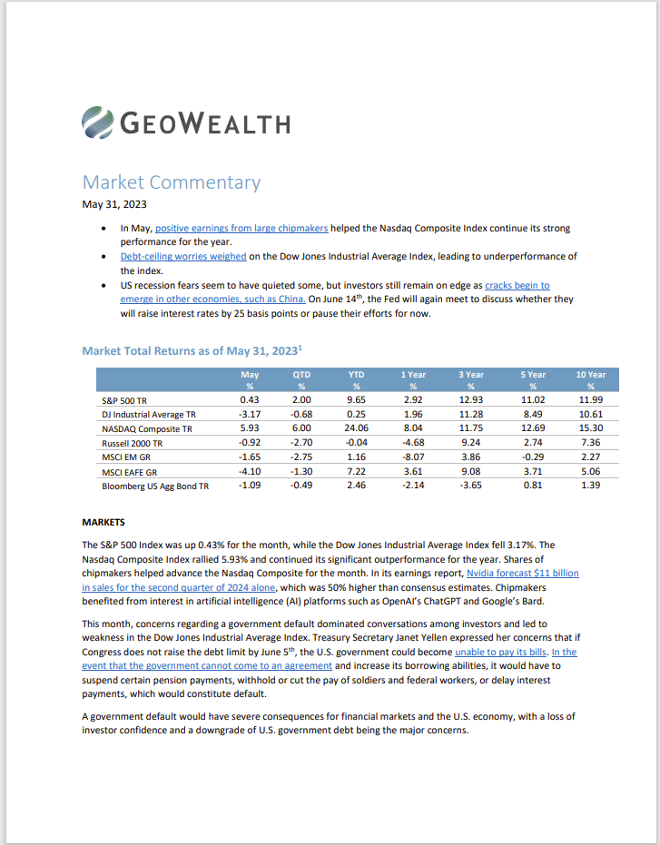
Keeping Your Clients Informed
Monthly Market Commentary so you can stay informed and start client discussions
Relevant and timely market commentary every month
General market update
Macro/Fed policy and rates
Actionable ideas
Quick market return snapshot
Compliance approved so you can share with your clients and prospects

Slide 10
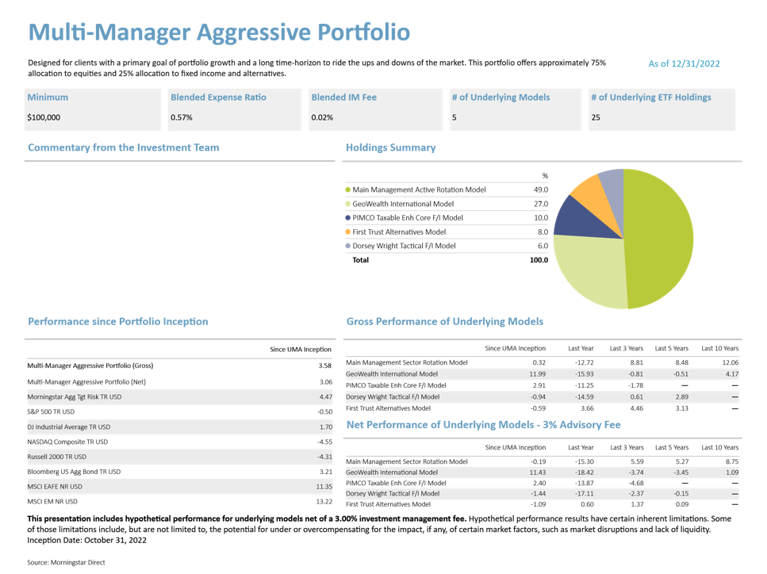
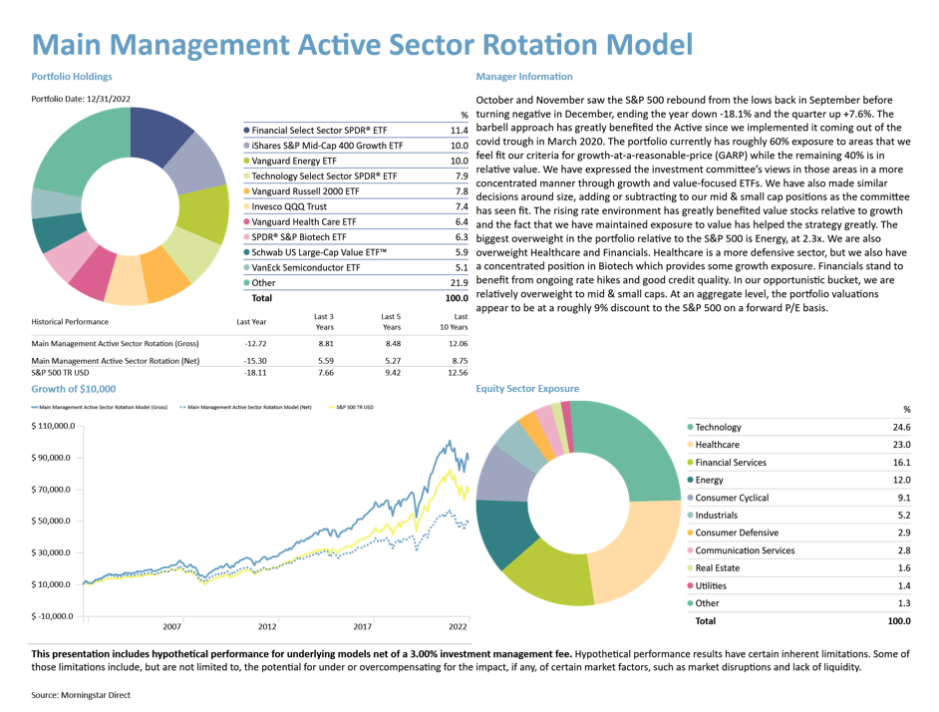
Investment Collateral
Thoughtful white-labeled collateral to enhance
client engagement and understanding
Overview bullets and statistics from the GeoWealth Investment team at the UMA level
Performance, holdings and written commentary straight from the third-party model portfolio managers
In Q1, volatility remained high. Overall markets showed resiliency – but not without taking investors – and our UMA portfolios – on a wild ride.
U.S. Equity: Main Active Sector rotation strategy was overweight Energy and Financials coming into Q1, which hurt returns. They were active during the quarter, trimming both sectors and adding to growth. While no one has a crystal ball, we feel confident in their positioning for 2023.
International Equity: Allocations to iShares factor international and JPMorgan’s active ETF in EM delivered results in-line with the market’s positive results.
Fixed Income: PIMCO Taxable Enhanced Core delivered solid relative performance. Portfolio Managers were active under the hood of the ETFs, adding to TIPS and duration, and staying up in quality.
Tactical Fixed Income: Dorsey Wright Tactical outperformed, adjusting to market swings with quick moves from “risk on” to “risk off” positioning.

Slide 11
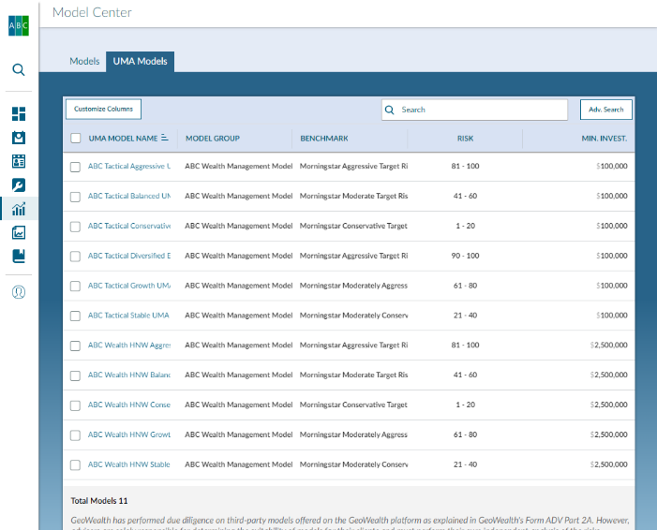
Getting Started
Strong investment solutions are at your fingertips
As the advisor, you select a portfolio that aligns with each client’s preferences and risk profile
Your
Team
GET STARTED TODAY
How to access the Multi-Manager UMAs:
★
EXPLORE
★
PITCH
★
GET SUPPORT
Check out the holdings and key statistics of each UMA Model in the platform
Run an Investment Proposal via the Client Dashboard to pitch the UMA to a client
If you have questions on how to access the models or enroll clients, reach out for support
PATH:
Model Center >
UMA Models
PATH:
Client Household >
Generate Proposal
PATH:
Email the GeoWealth Asset Management Team
AssetManagement@geowealth.com

Slide 12
Appendix

Slide 13
Manager Selection Inside of the UMA solutions
1
2
3
Our due diligence framework is rigorous and centered around evaluating the 4Ps: People, Philosophy, Process and Performance.
We believe manager selection is an art and a science, and therefore use both qualitative and quantitative analysis to select each manager.
We do not rely solely on past performance. We select managers that we believe will deliver long-term, risk-adjusted performance within their asset class.
ALLOCATING TO A MANAGER | TERMINATING A MANAGER
Performance | Performance
Consistency of performance versus benchmark and peers | Out-of-line with expectations within a reasonable time period.
Correlation to other managers and over various markets | Returns aren’t explainable and/or understandable
Impact of fees on performance | Changes in fees
People | People
Manager resources, expertise and team | Meaningful team changes that impact portfolios
Big brand with global resources, or small boutique with sole focus | Compliance/audit/legal issues
Philosophy & Process | Philosophy & Process
Strategic, dynamic or tactical | Changes to model mandate, philosophy or process
High or low turnover | High or abnormal turnover
Style or factor tilts | Capacity issues (can “close to new money”)
Transparency | Transparency
Does the manager have the willingness and ability to provide data transparency such as attribution | Ceases to provide data and transparency needed to evaluate the strategy effectively
Do we have access to the portfolio management team? | Ceases to provide content needed communicate effectively to clients

Slide 14
Core Fixed Income Exposure
People: PIMCO is a leading global fixed income asset manager based in California. PIMCO manages $1.8 trillion in assets for a wide variety of clients including central banks, sovereign wealth funds, pension funds, endowments, foundations, and individual investors.
Philosophy/Process: An outcome-oriented, concentrated model of PIMCO active and smart index ETFs that relies on forward-looking views, robust risk management, and the sector expertise to produce an optimal portfolio for a given level of risk.
Role in UMA: This model provides core fixed income exposure. It seeks to improve yield and interest rate risk from core fixed income.

Slide 15
Tactical Fixed Income Exposure
People: Dorsey Wright is a technical research and asset management firm with offices in Pasadena, CA and Richmond, VA. DW was founded in 1987 and acquired by Nasdaq in 2015.
Philosophy/Process: The foundation of DW’s research and investment philosophy is relative strength. This model is a quantitative strategy that can invest in a wide range of asset classes including U.S. Treasuries, inflation-protected securities, corporate bonds, convertibles, high yield bonds, and emerging market bonds.
Role in UMA: This model is a complement to core fixed income. It seeks to provide income and stability by allowing the portfolio to increase or decrease risk depending on the market environment.

Slide 16
Diversified Alternatives Exposure
People: First Trust is a privately owned asset manager with over $130 billion in assets under management. FT was established in 1991. The dedicated alternatives portfolio managers, John Gambla and Rob Guttschow, have over 30- and 25-years’ experience in the alternatives industry, respectively.
Philosophy/Process: This active ETF model is made up of "diversifiers" and "return enhancers," which can be dialed up and down depending on what type of market environment we are in. Investments may include hedged equity, managed futures, currency, opportunistic credit and inflation protection.
Role in UMA: This model is meant to add diversification to traditional equity and fixed income strategies.

Slide 17
Global Thematic Equity Exposure
People: Global X was founded in 2008 on the foundations of thematic growth, income and international ETFs.
Philosophy/Process: This Global equity model uses an open-architecture approach to identify themes within the early adaptors stage; targeting companies that may be poised to benefit from structural shifts in technology, people and demographics, and infrastructure development – such as Autonomous & Electric Vehicles, Robotics & AI, and Cloud Computing.
Role in UMA: This model provides global exposure to structural themes that may be disrupting various segments and sectors in the broad market, with a focus on technological disruption.

Slide 18
High Quality large cap equity exposure
People: Jensen is a boutique asset manager that was founded in 1988 in Portland, OR to cater to high-net-worth individuals. Jensen currently manages $12bn in AUM. The firm has a singular focus on SMA investment management.
Philosophy/Process: Strategy contains 25-30 high return on equity (ROE) businesses. Process focuses on business with stead, durable growth over the long-term.
Role in UMA: This model provides large cap US equity exposure across a diversified set of sectors and a historically low turnover (15% historical average since inception), with over three decades of a track record.

Slide 19
Small cap US equity exposure with a quality bias
People: Glenmede Trust Company was founded in 1956 and has approximately $13bn in AUM. Glenmede is an independently owned boutique asset management company offering actively managed equity, fixed income and ESG strategies.
Philosophy/Process: Seasoned portfolio management team utilizes a front-end quantitative screen to capture stocks that are inexpensive, higher quality and have positive trends. They pair this with fundamental research to select the most attractive names, which they believe should lead to greater alpha generation over time.
Role in UMA: This model provides US small cap exposure with approximately 90 names.

Slide 20
International equity exposure across globally listed equities and American Depository Receipts (ADRs.)
People: Henry James was founded in 2014 in New York City and currently has $500mm in AUM. The firm has a singular focus on international SMA investment management.
Philosophy/Process: The investment process looks for inefficiently priced international stocks – with a high conviction, low turnover approach. The philosophy combines bottom-up quantitative and fundamental stock analysis with a top-down risk mitigating country allocation system.
Role in UMA: This model provides International equity exposure, mostly leaning SMID cap, with about 50-70 names.

Slide 21
Efficient Emerging Market equity exposure
People: GeoWealth selects one or more ETFs to garner ETF exposure.
Philosophy/Process: The Dimensional Emerging Core ETF aims to achieve long term capital appreciation by offering a broadly diversified, total market exposure. The strategy aims to add value with a modest emphasis on securities with higher expected returns.
Role in UMA: The model is comprised of a single ETF with a 35bps expense ratio and a 5% turnover ratio.

