Slide 1

TIME STUDY TRAINING
Prepared for:
INDIANA MENTAL HEALTH PROVIDERS

Slide 2
Introduction
This training is to give you the instructions necessary to complete the time study during the week of October 13th – October 24th, 2025. There are three parts to the training and a quiz after each section. The training should take 30 – 45 minutes to complete. You may quit and return to the training at any point, the system will save your place. However, you must complete the training prior to the time study week and pass all three quizzes to meet the mandatory training requirement.
The training is complete, and your score will be recorded once you arrive at
the last slide that contains our program’s tollfree number in red.
If at any time you have a question regarding the time study or this training, please do not hesitate to call InteCare at
1-888-591-6128.

Slide 3
Learning Objectives
Part One: Understand the MHFRP Program
Part Two: Learn how to complete the time study
Part Three: Identify what activity codes to use

Slide 4
What Is The Mental Health Funds Recovery Program?
Indiana’s federally approved Medicaid reimbursement program requires certified mental health agencies to perform Medicaid administrative activities on behalf of the State of Indiana
Rather than the State operating a continuum of comprehensive community mental health care, it has determined the purpose of certified community mental health agencies are to also carry out functions that a State employee would perform in operating and managing State Medicaid programs
Medicaid administrative activities are activities ensuring Medicaid recipients receive comprehensive health care services that go above and beyond exceptional clinical care in a fee for service environment
The MHFRP is in addition to Medicaid fee-for-service direct care
reimbursement, including MRO, due to the additional requirements for certified mental health agencies

Slide 5
Why Are We Doing a Time Study?
A time study is an administratively efficient mechanism to quantify the time and effort agency staff spend performing Medicaid administrative activities
The intent of the time study is:
  To identify allowable Medicaid administrative activity
  To identify non-allowable Medicaid administrative activity for exclusion from the claim
  To provide support documentation that administrative activities were performed and do not duplicate other federal payments made to the agency
Completed time studies are aggregated into a state-wide time study
“result” that is applied to each agency’s MHFRP claim

Slide 6
Why is Training Important?
The time study results are a significant driving force for your agency to receive reimbursement
Training assures the accuracy and integrity of the program
Training keeps you updated with any programmatic changes

Slide 7



What is an Administrative Activity?
Administrative
Activity
Direct Service
Administrative Activity
Refer a patient for counseling
Participate in program planning meeting
Provide counseling

Slide 8
Types of Activities Performed by Agency Staff
There are many types of Medicaid administrative activities:
Client specific – activities that facilitate client and family access to care including care planning and coordination or arranging for transportation to and from Medicaid services
Non-Client specific – outreach and public awareness activities that assist potential Medicaid recipients learn about Medicaid services
Agency specific - activities that Indiana Medicaid employees would perform but have required your agency to perform on their behalf. For example, an advanced clinician (not the direct care provider) certify the diagnosis and treatment plans of Medicaid recipients; oversight of medical treatment/interventions minimally 90 days, and development of new state Medicaid programs to name a few.

Slide 9
Examples Of Medicaid Administrative Activities
Participating in Medicaid community outreach and public awareness
Seeking out Medicaid recipients that are medically at risk
Helping Medicaid recipients find Medicaid services and providers
Facilitating applications to become a Medicaid recipient
Assisting Medicaid recipients in making appointments and/or arranging for transportation to and from Medicaid services
Review of Medicaid treatment plans as required by the State of IN for specific state Medicaid programs your agency provides
Review of State program standards, quality requirements, assuring State of IN standards are met
Medicaid Mental Health Program planning for the State of IN

Slide 10

Time Study Selection Process
MHFRP
Database
Agency Roster
Time Study Participants
Time Study Week

Slide 11
Time Study Selection Process
Each quarter your agency sends InteCare a roster. The roster lists the names of all the employees at the agency who perform Medicaid administrative activities. Each name is placed in the appropriate participant category.
InteCare then puts the positions from all 32 agency rosters into an Access database and selects the time study participants from that state-wide database by participant category.
The process to select the time study participants is done by an approved random methodology. If you want more details on that methodology, please call InteCare at 1-888- 591-6128.

Slide 12

How Are Claims Calculated?
Time Study (T/S)
Staff selected to participate in T/S
Staff participate in T/S
T/S results tabulated
Financial Data
Agency expenditure data Collected
Expenditure data aggregated
Medicaid Eligibility Rate
Agency Medicaid eligibility Rate collected – The percent of clients Medicaid pending or Medicaid eligible
Agency Claim Calculated

Slide 13
How Do Dollars Flow?
Participating agencies list eligible staff on the roster and send to InteCare.
Randomly selected staff complete time study.
InteCare calculates % of eligible time after completed time studies are submitted.
Cost and Medicaid eligibility rates are submitted from each participating agency.
Claim is computed and submitted to the state.
The state is paid and returns payment to InteCare for distribution to agencies.

Slide 14
Part One: Understanding The MHFRP
QUIZ
Medicaid Administrative Claiming activities are activities a state employee would otherwise perform, but the state has required my agency to perform the activities on their behalf.
True
False
The time study is a productivity tool.
True
False
Your participation is key to the success of this program.
True False

Slide 15
Learning Objectives
Part One: Understand the MHFRP Program
Part Two: Learn how to complete the time study
Part Three: Identify what activity codes to use

Slide 16
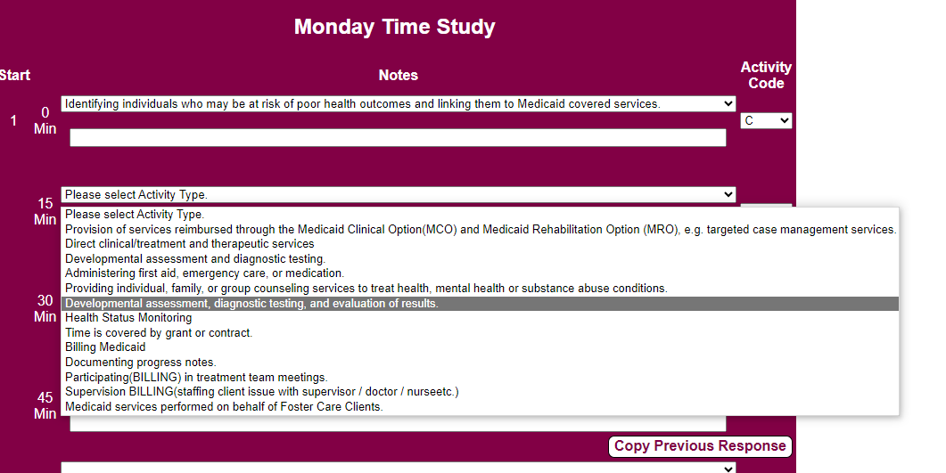

New Online Time Study
We have upgraded to a new online Time Study!
This new Time Study includes drop down choices for each code and a notes section.
In order to submit a time study, both a note and a code must be completed.

Slide 17
Materials Provided to Complete Time Study
You will receive a link via email on the first day of the time study week that includes the following information:
Activity code section – Select the code that represents your activities during the time study week.
Activity dropdown – Select the activity from the dropdown list that best describes what you are doing.
Notes section – Where you make notes of your activities during the time study week.
Time study instructions – Link located at the top of your time study.

Slide 18
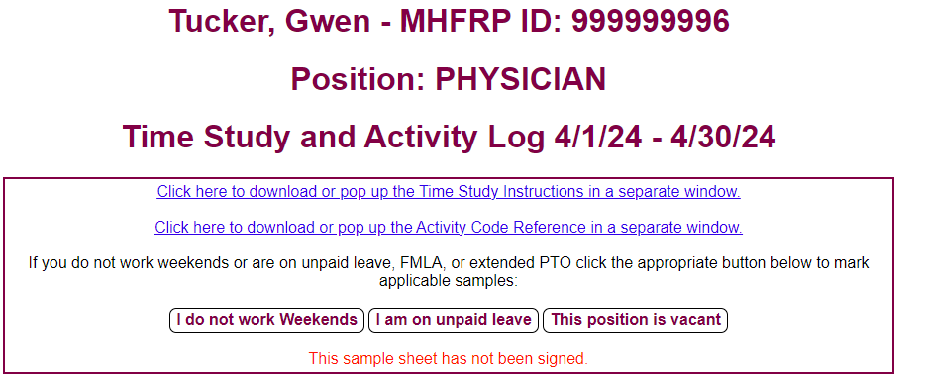
Participant Categories
Your time study shows your MHFRP ID, name, and participant category.
Take a look at the participant category to which you have been assigned.

Slide 19
Participant Categories
Non-SPMP | SPMP
Administrator | Physician
Case Manager | Nurse
Case Coordinator | Psychologist
Intake Specialist | Social Worker (LCSW, LSW)
Program Specialist | Licensed Therapist
Social Worker
Support Services Personnel
Unit Director

Slide 20
What Defines Skilled Professional Medical Personnel (SPMP)?
Federal regulations state staff are classified as SPMP if the following criteria are met:
  Licensed in a medically related profession;
  Have a position with duties and responsibilities that require their professional medical knowledge and skills.
Note: Contractors should not use SPMP codes

Slide 21
Additional Information For Skilled Professional Medical Personnel (SPMP)
Individuals qualified as SPMP are required to designate when the Medicaid activities they perform on behalf of the State of Indiana that a state employee would otherwise perform, REQUIRE their SPMP skills
Please note, that if a non-licensed person (non-SPMP) can do it, the activity is not eligible to be claimed as SPMP activity
For example, arranging transportation to a Medicaid service may be performed by a licensed staff, but is NOT considered an SPMP activity

Slide 22
Guidelines for Notes Section
The notes section needs to be completed in conjunction with the activity code section as supportive documentation.
Notes must include enough detail to support activity codes selected to support that this is a Medicaid administrative activity.
Notes are subject to audit and may require paybacks if not sufficient to support the activity code selected.

Slide 23
Guidelines for Notes Section (Continued)
Comments should be descriptive enough to distinguish between a Medicaid administrative activity or non-Medicaid administrative activity. Without clear notes, Medicaid administrative activities will be rejected.
CODE | INCORRECT | CORRECT
G1 | Staffing | Reviewing treatment/progress for IOP program and receiving recommendations from medical lead
A | Charting | Case notes from group therapy session
G2 | Supervision | Review client treatment plan progress and signing off on treatment plans
I | Driving | Driving to meet with Social Worker students to educate about Medicaid programming and opportunities in IN
G1 | Making phone calls | Calling clients to remind them of upcoming primary care appointments and seeing if they need transportation
G2 | Meeting | Providing medical recommendations to the team for high-risk persons calling the 24/7 access line

Slide 24
Time Study Guidelines
Complete the time study for the seven-day period, beginning Monday, July 21st and ending Sunday, July 27th .
Code all twelve hours per day; time should be coded in fifteen-minute increments.
□ When you are done coding your hours worked, use Code O to complete your time
study for hours ‘not scheduled to work’.
Select one activity code and the corresponding dropdown activity that best describes what you were doing during the majority of the fifteen minutes.
Begin coding your work time during hour one (1) on each day of the time study (Where it says Start).
Electronically sign the signature page of the time study to verify your completion.
Submit your time study once you have completed it.
This quarter’s time study is due Monday, July 28th, 2025.

Slide 25
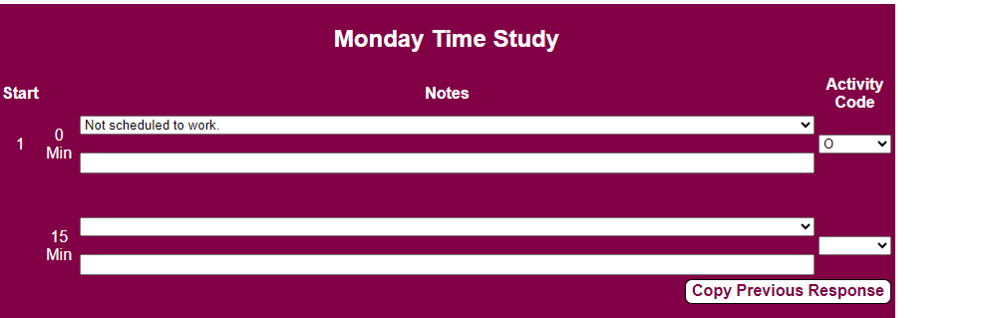
Time Study Example
Always start coding your time at the first increment indicating the first hour worked.
1. Select an activity code
2. Select your activity
3. Type your notes.

Slide 26
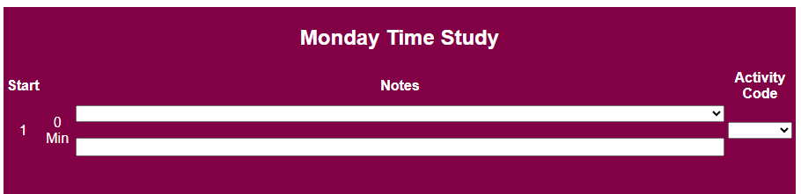
Time Study Example
Always start coding your time at the first increment indicating the first hour worked.
Note: The time represents hours of work; not the actual time of day.

Slide 27
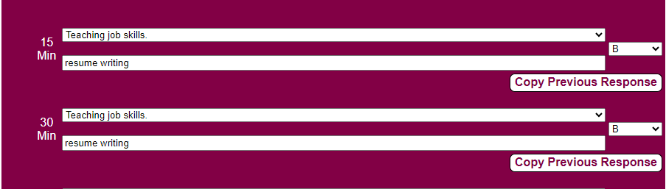
Correct Time Study Example
If you are doing an activity for a period of time, you can use the ‘Copy Previous
Response” button to prepopulate the notes and activity code for the next increment.

Slide 28
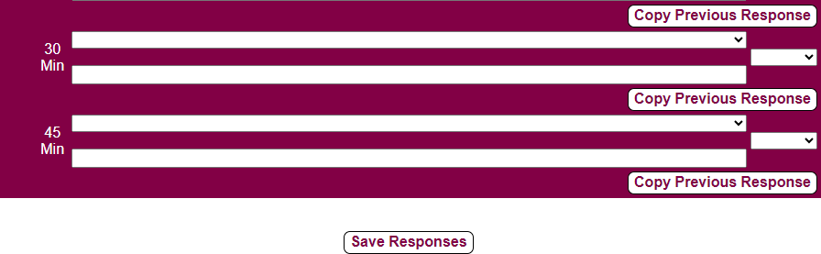
Correct Time Study Example
After each increment/day is complete, be sure to click the ‘Save Response’ button to save your response.
Doing so will save your response in case you need to come back and complete the time study for a particular day.

Slide 29
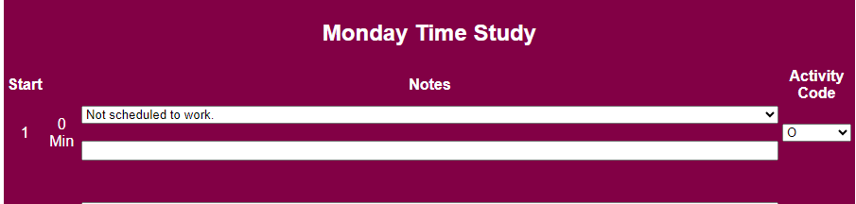
Correct Time Study Example
You will need to complete all 12 hours of each day.
For the hours you are not working, please indicate you are not scheduled to work and use code O, following the example above.

Slide 30
Completing the Time Study
Once you have received the link via email to the online Time Study, begin with
your first hour of work and complete all 12 hours per day.
If you don’t work 8 hours in a particular day; use code N (for paid time off) and O (for unpaid time off or the hours you do not work) to code up to the 12th hour.
□ For example: If you only work 8 hours, code the next four hours as “not scheduled to work
– Code O”.
If you work over 8 hours in a particular day; code all of your activities up to the first 12 hours of that day. We cannot account for any time over the first 12 hours of each day.
Code time continuously, even if you are on break or at lunch. Use code N (paid) or O (not paid), depending on whether you are paid or not)

Slide 31
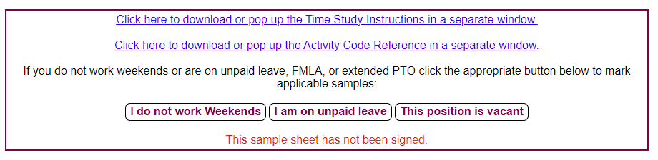

Completing the Time Study
If you do not work weekends, click on the button in the gray box that states, “I do not work weekends” and this will prepopulate Saturday and Sunday to “not scheduled to work – Code O”.
The ‘I am on unpaid leave’ button will prepopulate all 7 days as code O indicating you
are on unpaid leave.
If you are using one of these options, remember to click ‘Save” to record your response.

Slide 32
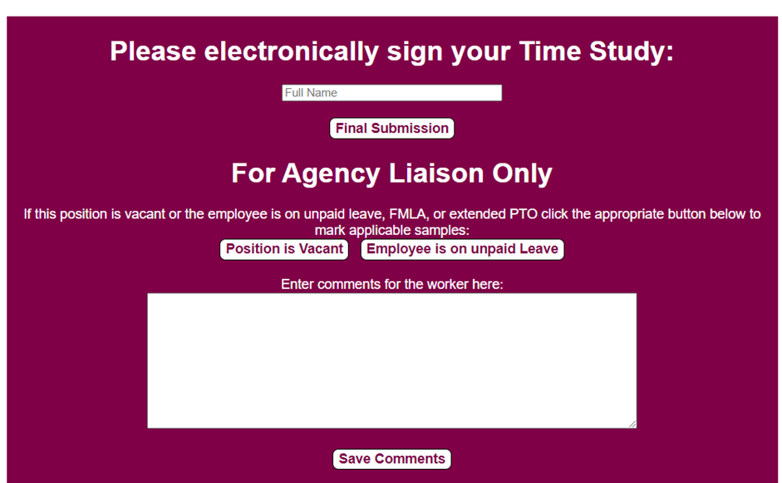
Signature Page
After completing the time study, click the signature page for your electronic signature stating you certify that the activities coded during this time study period accurately reflect your activities performed.
The software will not allow you to submit your final time study unless there is a signature.
Once signed, a notification will appear at the bottom of your screen including the date the time study was signed.

Slide 33
Reminders
Notifications will pop-up on your screen and will not let you submit your time study if you:
  Leave an increment blank with no note or code
  Fail to sign the signature page
Don’t forget to click “Save Responses” before closing
your browser.
Make use of the buttons in the gray box if you are on unpaid leave or do not work weekends.
Refer back to the activity code summary sheet for activity dropdowns and instructions at the top of your time study.

Slide 34
Part Two: Learn How To Complete The Time Study
QUIZ
Complete both the notes and activity code columns and submit after the time study week.
True False
Anyone can use codes G2 and J2 when coding their activities.
True False
Only code the hours you want to.
True False
Leave the time study blank for the day if you do not work on a particular day of the time study week.
True False
Mark multiple codes if you performed several activities within a 15 minute increment.
True False

Slide 35
Learning Objectives
Part One: Understand the MHFRP Program
Part Two: Learn How to Complete the Time Study
Part Three: Identify What Activity Codes to Use

Slide 36
Activity Codes
There are 17 activity codes to choose from when completing the Time Study if you are in a SPMP category and 15 activity codes to choose from if you are in a Non-SPMP category.
If you have difficulty choosing which Activity Code to use, please contact your liaison or InteCare at
1-888-591-6128 for assistance.

Slide 37

Important Code Information
Time spent driving should match the activity it supports upon destination (ex. Driving to a client’s home would be Code A)

Slide 38

Important Code Information
Paperwork should be coded based on the activity that best describes the type of paperwork being completed. For example, case notes following a meeting with a client would reflect the same code as the meeting with the client or Code A.

Slide 39
Important Code Information
You DO NOT need to be concerned about the client's insurance status or Medicaid eligibility status when choosing an activity code
Simply think of the activity you are performing when selecting a code then be descriptive in the note to capture what/why you are doing the activity

Slide 40
Important Code Information
Please note: When performing activities in the continuum of medical care for your client, such as intake, discharge, charting, preparing for encounter, chart review of the specific patient, referral to other providers or services, and/or pre-authorizations for care of your client are not part of Medicaid administrative claiming and are regular operations of your agency

Slide 41
Important Code Information
An allowable administrative cost … cannot be an integral part or extension of a direct medical or remedial service, such as patient follow-up, patient assessment, patient education, counseling (including pharmacy counseling), or other physician extender activities. Such services are properly paid for as part of the payment made for the medical or remedial service. Because Medicaid providers have agreed to accept service payment as payment in full, such providers may not claim an additional cost as administrative cost under the State plan.

Slide 42
Code A. Direct Medical Services and Other State Medicaid Program Services
Activities that provide direct medical services to individuals or groups and/or the provision of Medicaid billable services.
Activities include:
Direct clinical/treatment and therapeutic services;
Developmental assessment and diagnostic testing;
Administering first aid, emergency care, or medication; and
Provision of services reimbursable through Medicaid.
Targeted Case Management services are coded here when: 1) the client is eligible to receive TCM, and 2) the individual is a qualified TCM provider.

Slide 43
Code A. Direct Medical Services and Other State Medicaid Program Services (Continued)
Additional Activities:
Providing individual, family, or group counseling services to treat health, mental health, or substance abuse conditions;
Developmental assessment, diagnostic testing and evaluation of results; and
Health status monitoring and medication management (vitals, injections)

Slide 44
Additional Information for Code A
If your time is directly covered by a grant, any other reimbursement program or contract, use code A.
When you are billing MRO, code that time to code A.
If you are providing a direct medical service to a client, use code A.

Slide 45
Code B. Non-Medical and Non-Medicaid Related, Educational or Social Services
Activities provided which are not medical in nature, such as education or social services provided to clients.
Activities include:
Providing activities of daily living services, other than through MRO;
Non-therapeutic counseling;
Teaching job skills; and
Appearing in court on behalf of a client.

Slide 46
Code C. Medicaid Outreach
Activities that inform staff, eligible or potentially eligible clients, their families, and/or the community about Medicaid covered services and how to obtain them as a state employee would do
Activities include:
Explaining the services that are covered under Medicaid;
Helping individuals and their families access Medicaid covered health resources or informing them about the benefits of the Medicaid program;
Identifying individuals who may be at risk of poor health outcomes and linking them to Medicaid covered services;
Creating or distributing educational materials about Medicaid services;
Informing individuals and their families about the availability and benefits of Medicaid services in the community;

Slide 47
Code C. Medicaid Outreach (Continued)
Additional Activities:
Informing individuals for directions to Medicaid services, hours of business or programs/services offered;
Health fairs for general education representing the State Medicaid program, not just my agency; and
Developing a system for assuring that clients obtain needed preventative and health services by providing information on accessing transportation and assistance with scheduling of appointments.

Slide 48
Code D. Non-Medicaid Outreach
Activities that inform staff, eligible or potentially eligible clients, their families, and/or the community about non-Medicaid services and how to obtain them, such as WIC, TANF, Legal Aid, DMHA Supported Consumer, and Housing services.
Activities include:
Developing, disseminating or presenting non-Medicaid materials to effectively inform eligible individuals about non-Medicaid services and where to obtain services;
Informing individuals and their families about the availability of non-
Medicaid programs; for example, the DMHA Supported Consumer;
Explaining services available under non-Medicaid programs; and
Conducting outreach campaigns directed toward encouraging persons to access social, education and legal services and where to obtain services.

Slide 49
Code E. Facilitating Access To Medicaid Eligibility
Activities that assist an individual, client or their family to become eligible or maintain eligibility for Medicaid. This code includes all related paperwork, clerical activities, or staff travel required to perform these activities.
Activities include:
Explaining Medicaid eligibility rules and the enrollment process to potentially eligible clients and their family;
Referring an individual or family to the local assistance office to fill out an application for Medicaid benefits;
Assisting an individual in completing the Medicaid eligibility application, including interpreting the application and gathering information and documents in support of the application; and
Monitoring/assisting eligibility with re-determination for Medicaid and assisting individuals to provide third party resource information at Medicaid eligibility intake.

Slide 50
Code F. Facilitating Non-Medicaid Program Eligibility
Activities that assist an individual, client or their family in becoming eligible for non-Medicaid programs, such as food stamps, DMHA Supported Consumer (DSC), WIC, TANF, housing, vocational programs or legal aid
Activities include:
Explaining non-Medicaid eligibility rules and the enrollment process to
potentially eligible clients and the their family;
Completing the assessment and paperwork for DSC;
Referring an individual or family to make application for non-Medicaid benefits; and
Assisting an individual or their family with eligibility for non- Medicaid programs.

Slide 51
Code G1. Referral, Coordination and Monitoring Of Medicaid Services
As a certified mental health agency for Indiana State Medicaid, activities in this category go above and beyond exceptional clinical care in a fee for service environment to ensuring Medicaid recipient receive comprehensive health care services
Activities reflect not only making the referral, but walking the
client through the process, following up with the client to ensure
treatment was received, arranging transportation, etc.
These activities do not require participants’ SPMP knowledge, however, both a non-SPMP or an SPMP may perform them.

Slide 52
Code G1. Referral, Coordination and Monitoring Of Medicaid Services
Activities include:
Referring a client to Medicaid services for clinical treatment and therapeutic services via access line/call center or high-risk Medicaid recipient as required by the State of IN, not my client and not billing
Reviewing information and providing feedback for appropriate triage and assist with administrative case coordination via access line and/or high risk client, not my client and not billing
Arranging for and/or providing transportation services for a client or family to access Medicaid services
Arranging for translation services for a client or family to access Medicaid services outside of my agency

Slide 53
Code G1. Referral, Coordination and Monitoring Of Medicaid Services (Continued)
Additional Activities:
Monitoring and evaluating medical interventions, plans of care and assuring interventions of Medicaid services meet the appropriate level of care as oversight of the Medicaid programming only provided by a certified mental health agency, such as MRO, not my client and not billing
Preparing on call schedules for weekends and after hours to meet IN State Medicaid requirements for access and availability as a certified mental health center

Slide 54
Code G1. Referral, Coordination and Monitoring Of Medicaid Services (Continued)
Targeted case management services are coded under code A When:
1) the client Is eligible to receive TCM, and
2) the individual is a qualified TCM provider.
If case planning, referral, coordination and monitoring of Medicaid services are being performed on the behalf of foster care clients, the activities should be coded under code A.

Slide 55
Code G2. SPMP Referral, Coordination and Monitoring Of Medicaid Services
SPMP staff should use this code when performing the activities described in G1, AND when the activity performed requires their skilled medical expertise.
Only staff categorized as one of the following are eligible to use this code:
Physician, Nurse, Psychologist, Therapist and Social Worker – LCSW or LSW

Slide 56
Code G2. SPMP Referral, Coordination and Monitoring Of Medicaid Services
Individuals more likely to utilize G2 codes are those individuals using their medical expertise to help guide best practices, assess the skills of other Medicaid providers/professionals, impart their medical expertise to ensure Medicaid programming oversight, and to ensure best practices of care are being followed as per the State of IN.
When in doubt, please choose G1.

Slide 57
Code G2. SPMP Referral, Coordination and Monitoring Of Medicaid Services (Continued)
Activities include:
Referring a client to Medicaid services for clinical treatment and therapeutic services via access line/call center or high-risk Medicaid recipient as required by the State of IN, not my client and not billing
Reviewing information and providing feedback for appropriate triage and assist with administrative case coordination via access line and/or high risk client, not my client and not billing
Monitoring and evaluating medical interventions, plans of care and assuring interventions of Medicaid services meet the appropriate level of care as oversight of the Medicaid programming only provided by a certified mental health agency, such as MRO, not my client and not billing
If case planning, referral, coordination and monitoring of Medicaid services are being performed on behalf of foster care clients, the activities should be coded under code A

Slide 58
Code H. Referral, Coordination and Monitoring of Non-Medicaid Services
Activities that include making referrals, coordinating or monitoring the delivery of non-Medicaid covered services such as food stamps, WIC, TANF, housing, vocational programs or legal aid.
Activities include:
Referring to non-medical diagnostic or treatment services;
Gathering information that may be required in advance of referrals or evaluations to non-Medicaid covered services;
Coordinating necessary non-Medicaid covered services for clients;
Monitoring and evaluating the non-medical components of the individual’s plan of care and assuring that the plan of care objectives are achieved and appropriate; and
Arranging for and/or providing transportation or translation services for a
client or family to access non-Medicaid services.

Slide 59
Code I. Medicaid Provider Relations
Activities that include establishing, maintaining, and increasing provider resources to identify and have available qualified providers of essential Medicaid covered health services as required by the State of IN to ensure clinical and non-clinical staff are appropriate for the Medicaid population receiving services by the agency.
Activities include:
Recruiting providers to provide Medicaid covered services to meet the needs of the population and IN Medicaid program standards on behalf of the state;
Identifying potential Medicaid providers and linking them with EDS to facilitate Medicaid provider enrollment;
Facilitating the dissemination of information to providers on Medicaid
policy and regulations as well as Medicaid Program requirements;
Developing Medicaid service provider directories on behalf of the State of IN; and
Participating in meetings with Medicaid providers to assure maintenance or improvement of covered health services for the State of IN.

Slide 60
Code J1. Program Planning, Development and Agency-Wide Coordination
Activities that include planning and developing health related programs and services and the interagency and intra-agency coordination of those Medicaid covered services.
Activities include:
Utilization review of IN Medicaid programs/services only provided by a certified mental health agency, such as MRO, access and availability, TCM, etc.;
Quality improvement activities as required by the State to report on and monitor IN Medicaid Program outcomes specific to certified mental health agencies;
Working with other Medicaid providers to create/improve/expand Medicaid services to the community;

Slide 61
Code J1. Program Planning, Development and Agency-Wide Coordination (continued)
Participating in the development of clinical pathways, best practices, or evidenced based treatment/medical protocols for specific DSM diagnoses for statewide implementation;
Participating in the development of State plans and strategies that address the clinical capacity of medical/mental health services provided to Medicaid eligible individuals to meet the population health needs in a specific community; and
Providing technical assistance on practitioner protocols, including development of uniform policy and procedures on the care and treatment of Medicaid eligible individuals based on IN Medicaid Program requirements of a certified mental health agency

Slide 62
Code J2. SPMP Program Planning, Development and Agency-wide Coordination
SPMP should use this code when performing the activities described in J1 on the next slide, and when the activity performed requires their skilled medical expertise.
Only staff categorized as one of the following are eligible to
use this code:
Physician, Nurse, Psychologist, Therapist and
Social Worker - LCSW, LSW

Slide 63
Code J2. SPMP Program Planning, Development and Agency-wide Coordination
While SPMP’s have skilled medical knowledge, J2 codes are reserved for activities that fall outside of basic program evaluation.
Individuals utilizing J2 codes are those individuals utilizing their clinical expertise to develop and implement new practice guidelines, creating new programming, and/or collaborating with peers to review data/outcomes and strategizing new interventions for improvement in said outcomes on behalf of the State of IN.
When in doubt, please choose J1.

Slide 64
Code J2. SPMP Program Planning, Development and Agency-wide Coordination
Activities that include planning and developing health related programs and services and the interagency and intra-agency coordination of those Medicaid covered services.
Activities include:
Utilization review of IN Medicaid programs/services only provided by a certified mental health agency, such as MRO, access and availability, TCM, etc.;
Quality improvement activities as required by the State to report on and monitor IN Medicaid Program outcomes specific to certified mental health agencies;
Working with other Medicaid providers to create/improve/expand Medicaid services to the community;

Slide 65
Code J2. SPMP Program Planning, Development and Agency-wide Coordination (Continued)
Activities include:
Participating in the development of clinical pathways, best practices, or evidenced based treatment/medical protocols for specific DSM diagnoses for statewide implementation;
Participating in the development of State plans and strategies that address the clinical capacity of medical/mental health services provided to Medicaid eligible individuals to meet the population health needs in a specific community; and
Providing technical assistance on practitioner protocols, including development of uniform policy and procedures on the care and treatment of Medicaid eligible individuals based on IN Medicaid Program requirements of a certified mental health agency

Slide 66
Code K. Medicaid Administrative Training
Activities that include coordinating, conducting or participating in training regarding the benefit of the Medicaid program, how to assist individuals and families in accessing Medicaid services, how to more effectively refer to Medicaid services, and informing staff about how to find (early identification and intervention), screen and refer individuals to Medicaid services.
Activities include:
Training on referral and coordination of individuals to Medicaid services;
Participating in or coordinating training which improves the skills necessary to perform the administration of Medicaid programs which may include training related to access, outreach, referral, coordination, and monitoring, program services requirements, program development, and Medicaid Services, e.g., MRO;

Slide 67
Code K. Medicaid Administrative Training (Continued)
Additional Activities:
How to fill out paperwork pertaining to Medicaid
Training about Medicaid benefits, how to identify Medicaid clients, and how to refer clients to Medicaid

Slide 68
Code L. Non-Medicaid Administrative Program Training
Activities that include coordinating, conducting or participating in training regarding: 1) The benefit of non-Medicaid programs, such as food stamps, DSC WIC, TANF, housing, vocational programs or legal aid, 2) How to assist individuals and families in accessing non-Medicaid covered health services, and 3) How to more effectively refer to non-Medicaid programs.
Activities include:
Participating in or presenting training which improves the quality of identification, referral and coordination of individuals to non-Medicaid services;
Participating in or coordinating training which improves the knowledge and skills of personnel that Is necessary to and perform non-Medicaid program services; and
Participating in or coordinating training which improves the delivery of services for programs such as vocational rehabilitation.

Slide 69
Code M. Family Planning Referral
Activities that include providing family planning Medicaid administrative case management, outreach coordination and pregnancy prevention referral services to individuals of childbearing age to Medicaid services.
Activities include:
Identifying and referring at risk clients who may be in need of Medicaid family planning services;
Coordinating Medicaid family planning services; and
Referring to Planned Parenthood or Health Department
Targeted case management services are coded under code A. When:
1) the client Is eligible to receive TCM, and
2) the individual is a qualified TCM provider.

Slide 70
Code N. General Administrative
General administrative activities in support of the local agency. This code includes all related paperwork, clerical activities, or staff travel required to perform these activities
Activities include:
Taking paid lunch breaks or leave (vacation/PTO/holidays);
Reviewing technical literature and research articles;
Attending or facilitating general agency meetings;
Developing budgets and maintaining records;
Processing payroll or other personnel related documents;
Maintaining inventories and ordering supplies;
Meeting with direct reports/supervisor and performance reviews
Team/staff meetings
Participating in human resource training; and
Performing other administrative or clerical activities related to general
building or agency functions/operations.

Slide 71
Code O. Non-Paid Time
This code is to be used to account for unpaid time.
Activities include:
Not scheduled to work;
Persons work day has not started;
Staff person Is part-time;
Staff person is on an unpaid status; and
Staff person is carrying a pager or on call but is not on clock.

Slide 72
Part Three: Identify What Activity Codes to Use
QUIZ
Billable activities fall under multiple codes
True False
All paperwork falls under code N: General Administration
True False
Any time spent driving during your workday falls under the same code as the activity you are on your way to perform
True False
Time spent completing the time study falls under code N: General Administration
True False
For paid time off you should code 12 hours as code N: General Administration
True False
Time spent on the phone is coded to the code that represents the activity you are performing on the phone.
True False
Time spent being “on call” when you aren’t doing another work-related activity is coded to code O.
True False

Slide 73
PROGRAM HOTLINE
Please call InteCare with any questions!
1-888-591-6128
Gwen Tucker
If leaving a message, please provide the following:
Your name
Agency name
Phone number with area code
Your question
Please click the blue button on the next slide to complete your training.

