Slide 1




Slide 2

You will be enlightened today and learn things that the majority of Americans do not know but SHOULD!

Slide 3

To educate you:
How an insurance policy provides coverage
Secrets the insurance company does not want you to know
How you can obtain money for damage to your property
Our Goal

Slide 4

Insurance companies work hard to keep your money in their bank
They have adjusters looking out for their interests
Who is looking out for your interest?

Slide 5

We found, statistically, most insurance claims are underpaid
People need an advocate, someone who is going to stand up for them

Slide 6
What Does a Public Adjuster Do?
We help home and business owners when they have damage to their property
Through professional representation, we make sure the insurance companies treat them fairly, and more importantly, pay them fairly

Slide 7
Public Adjusters
Are licensed and bonded in their state of residence
Can be licensed in several states
Work on contingency
Work directly with the insurance adjusters to settle claims fairly

Slide 8
What we do for home and business owners
We represent home and business owners when they have damage to their property
We make sure the insurance companies treat them fairly, and more importantly, pay them fairly
We MAXIMIZE what a property is entitled to under their policy
We are paid on a contingency basis for claims we handle
We offer FREE Home Asset Protection Assessments
Notes:
Again, this is where we become valuable to home and business owners. Through professional representation we make sure the insurance companies treat them fairly and more importantly pay them fairly.

Slide 9
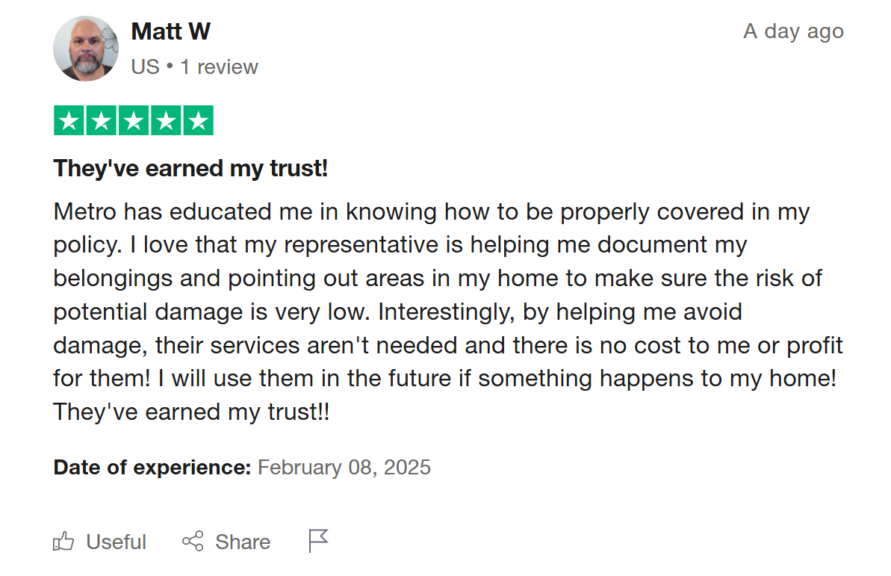

Slide 10
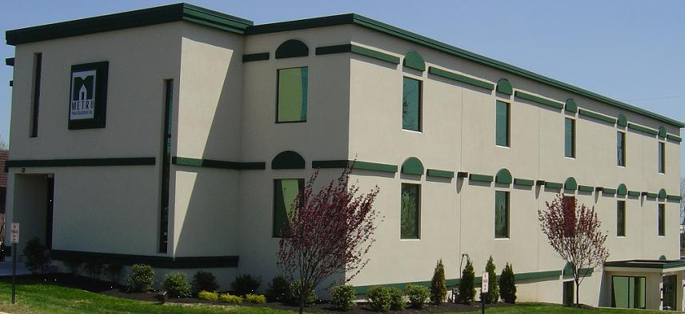


About Metro
  Metro Public Adjustment is the one of largest public adjusting firms in the United States
  Founded December 20, 1993
  Veteran Owned
  Operate Nationally
  Founding Member of AAPIA

Slide 11

METRO HAS BEEN IN BUSINESS FOR 30+ YEARS
Metro is Licensed by the Departments Of Insurance in 47 STATES and the District of Columbia in the most heavily regulated industry in the United States
Metro has recovered over 60 million for their clients over the last 12 months
Metro has Hundreds of Part-time & Full-time Reps across America

Slide 12




Metro Customers
Metro has served hundreds of thousands of clients
Residential and commercial
We are proud of our 99.7% claims handling satisfaction rate

Slide 13

About the Industry
2023
Commercial Insurance: Incurred losses reached $222.5 billion
Homeowners Insurance: Losses amounted to approximately $90 billion.
Source: Statista.com Nov 1, 2024
Less than 3% of the claimants were represented by a professional that prioritized their interests

Slide 14

Housing units per state
Alaska 318K
746K
3.1M
337K
515K
377K
638K
1.7M
2.5M
2.9M
735K
397K
2.7M
8.3M
4.6M
1.5M
469K
278K
1.4M
5.7M
3.6M
845K
5.2M
438K
1.3M
5.4M
2.9M
893K
2.5M
1.1M
2.4M
3.5M
319K
14.2M
1.3M
2.8M
2M
4.7M
3M
2.4M
3M
943K
1.7M
546K
1.3M
1.3M
2.1M
2.3M
4.3M
11M
9.5M

Slide 15

The Need for Public Adjusters

Slide 16
How Effective Are Public Adjusters?
“Policyholders who used public adjusters received an estimated $9,379 on their claim, compared to $1,391 for those policyholders that did not use a public adjuster,
…..a difference of 574%.”
(OPPAGA)
Office of Program Policy Analysis
and Government Accountability

Slide 17

“Roughly 80 percent of [ ] policyholders accept its damage appraisals without seeking an independent opinion. Those 80 percent [ ] get only 25 to 40 cents on the dollar.”

Slide 18

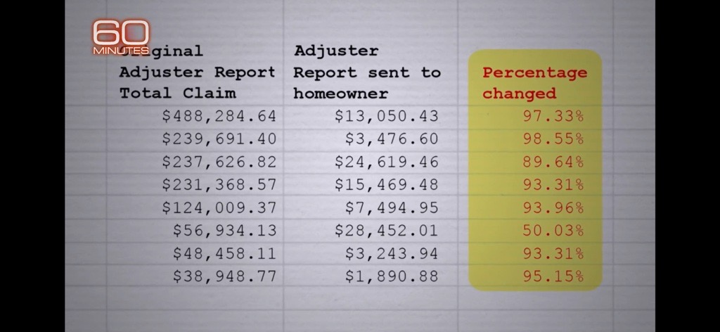
Aired September 29th
Insurance Company Reduced Their Adjuster’s Estimate

Slide 19
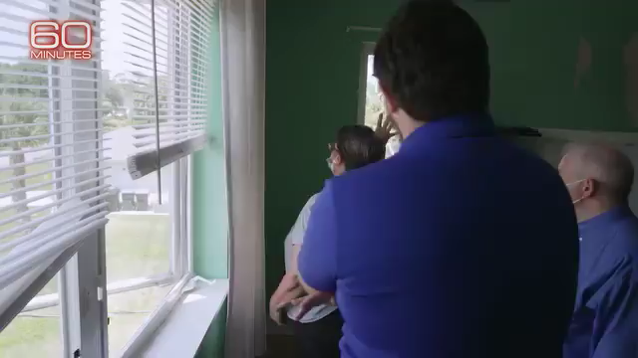

Slide 20
Settlement Audit results with Metro
Client | Cause Of Loss | Insurance Company | Insurance Payout | Settlement with Metro | The Difference Metro made
Apostolic Pentecostal Church | Wind | Philadelphia Insurance Co | Denied | $187,338.91 | Covered
Cicirello | Hail | State Farm | Denied | $8,120.92 | Covered
Culp | Hail | State Farm | $2,831.26 | $6,093.17 | 215%
Dixon | Fire | Allstate | Denied | $134,301.73 | Covered
Dojcinovski | Ice Damming | State Farm | $2,881.43 | $8,461.88 | 293%
Gaffney | Freeze | State Farm | $4,028.02 | $10,099.07 | 250%
Gibbs | Hail | Farmers | $2,556.79 | $11,497.45 | 450%
Rasberry, Joan | Freeze | State Farm | Denied | $24,495.92 | Covered
Pacific Realty | Fire | State Farm | $14,770.00 | $67,465.40 | 456%
Torres | Fire | Allstate | $90,044.31 | $118,376.63 | 32%
Weakley- Branch | Explosion | Assurant Group | Denied | $155,641.56 | Covered
Xin Zhang | Hail | Allstate | $370.85 | $11,538.70 | 3118%
Yonan | Acc. discharge water | State Farm | $4,938.16 | $22,259.55 | 450%
Nesreen Suwan | Acc. Discharge water | State Farm | Denied | $142,370.35 | Covered

Slide 21
Settlement Audit results with Metro
Client | Cause Of Loss | Insurance Company | Insurance Payout | Settlement with Metro | The Difference Metro made
Apostolic Pentecostal Church | Wind | Philadelphia Insurance Co | Denied | $187,338.91 | Covered
Cicirello | Hail | State Farm | Denied | $8,120.92 | Covered
Culp | Hail | State Farm | $2,831.26 | $6,093.17 | 215%
Dixon | Fire | Allstate | Denied | $134,301.73 | Covered
Dojcinovski | Ice Damming | State Farm | $2,881.43 | $8,461.88 | 293%
Gaffney | Freeze | State Farm | $4,028.02 | $10,099.07 | 250%
Gibbs | Hail | Farmers | $2,556.79 | $11,497.45 | 450%
Rasberry, Joan | Freeze | State Farm | Denied | $24,495.92 | Covered
Pacific Realty | Fire | State Farm | $14,770.00 | $67,465.40 | 456%
Torres | Fire | Allstate | $90,044.31 | $118,376.63 | 32%
Weakley- Branch | Explosion | Assurant Group | Denied | $155,641.56 | Covered
Xin Zhang | Hail | Allstate | $370.85 | $11,538.70 | 3118%
Yonan | Acc. discharge water | State Farm | $4,938.16 | $22,259.55 | 450%
Nesreen Suwan | Acc. Discharge water | State Farm | Denied | $142,370.35 | Covered

Slide 22
Settlement Audit results with Metro
Client | Cause Of Loss | Insurance Company | Insurance Payout | Settlement with Metro | The Difference Metro made
Apostolic Pentecostal Church | Wind | Philadelphia Insurance Co | Denied | $187,338.91 | Covered
Cicirello | Hail | State Farm | Denied | $8,120.92 | Covered
Culp | Hail | State Farm | $2,831.26 | $6,093.17 | 215%
Dixon | Fire | Allstate | Denied | $134,301.73 | Covered
Dojcinovski | Ice Damming | State Farm | $2,881.43 | $8,461.88 | 293%
Gaffney | Freeze | State Farm | $4,028.02 | $10,099.07 | 250%
Gibbs | Hail | Farmers | $2,556.79 | $11,497.45 | 450%
Rasberry, Joan | Freeze | State Farm | Denied | $24,495.92 | Covered
Pacific Realty | Fire | State Farm | $14,770.00 | $67,465.40 | 456%
Torres | Fire | Allstate | $90,044.31 | $118,376.63 | 32%
Weakley- Branch | Explosion | Assurant Group | Denied | $155,641.56 | Covered
Xin Zhang | Hail | Allstate | $370.85 | $11,538.70 | 3118%
Yonan | Acc. discharge water | State Farm | $4,938.16 | $22,259.55 | 450%
Nesreen Suwan | Acc. Discharge water | State Farm | Denied | $142,370.35 | Covered

Slide 23
Settlement Audit results with Metro
Client | Cause Of Loss | Insurance Company | Insurance Payout | Settlement with Metro | The Difference Metro made
Apostolic Pentecostal Church | Wind | Philadelphia Insurance Co | Denied | $187,338.91 | Covered
Cicirello | Hail | State Farm | Denied | $8,120.92 | Covered
Culp | Hail | State Farm | $2,831.26 | $6,093.17 | 215%
Dixon | Fire | Allstate | Denied | $134,301.73 | Covered
Dojcinovski | Ice Damming | State Farm | $2,881.43 | $8,461.88 | 293%
Gaffney | Freeze | State Farm | $4,028.02 | $10,099.07 | 250%
Gibbs | Hail | Farmers | $2,556.79 | $11,497.45 | 450%
Rasberry, Joan | Freeze | State Farm | Denied | $24,495.92 | Covered
Pacific Realty | Fire | State Farm | $14,770.00 | $67,465.40 | 456%
Torres | Fire | Allstate | $90,044.31 | $118,376.63 | 32%
Weakley- Branch | Explosion | Assurant Group | Denied | $155,641.56 | Covered
Xin Zhang | Hail | Allstate | $370.85 | $11,538.70 | 3118%
Yonan | Accidental discharge water | State Farm | $4,938.16 | $22,259.55 | 450%
Nesreen Suwan | Accidental Discharge water | State Farm | Denied | $142,370.35 | Covered

Slide 24
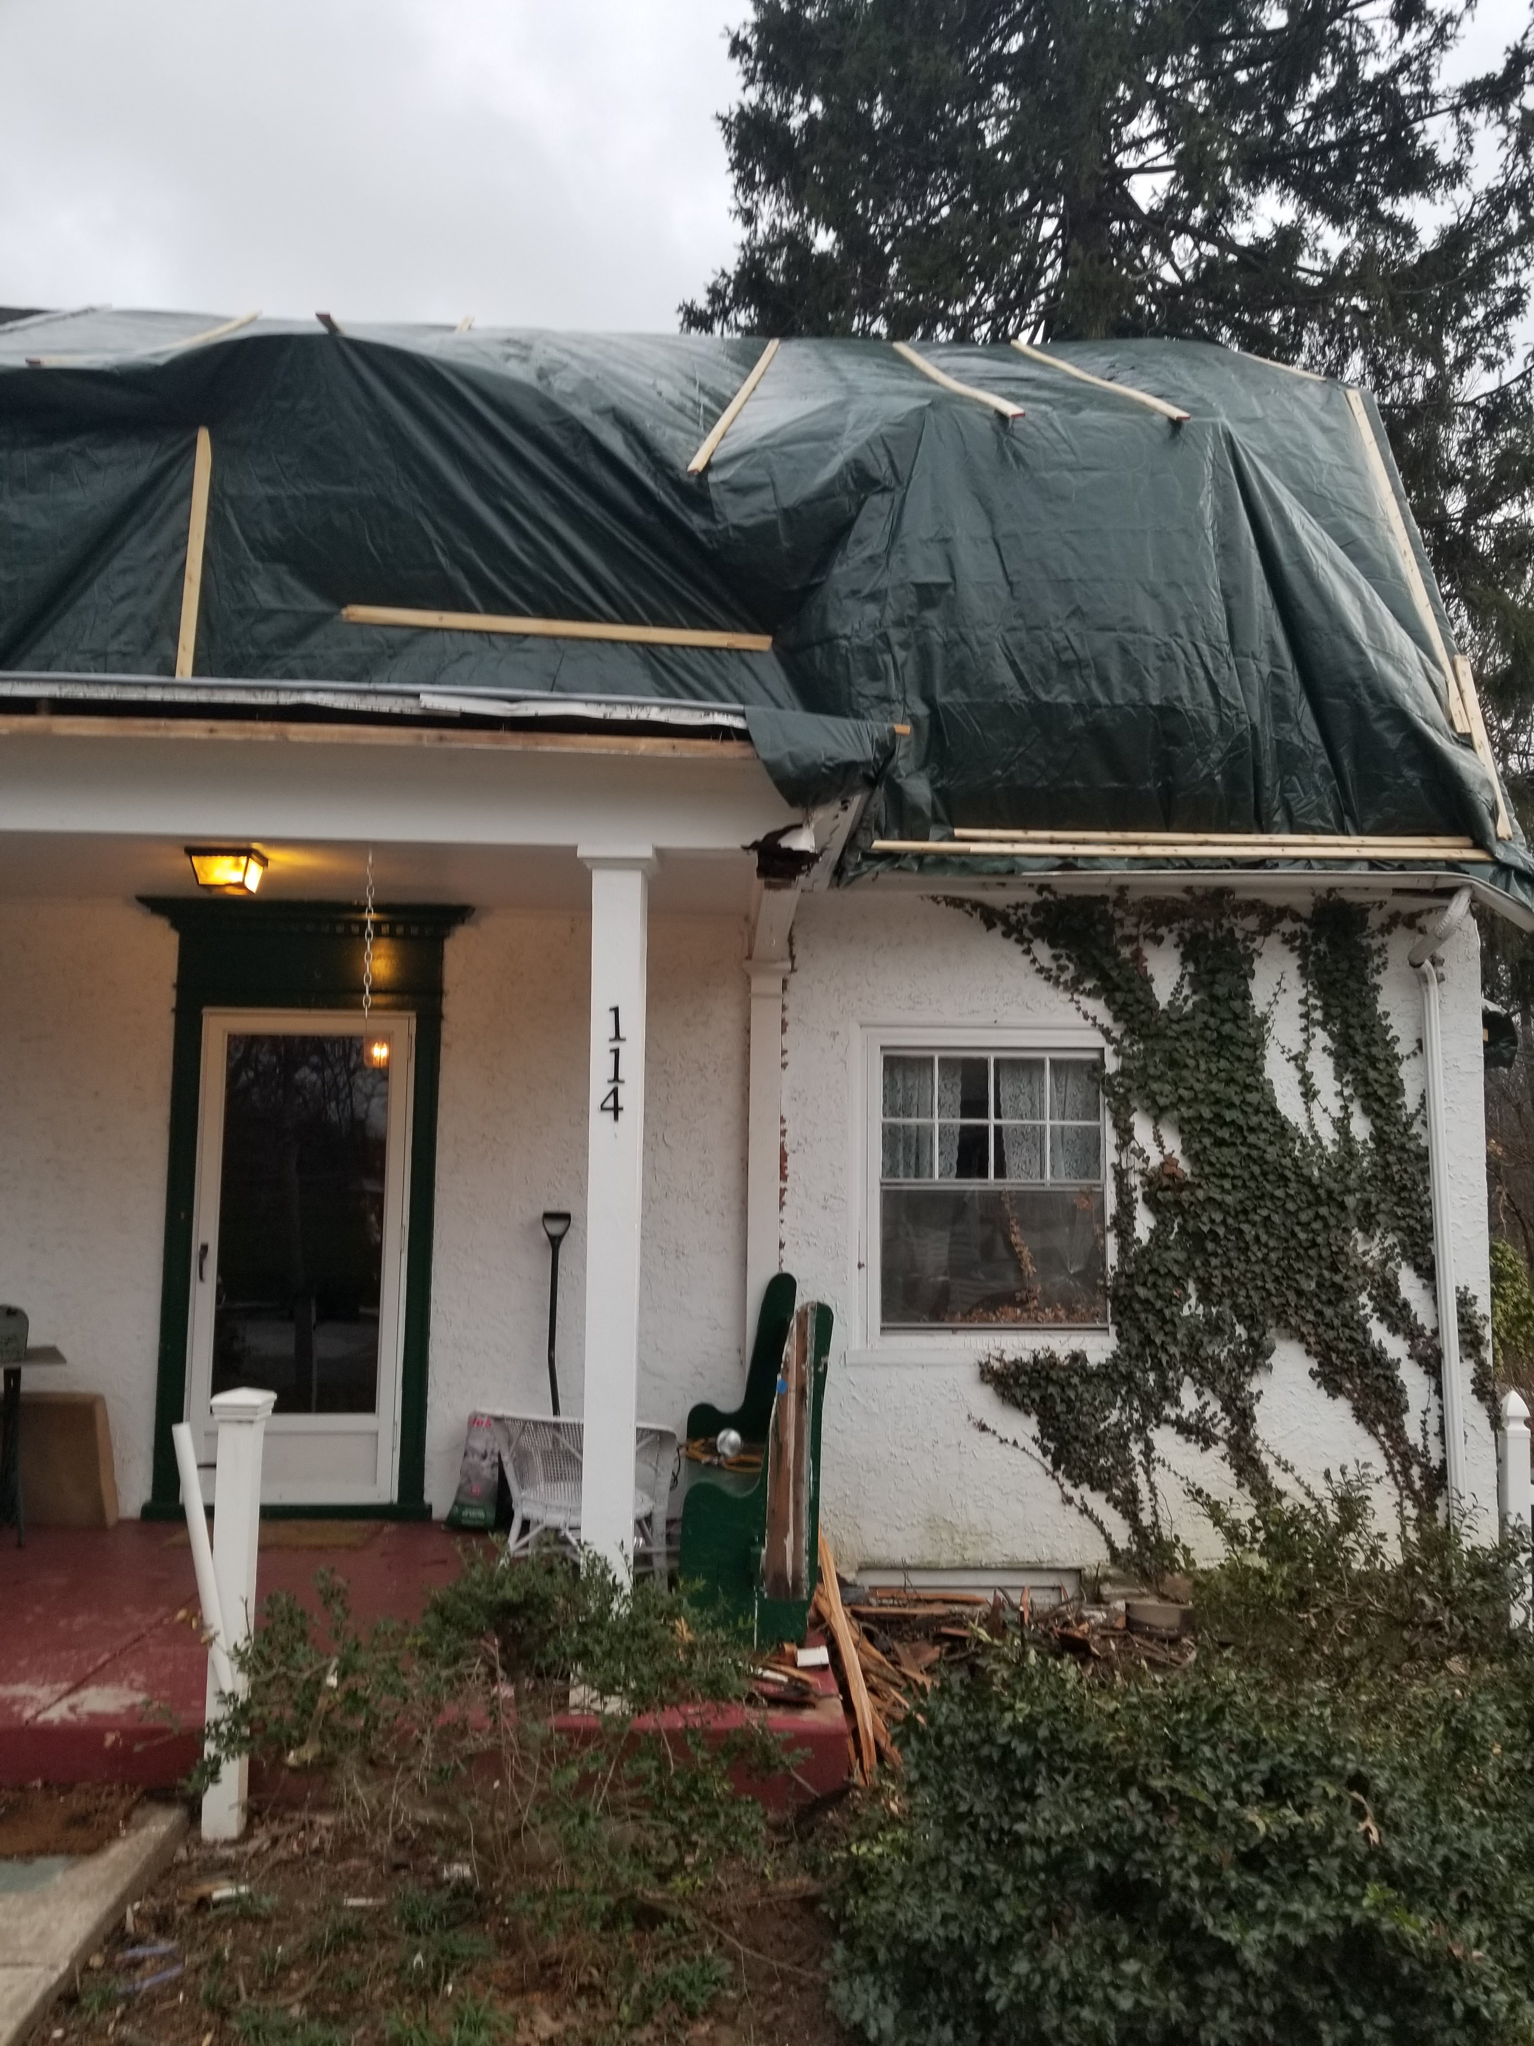
When Is A Public Adjuster Needed?
When the client discovers damage (to verify coverage).
When a current claim is under-paid or denied.
The sooner we get involved the better the settlement.

Slide 25


Dangers of Homeowners Handling Their Own Claim
Duties after loss
Claims can be denied for not completing policy duties
Conditions
Presenting the loss
Policies are full of confusing language
Insureds are required to meet the conditions of the policy

Slide 26

You have the right to remain silent….
Anything you say, can and will be used against you in your settlement.
Don’t risk losing thousands of dollars to fix your largest asset

Slide 27


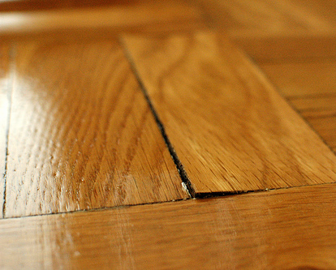
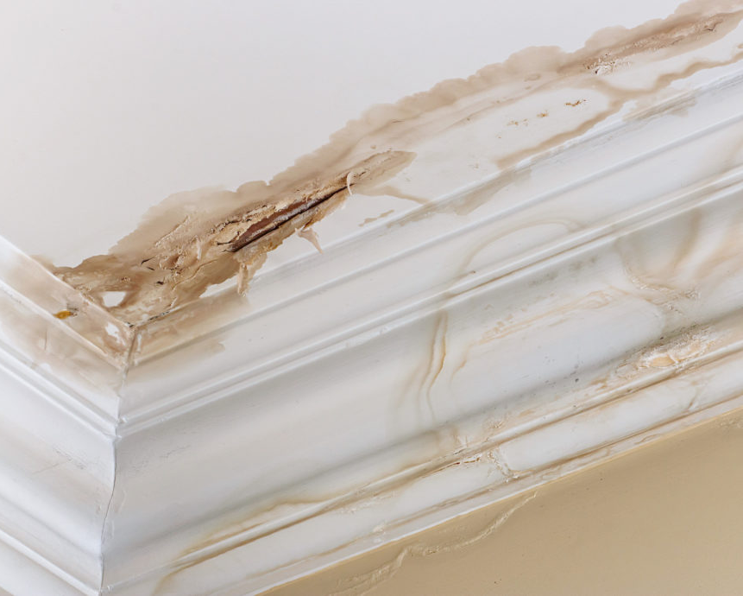
An example of a typical claim
During a storm, the homeowner noticed water leaking into bedroom and then into the dining room below.
Later, they noticed shingles missing from the roof
The homeowner cleaned up the water themselves

Slide 28
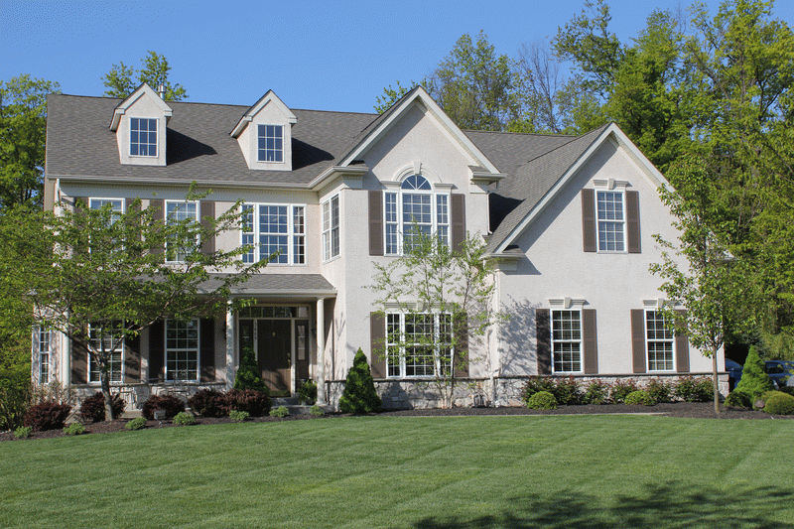
This is How the Insurance
Company Can View a Claim
Exterior
Item 1: Minimum roof repair for missing shingles
Bedroom
Item 2: Drywall repair minimum charge
Item 3: Tape and protect fan
Item 4: Spot seal and paint ceiling one coat
Item 5: Clean and deodorize carpet
Dining room
Item 6: Appearance allowance for slight cupping of wood floor in dining room
Item 7: Spot seal and paint walls and ceilings one coat
7 Items
Notes:
28

Slide 29
Metro’s Field Adjuster Prepares a Complete Estimate Showing the Full Extent of Damages
.
Exterior
Item 1: Proper roof evaluation and the mis-matching of the
roof required replacement of 2,800 sq. ft. of shingles
Bedroom
Item 2: Replace wet insulation
Item 3: Detach and reset ceiling fan
Item 4: Replace affected drywall
Item 5: Seal and paint walls and ceilings of bedroom 2 coats
Item 6: Replace carpet due to delamination of backing.'
Item 7: Manipulation of heavy bedroom furniture
Dining Room
Item 8: Replace affected drywall.
Item 9: Detach, reset, and repaint crown molding.
Item 10: Spot Seal walls and ceiling
Item 11: Paint walls and ceilings 2 coats
Item 12: repair hardwood floor
Item 13: Sand, and finish hardwood floors.
Item 14: Replace shoe molding.
Item 15: Paint baseboard, paint shoe molding, paint door, and 2 window trim.
Item 16: Remove and reset drapes
Item 17: Contents: pack and store china and move dining room furniture.
Living Room, Foyer, Kitchen
Item 18: Sand, stain and finish hardwood continuous floor.
Item 19: Replace shoe molding
Item 20: Paint baseboard and shoe molding
General
Item 21: Piano reset and retuned.
Item 22: Dust protection throughout the home.
Item 23: Debris removal.
Item 24: Dumpster
Item 25: Portable potty
Item 26: Additional living expenses as upstairs and kitchen is inaccessible due to floor refinishing.
26 Items
Notes:
29
Let’s look at how a Metro Field Adjuster would advocate on your behalf. As you can see, the Metro Adjuster identifies 26 items starting with the roof, after proper roof evaluation, it is determined that full replacement of the roof is required. We then discover that the insulation was wet requiring replacement. Moving on to item 5, we would require the ceiling to be painted with 2-coats, not 1. Then we would recommend replacement of the carpet due to delamination, of course, part of the estimate should include the manipulation of the heavy bedroom furniture.
As you can see, there are many items overlooked, to further illustrate our example, offering an appearance allowance unacceptable. These are hardwood floors. Rather, a repair and then they require sanding, staining and finishing the hardwood floors in the dining room, and where the floors continue in the living room, foyer and kitchen. We will also require replacing the shoe molding and paint the affected trim. To complete this job will require removing and resetting the drapes, the piano and various other contents. In addition to normal debris removal, a dumpster will be required for the roof shingles. A job of this magnitude would be a burden on the homeowner so the cost of living outside the home during this repair will be added to item 26.

Slide 30
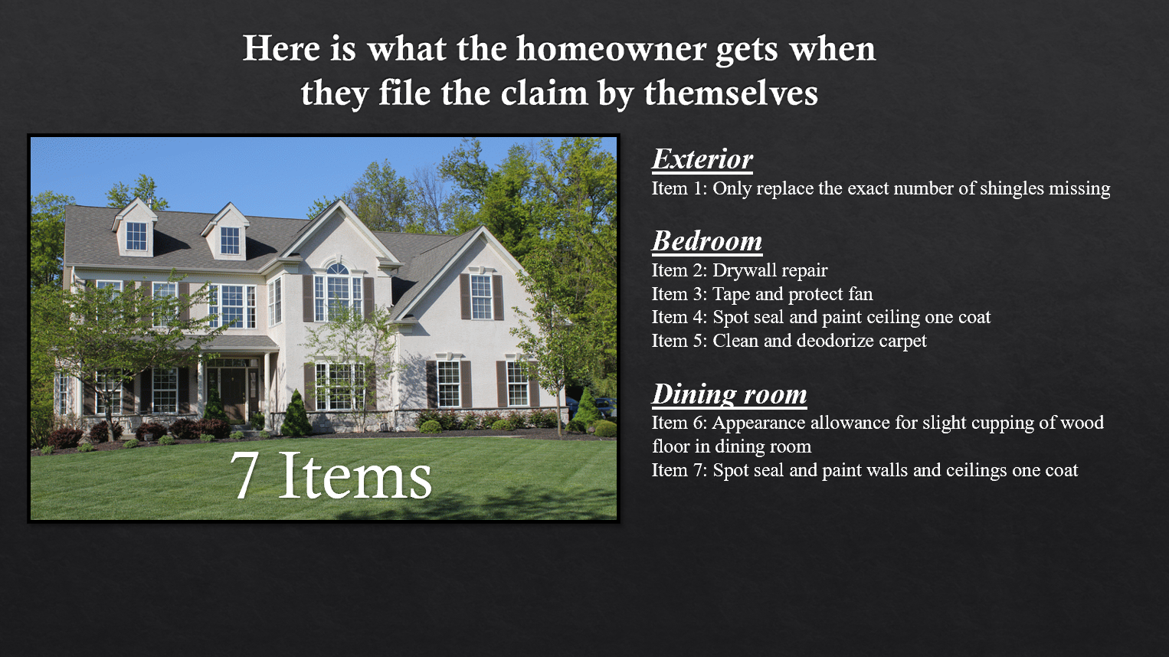
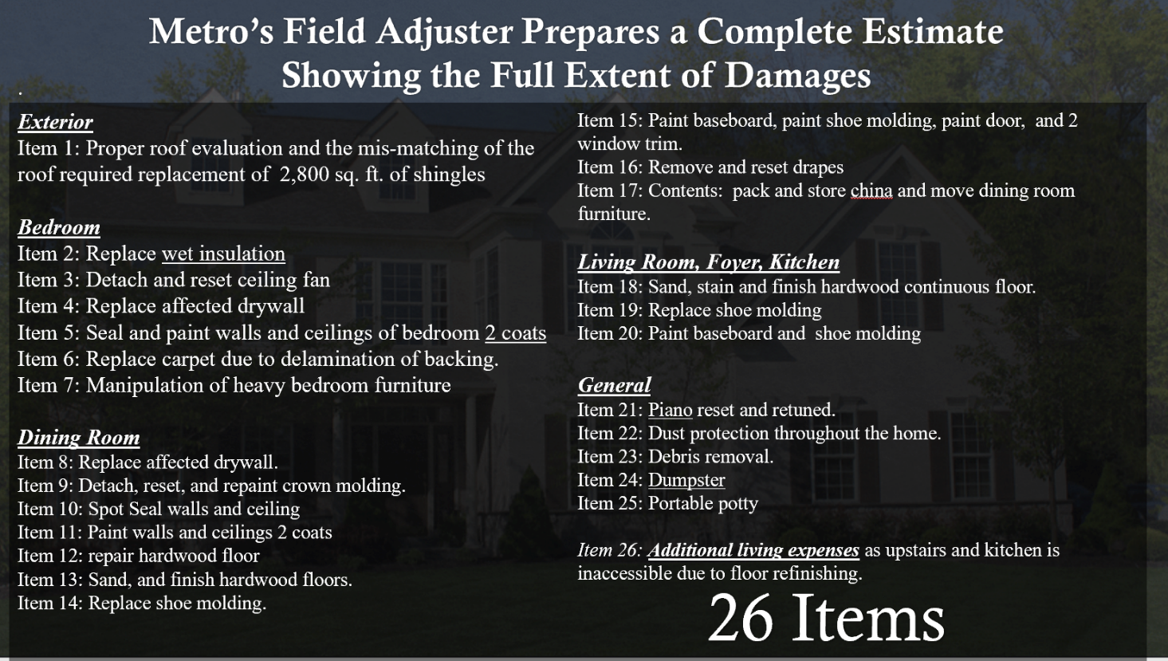
What would you prefer…
“A” or “B”?
A
Claim
B
Notes:
If this was your home, how would you prefer to be paid A or B?

Slide 31
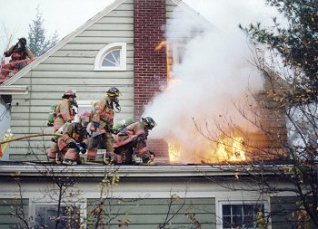
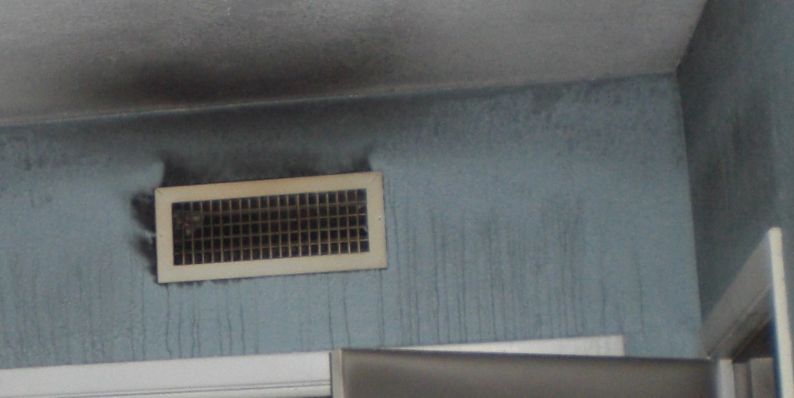
Damage that is covered
Typical All Risk Policy
Fire
Smoke
Lightning
Explosion

Slide 32
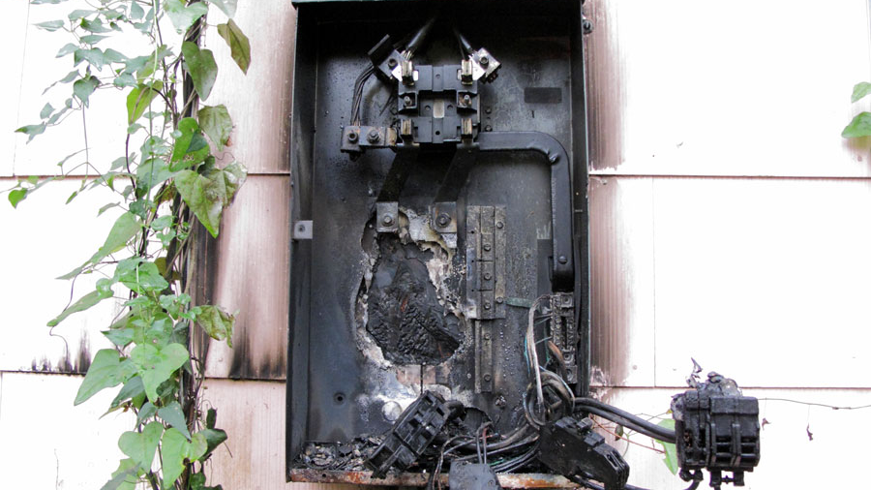
FIRE

Slide 33
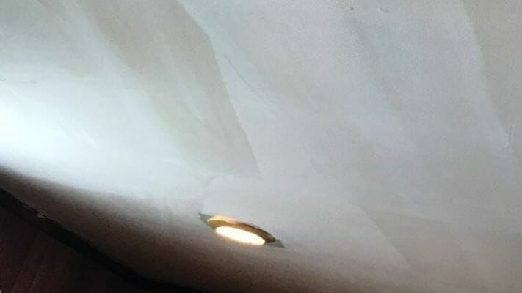
Smoke

Slide 34
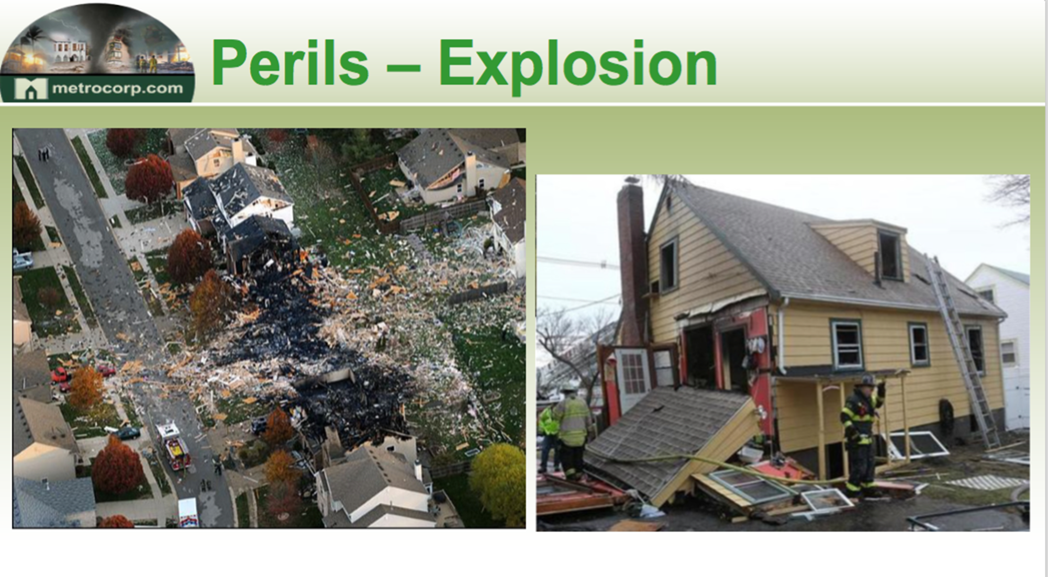
EXPLOSION

Slide 35
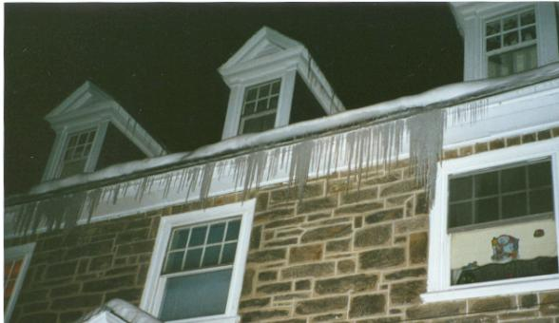
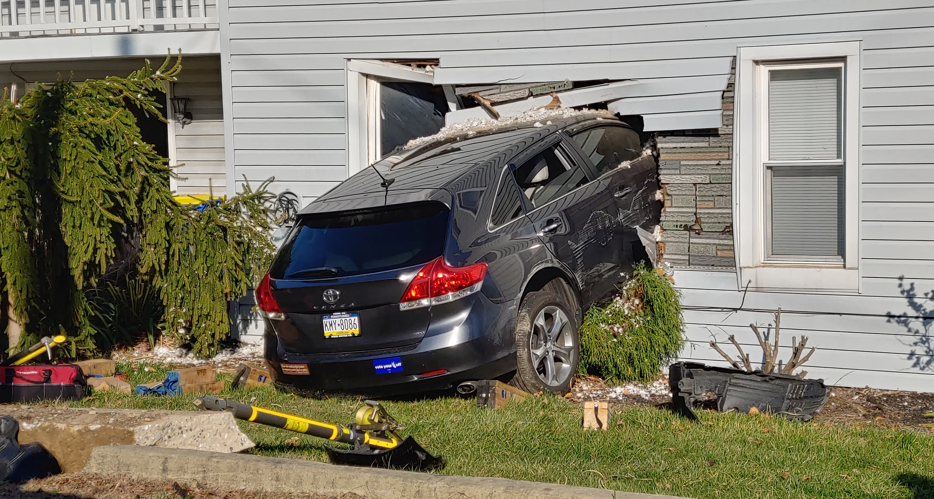
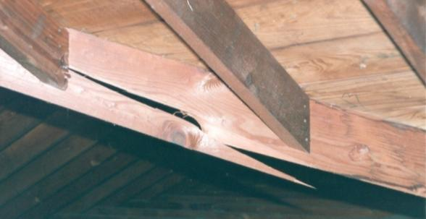
Ice damming
Weight of ice and snow
Collapse
Vehicles - car runs into house
Weight of ice and snow

Slide 36
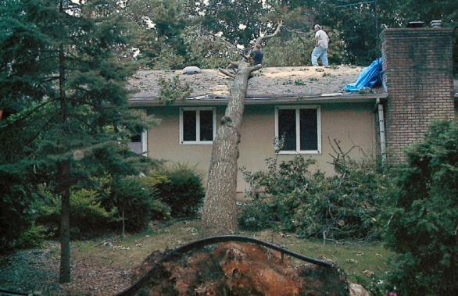
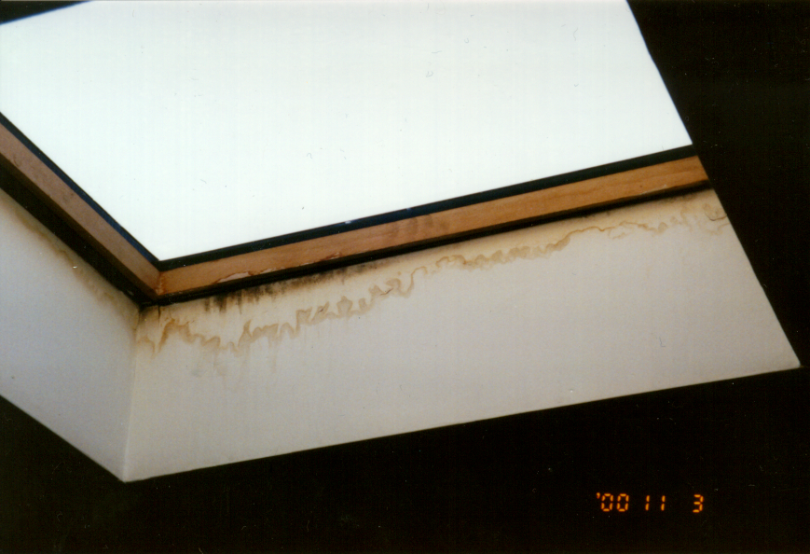
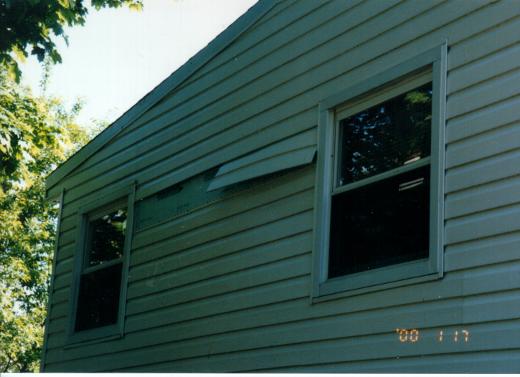
Windstorm
  tree blown into house
  shingles blown off
  siding blown off
Rainstorm
  roof leaks
  skylights

Slide 37
Melted siding
Lifted Shingles
Burned Carpet
Siding damage

Slide 38
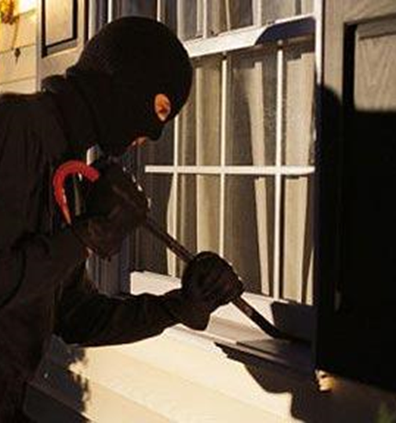
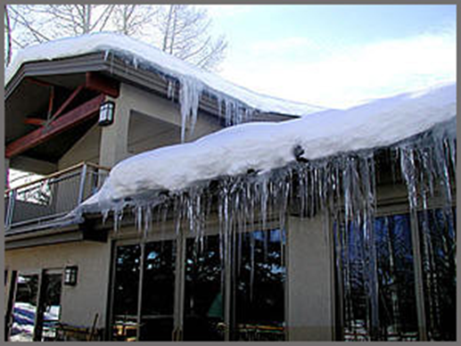
Ice and Snow
Burglary

Slide 39
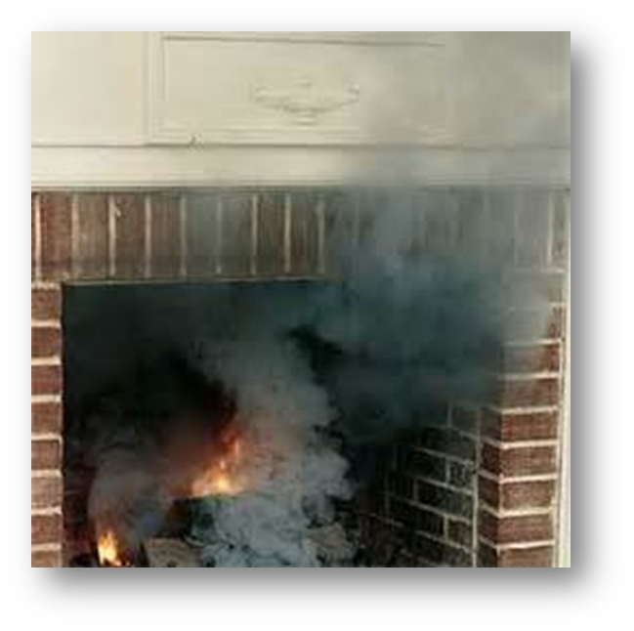
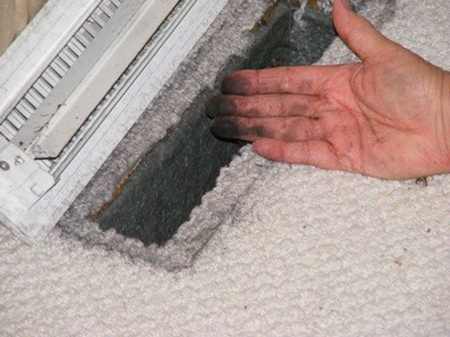
Smoke Damage
Puff Back

Slide 40
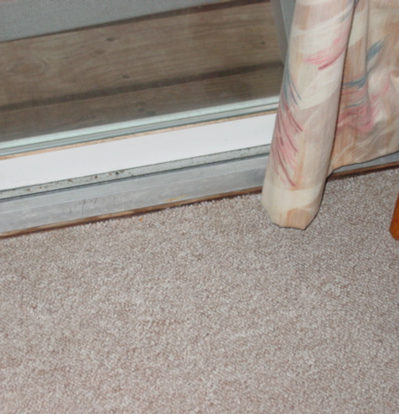
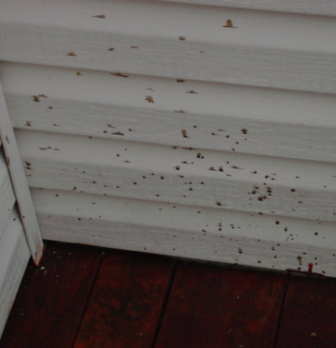
Water that enters the house from the ground or higher
Paint overspray

Slide 41
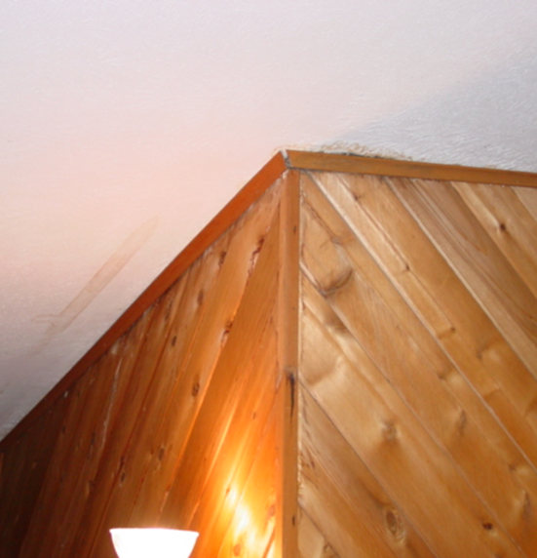
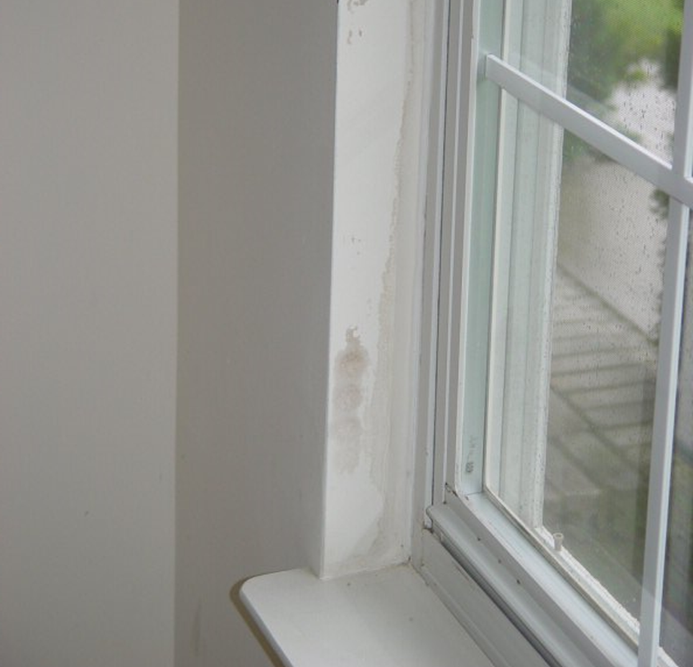
Roof leaking
Water through the window

Slide 42

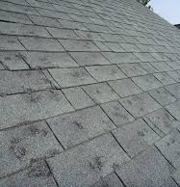
Hailstorm
Hail damage to roof

Slide 43
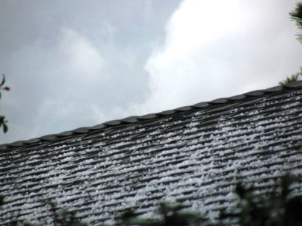
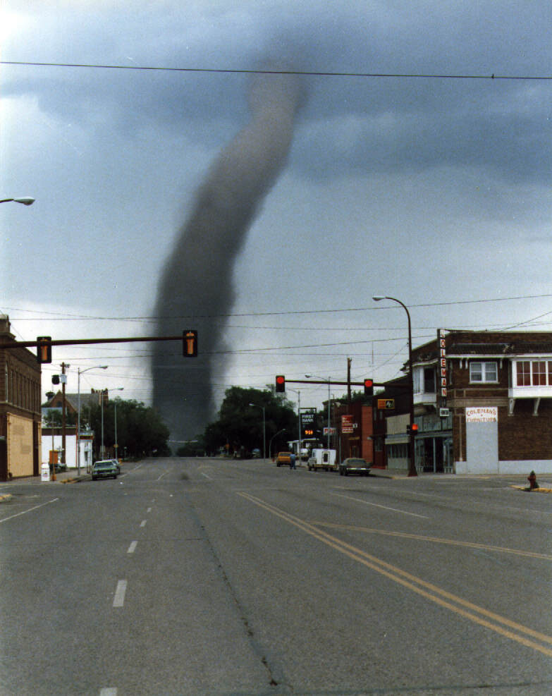
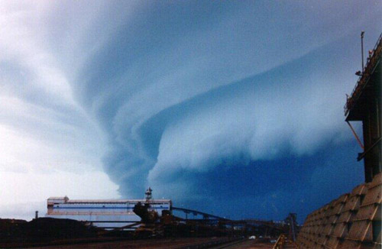
Hail
Tornado
Hurricanes

Slide 44
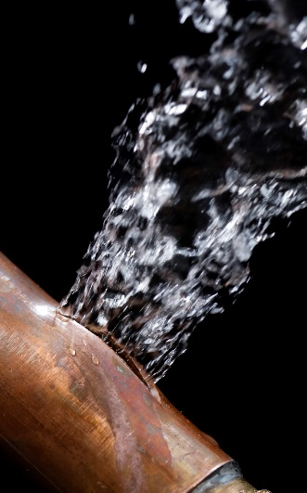
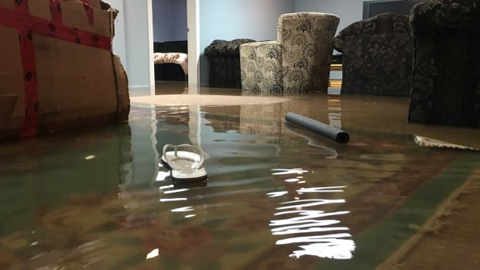
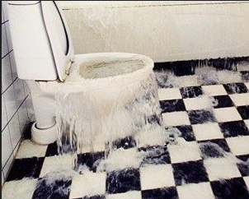
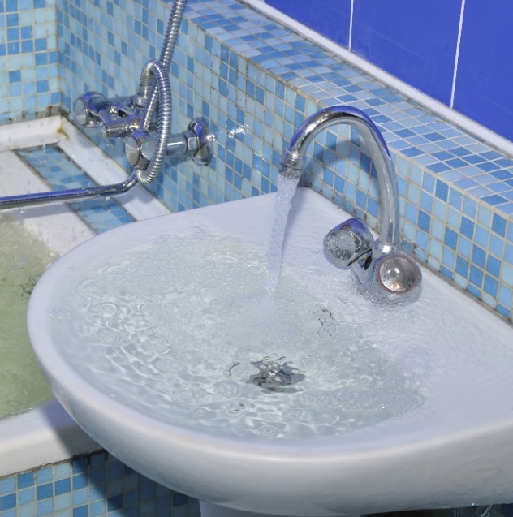
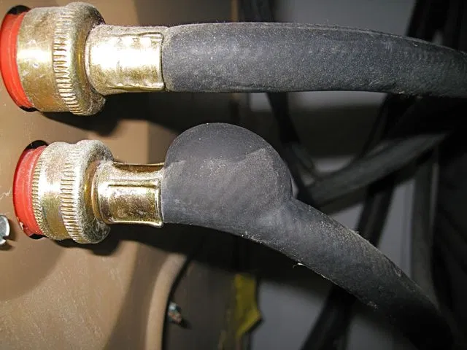
Water leaks from the following:
  Toilet, sink, or tub
  Dish washer
  Ice maker
  Washing machine
  Water heater
  Sewage back up
  Pipe breaks
  Drain lines
  Frozen pipes

Slide 45

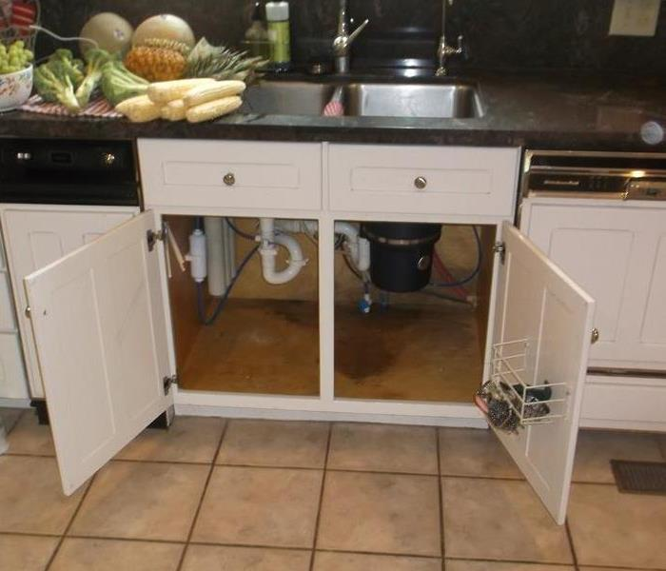
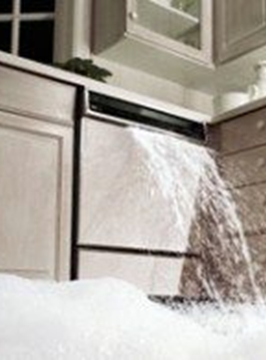
Water Leaking under the sink
Leaking dishwasher

Slide 46
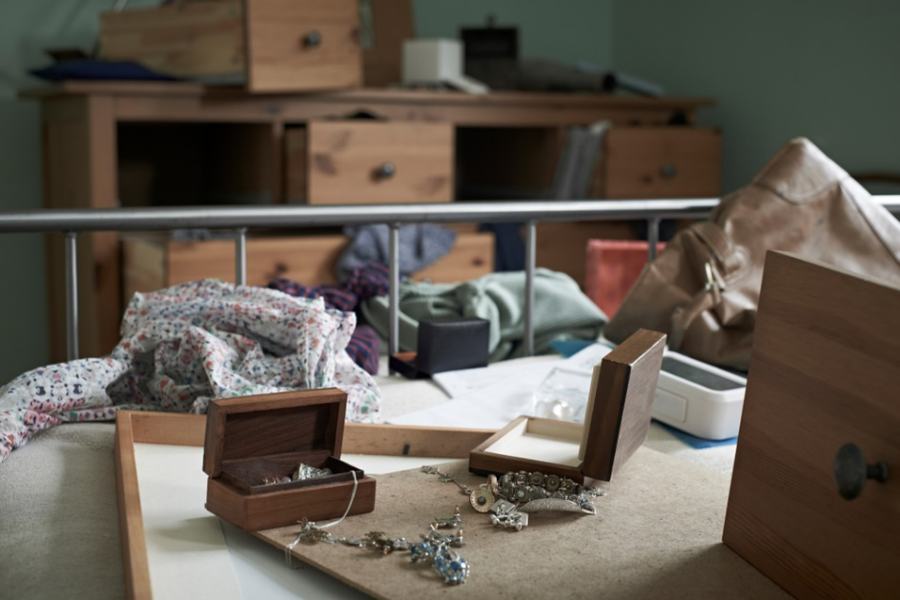
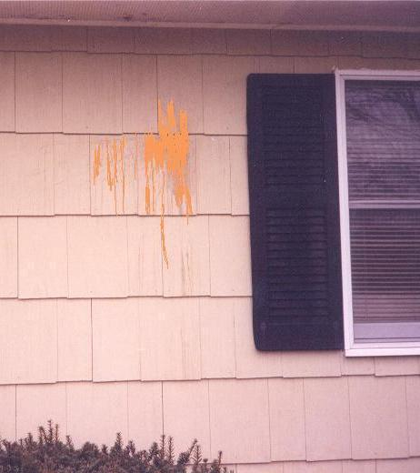
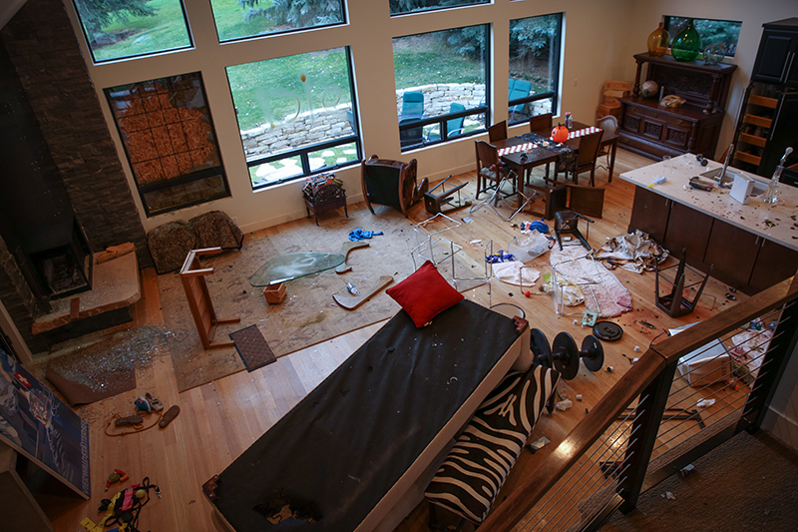
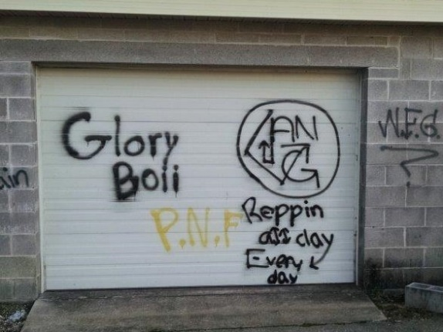
Theft and Vandalism
    Graffiti
    Eggs on siding
    Tenant vandalism

Slide 47
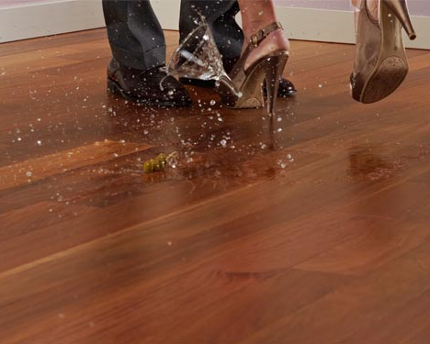
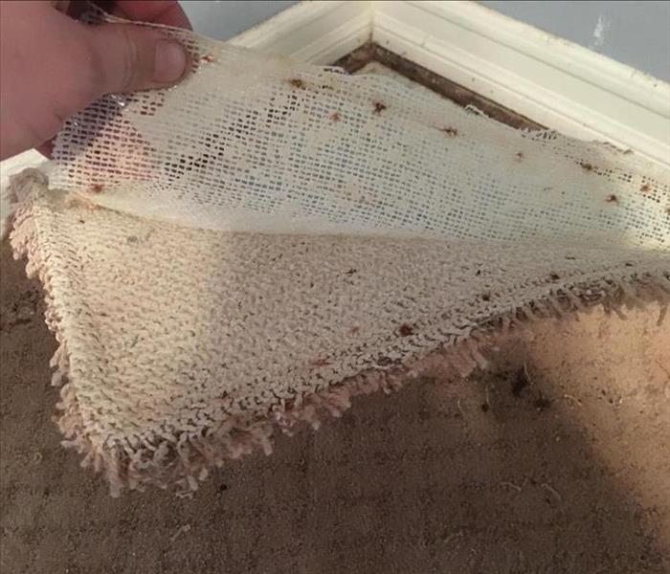
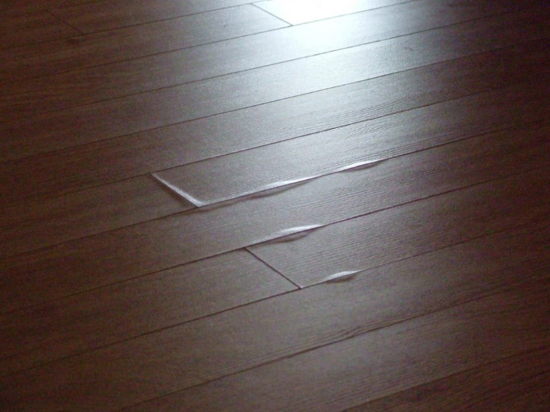
Common Losses
Flooring Damage
  Hardwood
  Laminate
  Carpet

Slide 48
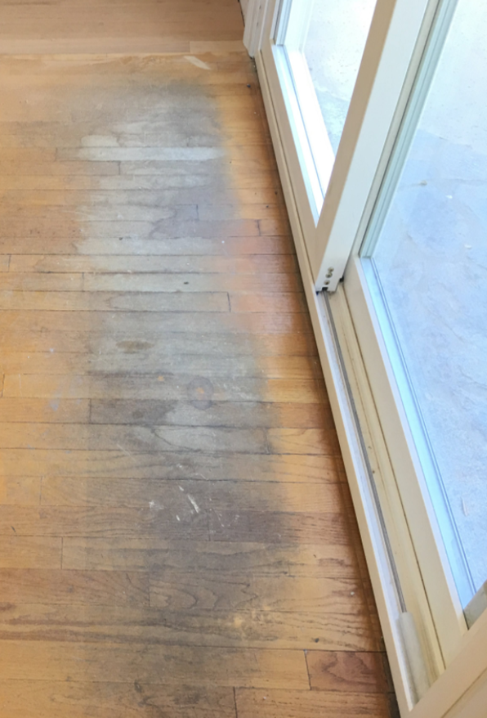
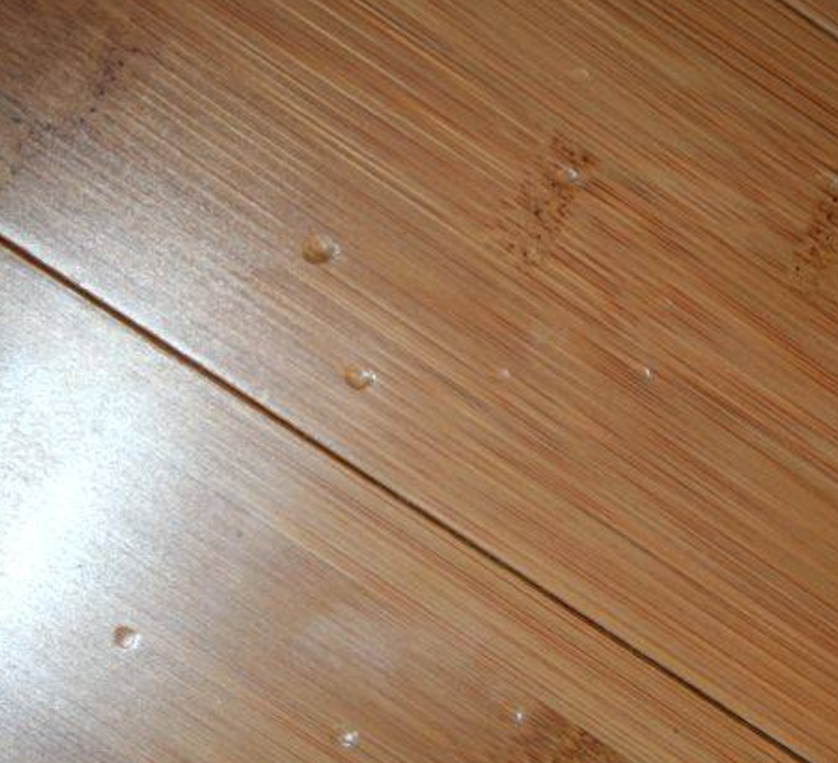
Damage to flooring

Slide 49
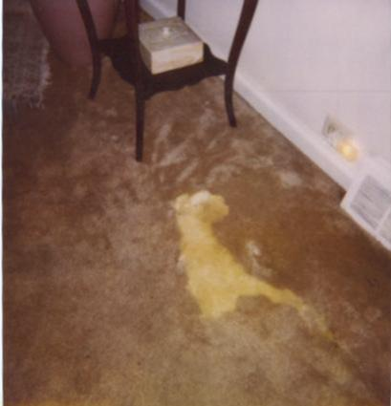


Common Losses We Represent
Accidental damages even if caused by the homeowner
  Spilled bleach
  Cracked tiles
  Melted siding from grilling
Mold (with an endorsement)
Code Upgrades
And yes….Even “Acts of
GOD are covered”

Slide 50
Common Policy Gap Checklist
Percentage Deductible
  Most people think a percentage deductible is based on the total amount of damage, which is untrue. It is a percentage of the policy coverage
  Example:
    If a home is insured for $500,000 and the homeowner had a 5% deductible, then their deductible would be $25,000
Access Limits
Roof Schedule
  Could result in homeowner being responsible for 90% of the cost.
Non-matching Endorsements
No Sump-Pump Coverage
Replacement Cost on Contents
Required Openings
  Will not cover water damage inside the home unless the roof blows off.
Code Coverage
Large Wind Deductible

Slide 51
What’s in your Policy?
Here’s the Good News
A homeowner should contact their agent to add back desired coverage
Most companies offer the option to buy back coverage gaps

Slide 52
Industry Fee Range
We represent clients on a percentage fee basis:
Fees range from 10%-35% based on size and complexity
Our fees are contingent; there is no fee unless there is a recovery
Residential and commercial

Slide 53

GREAT Referrals for me
People who would like a free home asset protection assessment
People who have damage to their home or business
People who have had a claim and would like us to audit the claim settlement to see if we can recover more money for them
Potential Power Partners. Ex: Plumbers etc

Slide 54
Interested in a part-time secondary income or change in career?
We’re hiring!
Contact me for details!

Slide 55
Part-Time Example
Personal Commissions
2 claims as a RM (RM is paid 30 %) = $1,844.00
Override Commissions
4 claims from CR (RM is paid 10 %) = $1,232.00
6 claims from SCR (RM is Paid 5 %) = $ 945.00
___________________________________________________________________
12
Notes:
55
Now remember a regional manager is managing and teaching a team. Now look at what happens because of those efforts. In this example the regional manager has four claims from claims reps and is paid 10% which equals $1,232 dollars

Slide 56
Part-Time Example
Personal Commissions
2 claims as a RM (RM is paid 30 %) = $1,844.00
Override Commissions
4 claims from CR (RM is paid 10 %) = $1,232.00
6 claims from SCR (RM is Paid 5 %) = $ 945.00
___________________________________________________________________
12
$4,021.00 per month
$48,252.00 per year
Part Time!
Notes:
56
And six claims from senior claims reps and is paid 5% from those claims which equals $945 dollars. Now the monthly total is $4,021.00 dollars Or $48,252 per year. Remember we are still talking part time

Slide 57
Full-Time Example
Personal Commissions
  8 claims as a RM (RM is paid 30 %) = $7,376.00
  Override Commissions
  5 claims from CR (RM is paid 10 %) = $1,537.00
  8 claims from SCR (RM is paid 5 %) = $1,229.60
CLAIM BONUS 5 % = $ 3,227.70
$13,370.30 per month
21
(When you and your team hit 20 or more claims you receive 5% on all claims)
Notes:
57
This gives you an income of $13,370.30 for the month. Can you see the power of our compensation system? Managing and training a team, positions you for a six-figure income.

Slide 58
Full-Time Example
Personal Commissions
  8 claims as a RM (RM is paid 30 %) = $7,376.00
  Override Commissions
  5 claims from CR (RM is paid 10 %) = $1,537.00
  8 claims from SCR (RM is paid 5 %) = $1,229.60
CLAIM BONUS 5 % = $ 3,227.70
$ 13,370.30 per month
21
(When you and your team hit 20 or more claims you receive 5% on all claims)
$160,443.60 per year
Notes:
58
That would give you the total of $160,443.

Slide 59
3 final questions
Which of these apply to you?
A – If you would like to learn more about the career opportunity
B – If you have a referral
C – You would like to schedule a Free Property Inspection and Policy Review
A
B
C

Slide 60


