Slide 1

Optimising the Gross Return value proposition when comparing Farmer Retained OP TT vs Hybrid CT and TT canola with varying seed sizes and plant population targets
Justin Kudnig & Dr David Tabah, Pacific Seeds

Slide 2

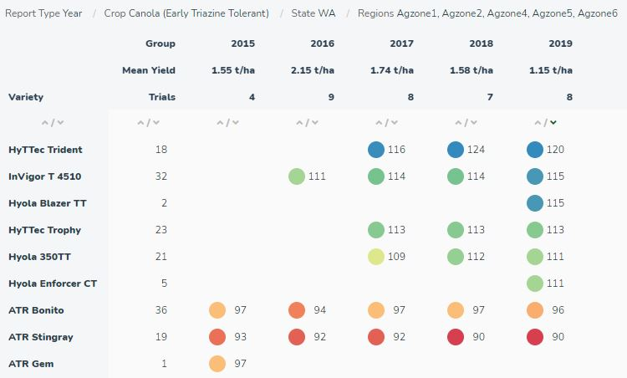
Background: Industry Hybrids vs OP Cropping Area – Breeding Advances
National % of sown area to hybrids estimated to be at 40-50% of crop (WA approx 35-45% Hybrids)
Growers/Advisors seeking more evidence of improved performance and $/ha Gross Return value proposition of >2mm graded OP TT seed vs new Hybrids
Yield gap between new elite Hybrids (any herbicide technology) and OP TT varieties is growing substantially over time
Long Term GRDC NVT MET yield results demonstrate the best Hybrids are showing good consistency, stability and adaptability across Low to High rainfall growing zones
2014-2019 GRDC NVT Long Term MET – WA Early TT Trials

Slide 3
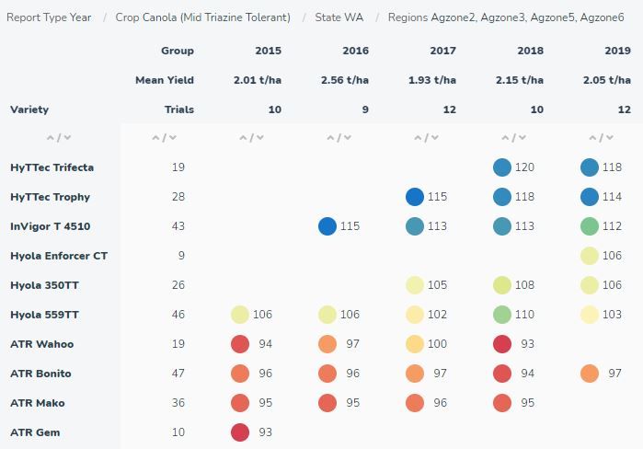
Background: Mid Season TT Hybrids vs OP TT Yield Gap Increasing (5-10% up to 15-25%)
2014-2019 GRDC NVT Long Term MET – WA Mid TT Trials
2020 GRDC NVT National Mid TT Results – All 3 varieties were common

Slide 4
2020 Trial Methodology: Seed Quality, Sowing Rate and Seed Costs $/ha Details
SEED SOURCE | Farmer Retained | Farmer Retained | Farmer Retained | Farmer Retained | Farmer Retained | Farmer Retained | Purchased | Experimental | Purchased | Purchased | Experimental | Purchased
CANOLA VARIETY | Bonito | Bonito | Stingray | Stingray | Gem | Gem | Hyola 350TT | CT200251 | HyTTec Trophy | Hyola Enforcer CT | CT90001 | Hyola 580CT
SEED SIZE (mm) | >2mm | <2mm | >2mm | <2mm | >2mm | <2mm | >2mm | <1.8mm | =2mm | =2mm | >2mm | =2mm
SEED TREATMENT | COM | COM | COM | COM | COM | COM | COM | BARE | COM | COM | BARE | COM
TSW Value | 5.41 | 3.33 | 6.75 | 3.27 | 5.26 | 3.12 | 6.45 | 2.47 | 4.65 | 4.17 | 6.06 | 4.65
Seed Count per Kg | 185,000 | 300,000 | 148,000 | 305,000 | 190,000 | 320,000 | 155,000 | 405,000 | 215,000 | 240,000 | 165,000 | 215,000
Germination % | 97 | 94 | 97 | 95 | 94 | 91 | 90 | 98 | 100 | 99 | 98 | 98
Vigour % | 91 | 88 | 96 | 84 | 88 | 84 | 98 | 82 | 90 | 96 | 92 | 97
Germination % Factorial | 90% | 90% | 90% | 90% | 90% | 90% | 90% | 90% | 90% | 90% | 90% | 90%
Establishment % Factorial | 75% | 75% | 75% | 75% | 75% | 75% | 75% | 75% | 75% | 75% | 75% | 75%
15p/m² seeds per packet | 200 SEEDS | 200 SEEDS | 200 SEEDS | 200 SEEDS | 200 SEEDS | 200 SEEDS | 200 SEEDS | NA | NA | 200 SEEDS | NA | NA
25p/m² seeds per packet | 300 SEEDS | 300 SEEDS | 300 SEEDS | 300 SEEDS | 300 SEEDS | 300 SEEDS | 300 SEEDS | NA | NA | 300 SEEDS | NA | NA
40p/m² seeds per packet | 500 SEEDS | 500 SEEDS | 500 SEEDS | 500 SEEDS | 500 SEEDS | 500 SEEDS | 500 SEEDS | 500 SEEDS | 500 SEEDS | 500 SEEDS | 500 SEEDS | 500 SEEDS
Estimated Plants/m² @ 15 | 17 | 17 | 17 | 17 | 17 | 17 | 17 | NA | NA | 17 | NA | NA
Estimated Plants/m² @ 25 | 25 | 25 | 25 | 25 | 25 | 25 | 25 | NA | NA | 25 | NA | NA
Estimated Plants/m² @ 40 | 42 | 42 | 42 | 42 | 42 | 42 | 42 | 42 | 42 | 42 | 42 | 42
Plot size in m² | 8 | 8 | 8 | 8 | 8 | 8 | 8 | 8 | 8 | 8 | 8 | 8
Effective seed rate kg/ha 15p/m² | 1.35 | 0.83 | 1.69 | 0.82 | 1.32 | 0.78 | 1.61 | 0.62 | 1.16 | 1.04 | 1.52 | 1.16
Effective seed rate kg/ha 25p/m² | 2.03 | 1.25 | 2.53 | 1.23 | 1.97 | 1.17 | 2.42 | 0.93 | 1.74 | 1.56 | 2.27 | 1.74
Effective seed rate kg/ha 40p/m² | 3.38 | 2.08 | 4.22 | 2.05 | 3.29 | 1.95 | 4.03 | 1.54 | 2.91 | 2.60 | 3.79 | 2.91
Seed Cost $/ha 15p/m² Target | $4.05 | $2.50 | $5.10 | $2.50 | $3.95 | $2.35 | $40.00 | NA | NA | $30.00 | NA | NA
Seed Cost $/ha 25p/m² Target | $6.10 | $3.75 | $7.60 | $3.70 | $5.90 | $3.50 | $60.00 | NA | NA | $45.00 | NA | NA
Seed Cost $/ha 40p/m² Target | $10.15 | $6.25 | $12.65 | $6.15 | $9.90 | $5.85 | $101.00 | $45.00 | $58.00 | $75.00 | $110.00 | $84.00

Slide 5
2020 Trial Methodology: Agronomic Details & Costing Assumptions
Trial | Trial | Design | Sowing | GSR (mm) | Trial Mean
Location | State | # Reps | Date | Rainfall | Yield (t/ha)
Geraldton | WA | RCB 3 | 25.05.20 | 389 | 1.25
Morbinning | WA | RCB 3 | 28.04.20 | 250 | 1.48
Katanning | WA | RCB 3 | 09.05.20 | 320 | 2.68
Kojonup | WA | RCB 3 | 08.05.20 | 268 | 2.00
Lake Bolac | Vic | RCB 3 | 06.05.20 | 372 | 2.39
Yarrawonga | Vic | RCB 3 | 24.04.20 | 334 | 2.99
Horsham | Vic | RCB 3 | 05.05.20 | 322 | 3.04
Lockhart | NSW | RCB 3 | 21.04.20 | 361 | 2.81
Wallendbeen | NSW | RCB 3 | 15.04.20 | 537 | 3.16
Variety | Hybrid | Seed | Seed | End Point | Base Price
Details | or OP | Source | Cost $/kg | Royalty | $/MT
ATR Bonito | OP | Retained | $3/kg | $5/MT | $600/MT
ATR Stingray | OP | Retained | $3/kg | NA | $600/MT
ATR Gem | OP | Retained | $3/kg | NA | $600/MT
Hyola 350TT | Hybrid | Purchased | $25/kg | NA | $600/MT
HyTTec Trophy | Hybrid | Purchased | $20/kg | $10/MT | $600/MT
Hyola 580CT | Hybrid | Purchased | $29/kg | NA | $600/MT
Hyola Enforcer CT | Hybrid | Purchased | $29/kg | NA | $600/MT
CT90001 | Hybrid | Experimental | $29/kg | NA | $600/MT
CT200251 | Hybrid | Experimental | $29/kg | NA | $600/MT

Slide 6
2020 Trial Methodology: Statistical Analysis
Population & Yield: Single Site analyses were performed fitting Entry, Popm², TargetPop, TSW as fixed linear factors and spatial adjustments performed using the auto-regressive model hence giving a BLUE output for each site.
Reference: Using ASReml Gilmour et al (2010)
Yield: Single Step Factor Analytic MET (Multiple Environment Trial), analysed with ASReml in a model with Popm² as a linear fixed factor with Composite Entry as a random factor hence giving a BLUP for each site.
Spatial adjustments were determined using the auto-regressive model.
Significant G*E*M effects identified by the MET analysis
Reference: Using ASReml Gilmour et al (2010)

Slide 7
2020 Plant Population by Seed Size/Count Results
Visual Establishment Comparisons
Trial Location Correlations
Variety Treatment % Plants Established Comparisons

Slide 8
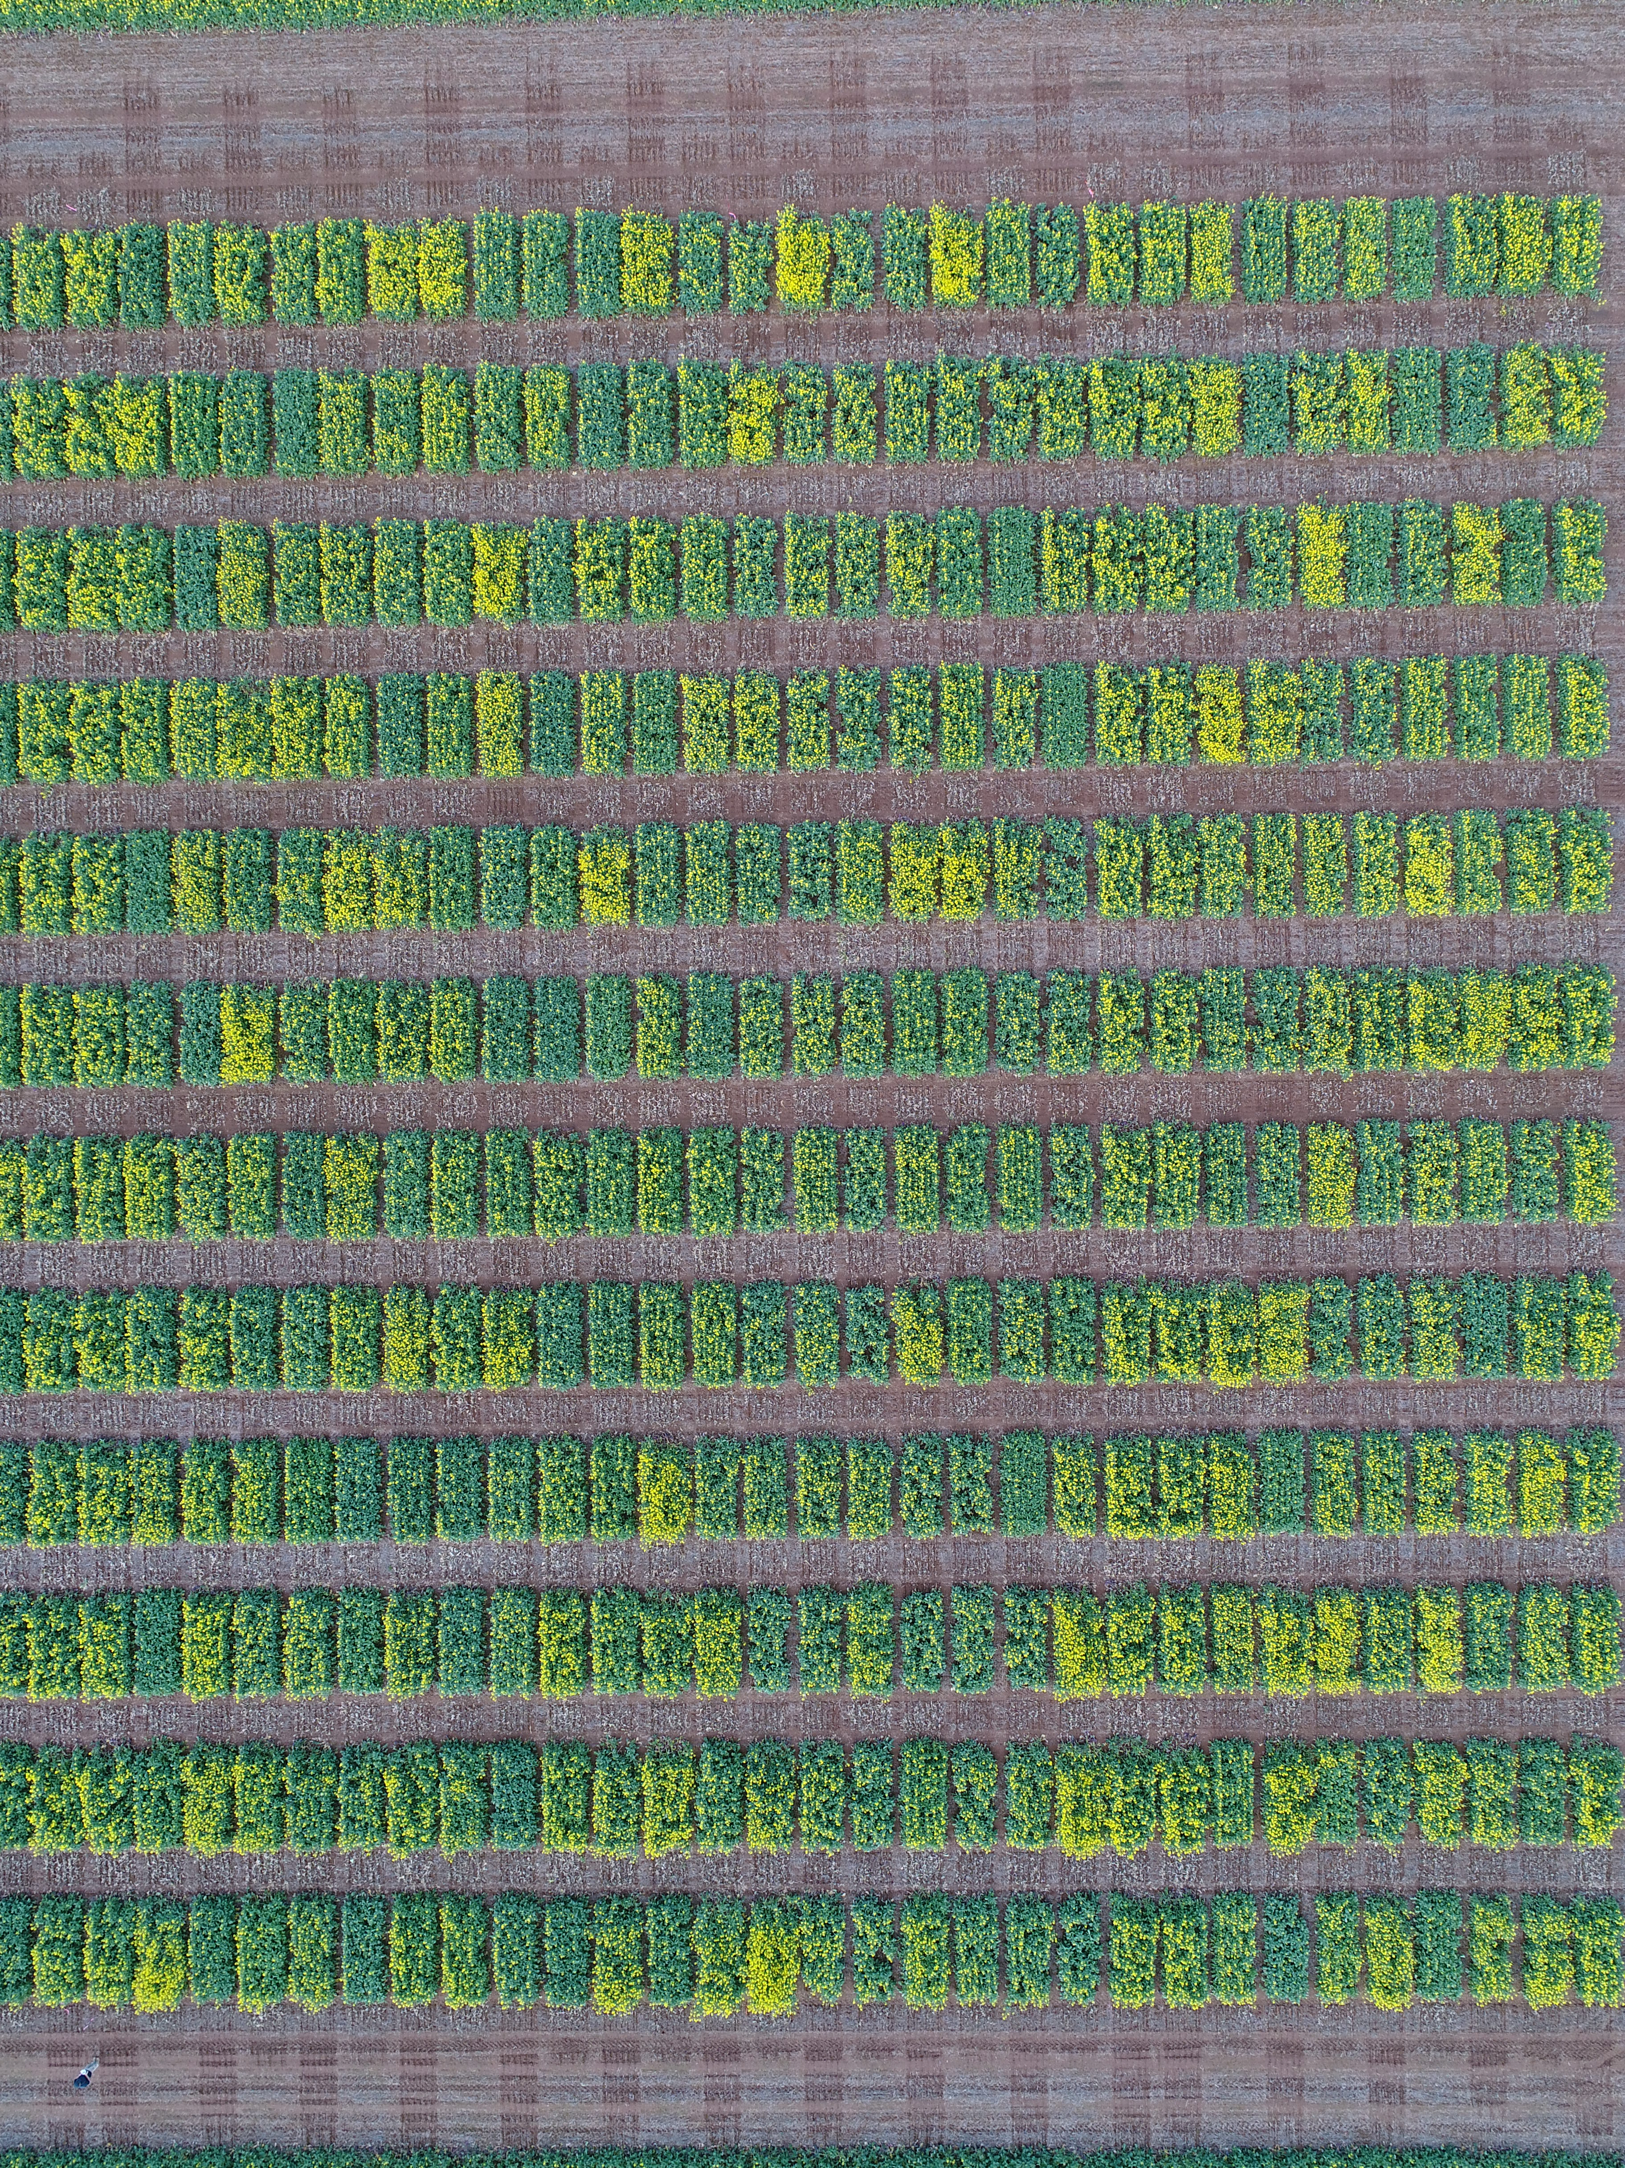
2020 Plant Population by Seed Size/Count Results – Visual Comparisons

Slide 9
2020 Plant Population Established p/m² Analysis Output
Trial Location Heatmap Correlation and Boxplot Populations across all Treatments
Heatmap reflects G*E*M. Most Trials show high levels of genetic correlation. Morbinning is the most different environment but we believe it represents a potential farmer seasonal situation.
This reflects the effect of G*E*M on establishment. Individual Trial Median of the
data shown by the dark line. The boxed areas represent the 25th to 75th percentiles
with the lines represent 1st to the 99th Percentile.

Slide 10
2020 Mean Plant Population Established p/m² - Heatmap with Spatial Correlation
This is the same dataset shown as a heatmap. The green colours represent higher establishment and red lower.

Slide 11
2020 Mean Plant Population Established per m² comparing OP TT vs Hybrid CT & TT - Population Targets 15, 25 & 40p/m²

Slide 12
2020 Mean Plant Population Established per m² comparing Higher vs Lower Rainfall Growing Environments

Slide 13
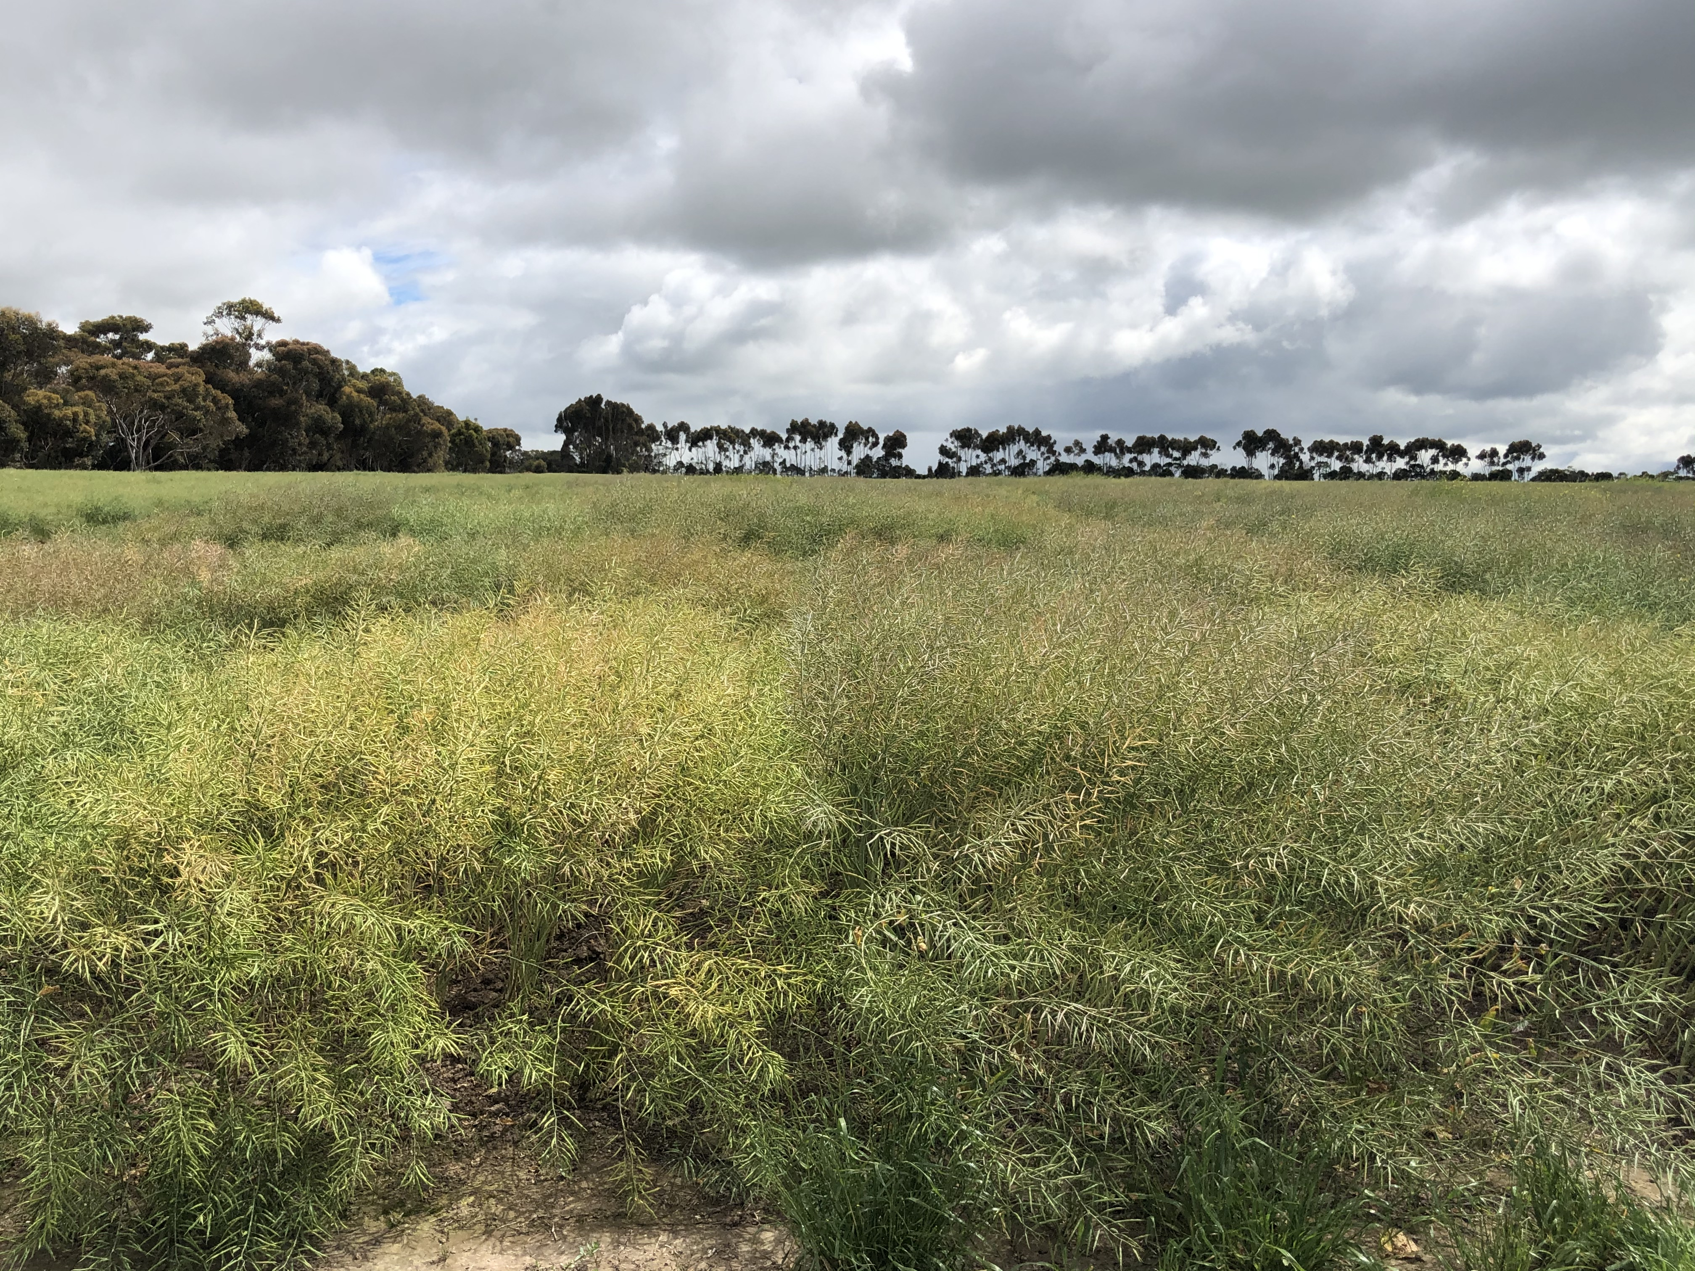
2020 Analysed Grain Yield (t/ha) & Gross Returns ($/ha) Results
Grain Yield (t/ha) Comparisons
Analysis % Variance Comparisons
Gross Return ($/ha) Comparisons
2020 Lake Bolac Vic - Trial Environment

Slide 14
2020 MET Analysis Grain Yield (t/ha) Results
Entry | TGV_Yield t/ha_Cluster_1 | Yield_t/ha_20STPVS8_KOJ | Yield_t/ha_20STPVS8_LKB | Yield_t/ha_20STPVS8_LKH | Yield_t/ha_20STPVS8_YAR | Yield_t/ha_20STPVS8_HOR | Yield_t/ha_20STPVS8_WAL | Entry | Yield_t/ha_Cluster_2 | Yield_t/ha_20STPVS8_YUN | Yield_t/ha_20STPVS8_MEK | Yield_t/ha_20STPVS8_KAT
CT200251-L1.8mm-40 | 3.327 | 2.188 | 2.771 | 3.422 | 3.443 | 4.271 | 3.885 | HyTTec Trophy=2mm-40 | 2.348 | 1.806 | 1.881 | 3.288
Hyola Enforcer CT=2mm-40 | 3.325 | 2.293 | 3.080 | 3.179 | 3.494 | 3.865 | 3.812 | Hyola Enforcer CT=2mm-40 | 2.264 | 1.699 | 1.817 | 3.207
HyTTec Trophy=2mm-40 | 3.241 | 2.277 | 3.056 | 3.070 | 3.435 | 3.653 | 3.703 | Hyola 350TT-G2mm-40 | 2.228 | 1.694 | 1.794 | 3.128
Hyola Enforcer CT=2mm-25 | 3.165 | 2.206 | 2.869 | 3.099 | 3.354 | 3.676 | 3.642 | Hyola 350TT-G2mm-25 | 2.088 | 1.546 | 1.690 | 2.959
Hyola 350TT-G2mm-40 | 3.048 | 2.186 | 2.846 | 2.938 | 3.273 | 3.365 | 3.487 | Hyola Enforcer CT=2mm-25 | 2.087 | 1.518 | 1.687 | 2.988
Hyola Enforcer CT=2mm-15 | 3.004 | 2.104 | 2.618 | 3.048 | 3.206 | 3.534 | 3.479 | Hyola 350TT-G2mm-15 | 1.987 | 1.447 | 1.617 | 2.829
Hyola 350TT-G2mm-25 | 2.958 | 2.130 | 2.707 | 2.909 | 3.191 | 3.285 | 3.396 | ATR Gem-G2mm-40 | 1.969 | 1.436 | 1.604 | 2.799
Hyola 350TT-G2mm-15 | 2.832 | 2.068 | 2.559 | 2.832 | 3.084 | 3.112 | 3.259 | Hyola 580CT=2mm-40 | 1.960 | 1.428 | 1.597 | 2.786
ATR Stingray-G2mm-25 | 2.766 | 2.000 | 2.381 | 2.870 | 3.011 | 3.152 | 3.209 | ATR Bonito-G2mm-40 | 1.918 | 1.378 | 1.565 | 2.741
ATR Gem-G2mm-40 | 2.759 | 2.038 | 2.493 | 2.772 | 3.025 | 2.986 | 3.174 | ATR Gem-G2mm-25 | 1.867 | 1.334 | 1.529 | 2.670
ATR Bonito-G2mm-40 | 2.758 | 2.029 | 2.466 | 2.790 | 3.020 | 3.016 | 3.178 | ATR Stingray-G2mm-40 | 1.845 | 1.295 | 1.511 | 2.659
ATR Stingray-G2mm-40 | 2.748 | 2.013 | 2.423 | 2.809 | 3.006 | 3.045 | 3.175 | ATR Stingray-L2mm-40 | 1.839 | 1.289 | 1.507 | 2.652
ATR Stingray-L2mm-40 | 2.748 | 2.012 | 2.420 | 2.811 | 3.005 | 3.047 | 3.175 | Hyola Enforcer CT=2mm-15 | 1.833 | 1.248 | 1.499 | 2.681
Hyola 580CT=2mm-40 | 2.743 | 2.030 | 2.475 | 2.760 | 3.011 | 2.961 | 3.155 | ATR Gem-L2mm-40 | 1.803 | 1.270 | 1.482 | 2.588
ATR Bonito-L2mm-40 | 2.669 | 1.968 | 2.315 | 2.773 | 2.937 | 2.955 | 3.092 | ATR Bonito-G2mm-25 | 1.794 | 1.249 | 1.474 | 2.591
ATR Stingray-G2mm-15 | 2.669 | 1.935 | 2.217 | 2.848 | 2.920 | 3.080 | 3.113 | ATR Bonito-L2mm-40 | 1.751 | 1.198 | 1.442 | 2.543
ATR Bonito-G2mm-25 | 2.662 | 1.973 | 2.331 | 2.749 | 2.934 | 2.913 | 3.078 | ATR Stingray-G2mm-25 | 1.729 | 1.161 | 1.424 | 2.532
ATR Gem-G2mm-25 | 2.653 | 1.982 | 2.360 | 2.713 | 2.933 | 2.850 | 3.059 | ATR Gem-L2mm-25 | 1.682 | 1.154 | 1.394 | 2.431
ATR Stingray-L2mm-25 | 2.646 | 1.945 | 2.253 | 2.785 | 2.911 | 2.969 | 3.074 | ATR Stingray-L2mm-25 | 1.660 | 1.098 | 1.374 | 2.439
ATR Gem-L2mm-40 | 2.577 | 1.944 | 2.269 | 2.668 | 2.869 | 2.749 | 2.977 | CT200251-L1.8mm-40 | 1.630 | 0.975 | 1.344 | 2.502
ATR Bonito-L2mm-25 | 2.467 | 1.861 | 2.059 | 2.662 | 2.761 | 2.699 | 2.873 | ATR Bonito-G2mm-15 | 1.609 | 1.071 | 1.339 | 2.348
ATR Gem-G2mm-15 | 2.463 | 1.867 | 2.077 | 2.643 | 2.761 | 2.666 | 2.864 | ATR Gem-G2mm-15 | 1.593 | 1.046 | 1.327 | 2.339
ATR Stingray-L2mm-15 | 2.432 | 1.845 | 2.022 | 2.638 | 2.732 | 2.647 | 2.834 | ATR Bonito-L2mm-25 | 1.551 | 0.997 | 1.295 | 2.293
ATR Gem-L2mm-25 | 2.414 | 1.864 | 2.082 | 2.564 | 2.730 | 2.517 | 2.796 | ATR Stingray-G2mm-15 | 1.551 | 0.971 | 1.293 | 2.321
ATR Bonito-G2mm-15 | 2.405 | 1.848 | 2.039 | 2.583 | 2.717 | 2.547 | 2.793 | ATR Stingray-L2mm-15 | 1.532 | 0.979 | 1.281 | 2.266
ATR Gem-L2mm-15 | 2.243 | 1.754 | 1.809 | 2.515 | 2.573 | 2.376 | 2.625 | ATR Gem-L2mm-15 | 1.399 | 0.852 | 1.184 | 2.091
ATR Bonito-L2mm-15 | 2.198 | 1.728 | 1.746 | 2.496 | 2.533 | 2.327 | 2.578 | ATR Bonito-L2mm-15 | 1.341 | 0.793 | 1.142 | 2.021
Mean Analysed Yield (t/ha) | 2.732 | 2.000 | 2.390 | 2.810 | 2.990 | 3.040 | 3.160 | Mean Analysed Yield (t/ha) | 1.803 | 1.250 | 1.480 | 2.610

Slide 15
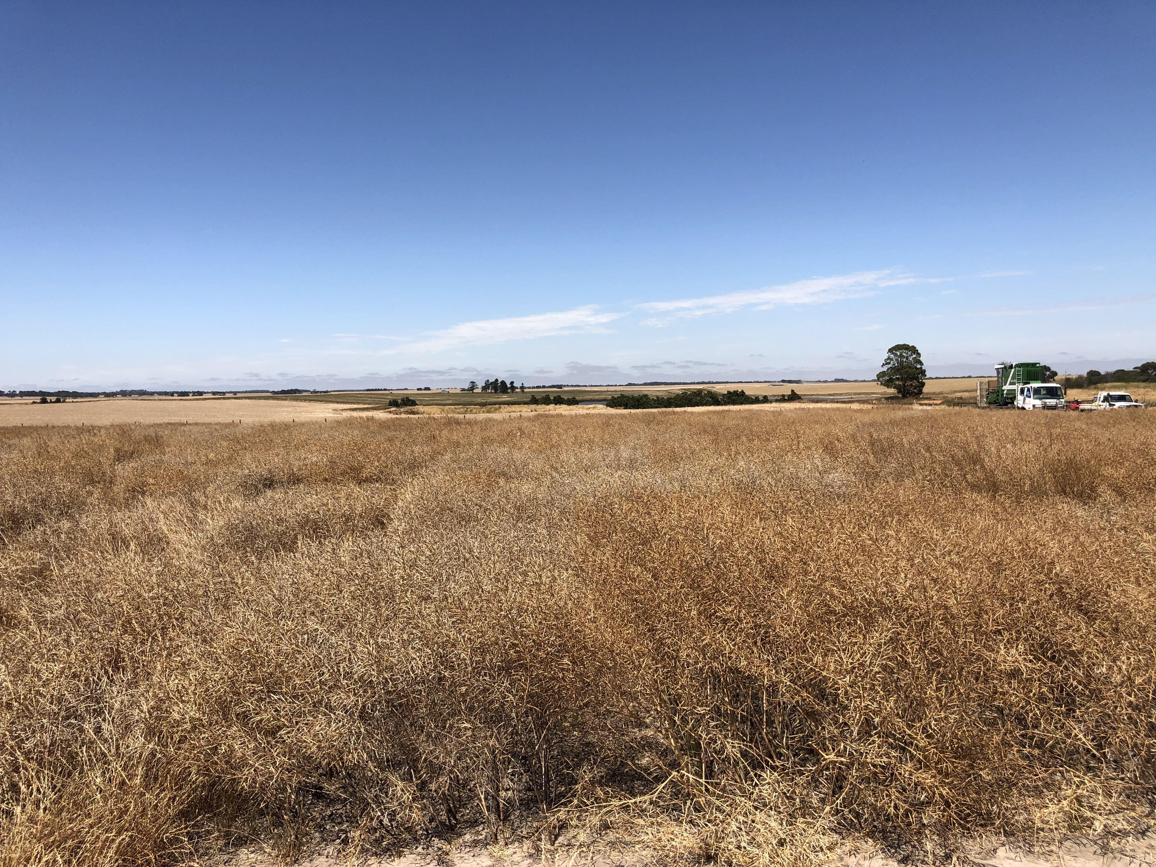
2020 MET Analysis Grain Yield (t/ha) - % Variance Comparisons – Key Points
ANALYSIS | 2020 Hyola TD - Population By Size Agronomy Trials - % Variance Accounted for by Factor on Yield
FACTOR | MET ALL | HOR | LKH | KOJ | WAL | YAR | LKB | KAT | YUN | MEK
Site | 85.93%
Entry | 8.90% | 84.24% | 76.45% | 46.41% | 61.72% | 61.33% | 64.33% | 65.92% | 60.55% | 79.88%
Popm2 | 5.17% | 15.76% | 23.55% | 53.59% | 38.28% | 38.67% | 35.67% | 34.08% | 39.45% | 20.12%
TargetPop | 0.00% | 0.14% | 1.91% | 1.00% | 0.58% | 2.63% | 0.58% | 3.27% | 3.79% | 8.85%
TSW | 0.00% | 0.43% | 2.56% | 1.01% | 0.41% | 1.54% | 5.91% | 8.66% | 7.35% | 7.58%
Where are you: Location, Site or Environment is key factor
What are you growing: Genetics is the 2nd most important factor
What is your plant stand: Target 40 plants per m² to achieve the highest yields

Slide 16
2020 Analysed Grain Yield (t/ha) comparing Higher vs Lower Rainfall Growing Environments

Slide 17
2020 MET Analysed Grain Yield Converted to Gross Returns $/ha Results
Expressed against Baseline (Key Grower Option) ATR Bonito >2mm @ 40 p/m² target
Entry | GR $/ha_Cluster_1 | GR $/ha_20STPVS8_KOJ | GR $/ha_20STPVS8_LKB | GR $/ha_20STPVS8_LKH | GR $/ha_20STPVS8_YAR | GR $/ha_20STPVS8_HOR | GR $/ha_20STPVS8_WAL | Entry | GR $/ha_Cluster_2 | GR $/ha_20STPVS8_YUN | GR $/ha_20STPVS8_MEK | GR $/ha_20STPVS8_KAT
CT200251-L1.8mm-40 | $321 | $71 | $160 | $358 | $234 | $733 | $405 | HyTTec Trophy=2mm-40 | $196 | $198 | $131 | $261
Hyola Enforcer CT=2mm-40 | $289 | $104 | $316 | $183 | $235 | $460 | $332 | Hyola Enforcer CT=2mm-40 | $152 | $135 | $94 | $228
HyTTec Trophy=2mm-40 | $223 | $88 | $287 | $103 | $182 | $313 | $246 | Hyola 350TT-G2mm-40 | $105 | $106 | $54 | $155
Hyola Enforcer CT=2mm-25 | $223 | $81 | $219 | $165 | $181 | $376 | $260 | Hyola 350TT-G2mm-25 | $62 | $58 | $33 | $94
Hyola 350TT-G2mm-40 | $97 | $14 | $149 | $12 | $76 | $134 | $111 | Hyola Enforcer CT=2mm-25 | $77 | $56 | $46 | $127
Hyola Enforcer CT=2mm-15 | $142 | $35 | $83 | $149 | $107 | $306 | $177 | Hyola 350TT-G2mm-15 | $22 | $19 | $9 | $37
Hyola 350TT-G2mm-25 | $84 | $21 | $107 | $36 | $68 | $127 | $97 | ATR Gem-G2mm-40 | $41 | $42 | $31 | $49
Hyola 350TT-G2mm-15 | $29 | $4 | $38 | $9 | $24 | $43 | $34 | Hyola 580CT=2mm-40 | -$39 | -$37 | -$47 | -$33
ATR Stingray-G2mm-25 | $22 | -$5 | -$37 | $64 | $12 | $99 | $37 | ATR Bonito-G2mm-40 | $0 | $0 | $0 | $0
ATR Gem-G2mm-40 | $15 | $16 | $28 | $3 | $19 | -$3 | $14 | ATR Gem-G2mm-25 | -$16 | -$15 | -$10 | -$25
ATR Bonito-G2mm-40 | $0 | $0 | $0 | $0 | $0 | $0 | $0 | ATR Stingray-G2mm-40 | -$37 | -$45 | -$27 | -$38
ATR Stingray-G2mm-40 | $6 | -$2 | -$16 | $23 | $5 | $30 | $12 | ATR Stingray-L2mm-40 | -$34 | -$42 | -$23 | -$36
ATR Stingray-L2mm-40 | $12 | $4 | -$11 | $30 | $11 | $38 | $18 | Hyola Enforcer CT=2mm-15 | -$61 | -$91 | -$52 | -$42
Hyola 580CT=2mm-40 | -$69 | -$63 | -$56 | -$78 | -$64 | -$92 | -$72 | ATR Gem-L2mm-40 | -$55 | -$53 | -$38 | -$74
ATR Bonito-L2mm-40 | -$49 | -$32 | -$86 | -$6 | -$46 | -$32 | -$47 | ATR Bonito-G2mm-25 | -$69 | -$72 | -$50 | -$86
ATR Stingray-G2mm-15 | -$34 | -$41 | -$132 | $54 | -$40 | $59 | -$18 | ATR Bonito-L2mm-40 | -$96 | -$103 | -$70 | -$114
ATR Bonito-G2mm-25 | -$53 | -$29 | -$77 | -$20 | -$47 | -$57 | -$56 | ATR Stingray-G2mm-25 | -$101 | -$121 | -$74 | -$109
ATR Gem-G2mm-25 | -$45 | -$14 | -$48 | -$28 | -$33 | -$80 | -$51 | ATR Gem-L2mm-25 | -$125 | -$121 | -$89 | -$166
ATR Stingray-L2mm-25 | -$47 | -$34 | -$109 | $18 | -$44 | -$7 | -$40 | ATR Stingray-L2mm-25 | -$139 | -$154 | -$100 | -$161
ATR Gem-L2mm-40 | -$90 | -$37 | -$102 | -$55 | -$71 | -$141 | -$101 | CT200251-L1.8mm-40 | -$198 | -$269 | -$160 | -$165
ATR Bonito-L2mm-25 | -$167 | -$93 | -$236 | -$70 | -$148 | -$182 | -$175 | ATR Bonito-G2mm-15 | -$177 | -$176 | -$129 | -$228
ATR Gem-G2mm-15 | -$157 | -$81 | -$215 | -$68 | -$134 | -$189 | -$166 | ATR Gem-G2mm-15 | -$179 | -$186 | -$129 | -$222
ATR Stingray-L2mm-15 | -$174 | -$92 | -$247 | -$70 | -$150 | -$199 | -$183 | ATR Bonito-L2mm-25 | -$212 | -$220 | -$154 | -$261
ATR Gem-L2mm-25 | -$186 | -$82 | -$212 | -$115 | -$152 | -$277 | -$206 | ATR Stingray-G2mm-15 | -$205 | -$232 | -$151 | -$233
ATR Bonito-G2mm-15 | -$204 | -$101 | -$248 | -$117 | -$174 | -$273 | -$223 | ATR Stingray-L2mm-15 | -$214 | -$224 | -$155 | -$264
ATR Gem-L2mm-15 | -$287 | -$147 | -$374 | -$143 | -$245 | -$361 | -$308 | ATR Gem-L2mm-15 | -$294 | -$301 | -$213 | -$369
ATR Bonito-L2mm-15 | -$325 | -$171 | -$421 | -$168 | -$282 | -$402 | -$349 | ATR Bonito-L2mm-15 | -$335 | -$340 | -$245 | -$421
Mean Analysed Yield (t/ha) | 2.732 | 2.000 | 2.390 | 2.810 | 2.990 | 3.040 | 3.160 | Mean Analysed Yield (t/ha) | 1.803 | 1.250 | 1.480 | 2.610

Slide 18
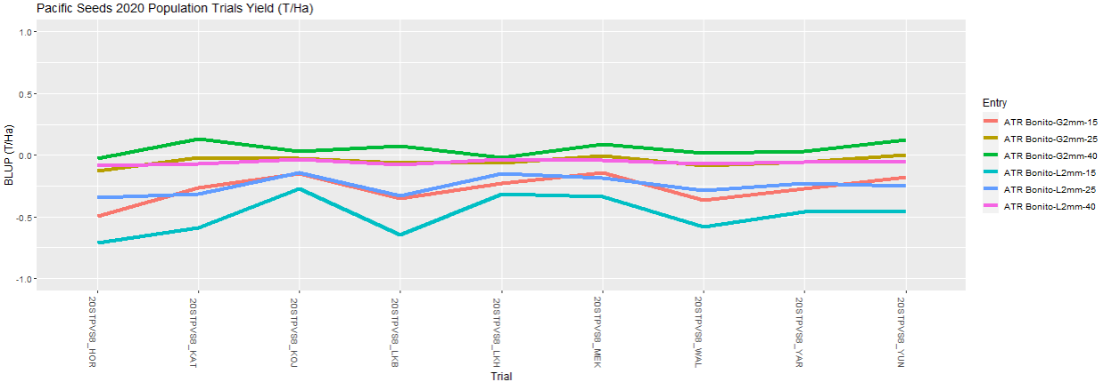
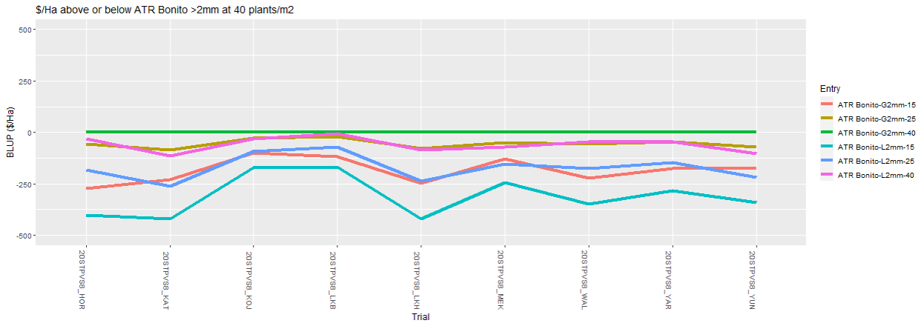
2020 Analysed Grain Yield (t/ha) & Gross Return ($/ha)
ATR Bonito - OP TT >2mm vs <2mm Seed Size Responses
G2mm vs L2mm – G2mm at 25 & 40p/m² with higher yield performance
L2mm at 40p/m² shows yield equivalence with G2mm at 25p/m²
Gross Return baseline is G2mm at 40p/m² – Highest returns across sites
G2mm at 25p/m² similar returns to L2mm at 40p/m²

Slide 19
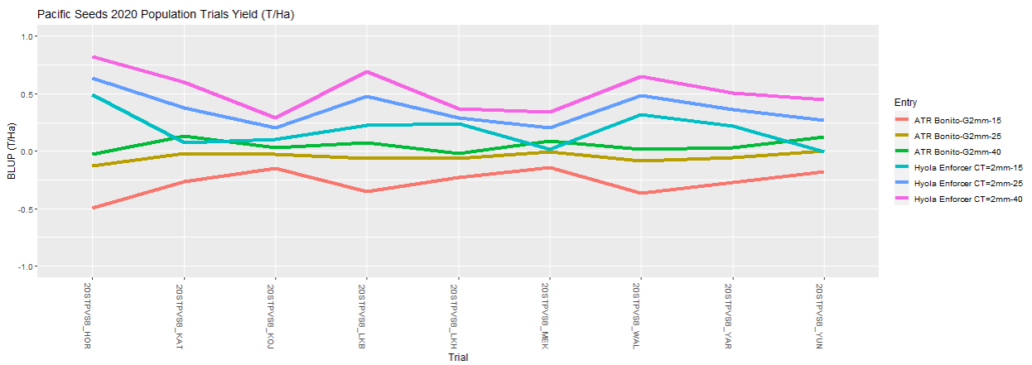
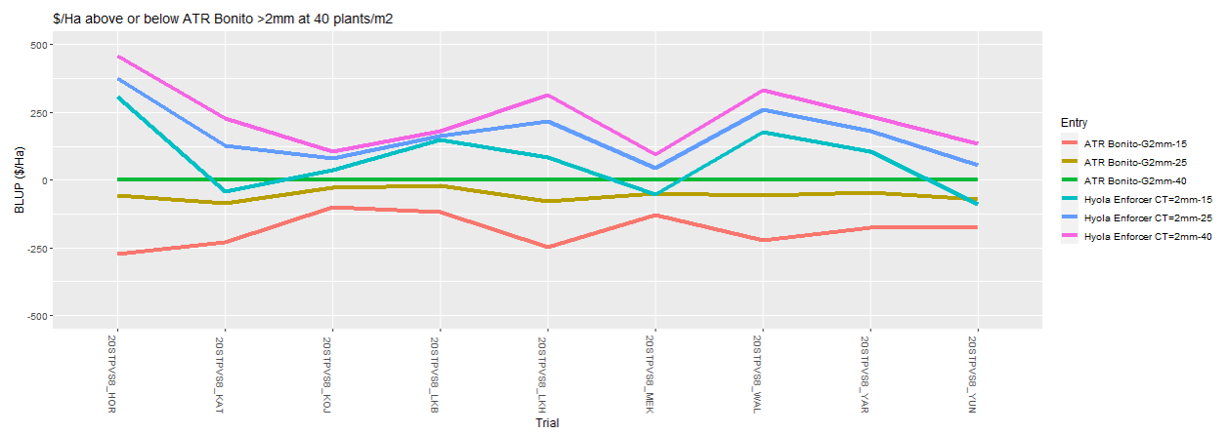
2020 Analysed Grain Yield (t/ha) & Gross Return ($/ha) Comparisons
Population Targets 15, 25 & 40p/m² – OP TT >2mm vs Hyola Enforcer CT = 2mm
Hyola Enforcer CT at 25 & 40p/m² provide higher yields even over ATR Bonito G2mm at 40p/m² over all sites
Hyola Enforcer CT at 15p/m² provides yields equal, just below or higher than ATR Bonito G2mm at 40p/m² across sites
Gross Return $/ha baseline is ATR Bonito G2mm at 40pm²
Hyola Enforcer CT at 25 & 40pm² provide higher $/ha returns at all sites and 15pm² at some higher rainfall sites

Slide 20
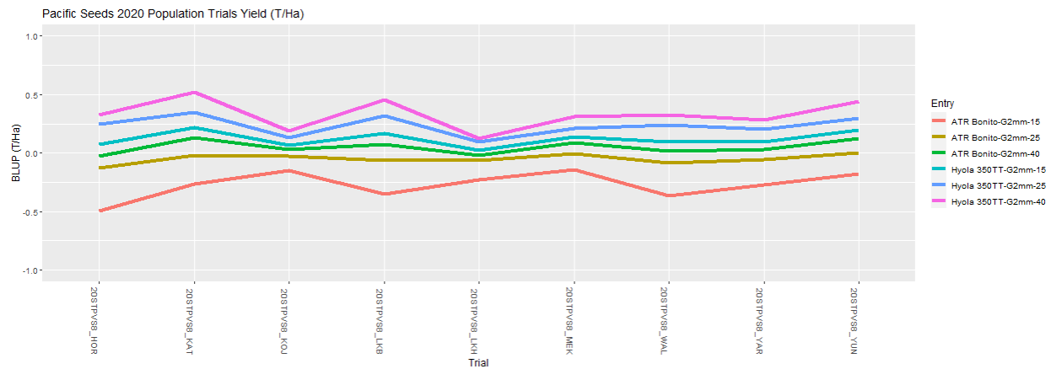
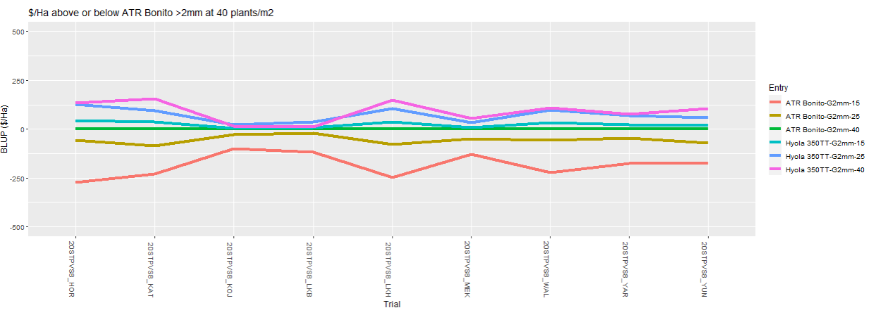
2020 Analysed Grain Yield (t/ha) & Gross Return ($/ha) Comparisons
Population Targets 15, 25 & 40p/m² – OP TT >2mm vs Hyola 350TT > 2mm
Hyola 350TT at 15, 25 & 40p/m² provide higher yields even over ATR Bonito G2mm at 40p/m² over all sites
ATR Bonito G2mm highest yields at 40p/m² over 25 & 15 p/m² across sites
Gross Return $/ha baseline is ATR Bonito G2mm at 40p/m²
Hyola 350TT at 25 & 40p/m² targets provide higher $/ha returns at nearly all sites and at 15p/m² provided similar returns to baseline

Slide 21
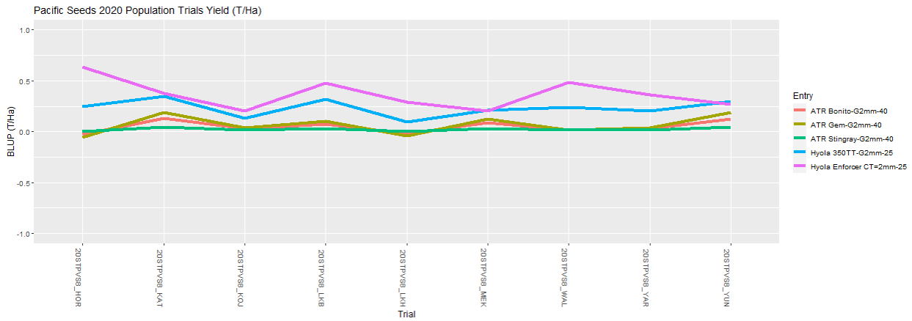
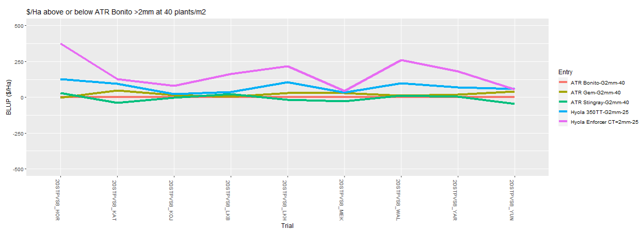
2020 Analysed Grain Yield (t/ha) & Gross Return ($/ha) Comparisons
OP TT >2mm 40p/m² Target vs Hyola 350TT > 2mm & Hyola Enforcer CT =2mm 25p/m²
Hyola Enforcer CT and Hyola 350TT at 25 p/m² provided higher yields over all 3 OP TT varieties G2mm at 40p/m² over all yield environments
Gross Return $/ha baseline is ATR Bonito G2mm at 40pm²
Hyola Enforcer CT at 25pm² target provided higher $/ha returns at all sites.
Hyola 350TT at 25pm² provided comparable to higher returns to all 3 OP TT varieties (due to higher seed cost associated with larger seed size)

Slide 22
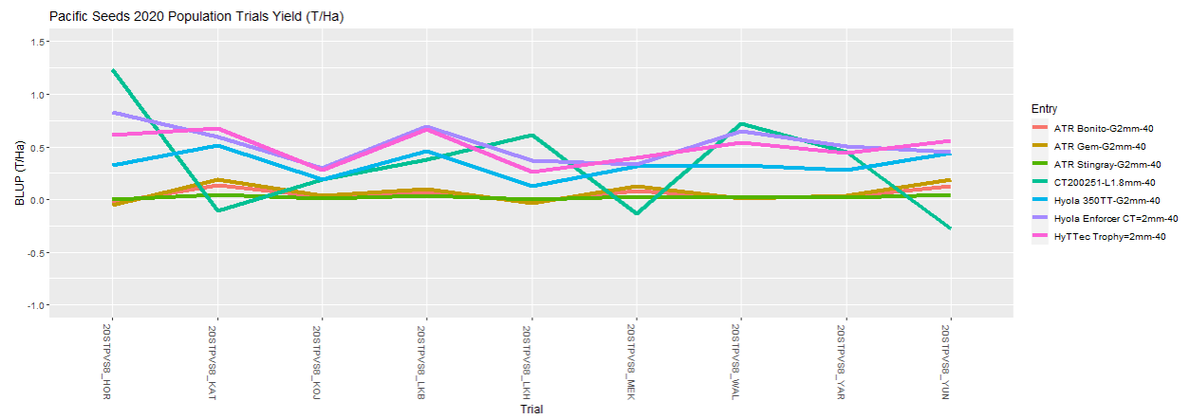
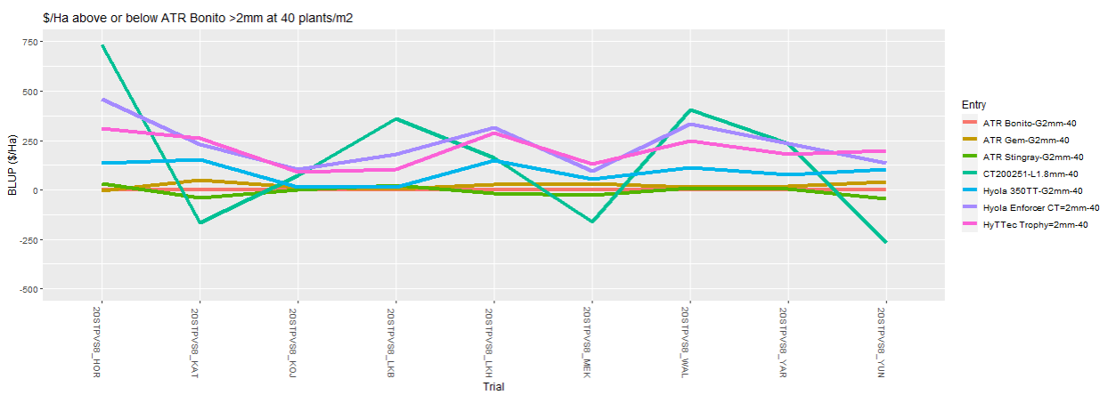
2020 Analysed Grain Yield (t/ha) & Gross Return ($/ha) Comparisons
Targets 40p/m² – 3 OP TT >2mm vs 4 Hybrids (<1.8mm to > 2mm)
3 of the 4 hybrids showed higher yields than all 3 OP TT varieties across all locations (many significantly higher)
CT200251 – longer season exp hybrid with <1.8mm seed showed very high yields in HRZ and was not as competitive at lower yielding sites.
Gross Return $/ha baseline is ATR Bonito G2mm at 40p/m²
2 Hybrids showed much higher returns than all 3 OP TT varieties across all sites, whereas 2 others showed varied responses due to genetics, maturity, site rainfall and seed size influences.

Slide 23
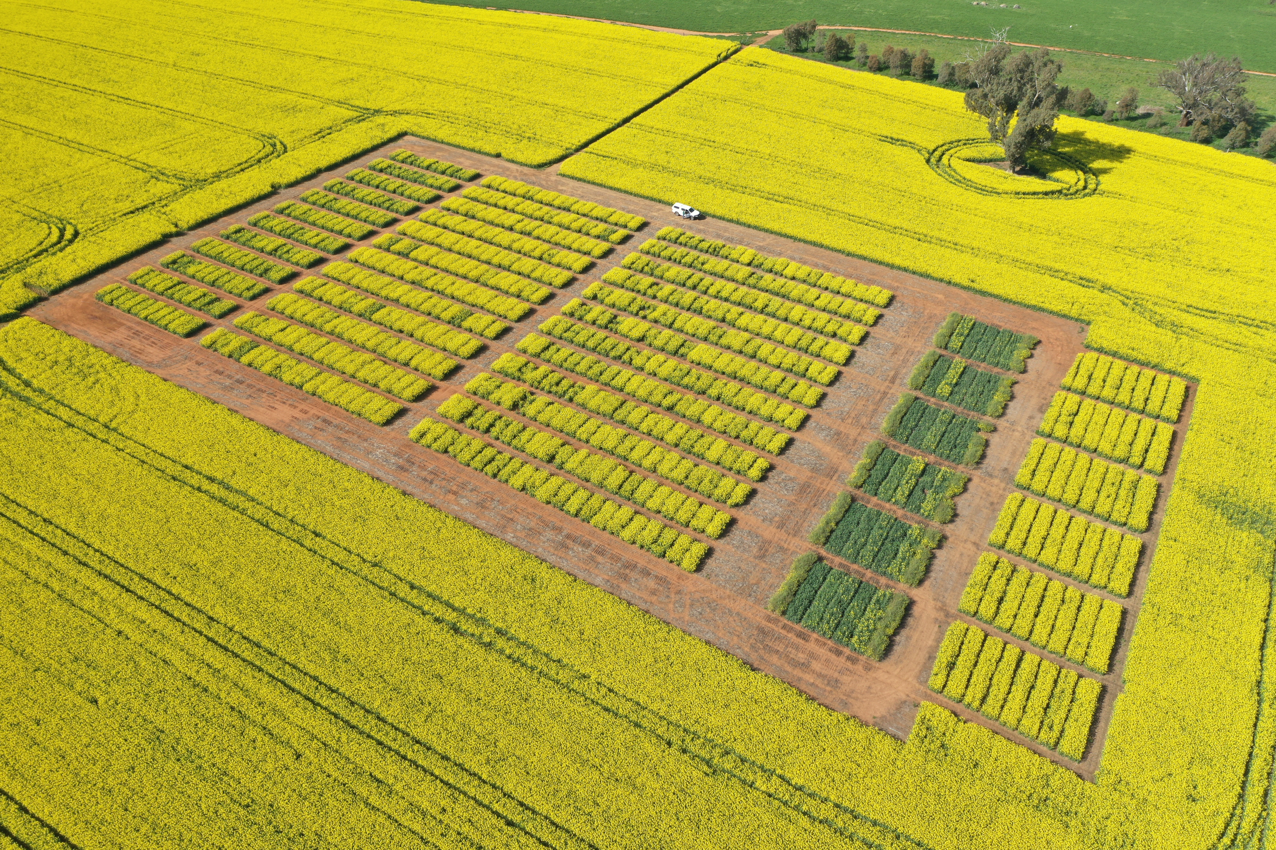
Overall Conclusions – Key Outcomes – “Growers - Grade Your OP Seed to >2mm”
Grading OP TT seed to >2mm compared to <2mm are showing 9 Trial average increases of:
Plants establishment (10-15%)
Grain yield (25kg/ha to 213kg/ha)
Gross returns ($10/ha to $128/ha)
Individual Environments are showing increases of:
(a) Plants establishment (up to 35.5%)
(b) Grain yield (up to 433kg/ha)
(c) Gross returns (up to $255/ha)
2020 Wallendbeen NSW - Trial Environment

Slide 24
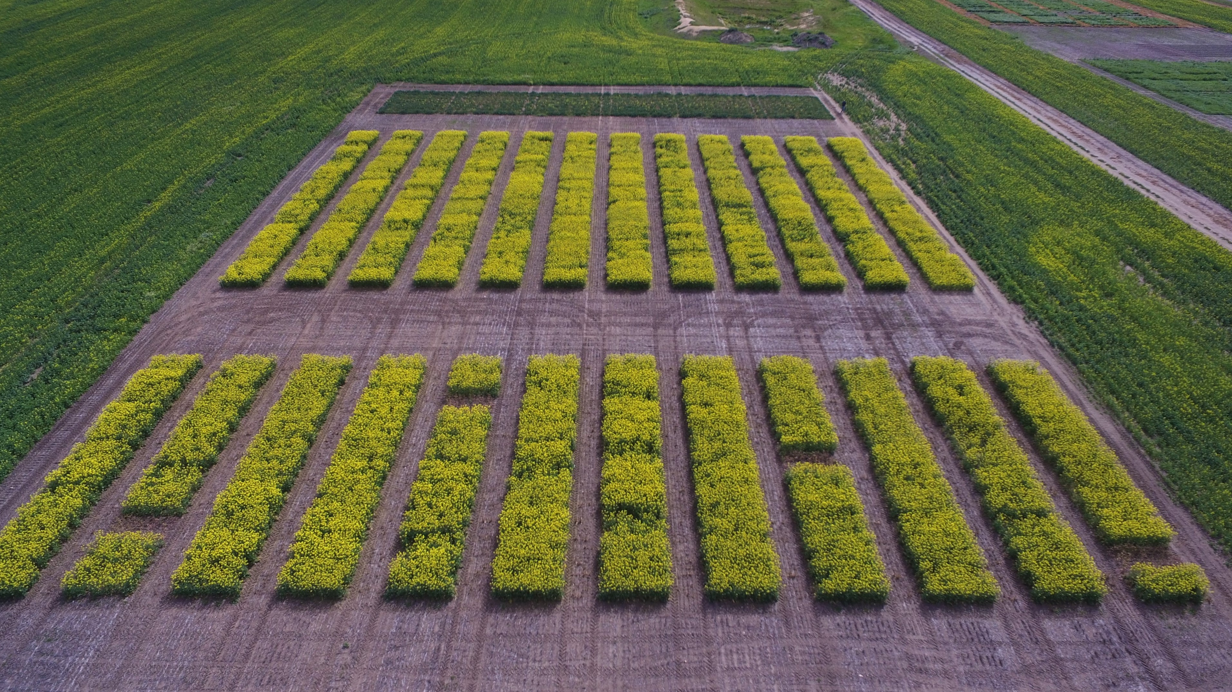
Overall Conclusions – Key Outcomes – “Best hybrids are worth the investment”
CT or TT Hybrids with =2mm or >2mm provided higher % establishment than OP TT <2mm or >2mm in nearly all environments
CT or TT Hybrids with higher genetic yield potential can provide significantly higher yields and gross returns than OP TT varieties across many growing environments
Growing these CT or TT Hybrids between (=2mm to >2mm) compared to OP TT varieties with >2mm are showing 9 Trial average increases of:
(a) Plants establishment across Environments - (10-35%)
(b) Grain yield - HYS (190kg/ha to 560kg/ha), MYS (50kg/ha to 350kg/ha)
(c) Gross returns - HYS ($84/ha to $321/ha), MYS ($36/ha to $196/ha)
HYS = Higher Yielding Site, MYS = Medium Yielding Site
2020 Katanning WA - Trial Environment

Slide 25
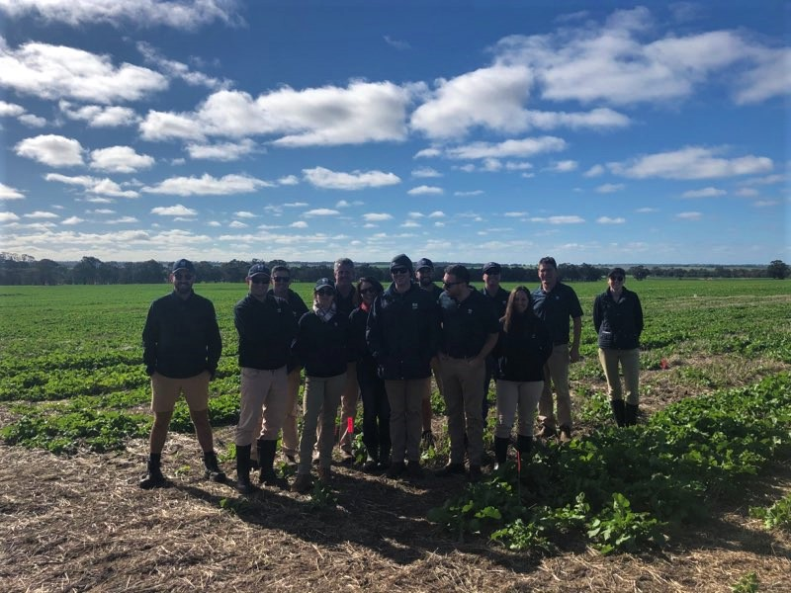
Overall Conclusions – Key Outcomes – “NVT Long Term Results highlight genetic potential”
Validates our previous related research, that (G) X (E) interactions can override (M) management decisions based around seed size and population targets.
Latest genetics in CT & TT hybrids shown in this research and Long Term GRDC NVT trial yield results validate their “increased adoption” by growers in future winter cropping programs over OP TT varieties.
2020 Morbinning WA - Trial Environment

Slide 26
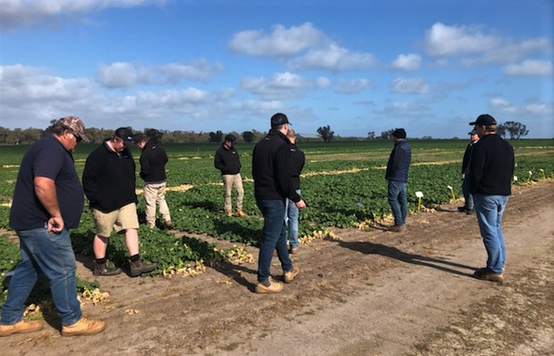
Acknowledgements
Trial development, design and analysis by Dr David Tabah, Crop Research Lead (Canola), Pacific Seeds
Trial planting, maintenance, spraying and harvest across Australia by Kalyx Australia, Crop Circle Consulting, Synergy (SLR Research & Extension) and TrialCo
GRDC for the opportunity to present at 2021 Crop Updates to the WA Industry
2020 Horsham Vic - Trial Environment

Slide 27
Thank You

