Slide 1


TruFlex/Clearfield (XC) GM dual herbicide stacked canola for integrated management of annual ryegrass
Christopher Preston¹, David Tabah² and Justin Kudnig²
¹University of Adelaide, ²Pacific Seeds

Slide 2
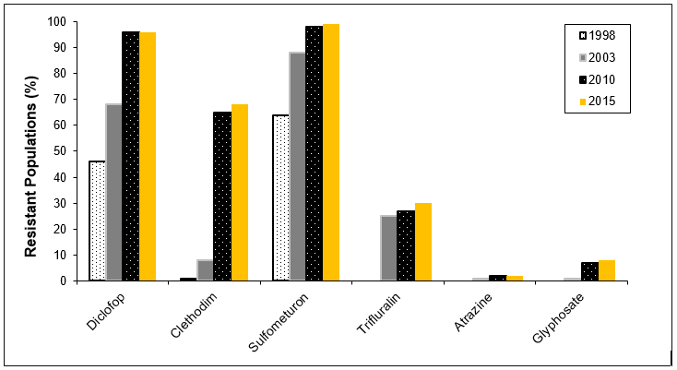
The problem of annual ryegrass
Herbicide resistance in annual ryegrass in Western Australia (from https://ahri.uwa.edu.au/research/surveys/)

Slide 3
Canola Herbicide Tolerance Options
New options in herbicide tolerance have introduced multiple choices
TruFlex (XX) – Up to 3 applications of glyphosate in crop, how should these be used best
TruFlex/Clearfield (XC) – Where or if to use imidazolinone herbicides
Is there a place for other dual tolerance options – (CT)

Slide 4
Field Trials in 2020
Frankland WA
Morbinning WA
Teesdale VIC
Hyola 410XX
Hyola 540XC
ADV-Equinox CL
Hyola Enforcer CT
ATR Bonito
Glyphosate + Sharpen knockdown, propyzamide pre-emergent, then 18 different in-crop strategies

Slide 5
XX and XC strategies
Treatment | Canola type | PSPE | 2 to 4-leaf | 4 to 6-leaf | First flower | Crop top
1 | Hybrid XC |  |  | Intervix
2 | Hybrid XX |  |  | High RRH | High RRH
3 | Hybrid XC |  |  | High RRH | High RRH
4 | Hybrid XX |  | Low RRH | Low RRH | Low RRH
5 | Hybrid XC |  | Intervix | High RRH | High RRH
6 | Hybrid XC |  |  | High RRH + Intervix | High RRH
7 | Hybrid XC |  |  | Intervix |  | RUM
8 | Hybrid XX |  | Low RRH |  | Low RRH | RUM
9 | Hybrid XC |  | Low RRH |  | Low RRH | RUM
10 | Hybrid XC |  | Intervix | Low RRH | Low RRH | RUM
11 | Hybrid XC |  |  | Low RRH + Intervix | Low RRH | RUM
12 | Hybrid XX |  |  | Low RRH | Low RRH | RUM

Slide 6
Strategies for other Canola Types
Treatment | Canola type | PSPE | 2 to 4-leaf | 4 to 6-leaf | First flower | Crop top
13 | Hybrid CL |  |  | Intervix + Clethodim
14 | Hybrid CL |  |  | Intervix + Clethodim |  | RUM
15 | Hybrid CT | Atrazine |  | Atrazine + Intervix + Clethodim
16 | Hybrid CT | Atrazine |  | Atrazine + Intervix + Clethodim |  | RUM
17 | OP TT | Atrazine |  | Atrazine + Clethodim
18 | OP TT | Atrazine |  | Atrazine + Clethodim |  | RUM

Slide 7
Annual Ryegrass Control
Treatment | Annual ryegrass (plants m⁻²) |  |  | Annual ryegrass (spikes plot⁻¹)
 | F | M | T | F | M | T
1 XC Int | 25.5a-d | 2.5ab | 7.1a | 39bc | 39.5ab | 240a
2 XX 2 x RRH | 8.5ef | 0c | 0.4c | 5.8e | 0d | 14.8de
3 XC 2 x RRH | 7.5ef | 0.1c | 0.8bc | 6.5e | 0d | 13.5de
4 XX 3 x RRH | 5f | 0.1c | 0.2c | 9.5e | 0d | 8.8de
5 XC Int, 2 x RRH | 8.8ef | 0.1c | 0.5bc | 7.5e | 1d | 12de
6 XC Int + 2 x RRH | 6f | 0c | 0.2c | 7.5e | 0d | 4de
7 XC Int, CT | 33.5ab | 3.9a | 6.9a | 36bcd | 19.5b | 168ab
8 XX 2 x RRH, CT | 15.5def | 0.2c | 1.9bc | 7e | 2.5cd | 26.5d
9 XC 2 x RRH, CT | 18.3cde | 0.2c | 1.8bc | 8e | 1d | 32.5d
10 XC Int, 2 x RRH, CT | 7.5ef | 0.1c | 0.1c | 4.3e | 1d | 2.3e
11 XC Int + 2 x RRH, CT | 7.5ef | 0.2c | 0.2c | 7.3e | 0d | 2.3e
12 XX 2 x RRH, CT | 8ef | 0c | 0.5bc | 8.5e | 0d | 8.8de

Slide 8
Annual Ryegrass Control
Treatment | Annual ryegrass (plants m⁻²) |  |  | Annual ryegrass (spikes plot⁻¹)
 | F | M | T | F | M | T
13 CL Int + Cleth | 31.5ab | 1.7ab | 6.3a | 26.3cde | 46a | 188ab
14 CL Int + Cleth, CT | 34a | 2ab | 5.6a | 31.3cde | 18b | 136bc
15 CT Atr, Atr + Int + Cleth | 24a-d | 2ab | 4.9a | 21.3de | 9.3bc | 124bc
16 CT Atr, Atr + Int + Cleth, CT | 20.5b-e | 1.9ab | 5.8a | 26cde | 6.8c | 89.3c
17 TT Atr, Atr + Cleth | 29abc | 2.4ab | 5a | 57.8a | 19.8b | 177ab
18 TT Atr, Atr + Cleth, CT | 30abc | 1.6b | 4ab | 53ab | 18.8b | 171ab

Slide 9
Canola Yield
Treatment | Canola yield (T ha⁻¹)
 | F | M | T
1 XC Int | 2.19ab | 1.12c | 3.57a
2 XX 2 x RRH | 2.53ab | 1.76ab | 3.73a
3 XC 2 x RRH | 2.44ab | 1.46abc | 3.71a
4 XX 3 x RRH | 2.50ab | 1.85a | 3.81a
5 XC Int, 2 x RRH | 2.49ab | 1.43bc | 3.70a
6 XC Int + 2 x RRH | 2.47ab | 1.42bc | 3.74a
7 XC Int, CT | 2.24ab | 1.21bc | 3.66a
8 XX 2 x RRH, CT | 2.50ab | 1.93a | 3.74a
9 XC 2 x RRH, CT | 2.43ab | 1.55abc | 3.79a
10 XC Int, 2 x RRH, CT | 2.59a | 1.51abc | 3.94a
11 XC Int + 2 x RRH, CT | 2.59a | 1.51abc | 3.92a
12 XX 2 x RRH, CT | 2.63a | 1.86a | 3.78a

Slide 10
Canola Yield
Treatment | Canola yield (T ha⁻¹)
 | F | M | T
13 CL Int + Cleth | 2.14ab | 1.50abc | 3.92a
14 CL Int + Cleth, CT | 2.26ab | 1.62abc | 4.08a
15 CT Atr, Atr + Int + Cleth | 2.16ab | 1.57abc | 3.79a
16 CT Atr, Atr + Int + Cleth, CT | 2.26ab | 1.69ab | 3.71a
17 TT Atr, Atr + Cleth | 1.69b | 1.32bc | 2.88b
18 TT Atr, Atr + Cleth, CT | 1.85ab | 1.40bc | 2.86b

Slide 11
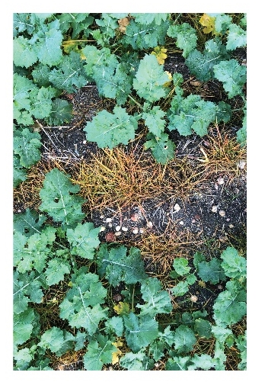
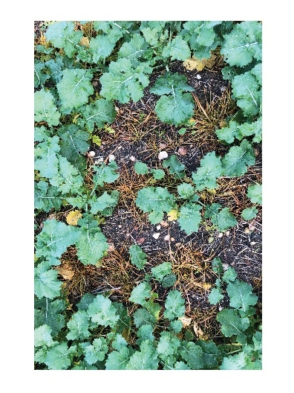
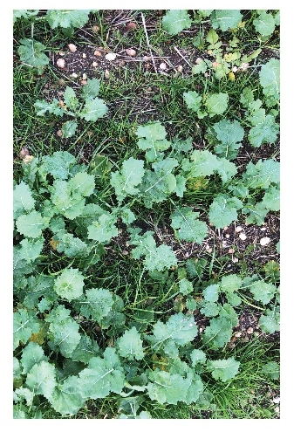
XC with Intervix
XC with 2 x RRH
XC with Intervix + 2 x RRH

Slide 12
Summary
Annual ryegrass control in Clearfield and TT canola is ineffective when resistance to clethodim and imidazolinone herbicides is present
2 RRH applications in XX canola is as effective as 3 RRH applications
Good early control of annual ryegrass is essential for maintaining crop yield
XC canola is useful for managing imidazolinone herbicide residues, but also allows imidazolinone herbicides to be used in crop if necessary
Choose an appropriate canola type for the resistance profile of annual ryegrass present

