Slide 1


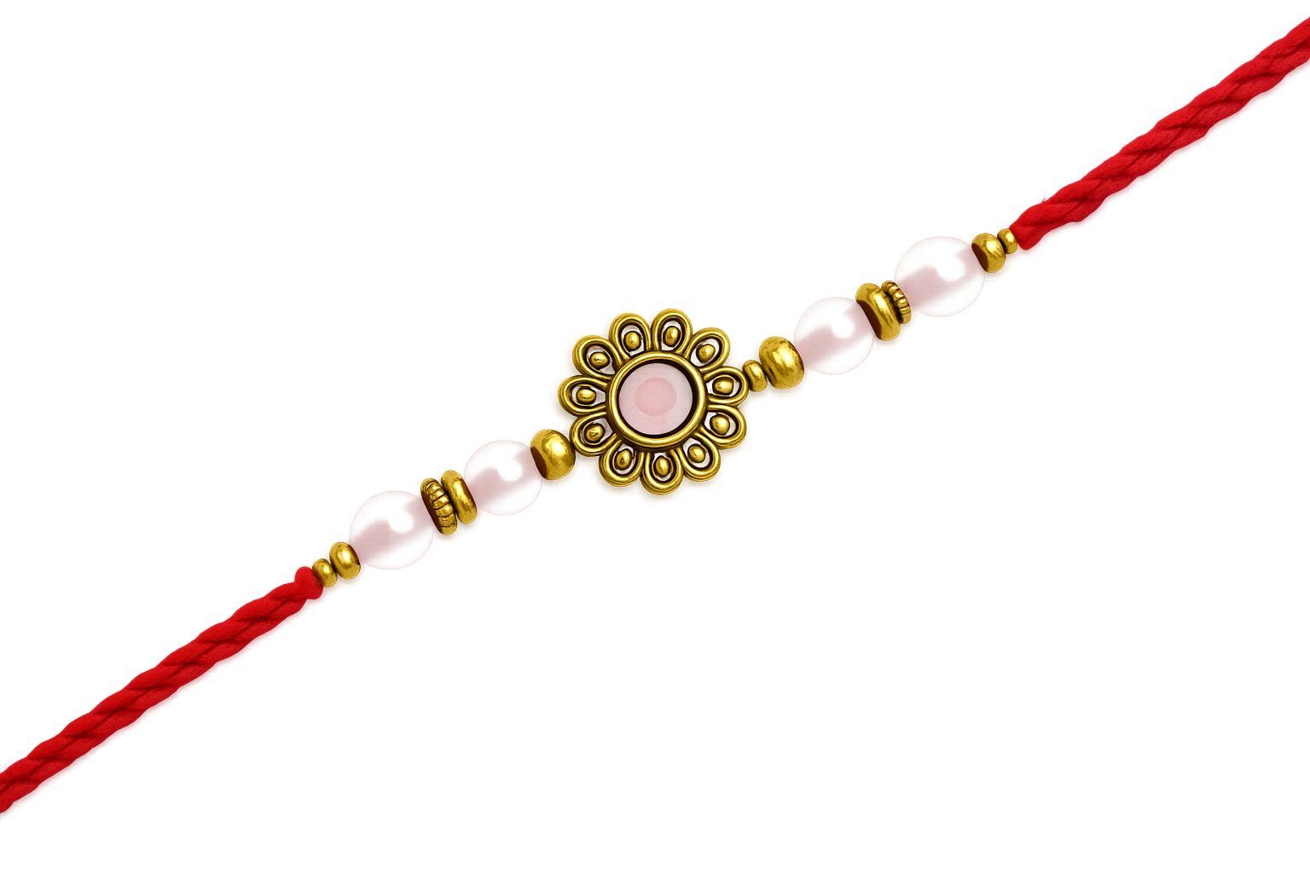
Raksha Bandhan
A Traditional Hindu Festival

Slide 2

What is Raksha Bandhan?
Raksha Bandhan is an annual traditional Hindu festival.
Raksha means 'protection' and Bandhan means ‘to bond’.
It celebrates the bond between family, friends and community.
Raksha Bandhan focuses on love, protection and family bonds and links with humanity and nature.

Slide 3
Origins of Raksha Bandhan
The origins of Raksha Bandhan are deeply rooted in the Gurukul tradition, particularly in the sacred relationship between Guru (teacher) and Shishya (disciple).
In ancient times, when a guru initiated their disciple, they tied a red or orange thread around the right wrist.
This multicoloured thread tied around the wrist started the tradition of Raksha Bandhan or Rakhi, meaning ‘promise to protect’. It signified the bond of mutual love and trust between the teacher and the pupil.
In later times, women began to tie Rakhi to their brothers. The rakhi is a rakshasutra, 'thread of protection’. By tying a rakhi—a sacred thread—on her brother’s wrist, a sister expresses her love and prayers for his well-being.
In this way, Rakhi became a symbol of affection between brothers and sisters.
Raksha Bandhan also promotes the message of universal friendship.

Slide 4
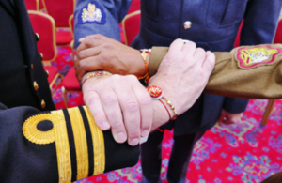
Origins of Raksha Bandhan
There was also a tradition of members of the public tying a Rakhi to their king or queen. It symbolised their allegiance to the civic authority and the leaders’ promise to look after their subjects.
This tradition has been kept alive in Britain by Hindus who every year tie a Rakhi to the Mayor of their city.
Rakhi is also tied to members of UK armed forces, police and firefighters to show gratitude to the service they provide to protect the nation.
Image showing personnel from the three UK services with rakhis tied around their wrists.

Slide 5
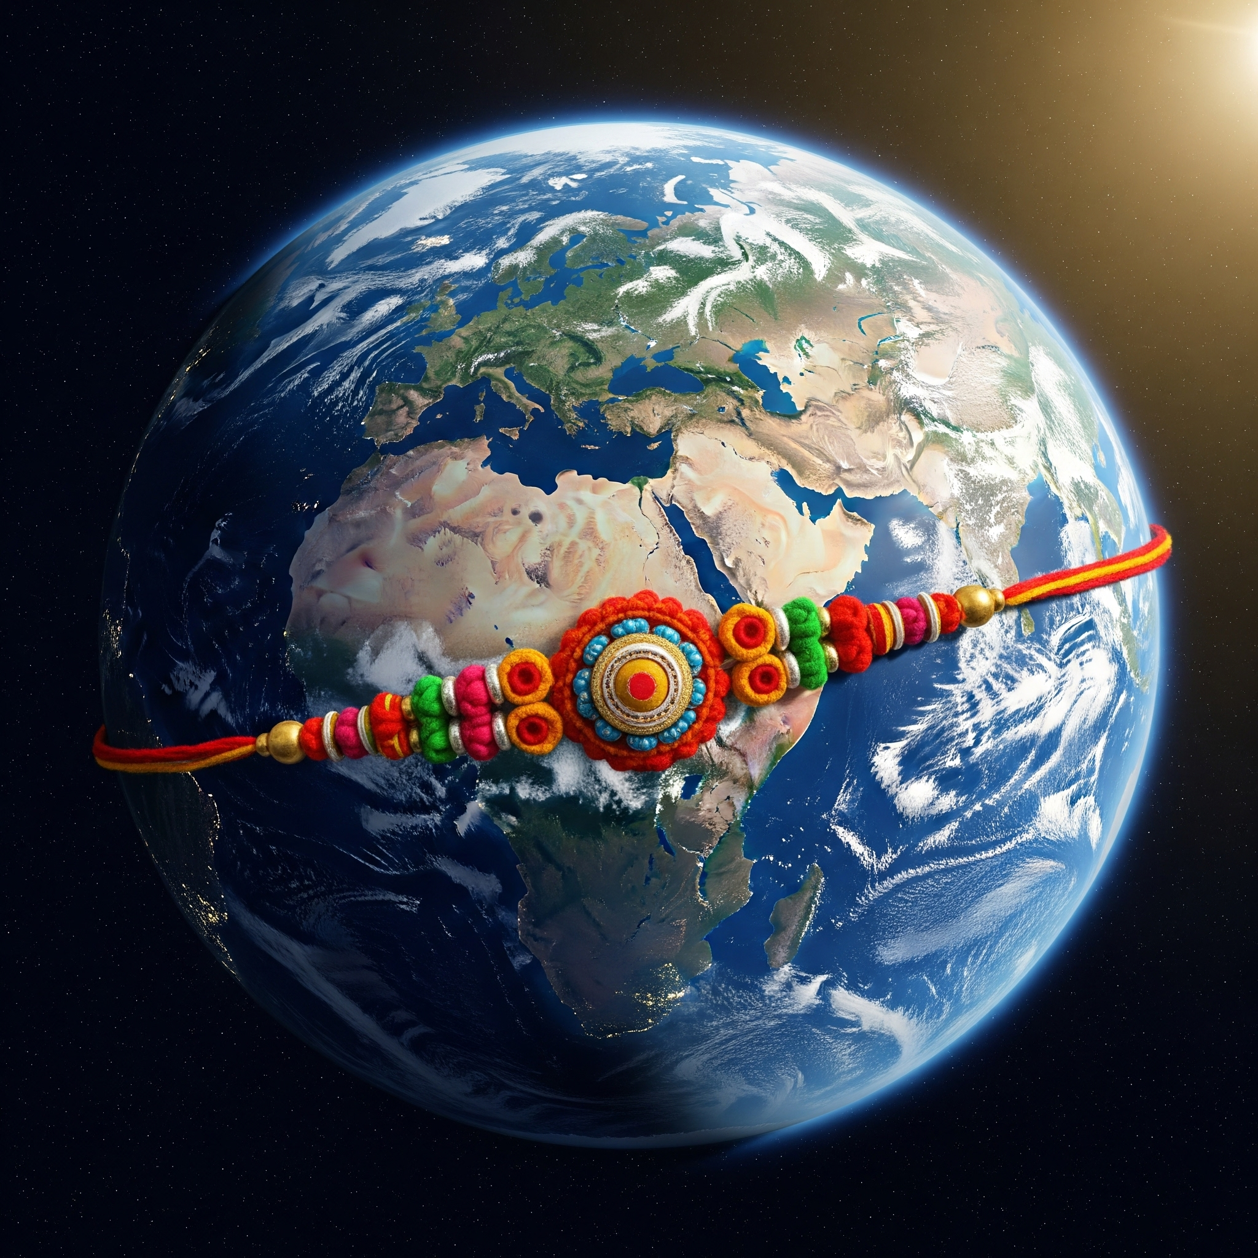
Significance of Raksha Bandhan
Raksha Bandhan's significance extends well beyond Hindus, resonating with communities worldwide.
It is a way for people to connect with their cultural roots and celebrate their heritage, even while being far from home.
This festival isn't just confined to siblings. Friends and wider community celebrate it too.
It promotes values of love, protection and mutual respect globally.

Slide 6
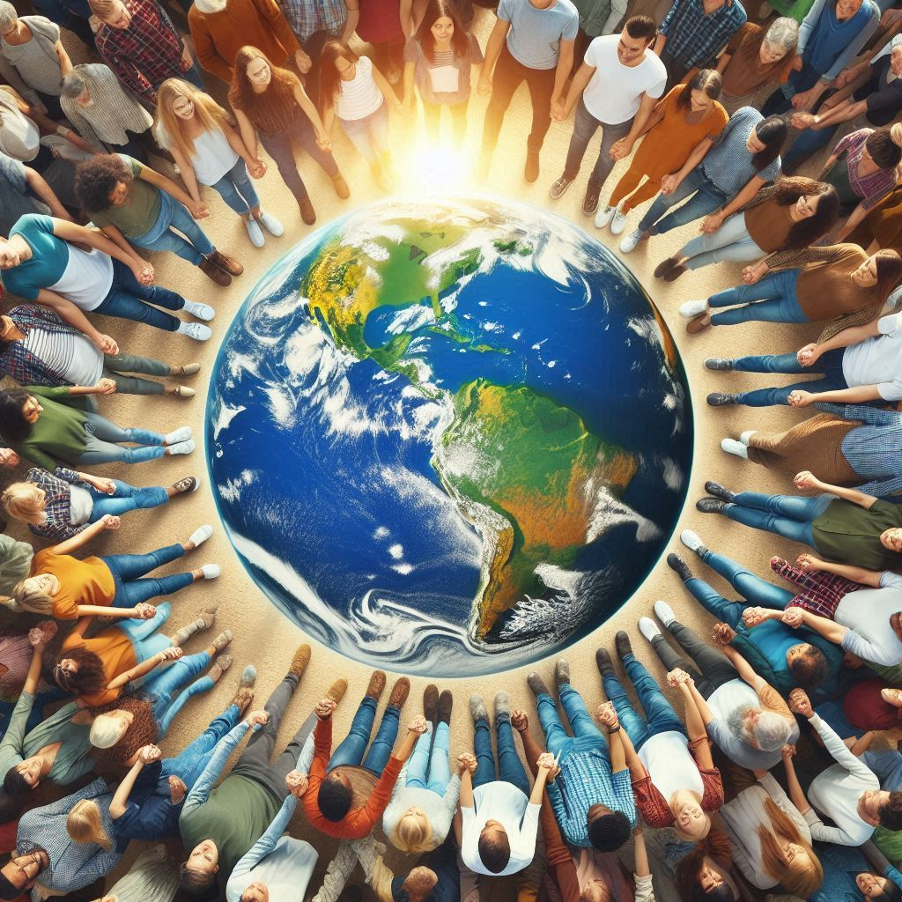
The World as One Family
In Hindu Dharma, there is an important saying:
Vasudhaiva Kutumbakam
Translation
“the world is one family”
By celebrating Raksha Bandhan, people embrace unity and shared cultural values, transcending borders.

Slide 7

The Celebrations
Raksha Bandhan

Slide 8
When does it take place?
Hindus follow the lunar calendar where months are based on Moon cycles.
Raksha Bandhan is celebrated on the day of a full moon in the Hindu month of Shravan, which usually falls in August.

Slide 9
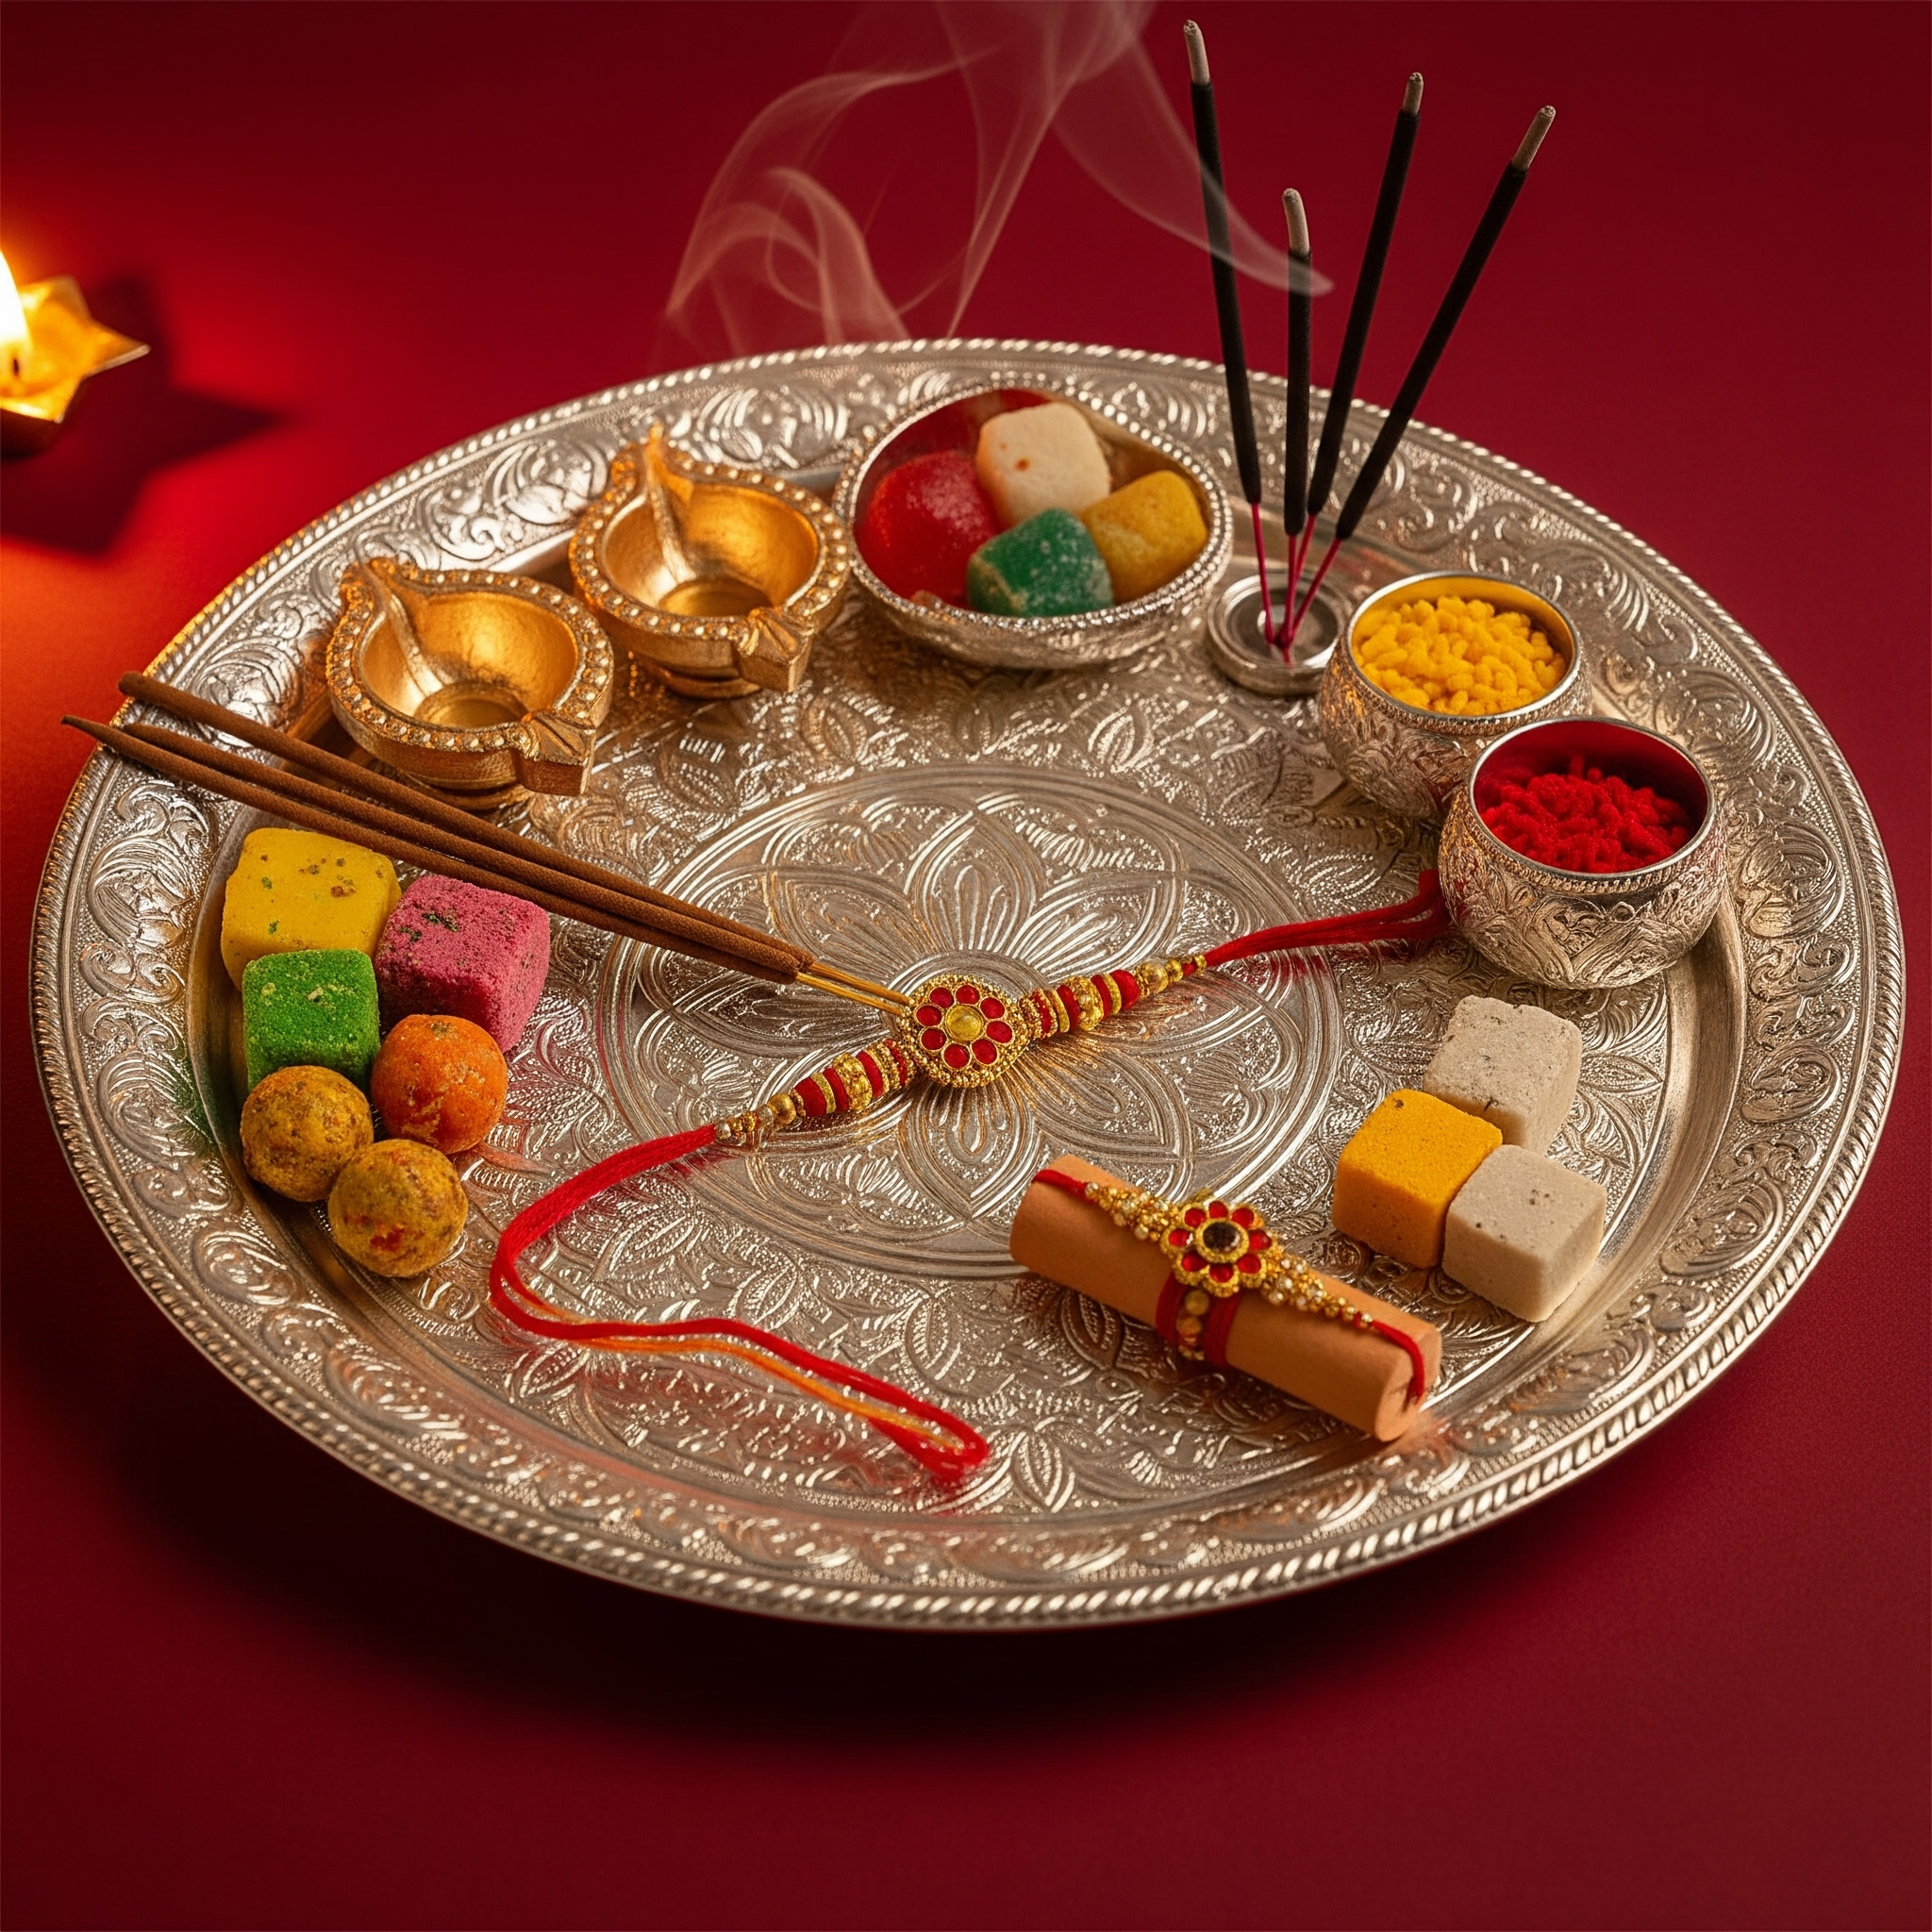
Items used in the Ceremony
Thali : A decorated plate
Diya : For the prayer rituals
Rice and Kum Kum : For the Tikka
Rakhi : The sacred thread or bracelet.
Sweets : To be offered to the brother
Gift : Is optional, but often exchanged as a token of love.
It’s less about the items and more about the sentiment behind them.

Slide 10
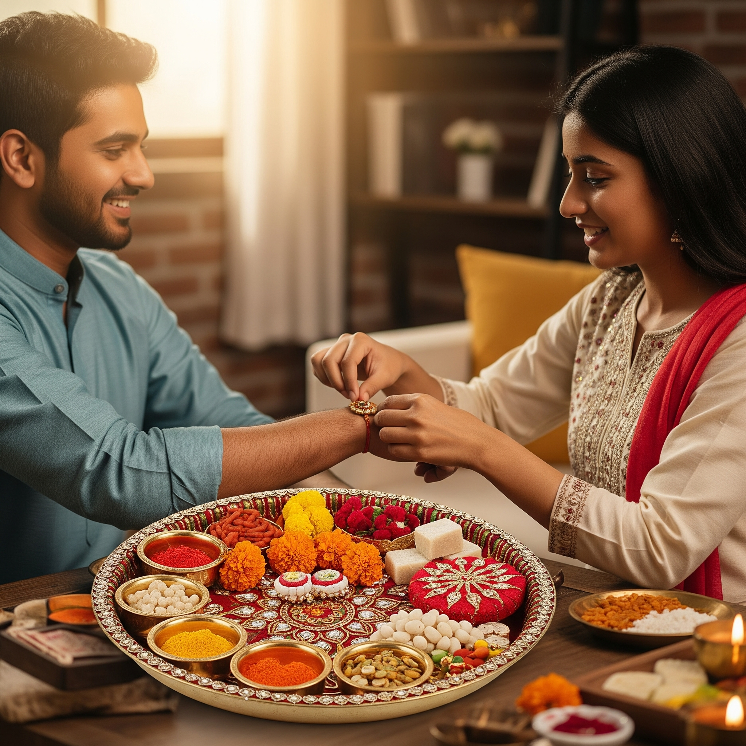
An example of a Rakhi Ceremony
Person one, who ties a Rakhi :
Applies a dot of kum kum (red powder) and a few grains of rice to the person’s forehead to form a Tikka.
Performs an aarti (prayer ritual) to the recipient.
Ties a Rakhi (a sacred thread of love) around the person’s wrist whilst chanting a special Raksha Bandhan Mantra.
Offers the person a sweet treat.
Person two, the recipient of the Rakhi:
Offers gifts and provides promises of protection.

Slide 11
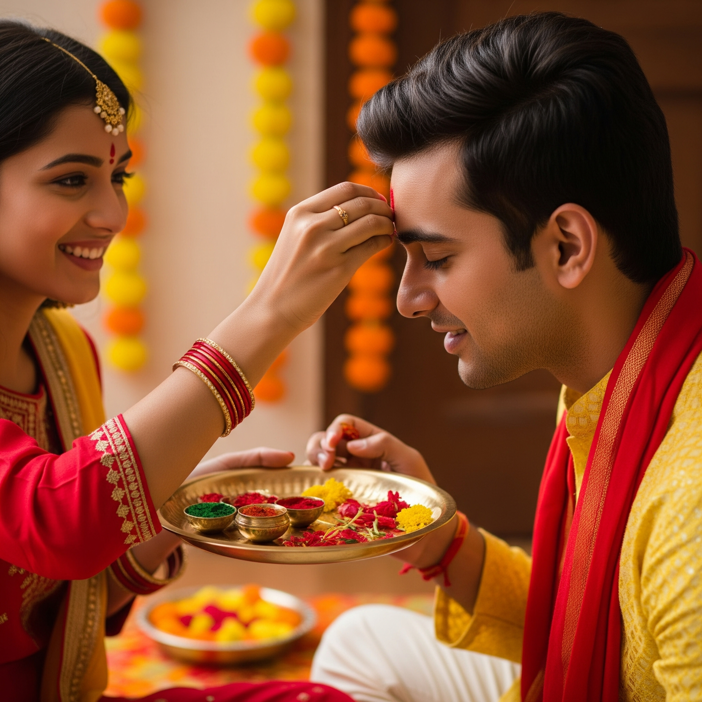
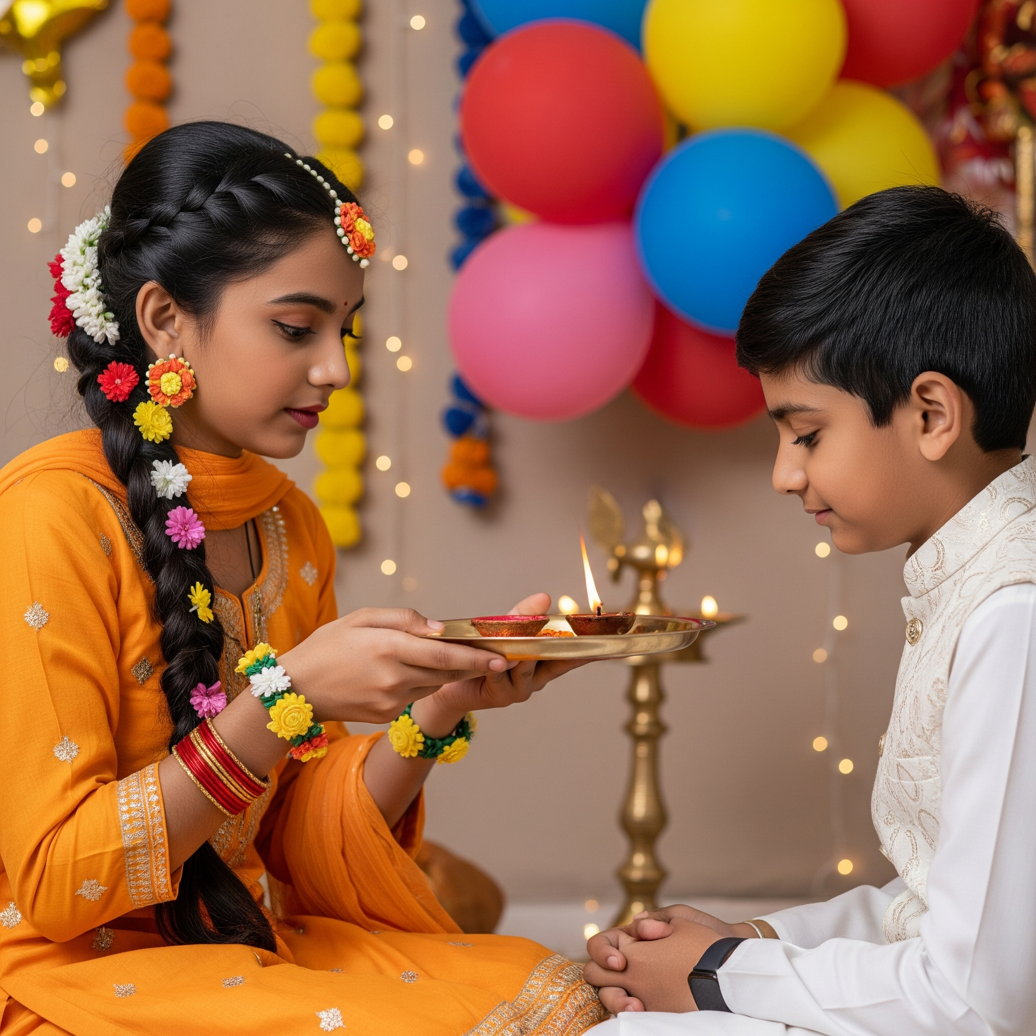
Applying a Tikka
Performing Aarti

Slide 12
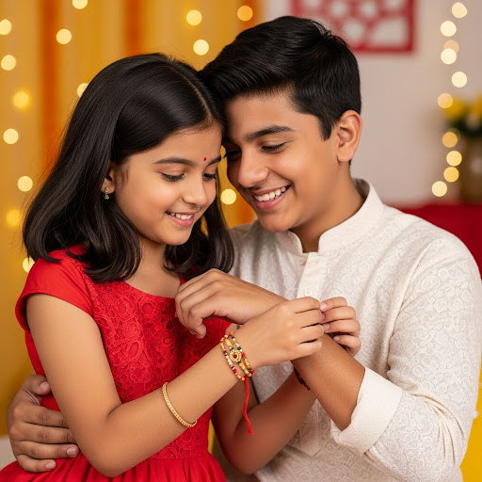
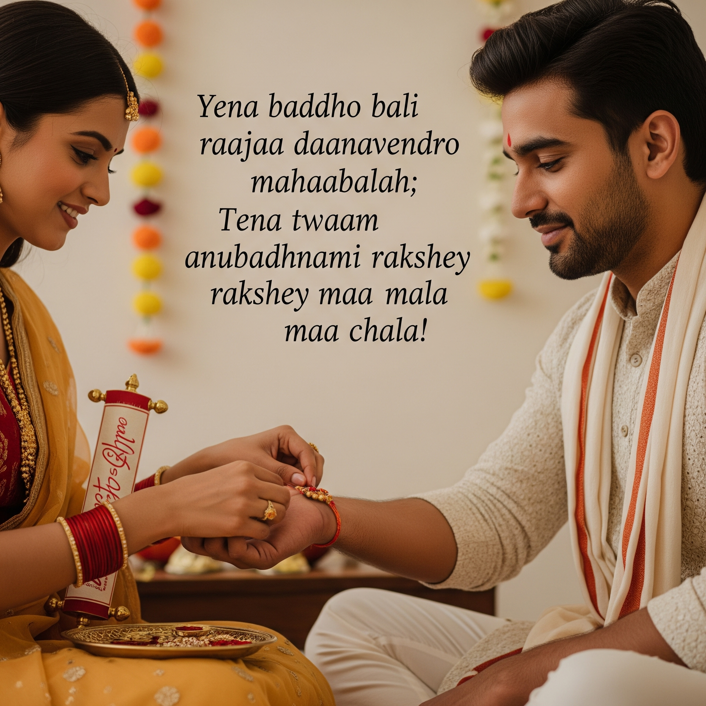
Tying the Rakhi
Reciting a prayer

Slide 13
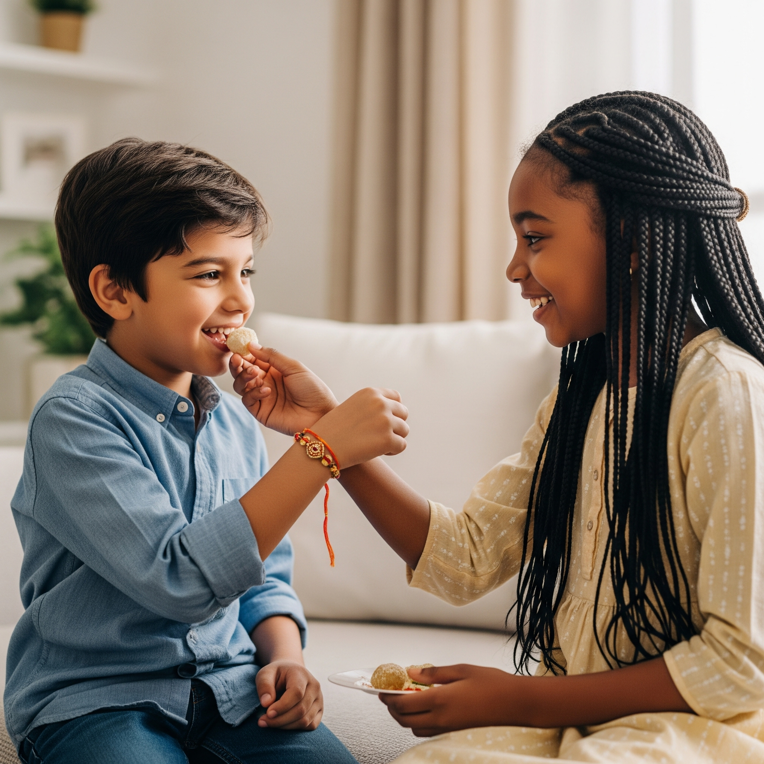
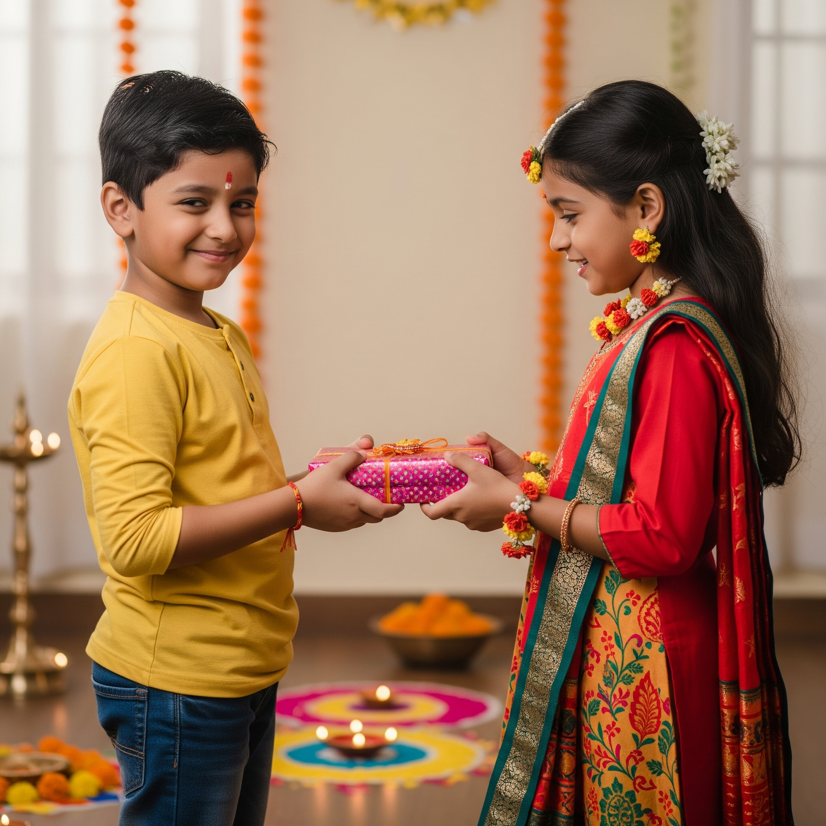
Feeding a sweet treat
A gift is provided from the person who the Rakhi is tied to

Slide 14
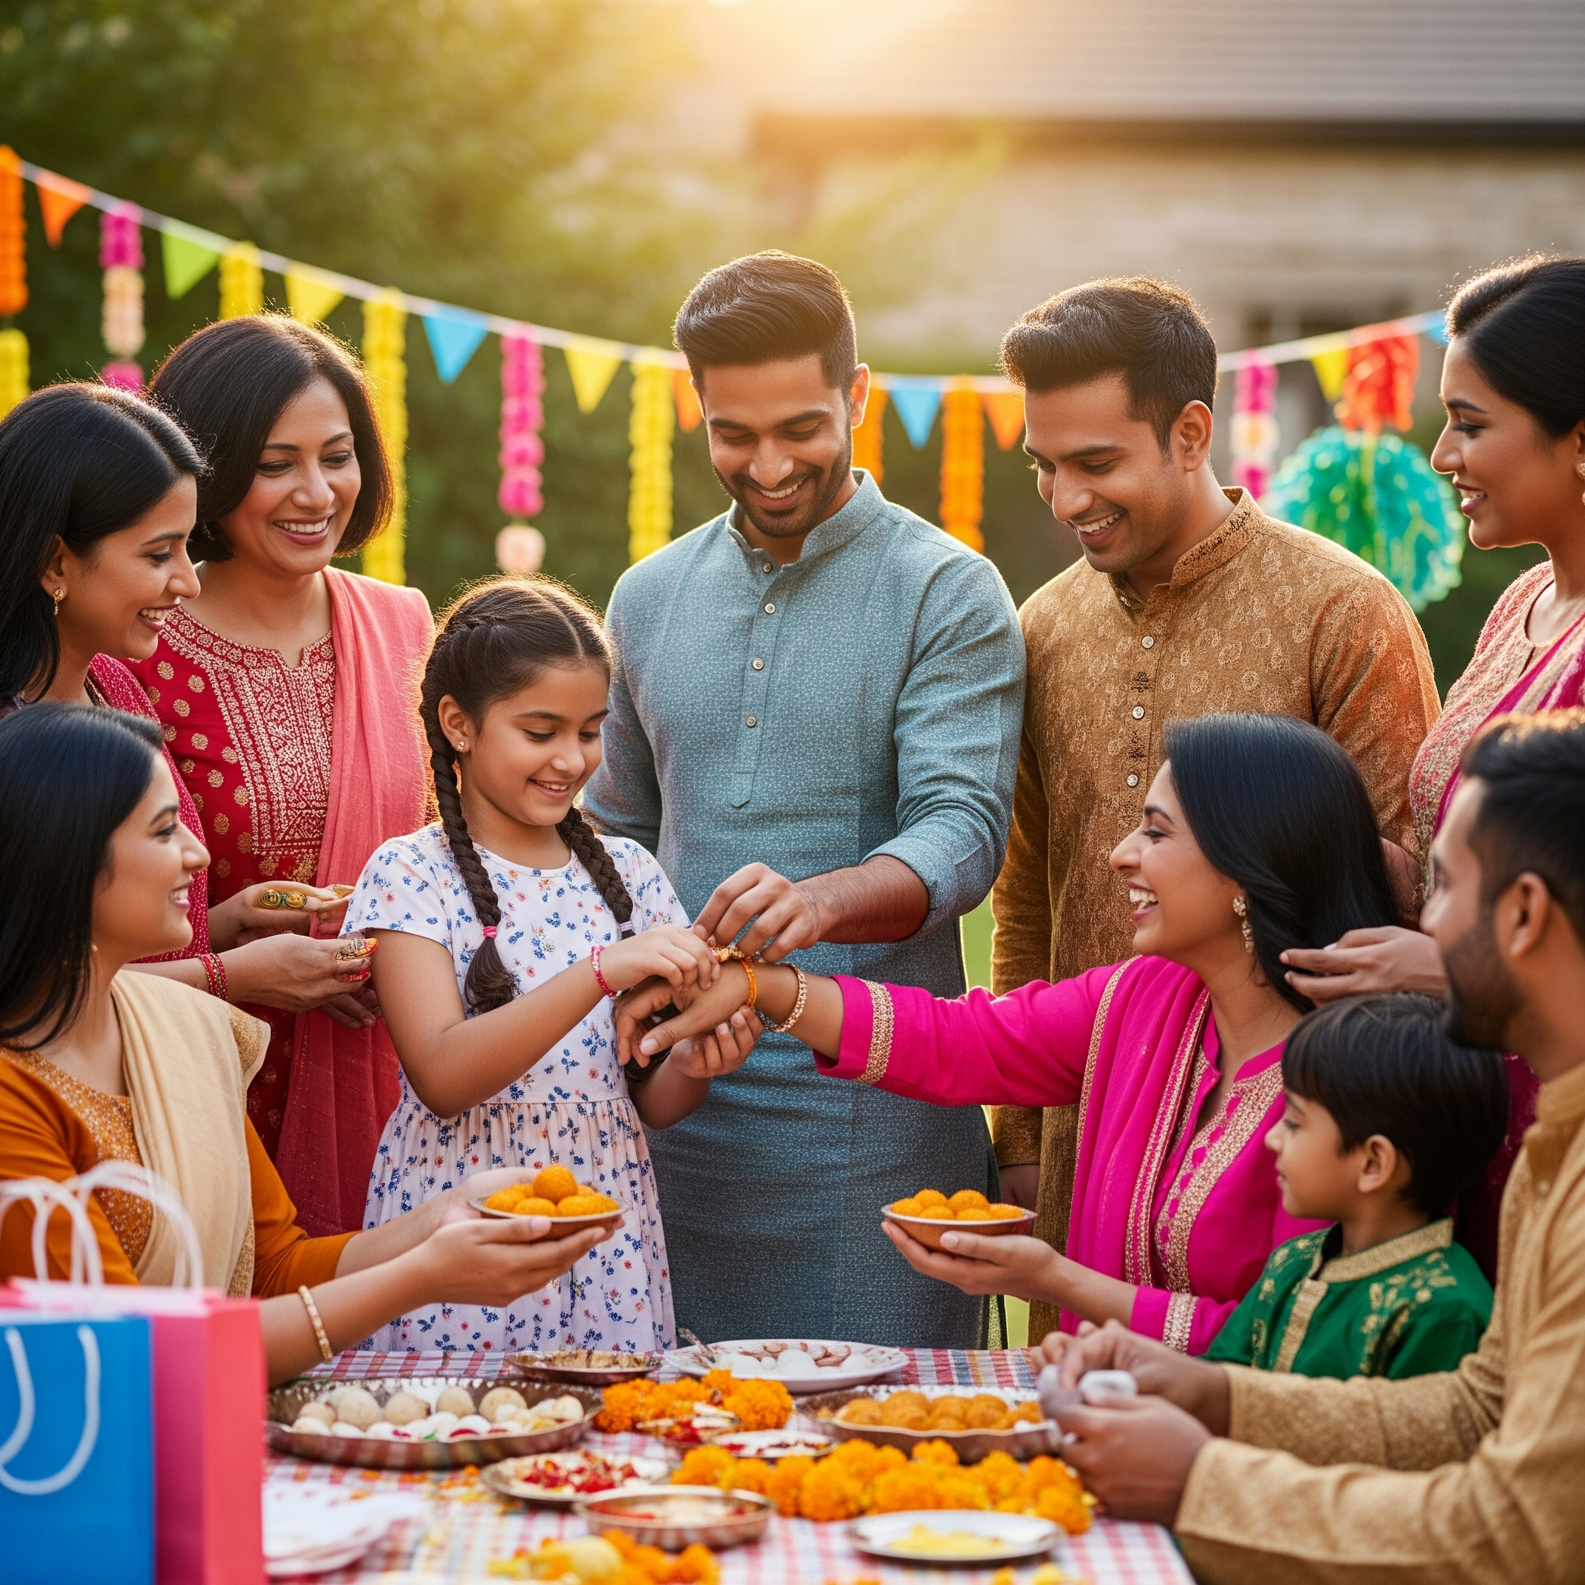
A Celebration for Everyone
The ceremony can involve a range of people, such as brothers and sisters, parents, friends, family, community, teachers and wider society.
Family and friends often join in the celebrations, making it a festive gathering.
It’s about honoring and celebrating those special, protective relationships in our lives.

Slide 15
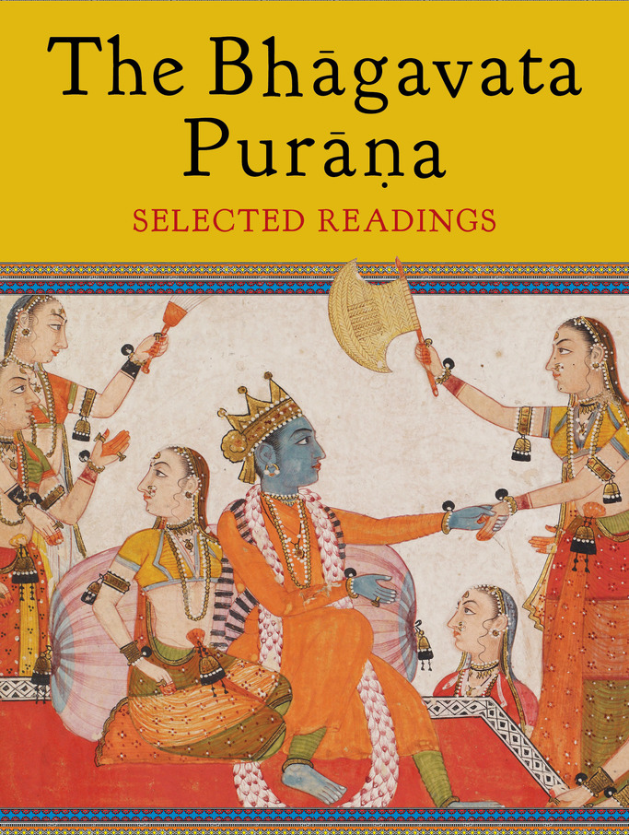
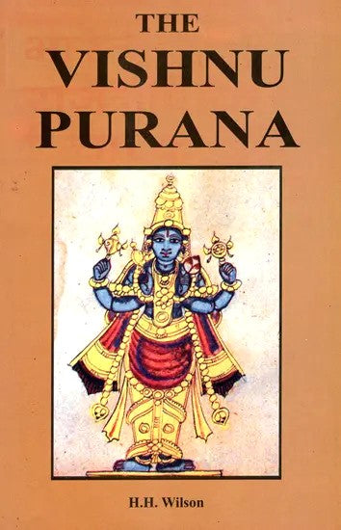
Origins of Raksha Bandhan
There are a few legends associated with the festival of Raksha Bandhan.
  One of the earliest and most well known story is associated with Goddess Lakshmi and King Bali.
This story can be found in the Hindu holy Scriptures called the Bhagavata Purana and Vishnu Purana.

Slide 16

King Bali &
Goddess Lakshmi
A story of Raksha Bandhan

Slide 17
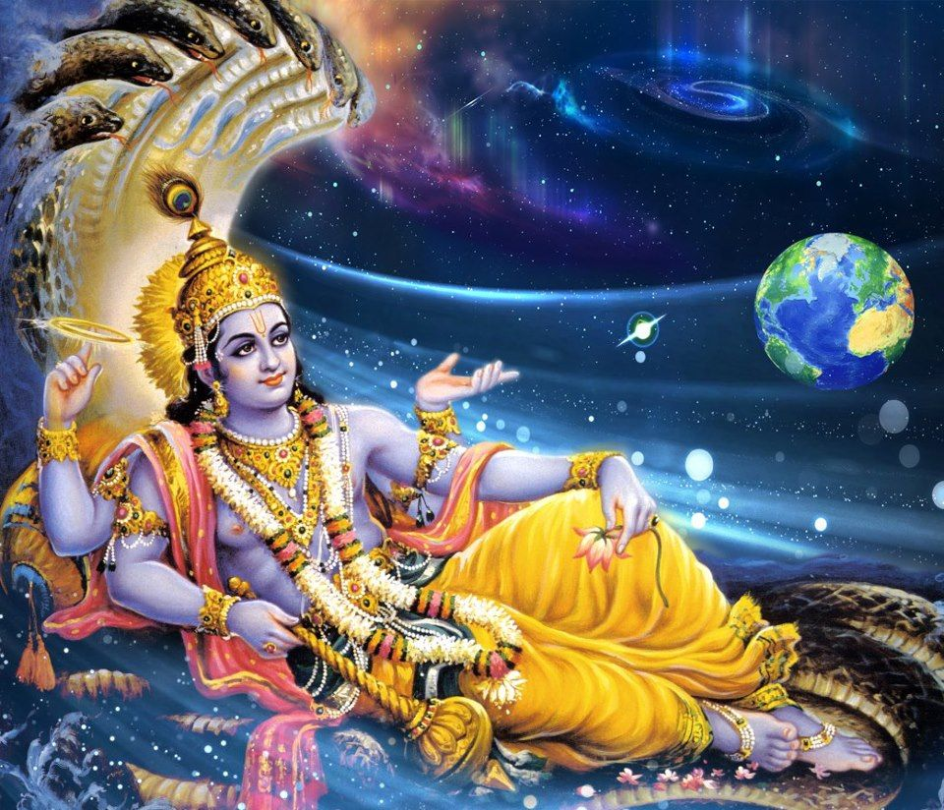
A story of Raksha Bandhan
There was once a powerful ruler called King Bali.
He was a loyal devotee of Lord Vishnu.
Once, King Bali put forward a request to Lord Vishnu, to leave his heavenly abode and descend on Earth to protect his Kingdom.
Lord Vishnu accepted and agreed to fulfill King Bali’s wish, however this meant leaving his wife, Goddess Lakshmi, behind.
Image of Lord Vishnu

Slide 18
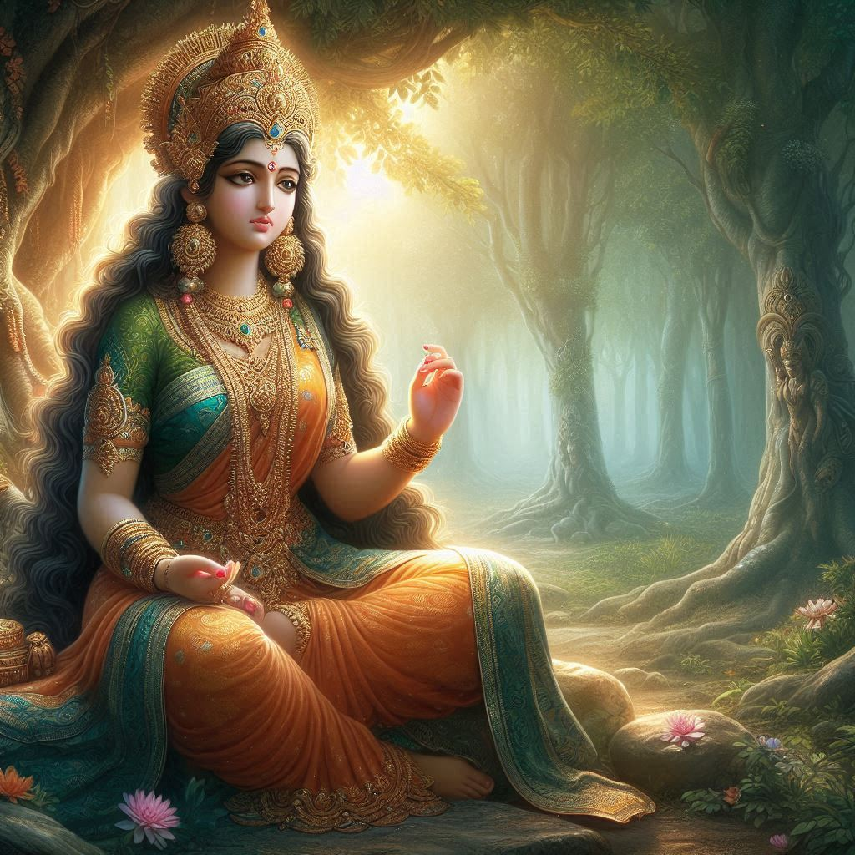
A story of Raksha Bandhan
Goddess Lakshmi was not happy about this arrangement.
She was distressed being away from her dear husband, Lord Vishnu.
Goddess Lakshmi disguised herself as a Hindu priest and travelled to King Bali's kingdom to request shelter until her husband’s return.
Goddess Lakshmi (The wife of Lord Vishnu)

Slide 19
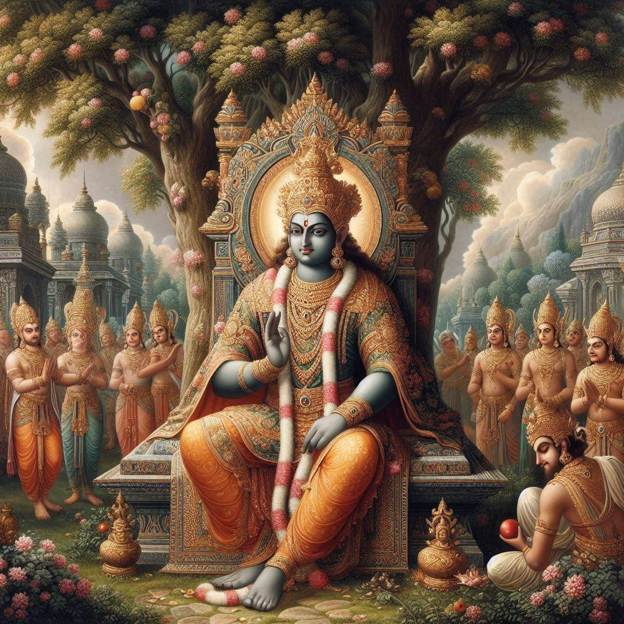
A story of Raksha Bandhan
On the day of a full moon, Goddess Lakshmi revealed her true identity and requested that King Bali let Lord Vishnu return home.
She tied a rakhi (a sacred thread) on King Bali’s wrist and made him her brother.
Honored by this gesture and touched by her concern for her husband and family, King Bali happily agreed to allow Lord Vishnu return to Goddess Lakshmi.
King Bali
(A devotee of Lord Vishnu and brother to Goddess Lakshmi)

Slide 20
Raksha Bandhan Mantra
“Yena baddho bali raajaa daanavendro mahaabalah;
Tena twaam anubadhnaami rakshey maa chala maa chala”
Bhavishya Purana, Uttara Parva (Section 137)
Translation of the Mantra
‘I bind you with that [same thread] by which the mighty King Bali, the lord of the demons, was bound.
[O] protection! Do not waver, do not waver.'

Slide 21
Why is it Celebrated?
It is celebrated in honour relationships.
It was on Shravan Sudh Poonam (A full moon in August) that Goddess Lakshmi revealed her true identity to King Bali and tied a Rakhi on him, making him her brother.
A story which encapsulates the theme of loyalty, perseverance, protection and deep family and community bonds.
A reminder to individuals to look after each other and the environment.

Slide 22
Questions &
Activity session
Raksha Bandhan

Slide 23
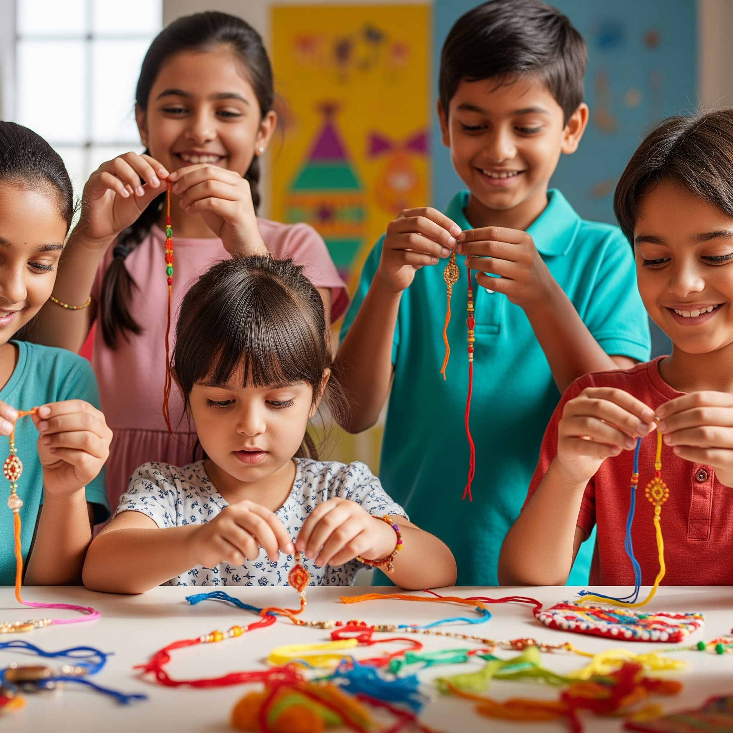
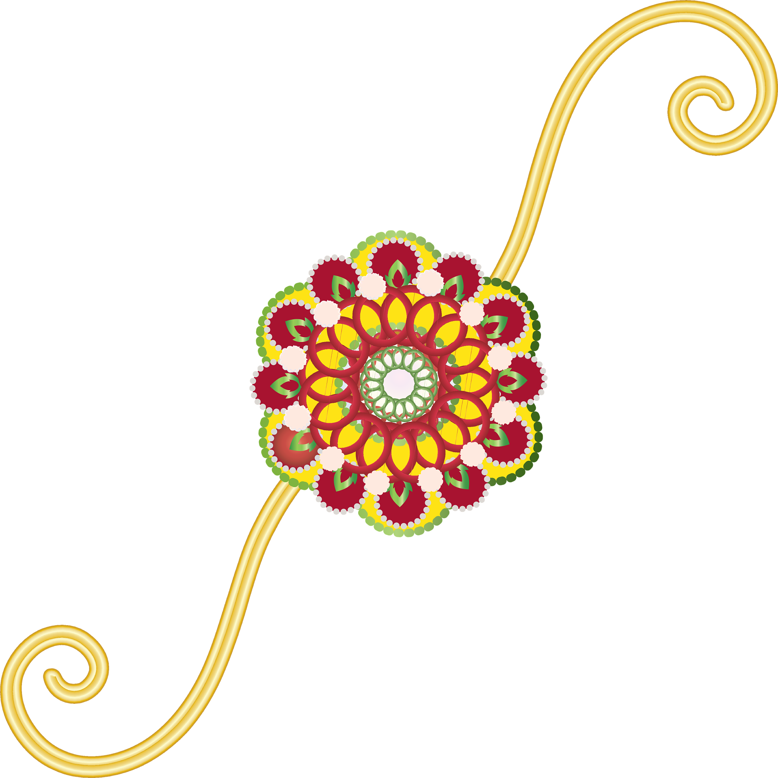
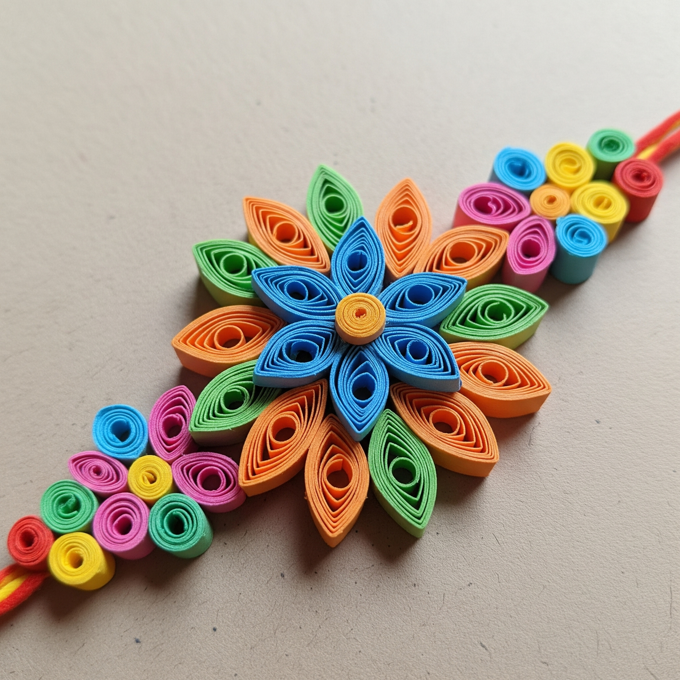
Questions :
1. In pairs, discuss all that you have learnt about Raksha Bandhan.
2. If you could choose anyone in the world to give a rakhi to, who would it be and why?
Activity :
Can you make a handmade Rakhi to gift your loved one/s next Raksha Bandhan? (Be as creative as you like in your designs).
The most important thing to remember is the sentiment behind gifting a Rakhi – love and protection.

Slide 24
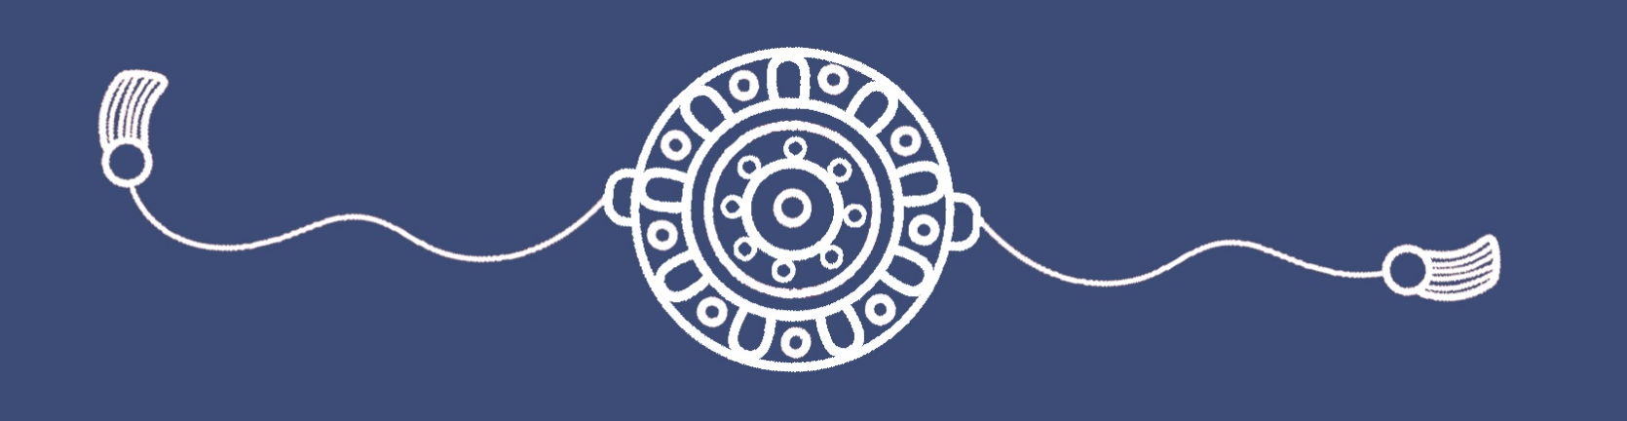
Raksha Bandhan
One simple thread – yet it holds the power to unite hearts, celebrate love and strengthen the ties that connects us all together.

