Slide 1
Hybrid
Step-by-Step

Slide 2
What is Hybrid and Who Cares?
Notes:
Hybrid is having some people in person and others online.
For TM meetings, this allows your club to admit people from far away to your meetings. This could be local members on vacation or business trips or sick at home; it could be members that have moved; it could be interesting people from other states or countries.
For business, it could be to allow different department to hold a single meeting, or to hire talent that is not local. It can also mean a reduction of floor space in high rent districts. And reduce travel (save the planet).
For personal events (family reunion, birthday parties, weddings) allow people who cannot travel to attend, at least for a little while.
This technology is available for all and can solve communication problems both large and small.

Slide 3


Step 1 – Computer Only
Equipment Required
Laptop computer
WiFi or Ethernet connection to Internet
Benefits
Easy to setup
Least equipment
Limitations
In-person members cannot see screen
Audio may be poor
Remote attendees cannot see in-person attendees

Slide 4
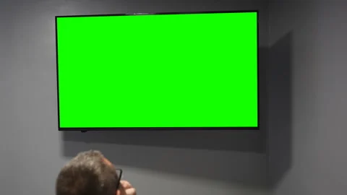
Step 2 – Add a Remote Large Screen
Wired or
Wireless
Equipment Required
Step 1 plus
Large screen
Remote video connection
Benefits
In-person members can view remote members (Zoom)
In-person members can view presentations
Limitations
Audio may be poor
Remote attendees cannot see inhouse audience
Notes:
Remote connection for screen may be:
VGA
HDMI wire
HDMI wireless
Display Port
Apple AirPlay
USB-C
Which will you use? Easy, see what your computer provides, then check the screen to see what it has.
On windows machine, press and hold the “Windows” key and press “P”, release both. Select Duplicate for Hybrid meetings or Extended for in person meetings.
Mac uses “Extended” as normal, to select duplicate, or as Mac called it Mirroring go to settings and select display then mirroring.

Slide 5
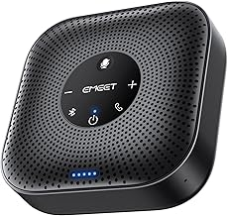
Step 3 – Add Conference Mic and Speaker
Equipment Required
Step 1 or 2 plus
Conference Room Microphone and Speaker
Benefits
Much better audio between remote and inhouse attendees
Limitations
Remote attendees cannot see inhouse audience
Notes:
Remote speaker may be wired or Blue-Tooth
EMEET Conference Speakerphone MO Plus $56.00 or
Anker Power Conf, model A3301 at $130.00 on Amazon

Slide 6
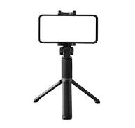
Step 4 – Add an In-House Camera
Equipment Required
Step 1, 2 or 3 plus
Tripod
Smart phone or iPad with meeting S/W loaded
Benefits
Nearly all attendees can see all others
Limitations
Remote camera becomes 2nd meeting attendee.
Notes:
In-house camera becomes 2nd attendee, this may be a limitation of Free virtual meeting software
Note: most computers can handle only one camera and that one will normally be looking at the speaker
Smart phone camera faces in-house audience
Tripod for smart phone from $20.00 up
Be sure to turn off Audio using the Zoom screen on the In-house camera. It will remind you with the most annoying feedback if you don’t

Slide 7
Step 5 – Load, Configure, and Launch S/W
Equipment Required
Step 1, 2, 3 or 4 plus
Online meeting software
Benefits
Conduct hybrid meetings
Limitations
May need a lot of luck and/or experience
Notes:
Online meeting software: Zoom, MSTeams, WebEx, Google Meets, GoToMeeting, ClickMeeting, Whereby, Brave talk, others.
Slack is a communication hub and uses Huddles for video. It is not a full featured meeting platform.

Slide 8
Step 6 – Load, Configure, and Launch S/W
Equipment Required
Step 5
Procedures
Test hardware and software in-depth
Enable remote logins at least 15 minutes before meeting to find and fix connections!!!
Notes:
Online meeting software: Zoom, MSTeams, WebEx, Google Meets, GoToMeeting, Slack, ClickMeeting, Whereby, Brave talk, other

Slide 9
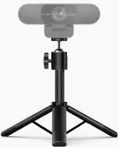
Optional – Speaker Camera
Equipment Required
Step 1, 2, 3 or 4 plus
Tripod and webcam
Benefits
Doesn’t use
in-computer camera
Limitations
More complicated
Notes:
You may not want to use the in-computer camera for the speaker because: 1) want higher quality video, or 2) Zoom Master wants to see Zoom screen.
Webcams use USB connections (usually). Must select camera on computer or other camera connected to computer.
Webcam faces speaker
Logitech web cam from $20.00, tripod from $21.00

Slide 10
For a copy of the slides and instructions:
Email: HughTM@HughCurley.com

