Slide 1


Amplifying Voices: The Power of Public Relations (VPPR)
Corporate Club Officer Training June 28, 2025, 9:00 am Virtual Mary Hoftiezer, PRM District 26
www.toastmasters.org

Slide 2
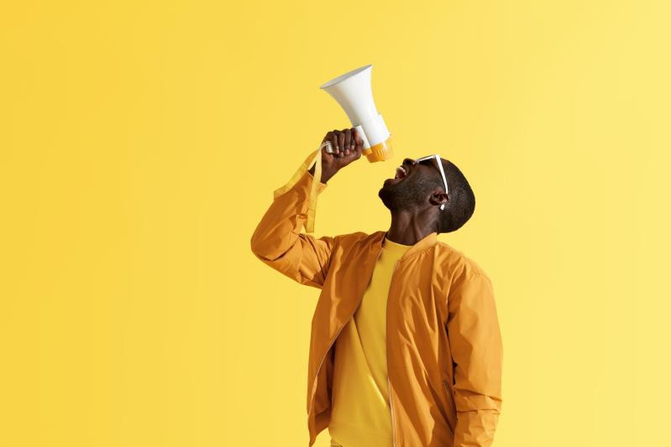
Objectives
 Objective: The primary goal of this training is to equip Toastmasters Club Vice Presidents of Public Relations with the skills and knowledge necessary to excel in their role, effectively promote their club, and enhance its public image.
www.toastmasters.org

Slide 3
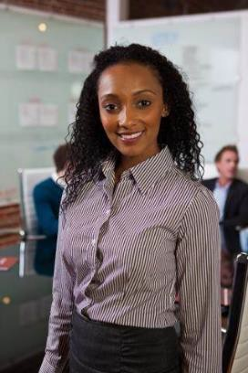
VPPR Role
Responsibilities and expectations of the VP of Public Relations:
Protect the Toastmasters Brand!
Develop a PR plan
  Use tools and resources to promote
  Set goals
  Create a calendar of promotions
  Communicate & collaborate with
members/officers
  Monitor status of plan
www.toastmasters.org

Slide 4
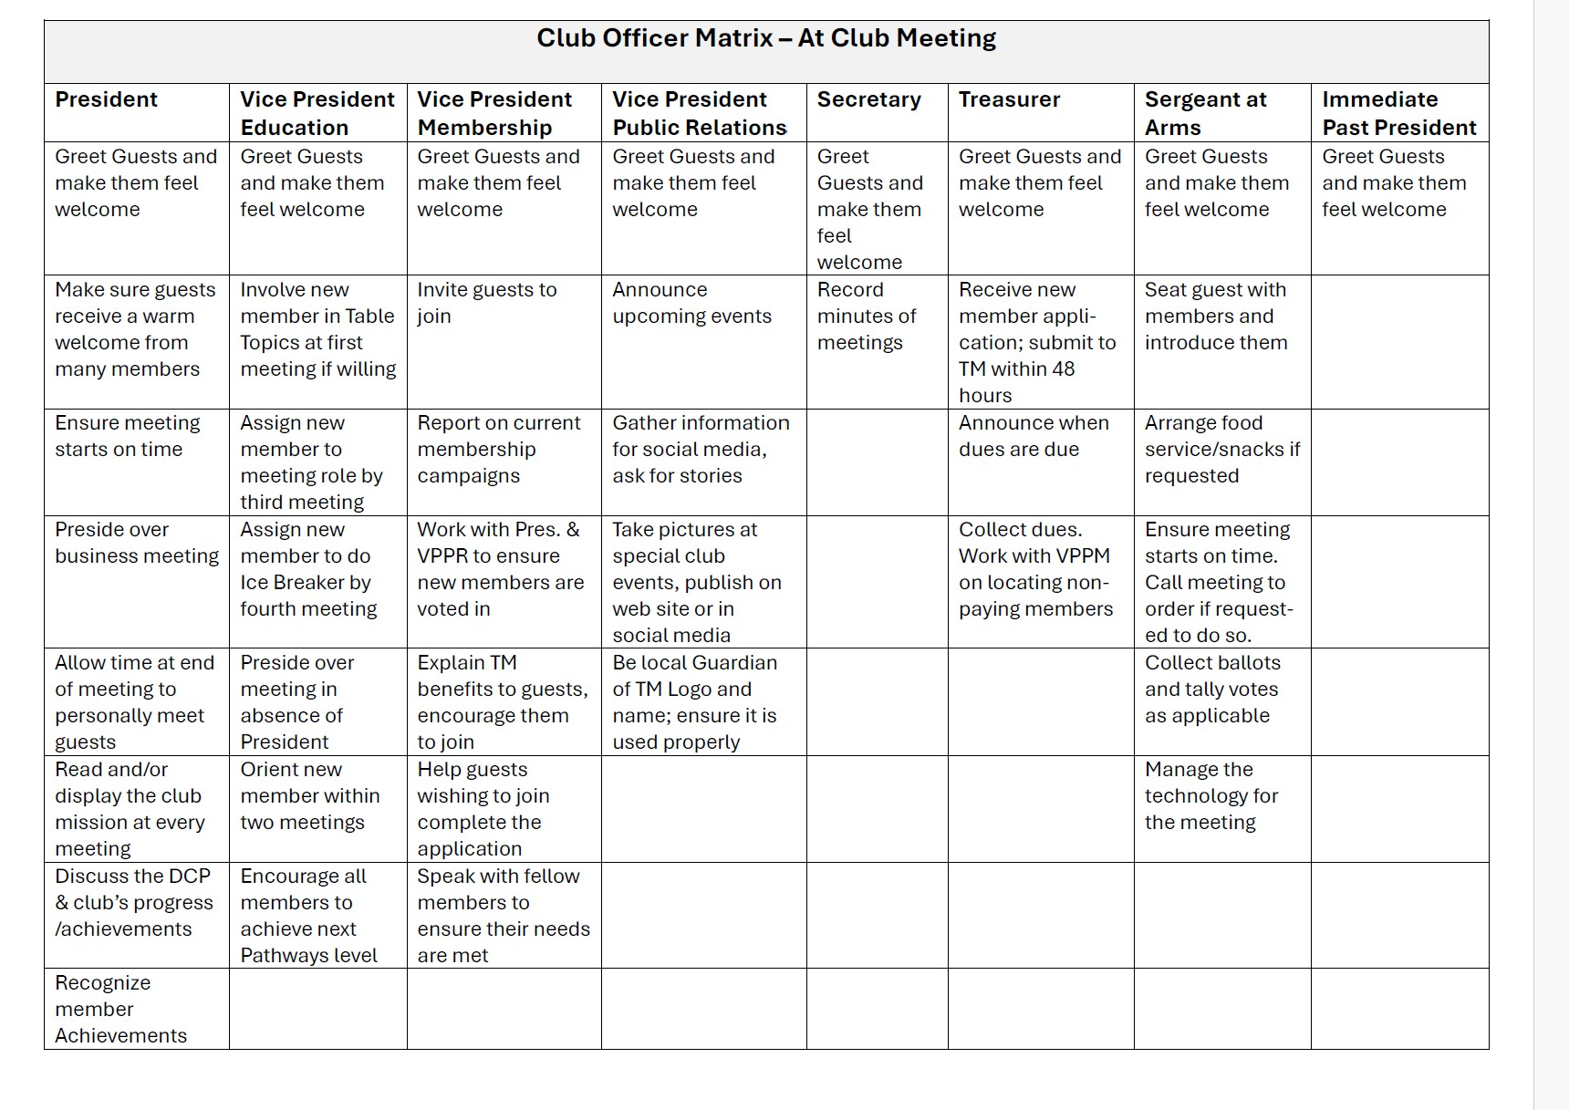
Club Officer Matrix At the Club Meeting
www.toastmasters.org

Slide 5
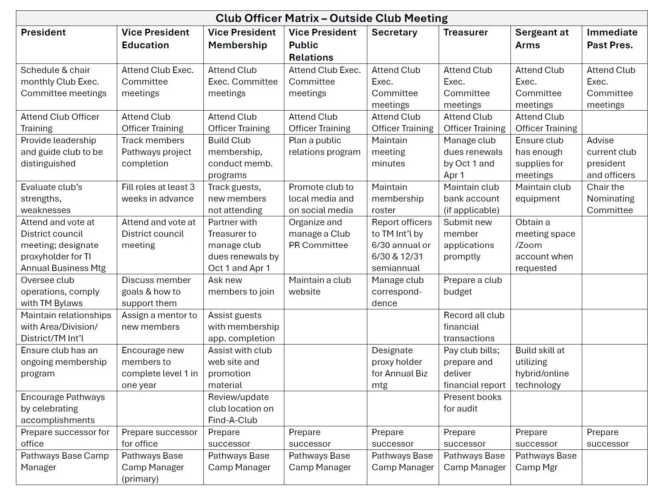
Club Officer Matrix Outside of the Club Meeting
www.toastmasters.org

Slide 6

Presenting 3 Top Tips for VPPR’s
www.toastmasters.org

Slide 7
VPPR: Top Tips
Promote your club’s unique value proposition and utilize promotional strategies
Use creative engagement strategies
Branding using the TI brand manual
www.toastmasters.org

Slide 8

Tip #1: Promote your club’s unique value proposition
and utilize promotional strategies
www.toastmasters.org

Slide 9

VPPR Role: Value Proposition
Creating a Strong Club Brand
Defining the club's unique value proposition
Developing a club brand that reflects its identity and goals
www.toastmasters.org

Slide 10
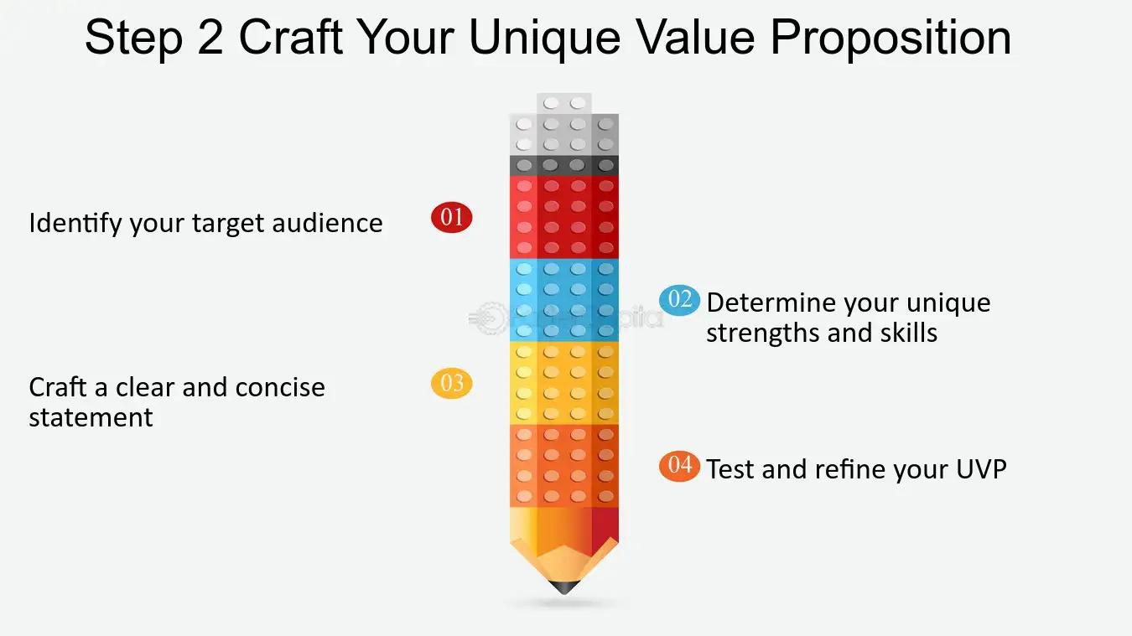
VPPR Role: Value Proposition
Defining the club's unique value proposition.
What is your clubs unique value proposition?
www.toastmasters.org

Slide 11

VPPR Role: Promote your club’s value!
Value Proposition: We, at ABC Corporation Toastmasters, offer a bi- weekly hybrid club meeting consisting of a variety of employees who are friendly, welcoming and excited to mentor new members.
We provide opportunities for our members to develop their communication and leadership skills in a supportive environment. We believe in helping employees develop their potential, engage with their colleagues and achieve success!
www.toastmasters.org

Slide 12
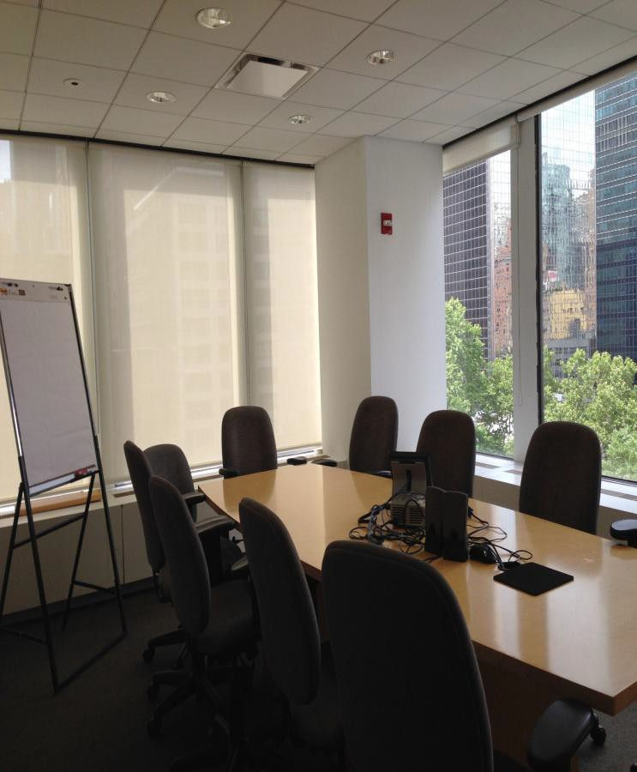
VPPR: Internal Communication
Leverage Internal Communication: newsletters, Slack, reminder emails
Spotlight Member Achievements: Pathways, speech contests
Host Demo Meetings/Open Houses: Invite non-members, management
Collaborate internally: Leadership tool
Incentives: Lunch & Learn, company swag
www.toastmasters.org

Slide 13




VPPR Role: Social Media
Utilize Social Media Effectively
Consistency
Engagement
Promote! Like, Comment and Share
Use TI Branding Materials
www.toastmasters.org

Slide 14
Get your club information on Google
Go to the District 26 Website for a video about how to get your club on Google! Go to item 3, Google Business Profile by Paola Perina
https://www.d26toastmasters.org/public-relations/
https://www.d26toastmasters.org/public-relations/
www.toastmasters.org

Slide 15
What to post?!
Corporate Clubs: Check with HR and or Marketing to know the policies
Make sure you have photo/video release form signed by all members.
Meeting information
Member celebrations/accomplishments Open Houses, social events
www.toastmasters.org

Slide 16
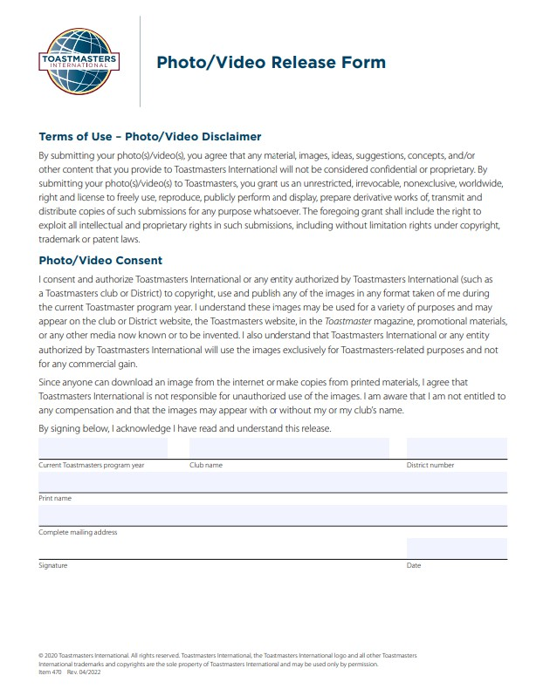
Photo/Video Release Form
www.toastmasters.org

Slide 17
Tip #2: Use creative engagement strategies
www.toastmasters.org

Slide 18

VPPR: Creative Engagement Ideas
www.toastmasters.org

Slide 19
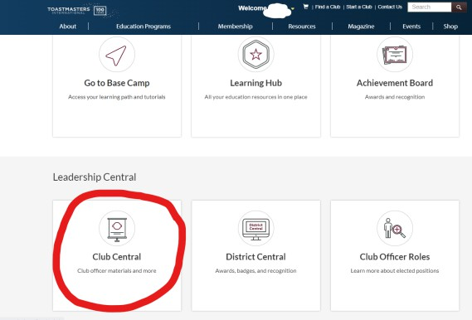
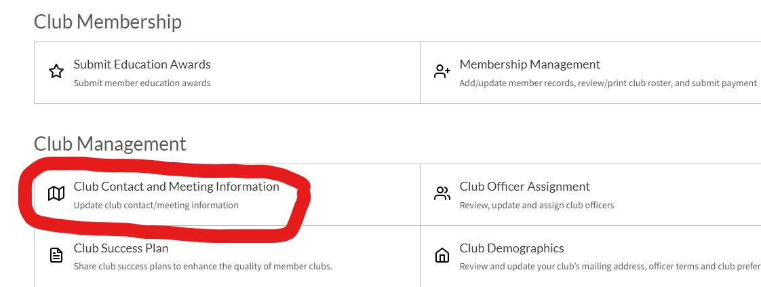
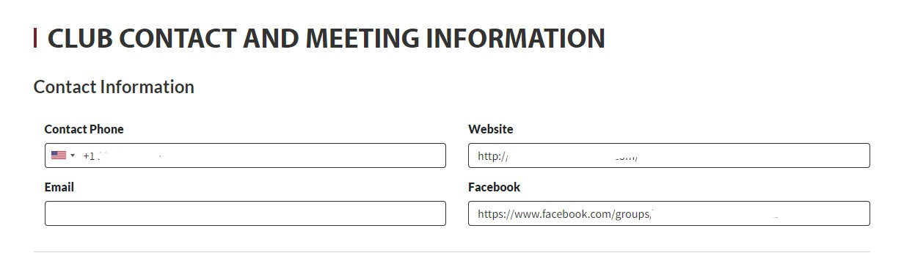
VPPR Role: Ensure Contact Us Information is up to date
www.toastmasters.org

Slide 20
Tip #3: Branding using the TI brand guidelines
www.toastmasters.org

Slide 21
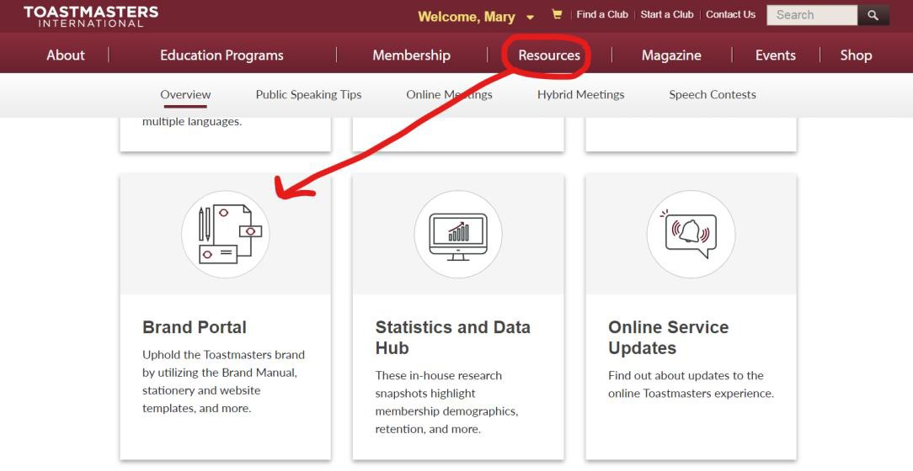
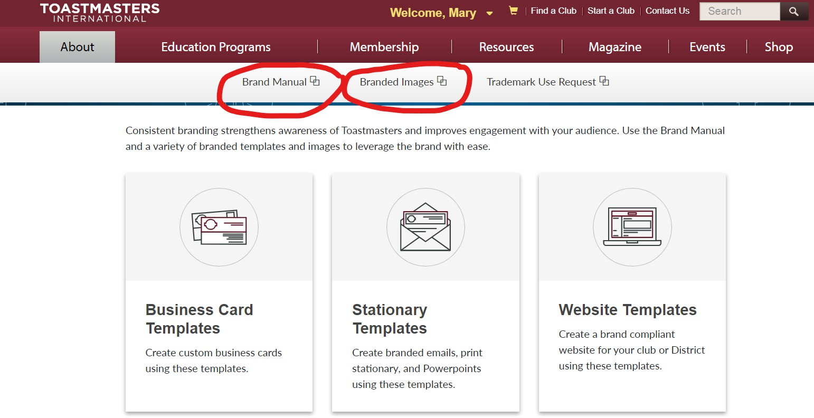
VPPR Role Brand Resources
www.toastmasters.org

Slide 22
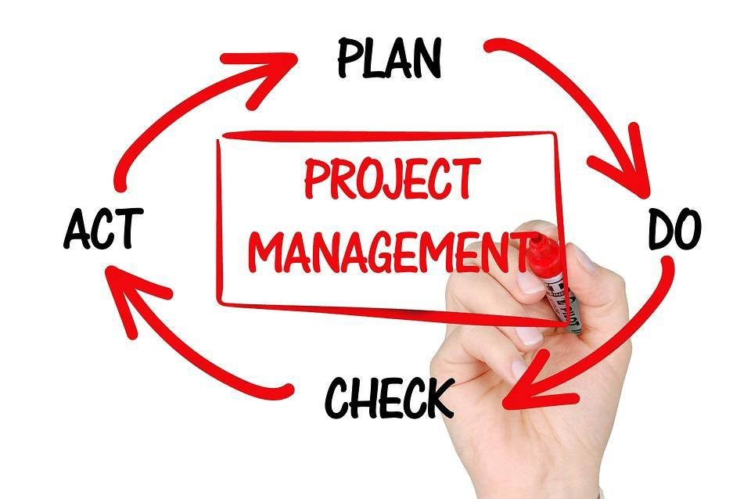
VPPR Responsibility Action Plan
How will you fulfill this responsibility?
Consider forming a committee or getting a partner to help you!
Who is available to help you?
What materials and resources can you use?
www.toastmasters.org

Slide 23
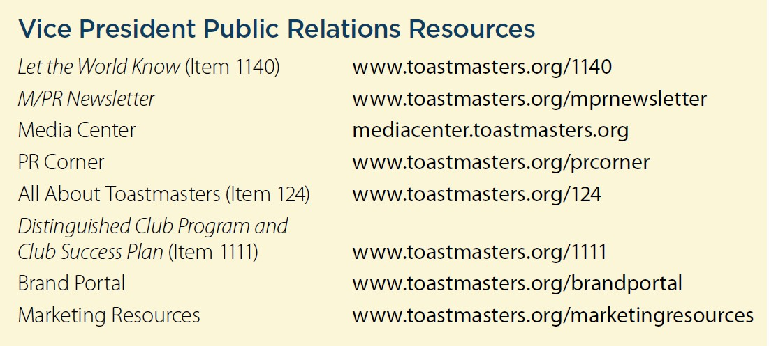
Additional Resources
www.toastmasters.org

Slide 24

VPPR Resources
https://www.toastmasters.org/resourc es
https://www.d26toastmasters.org/ https://www.canva.com/ https://www.hootsuite.com/ https://buffer.com/
WhatsApp Group for VPPR’s
www.toastmasters.org

Slide 25
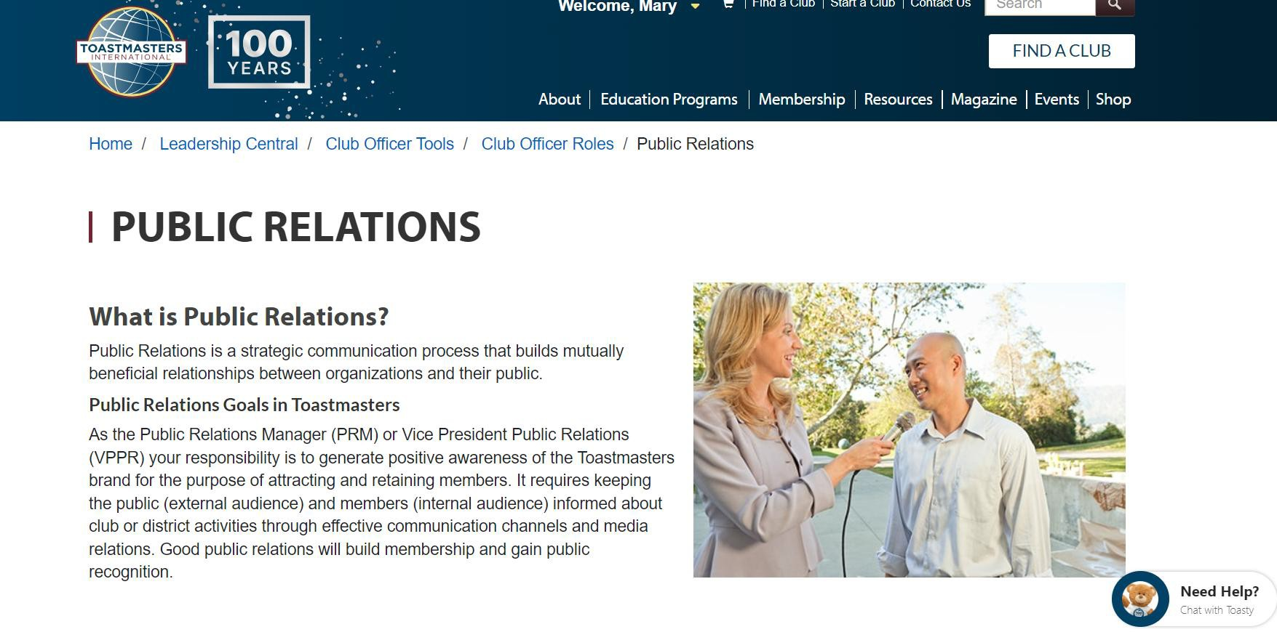
VPPR Resources
https://www.toastmasters.org/Leadership-Central/Club- Officer-Tools/Club-Officer-Roles/Public-Relations
www.toastmasters.org

Slide 26
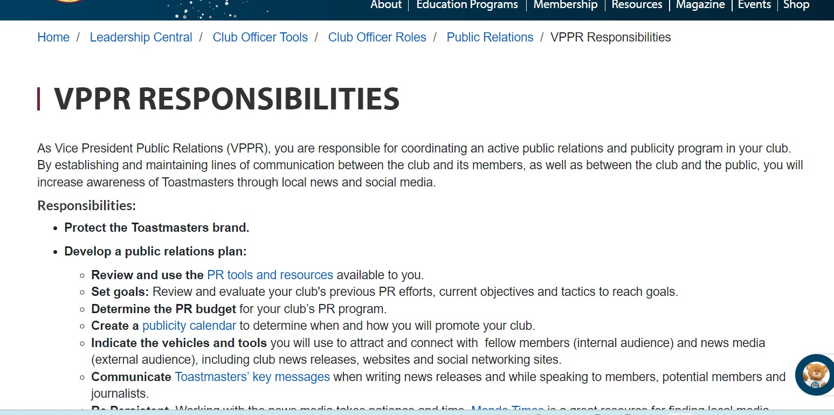
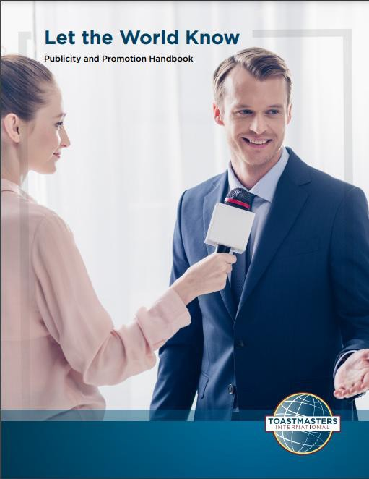
Getting Started
https://www.toastmasters.org/leadership-central/club-officer- tools/club-officer-roles/public-relations/vppr-responsibilities
www.toastmasters.org

Slide 27

VPPR: WIIFM
This Photo^{w}b^{w}y U^{w}n^{.t}kºnªo^{s}w^{t}n^{m}Aªu^{s}th^{te}o^{r}r ^{s}is^{.o}li^{r}c^{g}ensed under CC BY-SA

Slide 28
What has worked for you and your club?
www.toastmasters.org

Slide 29
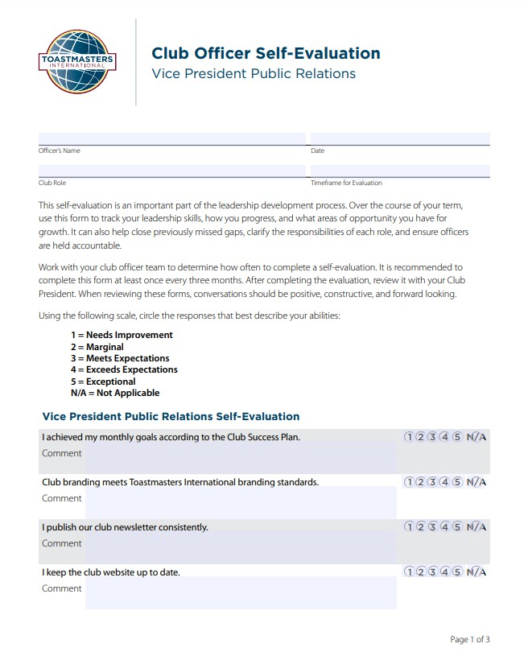
Self Evaluation
www.toastmasters.org

Slide 30
Need help? Have further questions?
I can be reached at:
Mary Hoftiezer, PRM
Email: mhoftiezer.prm@d26leaders.org
LinkedIn: https://www.linkedin.com/in/mary-hoftiezer/
www.toastmasters.org

Slide 31

Summary:
www.toastmasters.org

Slide 32

Club Officer Training VPPR
www.toastmasters.org

