Slide 1
Introduction to Pathways
November 22, 2025
Sandy Frost, DTM

Slide 2
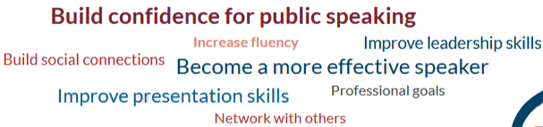
Primary Goals of Toastmasters Members
https://content.toastmasters.org/image/upload/Member-Satisfaction-Infographic-202507.pdf

Slide 3
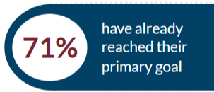
Primary Goals of Toastmasters Members
https://content.toastmasters.org/image/upload/Member-Satisfaction-Infographic-202507.pdf

Slide 4

“Pathways” – Toastmaster Education System
Complements your club experience by giving you access to engaging learning tools, videos, interactive quizzes and activities, feedback and recognition, useful tips and more.
Benefits of Pathways
  Opportunity to develop many skills relevant to an evolving global marketplace
  Frequent recognition of educational achievements
  Online access to educational materials
  Engaging videos that model the skills you are learning
https://www.toastmasters.org/membership/welcome-new-members
https://www.toastmasters.org/magazine/magazine-issues/2019/feb/pathways-designed-to-deliver#:~:text=The%20Pathways%20learning%20experience%20is%20designed%20to,*%20A%20wide%20range%20of%20elective%20projects

Slide 5
Getting Started
Make it transferable
Schedule the Ice Breaker
Navigate Pathways
Select a
path

Slide 6
What is a “path”?
It’s a specialized learning curriculum that helps members develop specific communication and leadership skills.
Each path is structured into five levels, each in increasing complexity.
Each level contains a series of projects that focus on a particular theme.
Each project requires a speech to be delivered, usually at a club meeting.
Project …
Project 2
Project 1
Level 5
Project …
Project 2
Project 1
Level 4
Project …
Project 2
Project 1
Level 3
Project …
Project 2
PATH
Project 1
Level 2
Project …
Project 2
Project 1
Level 1

Slide 7
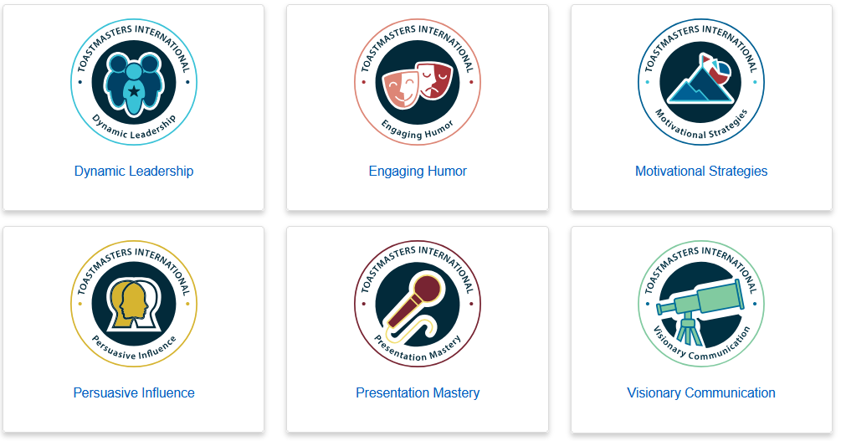
Select a Path
Presentation Mastery Path
How to understand and connect with your audience, mastering speech writing and delivery techniques, and applying these skills to various real-world situations, culminating in an extended speech
Default path

Slide 8
Select a Path

Slide 9
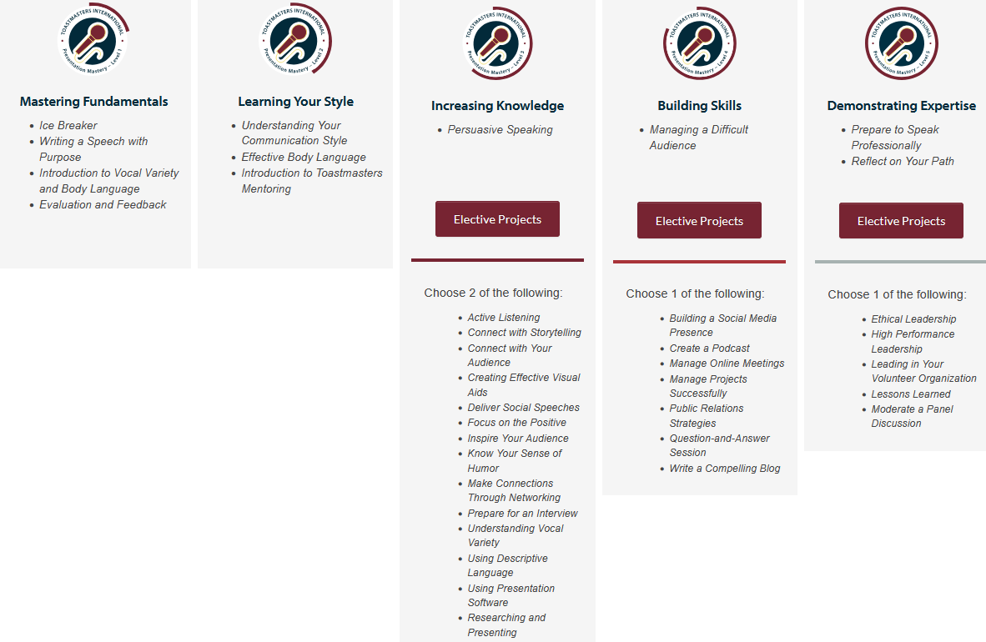
Projects
Level 1
Level 2
Level 3
Level 4
Level 5

Slide 10
Projects
Level 1
Level 2
Level 3
Level 4
Level 5

Slide 11
Getting Started
Make it transferable
Schedule the Ice Breaker
Navigate Pathways
Select a
path

Slide 12
How to get Started
Log in to www.toastmasters.org/login to ensure that your username and password are correct.
  If you have an account*, login here: https://www.toastmasters.org/myhome
Review The Navigator—your guide to Toastmasters.
Enroll in Pathways—choose your path
Sample your first project, the Ice Breaker.
Ask your vice president education to pair you with a mentor, to help you along the way
*Prospective Member Management System

Slide 13
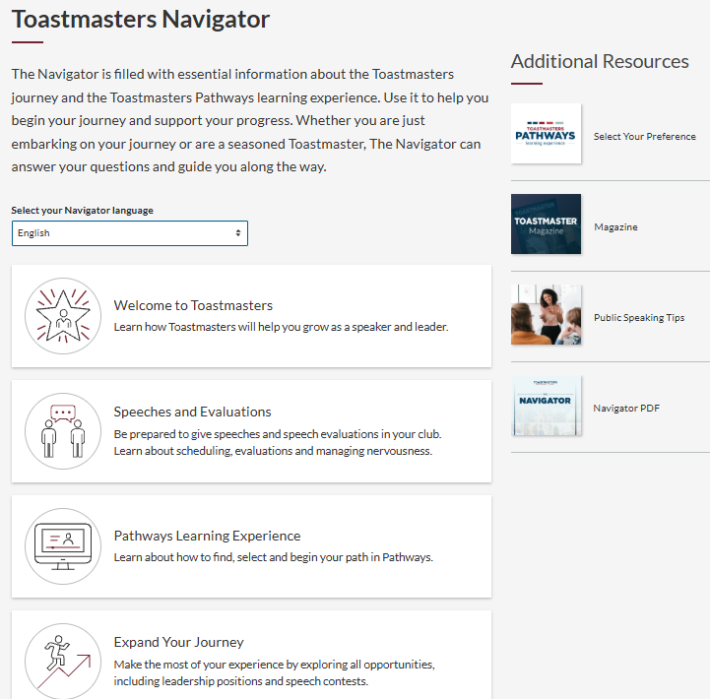
https://www.toastmasters.org/the-navigator

Slide 14
How to get Started
Log in to www.toastmasters.org/login to ensure that your username and password are correct.
  If you have an account, login here: https://www.toastmasters.org/myhome
Review The Navigator—your guide to Toastmasters.
Enroll in Pathways—choose your path
Sample your first project, the Ice Breaker.
Ask your vice president education to pair you with a mentor, to help you along the way

Slide 15
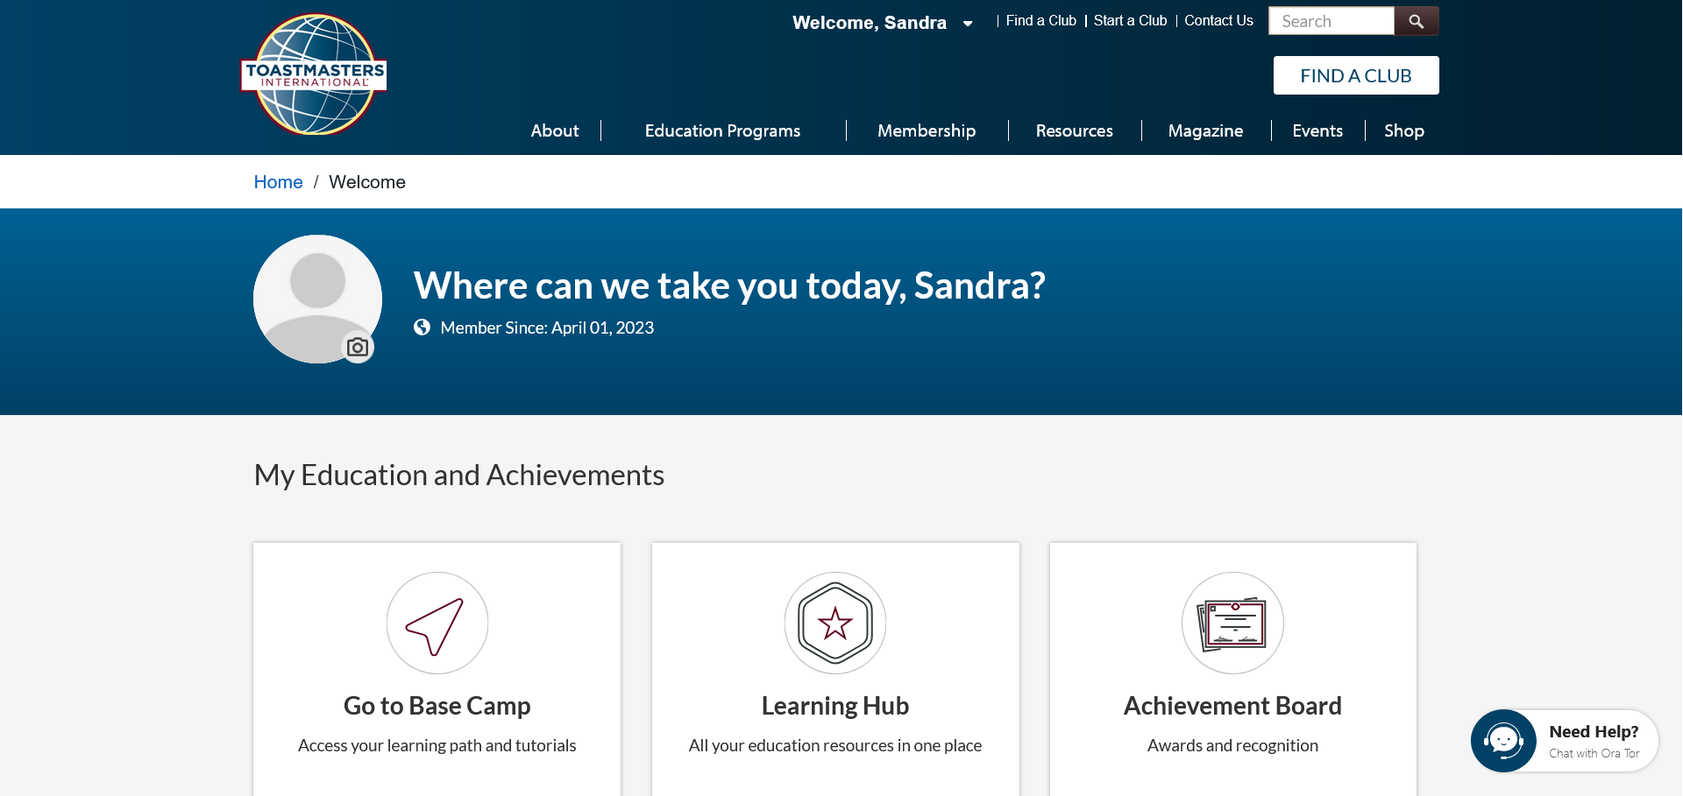

Slide 16
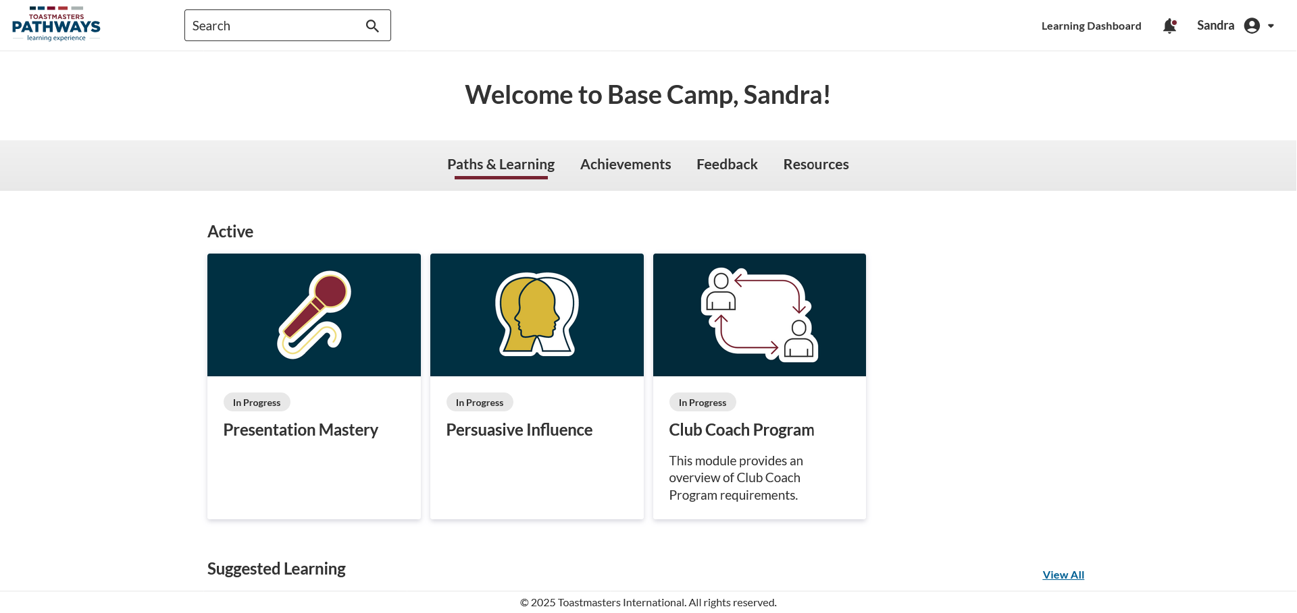

Slide 17
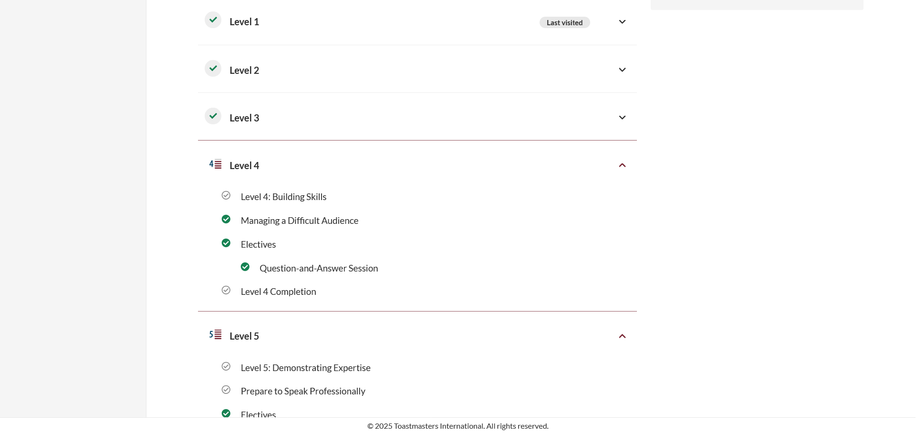
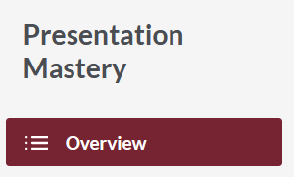

Slide 18
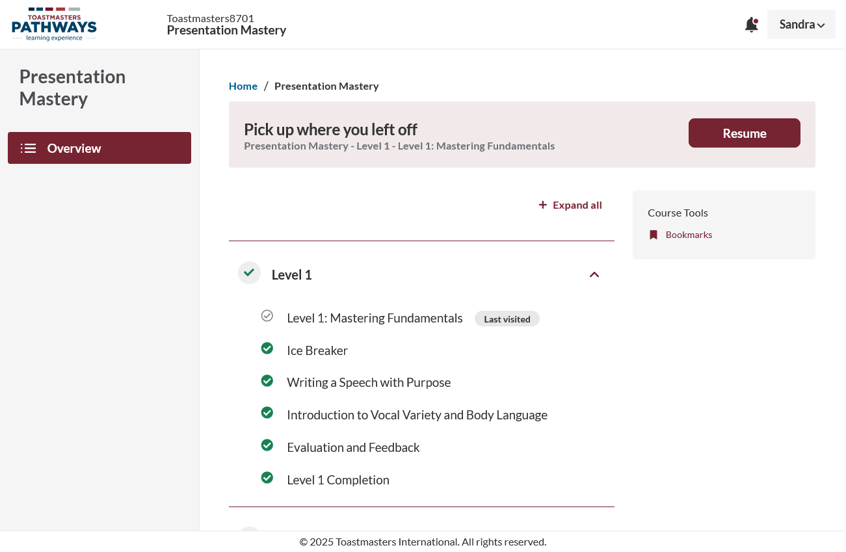

Slide 19
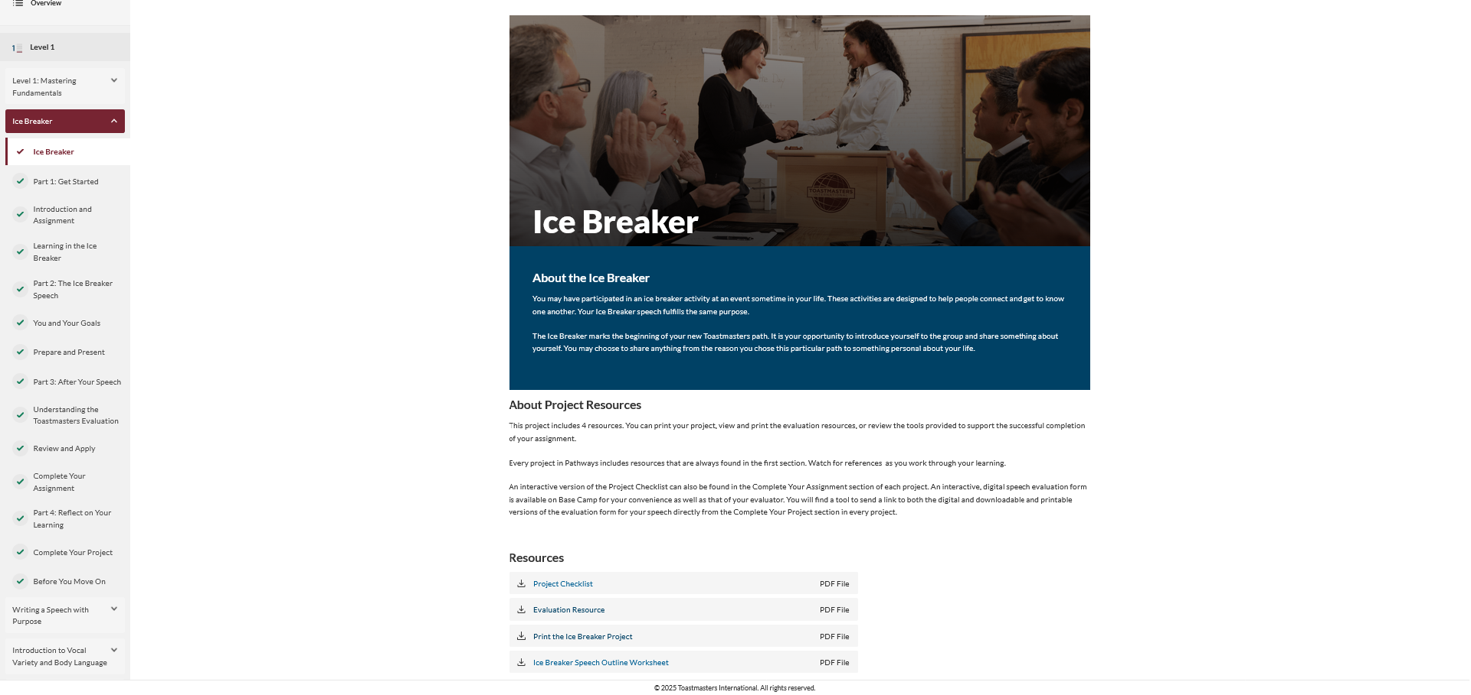

Slide 20
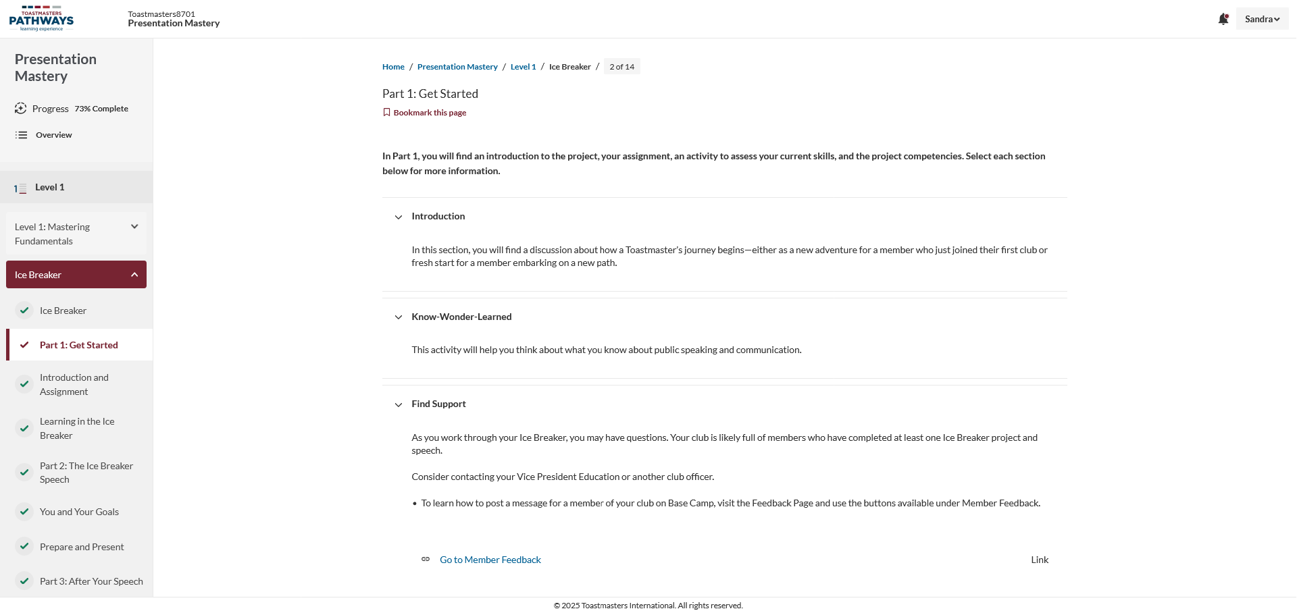

Slide 21
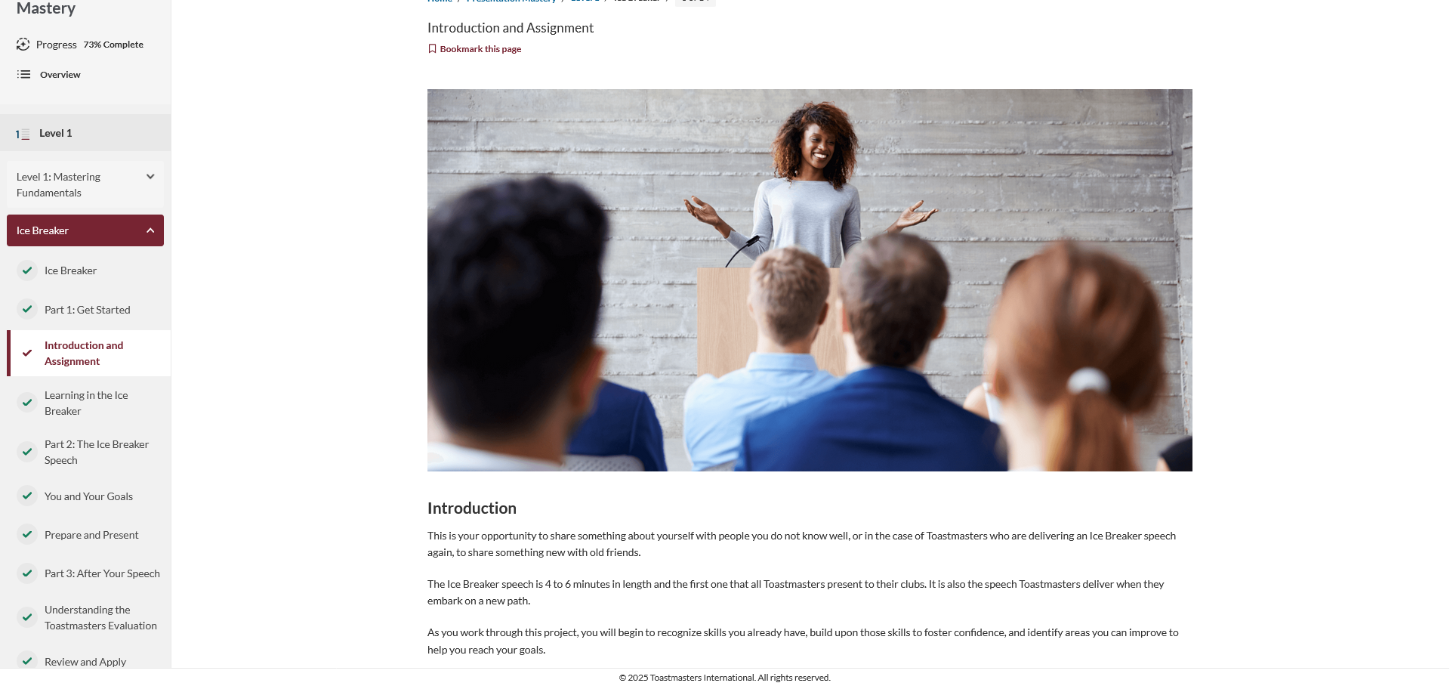

Slide 22
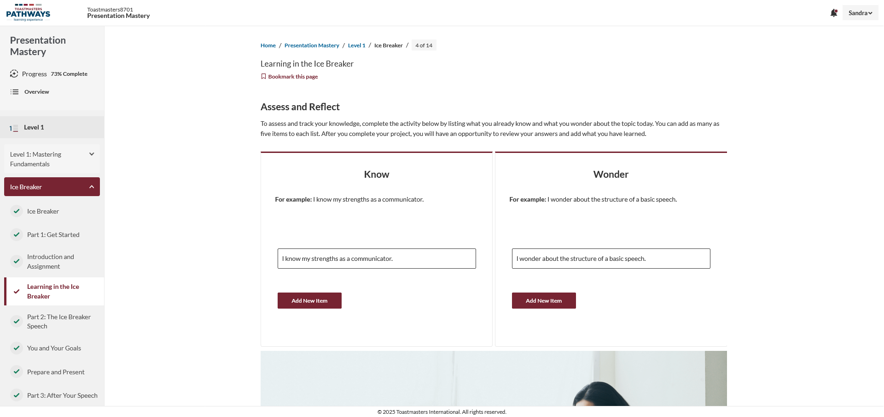

Slide 23
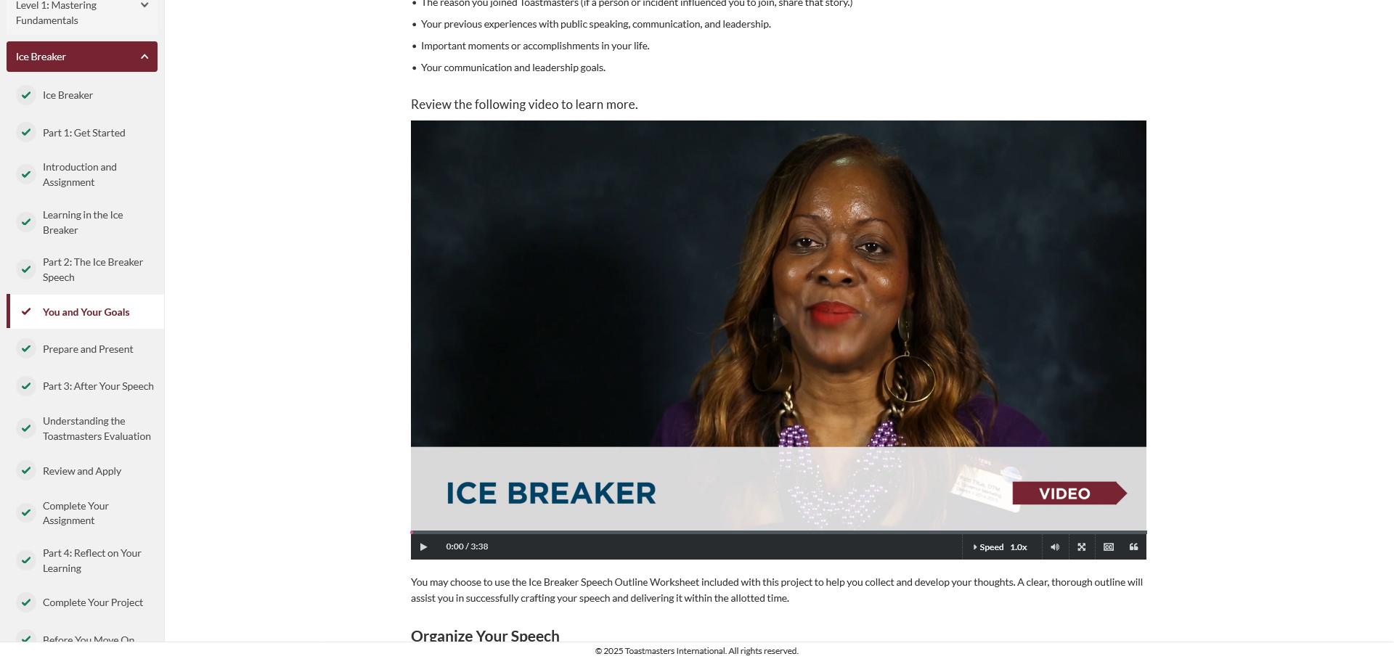

Slide 24
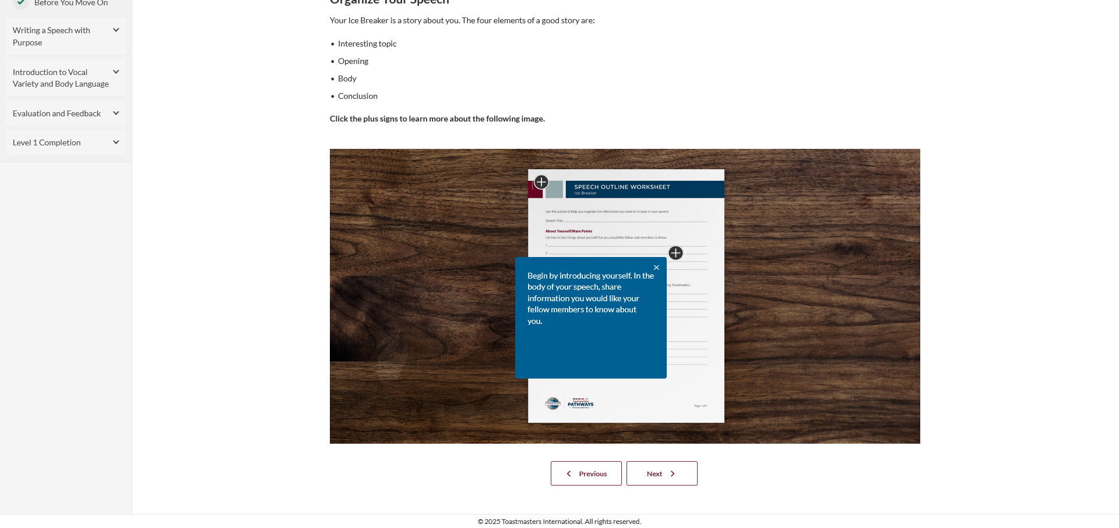

Slide 25
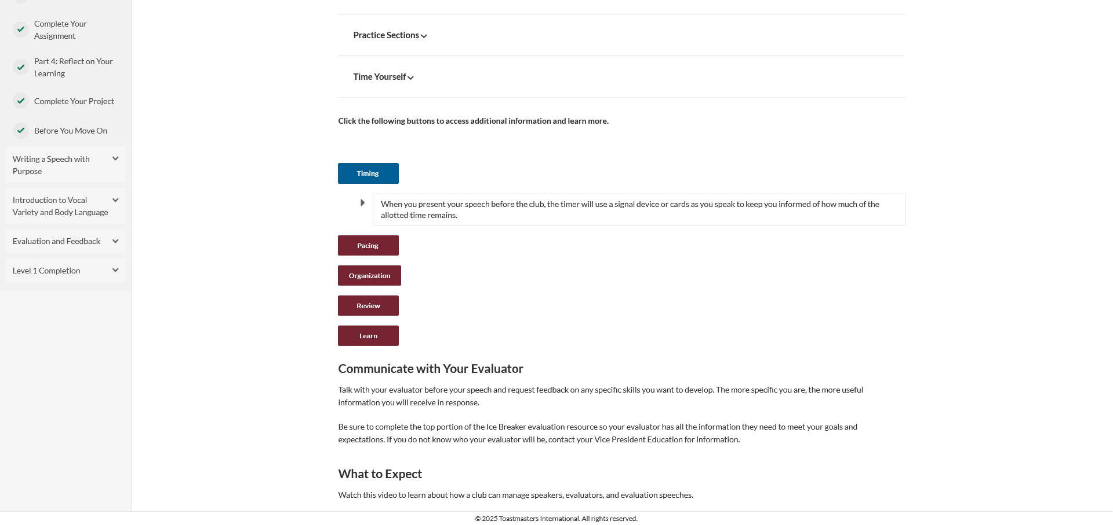

Slide 26
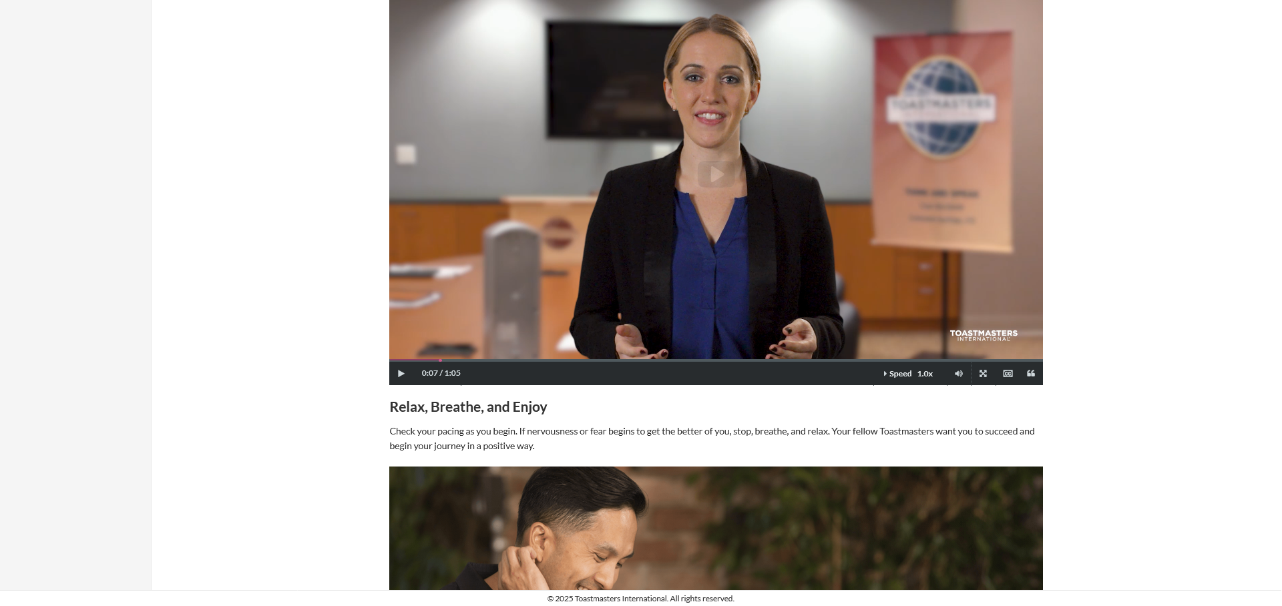

Slide 27
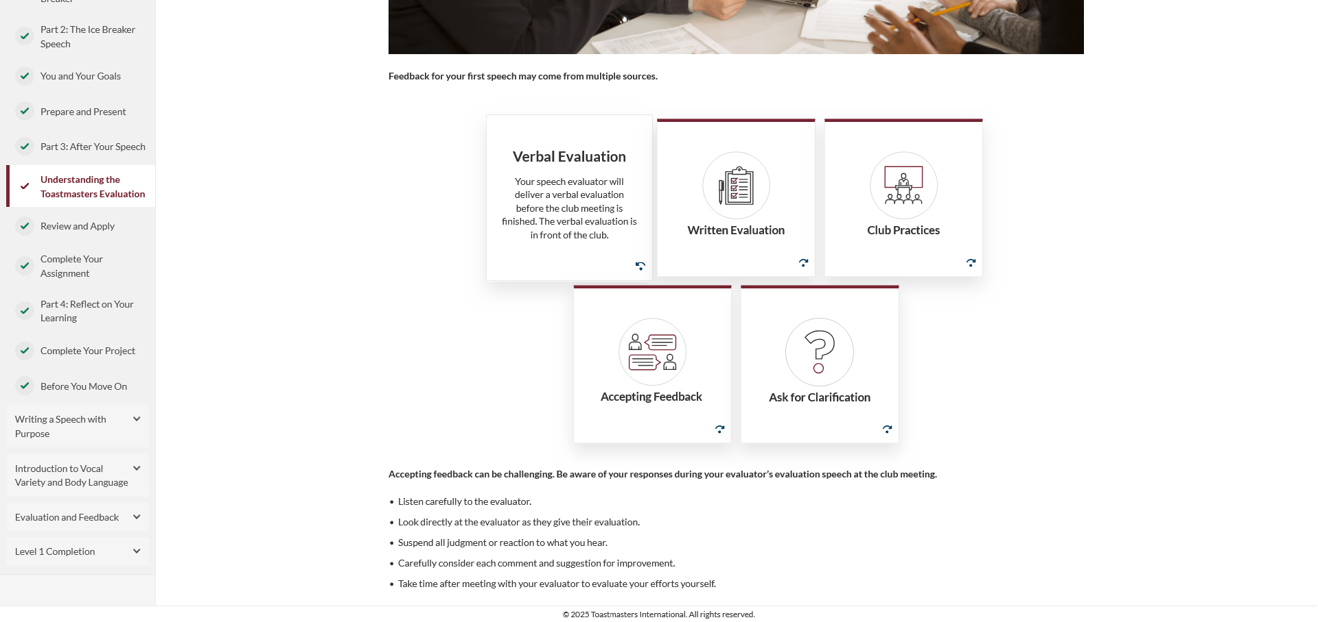

Slide 28
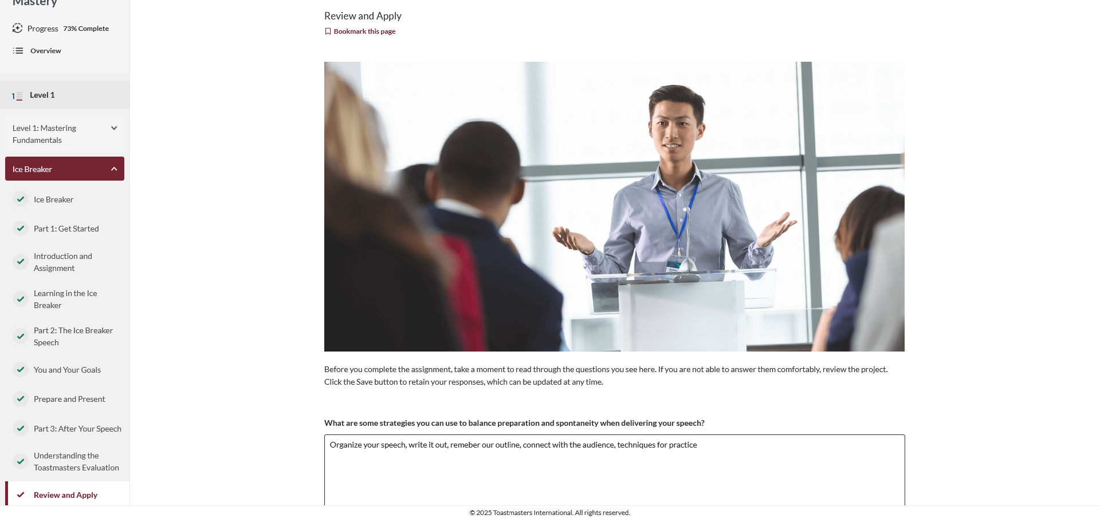

Slide 29
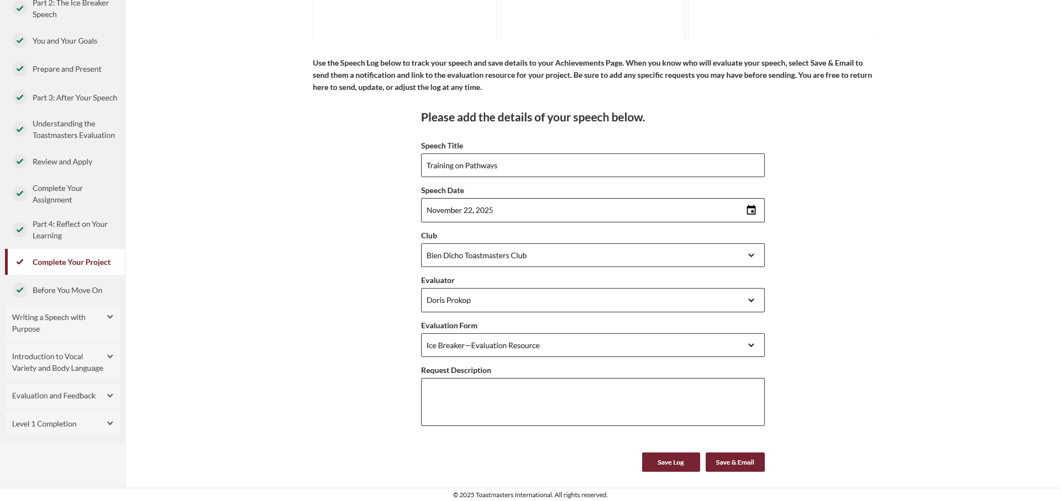

Slide 30
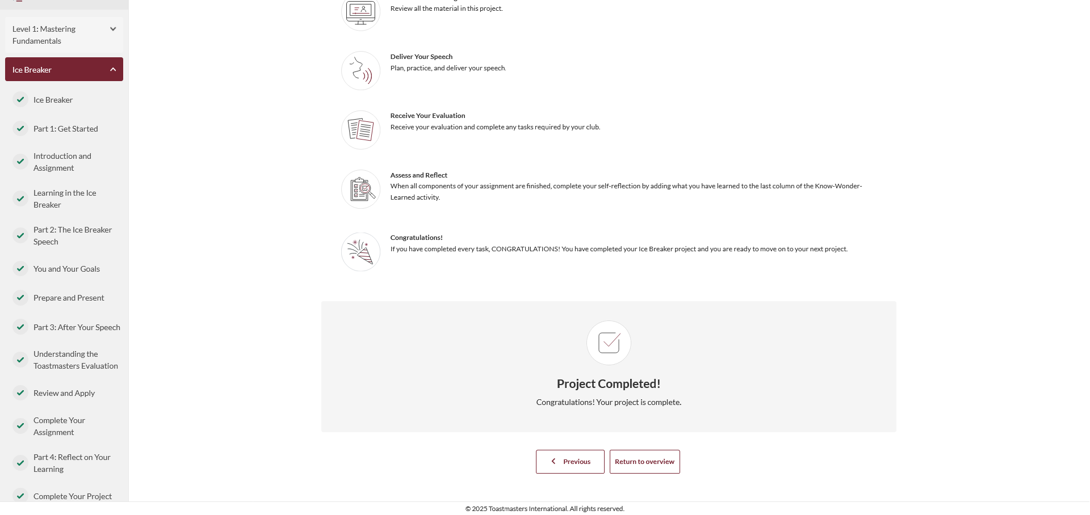

Slide 31
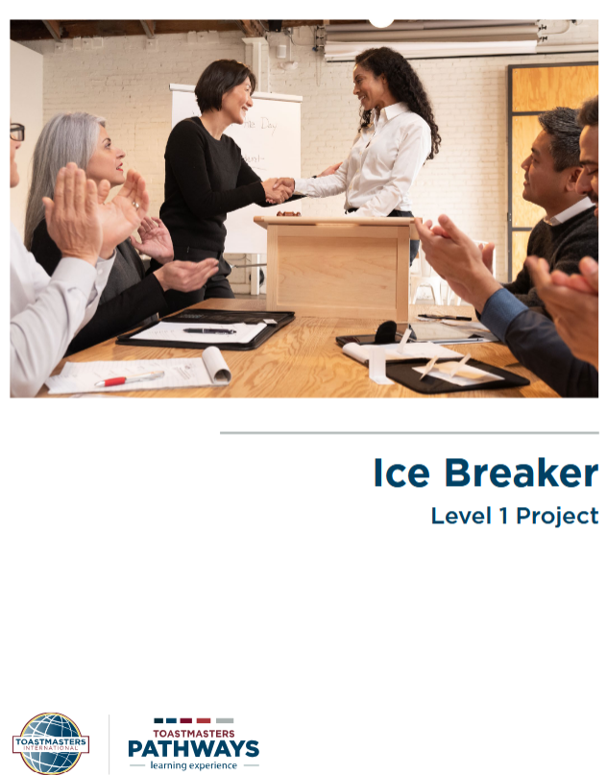
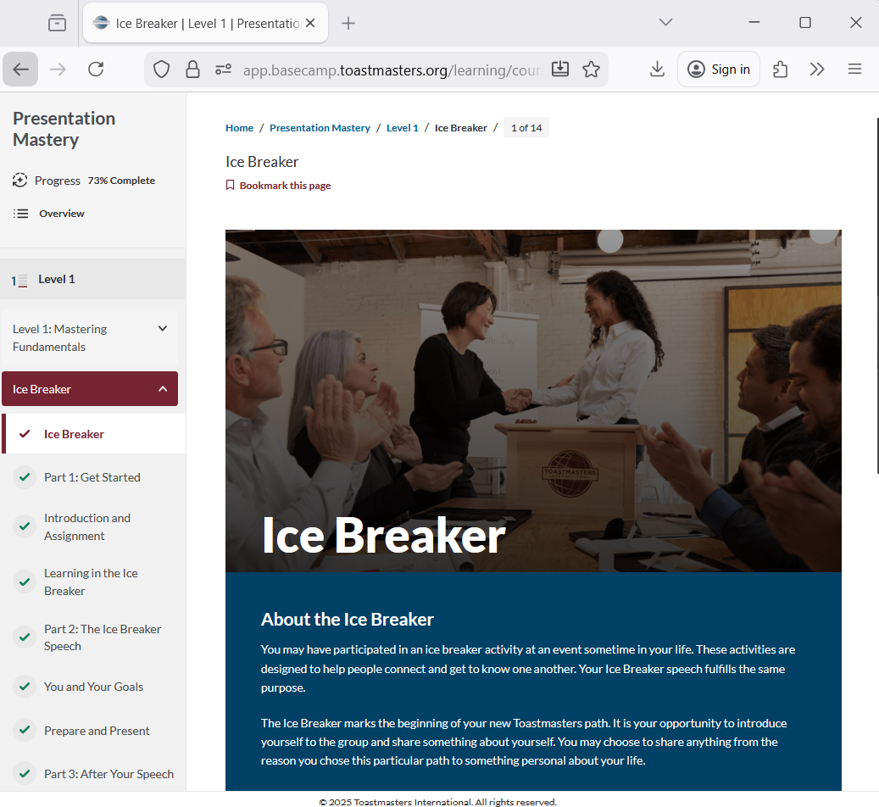

Slide 32
Getting Started
Make it transferable
Schedule the Ice Breaker
Navigate Pathways
Select a
path

Slide 33
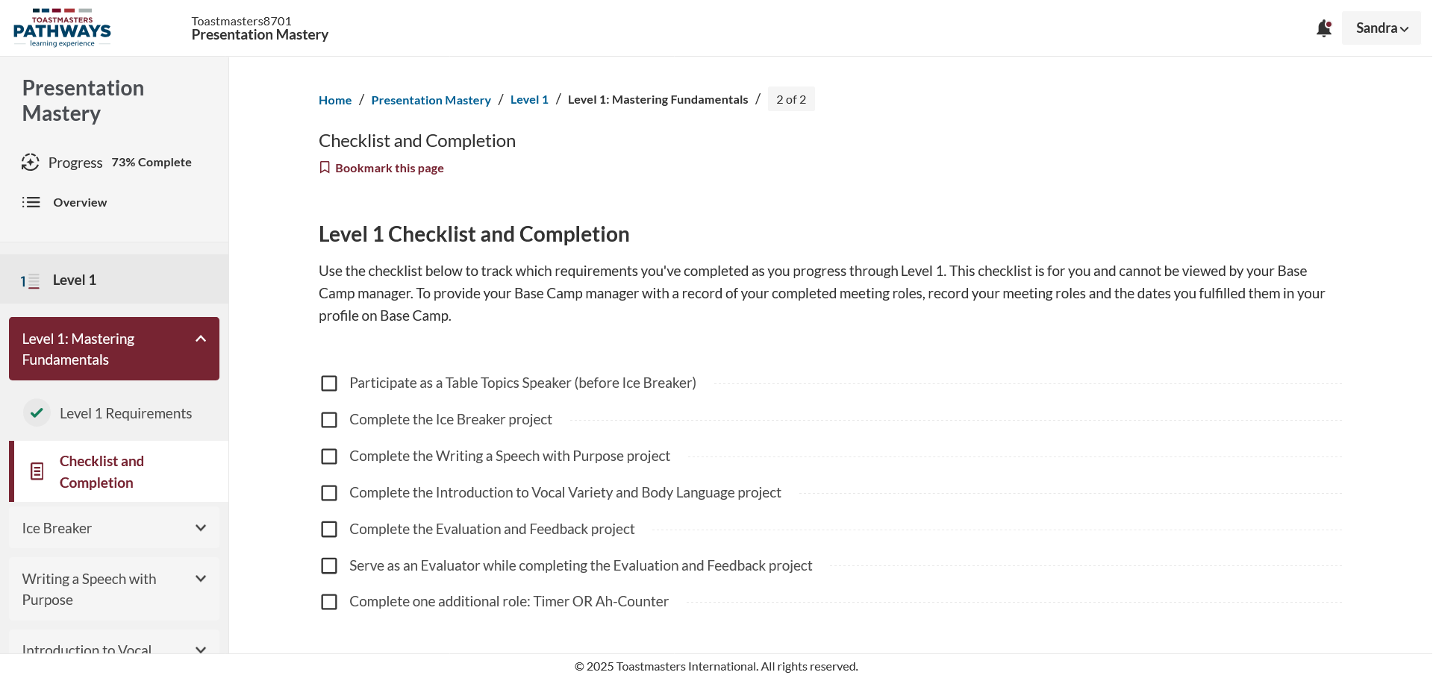
Schedule the Ice Breaker
There is a new requirement to be a Table Topics Speaker prior to giving your Ice Breaker.
Ask your vice president education to pair you with a mentor, to help you along the way

Slide 34
Getting Started
Make it transferable
Schedule the Ice Breaker
Navigate Pathways
Select a
path

Slide 35
Projects
Level 1
Level 2
Level 3
Level 4
Level 5

Slide 36
Call to Action
Pathways is the centerpiece of the Toastmasters International educational system
  Develop personalized skills in communication and leadership
  Uses a self-paced online program to provide a structured way to gain practical, real-world skills
Use Pathways as an enabler to help achieve excellence in your goals!

Slide 37
Questions?

Slide 38
Lab Time - How to get Started
Log in to www.toastmasters.org/login to ensure that your username and password are correct.
  If you have an account, login here: https://www.toastmasters.org/myhome
Review The Navigator—your guide to Toastmasters.
Enroll in Pathways—choose your path
Sample your first project, the Ice Breaker.
Ask your vice president education to pair you with a mentor, to help you along the way

