Slide 1
Welcome! I’m so glad you’re here! We’ve been talking about how Jesus was arrested, convicted at an unfair trial, sentenced to die, and killed. Thankfully, the story doesn’t end there.

Slide 2
How many of you like playing video games or games on your phone or tablet? (Group response) Have you ever lost when you were out of lives? (Group response) How did it feel? (Group response) Doesn’t it feel good when you die, but are able to come back to life in the game? (Group response)

Slide 3
I wish that we could make that happen in real life anytime we wanted. When a loved one or even a pet dies, don’t you wish that they could come back and be with us forever? (Group response) That just isn’t how it works. However, Jesus changed how death works by doing something really special. Jesus defeated death and came back to life. Today, we are going to talk about one of the most exciting events in the Bible, the Resurrection.

Slide 4
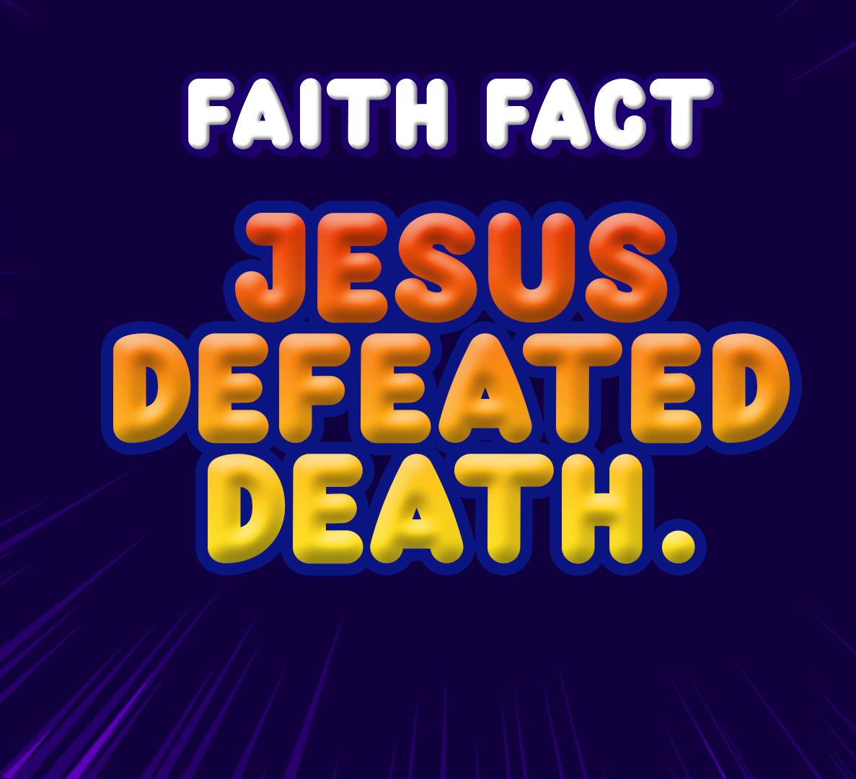
Our Faith Fact today is about Jesus’ Resurrection. When He came back to life, Jesus defeated death. Let’s say it all together. Jesus defeated death. We are going to say it one more time, but this time we are going to say it in our best professional sports announcer’s voice. Jesus defeated death. Great job!

Slide 5
Today, we will look at a very important passage of Scripture when it comes to our faith in Jesus. Being a Christian is very special because our Savior, Jesus, died for us even though we did not deserve it. He didn’t stop there. Jesus defeated death and came back to life.

Slide 6
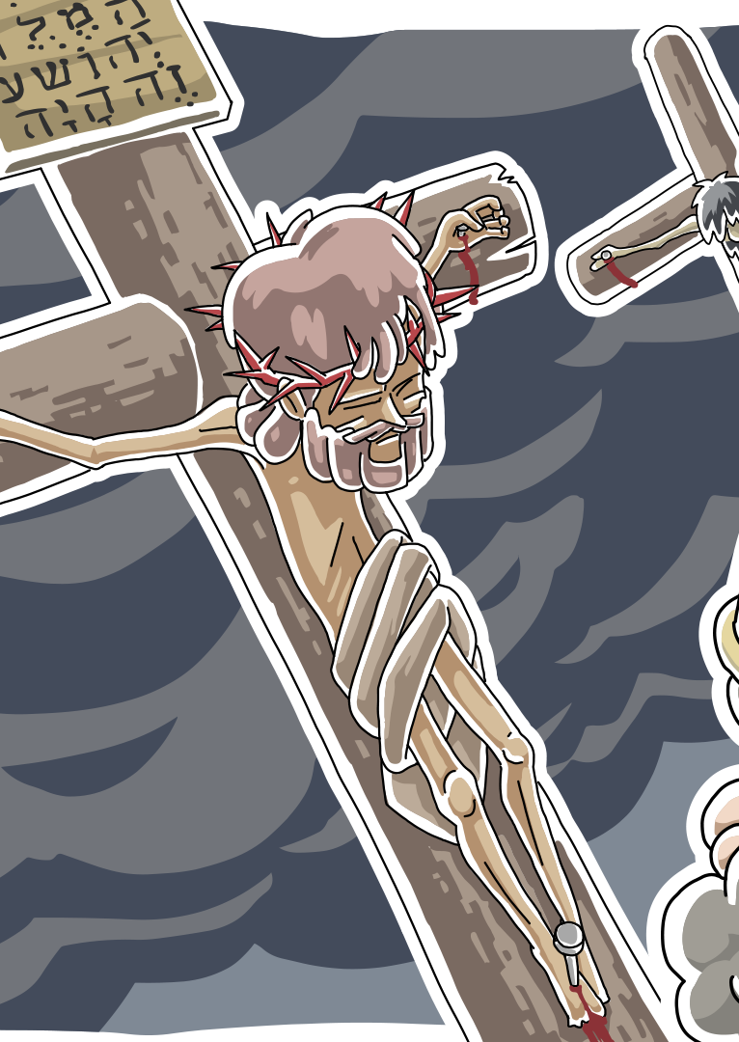
This is a two-part story. Last time, we were in Luke 23 and discovered that Jesus was crucified, or nailed to a cross, between two criminals. Then, He died. Many people who saw Jesus’ death were shocked. People realized there was something different about Jesus.

Slide 7
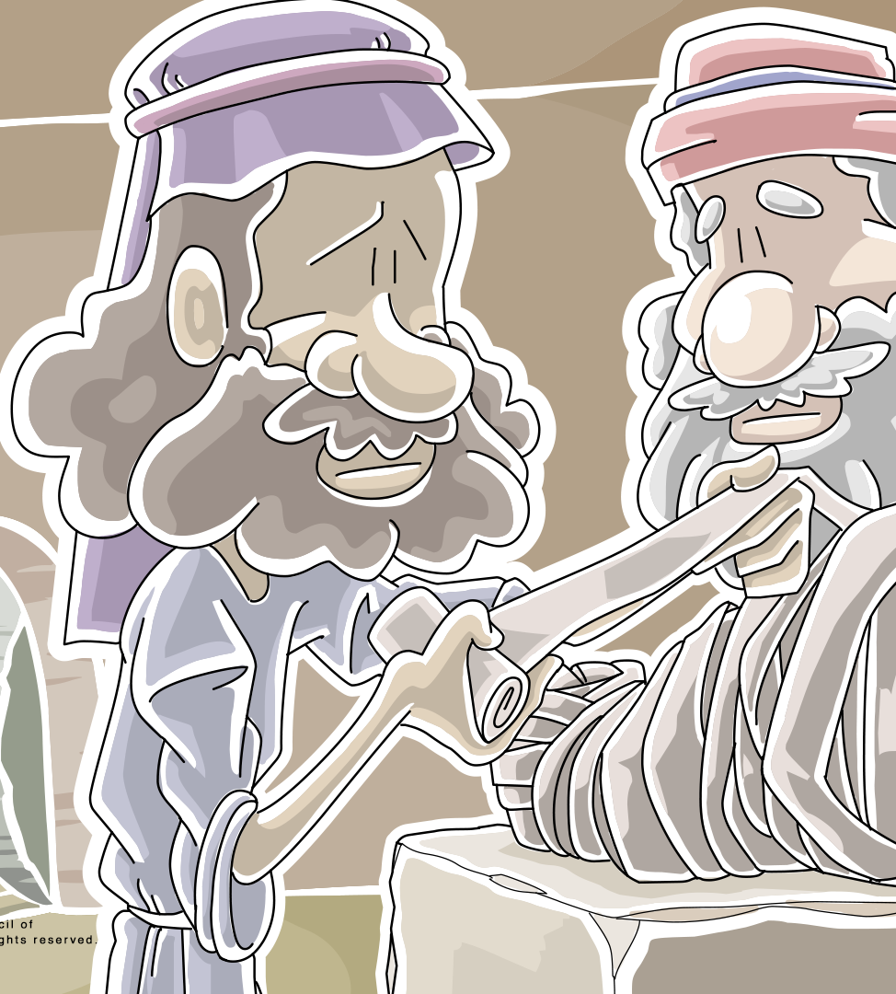
After Jesus died, they took His body and put it in a tomb. A man named Joseph donated his tomb for Jesus’ body. Then he rolled a massive stone in front of the tomb’s opening. The next day, the Jewish leaders asked the Roman leader to post guards at the tomb, so no one could steal the body.

Slide 8
Because of the time of day when Jesus died, the disciples didn’t have time to properly prepare His body for burial before the Sabbath, their day of rest. Jesus’ followers were following the Sabbath rules and not doing any kind of work. Let’s see what happened next.
Let’s read Luke 24:1-4

Slide 9
¹ On the first day of the week, very early in the morning, the women took the spices they had prepared and went to the tomb. ² They found the stone rolled away from the tomb, ³ but when they entered, they did not find the body of the Lord Jesus. ⁴ While they were wondering about this, suddenly two men in clothes that gleamed like lightning stood beside them.
Luke 24:1-4

Slide 10
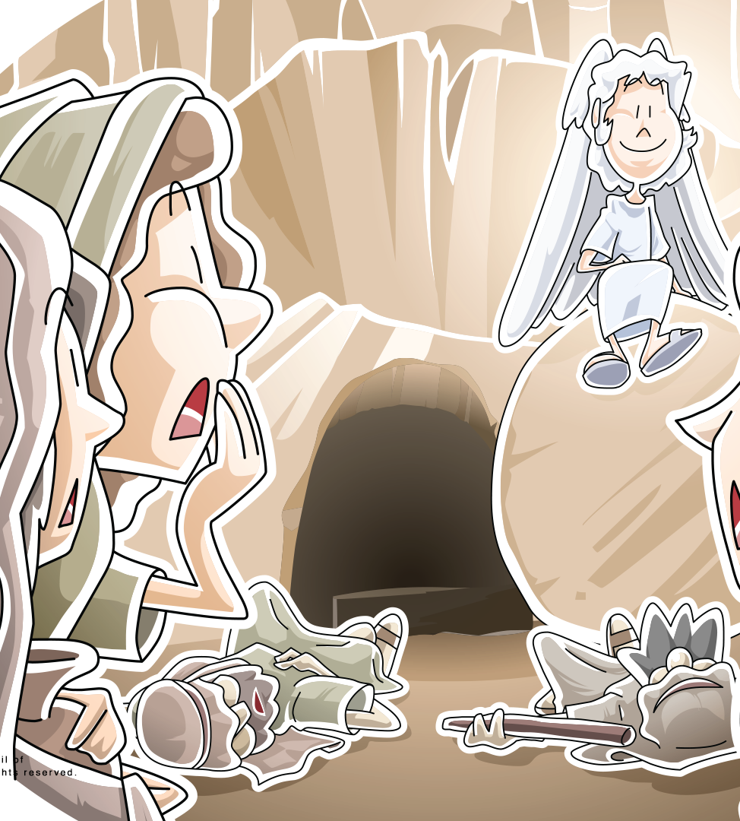
What had happened? The rock was moved! The women looked inside, but Jesus’ body was gone! Can you imagine the emotions they must have been feeling? They wanted to know what was going on. Suddenly, two angels appeared. Let’s read what the angels said to them.

Slide 11
⁵ In their fright the women bowed down with their faces to the ground, but the men said to them, “Why do you look for the living among the dead? ⁶ He is not here; he has risen! Remember how he told you, while he was still with you in Galilee: ⁷ ‘The Son of Man must be delivered over to the hands of sinners, be crucified and on the third day be raised again.
Luke 24:5-7

Slide 12
The Bible says the women were terrified and fell to the ground. Jesus was alive! He had defeated death, and the first people to know about it were these women who had followed Jesus.

Slide 13
The angels reminded them that Jesus had predicted He would be betrayed and crucified. They also reminded the women that Jesus had said He would come back to life. Suddenly, they remembered and realized in that moment that Jesus defeated death.

Slide 14
There have been lots of great leaders throughout history. All those leaders from the past have died, and they have stayed dead—except one. Jesus came to earth for one reason—to provide a way for us to have a relationship with God. Sin separates us from God, and only death could pay the punishment for that sin.

Slide 15
Jesus lived a perfect life. He was crucified even though He did nothing wrong. Then, three days later, the impossible happened. Jesus fulfilled God’s plan by showing that He is more powerful than even death itself. Jesus defeated death. Jesus did not stay in the tomb; He is alive!

Slide 16
That is important for each of us. Jesus died so that we could have eternal life with God. We can have a relationship with God here on earth. The Bible tells us that there is a time for everything and that one day all of us will die. We don’t have to worry about that or be sad about that. You know why? Jesus defeated death. I know that when I die, I will be alive with Jesus for all eternity. If you have asked Jesus to forgive your sins and help you make right choices, you will, too. That is exciting!

Slide 17
Let’s Pray!!

