Slide 1
Welcome! I’m so glad you’re here! Last time we talked about how Jesus shows us how to live even when we’re facing hard things. We’ve got even more to learn from Him today. Today we are learning that Jesus is my Savior!

Slide 2

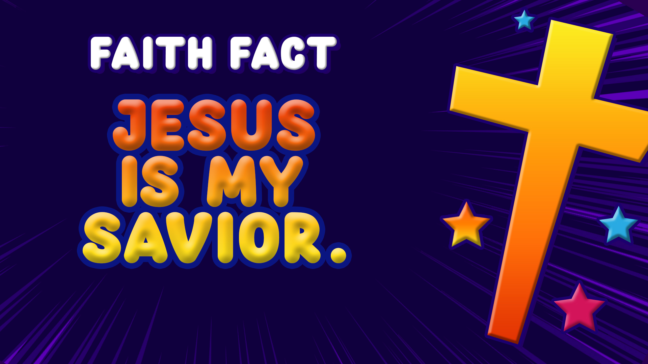
That is our Faith Fact for today. Let’s take a look at our Faith Fact and say it all together. Jesus is my Savior.
Let’s say it one more time. This time let’s say it in our favorite movie actor’s voice. Jesus is my Savior. Great job!

Slide 3
It is time for our faith to grow as we learn about Jesus. Let me tell you, today’s Bible lesson is not a fun-filled story with lions and giants. Today’s story is about one of the saddest days in history that leads to the greatest day in history, which we will talk about next time.

Slide 4
Jesus was born and lived a perfect life here on earth. He healed people and helped people understand that God wants to have a relationship with them.
But some of the things that Jesus said about who He is and the things He did made the religious leaders very angry.

Slide 5
Do you remember what we talked about last time? (Allow responses.) That’s right. We talked about the Last Supper, Jesus’s last meal with His disciples and how he washed their feet.
Later on, that same night, the religious leaders arrested Jesus. Then, He was put on trial and falsely accused of things because these religious leaders didn’t like Him. They beat Jesus and called Him names.

Slide 6
The Roman leader in Israel at the time gave in to the requests of the religious leaders who hated Jesus. This Roman leader agreed to their demand that Jesus die a horrible death on a cross. This method of execution is called crucifixion, and it is one of the most horrible ways a person could die.

Slide 7
Did Jesus do anything wrong? Did Jesus deserve to be punished? Let’s go to the Book of Luke and read together.

Slide 8
³² Two other men, both criminals, were also led out with him to be executed. ³³ When they came to the place called the Skull, they crucified him there, along with the criminals—one on his right, the other on his left.
Luke 23:32-33

Slide 9
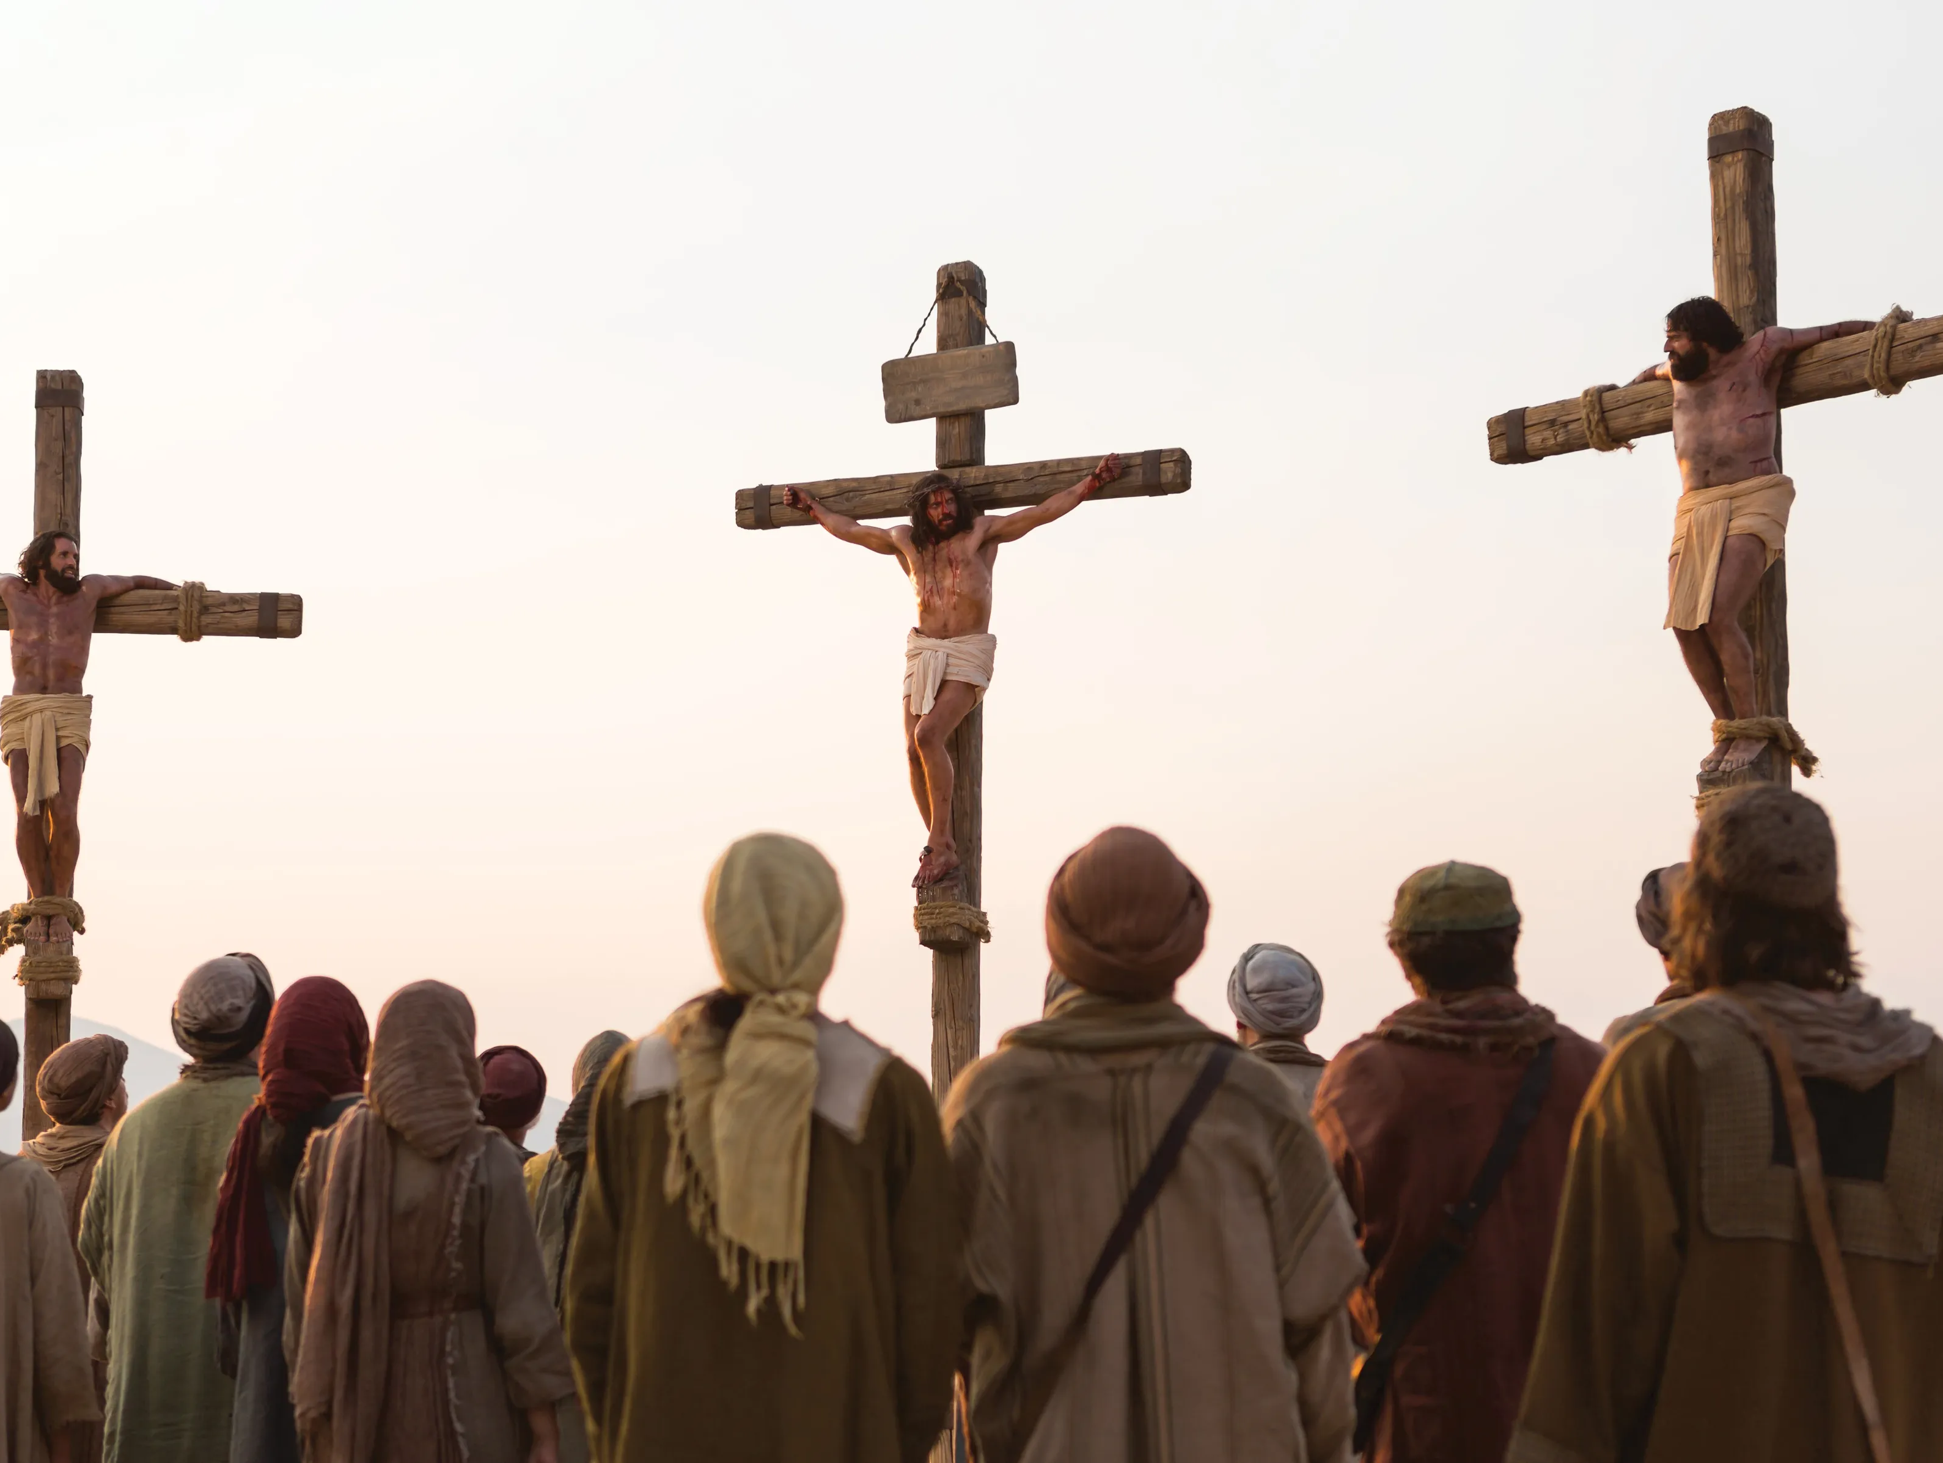
You may have seen pictures before of three crosses. That is because Jesus was sentenced to die with two criminals.
The Roman soldiers nailed Him to a cross. What happened next is one of the saddest things ever as Jesus prepared to die. Remember, this story will have a happy ending because Jesus is my Savior.

Slide 10
Even though very bad things were happening to Jesus, He still loved those who were doing this to Him. Rather than being angry, Jesus cried out for God to forgive them.
While Jesus hung there on the cross, the soldiers placed bets to see who would get His clothes. They mocked Jesus, laughed at Him, and put up a sign calling Him the “King of the Jews.”

Slide 11
Then, we see something happen with the two criminals hanging next to Jesus. One of them started to make fun of Him as well.
³⁹ One of the criminals who hung there hurled insults at him: “Aren’t you the Messiah? Save yourself and us!” Luke 23:39

Slide 12
Jesus didn’t answer him; someone else did. Let’s keep reading.
⁴⁰ But the other criminal rebuked him. “Don’t you fear God,” he said, “since you are under the same sentence? ⁴¹ We are punished justly, for we are getting what our deeds deserve. But this man has done nothing wrong.”
⁴² Then he said, “Jesus, remember me when you come into your kingdom.
Luke 23:40-42

Slide 13
God’s Holy Spirit was doing something in the heart of that second criminal. He was starting to realize that he had sinned and deserved to be punished, but Jesus had done nothing wrong. The man asked Jesus to remember him when Jesus came into His kingdom. The man realized that Jesus could save him for eternity.

Slide 14
Jesus shows us the reason He allowed all of this to happen to Him.
In one statement, Jesus reveals the plan that God had made for those who love him.
⁴³ Jesus answered him, “Truly I tell you, today you will be with me in paradise.”
Luke 23:43

Slide 15
In the next two verses, we see that the sun suddenly went dark for about three hours even though it was the middle of the day. The curtain in the temple was torn in half from top to bottom. Finally, Jesus cried out.
⁴⁶ Jesus called out with a loud voice, “Father, into your hands I commit my spirit.” When he had said this, he breathed his last.
Luke 23:46

Slide 16
At that moment, the people who were there understood that what happened to Jesus was wrong. They left with sorrow knowing that He had done nothing wrong.
Because of His willingness to die on the cross, it made a way for us to have a relationship with God. Because of Jesus, our Faith Fact can be true for each one of us. Jesus is my Savior.

Slide 17
This final day of Jesus’ life on earth seems like a horrible ending, but the story isn’t over yet. Next time, we are going to look at what happened after this. Who knows what occurred three days later? It’s the reason we celebrate Easter.
TO BE CONTINUED…

Slide 18
Let’s Pray!!

