Slide 1
Welcome Friends! Are you glad you came today? I know I’m glad you’re here. Today we’re going to learn about how Jesus served others.

Slide 2

Our Faith Fact for today is Jesus Shows Me How To Live. Can you say that with me? 1,2,3, Jesus Shows Me How To Live

Slide 3
Our story today picks up at the start of a very important festival for God’s people, called Passover. Do you know what Old Testament event the Jewish people celebrated at Passover? (Allow responses.)

Slide 4
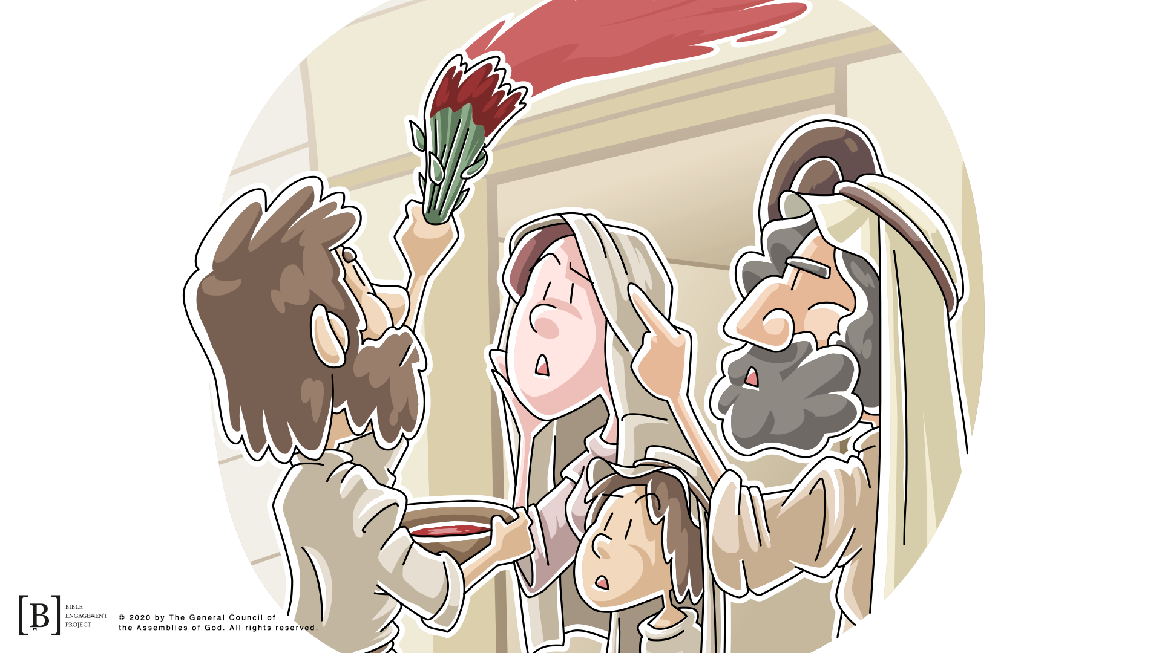
Passover is when they remembered how God had freed them from slavery in Egypt. At the first celebration of Passover in Egypt, every Israelite family sacrificed a lamb to God and used the blood to cover their doorposts. Their obedience to God’s instructions saved them from the final plague and freed them from Egypt. Every year, the Israelites celebrated that event with a special meal.

Slide 5
Being freed from slavery was an important part of Israel’s history, but God knew there was a bigger issue that His people needed to be freed from. Sin was a big issue for all people, and God sent Jesus to do something about it.

Slide 6
In the verses we’re going to read, Jesus knew it was almost time for His life to be sacrificed like the Passover lamb so all people could be freed from their sin.
Read or have a kid volunteer read John 13:1–2.
Use as many volunteers as possible for the rest of the readings.
13 It was just before the Passover Festival. Jesus knew that the hour had come for him to leave this world and go to the Father. Having loved his own who were in the world, he loved them to the end.
² The evening meal was in progress, and the devil had already prompted Judas, the son of Simon Iscariot, to betray Jesus.

Slide 7
Okay, what can we learn from these verses? (Allow responses.) Jesus loved His disciples. They had followed Him and lived with Him for the last three years, but now He knew His time left with them was short. Jesus was about to eat His last meal, and He knew one of the disciples was about to betray Him and turn Him over to His enemies. Instead of being angry or upset, He did something very unexpected. Let’s read the next few verses.

Slide 8
³ Jesus knew that the Father had put all things under his power, and that he had come from God and was returning to God; ⁴ so he got up from the meal, took off his outer clothing, and wrapped a towel around his waist. ⁵ After that, he poured water into a basin and began to wash his disciples’ feet, drying them with the towel that was wrapped around him.
John 13: 3-5

Slide 9
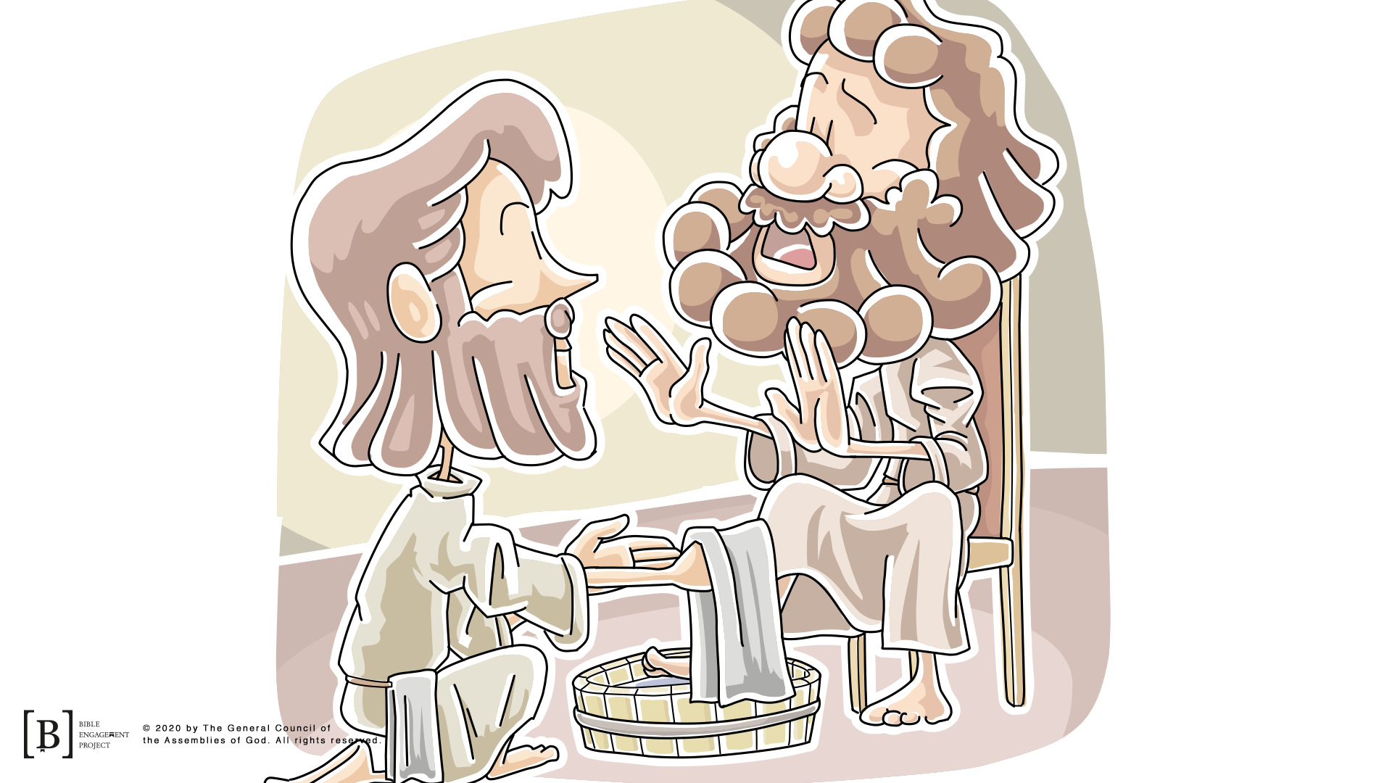
Jesus took the role of a servant and washed the feet of all the disciples, even Judas who was about to betray Him. Jesus was showing us to love everyone, including our enemies or those who have hurt us.

Slide 10
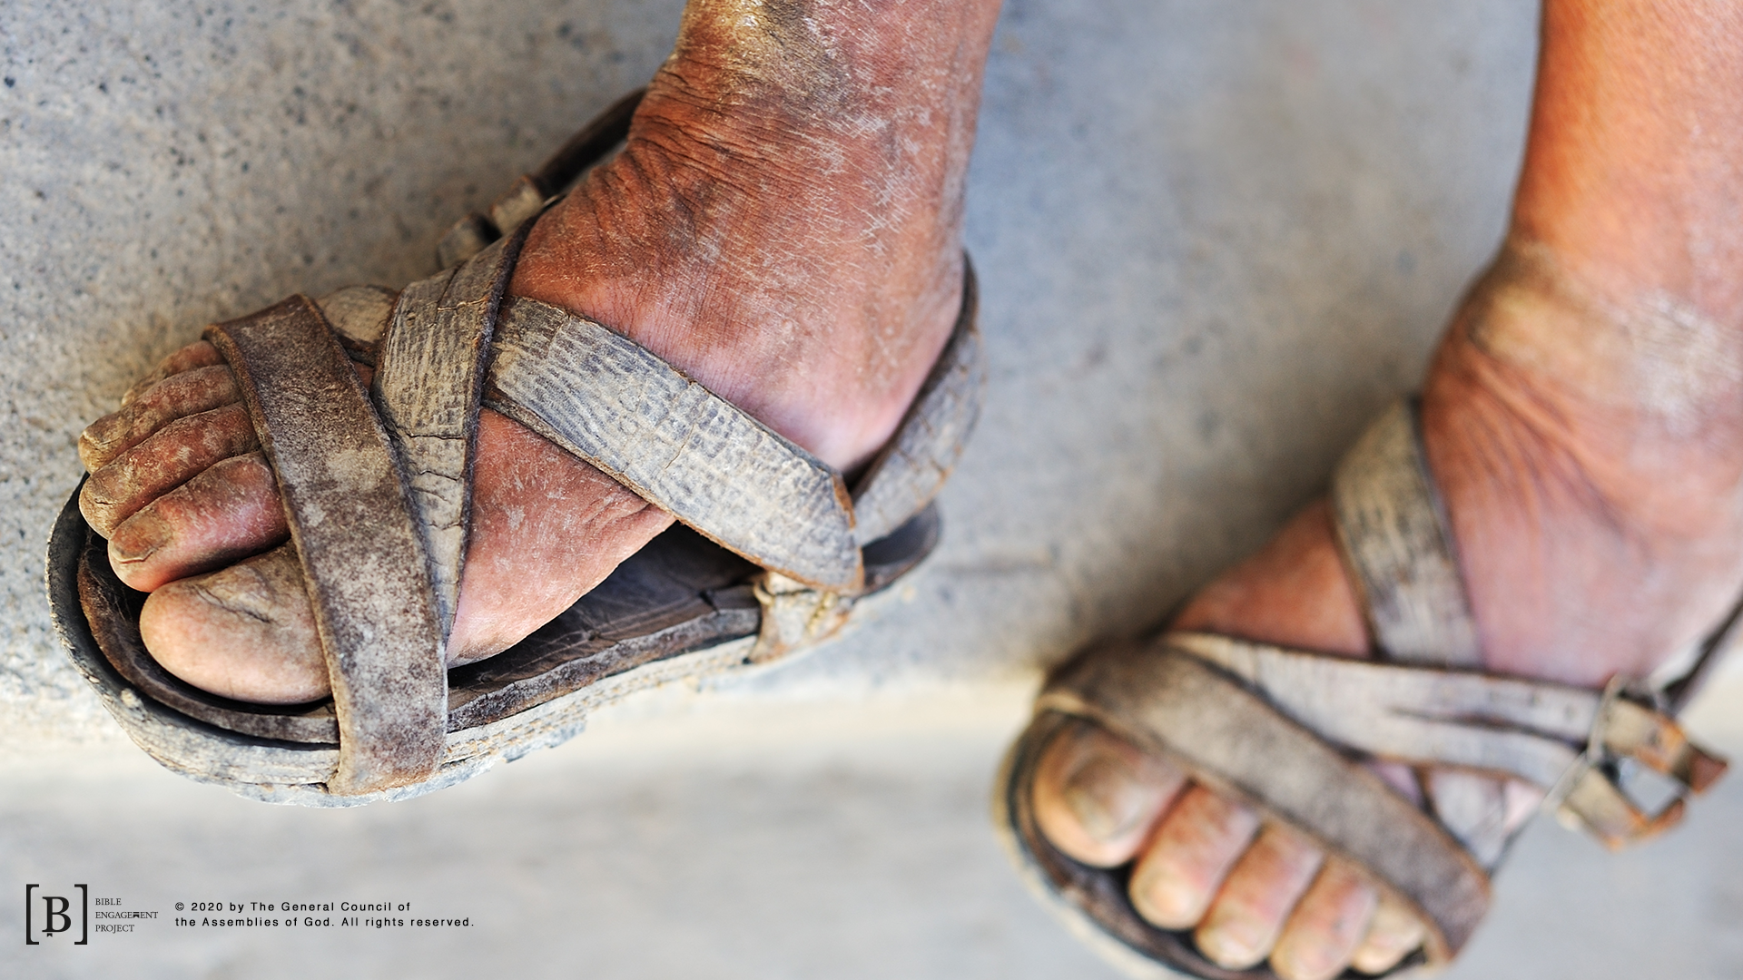
During the time of Jesus, people walked everywhere and had very dirty feet because of it. Sweaty feet, dust, and dirt together don’t make a good combination. Back in that time, it was common for disciples to wash the feet of their teacher. But what did we see Jesus do? (Allow responses.) Let’s Read John 13:6-8

Slide 11
⁶ He came to Simon Peter, who said to him, “Lord, are you going to wash my feet?”
⁷ Jesus replied, “You do not realize now what I am doing, but later you will understand.”
⁸ “No,” said Peter, “you shall never wash my feet.”
Jesus answered, “Unless I wash you, you have no part with me.”

Slide 12
Jesus was the Teacher here. He was the Leader of His disciples. They should have washed His feet. That’s why Peter was so upset. He basically told Jesus, “There is no way You are washing my feet.” But Jesus continued on and washed the feet of all the disciples. Why do you think Jesus chose to wash their feet? Let’s keep reading and find out.

Slide 13
¹² When he had finished washing their feet, he put on his clothes and returned to his place. “Do you understand what I have done for you?” he asked them. ¹³ “You call me ‘Teacher’ and ‘Lord,’ and rightly so, for that is what I am. ¹⁴ Now that I, your Lord and Teacher, have washed your feet, you also should wash one another’s feet. ¹⁵ I have set you an example that you should do as I have done for you. ¹⁶ Very truly I tell you, no servant is greater than his master, nor is a messenger greater than the one who sent him. ¹⁷ Now that you know these things, you will be blessed if you do them.
John 13:12-17

Slide 14
Jesus was teaching them a principle that they should live by. Jesus was showing them how to serve others.
Sometimes we might think we are better than other people or that other people are better than us. Jesus shows me how to live in a way that is different from the pattern in the world. Whether I am important or not important to other people doesn’t matter because I am important to Jesus.

Slide 15
Jesus chose to serve His disciples. We need to serve the people around us just like Jesus did. Jesus didn’t do this to say that we have to wash each other’s feet every time we get together. He was showing us the way we need to live our life. That means that I need to be willing to help people even if I don’t want to.
When I love others and respect who they are, I want to help them and serve their needs. When I think I am better than others, I am not living my life the way that Jesus wants me to. I need to be a servant, not a master. Remember, we learned that Jesus shows me how to live and that we should live a life that helps and serves others.

Slide 16
Let’s Pray!!

