Slide 1
Welcome! This is going to be a fun day as we talk about how each one of us can make a difference in this world. We’ve already talked about how Jesus died for us and then defeated death. Because Jesus did those things for us, we have the opportunity to live forever with Him.

Slide 2
As we begin, I have a question. Who has ever traveled away from home? (Allow responses.) Who has gone on a road trip? (Allow responses.) Has anyone ever traveled on a bus or train? (Allow responses.) How about an airplane? (Allow responses.) What is the farthest away you have gone? (Allow responses.)

Slide 3
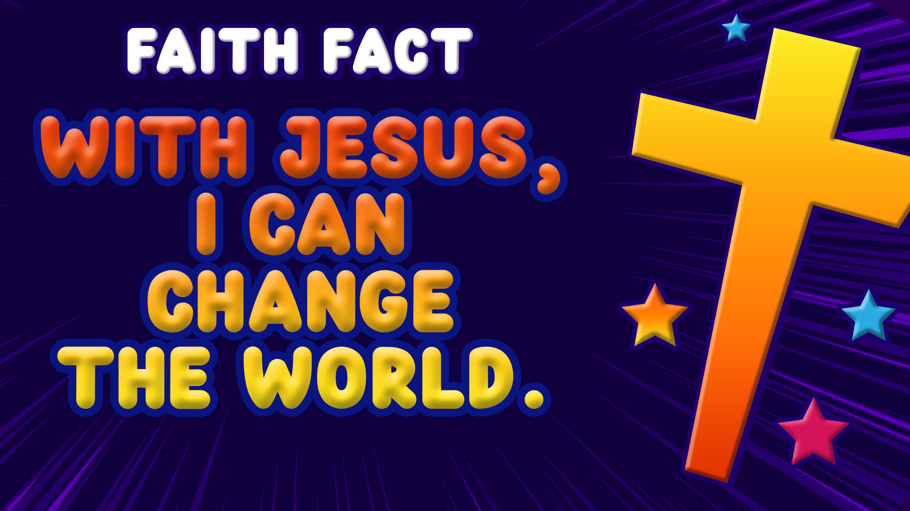
Today, we are going to hear that Jesus wants us to help spread the good news about Him all over the world. Wherever we go, we should tell people about Jesus every chance we get. Today, we are learning that: With Jesus, I can change the world.

Slide 4
We have learned so much over the last couple of sessions about the last few days of Jesus’ life here on earth. Do you remember the Last Supper when Jesus washed His disciples’ feet? Then, we heard about Jesus dying on the Cross and coming back to life, which is the Resurrection.

Slide 5
Today we will be talking about what happened after Jesus was resurrected. We will be in two Bible books today, Acts and Matthew. We’re going to start with Acts 1:3. Acts is the fifth book in the New Testament.

Slide 6
After His resurrection, what kinds of things do you think Jesus talked about with His disciples? (Allow responses.) Do you think they just talked about their sandals or what they bought in the market that day? (Group response) No, Jesus talked to His followers about how they were going to change the world. Look what Jesus told them.

Slide 7
³ After his suffering, he presented himself to them and gave many convincing proofs that he was alive. He appeared to them over a period of forty days and spoke about the kingdom of God.
Acts1:3

Slide 8
Now let’s read Matthew 28:19. Matthew is the very first book in the New Testament. Let’s see what Jesus said.
¹⁹ Therefore go and make disciples of all nations, baptizing them in the name of the Father and of the Son and of the Holy Spirit.

Slide 9
We often call this command of Jesus the Great Commission. Jesus told His disciples to do three things. Everyone hold up your pointer finger. (Pause for kids to hold up a pointer finger.) First, Jesus told them to go and make disciples. He wanted them to tell others the good news about Him so those people could have a relationship with Him and receive God’s forgiveness for their sins.

Slide 10
Now, hold up two fingers. (Pause for kids to hold up two fingers.) Next, they were to baptize the new disciples. Water baptism is a symbol to announce to the world their commitment to God.

Slide 11
Finally, let’s hold up three fingers. (Pause for kids to hold up three fingers.) Then, Jesus told them to teach others what they had been taught. Part of being a disciple is learning about God. This is why we read our Bible and go to church. Another part of being a disciple is telling others what we have learned.

Slide 12
Well, that seems like kind of a hard thing. I mean these were the disciples who ran away from Jesus’ side when He was arrested. How were they ever going to do what Jesus wanted? It’s a good thing that God’s plans are greater than ours. Now we’re going to jump back over to the Book of Acts.

Slide 13
⁴ On one occasion, while he was eating with them, he gave them this command: “Do not leave Jerusalem, but wait for the gift my Father promised, which you have heard me speak about. ⁵ For John baptized with water, but in a few days you will be baptized with the Holy Spirit.”
Acts1:4-5

Slide 14
Jesus told them that there would also be another kind of baptism. The disciples had seen Jesus being baptized in water. Now, Jesus said there was going to be another different baptism. Let’s read more about the coming of the Holy Spirit.

Slide 15
⁸ But you will receive power when the Holy Spirit comes on you, and you will be my witnesses in Jerusalem, and in all Judea and Samaria, and to the ends of the earth.
Acts 1:8

Slide 16
This is a really important verse. I know that God’s Holy Spirit comforts me and gives me peace. I know the Holy Spirit gives me wisdom. In the Old Testament, the Holy Spirit would help some people to do great things. Here, Jesus is saying that the Holy Spirit is going to give His followers power to be witnesses. They are going to receive a boldness to tell others about Jesus.

Slide 17
He takes it a step farther. It isn’t just about telling the people around you about Jesus. He wants to use us to change the world. He told them to share with the people in Jerusalem, the town they were in, and in Judea, the country they lived in. Then, they were to share in Samaria, which was the neighboring country. Then, Jesus told them to keep going and to go and tell the whole world.

Slide 18
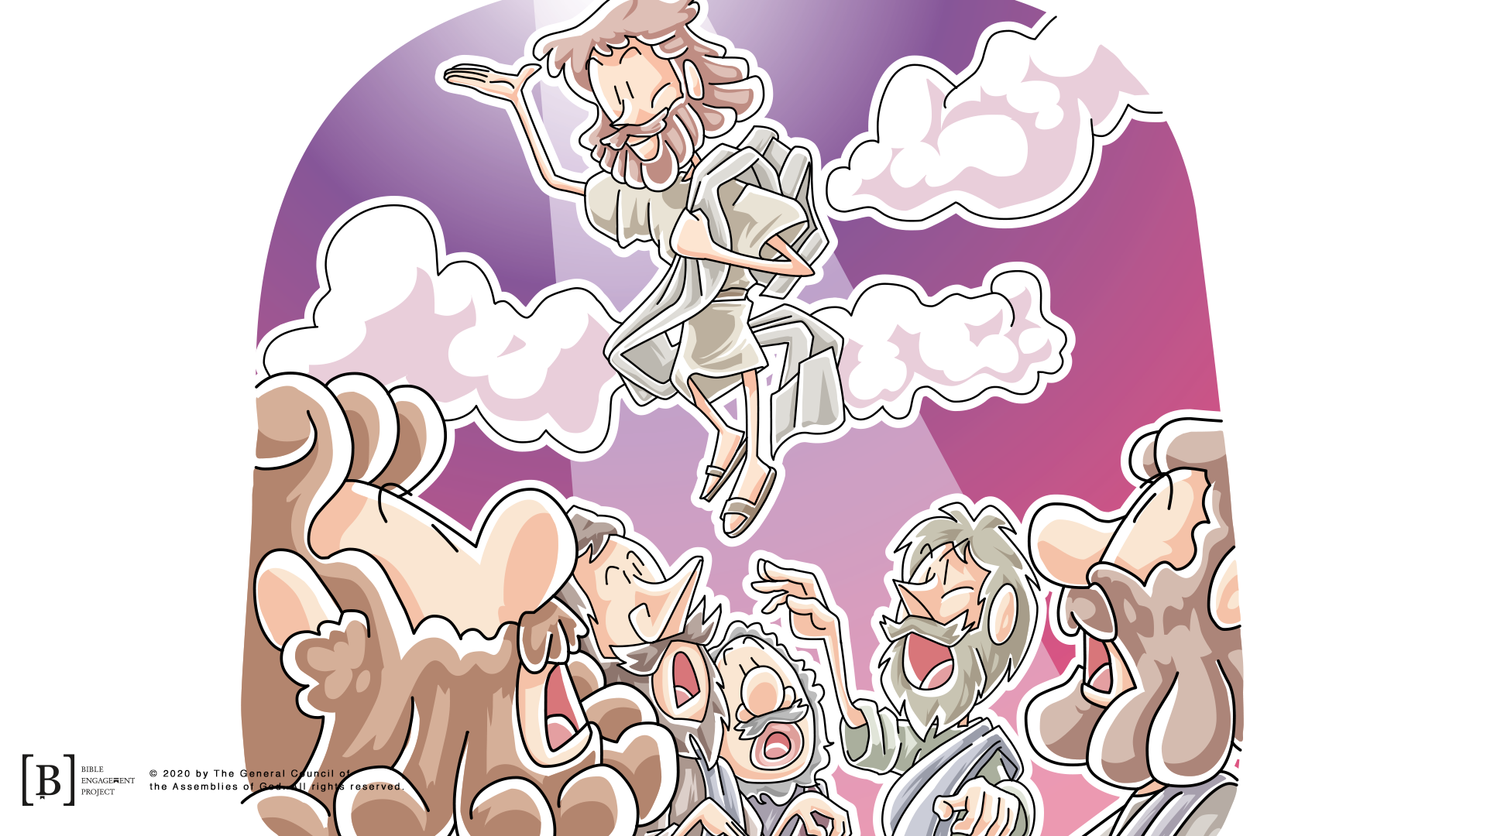
Immediately after He said this, Jesus ascended into heaven. He went into the sky right in front of them. Two angels appeared and told the disciples that Jesus would come back the same way that He had left.

Slide 19
Jesus will return some day! Until He does, we have a job to do and a world that needs to hear the good news about Jesus. Matthew 28:19–20 is what we call the Great Commission. Jesus told us to share the good news and make disciples of people not only right around us but also all over the world. We do this best with the power of the Holy Spirit that Jesus offered to us. Just like our Faith Fact says, With Jesus, I can change the world.

