Slide 1
Today I’m excited because we will be focusing on a very important person from the Bible. In fact, He is the most important person who was born into this world. Can you guess who I might be talking about? (Allow responses.) That’s right! That person is Jesus. We are going back to the beginning of the story of Jesus’ time on earth. This happened even before He was born.

Slide 2
We will be taking a look at the promise God made to Joseph that Mary would have a very special baby. We will see how that promise of that gift was confirmed by another guy who knew God very well.

Slide 3
God made many promises to us in His Word, but the promise to send the gift of Jesus was one of the most important. Who knows why it was so important for Jesus to come to earth? (Allow responses.) He came so we could have a relationship with God by having our sins forgiven.

Slide 4

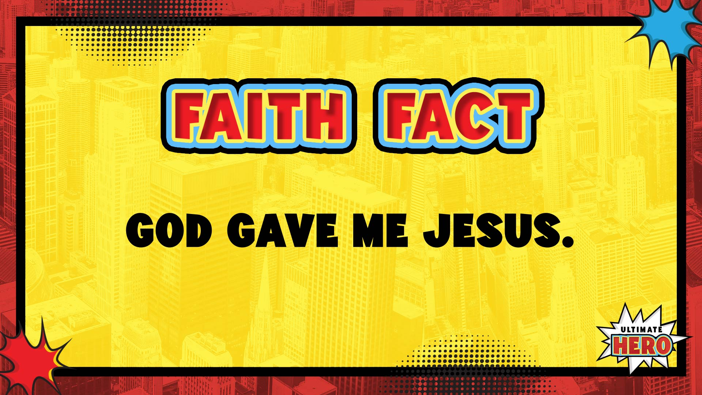
That’s why our Faith Fact is so important. It tells us that God kept His promise to us. Today’s Faith Fact is God gave me Jesus.
Let’s say the Faith Fact one more time as loudly as possible! God gave me Jesus. Great job! Now let’s get into our bible story.

Slide 5
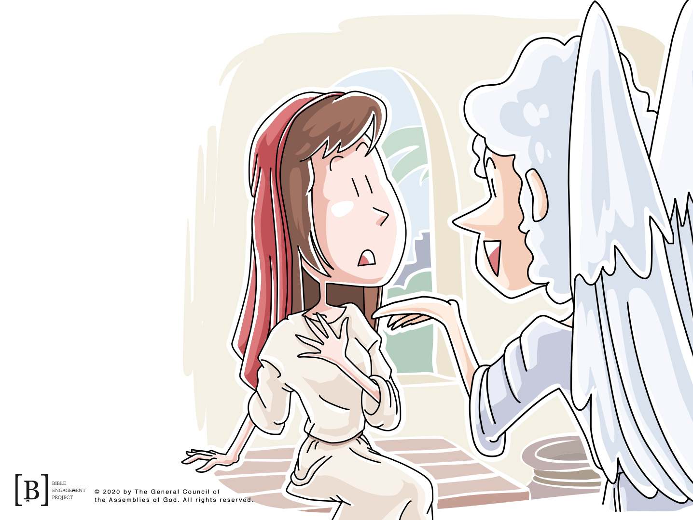
One day, an angel appeared to a young woman named Mary with special news. Mary was a regular girl in the small town of Nazareth. She was about to be married to Joseph, but her life was turned upside down by the angel’s news that she would become pregnant with a baby boy. The Baby would be the gift that everyone was waiting for.

Slide 6
When Joseph heard this news, he was confused and scared about what people would think. He started making plans to cancel their wedding. Joseph didn’t realize that Mary’s child would be a special and very important baby. As Joseph thought about what he might do, something amazing happened. Let’s read to find out more!

Slide 7
Matthew 1:20-23
²⁰ But after he had considered this, an angel of the Lord appeared to him in a dream and said, “Joseph son of David, do not be afraid to take Mary home as your wife, because what is conceived in her is from the Holy Spirit. ²¹ She will give birth to a son, and you are to give him the name Jesus, because he will save his people from their sins.”
²² All this took place to fulfill what the Lord had said through the prophet: ²³ “The virgin will conceive and give birth to a son, and they will call him Immanuel” (which means “God with us”).

Slide 8
Can you imagine how Joseph might have felt? Make the expression with your face you would have had if you were Joseph. (Allow kids to make their expression.) He must have been scared, shocked, and amazed all at the same time! The little Baby, growing inside Mary, was the fulfillment or answer for prophecies that had been made by the Old Testament prophets hundreds of years before.

Slide 9
As the story continued, Mary and Joseph had to travel to Bethlehem for a census to be counted by the Roman government. While there, it was time for the baby to be born. Jesus spent His first night sleeping in a manger, which is a trough (A long shallow container that the animals would have eaten from).

Slide 10

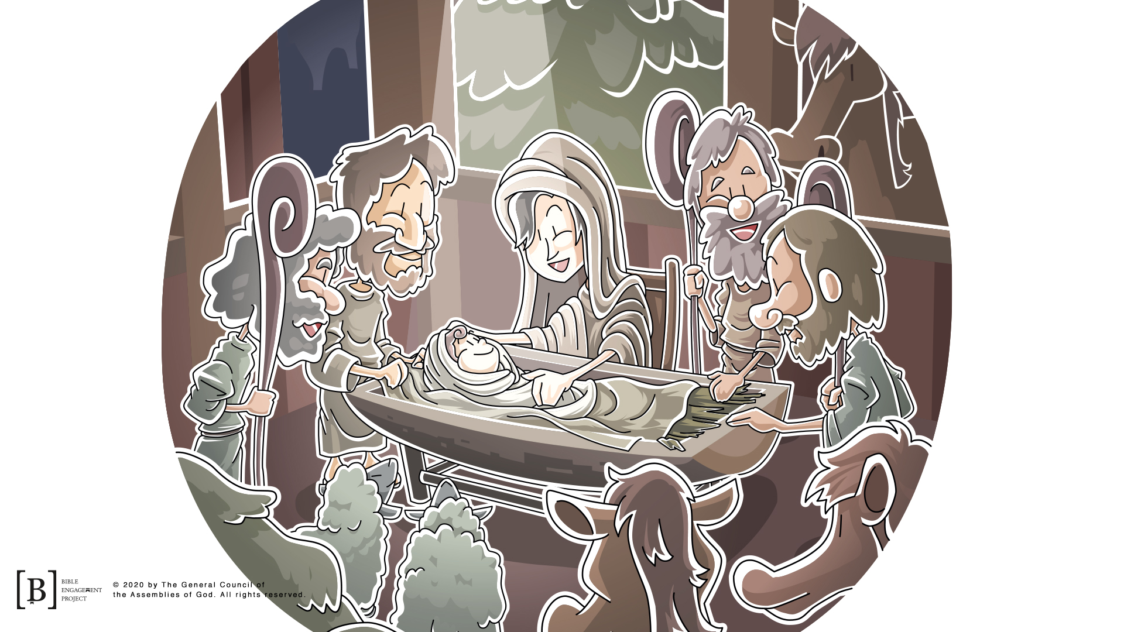
Later Angels appeared to some shepherds and told them that the Savior was born. The shepherds immediately visited Jesus to see God’s special gift.

Slide 11
Let’s fast-forward to a few days after Jesus was born.
Luke 2:27-32
²⁷ Moved by the Spirit, he went into the temple courts. When the parents brought in the child Jesus to do for him what the custom of the Law required, ²⁸ Simeon took him in his arms and praised God, saying:
²⁹ “Sovereign Lord, as you have promised,
you may now dismiss your servant in peace.
³⁰ For my eyes have seen your salvation,
³¹ which you have prepared in the sight of all nations:
³² a light for revelation to the Gentiles,
and the glory of your people Israel.”

Slide 12
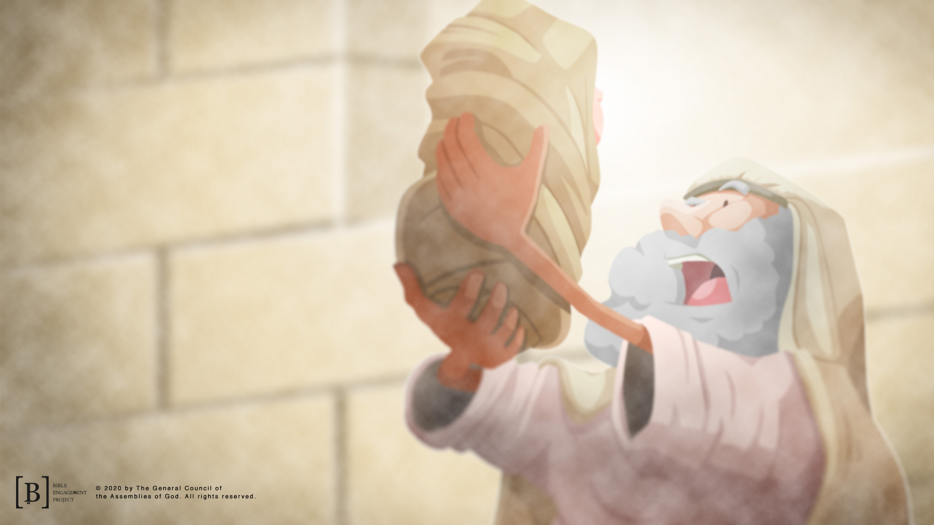
In these verses, we read about a man named Simeon. He was a very old and devoted follower of God. He had waited his whole life to meet the promised Messiah. The Holy Spirit had told Simeon that he would not die until he had seen the Messiah. That’s a pretty cool promise!

Slide 13
God kept His promise to Simeon! God told Simeon that he would have a chance to meet the Messiah before he died, and God revealed to Simeon that Jesus was the Messiah he had been waiting for.

Slide 14
It’s so cool to see that God made those promises to Mary and Joseph, and Simeon and that He came through for them. Those are just two of the many promises God made that can be found in the Bible. God gave many prophecies through the Old Testament prophets that were fulfilled through Jesus’ life on earth. The same God who made those promises in the Bible and kept them is the same God we worship today.

Slide 15
The promises of God found in His Word were not just for the people in the Bible; they are for all of us as well. That’s why our Faith Fact is God gave me Jesus. Jesus came to help you and me. We can have a relationship with Him, and He can help us just like He helped others in the Bible.

Slide 16
Let’s take some time right now to thank God for His gift and promises. If God had not kept His promise of sending the gift of Jesus, our life and future would be very different. When Jesus grew up and eventually died on a cross, He took the punishment for all our sins. Because He was willing to die, we have the opportunity to live forever with Him. If you haven’t done so, take a moment to ask Jesus to come into your life and forgive your sins right now. Don’t let God’s promise and Jesus’ sacrifice go to waste!

Slide 17
LET’S PRAY!

