Slide 1


Welcome! I’m so glad you are here! Today, we are going to talk about when God created the world, and how He had a plan for how people were/are to live. Do you think He wanted people to be kind to each other? Do you think He wanted people to obey Him? Do you think everyone did obey God? (Group response)

Slide 2
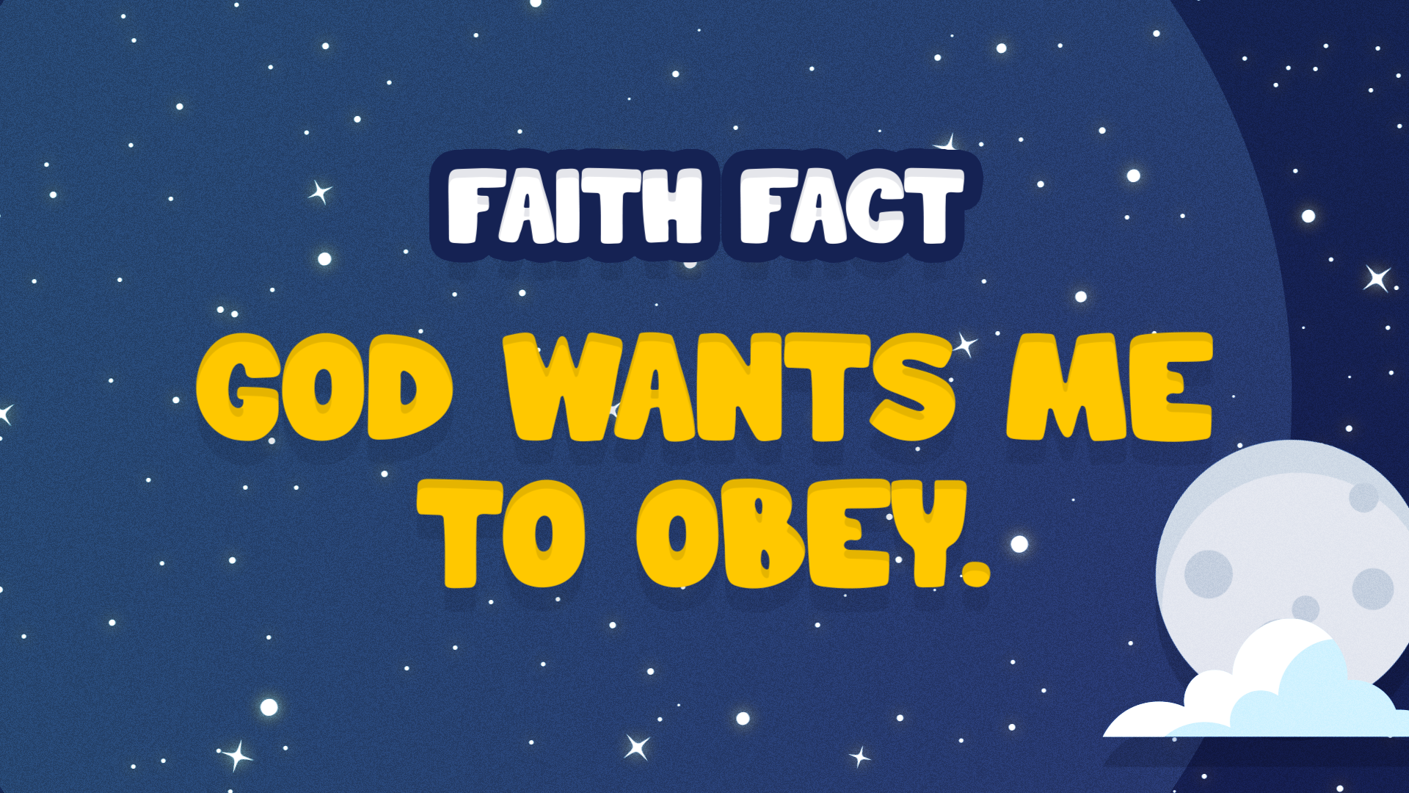
let’s take a look at our Faith Fact and say it all together. God wants me to obey.
One more time! 1, 2, 3. God wants me to obey. Great job!

Slide 3
In the time of Noah, wicked and terrible people who only thought about doing evil, were everywhere. God saw this, and He decided to do something about it. Let’s read Genesis 6:7.

Slide 4
⁷ So the Lord said, “I will wipe from the face of the earth the human race I have created—and with them the animals, the birds and the creatures that move along the ground—for I regret that I have made them.”
Genesis 6:7

Slide 5
How do you think God felt? (Group response) The whole earth made God so sad He decided to start again. Thankfully, there is one thing that made God pause. Let’s read Genesis 6:8: “Noah found favor with the Lord.”

Slide 6
We should be very thankful for Noah. God gave Noah instructions and said, “I am going to destroy the earth with a flood, so you need to build a boat. Everyone and everything on the boat will be saved.”

Slide 7
Do you think Noah obeyed God? (Group response) He sure did. Noah was well over five hundred years old when he started and he probably worked on the ark for about seventy-five years! God told Noah to use cypress wood to make the ark. It was longer and wider than a football field, and taller than the goalposts.

Slide 8
God also told Noah to leave a space for a window near the roof and to put a door on the side. There were three decks, a lower, middle, and upper. The inside of the ark could hold as much as 450 semitrucks can hold. Wow!

Slide 9
God promised to keep Noah and his family safe and told him to bring a male and female pair of every type of bird, animal, and creature that crawls on the ground into the boat. God told Noah to take enough food and keep the animals safe.

Slide 10
When Noah was six hundred years old, God told him it was time to go into the ark with his family and the animals. The door was still open. It was too big for Noah to close! Imagine a door that doubled as a ramp into the boat. It would need to be tall enough to allow giraffes to walk in, but strong and heavy enough to allow elephants to walk on it without breaking. The door was heavy!
Noah didn’t close the door. He built the whole boat to God’s specifications and yet, he didn’t close the door. God sealed up the door. Then it rained for forty days and forty nights, and the earth was flooded.

Slide 11
When the rain stopped, Noah, his family, and the animals couldn’t get off the boat. There was no land in sight. They had to stay on the boat for close to ONE year.
When the land finally dried up, and Noah and his family could get off the ark. God then promised that He would never punish people by destroying the earth with water again. And He gave us a very special sign of that promise. Do you know what it is?
(rainbow)
Have you seen a rainbow in the sky after it rained? (Group response)

Slide 12

Whenever you see that rainbow, it’s a reminder of the promise God made and the fact that He always keeps His promises.

Slide 13
Satan tried to disrupt God’s plan by encouraging people to disobey God and be as evil as possible. He tried to ruin God’s ultimate plan to send Jesus into the world. But God would not allow that to happen. God judged and punished the wicked people for their evil acts.

Slide 14
And just like in Noah’s time, people (you and me) today still sin and disobey God’s word. When we disobey God’s word and sin, it separates us from God and the wages (payment) for that sin is death (separation from God in eternity)

Slide 15
But God has an amazing plan for us. God’s plan was that Jesus would come to earth and take that punishment on Himself. Jesus died on a cross for your sin and mine. He was not guilty, but we are! Jesus died in our place. After three days, He came back to life. Jesus, the Savior of the world, is alive and wants you in God’s family.

Slide 16
Let’s Pray!

