Slide 1
Today we’re going to talk about Adam and Eve and how they made a huge mistake. They sinned by doing something God told them not to do. We’re going to learn what God thinks of those mistakes—big ones and small ones. We all make mistakes too. We all sin.

Slide 2
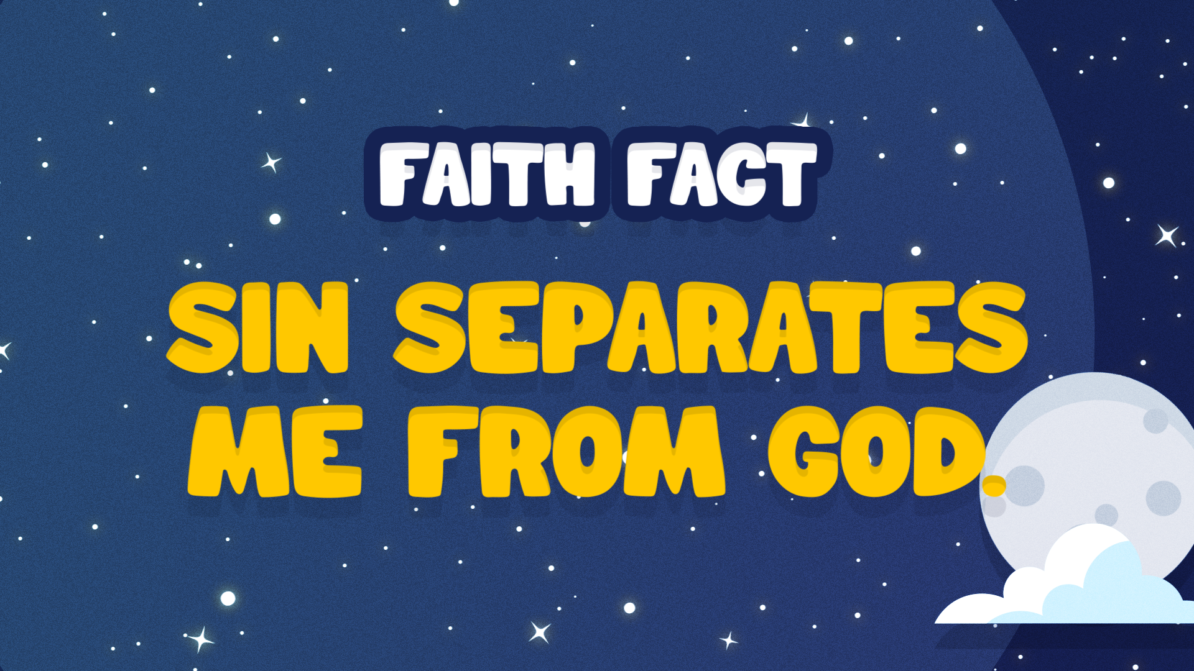

Slide 3
God told Adam and Eve that they were in charge of the whole world. God gave them jobs to do and told them that the whole world was made for them to enjoy. They could ride a giraffe and cuddle with a lion. It was perfection. They could eat from almost every tree, and the fruit was ripe and wonderful. God walked with them every day in the Garden. They lived in a close relationship with God.

Slide 4
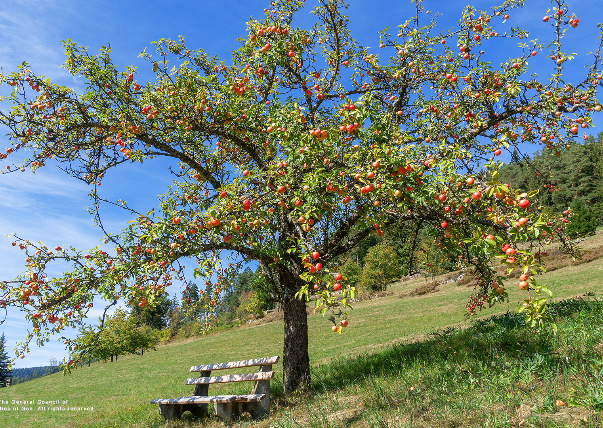
There was one very important rule. God told them that they could eat from any tree, except for one. It was called the tree of the knowledge of good and evil. It was placed in the middle of the Garden. God told them that if they ate from it, they would die.

Slide 5
One day, Eve was hanging out near the tree. This is where we meet a new character in the Bible—someone who means to do harm to people, to us, someone who wants us to live apart from God. It’s the devil, Satan.

Slide 6
Satan curled up like a snake in the tree. He began to talk with Eve and encouraged her to eat from the tree. He told her that God didn’t want her to know the truth. If she ate from the tree, she would become like God, knowing the difference between good and evil.

Slide 7
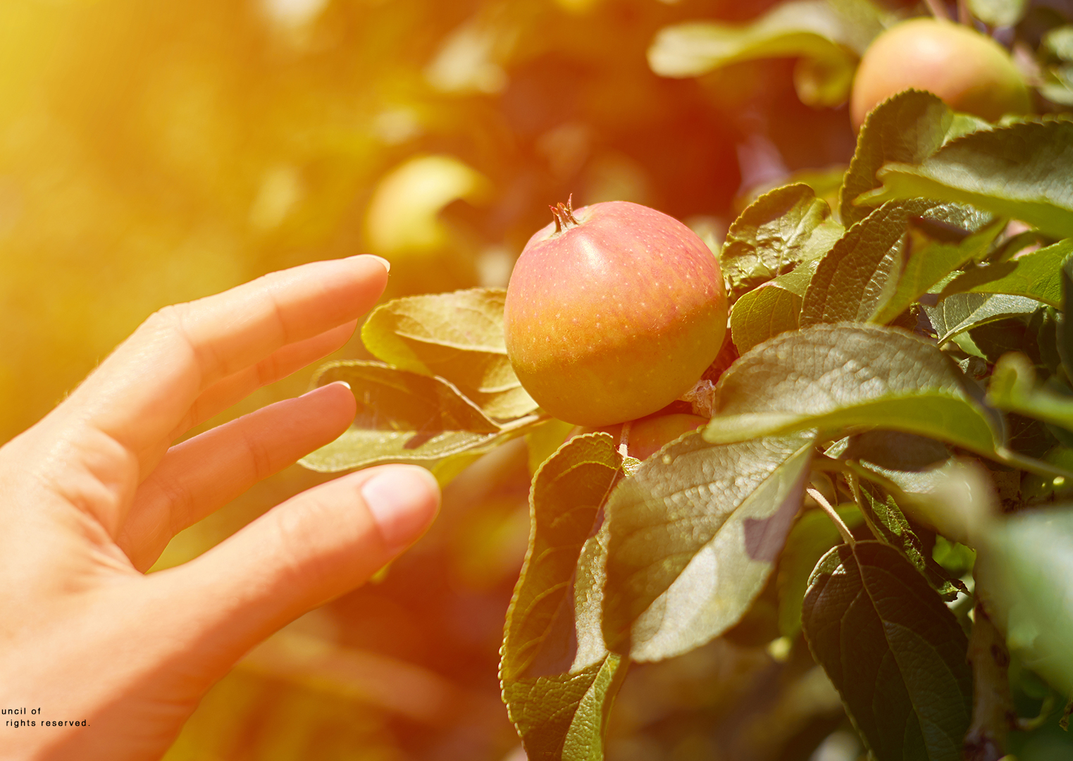
Eve thought the fruit looked really good, so she took some and ate it. Do you know what she did next?

Slide 8
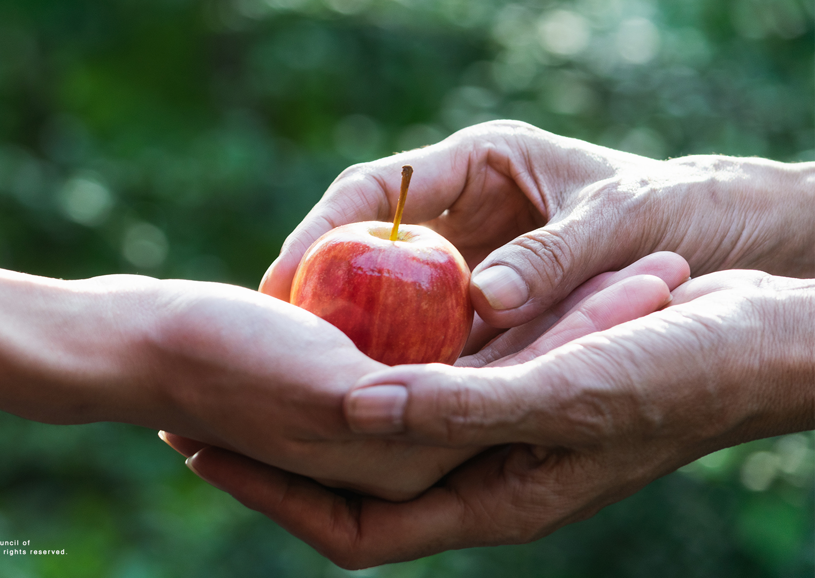
She gave some to her husband, Adam. Do you know what he did?

Slide 9
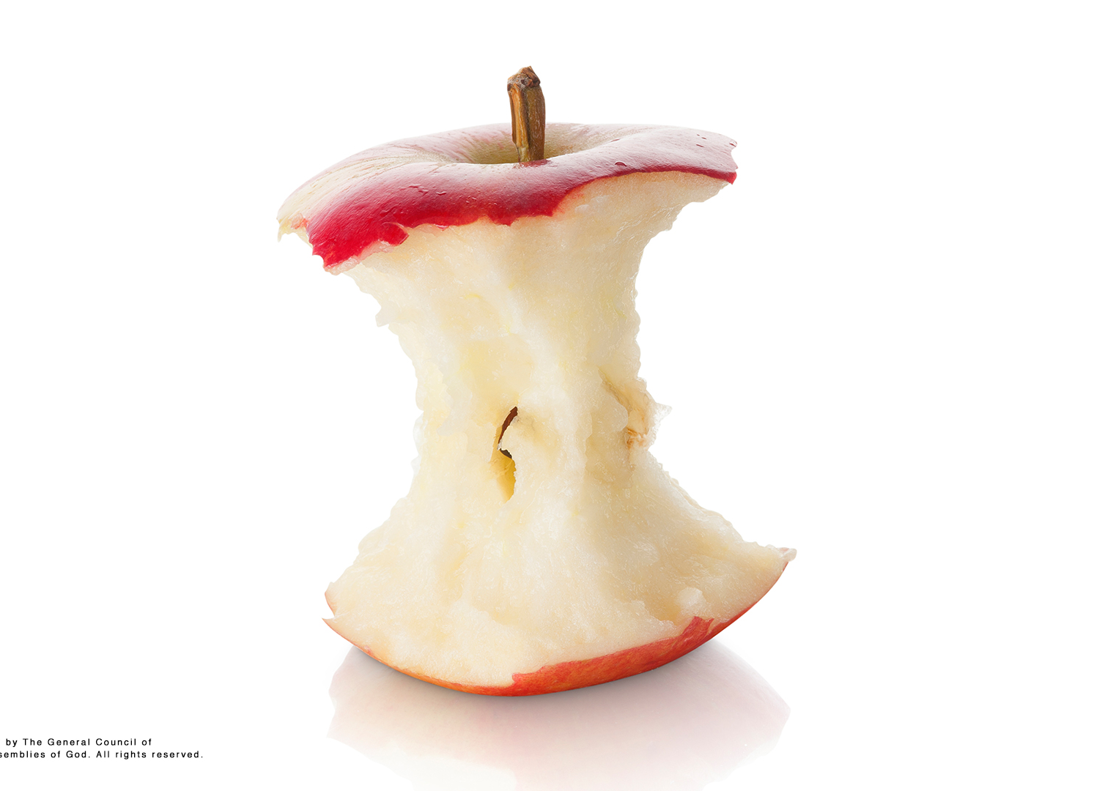
He ate the fruit too.

Slide 10
At that moment, they started to feel bad about themselves. Now they could see the difference between good and evil. They could see that God was good and that what they had done was not good. They felt so bad that they even tried to hide from God. He is perfect and holy, and their sin had separated Adam and Eve from Him.

Slide 11
Imagine trying to throw the paper into the bucket every minute of every day of your life. If you lived to be one hundred years old, you would throw 52,560,000 paper balls. Would you hit the basket every time? No, you’d miss eventually. What if the consequence or penalty for missing the mark of perfection was that we would die? That’s pressure! However, the outcome wouldn’t change. We would still miss.

Slide 12
But God never misses. He is perfect. Because we aren’t perfect, we are like all these pieces of paper on the ground around the target. When Adam and Eve chose to eat the fruit, they missed the mark of God’s perfection. The Bible calls that sin. Sin is knowing the right thing to do and choosing to do the wrong thing anyway. It’s not an accident or mistake like spilling your chocolate milk. Sin is when we know what we shouldn’t do and choose to do it anyway.

Slide 13
Adam and Eve ate the fruit. We may choose to lie to our parents or cheat on homework. At one time, we have all chosen to do the wrong thing.

Slide 14
God is holy, which means that He is perfect. Because He is holy, our sin keeps us from being close to Him. What’s our Faith Fact? Sin separates me from God. God is the source of all life and to be separated from life is death. The punishment for our sin is death.

Slide 15
God doesn’t want us to be separated from Him, so He had a plan in place to save us. We are His children, made by His hands. Because the punishment for sin is death, God put a plan in place so that we could be reunited with Him as a part of His family.

Slide 16
The plan was in place even before God created the world. In Genesis 3:15, God gave us a hint that He would send His only Son, Jesus, to earth. While Jesus was here, He showed us God’s love and care. He showed us that God wants to be close to us. Jesus showed us that God wants us to be part of His family. This was promised back in the very beginning.

Slide 17
While sin separates us, God made us to be in relationship with Him. God wants us to know Him and love Him the way He knows and loves us.

Slide 18
Let’s Pray!

