Slide 1
Today, we’re going to explore why the world and everything in it was made. And that includes us! In fact, our Faith Fact today is God is my Creator. Can you say that with me on the count of 3? 1, 2, 3. (God is my Creator.)

Slide 2
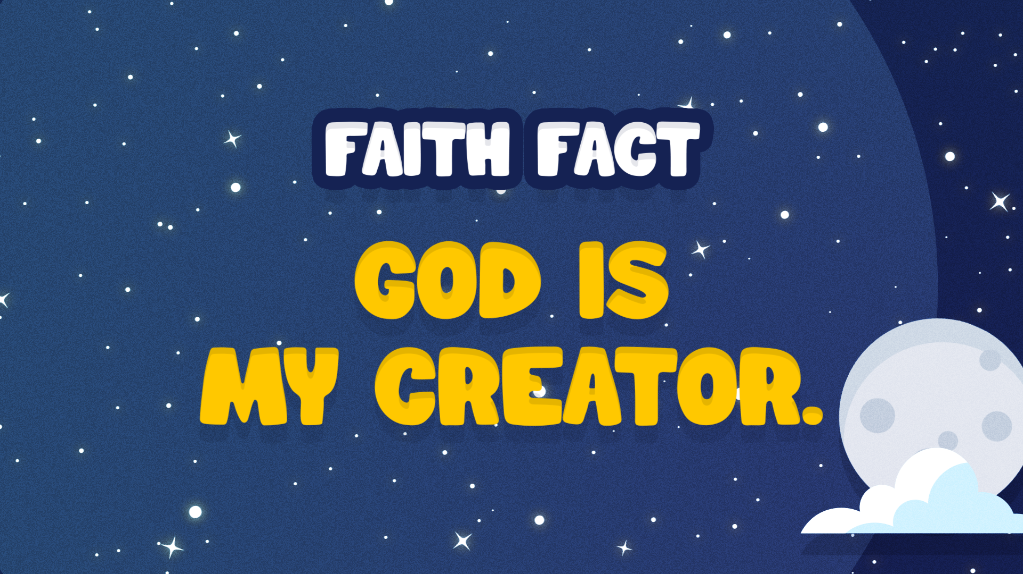

Slide 3
¹ In the beginning God created the heavens and the earth. ² The earth was formless and void, darkness was over the surface of the deep, and the spirit of God was moving over the surface of the water.
Genesis 1:1-2

Slide 4
Everyone, close your eyes. Can you see anything?

Slide 5
The Bible says the world was dark and shapeless. God’s Spirit was moving over the waters. Imagine if we had been there. We probably couldn’t see God’s Spirit, but maybe we can see the imprint of His presence, a gentle wind, or the waters rippling in response.
Keep your eyes closed for a little longer. Here’s what happened next. God spoke and said, “Let there be . . .” Does anyone know what He made? Shout it out. (light)

Slide 6

Light! Open your eyes! Just
like you immediately saw
light when you opened
your eyes, there was light
then too. God called the
light, “Day” and the
darkness, “Night.” Then, do
you know what God said?
He said that it was good.
That was the first day.

Slide 7
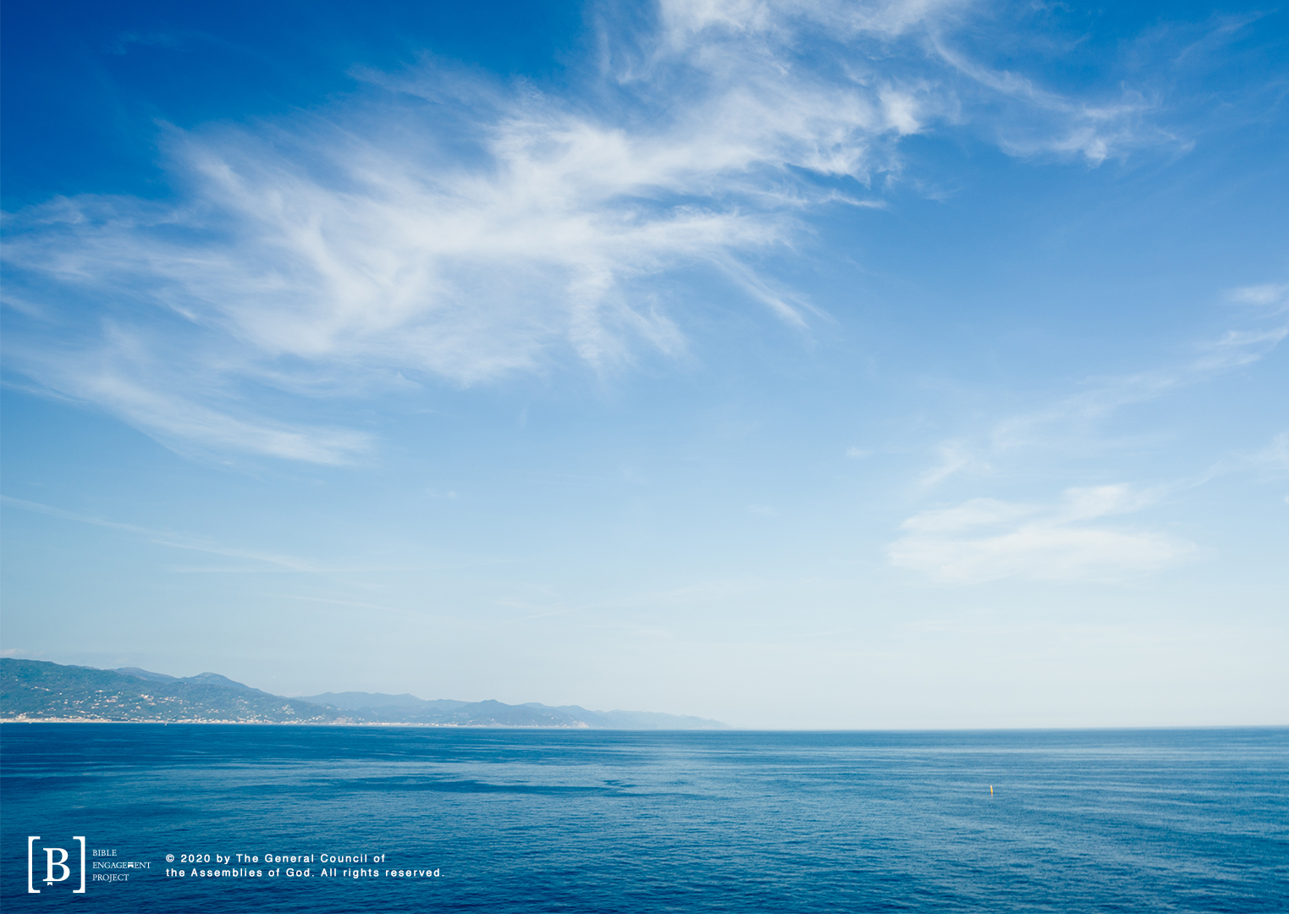
On the second day, God separated the waters in the heavens from the waters on the earth. He made the sky!

Slide 8
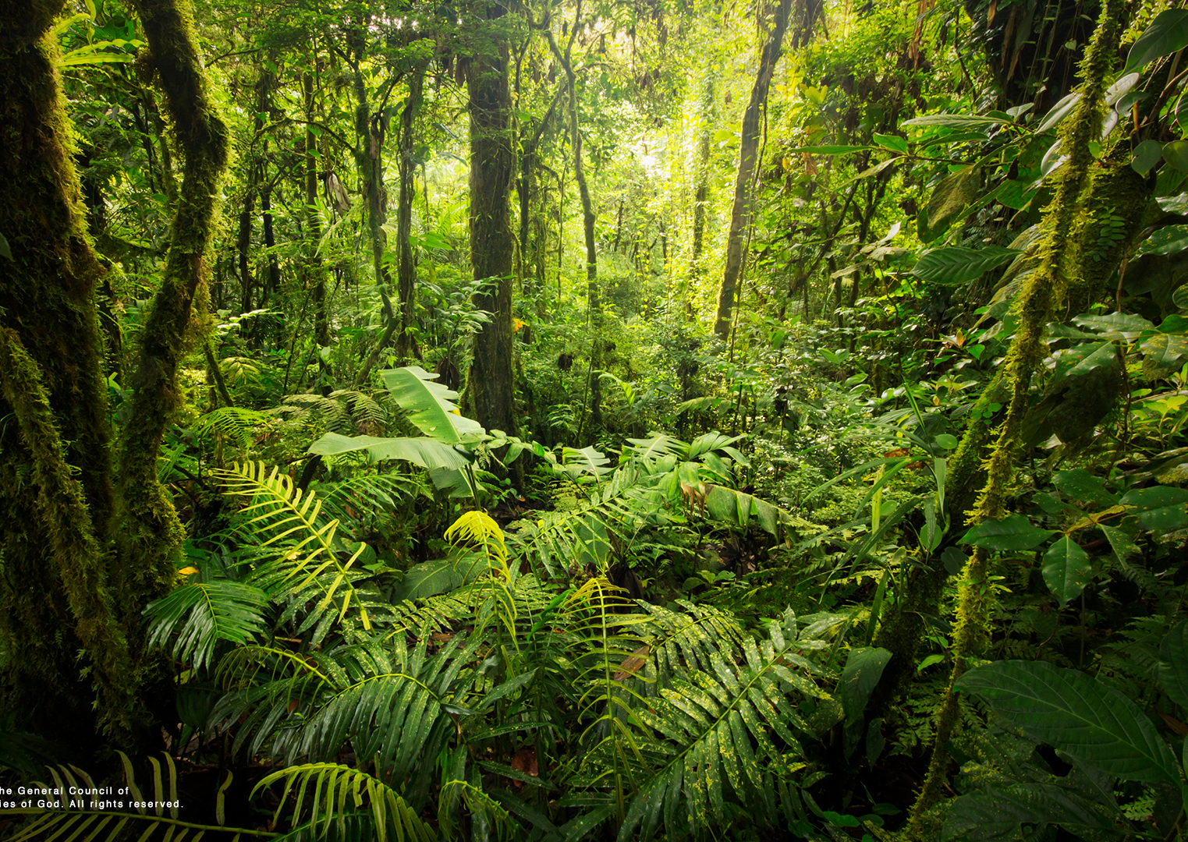
On the third day, God made land, trees, plants, and all sorts of vegetation. That’s a lot of stuff He made in those two days!

Slide 9
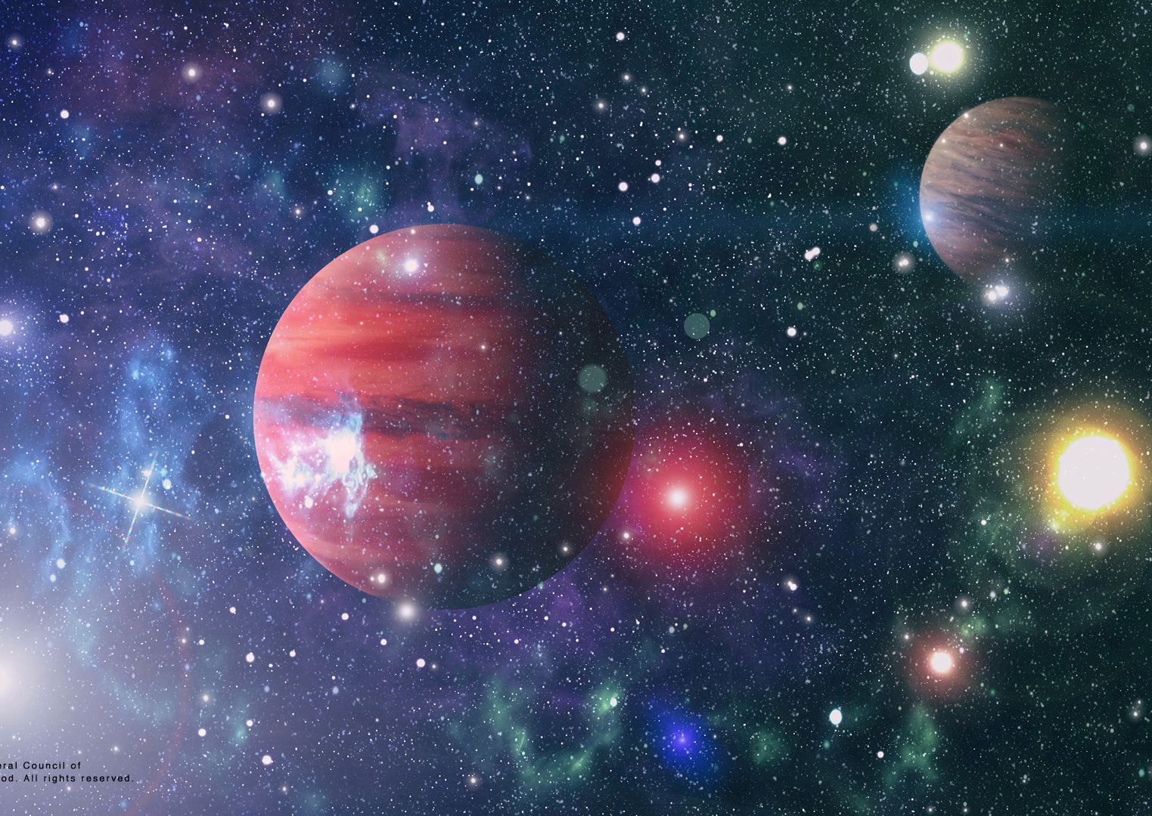
Remember that I said God made light before He made the sun, moon, and stars? Well, on the fourth day, God made all the stars in the universe. That means that He made our solar system on the fourth day. He made all the planets in our galaxy.

Slide 10
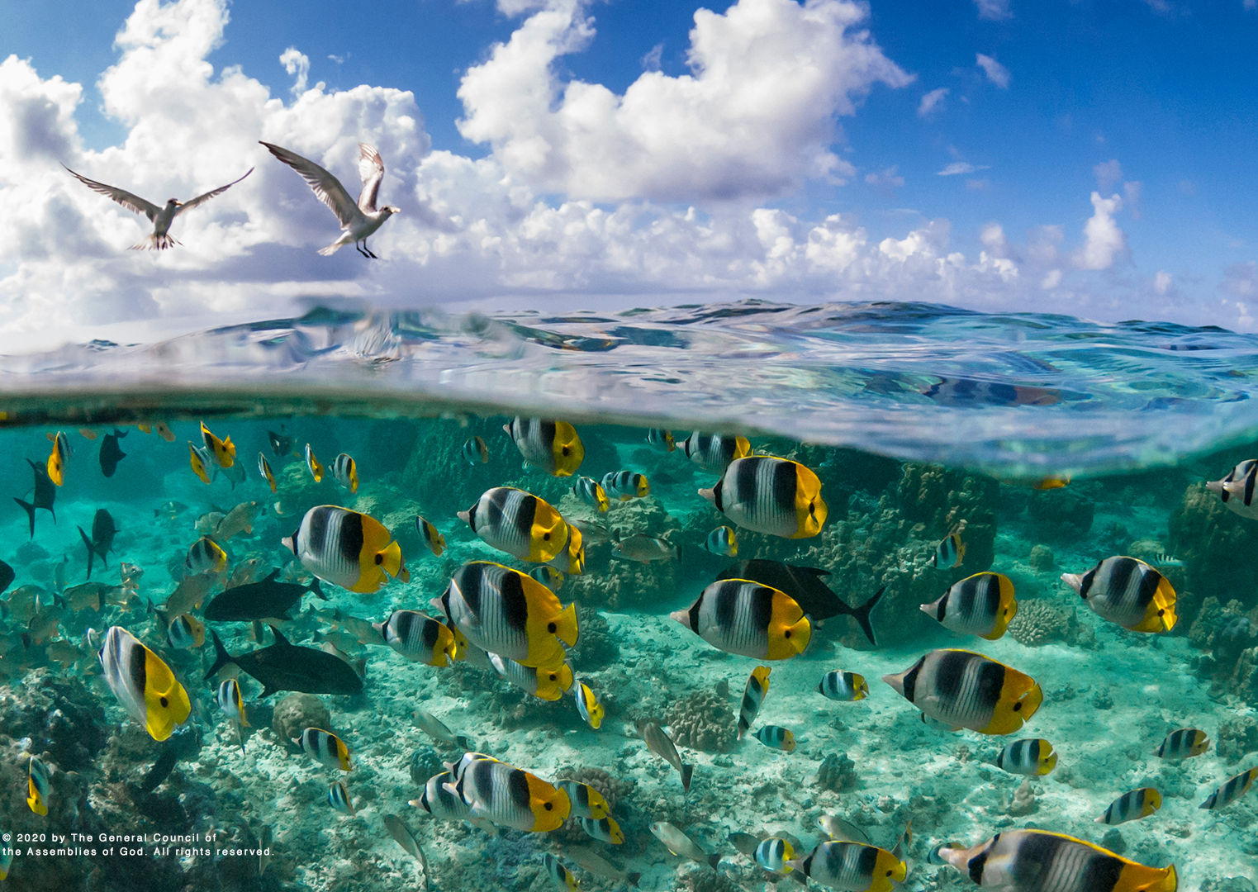
Let’s move forward one more day in creation. We find that God created the birds and sea creatures on the fifth day.

Slide 11
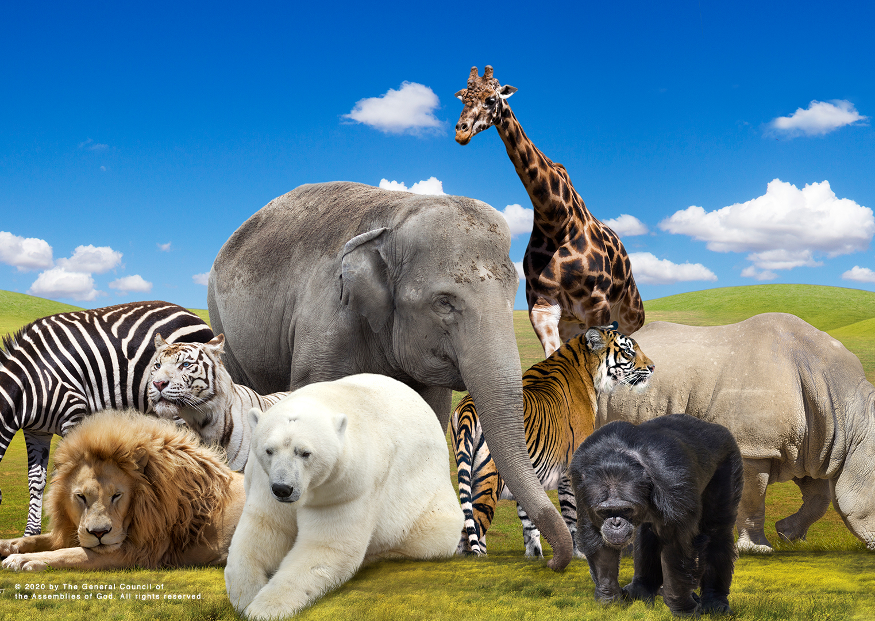
That doesn’t even count the animals on land yet! On the sixth day, God created animals to walk around on the earth.

Slide 12
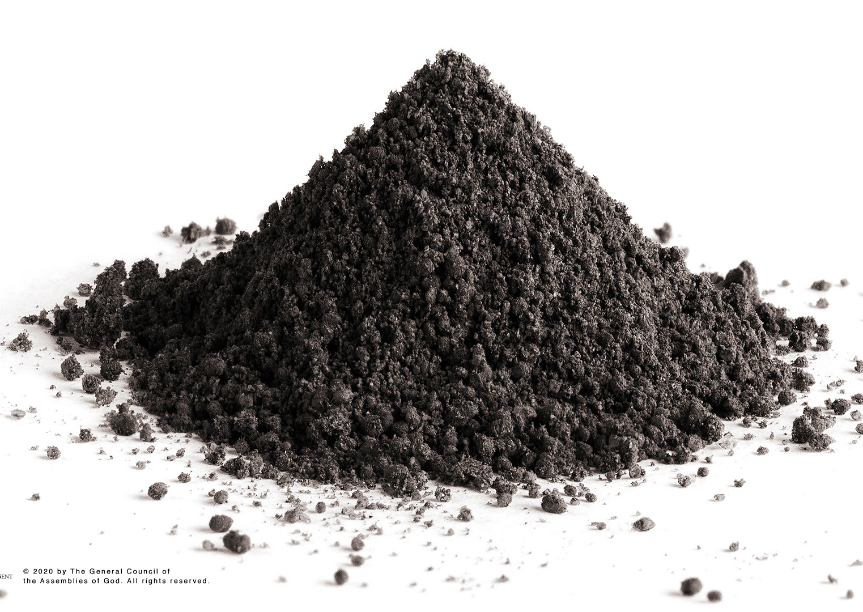
On the sixth day, God also made human beings.
He formed dust together. Then He made the first person with His hands. Carefully, He shaped Adam out of the dust of the earth and breathed life into him. God made people to be like Him. God made us to have a spiritual nature. We can make choices. We can reflect the nature of God. Best of all, God wants us to know and love Him. Isn’t that amazing?

Slide 13
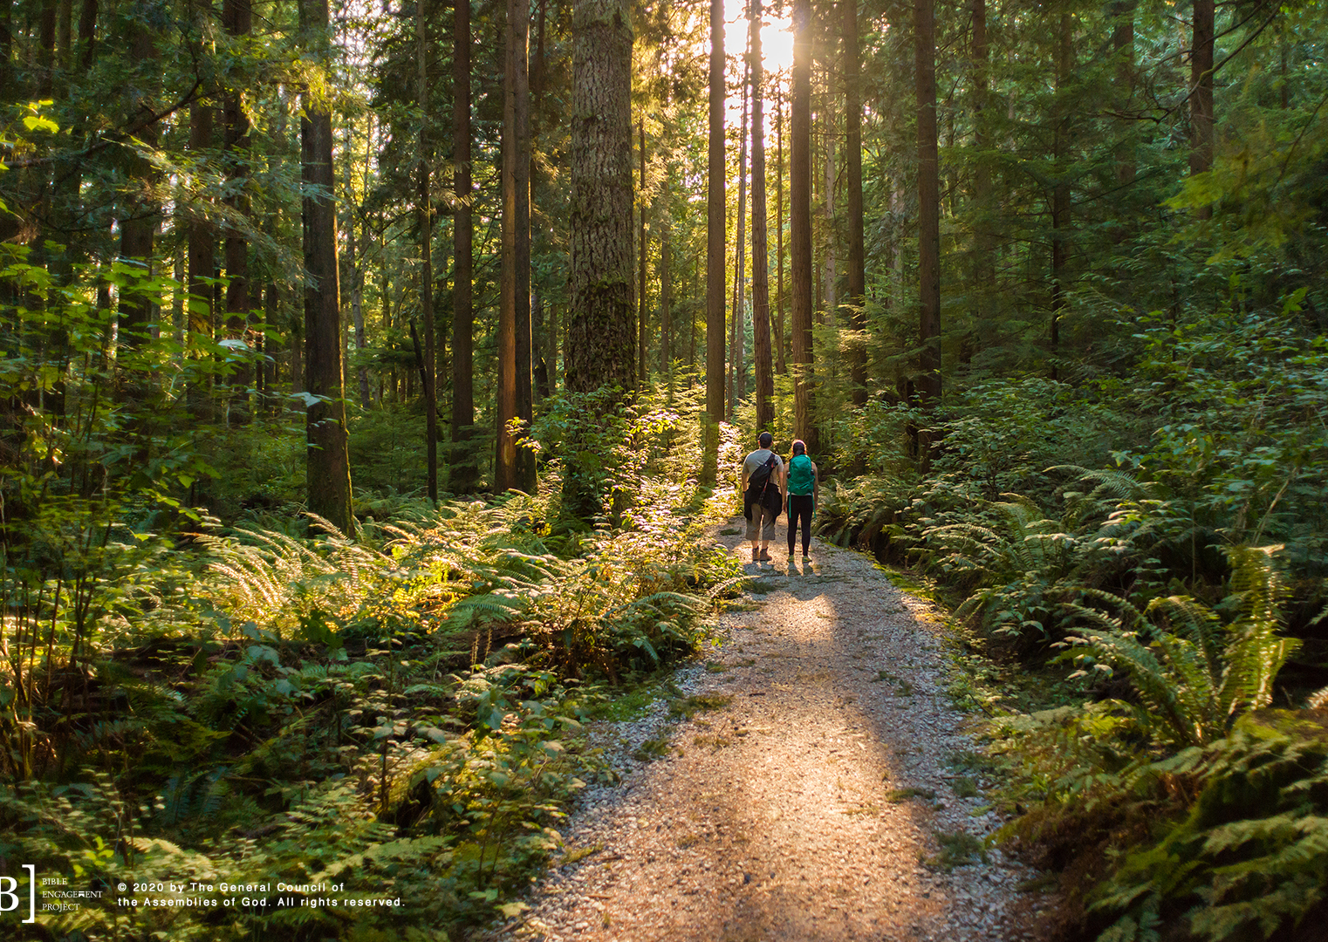
On the seventh day he rested.

Slide 14
God is incredibly large, astronomically powerful, and unbelievably creative. Nothing compares to Him! This same large, powerful, and creative God made you to be exactly the person you are! He made you to be like Him. Every single person who has ever been born was made on purpose!
Best of all, He wants us to be in relationship with Him. God wants us to know Him and love Him the way He knows and loves us.

Slide 15
Let’s Pray!

