Slide 1
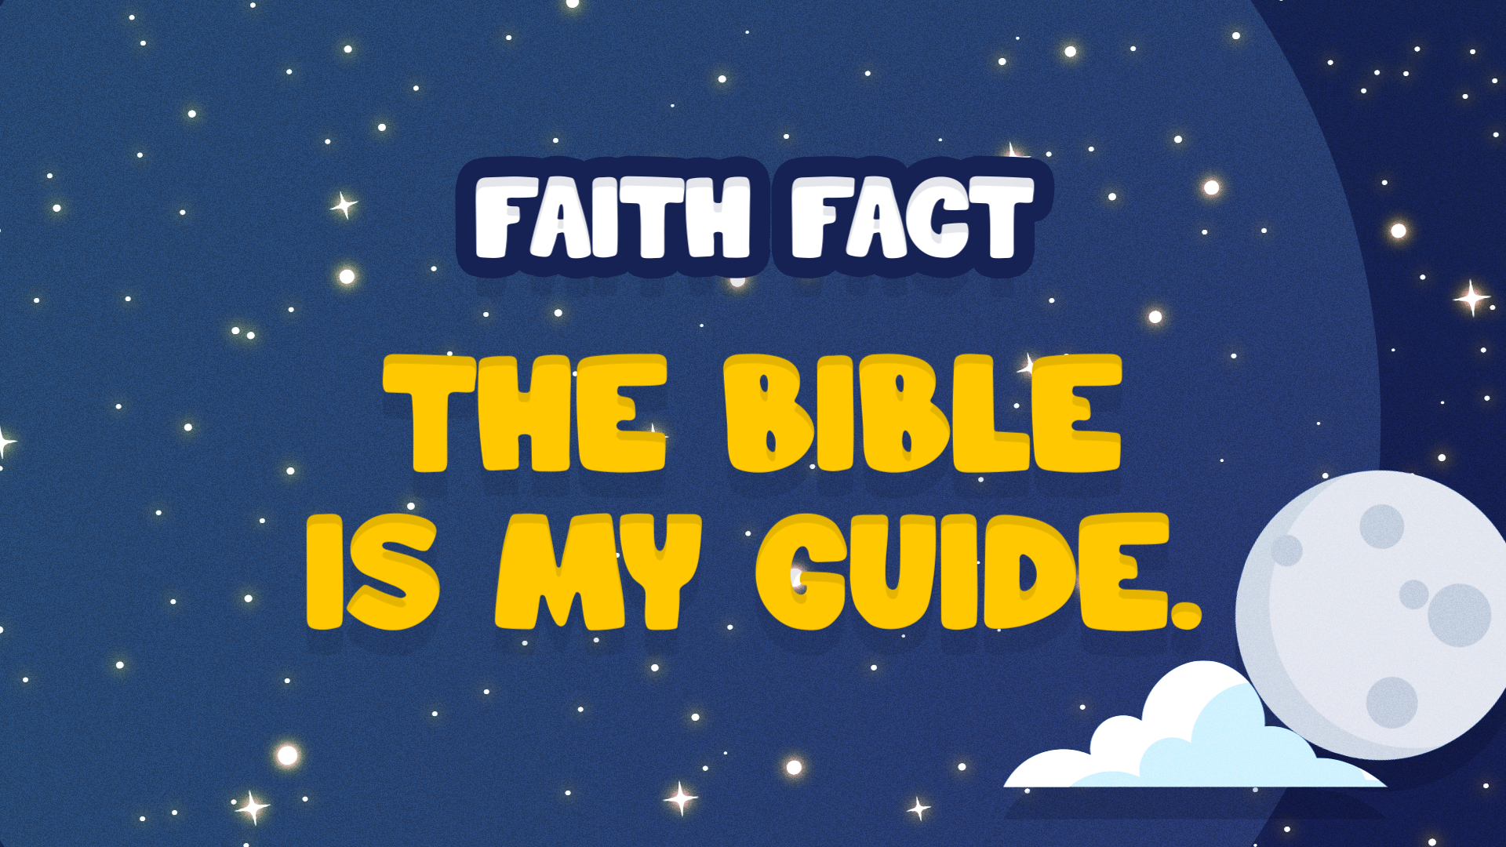

Slide 2
When we go on a trip, we can use a map, or we can use our phones. But there’s always a chance that we might put in the wrong address or run into traffic. The only sure way to get to where you are going is to have a professional guide. You ask someone who knows what to expect and exactly where to take you.

Slide 3
God knew that we would have questions as we grow up, and as we go through our everyday lives. God wanted to make sure that we would have the answers, that we would have a guide to keep us on the road to where He wants us to be. That’s why our Faith Verse is so important. It reminds us to know God’s Word, the Bible, so we can stay close to God.

Slide 4


Slide 5
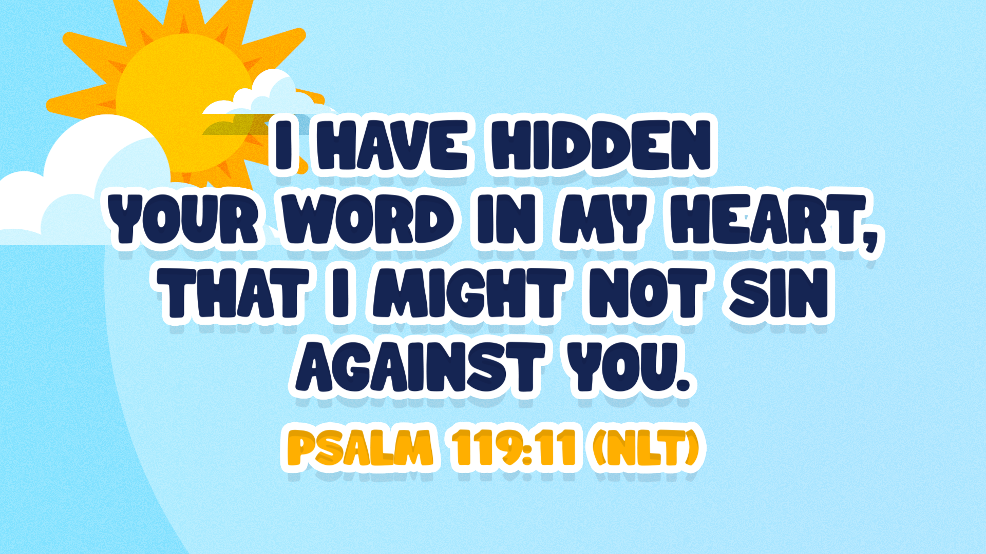

Slide 6
The greatest thing about knowing God’s Word is that it not only keeps us from doing wrong things, but it also shows us exactly how we can live for God. It teaches us the way He loves us, so that we can show others His love and teach them to follow the Bible. The Bible is my guide, and it can be yours too!

Slide 7
Here are a couple of other Bible verses that show us how Gods word is a guide for our lives.

Slide 8
"Your word is a lamp to my feet and a light to my path”
Psalm 119:105

Slide 9
This verse emphasizes the guiding and illuminating nature of God's word

Slide 10
"All Scripture is God-breathed and is useful for teaching, rebuking, correcting and training in righteousness.”
2 Timothy 3:16

Slide 11
This verse shows us that the Bible comes from God and helps us learn, grow, and make good choices in life

Slide 12
In closing, Let’s take a moment to focus on God and His love for us. He sent Jesus to live, die, and rise again for us. And He made sure the Bible was written so we’d never have to guess how much He loves us or how to live for Him. He did that just for you.

Slide 13
Let’s Pray!

