Slide 1


An advanced indoor air purification system that significantly reduces harmful airborne microorganisms.
The Zentox Pure Air system resolves more issues than other air purification devices.

Slide 2

Airborne Challenges
Ethylene
Viruses
  H1N1 Puerto Rico 8
  MRSA
  SARS-CoV-2
Mold and Mildew
Bacteria
Fungus
Volatile Organic Compounds
Downy Mildew
Mold Spores
Allergens
Terpenes
Mycobacterium

Slide 3
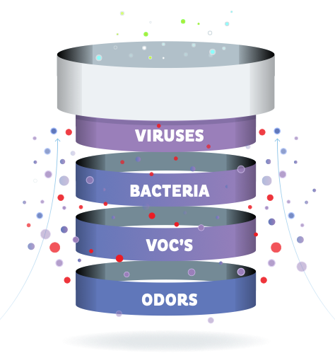
What’s in your air?
Zentox Pure Air™ effectively reduces airborne microorganisms and indoor air pollutants. The process, known as Photocatalytic Oxidation (PCO), renders live airborne substances inactive and therefore harmless without creating any hazardous waste.

Slide 4








































































How the technology works
S TEP
1
A fan delivers air through a fibrous glass media coated with fumed titanium dioxide and a proprietary blend of novel catalyst reaction materials.
TiO2
TiO2
TiO2
TiO2
TiO2
TiO2
TiO2
TiO2
TiO2
TiO2
TiO2
TiO2
TiO2
TiO2
TiO2
TiO2
TiO2
TiO2
TiO2
TiO2

Slide 5
How the technology works
S TEP
1
A fan delivers air through a fibrous glass media coated with fumed titanium dioxide and a proprietary blend of novel catalyst reaction materials.
S TEP
2
The catalyst is activated by a UV light source.

Slide 6
How the technology works
S TEP
1
A fan delivers air through a fibrous glass media coated with fumed titanium dioxide and a proprietary blend of novel catalyst reaction materials.
S TEP
2
The catalyst is activated by a UV light source.
S TEP
Airborne organic pathogens,
micro bacteria and other airborne substances are oxidized on the catalytic source.
3

Slide 7
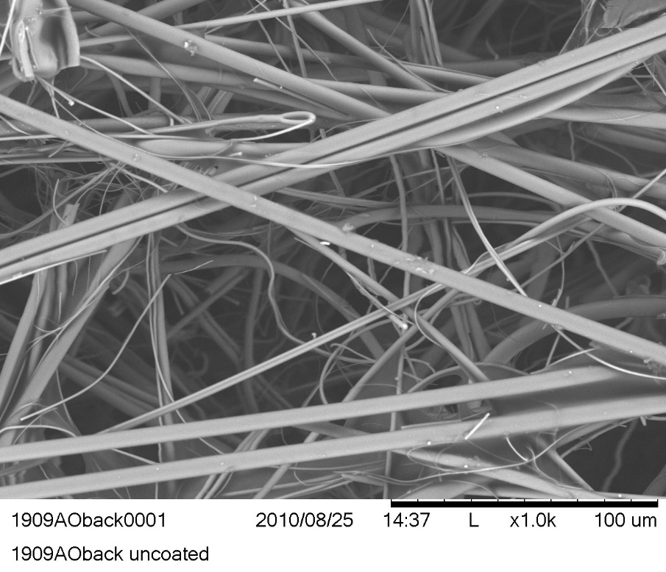
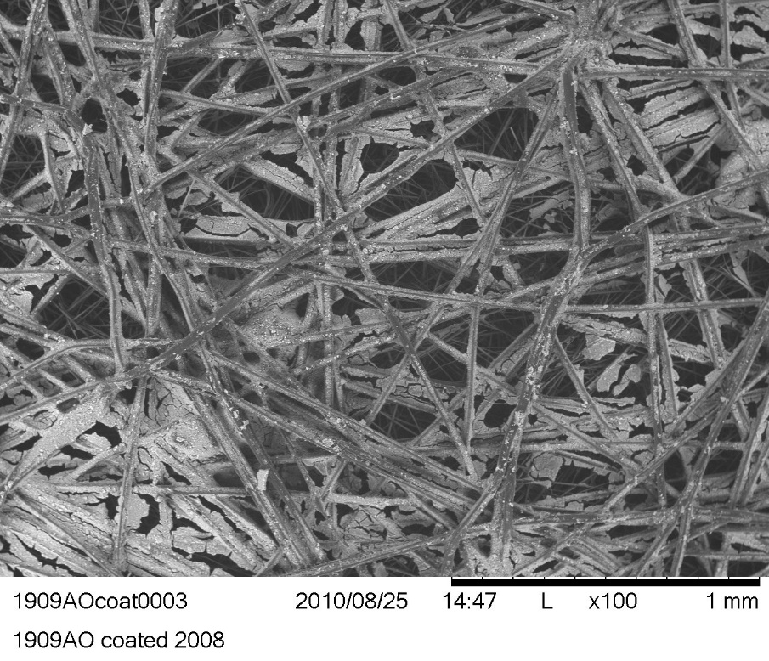
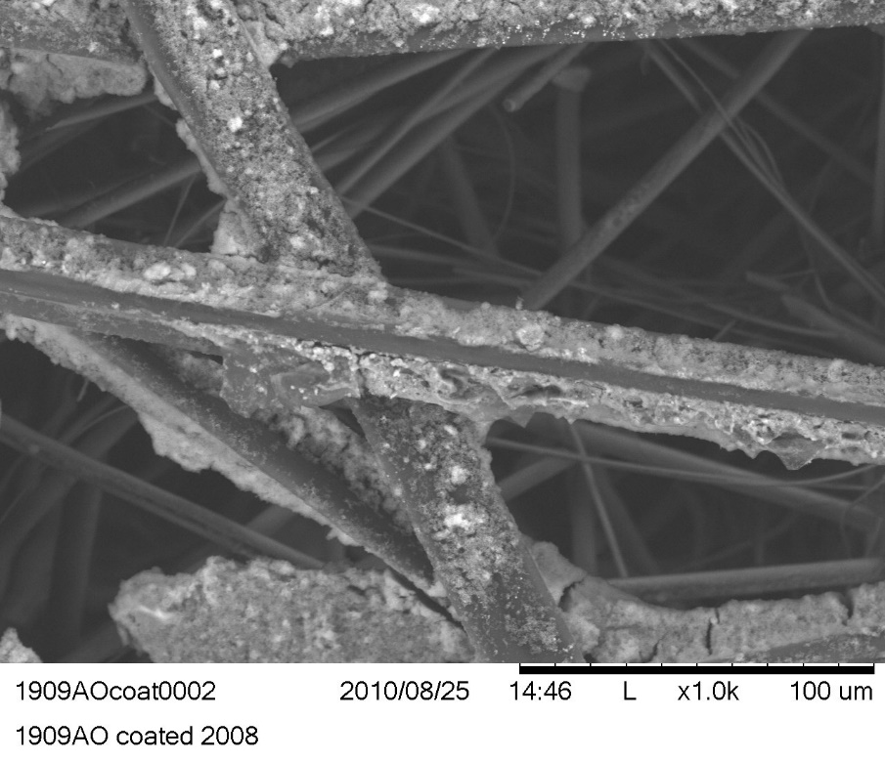
A Closer Look
Untreated Media 100X
Coated Media 100X
Coated Media 1,000X
Notes:
fumed titanium dioxide nanoparticles - 20 nm in size
To a white powdery mildew molecule of 1-3 microns in size as it tries to travel through the coated media thickness is like trying to fly a 3-foot drone through the amazon jungle and not hit a tree coated with titanium dioxide in a windstorm

Slide 8
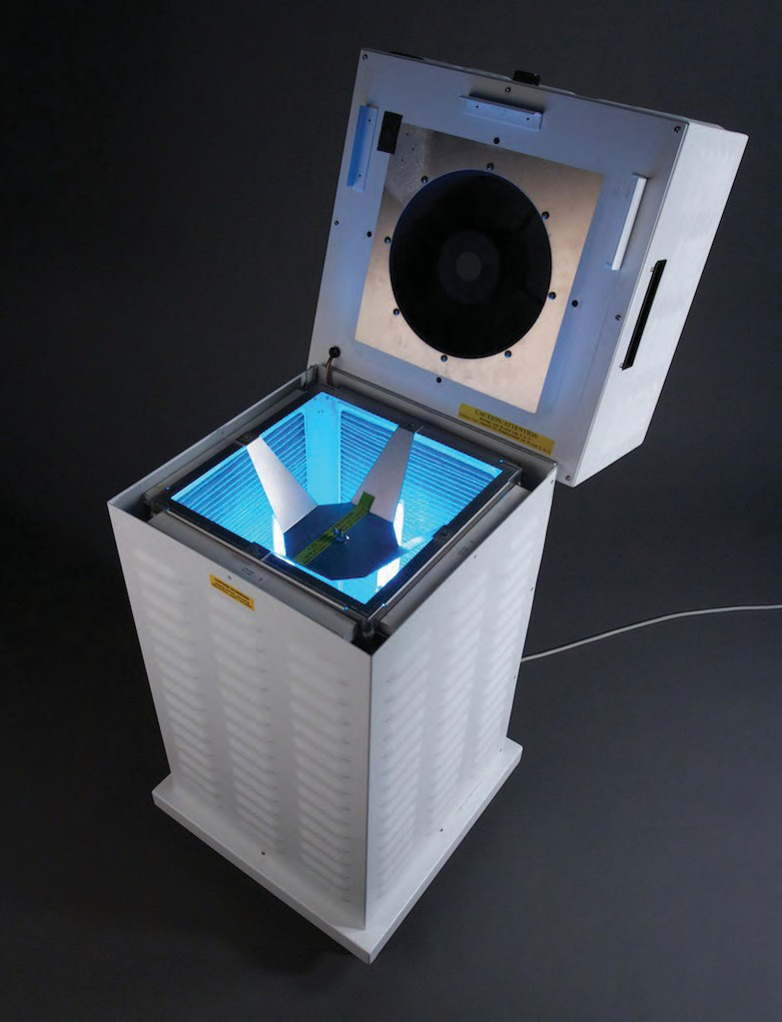
Benefits
Zentox Pure Air proprietary process reduces airborne contaminants
Oxidized pathogens are destroyed
Minimizes chance for reinfection
No waste disposal
Safe to use: No ozone or other harmful air products are emitted
Easy to use: simply turn on and let it run
Zentox Pure Air™ 500

Slide 9
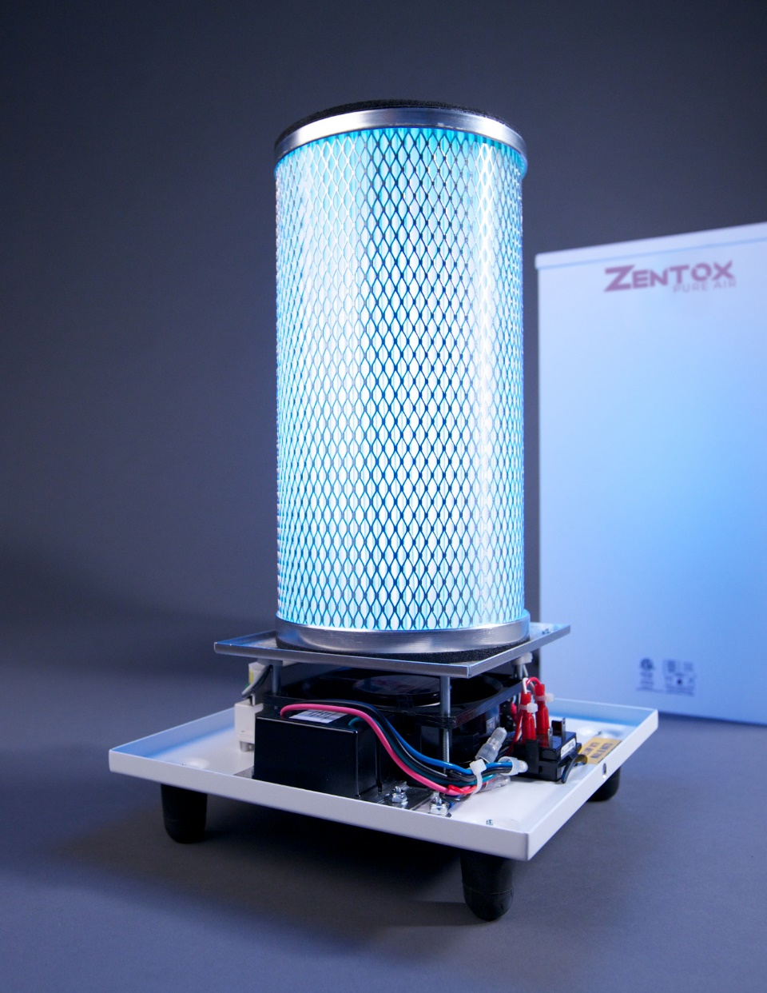
Zentox Pure Air™ vs. simple PCO devices
Zentox added a complex mix of elements and compounds as catalyst.
Embedding catalyst into a proprietary ﬁbrous mat media increases active photocatalytic surface area which leads to dramatically improved performance.
Zentox Pure Air reduces ethylene, carbon monoxide and other contaminants not affected by traditional PCO devices.
Zentox Pure Air™ 200

Slide 10
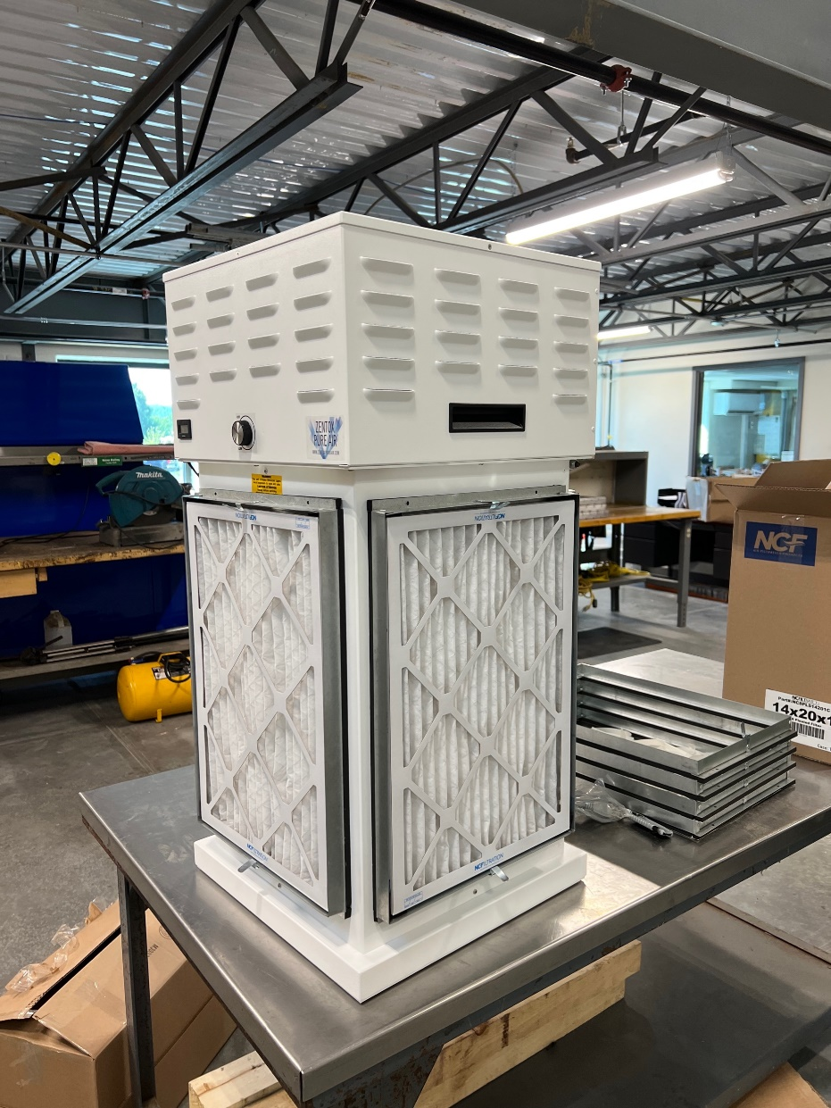
Background: Ethylene Management in Cold Storage Facilities
Fresh fruits are important for a healthy diet;
However, their shelf-life can be shortened because of ethylene, a key chemical associated with the ripening process.
As a result, due to fruits production seasonality, regional specific cultivation and perishability, a large proportion of fruits and vegetables are discarded before reaching the consumer.
It is estimated that about 10 percent of the total food loss occurs at the post-harvest, processing, and packaging stages of the produce supply chain. ⁽¹⁾
Therefore, detecting ethylene concentration at trace levels and regulating its activity by safe and effective approaches are of paramount importance in extending postharvest shelf-life.
Zentox Pure Air 500 CS

Slide 11
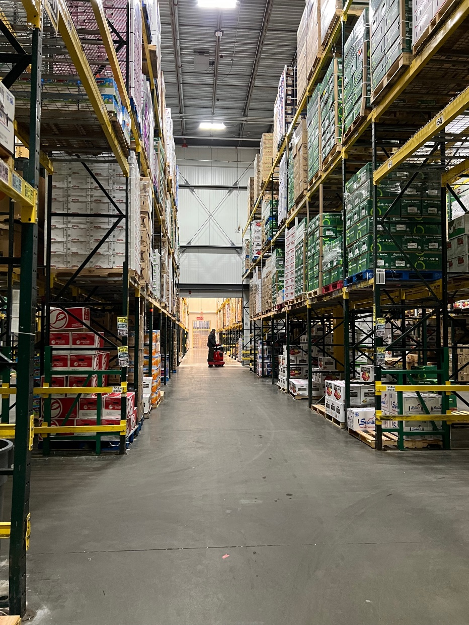
Cold Storage Facility Case Study:
Ethylene, Airborne Mold, Mildew, Fungus and Bacteria Testing
Four Seasons Produce: a full-service wholesaler offering fresh organic, local, and conventional produce for the Mid-Atlantic & Northeast US
It’s two main facilities include over 5 million cubic feet of cold storage.
FSP was seeking competitors for ethylene management of their cold storage expansion warehouse which measures ~2.5 million cubic feet.
Four Seasons Produce
Test Area

Slide 12
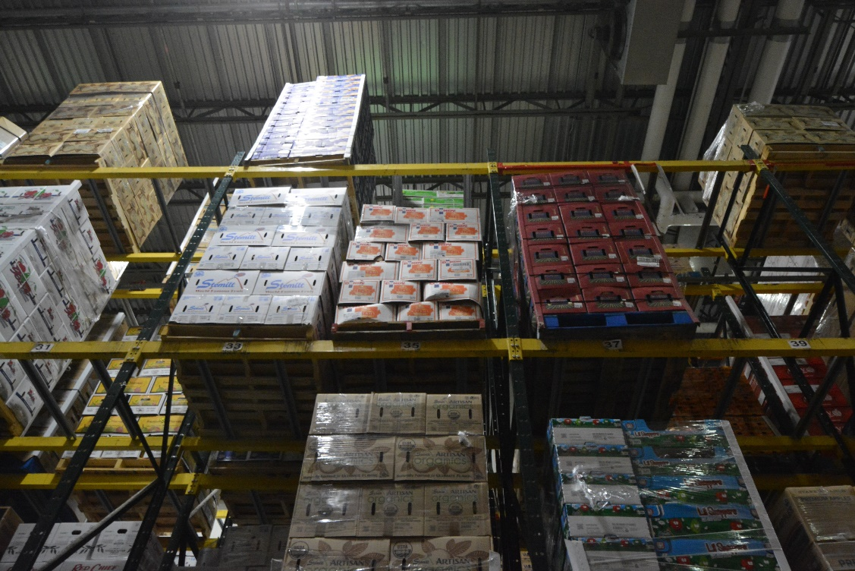
Cold Storage Facility Case Study:
A Deeper Look
In addition to ethylene, airborne mold, mildew, fungus and bacteria are also perilous during post-harvest storage and transportation of fresh fruits and vegetables.
FSP and Zentox Corporation devised a comprehensive six-week study in FSP’s working and rather active cold storage facility that included taking a multitude of air quality measurements for A) ethylene, B) airborne fungus, mold/mildew, and C) bacteria.
Four Seasons Produce
Test Area

Slide 13
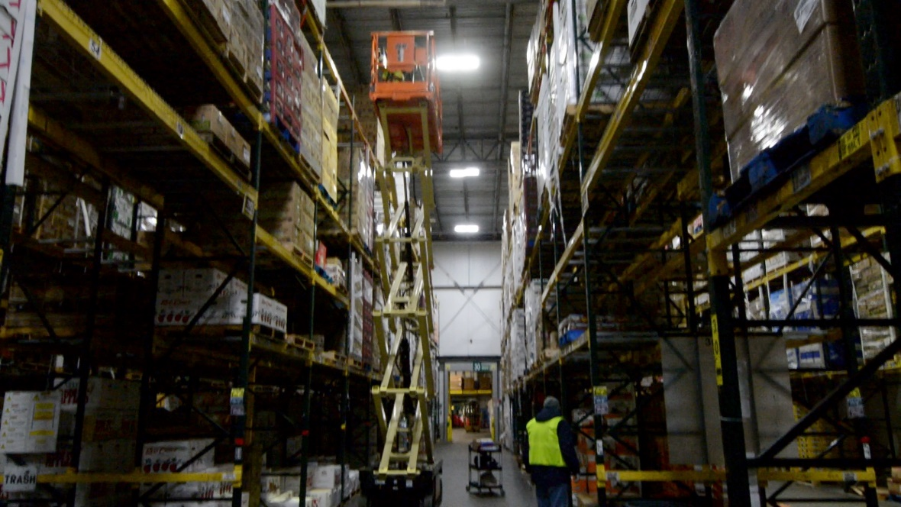
Cold Storage Facility Case Study:
Two Phase Testing
Phase One testing consisted of three weeks of Indoor Air Quality (IAQ) sampling and testing while operating FSP’s current PCO air purification systems incorporating titanium dioxide coated chamber and UV-C lamps. Nine (9) of these PCO units had been installed in 3 aisles. Phase One established a baseline set of airborne measurements for produce consisting of apples and other climacteric fruit where ethylene sensitivity is higher than average as are the spoilage rates.
Phase Two testing consisted of an additional three weeks of testing utilizing only three (3) Zentox Pure Air 500 systems installed in the same 3 aisles. FSP’s current nine PCO air purification systems were turned off to permit direct air purifier comparisons.
30 Foot Air Sampling
Notes:
Clearly a case of measuring apples to apples

Slide 14
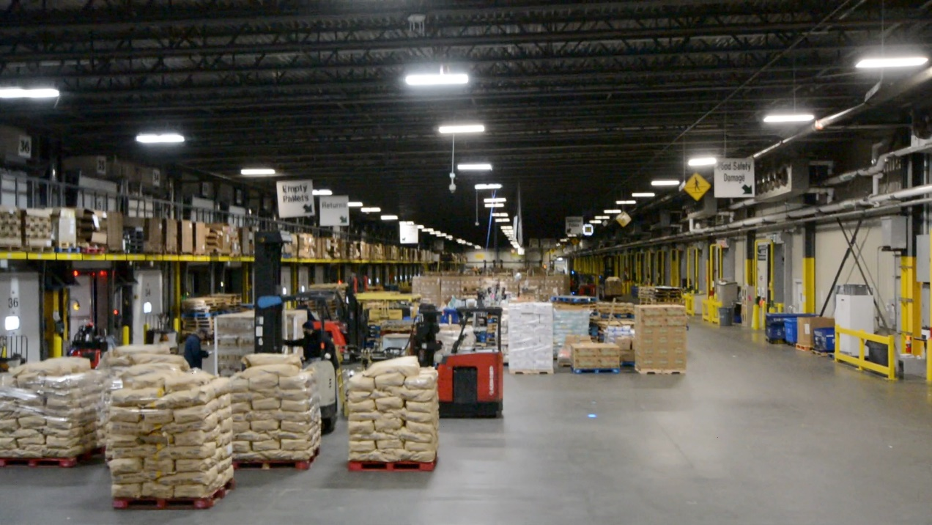
Cold Storage Facility Case Study:
Testing Methodology and Set Up
FSP cold storage areas are closed air systems.
There is some fresh air leakage from the loading docks.
The ambient temperature in aisles 28-32 is 34˚F.
The current FSP air purification systems are flush mounted ceiling units at an elevation of 30 feet and are capable of a single air turn per day.
The location of the three Zentox air purification units were located on the top produce shelves at approximately 23 feet elevation and underneath the centrally located air chiller evaporator inlets. The three installed Zentox Pure Air Systems were sized for 6 air turns per day.
Four Seasons Produce
Loading Dock
Notes:
The prevailing understanding is that ethylene rises, while the FSP Quality Control (QC) Manager was focused on the air directly in the vicinity of the produce- cross contamination.
1) to avoid mishaps to the Zentox Pure Air 500 equipment from the quickly moving forklifts and
2) this would be the position in the facility to have gathered the most air contaminants in the Ferris wheel like air flow from the air chiller evaporators across the top of aisles 28-32 and returning to the chiller evaporator intakes.
KES - 27 cu ft/min
ZPA 500 – 500 cu ft/min

Slide 15
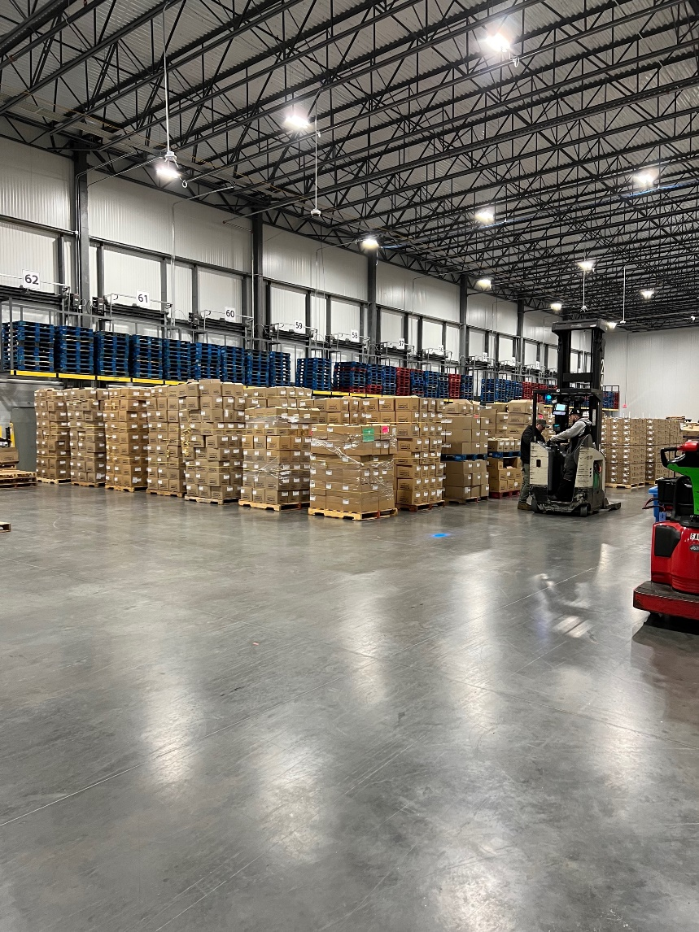
Cold Storage Facility Case Study:
Testing Period and Sample Locations
Air Sample Measurement Categories:
Ethylene
Fungus, Mold, and Mildew
Bacteria
Air Sample Elevations:
5 feet
15 feet
30 feet
Air Sample Frequency:
Monday
Wednesday
Friday
27 measurements/week for a period of 6 weeks.
Phase 1 Testing October 20 to November 5
  Shelf Capacity ~55%
Phase 2 Testing November 15 to December 3
  Shelf Capacity ~95% (Thanksgiving & Holiday Season)
Four Seasons Produce
Expansion Loading Dock

Slide 16
IAQ Test Results
Test Period Total CFU/M³ = 26,240
Daily Average CFU/M³ = 3,280
Produce Load = 55% Shelf Space Occupied
Notes:
Examples of spore types measured are Aspergillus/Penicillium, Basidiospores, Cladosporium, Epicoccum, Stachybotrys/Memnoniella and Nigrospora.

Slide 17
IAQ Test Results
Test Period Total CFU/M³ = 16,920
Daily Average CFU/M³ = 1,880
Represents 43% Reduction in Fungus, Mold/Mildew
With a Produce Load Increase of 73%

Slide 18
IAQ Test Results
Test Period Total CFU/M³ = 1,066
Test Period Daily Average CFU/M³ = 133
Produce Load of ~ 55% Shelf Space Occupied

Slide 19
IAQ Test Results
Test Period Total CFU/M³ = 742
Daily Average CFU/M³ = 82
Represents 38% Reduction in Bacteria
With a Produce Load Increase = 73%

Slide 20
IAQ Test Results
Test Period Average 0.51 PPM
Aisles 28-32 shelf capacity at ~55%

Slide 21
IAQ Test Results
Test Period Average 0.98 PPM
Represents a 53% Increase in Ethylene
With a Produce Load Increase = 73%
Zentox Pure Air 500 Results in a 20% decrease in Ethylene

Slide 22
Zentox Pure Air™ vs. FSP Current Systems
Zentox Pure Air 500
FSP Current Systems
Reduced airborne bacteria, mold, fungus, and mildew by ~40% under a 72% load increase with one third the number of units and at one third of the total price.
Decreased the amount of ethylene by 20% when factoring the increased produce load.
The Zentox Pure Air provides superior performance at 1/3 the cost.
One air turn per day
Requires 3 machines vs. one Zentox Pure Air 500
vs.
Notes:
Caution about heavy dust laden areas -

Slide 23
Zentox Pure Air™ vs. FSP Current Systems
Zentox Pure Air 500
FSP Current Systems
Four Seasons Produce achieved a far superior performance with Zentox Pure Air 500 units and a savings of $164,000 in capital equipment expenditures based on the MSRP of the competing equipment.
On a per cubic foot basis, Zentox Pure Air cost of less than $ 0.03 /ft³ at 5 air turns per day compared to the competing systems at $.10/ft³ with a single air turn per day.
One air turn per day
Requires 3 machines vs. one Zentox Pure Air 500
vs.
Notes:
Caution about heavy dust laden areas -

Slide 24
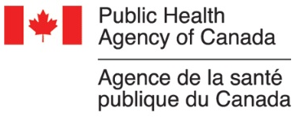






Performance Evaluation
PUBLIC HEALTH AGENCY OF CANADA
Laboratory testing found that Zentox Air Purification Technology was able to inactivate and remove all airborne organism types tested, including spores, mycobacterium, and viral species including H1N1 and SARS.
WAKE FOREST BAPTIST HEALTH
Werner Bischoff, MD, PHD, Director of Hospital Epidemiology is conducting a series of clinical trials on the Zentox Pure Air Puriﬁcation System. His conclusion after the ﬁrst trial was that “use of the Zentox Pure Air instrument in an ED setting leads to a signiﬁcant reduction of the airborne bacterial load. Applications of this new technology promise to reduce the pathogen load, reduce exposure, and provide a safe environment for patient care.”
EPA
Zentox Pure Air air purifiers are EPA antimicrobial devices.
®
Notes:
When there is

Slide 25



Certifications
The Zentox Pure Air puriﬁcation system has an EPA establishment number.
The Zentox Pure Air purification systems carry ETL and CSA certifications for electrical safety.
The Zentox Pure Air purification systems are certified by the California Air Resources Board for meeting EPA ozone emissions safety standards for air purifiers.

Slide 26
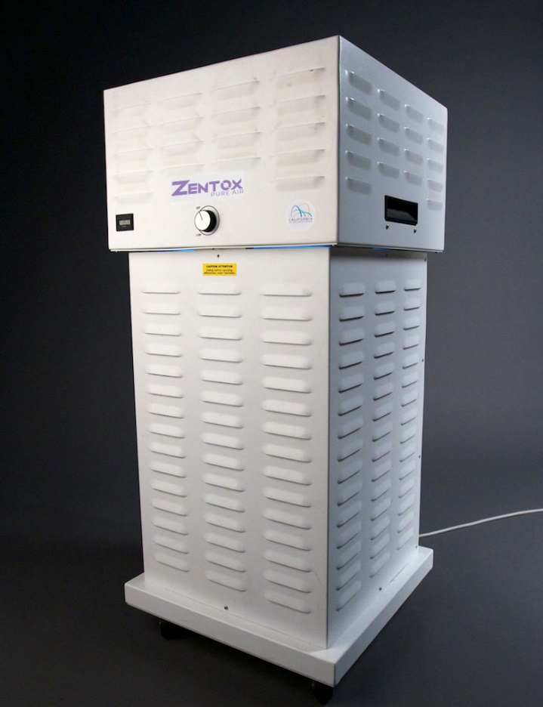
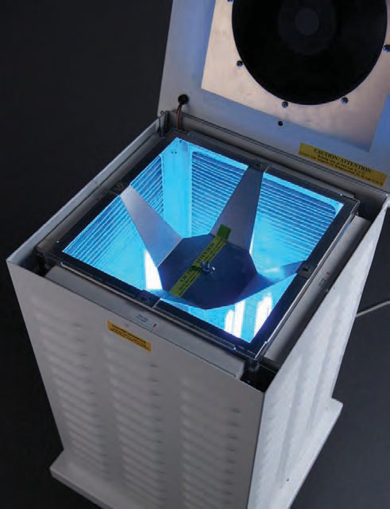
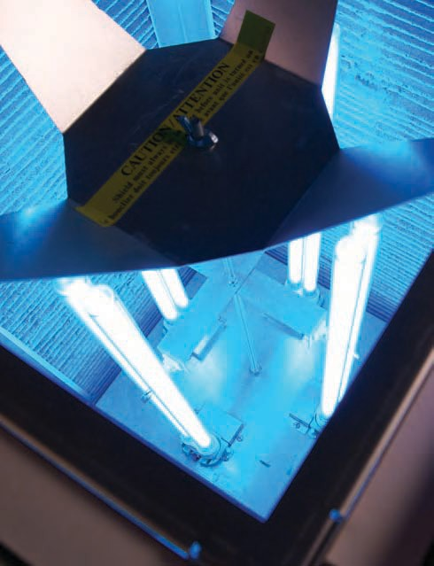
Products: Zentox Pure Air™ 500
Treats up to 500 cubic feet per minute of ambient air
Notes:
500 CFM
18” x 18” x 38”
45 pounds
180 watts, 5 amps
6’ @500 CFM = 62 dB(A)
3’ @500 CFM = 64 dB(A)
6’ @250 CFM = 60 dB(A)
3’ @250 CFM = 64 dB(A)
6’ @Slowest = 60
3’ @Slowest = 64

Slide 27
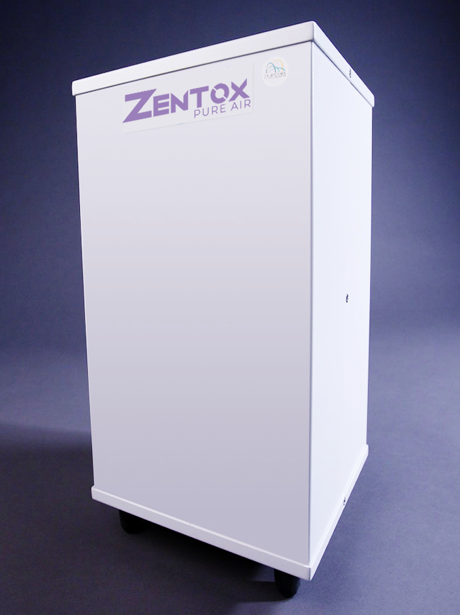
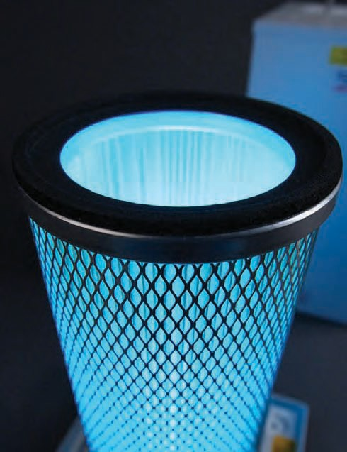
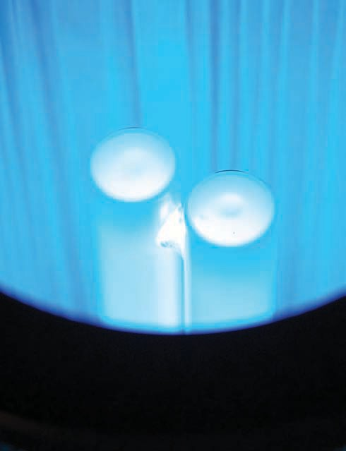
Products: Zentox Pure Air™ 200
Treats up to 100 cubic feet per minute of ambient air
Notes:
100 CFM
9.25” x 9.25 x 19”
7 pounds
25 watts, 2 amps
6’ @100 CFM = 60 dB(A)
3’ @100 CFM = 64 dB(A)
6’ @ 50 CFM > 58 dB(A)
3’ @ 50 CFM = 60 dB(A)

Slide 28
For More Information:
Contact:
Jack Soost Associates, Inc.
Zentox Distributer
533 Red Maple Way
Lancaster, PA 17603
(714) 449-0833
jack.soost@mac.com
Technical Papers & Studies
Success Stories
Testimonials
www.zentoxpureair.com
Contact:
Tom McCarthy
Zentox Corporation
600 Elm Court
Hopewell, VA 23860
(703) 328-4730
tmccarthy@zentox.com

