Slide 1

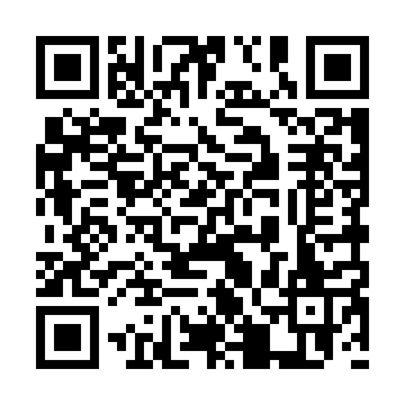





S
AREPTEMBER
SAREPTA MISSIONS MONTH
Follow on
Facebook all
month for mission
highlights!
Supporting
Churches
Shepherding
Pastors
Mobilizing
Congregations
PRAY
GIVE
GATHER
Join us for a week of prayer
(Sept. 28 - Oct. 4) leading up to the Mission Celebration
Encourage your church to participate in this month’s special offering.
On Oct. 4th as we celebrate what God is doing through our 68 Churches.

