Slide 1
Milan International Soccer Academy
PRESENTS
UNDERSTANDING COGNITIVE DISSONANCE

Slide 2

Understanding Cognitive Dissonance and Its Impact on Youth Soccer Players
Exploring mental conflicts affecting young athletes' performance
Notes:
---
This presentation explores the concept of cognitive dissonance and its specific implications for youth soccer players. We will delve into defining the theory, identifying its manifestations, examining its effects, and discussing strategies to address it effectively.
Image source: Microsoft 365 content library

Slide 3

Agenda Overview
Defining Cognitive Dissonance in Soccer
Manifestations of Cognitive Dissonance in Youth Soccer
Effects on Player Well-Being and Performance
MISA Strategies to Mitigate Cognitive Dissonance in Youth Soccer
Notes:
---
We will cover four main sections: defining cognitive dissonance in sports, recognizing how it appears in youth soccer, understanding its impact on players' well-being and performance, and exploring strategies to mitigate its effects within youth soccer environments.
Image source: Microsoft 365 content library

Slide 4
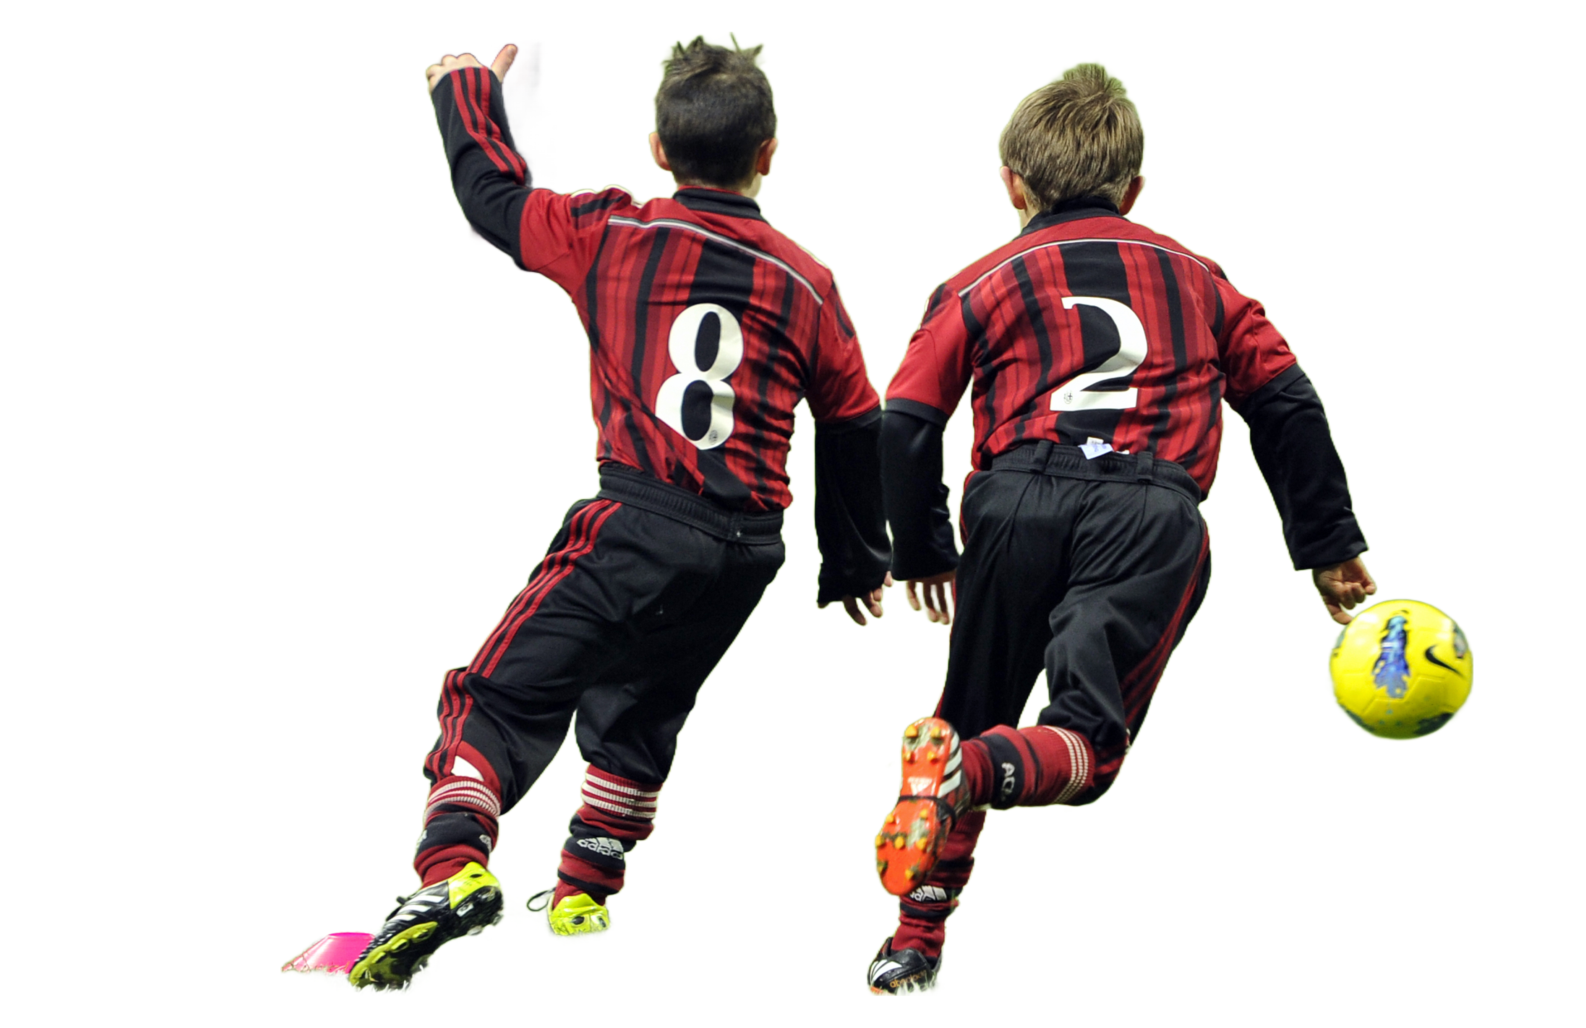
Defining Cognitive Dissonance in Soccer
Notes:
First, we will define cognitive dissonance theory and identify common triggers of dissonance specifically in athletic settings, setting the foundation for understanding its role in youth soccer.

Slide 5
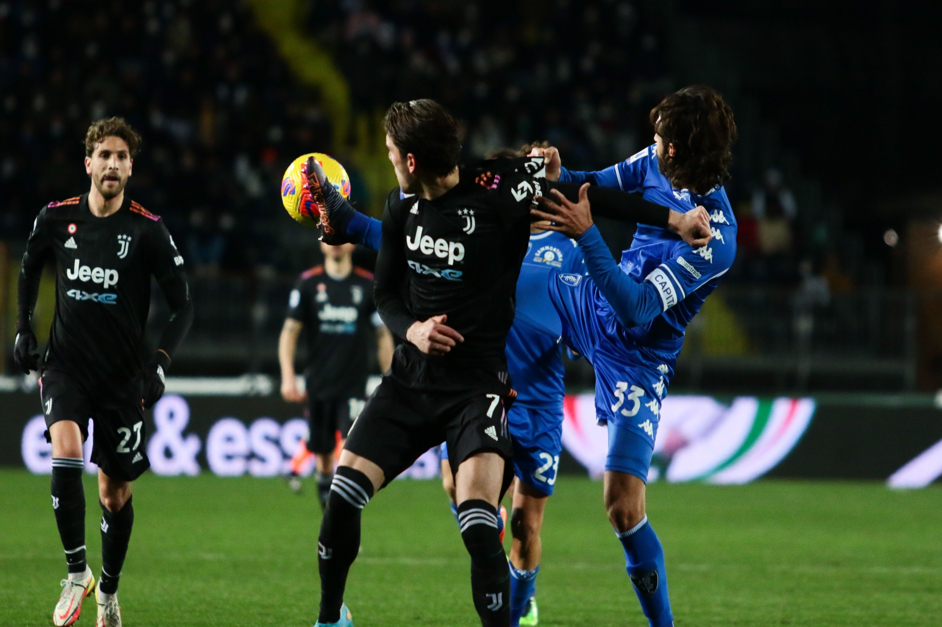
Explaining Cognitive Dissonance Theory
In A Nutshell
Definition of Cognitive Dissonance
  Cognitive dissonance is the mental discomfort from holding conflicting beliefs or behaviors simultaneously.
Cognitive Dissonance in Sports
  Athletes experience dissonance when their values, expectations, or actions contradict, causing psychological tension.
Notes:
---
Cognitive dissonance refers to the mental discomfort experienced when a person holds conflicting beliefs or behaviors. In sports, this arises when athletes face contradictions between their values, expectations, or actions, leading to psychological tension.
Image source: Microsoft 365 content library

Slide 6
Common Triggers in Athletic Environments
Conflicting Coach Messages
Mixed or contradicting instructions from coaches create confusion and mental stress for athletes.
Performance Pressure
Athletes face intense pressure to exceed their capabilities, causing mental strain and dissonance.
Goal and Expectation Discrepancies
Differences between personal objectives and team demands lead to internal conflict and imbalance.
Notes:
---
Triggers of cognitive dissonance in sports include conflicting messages from coaches, pressure to perform beyond one's abilities, and discrepancies between personal goals and team expectations, all of which can disrupt an athlete's mental balance.
Image source: Microsoft 365 content library

Slide 7

Manifestations of Cognitive Dissonance in Youth Soccer
Notes:
Next, we will observe how cognitive dissonance manifests among youth soccer players through performance pressures, coach-athlete relationship issues, and the influence of team dynamics and peers.

Slide 8
Performance Pressure and Conflicting Beliefs
Everyone Handles Pressure Differently
Pressure to Excel
  Youth athletes experience intense pressure to perform well and meet high expectations from coaches and peers.
Beliefs about Fair Play
  Many players hold strong beliefs in fair play and personal limits, which may conflict with competitive demands.
Emotional Impact
  This conflict can lead to discomfort, anxiety, and a decline in enjoyment of sports participation.
Notes:
---
Youth players often face pressure to excel while holding beliefs about fair play or personal limits. This clash can cause discomfort, potentially leading to anxiety or reduced enjoyment of the sport.
Image source: Microsoft 365 content library

Slide 9

Coach-Athlete Relationship Challenges
Mental Aspects Matter
Inconsistent Coaching Styles
  Varying coaching methods can confuse athletes, leading to uncertainty in training and performance expectations.
Unclear Expectations
  Lack of clear guidance from coaches creates conflict as athletes try to balance compliance with personal approach.
Player-Coach Dissonance
  Athletes may feel torn between pleasing the coach and staying authentic to their own playing style.
Notes:
---
Inconsistent coaching styles or unclear expectations may cause dissonance if players feel misunderstood or conflicted between wanting to please their coach and staying true to their own approach.
Image source: Microsoft 365 content library

Slide 10

Team Dynamics and Peer Influence
Peer Pressure Impact
  Peer pressure influences young athletes by creating conflicts between team expectations and personal beliefs.
Team Rivalries
  Rivalries between teams can heighten tension, leading to increased stress and cognitive dissonance for athletes.
Cognitive Dissonance
  Conflicting group norms and personal goals intensify cognitive dissonance, causing emotional struggles for athletes.
Notes:
---
Peer pressure and team rivalries can create internal conflicts for young athletes, especially when group norms contradict personal values or goals, intensifying cognitive dissonance.
Image source: Microsoft 365 content library

Slide 11

Effects on Player Well-Being and Performance
This Photo y Unknown Author is licensed under CC BY-SA-NC
Notes:
We will now examine the emotional, motivational, and behavioral consequences that cognitive dissonance can have on youth players' well-being and athletic performance.

Slide 12

Emotional and Psychological Consequences
Stress from Cognitive Dissonance
  Conflicting beliefs or actions can cause stress, impacting a player's emotional well-being during sports.
Frustration Effects
  Frustration resulting from mental conflict may reduce motivation and enjoyment in sports activities.
Reduced Confidence
  Cognitive dissonance can diminish players’ confidence, negatively affecting performance and mental health.
Notes:
---
Cognitive dissonance may lead to stress, frustration, and diminished confidence, which can adversely affect a player's mental health and enjoyment of the sport.
Image source: Microsoft 365 content library

Slide 13
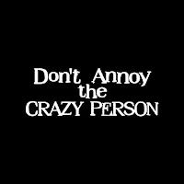
Impact on Motivation and Self-Esteem
Why Is Little Johnny Not Performing?
Decreased Motivation
  Persistent internal conflicts can lead to a significant drop in players' motivation levels during sports activities.
Lowered Self-Esteem
  Ongoing internal struggles may reduce players' confidence and self-esteem, affecting their performance and participation.
Withdrawal from Participation
  Decreased motivation and self-esteem can cause players to withdraw from games and training sessions.
This Photo by Unknown Author is licensed under CC BY
Notes:
---
When internal conflicts persist, players might experience decreased motivation and lowered self-esteem, potentially causing withdrawal from participation or reduced effort during games and training.
Image source: Microsoft 365 content library

Slide 14
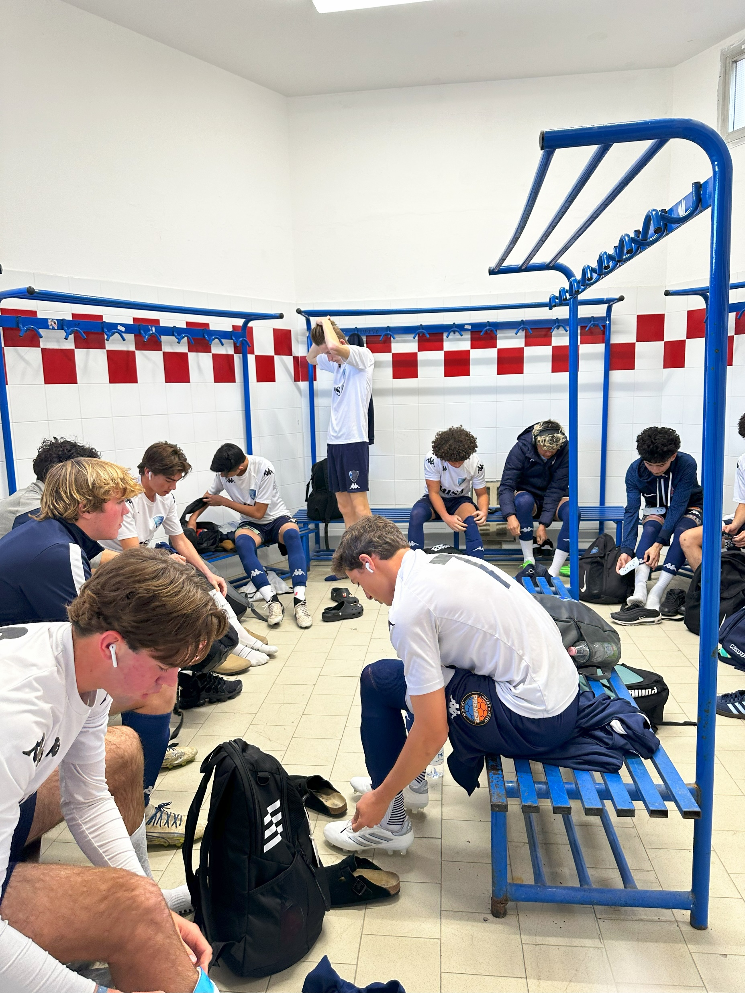
Decision-Making and Sportsmanship
Impact of Dissonance
  Dissonance negatively affects athletes' decisions causing inconsistency in actions and sportsmanship during games.
Ethics and Team Outcomes
  Ethical conflicts impact both individual performance and overall team results in competitive sports.
Notes:
---
Dissonance can impair decision-making on the field, leading to inconsistent sportsmanship or choices that conflict with personal or team ethics, impacting both individual and team outcomes.
Image source: Microsoft 365 content library

Slide 15

Role of Coaches and Parents
Clear and Consistent Messages
  Coaches and parents should provide clear and consistent messages to support players effectively and avoid confusion.
Supporting Player Autonomy
  Supporting players’ autonomy helps build their confidence and promotes independence in their sports journey.
Recognizing Individual Needs
  Recognizing each player's unique needs reduces conflicting expectations and fosters trust among all involved.
Notes:
---
Coaches and parents can help by providing clear, consistent messages, supporting players’ autonomy, and recognizing individual needs to reduce conflicting expectations and build trust.
Image source: Microsoft 365 content library

Slide 16

Promoting Positive Team Culture
Inclusive Environment
  Fostering inclusivity ensures every team member feels valued and respected, promoting unity and collaboration.
Aligning Values
  Aligning personal and group values reduces conflict and cognitive dissonance within the team.
Supportive Culture
  A supportive environment encourages open communication and mutual respect, enhancing team morale.
Notes:
---
Creating an inclusive, supportive team environment where players feel valued and respected helps to align personal and group values, minimizing cognitive dissonance.
Image source: Microsoft 365 content library

Slide 17

Encouraging Open Communication and Self-Reflection
Expressing Feelings
  Encouraging players to openly share their emotions helps in identifying and resolving internal conflicts.
Reflecting on Experiences
  Self-reflection enables players to understand their experiences and develop healthier coping strategies.
Notes:
---
Encouraging players to express their feelings and reflect on their experiences can help them resolve internal conflicts and develop healthier coping strategies.
Image source: Microsoft 365 content library

Slide 18
FILLING THE EMOTIONAL TANK
On a separate 3x5 index card write the name for each of your players
Write 3 positive things for each player
Bring cards to your next session
Have players gather around facing you
Read out loud your positive observations
Observe each players reaction as you fill their emotional tank
REMEMBER: Your car doesn’t run well on an empty tank and neither do your players

Slide 19
Conclusion
Understanding Cognitive Dissonance
Recognizing mental conflicts in youth soccer players helps tailor better support strategies for their growth and well-being.
Effective Support Strategies
Applying strategies to manage cognitive dissonance improves players’ performance and mental resilience.
Fostering Positive Development
Coaches and parents play a key role in creating a supportive environment for young athletes’ overall development.
Notes:
Understanding cognitive dissonance in youth soccer is essential for supporting players’ mental health and performance. By recognizing its manifestations and applying effective strategies, coaches, parents, and teams can foster positive experiences and development for young athletes.

Slide 20

THE END

