Slide 1


Design Dogo Media Solutions
for every audience
©2026 Design Dogo Media Solutions – Design Dogo

Slide 2

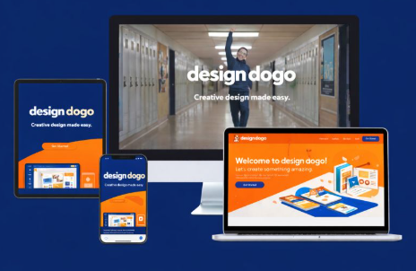
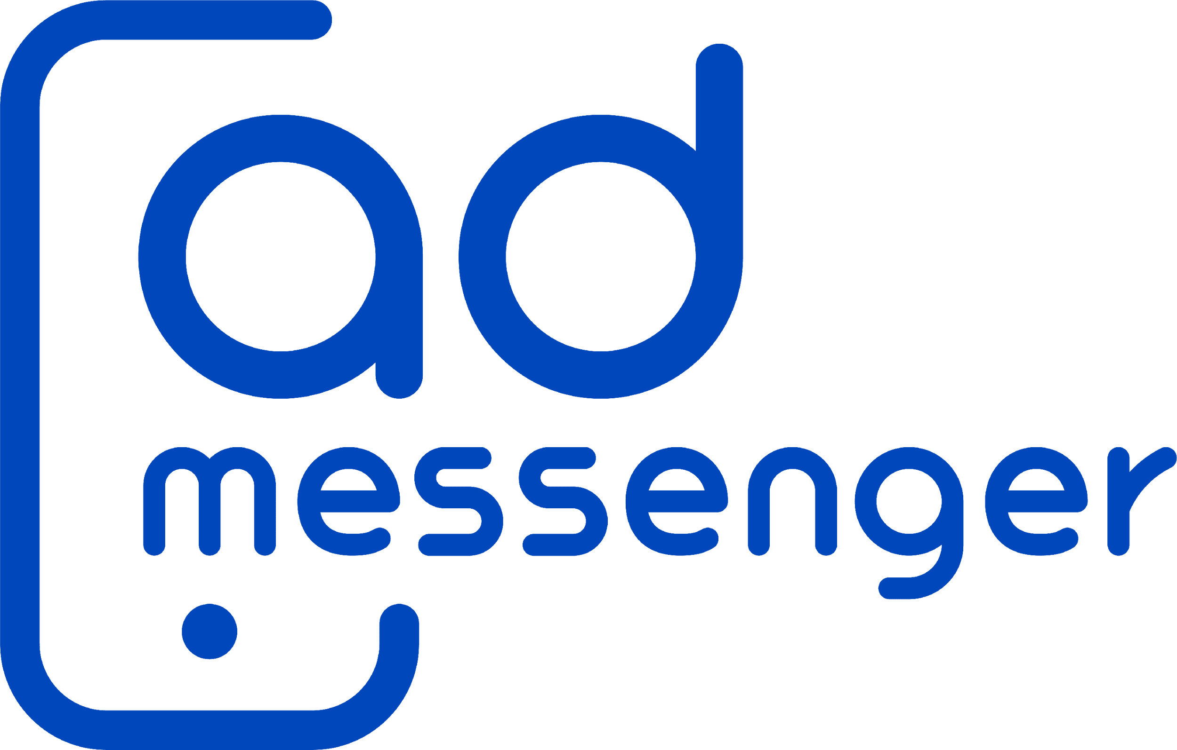
Our Design Dogo
family of connectivity
Telecommunications brand and 4th largest cable provider
Leader in hyper-local news in the tri-state area
Proprietary mobile ticker-style ad platform
©2026 Design Dogo Media Solutions – Design Dogo

Slide 3


We’re not
just another advertising company.
Design Dogo Media Solutions is a multiscreen advertising sales media consultancy agency for small and medium businesses, as well as national, political, media & entertainment, and agency clients across the U.S.
We are your audience
first partner.

Slide 4

Smart Planning
Strategic Buying
Proven Results
Design Dogo Media Solutions provides innovative, data-driven multiscreen advertising solutions reaching every DMA in the U.S.
Our Mission Is Simple:
Help our advertisers
meet their business goals.

Slide 5



Our process.
Strategize with you to create the perfect custom solution.
Reach any audience on every device with accuracy.
Provide world class service to ensure your goals’ success.
©2026 Design Dogo Media Solutions – Design Dogo

Slide 6
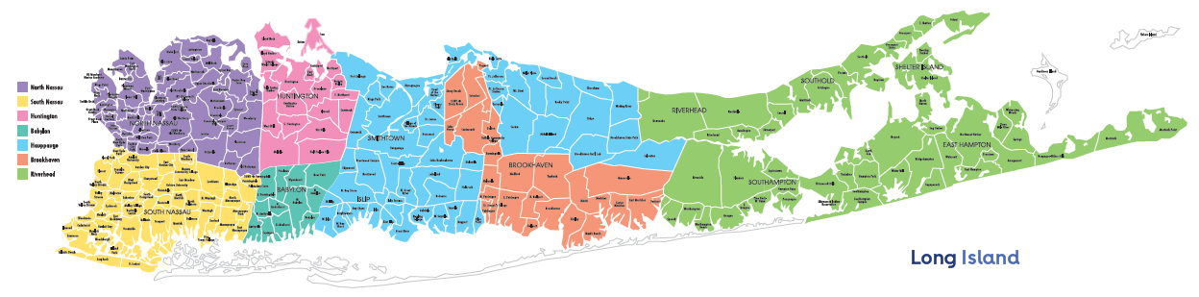
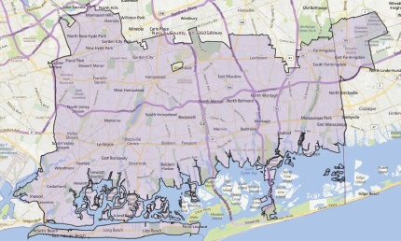
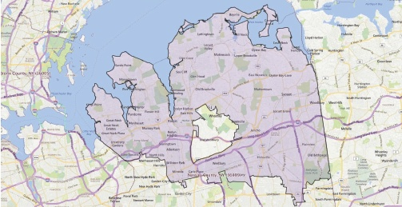
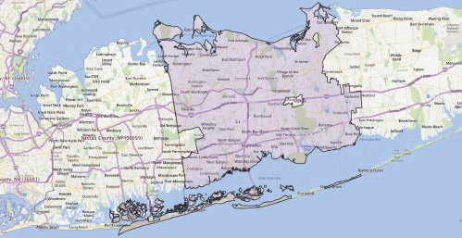
Design Dogo Media Solutions Coverage
FIOS Coverage

Slide 7
Geography: Long Island
LI Households Are Connected & Engaged Across All Types of Viewing
Household % Reach
Insights:
Internet Usage on Top – 99% of households on Long Island reports using the internet, meaning they can be reached using our digital products.
Streaming is Dominant – 86% of Long Island households report streaming content, with 82% of residents using an Ad-Supported streaming service, meaning they can be served ads while they are viewing content.
TV is still a Strong Anchor – Traditional TV is still very relevant, with 74% of the audience having watched cable TV in the past 7 days.
People are Streaming Everywhere – 55% of respondents report viewing streaming content on their mobile device, taking their favorite programs on the go.
Cord-Cutters and Cord-Nevers are Not Prominent – The presence of cord-cutters and cord-nevers are still quite low on Long Island, with each category sitting below 23% of the total population.

Slide 8
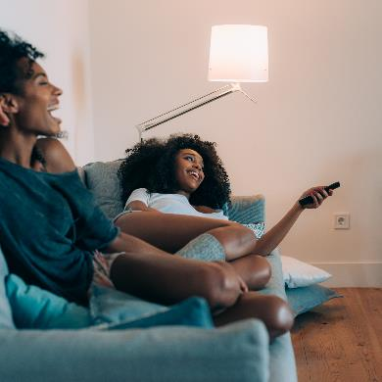
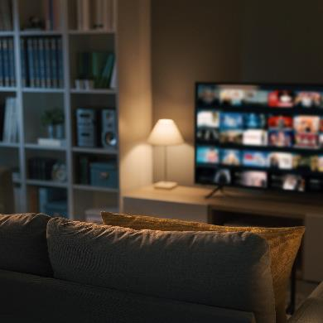


Reach Premium Audiences on Every Screen
Traditional TV
Streaming TV
Integrate, optimize, and maximize your brand messaging on the #1 brand builder with audiences of major programs, events, and LIVE sports.
Extend your brand message beyond traditional TV to reach Netflix subscribers, YouTube TV subscribers, Amazon Prime Video subscribers, cord-stackers, cord-cutters, and cord-nevers while they are streaming at their convenience.
Digital Solutions
AdMessenger Mobile Solutions
Align with engaged audiences consuming content with our online video (including non-skippable YouTube and Twitch), digital out-of-home, online display, & social solutions
Reach customers in the consideration phase on our proprietary mobile-only solution, AdMessenger,
with best-in-class engagement, cost efficiency.

Slide 9
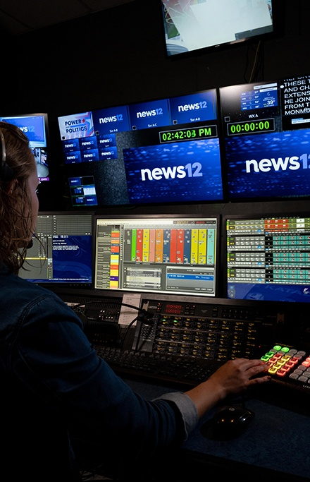



News 12 Network
Gain access the #1 News Network in the Tri-State area or reach streamers catching up on news for free via News 12 New York!
Hyper-local Reach
In-Depth Coverage
Award-Winning Content
News 12 is the largest and #1 news network in the Tri-State area with 7 distinct news channels reaching communities.
Viewers tune in for local anchors reporting local news and weather affecting their communities.
Winning over 150 Emmy Awards through the last 10 years - this is more than any other news station.

Slide 10




Traditional TV
Harness the power of real set-top box viewership data and proprietary technology with our Traditional TV solution!
Viewership Data
High Profile Programming
Build Brand Awareness
Target an audience based on real viewership data, not panel survey data!
Reach broad audiences during live sports and high-profile programming on top cable networks!
TV ads complement digital marketing and reinforces brand messaging to customers.

Slide 11
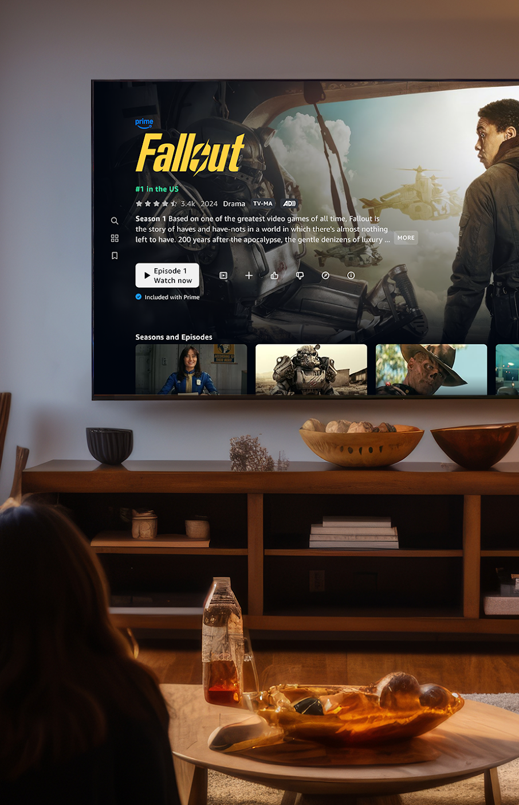



Amazon Prime Video Premiere
Tap into Amazon’s premium O&O inventory, including Prime Video catalog, hit Originals, exclusives, and new releases!
Premium
Content
High-impact Ad Moments
Exclusive Audiences
Includes hit Originals, new releases, exclusive movies, and more.
Unskippable ads appear during in-demand, must-watch content.
Amazon’s first-party shopping and streaming insights fuel precision targeting.

Slide 12
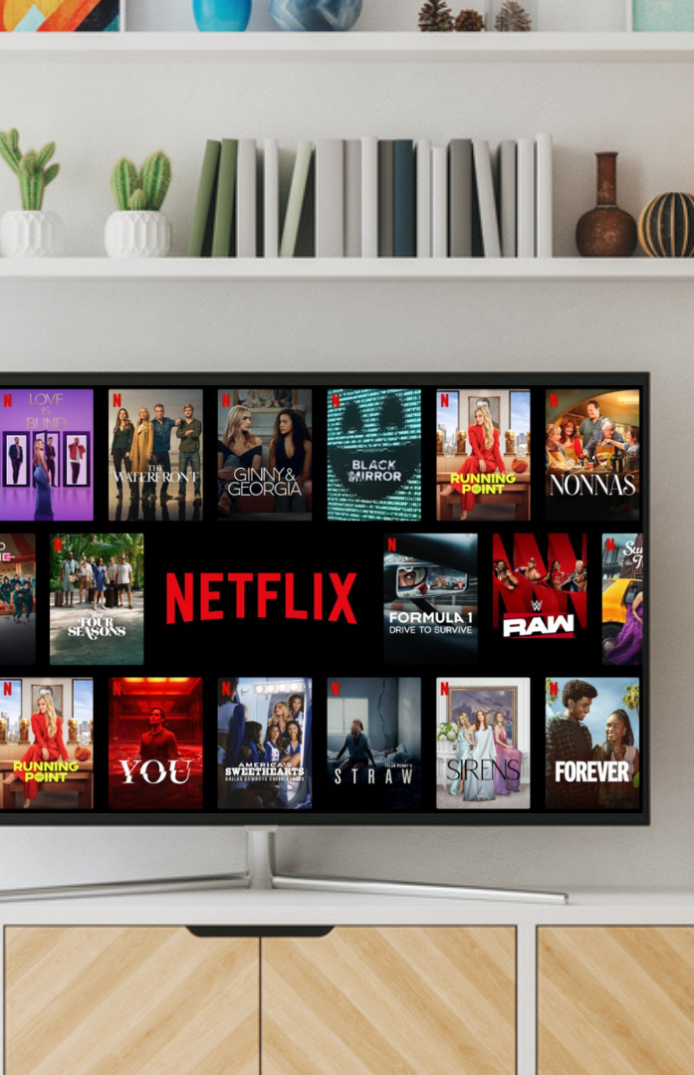

Netflix
Reach audiences where they binge on the #1 platform for streaming time.
Content Targeting
Reach Cord Cutters/Stackers
Engaged Audiences
Reach your audience across popular content genres and by geography, demographics, or dayparts
Reach cord-stackers, cord-cutters, and cord-nevers, and highly sought-after younger audiences!
Running across hit tv shows and films with non-skippable ads means higher attention to your message

Slide 13
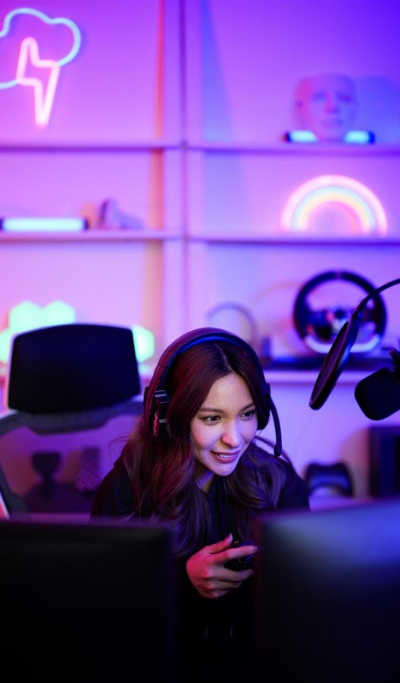

Twitch
Reach younger, highly engaged audiences on the world’s leading live streaming and gaming content platform.
Engaged Users
Key Missed Audiences
Precision Targeting
Twitch users are associated with markedly higher online engagement through the platform’s live content features
Reach younger audiences who may have moved from traditional forms of television and entertainment.
Owned by Amazon, their first-party shopping and streaming insights fuel precision targeting.

Slide 14
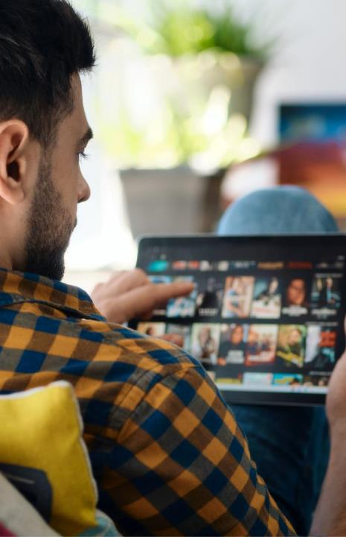




Streaming TV
Reach audiences on connected devices while they are streaming.
Precise Targeting
Reach Cord Cutters/Stackers
Premium Content
Reach your audience with targeting capabilities based on demographics, interests, and behavior.
Reach cord-stackers, cord-cutters, and cord-nevers, and highly sought-after younger audiences!
Align with premium content from popular streaming services to actively engaged viewers.

Slide 15

Sample OTT Publisher List
PLUTO TV | TV PLUS | DANGER TV
VIACOM CBS | TUBI TV | JUKIN MEDIA
GLEWED TV | FAWSOME TV | CANELA TV
AMC | THE CHIVE | HAYSTACK TV
WURL TV | ROKU | DISCOVERY LIFESTYLE
LOOP | FOX NEWS CHANNEL | LOCAL NOW: NEWS & TV+
WATCH FREE CHANNELS | LG DIGITAL CHANNELS | LG CHANNEL PLUS
XUMO | RAKUTEN VIKI (VIKI TV) | NOSEY
PLEX | CHEDDAR | PERFORMANCE ONE
FANDOM | SLING TV | NORTHERN VA MEDIA
SYNCBAK, INC. | UNIVISION | PHILO: LIVE/ON-DEMAND
OUTSIDE TV | SCRIPPS NETWORKS | REAL AMERICAS VOICE
FILMRISE | BARNES AND NOBLE | FUBO TV
ATMOSTPHERE TV | NEWSY | INSPIRIED TASTE INC.
BLOOMBERG | KIDOODLE TV | A&E
WEATHER NATION | HERRING NETWORKS | REDBOX
XANDR WEB | RANKER.COM | DISCOVERY GO
USA TODAY | HEARST DIGITAL | 33ACROSS
TV PLUS CHANNELS
YAHOO!
VUIT
ONE AMERICAN NEWS
COURT TV
TEGNA
RAINBERRY, INC.
ORKATV
CONSUMABLE, INC.
CINEDIGM ENT.
CRACKLE
CNN

Slide 16
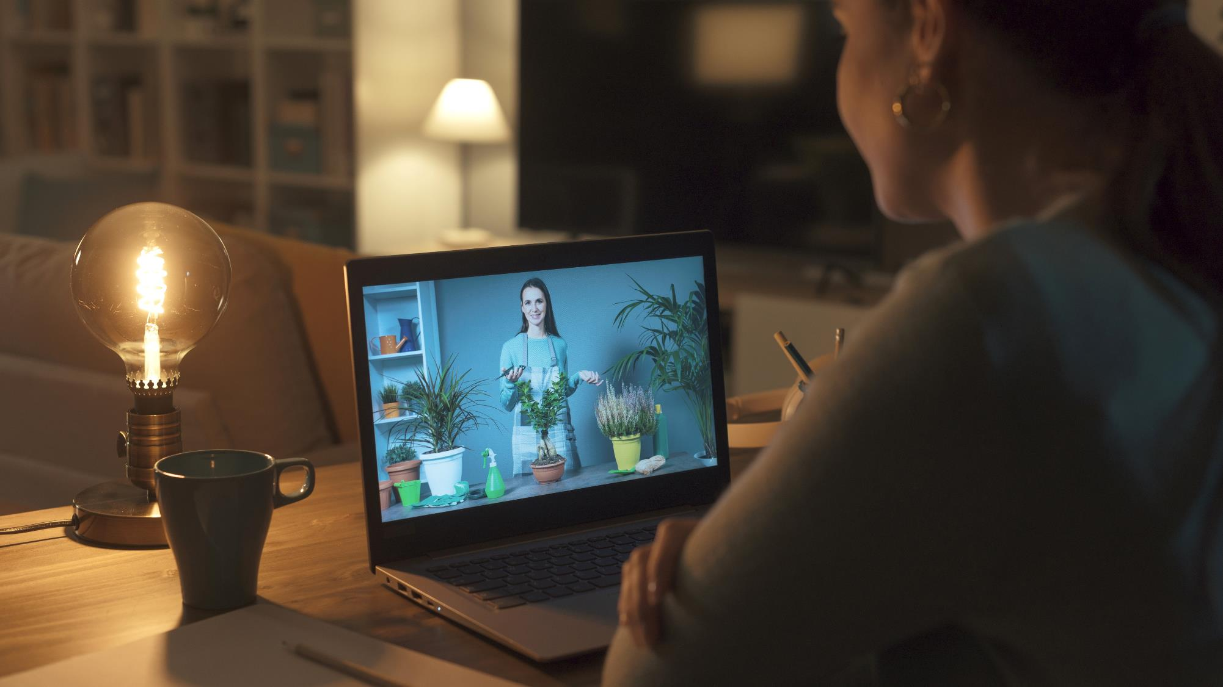

YouTube Video
Premium non-skippable ads exclusively displayed on YouTube's primary platform, mobile app, and CTV app.
Premium Inventory
Vast Reach
Precision Targeting
Inventory displays only on YouTube’s main platform, blocking Google’s third-party network for focused, premium viewing.
Extend the reach of your video message to YouTube’s vast user base accessing content daily.
YouTube’s highly tailored ad targeting ensures your ads reach your relevant audience at the right moment.

Slide 17


Digital Solutions
Reach your audience on the web and on the go with our online video, online display, & social media solutions!
Extend Your Reach
Precision Targeting
Engaged Users
Extend your message in multiple formats to all screens to ensure you are reaching relevant audience!
Reach your audience with targeting capabilities based on demographics, interests, and behavior.
Interactive ad formats that drive engagement and interaction and retarget to those engaged users.

Slide 18


Why Design Dogo Media Solutions?
Owned & Operated Inventory
Proprietary Media Products
Exclusive Data
Proprietary Technology
Best-in-class Partnerships
Expert Support Teams
©2026 Design Dogo Media Solutions – Design Dogo

Slide 19
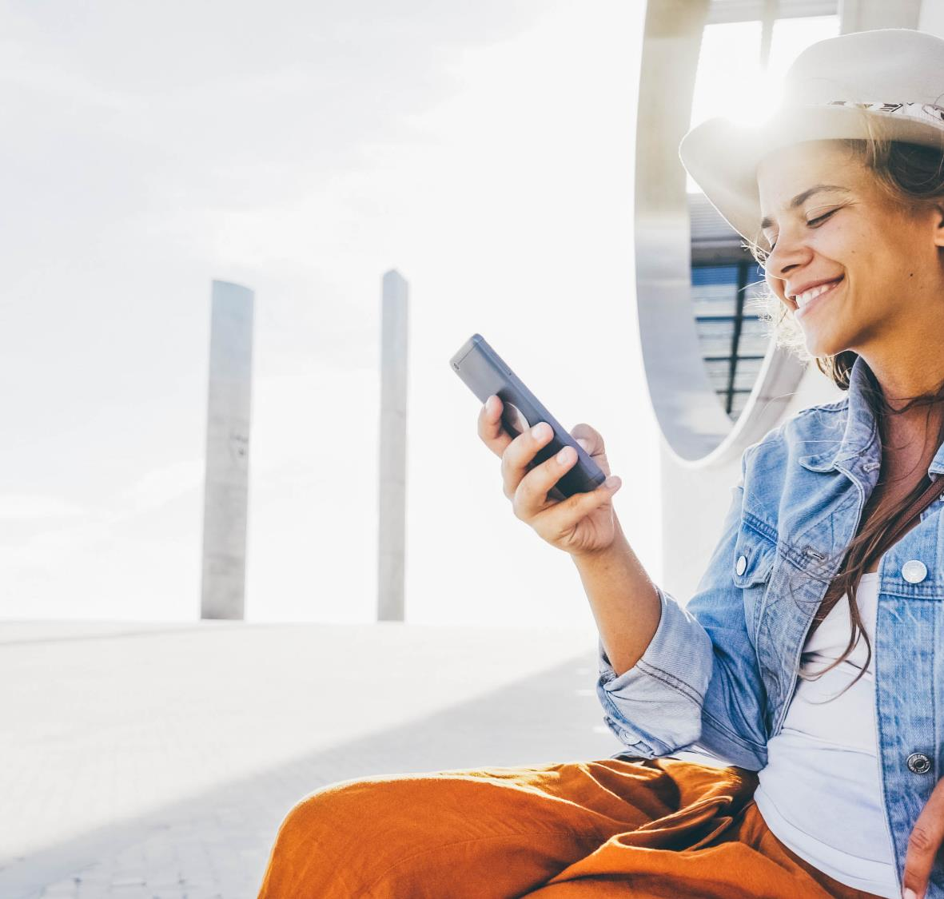
How can we help?
We look forward to partnering with you.
Lula Lukas
CEO
C: (631) 575-0652
lula@designdogo.com
©2026 Design Dogo Media Solutions – Design Dogo

