Slide 1


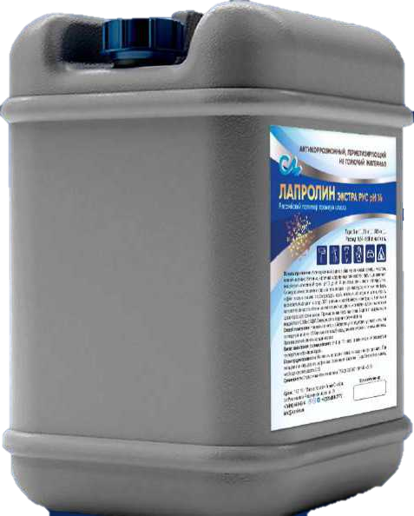
LAPROLIN EXTRA RUS PH 14
A NEXT GENERATION INNOVATIVE
Polymer Coating System

Slide 2


LAPROLIN -
Universal Innovative Polymer System
Designed to protect against corrosion and destruction of metal, concrete, brick, wooden structures and foundations.
Made on the basis of simple polyester, which hardens at temperatures from -30℃ to +50℃.
1. Suitable for all concrete and metal surfaces. The material can be handled at temperatures down to –15 °C
2. In combination with dry fine-dispersed materials, it forms polymer concrete (repair composition)
3. Resistant to UV, cavitation and abrasive wear, corrosion, erosion and weather. Up to 10 years warranty provided
4. When applied to a concrete surface, it pins on the continent body at the intermolecular level
5. Can be used unpigmented, as well as tinted as required
6. Forms a powerful dielectric surface (dielectric continuity of 17,400 V)
7. Forms a strong glossy water-and-gastight surface; excellent for waterproofing service.
8. Certified by the Russian Maritime Register of Shipping as an anticorrosive antifouling ship coating (ANTIFOULING)
9. The polymer is also an impregnating binder for carbon fiber, Kevlar fabric, fiberglass
10. Resistant to a wide range of harsh aggressive environments, with superb adhesion and protection properties
11. Fully maintainable, available in 20/100 kg drums
12. According to its technical characteristics, protective properties and price, the polymer surpasses all its counterparts available in the world

Slide 3
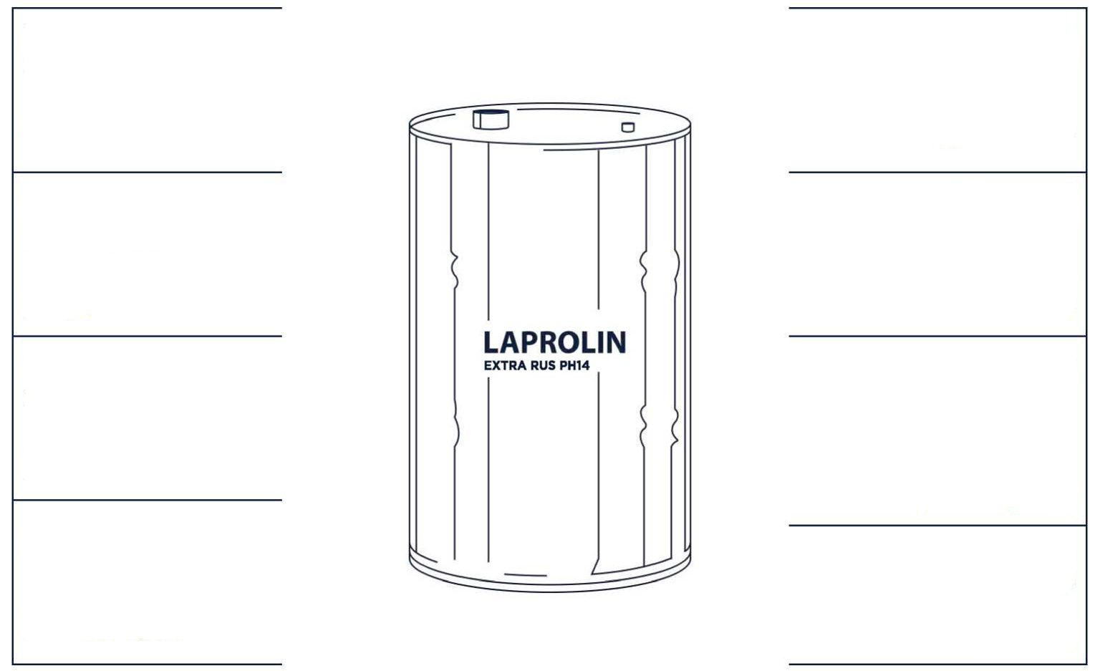
LAPROLIN Polymer Characteristics
Drying time
4-15 hours
Operating temperature*
–70 °С - +130 °С
Flexural resistance
2 mm
Humidity range
25% - 85%
Impact strength
55 cm
Resistant to any aggressive environments
(alkali, sugar, vinegar, benzene group, lactic acid, other acids, except for concentrated hydrochloric, sulfuric and sulfurous acids)
рН 0 - рН 14
Viscosity
15 - 45 c/td
Tensile strength
65 MPa
*up to 190 °C for max 9 hours

Slide 4


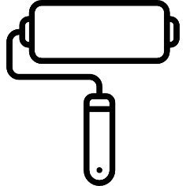
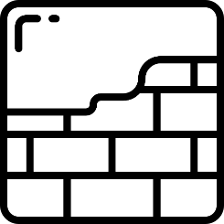
USE OF LAPROLIN POLYMER
The polymer is easy to use:
It is applied with a brush, roller or airless sprayer.
The polymer application rate with a brush or roller per 1 m2 is up to 140 g,
with an airless sprayer it is up to 110 g.
After polymerization, it is irreversible.
It cannot be dissolved and removed with a solvent, petroleum toluene, gasoline or other benzene groups. Mechanical cleaning only.
LAPROLIN is a multipurpose polymer for a wide range of applications:
Anti-corrosion protection of any metal items and surfaces (power transmission poles, pipelines, bridges, tanks, etc.)
Antifouling ship coating (protects ship bottoms against shell build-up, which significantly saves fuel)
Repair compound (polymer concrete) for concrete surfaces and items
Industrial resin flooring (parking lots, shopping centers, warehouses, garages, enterprises)
Repair compound to seal leaks and holes
Waterproofing of foundations and roofs
Anticorrosive protection of any concrete and brick surfaces and items (bridge superstructure, piers, water pipelines, sewage treatment plants)
Protection of ferrous metal vessels as an inexpensive but still reliable alternative to stainless steel vessels
Conserving agent for facades of infrastructure and cultural facilities
Heavy-duty facade finishing coating
Lining for concrete and metal vessels
Protective paint for vehicles, tractors and other equipment

Slide 5
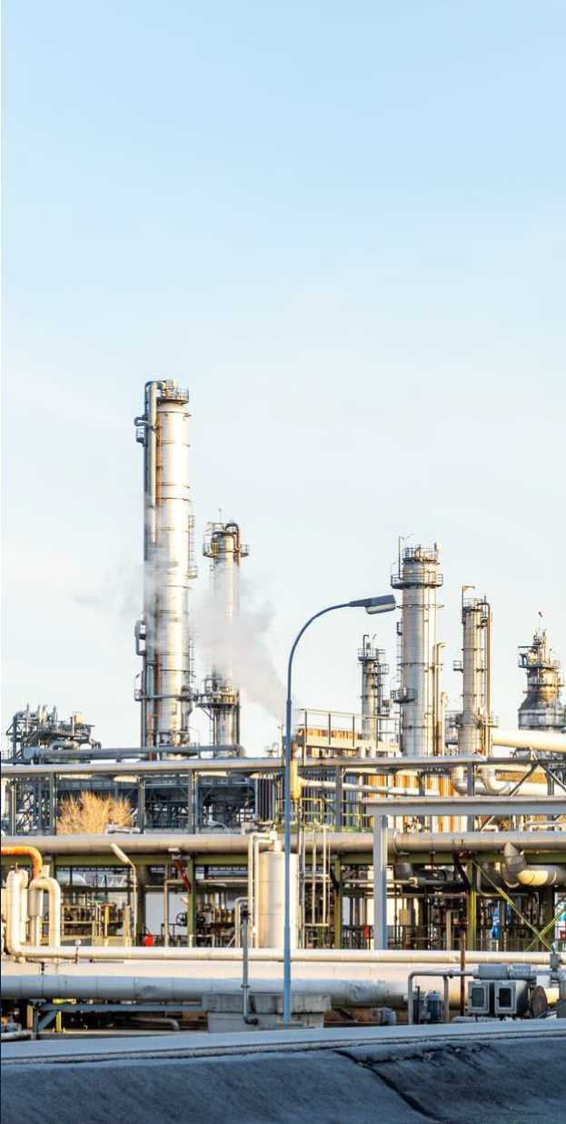


Use of LAPROLIN polymer at Oil and Gas facilities
Protective anti-corrosion and sealing coating:
offshore platforms
oil-and-gas rigs
oil-and-gas pipelines
oil and gas tanks and reservoirs
oil vessels
piping and steel structures
Our products provide a highly reliable protection against corrosion even in rigorous climatic conditions at temperatures from –70 °C to + 130 °C, and up to +190 °C for max 9 hours.
Dried material forms a strong glossy protective film, which,
if necessary, can be strengthened by application of additional layers.

Slide 6
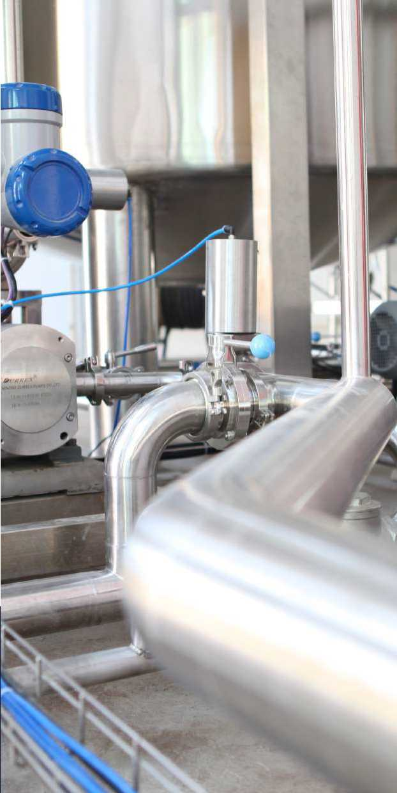

Use of LAPROLIN polymer at Chemical facilities
Wide variety of applications in the chemical industry: from agriculture to capital goods:
tanks and vessels for mixing, storage and transportation of chemical products
devices, machines and mechanisms used in the chemical industry
pipelines
distillation towers
granulators, sublimation plants, agitators and reactors
LAPROLIN protects in both alkaline and acidic environments.
The polymer is suitable for storage and transportation of finished chemical products.

Slide 7
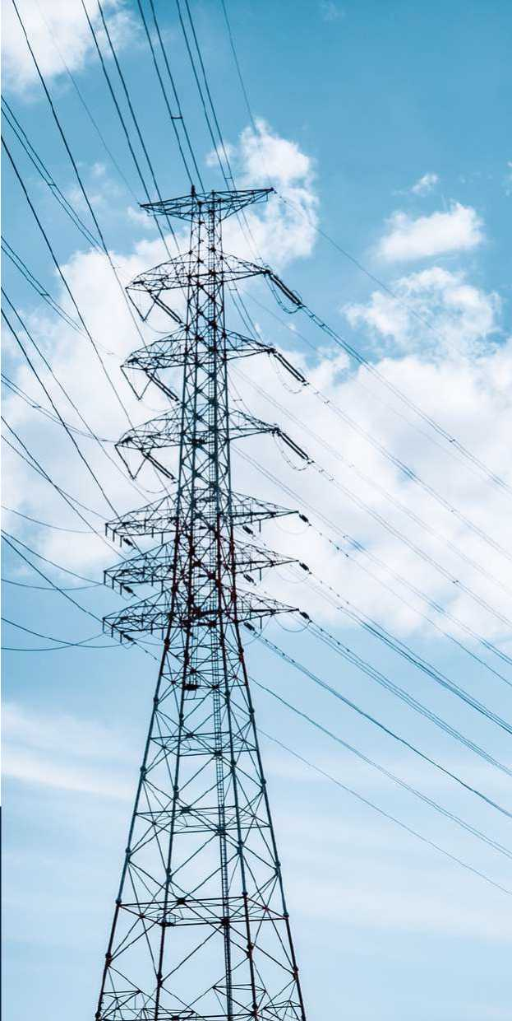
Use of LAPROLIN polymer at
Communication and Energy-generating facilities
Reliable anti-corrosion protection, UV-resistant, with a wide range of operating temperatures, indispensable for energy facilities located in different climatic regions:
power stations
high-tension-line towers
power transmission line poles
radio towers
cellular towers
LAPROLIN Extra Rus pH14 polymer is a dielectric which can be used as an insulator on high voltage surfaces.
Active stray-current protection.

Slide 8
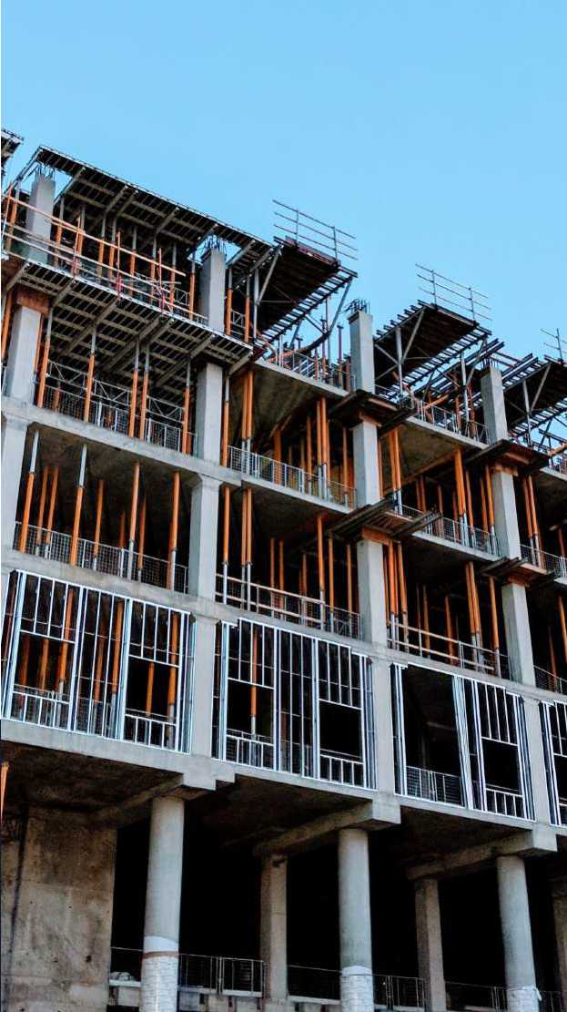
Use of LAPROLIN polymer in
Public Utilities sector and Infrastructure facilities
Not only a protective coating, but also a repair compound for all types of concrete products:
sewage treatment facilities
repair of ramps, staircases, concrete floors
repair of bridges, pillars, piles, tunnels
floors of underground parking lots, production workshops
repair of leaks and holes in concrete structures
When mixed with fine-dispersed materials, the polymers forms an ultra-strong elastic polymer concrete with the highest adhesion.
Technology compliance ensures resistance to strong dynamic loads.

Slide 9
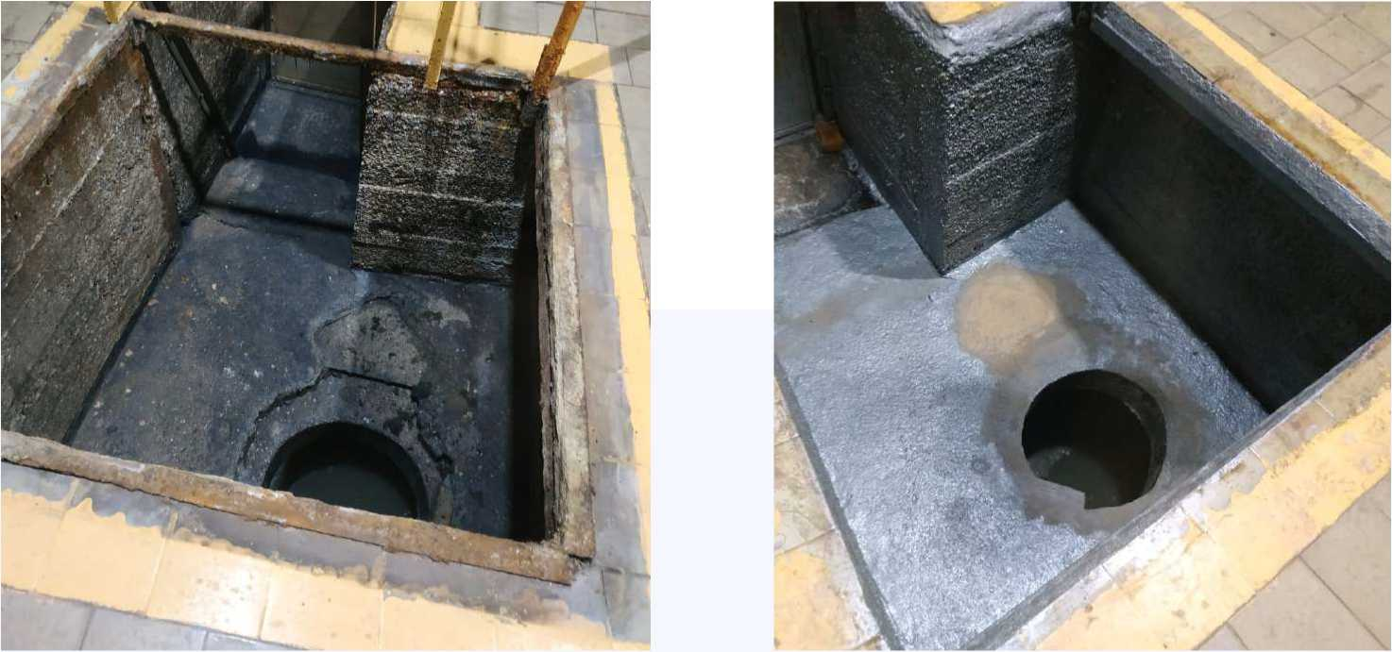
LAPROLIN Extra RUS pH14 Polymer Use Case
Repair of a sewage pumping station
BEFORE
AFTER

Slide 10
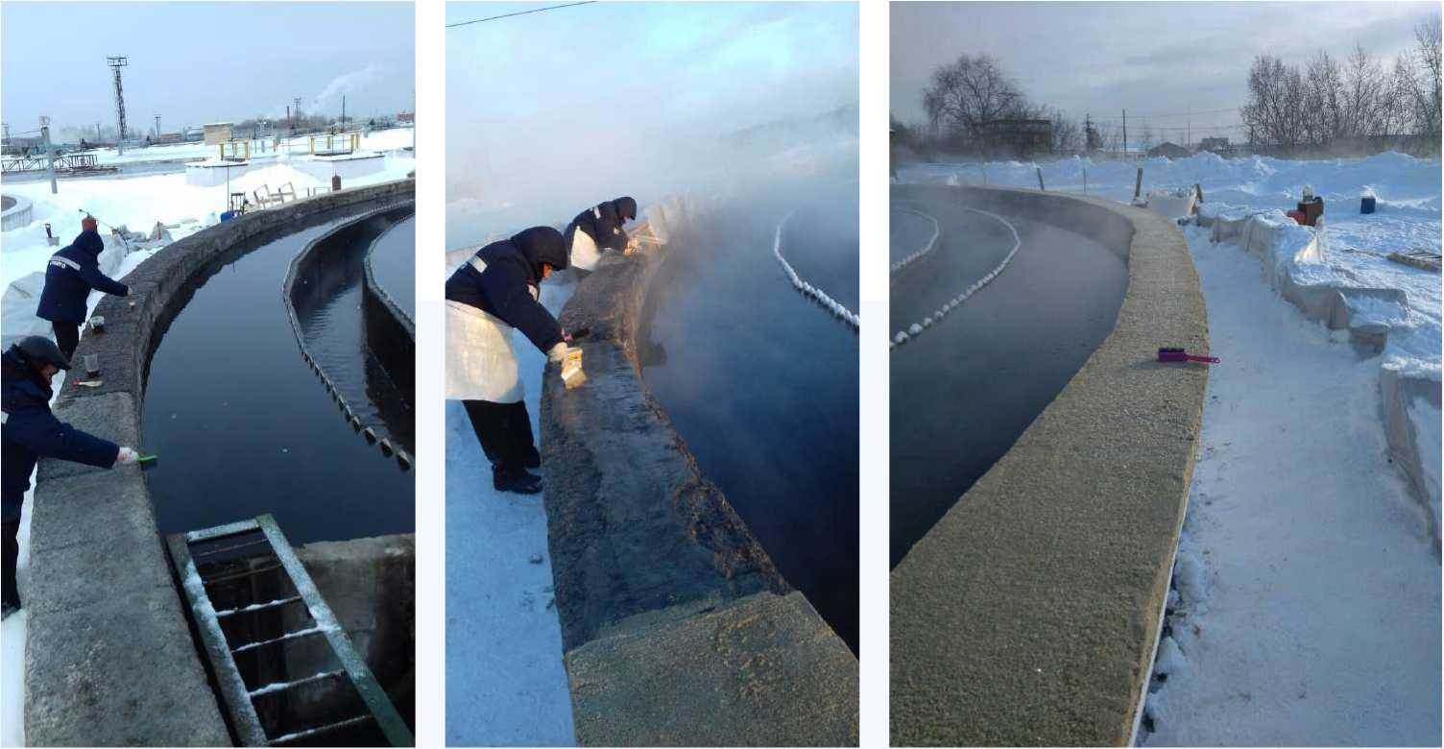
LAPROLIN Extra RUS pH14 Polymer Use Case
Track repairs in winter
BEFORE
AFTER

Slide 11
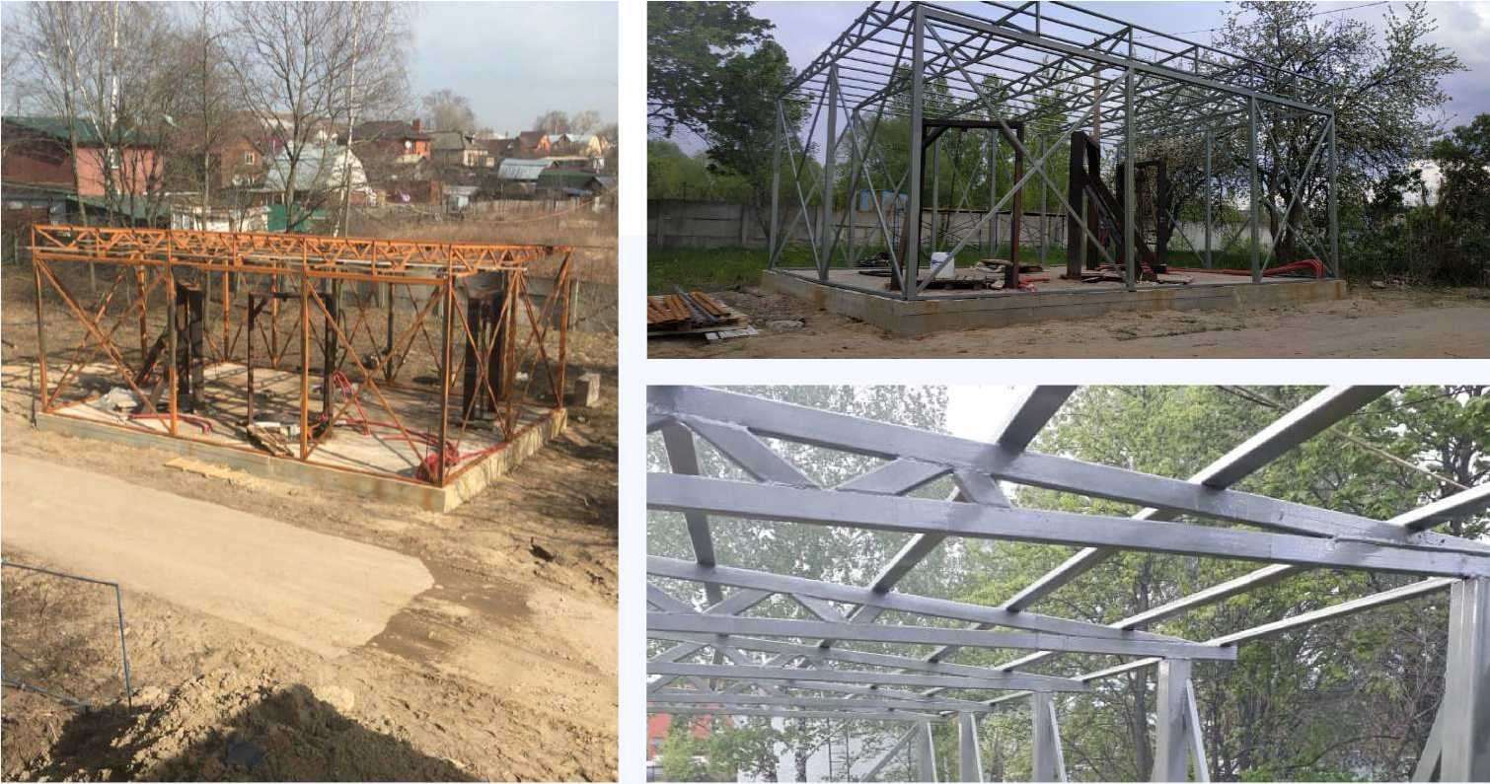
LAPROLIN Extra RUS pH14 Polymer Use Case
Repair and protection of metal structures
BEFORE
AFTER

Slide 12
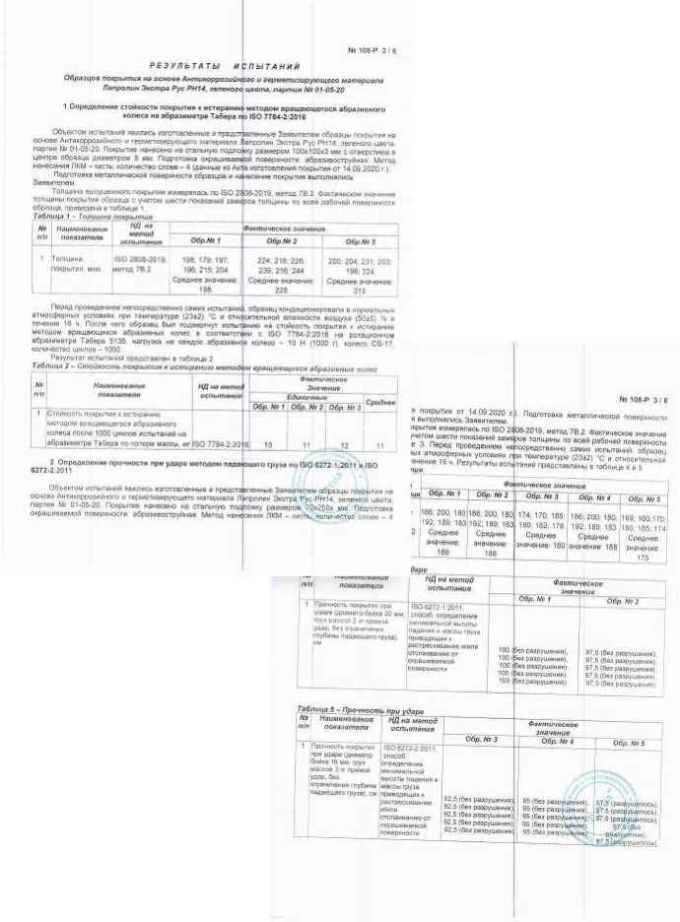

LAPROLIN Polymer binding properties
The polymer is an effective binder for reinforced concrete products and structures.
When mixed with 1.25-1.8 size sand in the proportion
of 10% polymer to 100% sand
(or any other fine-dispersed material),
the polymer produces a good polymer concrete
(repair compound) with very strong adhesion to any conditioned surfaces, and does not form a "cold seam", but pins on the surface at the chemical (intermolecular) level.
LAPROLIN can be mixed and applied at below-freezing temperatures:
up to –15 °C (according to documentation)
up to –50 °C (based on test results)

Slide 13
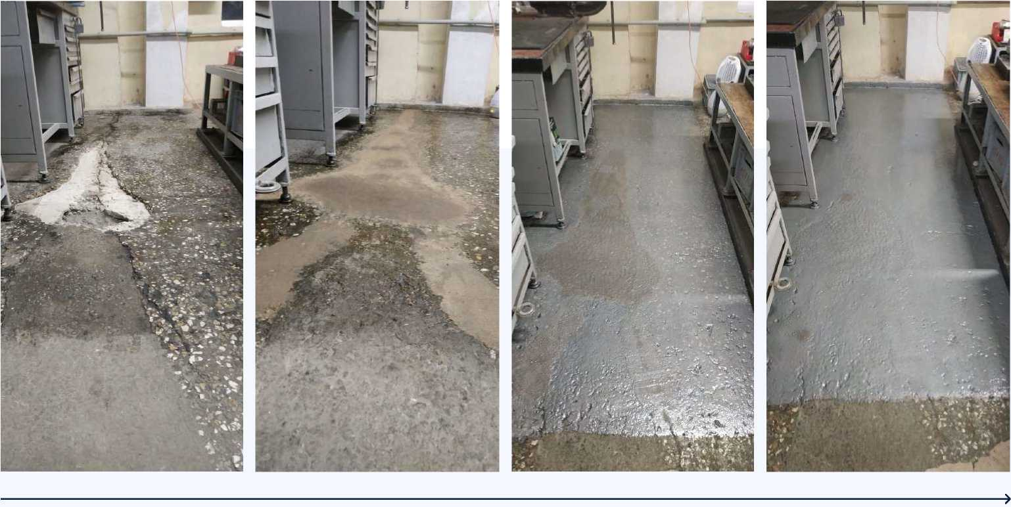
LAPROLIN Extra RUS pH14 Polymer Use Case
Repair and reconstruction of industrial floors
BEFORE
AFTER

Slide 14
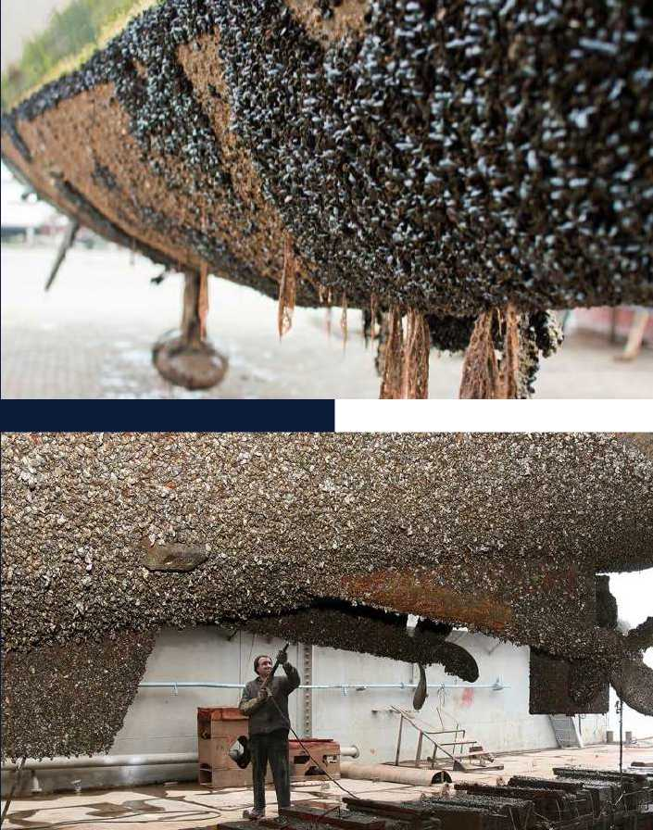
Antifouling ship coating
Ship's hull fouling with shellfish, mussels, algae and other microorganisms affects the following technical characteristics:
Speed
Adhered microorganisms form buildups, sometimes reaching a length of 1 km and weighing up to tens of tons. They make a ship surface uneven and increase the load due to their mass. The speed loss occurs due to a higher resistance when moving.
Fuel consumption rate
Shellfish and microorganisms increase the weight of a ship, which in turn requires an increase in engine rpm. This leads to an increase in fuel consumption rate and negatively impacts the environment.
Integrity
Surface fouling sooner or later leads to a decrease in the skin strength, since when microorganisms die off, they "take away" metal particles.

Slide 15
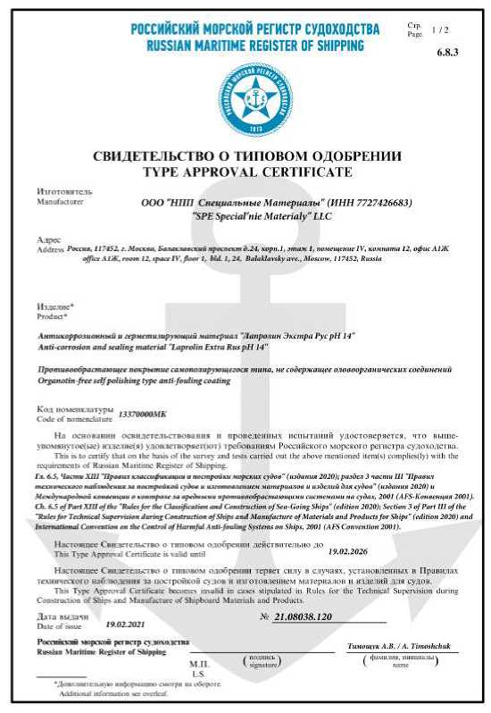

LAPROLIN Extra RUS pH 14 polymer -antifouling ship coating
Laprolin Extra Rus pH 14 has been tested and meets the requirements of the Russian Maritime Register of Shipping, as an anti-fouling coating of ship hulls.
The struggle against adhered microorganisms is facilitated by the absence of organo-tin compounds,
a heavy-duty glossy surface of the material and a secret formula with a fundamentally new breakthrough approach to the problem.
1. Anti-corrosion and sealing properties
2. Protection against shellfish and microorganisms not damaging the surface
3. Surface protection against any aggressive environment in the entire range from pH 0 to pH 14

Slide 16

Suggested use of LAPROLIN Polymer
Protection of metal structures, piping and fences against corrosion, alkaline and acidic media
Protection of all metal and concrete surfaces
Protection of concrete foundations against corrosion and destruction
Minerals transshipment devices
Wear-resistant industrial resin flooring, with high dynamic loads
Car treatment to protect them against corrosion, freezing, salt solutions
Polymer application rate per 1 m²
up to 150 g/m2
with a brush or roller
up to 110 g / m2
with an airless sprayer
NB The cost of the LAPROLIN Polymer system is much cheaper than any coating in the world with similar protective properties.

Slide 17
Comparison of LAPROLIN Extra RUS pH 14 polymer with foreign counterparts
Company | Sigma | UltraTech USA | Hempel | Steelpaint | SPE “Spetsialnye Materialy”
Name | Sigmadur Gloss | UltraTech _ International | Hempatane Enamel | Steelpaint | Laprolin Extra Rus pH 14
Dry residue, % | 60 | 50 | 70 | 75 | 70
Number of layers | 3 | 4 | 3 | 3 | 3
Application rate per layer | 0.25 kg/m2 | 0.20 kg/m2 | 0.30 kg/m2 | 0.28 kg/m2 | 0.15 kg/m2
Total per system | 0.75 kg/m2 | 0.80 kg/m2 | 0.90 kg/m2 | 0.84 kg/m2 | 0.45 kg/m2
Petroleum product resistance | + | + | + | + | +
Water resistance | + | + | + | + | +
Acid resistance | - | - | - | +/- | +
Alkali resistance | + | - | + | + | +
Sea water resistance | + | + | + | + | +
Application method | ALS | ALS | ALS | ALS | ALS
Application conditions | +10 °С or higher | +10 °С or higher | 0 °С or higher | +10 °С or higher | -15 °С or higher
Operating temperature | +90 °С or lower | +90 °С or lower | +100 °С or lower | +100 °С or lower | +130 °С or lower
ALS - airless spraying

Slide 18
Comparison of LAPROLIN Extra RUS pH 14 polymer and urea resin
Product | Laprolin Extra Rus pH 14 | Urea resin
Materials system cost
Tensile strength | 65 MPa | 20 MPa
The cost of application equipment | Airless sprayer - from 50 thousand rubles or a brush/roller from 30 rubles. | Two-component dispenser - from 1.9 million rubles.
Application principle | Applicable to any dry surface. Multi-layered application eliminates the risk of an untreated surface. The polymer binds to the continental surface at the intermolecular level. | Cannot be used on porous surfaces. Is applied in one layer and glued to the surface. Bubbling, gaps in the covering material.
Stability | Resistant to a wide range of aggressive environments from pH 0 to pH 14. UV rated. | Destroyable when exposed to mineral acids, benzene, acetone, toluene. Not UV rated.
Application temperature | Application temperature from –15 °С to +50 °С. Actually applicable at temperatures from –50 °С to +50 °С. | From –10 °С to +30 °С
Guarantee for work | 10 years | 5 years
Work supervision | Complete construction and installation work supervision | No information
Manufacturer | Russian production | Foreign production Prices depend on the exchange rate.

Slide 19
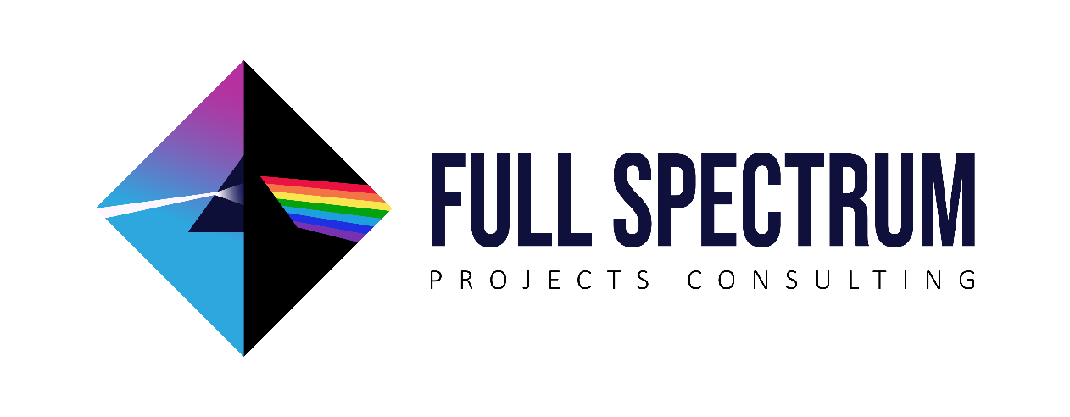


UAE and OMAN
FSPC - The exclusive LAPROLIN distributor for UAE & Oman
For all enquires please contact:
+971 585677459
victor@fspc.ae
www.laprolin.ru

