Slide 2
REVELATION
ROCKPOINTE CHURCH

Slide 3
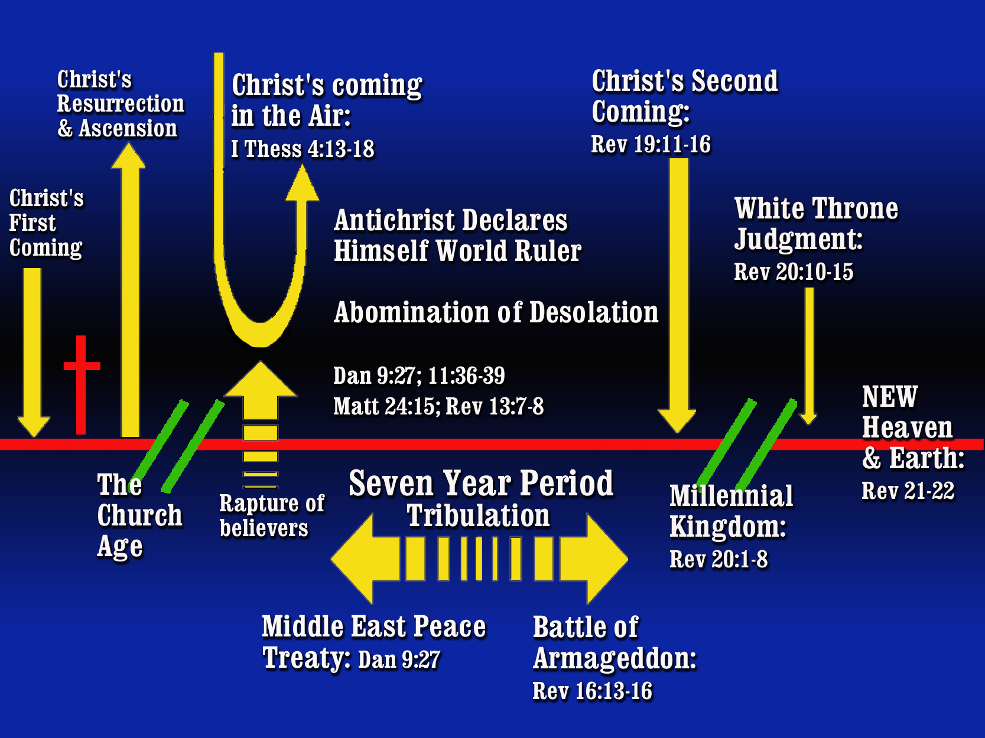
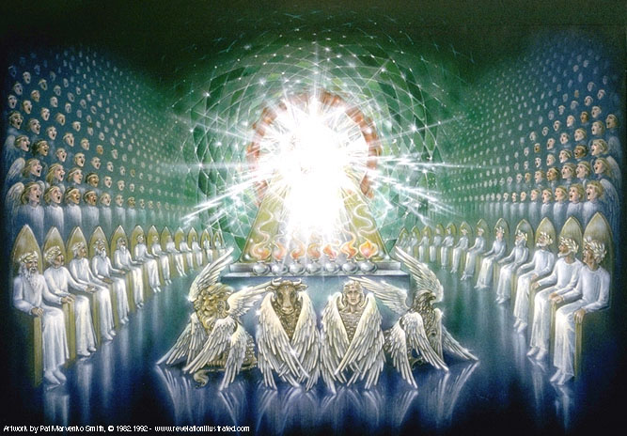





Events in the Throne Room of Heaven
(Revelation 4–5)
(Revelation 1–3)
(Revelation 6–18)

Slide 4

Revelation 6–19 Seals, Trumpets, Bowls
Seal #1
Seal #2
Seal #3
Seal #4
Seal #5
Seal #6
Interlude
#1
Seal #7
Revelation 6-7

Slide 5
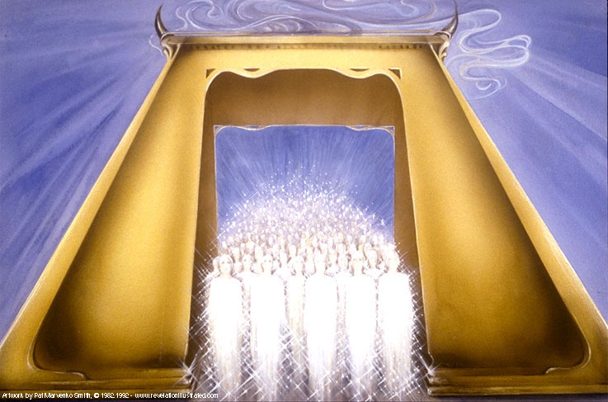
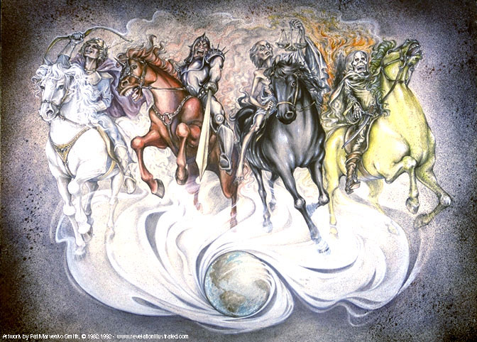
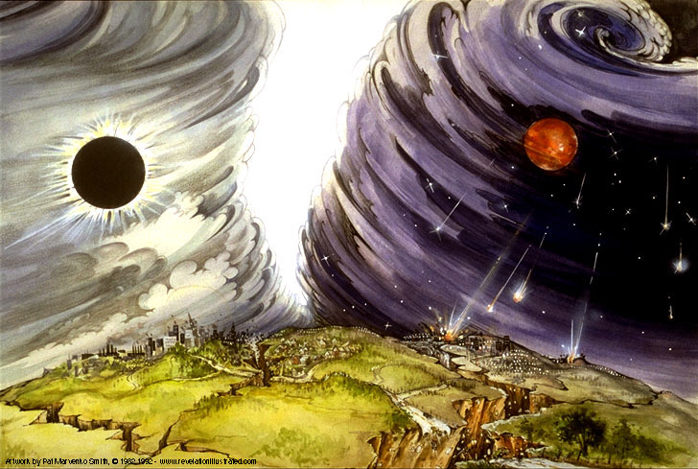
The Seal Judgements
Notes:
Note parallels with Matt 24:1-14 “beginning of birth pains”

Slide 6
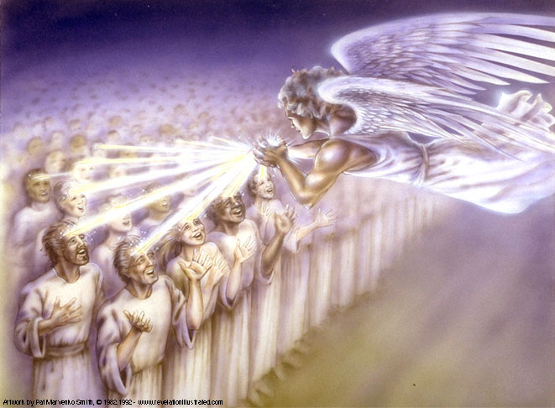
Interlude
#1
Group #1
144,000 Sealed (7:1-8)

Slide 7
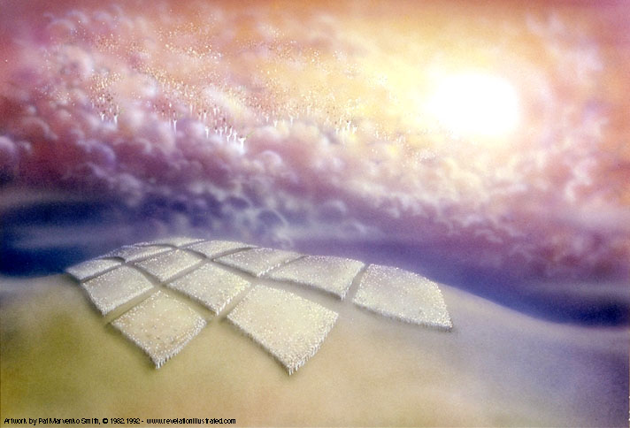
Group #2
The Great Multitude in White Robes ( 7:9-17)
Interlude
#1

Slide 8

Revelation 6-19: Seals, Trumpets, Bowls
Seal #1
Seal #2
Seal #3
Seal #4
Seal #5
Seal #6
Interlude
#1
Seal #7
Revelation 6-7
Interlude
#2
Interlude
#3
Revelation 8-14
Trumpet #1
Trumpet #2
Trumpet #3
Trumpet #4
Trumpet #5
Trumpet #6
Trumpet #7

Slide 9
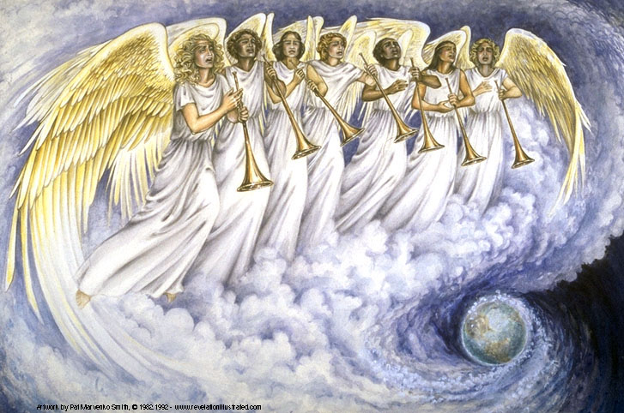
Notes:
The Purpose and Function of the Seals and the Seven Trumpets is to reveal the righteousness, holiness and justice of God in terrifying and traumatic ways

Slide 10
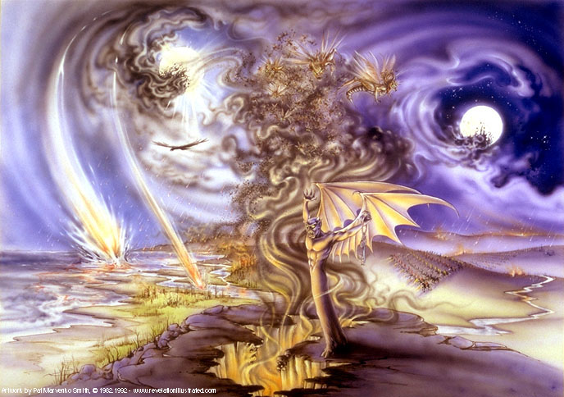
The Trumpet Judgements

Slide 11
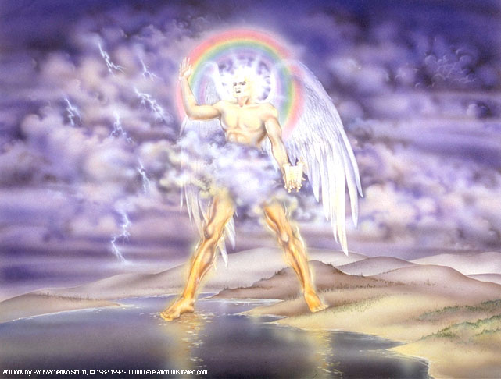
Interlude
#2
A Strong Angel with a Little Scroll
(Revelation 10:1-11)

Slide 12
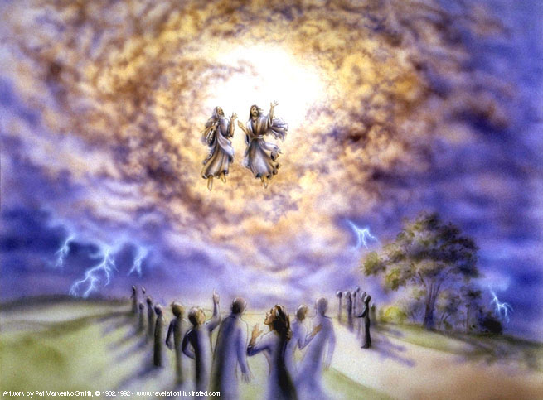
Interlude
#2
Two Witnesses
(Revelation 11:1-14)

Slide 13
Now:
Seventh Trumpet then Interlude #3

Slide 14
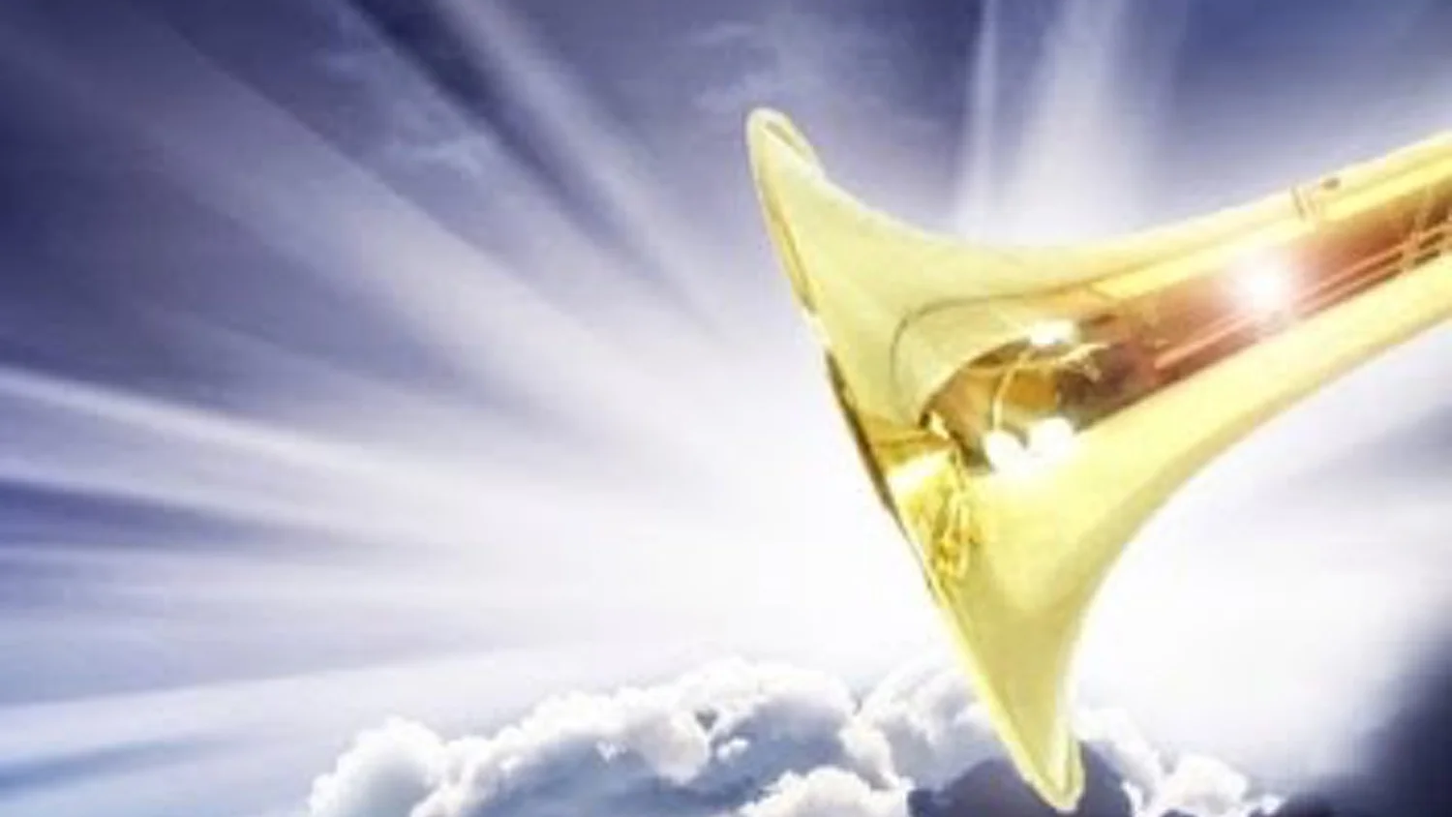
The Seventh Trumpet introduces the coming Seven Bowls
But before the Seals there is Interlude #3
Notes:
In Rev 8:1–6 the chronology picks up again when the seventh seal is opened, and it contains the seven trumpets, the first 6 of which are described in 8:7–9:21.
Silence in heaven Heaven is a noisy place. Fall silent. Shock and awe
The silence before the storm
Time in Heaven?

Slide 15
Revelation 6–19 Seals, Trumpets, Bowls
Seal #1
Seal #2
Seal #3
Seal #4
Seal #5
Seal #6
Interlude
#1
Seal #7
Revelation 6-7
Interlude
#2
Interlude
#3
Revelation 8-14
Trumpet #1
Trumpet #2
Trumpet #3
Trumpet #4
Trumpet #5
Trumpet #6
Trumpet #7

Slide 16
Interlude #3
Rev 12–14
The Radiant Woman and Evil Dragon
War in Heaven and Satan is Cast Out
3. Evil Beast out of the Sea
4. Evil Beast out of the Land
5. The Lamb and the 144,000 in Heaven
6. Messages of the Three Angels
7. The Harvest of the Earth

Slide 17
REVELATION
ROCKPOINTE CHURCH

Slide 18
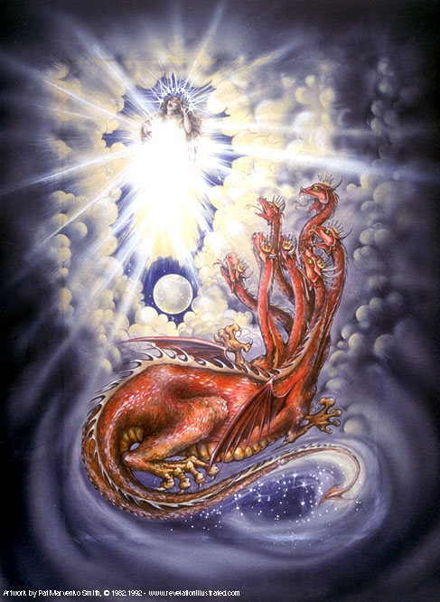
Interlude #3
Rev 12–14
The Radiant Woman and the Evil Dragon (12:1-6)

Slide 19
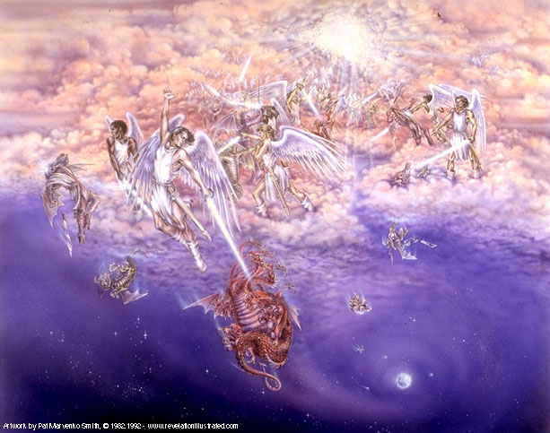
Interlude #3
Rev 12–14
2. War in Heaven and Satan is Cast Out (12:7-17)

Slide 20
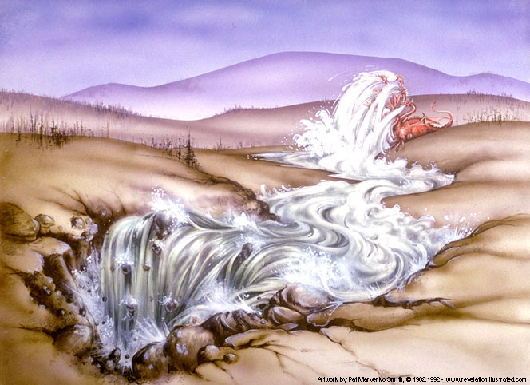
Satan Now will Seek to Destroy Anyone who Believes in Jesus (Rev 12:17)

Slide 21
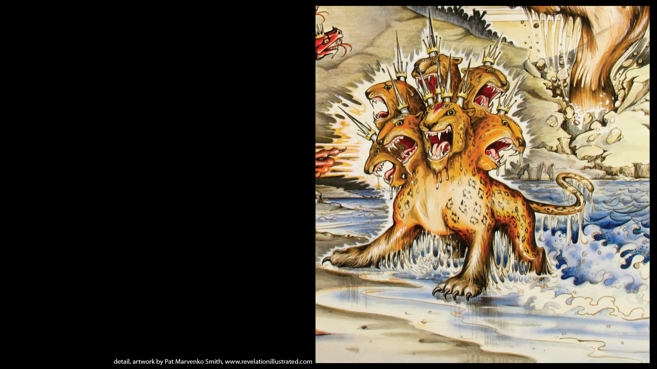
Interlude #3
Rev 12–14
3. Evil Beast Out of the Sea (13:1-10)

Slide 22
Interlude #3
Rev 12–14
3. Evil Beast Out of the Land (13:11-18)

Slide 23
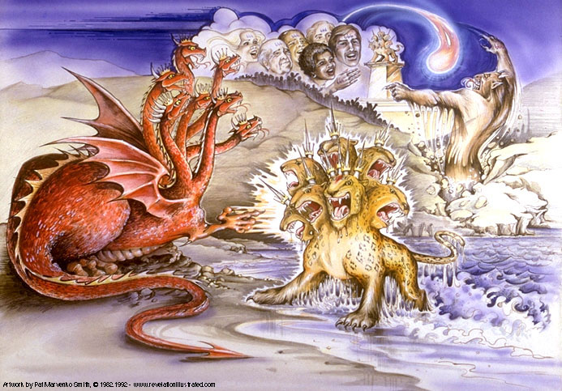
The Unholy Trinity: the Dragon, the Beasts from the Sea and Land (Revelation 13)

Slide 24
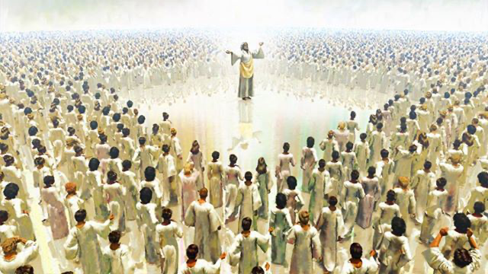
Interlude #3
Rev 12–14
5. The Lamb and the 144,000 in Heaven (14:1-5)

Slide 25
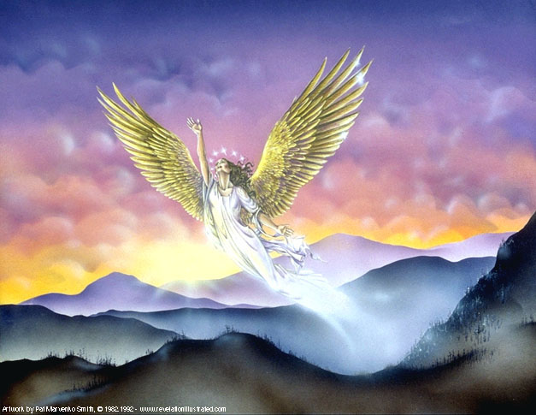
Interlude #3
Rev 12–14
6. Messages of the Three Angels (14:6-13)

Slide 26
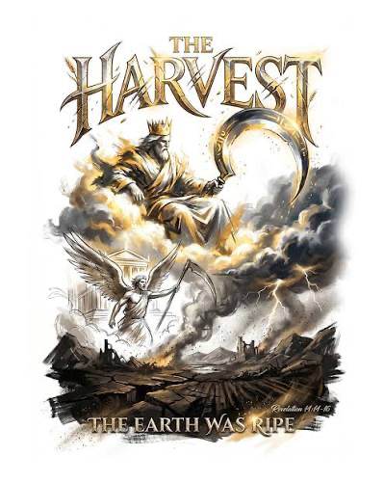
Interlude #3
Rev 12–14
7. Great Harvest of the Earth (14:14-20)

Slide 27
Interlude #3
Rev 12–14
The Radiant Woman and Evil Dragon
War in Heaven and Satan is Cast Out
3. Evil Beast out of the Sea
4. Evil Beast out of the Land
5. The Lamb and the 144,000 in Heaven
6. Messages of the Three Angels
7. The Harvest of the Earth

