Slide 1
REVELATION
ROCKPOINTE CHURCH

Slide 2
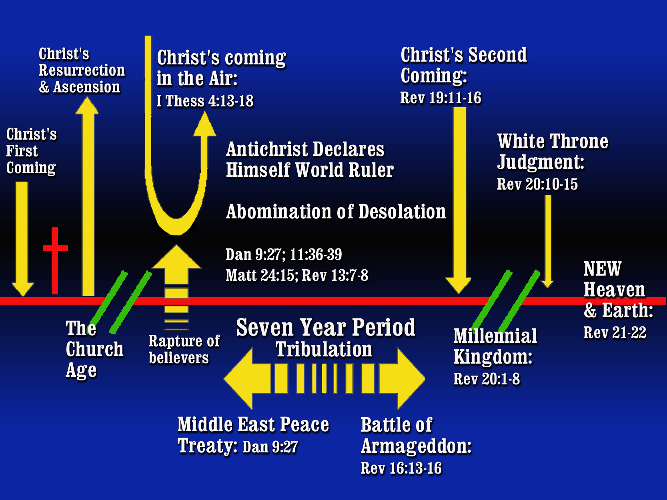
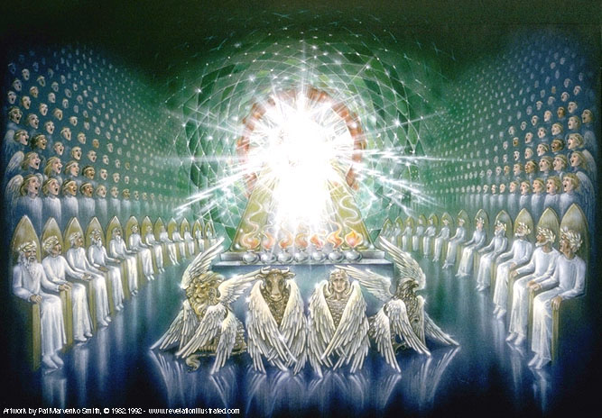



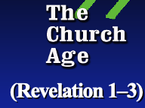

Events in the Throne Room of Heaven
(Revelation 4–5)
(Revelation 1–3)
(Revelation 6–18)

Slide 3
REVELATION
ROCKPOINTE CHURCH

Slide 4

Revelation 6–19 Seals, Trumpets, Bowls
Seal #1
Seal #2
Seal #3
Seal #4
Seal #5
Seal #6
Interlude
#1
Seal #7
Revelation 6-7
Notes:
Contain events when God’s judgement is
God's judgment in the Book of Revelation is God's final, holy action to stop evil, right every wrong, and show His ultimate justice on earth. [1, 2]
The book shows this judgment through a series of escalating plagues and a final courtroom scene
Leading up to the Great White Throne Judgment in chap 20
-demonstrates his power and authority because of his death and resurrection
-God is reigning but He has not demonstrated His absolute authority and Christ breaks the seals and begins to bring it down on this earth.

Slide 5
Revelation 6–19 Seals, Trumpets, Bowls
Seal #1
Seal #2
Seal #3
Seal #4
Seal #5
Seal #6
Interlude
#1
Seal #7
Revelation 6-7

Slide 6
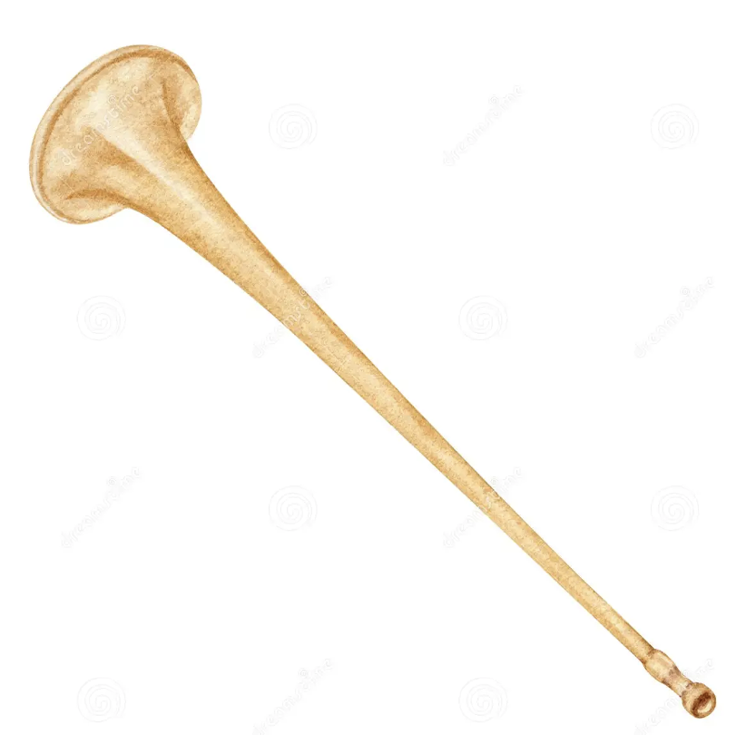
Revelation 6–19 Seals, Trumpets, Bowls
Seal #1
Seal #2
Seal #3
Seal #4
Seal #5
Seal #6
Interlude
#1
Seal #7
Revelation 6-7
Interlude
#2
Interlude
#3
Revelation 8-14
Trumpet #1
Trumpet #2
Trumpet #3
Trumpet #4
Trumpet #5
Trumpet #6
Trumpet #7

Slide 7
Revelation 6–19 Seals, Trumpets, Bowls
Seal #1
Seal #2
Seal #3
Seal #4
Seal #5
Seal #6
Interlude
#1
Seal #7
Revelation 6-7
Interlude
#2
Interlude
#3
Revelation 8-14
Trumpet #1
Trumpet #2
Trumpet #3
Trumpet #4
Trumpet #5
Trumpet #6
Trumpet #7

Slide 8
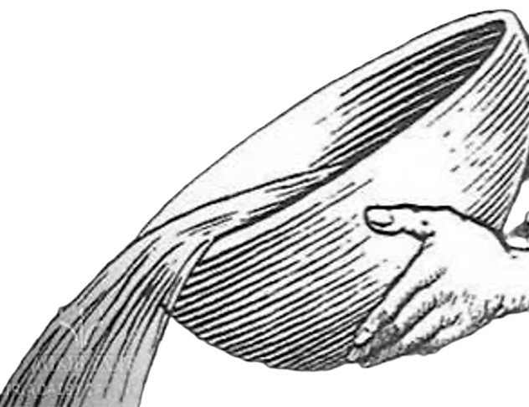
Revelation 6–19 Seals, Trumpets, Bowls
Seal #1
Seal #2
Seal #3
Seal #4
Seal #5
Seal #6
Interlude
#1
Seal #7
Revelation 6-7
Interlude
#2
Interlude
#3
Revelation 8-14
Trumpet #1
Trumpet #2
Trumpet #3
Trumpet #4
Trumpet #5
Trumpet #6
Trumpet #7
Interlude
#4
Interlude
#5
Revelation 15-18
Bowl #1
Bowl #2
Bowl #3
Bowl #4
Bowl #5
Bowl #6
Bowl #7

Slide 9
Revelation 6–19 Seals, Trumpets, Bowls
Seal #1
Seal #2
Seal #3
Seal #4
Seal #5
Seal #6
Interlude
#1
Seal #7
Revelation 6-7
Revelation 6
Notes:
Contain events when God’s judgement is
God's judgment in the Book of Revelation is God's final, holy action to stop evil, right every wrong, and show His ultimate justice on earth. [1, 2]
The book shows this judgment through a series of escalating plagues and a final courtroom scene
Leading up to the Great White Throne Judgment in chap 20
-demonstrates his power and authority because of his death and resurrection
-God is reigning but He has not demonstrated His absolute authority and Christ breaks the seals and begins to bring it down on this earth.

Slide 10
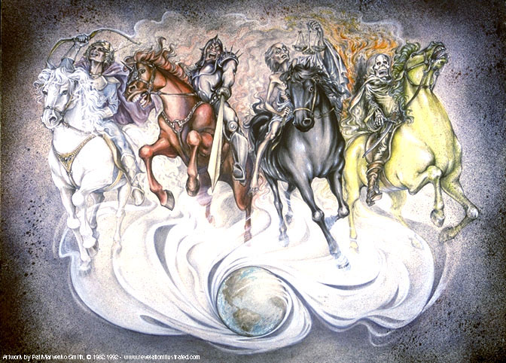
First Seal: White Horse (6:1-2) Conquest
Second Seal: Red Horse (6:3-4) War
Third Seal: Black Horse (6:5-6) Famine
Fourth Seal: Pale Horse (6:7-8) Death for ¼ of People
Notes:
Note parallels with Matt 24:1-14 “beginning of birth pains”

Slide 11
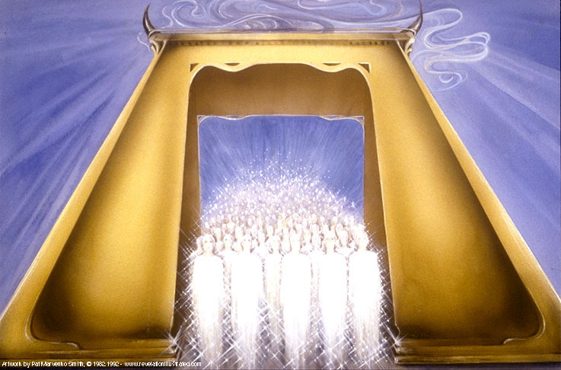
Fifth Seal: Souls Under the Altar (6:9-11)
Martyrdom
Notes:
-this seal assumes the killing of believers on earth
-they are then taken directly to heaven but, like OT believers in the first 483 years, await their resurrected bodies (just “souls”) yet they are given robes (signs) of righteousness
-more martyrs to follow
-later, in chapter 7, we will find out about how they knew what to believe

Slide 12
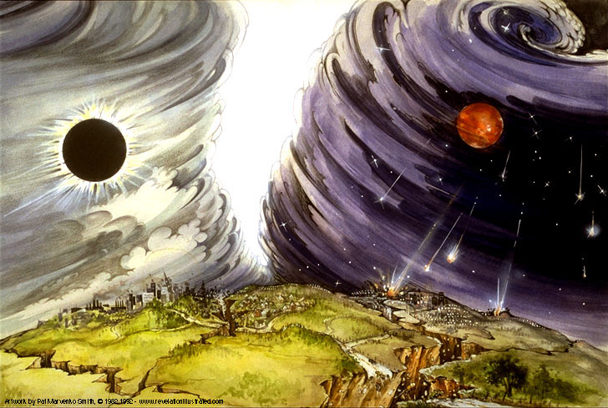
Sixth Seal: The Great Earthquake (6:12-17)
Terrible Destruction

Slide 13
Revelation 6–19 Seals, Trumpets, Bowls
Seal #1
Seal #2
Seal #3
Seal #4
Seal #5
Seal #6
Interlude
#1
Seal #7
Revelation 6-7
Revelation 7
Revelation 6
Notes:
Contain events when God’s judgement is
God's judgment in the Book of Revelation is God's final, holy action to stop evil, right every wrong, and show His ultimate justice on earth. [1, 2]
The book shows this judgment through a series of escalating plagues and a final courtroom scene
Leading up to the Great White Throne Judgment in chap 20
-demonstrates his power and authority because of his death and resurrection
-God is reigning but He has not demonstrated His absolute authority and Christ breaks the seals and begins to bring it down on this earth.

Slide 14
REVELATION
ROCKPOINTE CHURCH
Interlude #1 and then the Seven Seal (Chapters 7:1 –11:14)
1. 144,000 and A Great Multitude (Revelation 7)

Slide 15
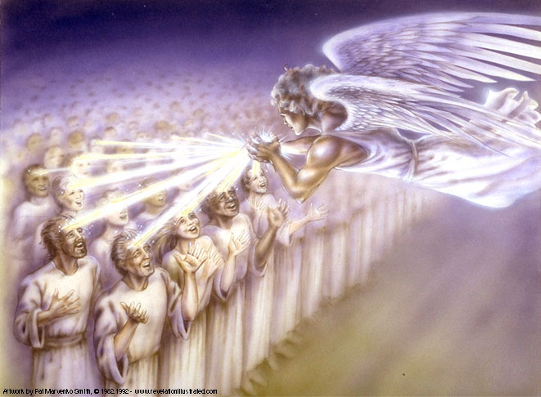
Interlude
#1
Group #1
144,000 Sealed (7:1-8)

Slide 16
REVELATION
ROCKPOINTE CHURCH

Slide 17
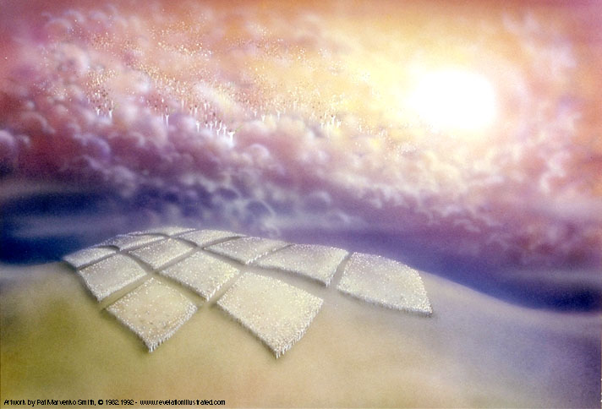
Group #2
The Great Multitude in White Robes ( 7:9-17)
Interlude
#1

Slide 18
REVELATION
ROCKPOINTE CHURCH

Slide 19
REVELATION
ROCKPOINTE CHURCH
Interlude #1 and then the Seven Seal (Chapters 7:1 –11:14)
2. Seventh Seal Reveals Seven Trumpets (Revelation 8–9)
REVELATION
ROCKPOINTE CHURCH

Slide 20
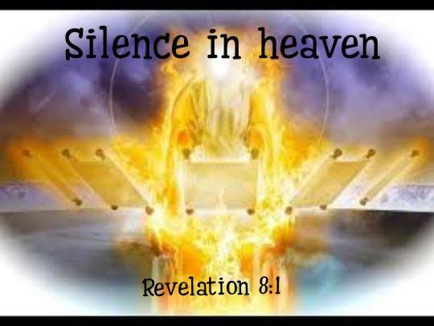

The Seventh Seal

Slide 21
The Seventh Seal
Notes:
Worship in Heaven is stilled
What is seen takes some time to process, it’s so terrible nothing can be said

Slide 22
Revelation 6–19 Seals, Trumpets, Bowls
Seal #1
Seal #2
Seal #3
Seal #4
Seal #5
Seal #6
Interlude
#1
Seal #7
Revelation 6-7

Slide 23
Revelation 6–19 Seals, Trumpets, Bowls
Seal #1
Seal #2
Seal #3
Seal #4
Seal #5
Seal #6
Interlude
#1
Seal #7
Revelation 6-7
Interlude
#2
Interlude
#3
Revelation 8-14
Trumpet #1
Trumpet #2
Trumpet #3
Trumpet #4
Trumpet #5
Trumpet #6
Trumpet #7

Slide 24
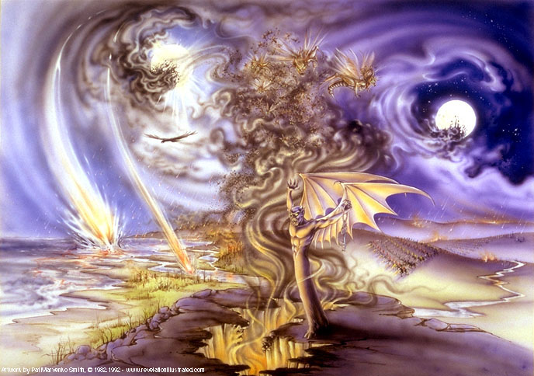
The First Six Trumpets (8:2-21)
Notes:
#1 1/3 of the Earth Burned (Rev 8:6-7)
#2 1/3 of the Sea Turned to Blood (Rev 8:8-9)
#3 1/3 of River Water turned Bitter (Rev 8:10-11)
#4 1/3 of the Sun/Moon/Stars turned Black (Rev 8:12)
Woe, Woe, Woe
#5 Locusts [Demons from the Pit] (Rev 8:13-9:12)
#6 Four (Evil) Angels (and armies) from the Euphrates (Rev 9:13-21)

Slide 25
REVELATION
ROCKPOINTE CHURCH

Slide 26
REVELATION
ROCKPOINTE CHURCH
Interlude #1 and then the Seven Seal (Chapters 7:1 –11:14)
3. A Strong Angel with a Little Scroll and then Two Witnesses (Revelation 10:1–11:14)
REVELATION
ROCKPOINTE CHURCH

Slide 27
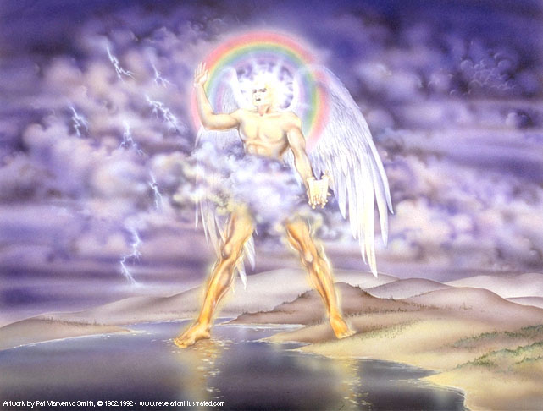
Interlude
#2
A Strong Angel with a Little Scroll
(Revelation 10:1-11)
Notes:
I. A Strong Angel (10:1-2)
II. The Startling Announcements (10:3-7)
III. The Unusual Assignment (10:8-10)

Slide 28
REVELATION
ROCKPOINTE CHURCH

Slide 29
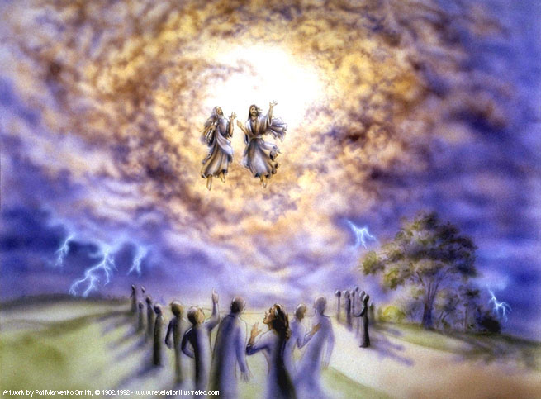
Interlude
#2
Two Witnesses
(Revelation 11:1-14)

Slide 30
REVELATION
ROCKPOINTE CHURCH
Notes:
Application:
God desires all peoples to be saved, He gives witnesses throughout this period of great judgment

