Slide 1

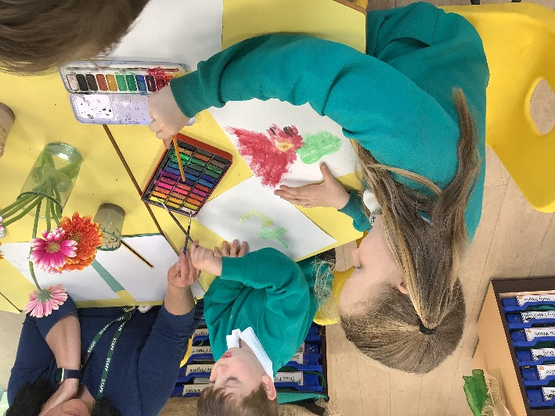
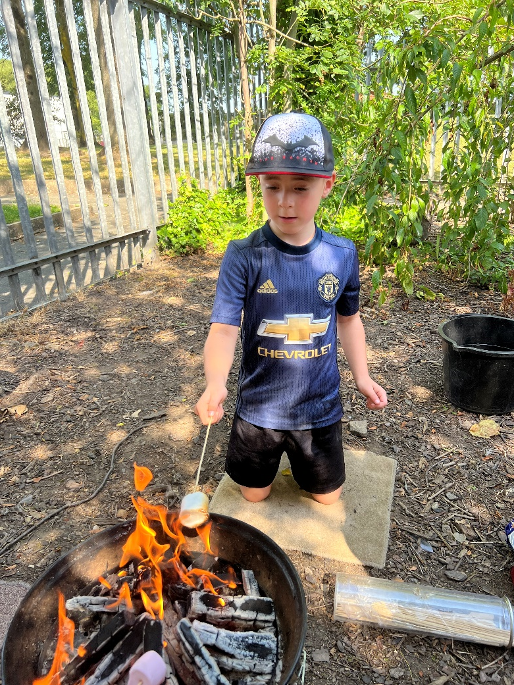
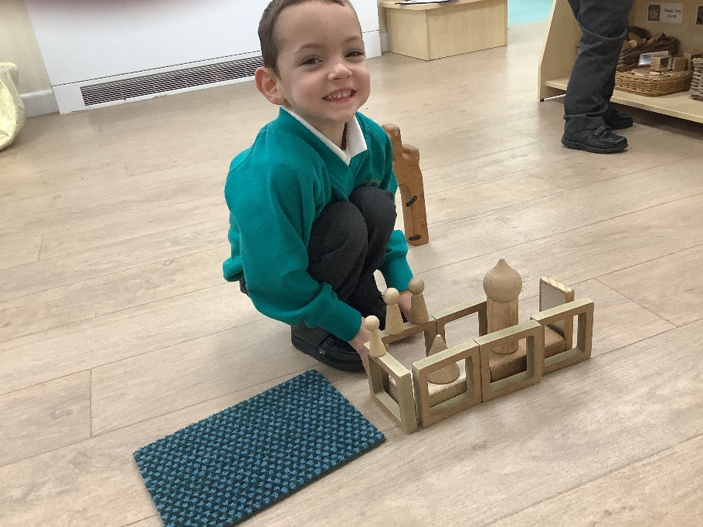
St. Aidan’s Catholic Primary School
Early Years Curriculum
Our Vision
At St. Aidan’s we strive to create unique, happy and independent children, who learn through play to make their own choices in an active and stimulating learning environment. Children are supported by caring adults who encourage children to think critically, communicate with each other, be resilient, have a positive attitude, persevere and develop skills for life.

Slide 2
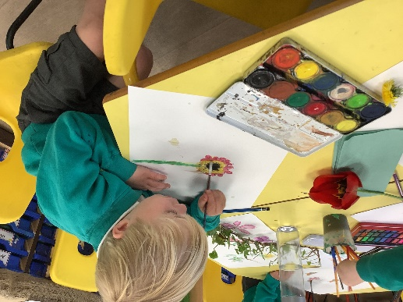
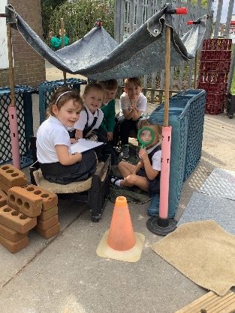
Early Years Curriculum Rationale
At St. Aidan’s we are eager to learn! We want our youngest children to love their educational experiences. We want them to succeed, to have ambitions and grow up wanting to be whatever they choose to be. The principles of the Early Years Foundation Stage are to develop the unique child, providing care and support in a safe environment so that every child’s full potential is reached. Positive relationships ensure that children feel secure, whilst a rich and varied learning environment allows children to discover the world around them and provides opportunities for challenge whilst remaining safe.
Children require opportunities to develop independence and self-confidence in an environment where they feel valued, respected and cared for. Clear rules help each child feel safe, whilst high but realistic expectations encourage each child to strive to achieve their best. All children develop at different rates and learn in different ways. Well planned experiences in all areas of learning and development are essential, with purposeful play underpinning the delivery of the Early Years education.
A high-quality Early Years education lays the foundations for children, with a focus on developing the whole child and to ensure ‘school readiness’. The EYFS provides children with a broad range of learning opportunities with the aim to embed firm foundations in the knowledge and skills needed for good future progress. We aim to develop children’s cultural capital so that they are able to engage with society and understand the importance of being a good UK and global citizen.

Slide 3
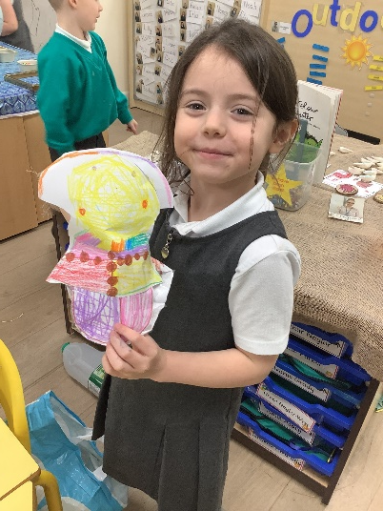
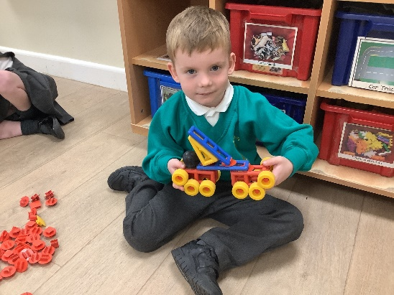
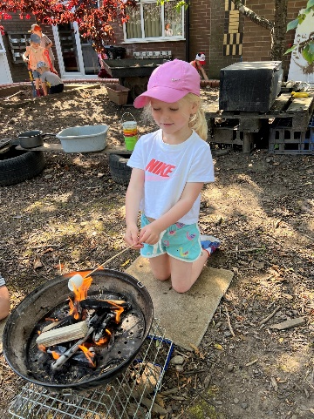
Curriculum Intent
The intent for our children is to enter the next stage of their education ready to tackle new challenges with confidence and a positive mind set. We will engage our pupils in a stimulating environment led by the children yet carefully organised and managed by adults. Providing a curriculum responsive to individual starting points and needs. We want our children to take the lead in their own learning, encouraging confidence to explore new ideas, think about problems, take risks, make links and seek challenge.
They will develop high levels of engagement, curiosity, collaboration and cooperation and become adept at managing their own behaviour in the classroom and in social situations. Children will express themselves with confidence in a meaningful way. Respecting the opinions and values of themselves and others. Through careful consideration of the Characteristics of Effective Learning, our curriculum will give the children skills for learning in and outside of the classroom to become lifelong learners.

Slide 4
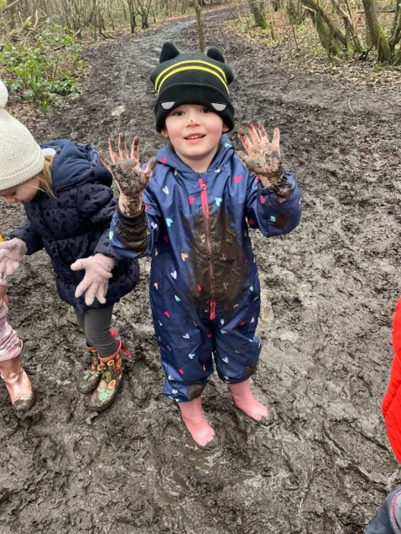
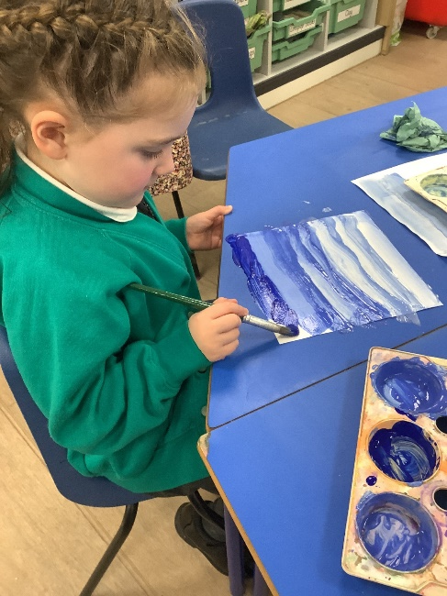
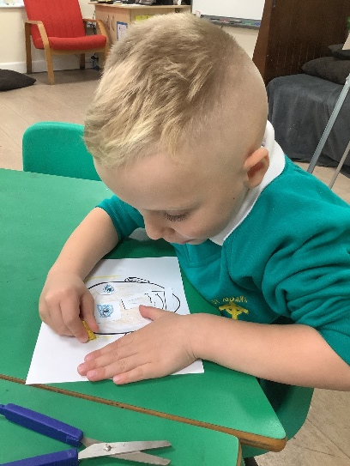
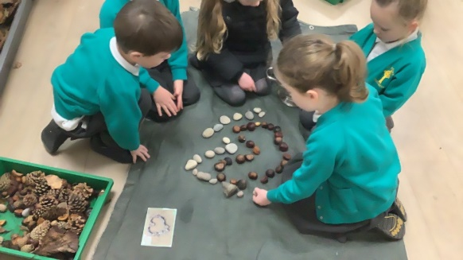
Curriculum Implementation
Across our EYFS, we follow the Early Years Statutory Framework. This Framework specifies the requirement for learning and development in the Early Years and provides prime and specific areas of learning we must cover in our curriculum.
Prime Areas
• Personal, Social and Emotional Development
• Physical Development
• Communication and Language development
Specific Areas
• Literacy
• Mathematics
• Understanding the World
• Expressive Arts and Design

Slide 5
Curriculum Implementation
We incorporate the Characteristics of Effective Learning (COEL) into our teaching and learning experiences. The children are taught the skills required in the EYFS through half-termly themes which are coherently planned to build upon the children’s current knowledge and understanding by a cumulative sequence of lessons. The pupils are encouraged to wonder and ask questions about what they are learning and this information is used to plan subsequent lessons. Parents are regularly informed about their child’s progress through Seesaw.
Our approach is influenced by the work of educationalists, researchers, psychologists and practitioners who have guided our knowledge of how young children learn and how adults can support their learning.
“Knowledgeable practitioners appreciate that adult-led learning offers a child something different from, but complementary to, child led learning and it is one without the other that leads to an impoverished educational experience.” Fisher, 2016. At St. Aidan’s provision is underpinned by a complementary relationship between adult led, adult-initiated and child led learning. We are ambitious in our approach using a continuous cycle of observation and assessment, planning/teaching, alongside structured and systematic lessons and guided group work.
In our Early Years classroom, children will receive a well planned balance of adult and child led learning. In Reception, children will take part in a ‘Shared Input’ four times a day as a whole class covering the specific areas of maths and phonics alongside covering other subjects relating to our theme for learning. Our curriculum has been planned alongside subject leaders to ensure that children are ready for the next stage in their learning, using the curriculum documents ‘Development Matters’ 2020 alongside ‘Little Wandle Letters and Sounds’ and ‘White Rose’ maths. There will also be a range of adult led focused groups where short focused groups are planned for Writing, Reading, Maths, RE, PSED, Physical development, Expressive Arts and Understanding the World these relate to the inputs that have been given during the week. These sessions are planned with care, meeting the needs of all children, using prior knowledge of the child’s learning experiences, guidance from the EYFS document ‘Development Matters’, 2020 and have been planned to ensure the children have the skills and knowledge required for the next stage in their education.
Continuous Provision is an integral part of our curriculum offer;
“To continue the provision for learning in the absence of an adult.” Alistair Bryce-Clegg, 2013
Indoors and outdoors resources are organised to develop children’s skills in personal interaction and exploration and are linked to current assessment data. Resources are carefully selected to meet the development needs of the children in order to enhance potential for new learning and consolidate prior learning. Resources are dressed/displayed to reflect children’s interests – discover, experiment and explore key themes. Continuous provision encompasses all areas of learning and provides children with the opportunity to demonstrate the three characteristics of effective learning. Children are given the freedom to make independent choices and are encouraged to be active learners and take control of their own learning.

Slide 6
Curriculum Impact
Through the delivery of a well-planned, child-led and challenging curriculum we aim that the pupils will leave the Early Years Foundation Stage as independent learners, with transferrable skills needed to start Key Stage One. This will be measured at the end of Reception against the Early Learning Goals and as to whether the pupils have achieved a Good Level of Development. We have devised our own Curriculum Goals based on our own unique curriculum that state what we want children to achieve by the end of their Early Years journey.
To become a Confident Communicator who can listen carefully in different situations, hold a conversation with friends and adults, ask relevant questions and use new vocabulary to explain ideas and feelings. | To become an Independent Individual who can follow the class rules and can show resilience and make own choices when selecting own learning. They follow rules, set simple goals and persevere to achieve them. They manage their own personal needs and know how to stay fit and healthy. | To become a Fantastic Friend who can be kind, caring and helpful, show empathy and respect to others, work and play co-operatively whilst considering others’ ideas and feelings. | To become an Amazing Athlete who can show strength, balance and co-ordination when playing, move confidently and safely in a variety of different way and use a range of equipment.
To become a Talented Tool User who can hold a pencil effectively, use a range of tools (for example scissors, cutlery, paintbrushes, tweezers, hammer, screwdrivers) safely and with confidence. | To become a Brilliant Bookworm who can show a love for reading, use new vocabulary to talk about what they have read or has been read to them, read words and simple sentences (using single sounds and digraphs they have learnt) | To become a Wow Writer who can write letters that are formed correctly, write words and simple sentences (using single sounds and digraphs they have learnt) that can be read by others. | To become a Master of Maths who can show a deep understanding of numbers to 10, recognise patterns within the number system, subitise, compare quantities and recall number bonds to 5.
To become an Exceptional Explorer who can show curiosity about the world around them, understand how to read and draw a simple map, understand some differences between times and places. | To become a Caring Citizen Who has an understanding of their own identity and an awareness of other people’s culture and beliefs. Who knows about where we live and show responsibility when looking after our classroom and the wider environment. | To become a Proud Performer who can perform a song, poem or dance to an audience, retell stories with expression and confidence and play instruments. | To become a Dynamic Designer who can make their own choices and safely use the resources they need to make their creations, talk about what they have made and how they have made it.

Slide 7
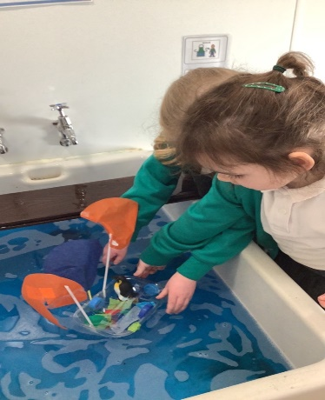
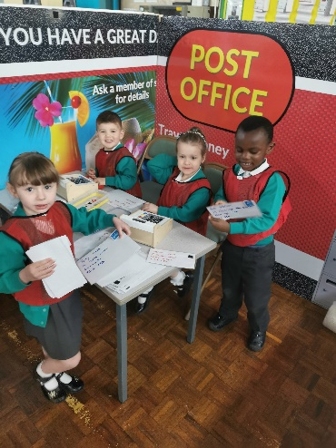
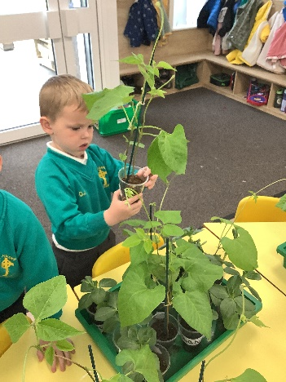
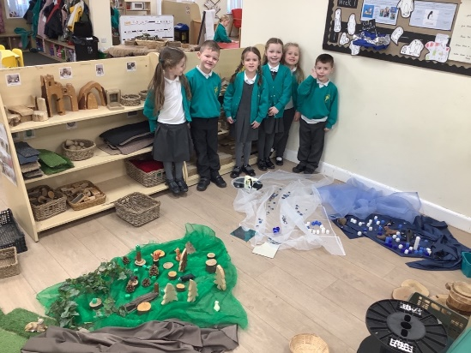
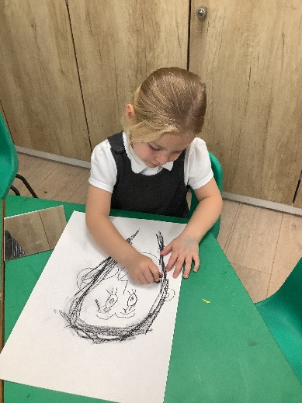
Long Term Planning
Themes
Year Group | Autumn Term 1 | Autumn Term 2 | Spring Term 1 | Spring Term 2 | Summer Term 1 | Summer Term 2
Nursery | All About Me | Traditional Stories | Transport | People Who Help Us | Growing | Animals
Reception | Marvellous Me | Journeys | Hot and Cold | Blast off | Growth and Change | Dinosaurs

Slide 8
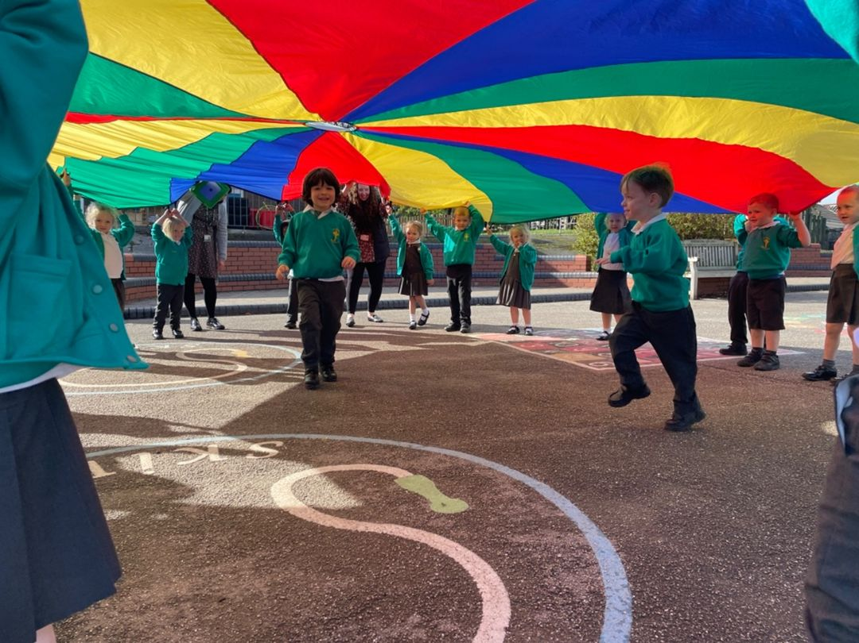
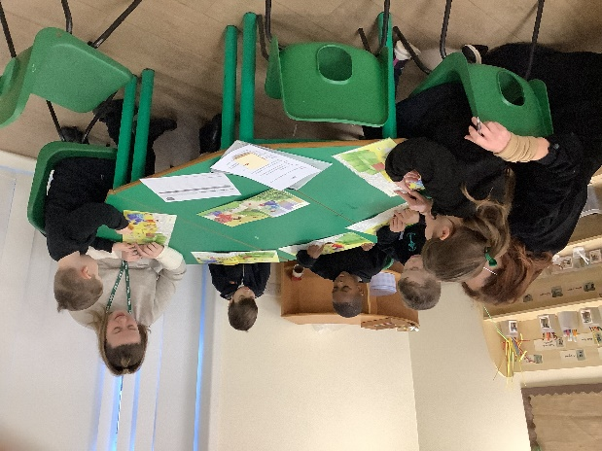
The Role of the Adult
Research shows that progress will be significantly enhanced by the effective support and role models of adults within a high-quality learning environment.
At St. Aidan’s our interactions between children and adults will look like this:
• Tuning in to what is happening or a child’s thinking
• Showing genuine interest
• Respecting children’s own decisions and choices
• Inviting children to elaborate
• Recapping on what has happened so far
• Offering personal experience
• Clarifying ideas
• Reminding
• Using specific praise e.g. that is a good idea because…
• Offering an alternative viewpoint
• Speculating/ using ‘I wonder if…’
The adults in the Early years’ classroom are always teaching. Teaching includes the adult’s interactions with children during planned and child-initiated play and activities: communicating and modelling language, showing, explaining, demonstrating, exploring ideas, encouraging, questioning, recalling, providing a narrative for what they are doing, facilitating and setting challenges. It takes account of the equipment they provide and the attention to the physical environment as well as the structure and routines of the day that establish expectations.

Slide 9
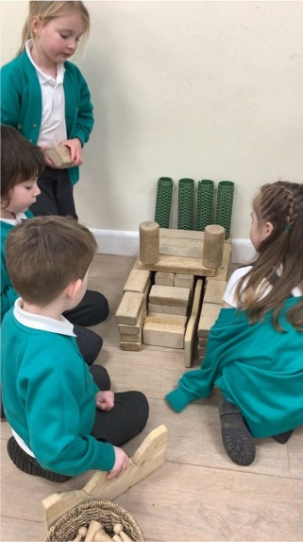
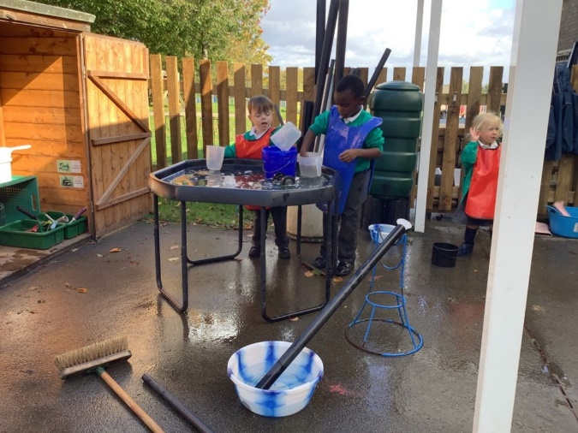
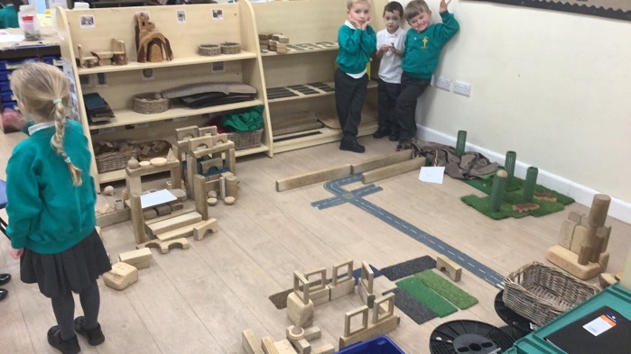
The Role of the Environment
The importance of each adult to support progression is crucial. We equally understand that in times when a child is on their own independent learning journey the environment plays a significant role in development.
“When it comes to what we have and where we have it, then nothing should be left to chance” Alistair Bryce-Clegg, 2015.
At St. Aidan’s each area of the classroom is informed by children’s predictable interest and ongoing assessments. As the needs of the children change, as they grow and develop, so does their learning space. Using resources that are open ended encourage creativity, imagination and high order thinking skills. For example, the workshop may contain ribbon, lace, pinecones or lolly sticks. Outside role play is deconstructed with access to logs, planks, sheets and tyres. These resources can become anything and have unlimited potential. Our timetable allows for long uninterrupted periods of continuous provision that allow the children time to reach a deep level of involvement as they engage, play, investigate and talk.
Throughout ‘continuous provision’ and ‘adult directed’ activities, observation forms a fundamental aspect of the pedagogy of EYFS at St. Aidan’s Primary School.
“Young children demonstrate language, mathematics, science, creativity, physicality – sometimes all within one activity – and the task of the practitioner is to make sense of what is seen, to recognise any significant steps in learning that may have taken place and to identify where help and support are needed to make further progress” Jan Dubiel, 2014
Observing and responding to children informs our planning and enables us to create experiences and opportunities. All adults record ‘Wow!’ moments – when a child does or says something that demonstrates progress or skill in a particular area. As a result of these observations and assessments, staff plan experiences and further opportunities to develop or consolidate learning, which feed in to the planning cycle. A continuous cycle of observation, assessment and planning is embedded throughout our EYFS provision.
In addition to the continuous cycle of observation and formative assessment which informs each child’s next steps, summative assessments are carried out for phonic development and an assessment of each child’s stage of development for each of the 7 areas of learning. These take place termly and informs planning of subsequent teaching and learning.

Slide 10
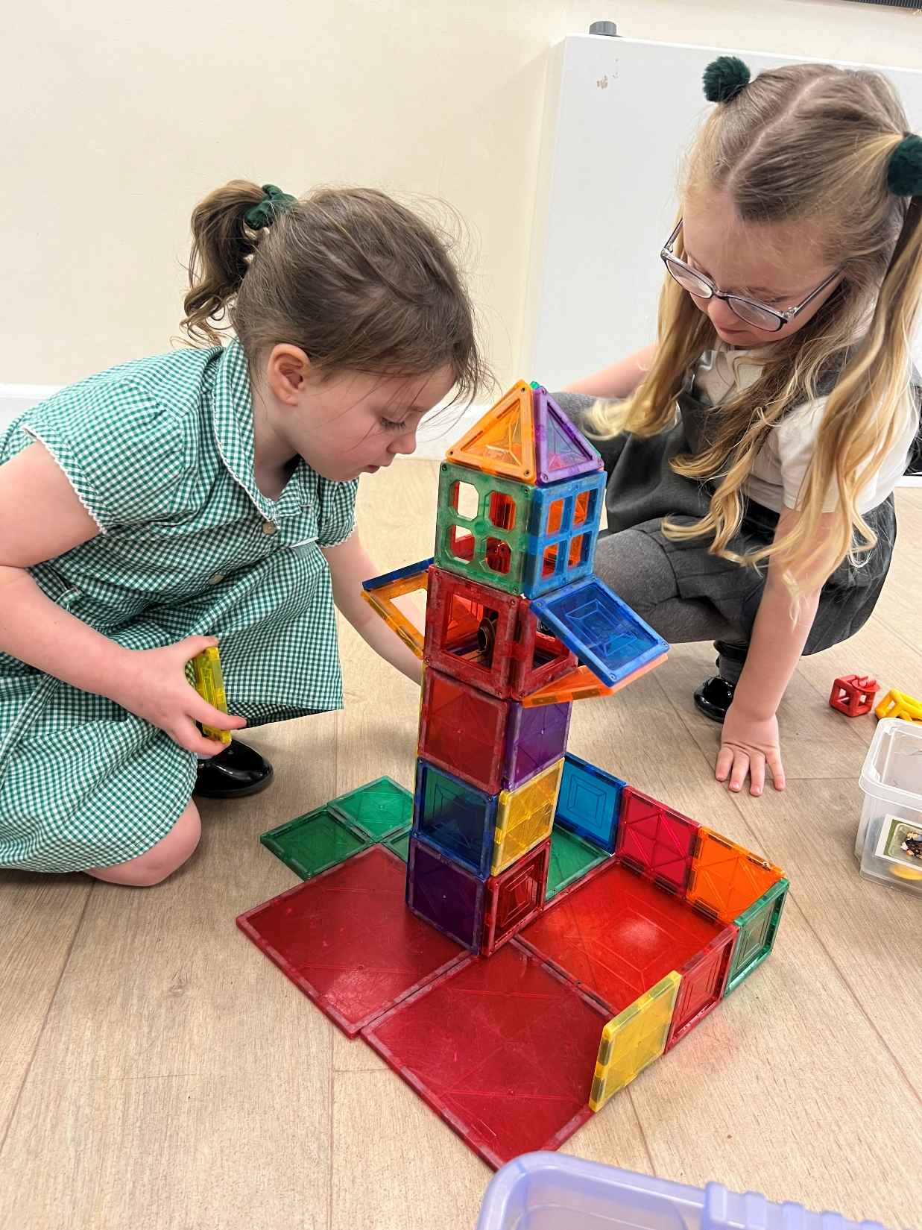
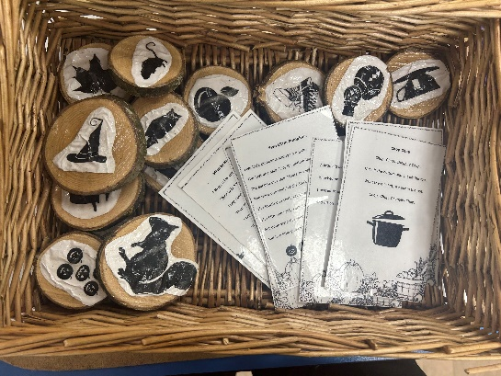
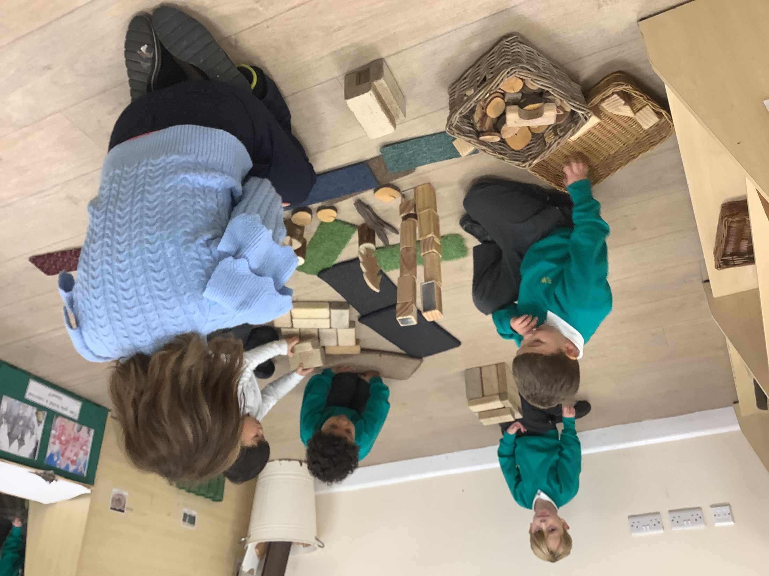
Vocabulary Development in Early Years
At St Aidan’s we know that early language ability is one of the strongest predicators of later development through school and in life. Language is essential for thinking, expressing our feelings, making friends and finding solutions. The rate of language development in the first few years of life is, like many other aspects of young children's development, dramatic. If a young child does not develop the basic skills of speech, language and communication they are likely to be disadvantaged for life. For this reason, it is a priority in our EYFS curriculum. The importance of early language development is set out in the statutory educational programme.
The development of children’s spoken language underpins all seven areas of learning and development. Children’s back-and-forth interactions from an early age form the foundations for language and cognitive development. The number and quality of the conversations they have with adults and peers throughout the day in a language-rich environment is crucial. By commenting on what children are interested in or doing, and echoing back what they say with new vocabulary added, practitioners will build children's language effectively. Reading frequently to children, and engaging them actively in stories, non-fiction, rhymes and poems, and then providing them with extensive opportunities to use and embed new words in a range of contexts, will give children the opportunity to thrive. Through conversation, story- telling and role play, where children share their ideas with support and modelling from their teacher, and sensitive questioning that invites them to elaborate, children become comfortable using a rich range of vocabulary and language structures.
At Saint Aidan’s the adults are the most important element in this environment – alert to opportunities to use sophisticated, interesting and precise language. Adults are sensitive to words and show their own curiosity about words. Adults take spontaneous opportunities to introduce new words as they naturally arise, using their professional judgment as to what best to do with words as they enter the verbal environment. There are plenty of opportunities for to provide a language rich environment for the children, these include:
Whole Class Shared Reading
Daily songs, poems and rhymes.
Rich, varied and meaningful activities and experiences
Informal 1:1 conversation, planned and unplanned.
Sustained opportunities for peer talk and chatter.
Early Intervention when required.
The Poetry basket, Story Dough and Drawing Club are all planned into our curriculum and provide the opportunity to introduce new vocabulary through stories, poems and texts. We believe that all children are entitled to a core knowledge that will prepare them for the next stage in their education.
The themes below have been specifically selected to ensure that the children leave early years with the tier 1 vocabulary they need, plus tier 2 and tier 3 vocabulary which will prepare them for the next stage of education.

Slide 11
Term | Topic | Key Vocabulary
All Year | Seasons | sun, rain, cloud, snow, wind, hail, fog, wind, season, summer, autumn, winter, spring, change.
All Year | Physical Development | Run, walk, hop, climb, crawl, land, balance, stand, jump, space, race, speed, directions, throw, kick, catch, push, aim, follow, copy, sequence. Pinch, squeeze, pat, roll,
All Year | Musical Development | Song words, clap, stamp, move, dance, instrument, glockenspiel, loud, quiet, shake, tap, bang, pulse, high, low, fast, slow
All Year | Art | Draw, observe, paint, collage, rip, cut, stick, print, line, wavy, zigzag, spiral, smudge, blend, combine, mix.
Autumn (Nursery) | Myself | Body parts, heads, shoulders, knees, toes, eyes, ears, mouth, nose, baby, toddler, child, feelings, happy, sad Draw, line, circle.
Autumn (Reception) | All About Me | hair/eye/skin colour, arm, leg, hand, fingers, thumb, elbow, knee, foot, toes, back, neck, shoulder, unique, senses, feelings, happy, sad, calm, sleepy, frustrated, cross, upset, silly. portrait, self-portrait, line, circle, draw.
Autumn (Nursery) | Traditional Stories | Material, rough, smooth, hard, soft. Mix, combine, clean, change, cook
Autumn (Reception) | Journeys | map, Wigan, England, United Kingdom, land, sea, aerial view, road, house, woods sculptor, natural materials, overlap, combine, pine cone, conkers, stones, petals, leaves, acorns. old, new, the past, the present, plastic, wood, metal observe, pastels, smudge, blend, line, tip.
Spring Nursery | Transport | old, new, the past, the present, same, different, rail, road, air, train, bus, aeroplane, ship, boat, walking, travel, holiday, close, far away, traffic. push, pull
Spring Reception | Hot and Cold | polar regions, globe, Earth, climate, woodland, desert, sea, rainforest. float, sink, waterproof, materials, plastic, wood, glass, metal
Spring Nursery | People Who Help Us | nurse, doctor, vet, police officer, fire fighter, teacher, lollipop person, job, future, family, friend.
Spring Reception | Blast Off | Earth, Moon, stars, sun, rocket, planets, globe, astronaut, significant person, past, present, future. primary colours, line, print, abstract.
Summer Nursery | Growing | plant, leaf, flower, egg, caterpillar, chrysalis, butterfly, life cycle.
Summer Reception | Growth and Change | plant, root, stem, leaf, change, observe, life-cycle. fruit, vegetable, healthy, food, exercise, mind. plan, design, make, cut
Summer Nursery | Animals | farm, names of key animals, pets, maps, country, Winstanley, Wigan, road, school, globe
Summer Reception | Dinosaurs | extinct, carnivore, herbivore, omnivore, land, environment, fossils, man-made, natural, significant person, past, present. clay, shape, sculpt, mould, roll, pinch

Slide 12
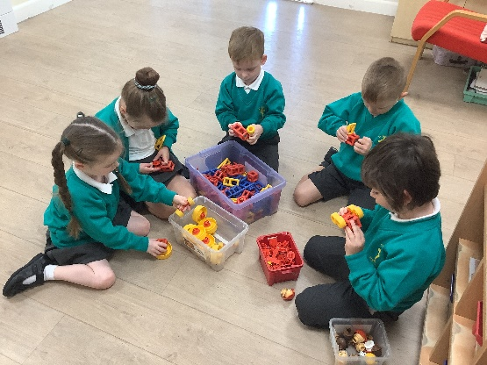
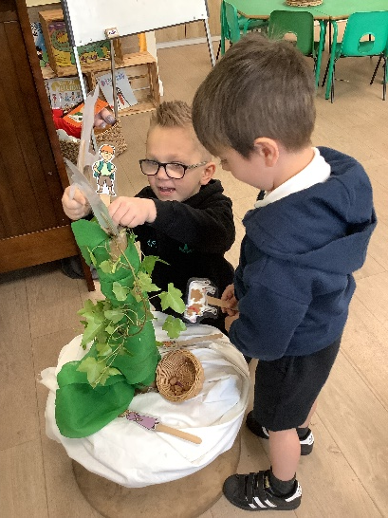
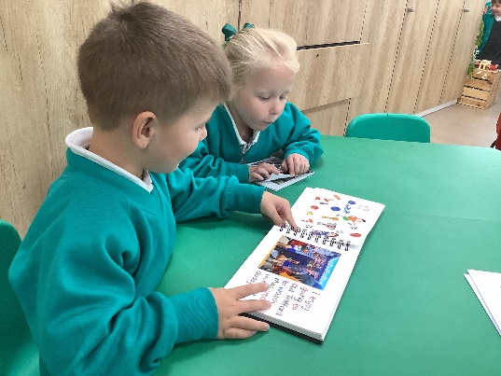
Communication and Language
EYFS Statutory Educational Programme:
The development of children’s spoken language underpins all seven areas of learning and development. Children’s back-and-forth interactions from an early age form the foundations for language and cognitive development. The number and quality of the conversations they have with adults and peers throughout the day in a language-rich environment is crucial. By commenting on what children are interested in or doing, and echoing back what they say with new vocabulary added, practitioners will build children’s language effectively. Reading frequently to children, and engaging them actively in stories, non-fiction, rhymes and poems, and then providing them with extensive opportunities to use and embed new words in a range of contexts, will give children the opportunity to thrive. Through conversation, storytelling and role play, where children share their ideas with support and modelling from their teacher, and sensitive questioning that invites them to elaborate, children become comfortable using a rich range of vocabulary and language structures.
What this looks like
We provide a ‘language rich’ environment that has been carefully arranged to promote collaborative play and problem solving. Staff are situated throughout the spaces to ensure we can play alongside children, offering high-quality interactions, introducing new vocabulary, and moving language foreword. Vocabulary acquisition is developed in a number of ways, it is planned along with topic cycles, throughout provision areas and developed through high quality texts and poems. Ambitious vocabulary is also taught ‘Drawing Club’ sessions.
We use poems from ‘The Poetry Basket’ that are planned throughout Nursey and Reception, meaning that the children have a bank of known poems and rhymes by the end of their time in Early Years.
Children with communication and language difficulties are highlighted early on, allowing us to share concerns with parents, offer strategies to use at home, and carry out some targeted intervention work in school. Early Years staff use ‘ELKLAN’ strategies and ‘Keys to Communication’ to support language development.
Wellcomm Speech and Language package is used to carry out screening and deliver interventions to those in need. Children are referred to Speech and Language Therapists when necessary, through clear channels.

Slide 13
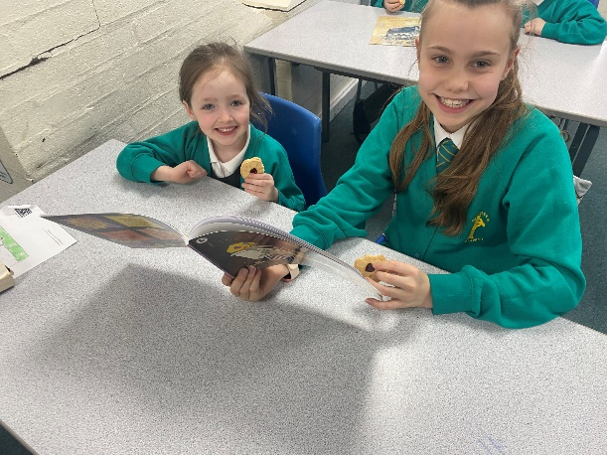
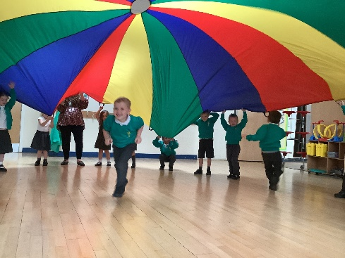
Personal, Social and Emotional Development
EYFS Statutory Educational Programme:
Children’s personal, social and emotional development (PSED) is crucial for children to lead healthy and happy lives, and is fundamental to their cognitive development. Underpinning their personal development are the important attachments that shape their social world. Strong, warm and supportive relationships with adults enable children to learn how to understand their own feelings and those of others.
Children should be supported to manage emotions, develop a positive sense of self, set themselves simple goals, have confidence in their own abilities, to persist and wait for what they want and direct attention as necessary. Through adult modelling and guidance, they will learn how to look after their bodies, including healthy eating, and manage personal needs independently. Through supported interaction with other children they learn how to make good friendships, co-operate and resolve conflicts peaceably. These attributes will
provide a secure platform from which children can achieve at school and in later life.
At St. Aidan’s:
Establishing positive relationships with all children and families is what the heart of what we do. Our children settle quickly, due to the nurturing and encouraging relationships they create. Our environment well is set up to support transition and develop relationships and social skills. Open ended resources that are enhanced according to children’s needs and interests and ensure children have the opportunity to play collaboratively together. Our environments are carefully planned to promote collaborative play, problem-solving and negotiating.
We understand that every child is a unique child, with different strengths, talents and needs. We know that children are experts in their own rights, and celebrate talents and skills within the classroom, and share news from out of school .
Positive relationships and high expectations ensure that the children’s self esteem is raised. Children are encouraged to try their best, have a positive attitude to learning and persevere. We use ‘Zone of Regulation’ to talk about our feelings and find ways to regulate our behaviuor.
Children receive ‘People in the Pot’ for following the class rules and receive a whole class treat when the pot is full. Behaviours are also rewarding through the use of specific praise, certificates, stickers and taking the ‘Everywhere Bear’ home.
Independence is a key skill and children are encouraged to be as independent as possible, they are encouraged to take off their coats in the morning, access resources independently, tidy up and take care of our resources.
In Reception children are paired up with a Y6 child as part of our ‘Seeds and Gardener’ Programme. The Y6 children act as a positive role model to the children and help them to settle in. We meet up regularly and the children form positive relationships and create a strong bond.

Slide 14
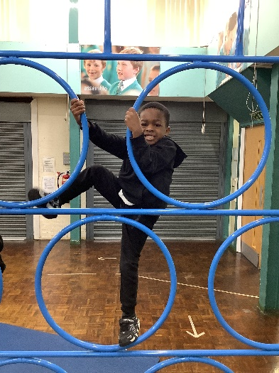
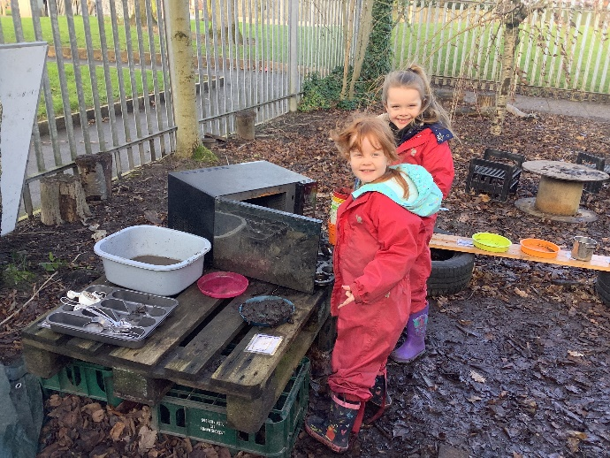
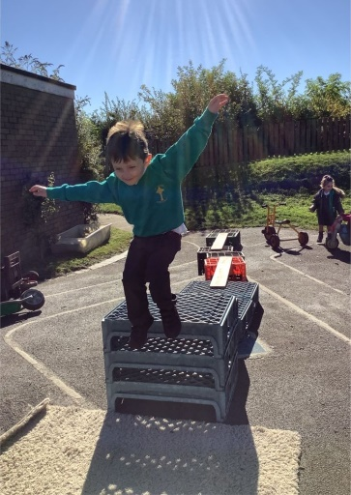
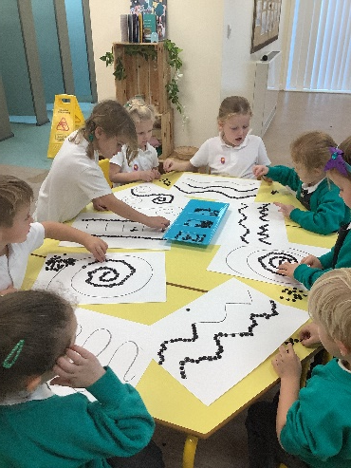
Physical Development
EYFS Statutory Educational Programme:
Physical activity is vital in children’s all-round development, enabling them to pursue happy, healthy and active lives. Gross and fine motor experiences develop
incrementally throughout early childhood, starting with sensory explorations and the development of a child’s strength, co-ordination and positional awareness through tummy time, crawling and play movement with both objects and adults.
By creating games and providing opportunities for play both indoors and outdoors, adults can support children to develop their core strength, stability, balance, spatial awareness, co-ordination and agility. Gross motor skills provide the foundation for developing healthy bodies and social and emotional well-being.
Fine motor control and precision helps with hand-eye co-ordination which is later linked to early literacy. Repeated and varied opportunities to explore and play
with small world activities, puzzles, arts and crafts and the practice of using small tools, with feedback and support from adults, allow children to develop proficiency, control and confidence.
At St. Aidan’s
A large outdoor learning environment can be found in both our Nursery and Reception classrooms. Children develop gross motor skills and spatial awareness through our outdoor play. Provision includes; bicycles, scooters, large construction, large scale water play, mud kitchens and large-scale mark-making opportunities.
Children have continuous assess to a range of opportunities in the indoor and outdoor environment.
Nursey have regular ‘Dough Disco’ sessions that develop to ‘Pen Disco’ sessions. In Reception we start to have weekly PE lessons. We focus on Dance, Gymnastics and Games. It is critical that children develop fine motor skills early in life, in order for them to become effective writers. Our children enjoy a range of activities throughout the indoor provision. Resources and activities are carefully planned, to meet the physical needs of all children, including encouraging the development of scissors skills, progression in mark making and the development of gross and fine motor skills.

Slide 15
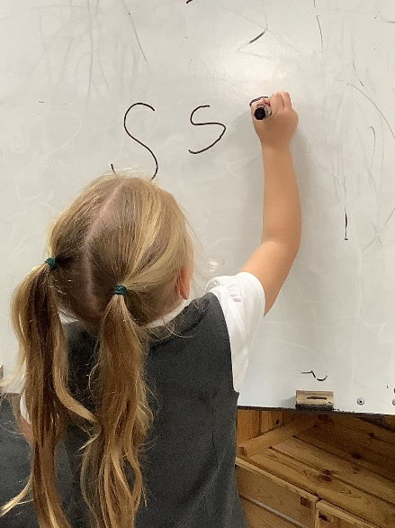
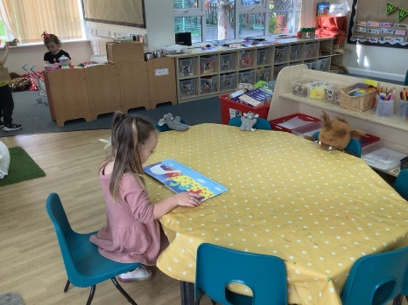
Literacy
EYFS Statutory Educational Programme:
It is crucial for children to develop a life-long love of reading. Reading consists of two dimensions: language comprehension and word reading. Language comprehension (necessary for both reading and writing) starts from birth. It only develops when adults talk with children about the world around them and the books (stories and non-fiction) they read with them, and enjoy rhymes, poems and songs together. Skilled word reading, taught later, involves both the speedy working out of the pronunciation of unfamiliar printed words (decoding) and the speedy recognition of familiar printed words. Writing involves transcription (spelling and handwriting) and composition (articulating ideas and structuring them in speech, before writing).
At St. Aidan’s
We are passionate about reading and want to ensure that our children develop a life-long love of reading. We nurture this passion by sharing both fiction and non-fiction books and poetry throughout the school day and beyond. Throughout the provision, books are carefully chosen to support the resources and interests identified. Areas of provision have mark-making opportunities, and practitioners skilfully incorporate writing for a purpose into play wherever possible.
All children in the EYFS take home sharing books every week, ensuring that they are exposed to a wide variety of rich, high-quality texts. The importance of reading with children is shared with parents, and communication between parents and teachers around reading, is fluid. In Reception, children also take home a book to read, which is matched perfectly to their phonic ability, to practise fluency.
We understand the power of repetition when it comes to reading, which is why our planned texts can last for a week or two, allowing the children to truly delve in to the text, unpick, discuss, act out, share thoughts and opinions, make links, and retell. The planned texts are chosen carefully to link to current interests or themes, with opportunities to embed knowledge across other areas of learning too. We use ‘The Poetry Basket’ to teach child a wide rage of poems, these are planned across Nursey and Reception and result in children having an oral bank of poems by the end of their time in Early Years.
We teach phonics using Little Wandle Letters and Sounds Revised, which is a systematic and synthetic phonics programme. We ensure that Nursery children are well prepared to begin learning grapheme-phoneme correspondences and blending in Reception by providing well sequenced pre-reading opportunities. Phonics sessions are taught daily in Nursery and Reception, the length of these sessions increase as the year progresses.
Pencil grip, letter formation and writing expectation are carefully planned and developed throughout Early Years. In Reception, writing is taught as part of our phonics session and also outside of these sessions in Guided Writing sessions. We also use ‘Drawing Club’ sessions to develop a love for drawing, mark making and writing.

Slide 16
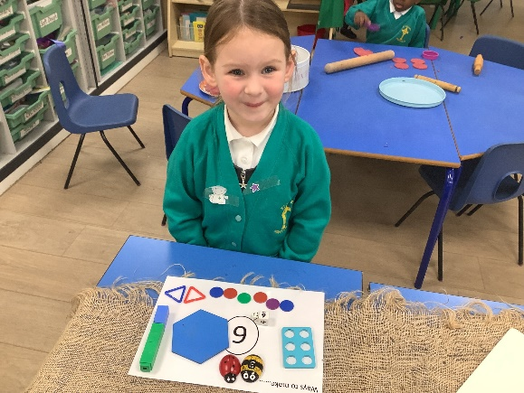
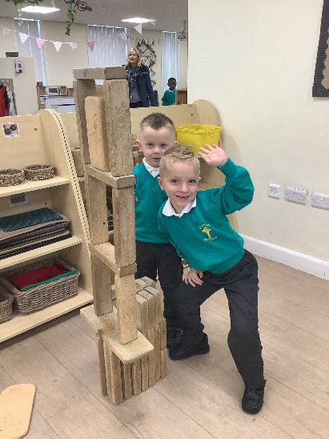
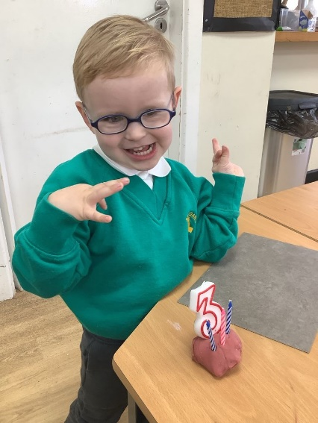
Mathematics
EYFS Statutory Educational Programme:
Developing a strong grounding in number is essential so that all children develop the necessary building blocks to excel mathematically. Children should be able to count confidently, develop a deep understanding of the numbers to 10, the relationships between them and the patterns within those numbers. By providing frequent and varied opportunities to build and apply this understanding – such as using manipulatives, including small pebbles and tens frames for organising counting – children will develop a secure base of knowledge and vocabulary from which mastery of mathematics is built. In addition, it is important that the curriculum includes rich opportunities for children to develop their spatial reasoning skills across all areas of mathematics including shape, space and measures. It is important that children develop positive attitudes and interests in mathematics, look for patterns and relationships, spot connections, ‘have a go’, talk to adults and peers about what they notice and not be afraid to make mistakes.
At St. Aidan’s:
Maths is everywhere! Our provision areas have been carefully planned to ensure that there are opportunities to apply and consolidate maths skills.
We use schemes of learning from’ White Rose’ maths, carefully adapting them to meet the needs of our children. Through a balance of adult-initiated and child led learning opportunities, children develop a grounding in number and skills, including understanding shape, pattern, cardinality and comparison.
Opportunities to develop maths skills are evident throughout the spaces including opportunities to count resources when tidying, talk about size and length when selecting paper/ribbon the creative area. Discuss size, similarities and differences when using the block and small world areas.
Children learn number rhymes and counting songs. Our youngest children develop a sound understanding of how numbers change, and what that looks like, through using a wide range of practical resources.. Practitioners plan activities to consolidate learning, so that children can apply new knowledge in a natural and meaningful way.
Maths language and vocabulary is clearly planned and progressive and is modelled by skilled adults during play and guided activities.

Slide 17
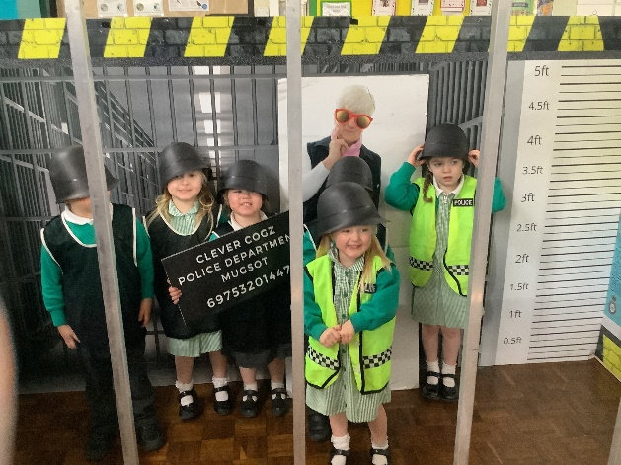
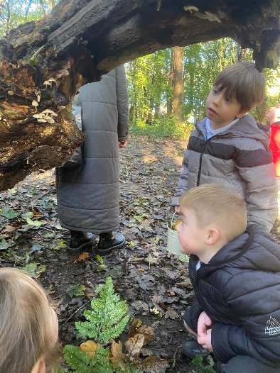
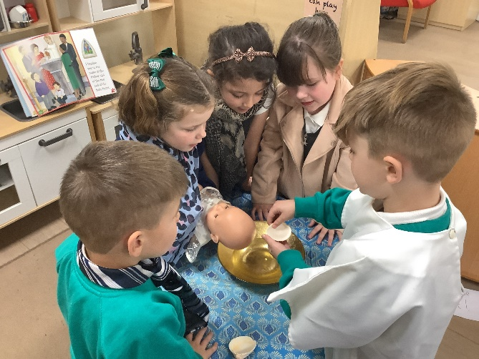
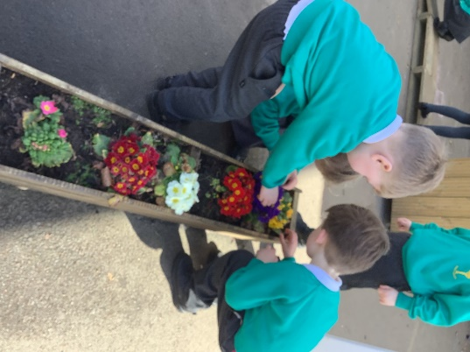
Understanding The World
EYFS Statutory Educational Programme:
Understanding the world involves guiding children to make sense of their physical world and their community. The frequency and range of children’s personal experiences increases their knowledge and sense of the world around them – from visiting parks, libraries and museums to meeting important members of society such as police officers, nurses and firefighters. In addition, listening to a broad selection of stories, non-fiction, rhymes and poems will foster their understanding of our culturally, socially, technologically and ecologically diverse world. As well as building important knowledge, this extends their familiarity with words that support understanding across domains. Enriching and widening children’s vocabulary will support later reading comprehension.
At St. Aidan’s:
Our curriculum is purposely designed to provide opportunities to embed cross-curricular links. Our key texts are carefully planned to address history, geography and scientific learning, embedding new knowledge in a purposeful way, whilst creating a smooth transition to KS1 curriculum. We want our children to have a sound understanding of their personal community and wider community. , children develop a sense of belonging, whilst keeping in touch with the community and other people and buildings within it.
Children take walks in their local area, visit the local woods at different seasons and attend Forest School sessions.
Children enjoy a range of hands on experiences such as farm visits, visits to the zoo, visits linked to topics, such as ‘Aspiration Street’. As well as a wide range opportunities within provision such as; cooking, planting and growing, and caring for the environment and for those who share it with us.
Children initially develop a sense of history which is relatable to themselves, how they have grown, things they like to play with. History knowledge then progresses to events outside of their own experiences through stories and links to topics, which may include significant individuals.
We celebrate a diverse range of festivals from around the world, throughout the year, exposing children to, and celebrating differences. Through our RE scheme ‘Come and See’ the children learn about different religions and festivals.

Slide 18
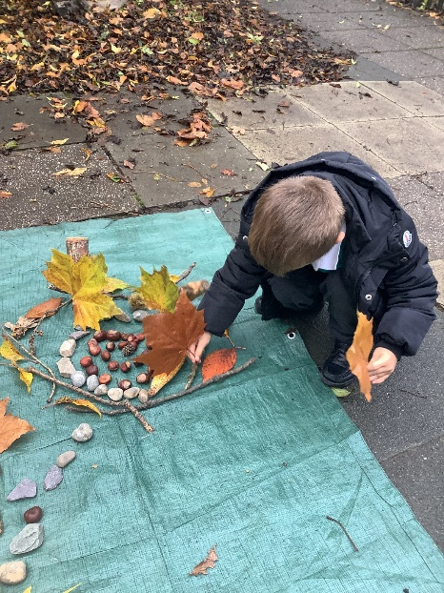
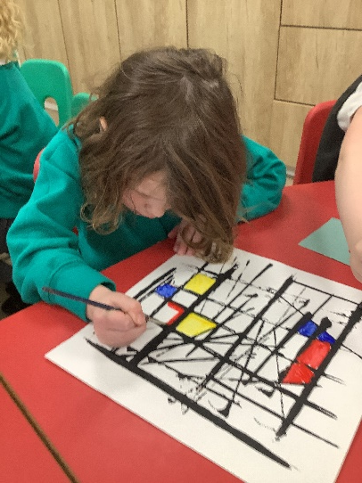
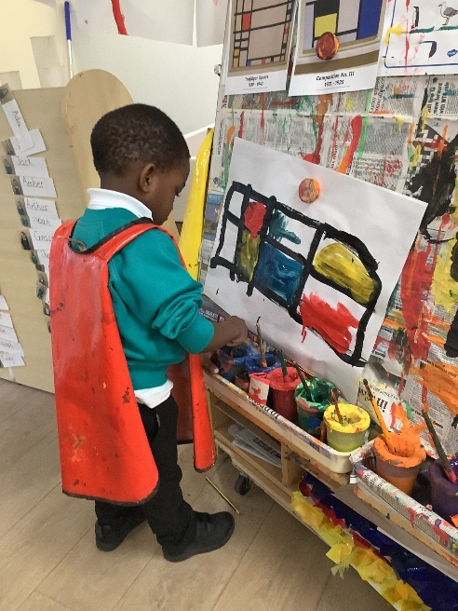

Expressive Arts and Design
EYFS Statutory Educational Programme:
The development of children’s artistic and cultural awareness supports their imagination and creativity. It is important that children have regular opportunities to engage with the arts, enabling them to explore and play with a wide range of media and materials. The quality and variety of what children see, hear and participate in is crucial for developing their understanding, self-expression, vocabulary and ability to communicate through the arts. The frequency, repetition and depth of their experiences are fundamental to their progress in interpreting and appreciating what they hear, respond to and observe.
At St. Aidan’s:
We understand that children develop the ability to express themselves through a range of arts, such as poetry, music, role play, dance, storytelling and creative art.
Our environment is planned to develop creativity and allows children to express themselves and explore their own ideas. We have workshop, construction, small world and writing areas that contain loose parts and a wide range of open ended resources that allow children to work creatively.
As part of our topic cycle, children are exposed to work of different artists for inspiration in creative arts. They are also taught specific skills linked to Art and DT.
Children follow the ‘Charanga’ music scheme, teaching skills such as pulse and rhythm which exposing children to music from different genres and cultures.
We use ‘Poetry Basket’ to nurture a love of hearing and reciting poetry. The children are given the opportunity to perform these poems to an audience.
The range or resources provided in role-play reflect the broad range of cultures and background that are familiar and less familiar to us.

