Slide 1

Northern Star Scouting
2026 Popcorn Sale
the legend of Buccaneer Poppington’s treasure
Sept. 19-Nov. 1

Slide 2
Crew Leader
Bill
Anderson-Horecka
Staff advisor - Northern Star Scouting

Slide 3
What’s New for 2026??
New Training options, including this one!
Veteran chairs have the option of staying only for the “What’s new section” but they are of course invited to stay and help our new chairs!

Slide 4
What’s New for 2026??
SALE START and Council Kick-Off Date and Time
Sale starts on SATURDAY, Sept 19, 2026 at 8am.
Council Kick-offs will be Friday Sept 18
Date: Friday, Sept. 18, 5-8pm
Base Camp—6202 Bloomington Road, Fort Snelling, MN 55111.
Hermantown/Duluth Service Center-3877 Stebner Road, Hermantown, MN 55811
Mankato Scout Office – 810 Madison Ave, Mankato, MN 56001

Slide 5
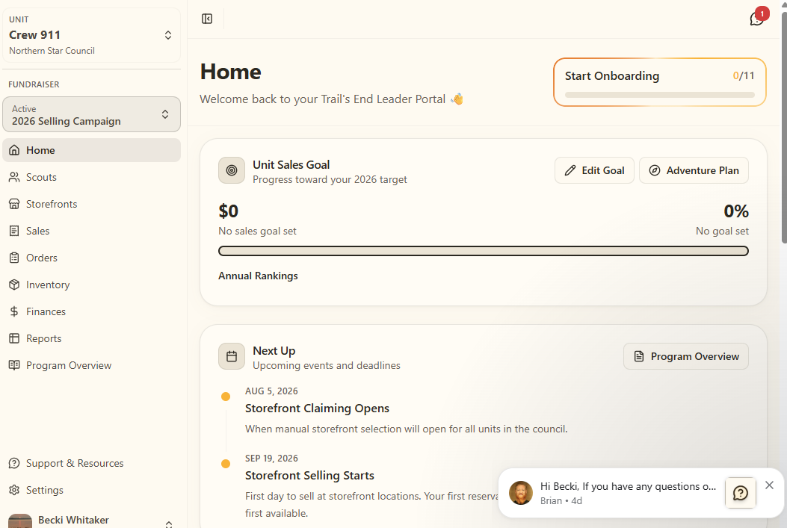
What’s New for 2026??
Trail’s End Leader Portal
Leader Portal
Much more mobile friendly
Onboarding process---MUST DO!!
Simplified Finance page

Slide 6
What’s New for 2026??
Trail’s End Leader Portal and Storefronts
Leader Portal/Storefronts
Better Storefront Filtering/Map
Sign up for TE Storefronts is AUG 5 at 7pm.
  Not all Councils are the same
  Only for TE storefronts
  No selling/tiered requirement
Split reservations and return unused/scheduled hours
Unscheduled shifts are released at 7pm on TUESDAY.
Storefront Splits by shift or by individual sale
  Split by Day

Slide 7
What’s New for 2026??
Scout Selling App
Scout selling app is ONLY accessible by the Trail’ End App, no more website to login to.
The ONLY way for your Scouts to earn gift cards is to log sales in the Trail’s End App---no exceptions.

Slide 8
What’s New for 2026??
Trail’s End Reward Points (Gift Cards)
New way that prize points for gift cards are calculated
Each point = 1 penny in gift cards, even between levels
Earn 4 points per $1 for credit and online sales
Cash to credit – earn 3 points per $1 when a parent uses cash to credit
1 bonus point per $1 for HH sales
Bonus points for hitting level tiers (starting at $600 in sales)
Leaders can release rewards one Scout at a time

Slide 9
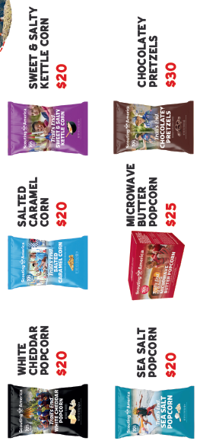
What’s New for 2026??
Trail’s End Products
Popping corn has been replaced by ready to eat Sea Salt Popcorn

Slide 10
What’s New for 2026??
Trail’s End Damage Reporting
Any and all damaged products now are reported directly to Trail’s End
Product that is damaged or cases that are missing product when you receive them are reported to Trail’s End by emailing support@trails-end.com.
Please include as much of the following information as possible when submitting your report:
Clear photos showing the damage (of each item if multiple)
A photo of the lot code / Best By date on the damaged bag or container
A photo of the white label on the outside of the case
The unit type/number reporting the issue – (Pack or Troop + 4 digit number)
Make sure to tell them you are with Northern Star Council

Slide 11
What’s New for 2026??
Northern Star Credit Card Fees for Popcorn Payments to Council
Starting 1/1/26, all credit card transactions with Northern Star Council are subject to a 2.5% fee.
Avoid this by submitting your final payment by check, or collect CC payments while selling so TE owes YOU money - TE still covers those fees!
No fees if your unit pays via check.

Slide 12
What’s New for 2026??
Prizes before hand!
Northern Star is giving all popcorn selling units a Treasure bag, along with a bit of treasure to get started!
Bonus Prizes for Selling Levels
Patches
Holiday Coupons for $150 and $300 levels.
“Treasure Prizes”
Hand these out how you see fit!
Raising Cane’s Kids Combo meals
Nick U Mystery Ride passes
Paracord wristbands (Cubs only)
Papa Murphy Pizzas (COMING SOON)

Slide 13
What’s New for 2026??
Prizes!
New Northern Star prizes for 2026
Bonus Prizes for Selling Levels
$500 5Up Game
$888 Mystery Prize!
$1,300 Loot Bag
Adventure Doubloons
MN United FC
Maverick Hockey
5D Extreme Action at MOA
Brickbuilders 10.0
Snorkeling at SeaLife
Camping Items
  Hammock
  Binoculars
  Junior Metal Detector

Slide 14
Questions about New for 2026?

Slide 15
New Chair Overview

Slide 16
Why do we sell?

Slide 17
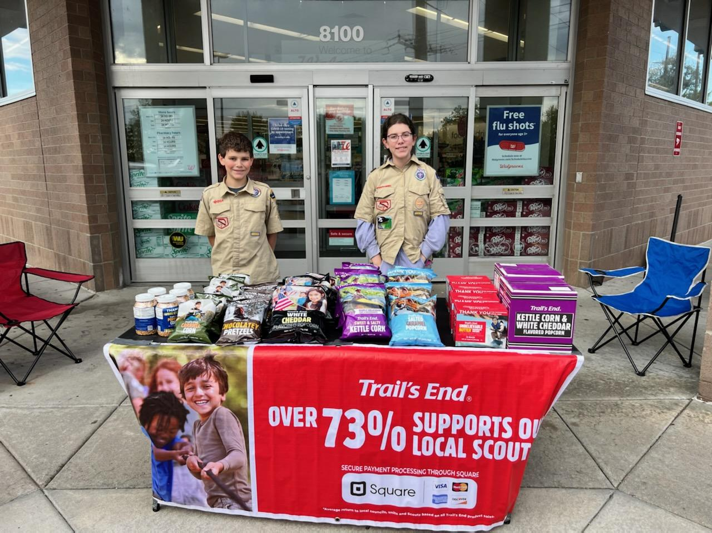
WHY do we sell Popcorn?
73% Return to Scouting
Fund our unit’s Scouting program
Scout character development
Improve our camps and council resources
OVER $1.7 million Returned to Northern Star Scouting in 2025

Slide 18

WHY do we sell Popcorn?
Benefits for Scouts
Personal growth program that can be applied to advancement opportunities and service projects.
Earn Amazon eGift Cards
  Millions of prize choices
  Scouts choose the prizes they want
Scouts Learn
How to help others around them
Public speaking & math skills
Salesmanship & perseverance
How to earn their own way
The value of hard work
How to handle rejection

Slide 19
Your Unit Earns
Commission Type: | Commission Percentage:
ONLINE DIRECT* | 35%
TRADITIONAL/WAGON/TAKE ORDER | 32%
Training Bonus | 3%
Notes:
Opt-Out commissions generally provided 3% of benefit to the Scout, whereas Trail’s End Rewards provides an average of over 5%, and up to 20% benefit to the Scout!

Slide 20
Sale Runs
Sept. 19-Nov. 1

Slide 21
Trail’s End Resources

Slide 22
It’s helpful to know who is on the journey!
Council: Northern Star Council
District: (Area within the Council, Alpha Letter)
Unit Type: (Pack, Troop, Crew, Ship)
Unit Number: (4-Digit Number)

Slide 23
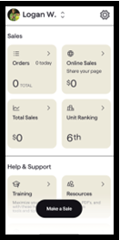
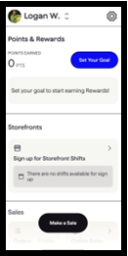
Trail’s End App
Features
Tap to Pay
Simple dashboard for easy navigation
Sales button right on the dashboard
Training videos

Slide 24
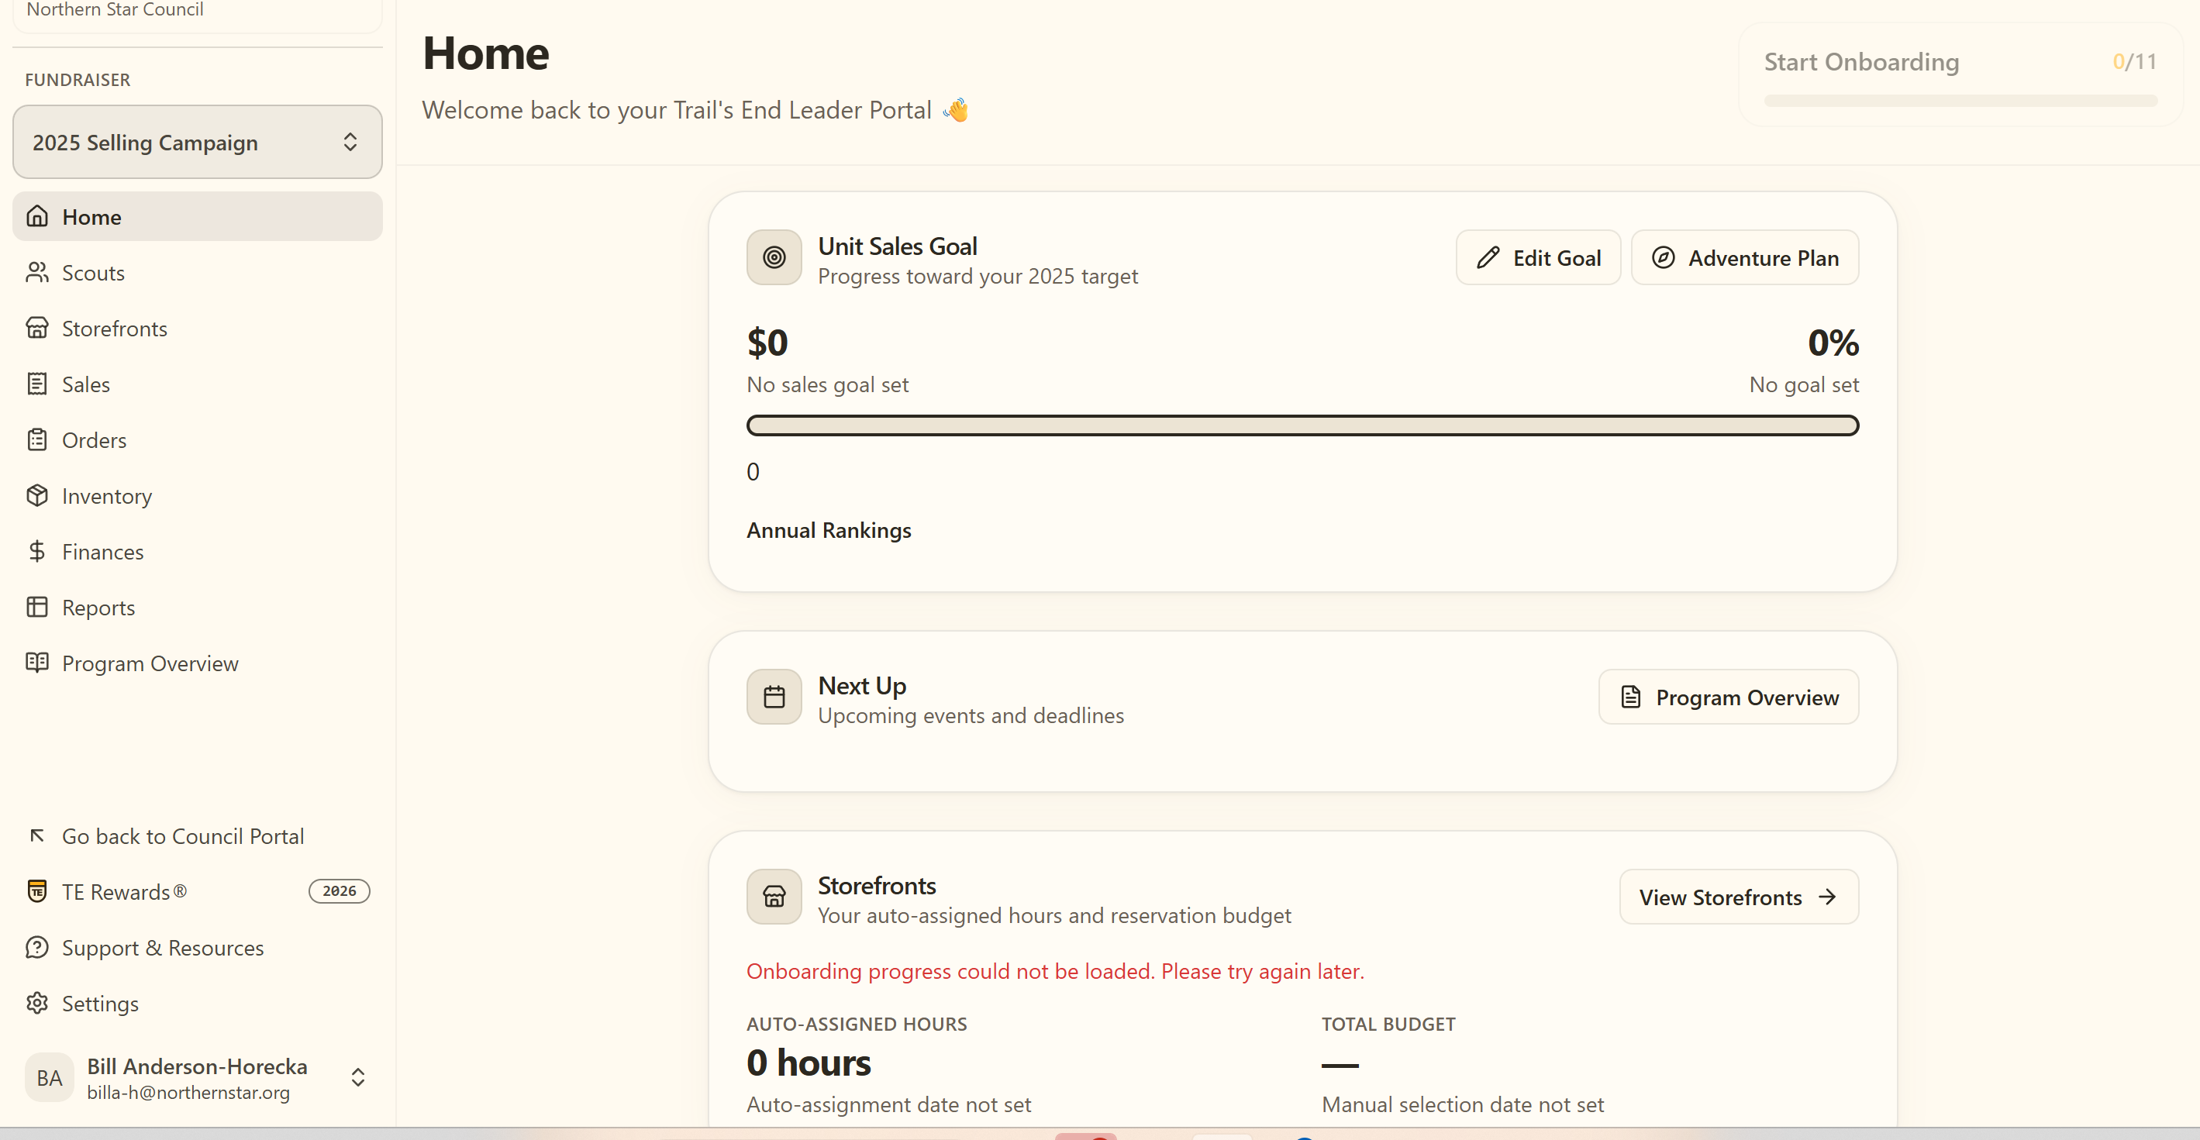
Trail’s End Leader Portal
Your one-stop-shop for sale management!
Order Popcorn.
Invite their Scouts to register; manage Scout roster.
Easily set Unit and Scout goals.
View real time reporting of sales, inventory and cash management; all in one place.
Unit-to-Unit product transfers. No Council intervention needed.
Create, schedule, and manage storefront sites and shifts.
Login at: www.trails-end.com/leader
with your Trail’s End Leader account.

Slide 25


Leader Training Helps
Videos
Leader Portal - Training page
Returning Leaders
What’s New?
New Leaders
Ideal Year of Scouting
Unit Kickoff & Parent Buy-In
Leader Portal training
Storefront Best Practices
Storefront Reservations & Management
Managing Inventory
Sale Resources
Leader Portal - Training page
Leader Guide
Unit Program Planner
Scout & Parent Guide
Banner
Table Payments Sign
Scout Pitch
Q&A Webinars
Please watch the training videos before
Trail’s End experts will stay on and answer every question!

Slide 26
selling the product

Slide 27


Products
^{$20}
Products and flavors consumers purchase every day.
Fewer products simplifies the sale for Councils, Units & Scouts.
Heroes & Helpers Donations
Donations in App will be automatically processed nightly & reflected on Unit orders, eliminating manual ordering, and saving time!

Slide 28


Pretzel Ordering info
Order your pretzels in the Show and Delivery Order.
Pretzel delivery information will be determined closer to September.

Slide 29

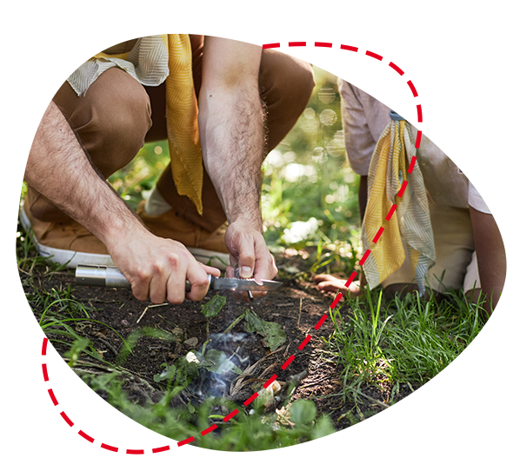

Ways to Sell
Storefronts
Setup tables at high foot traffic locations.
Scouts sell to customers coming in and out of stores.
Best Practice: One Scout and their parent per shift.
Wagon
Sell door-to-door
Best Practice: Bring product with you to avoid second trip to deliver.
Scouts can record undelivered orders in App.
Online
Sell virtually to family and friends by sharing your online fundraising page via social, email & text.
Product ships to the customer.

Slide 30
Trail’s End Storefront Settings & Reservations
Default Settings
Before reserving, set your split method.
Best practice: 2-hour shifts.
Trail’s End Reservations UPDATE
Units can log in and reserve TE storefronts at 7pm on Aug 5th.
NEW: Auto-release on Tuesday at 8 pm (ET) for Fri - Sun reservations​ with zero Scouts claimed.
38% of weekend hours were claimed in 2024 and not used by Scouts
Trail’s End Reservations
Trail’s End is reserving the best-selling times and storefronts for your Scout families!
Reserve on Storefront Reservations page.
Best hours will be highlighted.
Notes:
One Scout and their Parents

Slide 31
Unit Booked Storefronts
Best practices when booking your own storefronts:
Determine high foot traffic days, times, and locations (Google Analytics)
Book as far in advance as you can
Visit the store in your Uniform with one or more Scouts
Shop the store, then request to speak with the manager
If permission is granted, ask for and notate expectations and follow the rules
Always say ‘Thank you!”
2 Scouts-2 Adults-2 Hours

Slide 32
Storefront Best Practices
Prep
Enough popcorn to sell $500 per hour.
A fully charged phone with the Trail’s End App.
6-foot table & banner
Cash box with small bills.
Scout should use the restroom before shift.
Place products highest to lowest.
NEVER put prices on table.
Scout Role
Wear your uniform.
Stand in front of the table.
Smile & walk up to everyone.
Look the customer in the eye and give your pitch.
Guide them to the table to pick their products.
It helps to memorize the prices!
Parent Role
Encourage your Scout to keep asking. No’s happen, that’s okay!
Handle table and products setup.
Stand and thank everyone!
Share what your Scout will get with the consumers’ support.
Submit all donations in App.
Notes:
Parent Pay Now & Heroes & Helpers

Slide 33
Ordering Info
    SHOW AND DELIVER (WAGON) ORDER DUE Aug 26 at Midnight
    Order through the Leader Portal at www.trails-end.com
    Up to 90% of what you sold in 2025 (Retail dollars) *(exceptions)
    Order in full cases only
    We WILL have more product during the sale to check out.
    TAKE ORDER DUE SUNDAY NOV 8 AT MIDNIGHT
    Order through the Leader Portal at www.trails-end.com
    Can order singles
    Order your Hometown Heroes credits at take order
    NOTEABLE FEATURES
    What to order auto populate button
    Multifactor Authentication – 30 days
    Ordering for two Units

Slide 34
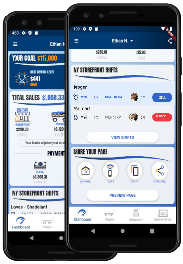
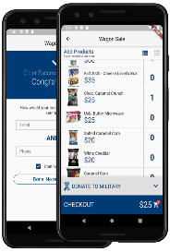
Online Direct
SHARE YOUR PAGE
Share your fundraising page
via email, text, or social media.
Customers click your link to place online orders.
Products ship directly to your customer’s home.
DIRECT ORDERS
Pick your products.
Credit or debit payments only
Products ship directly to your customer’s home.

Slide 35

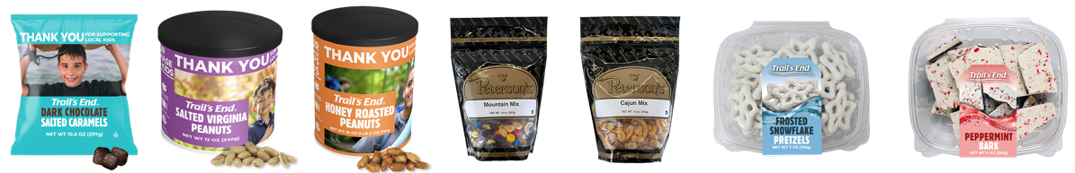
Online Best Practices
Safe & Easy
Trail’s End ships the product directly to the customer.
No handling of products or cash for Scouts or Unit.
As many traditional products and prices as possible.
Additional products online.
Customize Page
Upload a profile picture.
Write a description - “Tell your customers why they should support Scout fundraising.”
Select your favorite product.
Share
Share your online fundraising page link with family and friends!
Use the App to post on social, send emails and texts & generate a QR code.
Follow-up with customers who have not bought.
Notes:
Parent Pay Now & Heroes & Helpers

Slide 36




Credit Cards
Credit is Best for Scouts
Safer, easier & higher sales for Scouts!
Trail’s End pays all fees!
Ways to accept credit in App:
      Square Bluetooth - contactless cards, chip cards, Apple Pay & Google Pay
      Square Swipers: Lighting (Apple) & Headphone jack (Android)
      Manual Entry (no reader): type card
      Apple Pay, Google Pay & Cash App Pay: use share feature at checkout for customers to pay on their device!
Cash to Credit
Parents
Use their card and keep the cash.
Available at end of shift (up to 30 minutes after).
Scouts earn more Rewards.
Leaders
Use their card and keep the cash.
Available after shift until 2:59am ET.
Scouts earn more Rewards.

Slide 37
Distribution

Slide 38
Distribution
Show and Deliver Pick Ups
  Sept 10
  Several Locations Around Council
Reordering Starting Tues Sept 22 Pick up at reorder warehouse, Snack Semi or a Snack Spot (outstate)
Home Delivery
  Over $15,000 in sales in 2025
  Must order at least $7,000 or 35% of last year’s sale (whichever is greater)
  Need home Delivery Info by Aug 26. We will send out a survey to request the info

Slide 39
Distribution
EARLY RETURNS
Sunday Oct. 4 and Monday Oct 5 4-7p.m.
No questions asked
  Units can only return FULL Cases of product at early return days.
  Units will only be able to return up to 15% of their TOTAL Show and Deliver order after Oct 5.
FINAL RETURNS—up to 15% of what physical product you have checked out on Nov 8.
Sunday Nov 8 4p.m.-7p.m.
Several Locations around the Council
ABSOLUTELY NO RETURNS AFTER NOVEMBER 8

Slide 40
Ordering more —
Snack Semi/warehouse/Snack Spots
During the sale for reorders you can order from the warehouse, Snack Semi or Snack Spot.
The Snack Semi is similar to the Amazon Treasure Truck
Order by a certain date each week for pick up around the metro and outlying areas.
Order in full cases
3 days will have stops in 5-7 communities for 30 min before moving on.
Snack Spots will be a few locations in the Council (outstate) that will have inventory of popcorn

Slide 41
Transfers
All Transfers are done through the
Trail’s End Leader Portal
You can initiate a transfer
Both parties have to accept
Invoice automatically updates for both Units

Slide 42
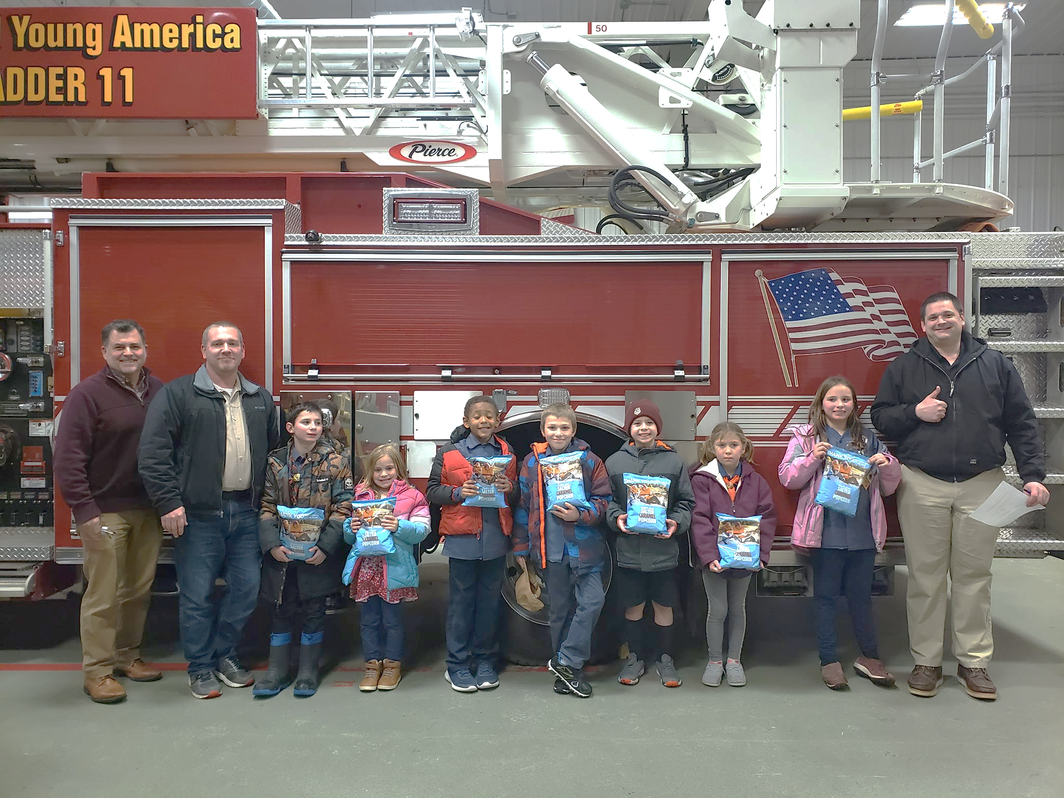
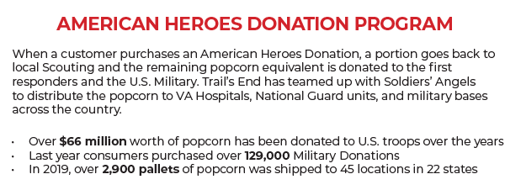
Hometown Heroes
Return product is used to fill our local Hometown Heroes orders
In 2025, over $150,000 was given to local heroes!

Slide 43
Prizes!

Slide 44
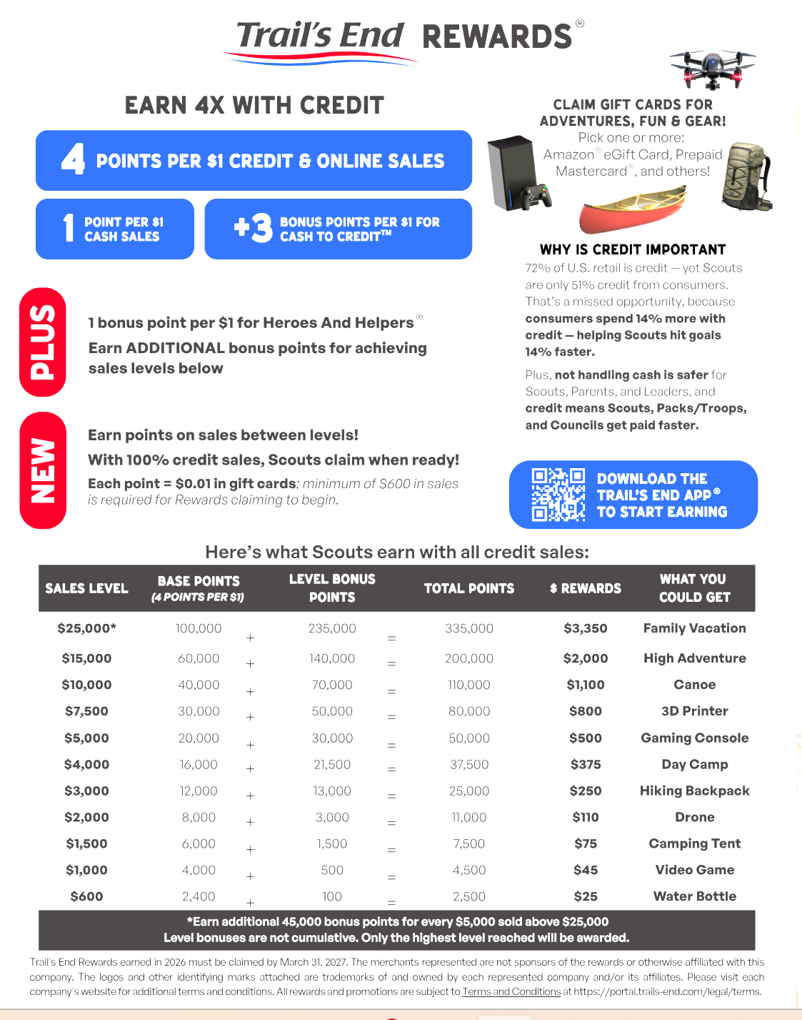
Scout Rewards
Notes:
Make point values BIGGER; Parent Pay Now

Slide 45

Bonus Prizes—a Northern Star Tradition!
Bonus Prizes — (All units eligible) Will be at Take Order pick up.
Sell 1 Item— Patch
$150—Slushie from Holiday/Circle K
$300—2 Cookies and 2 Sodas from Holiday/Circle K
$500—5Up Dice Game
$888 Club — Mystery Prize
$1300 —BassPro Bag
$1900+ — Adventures!
$2600—Champions Pancake Breakfast! January 9, 2027 at Base Camp.
Notes:
3 min

Slide 46




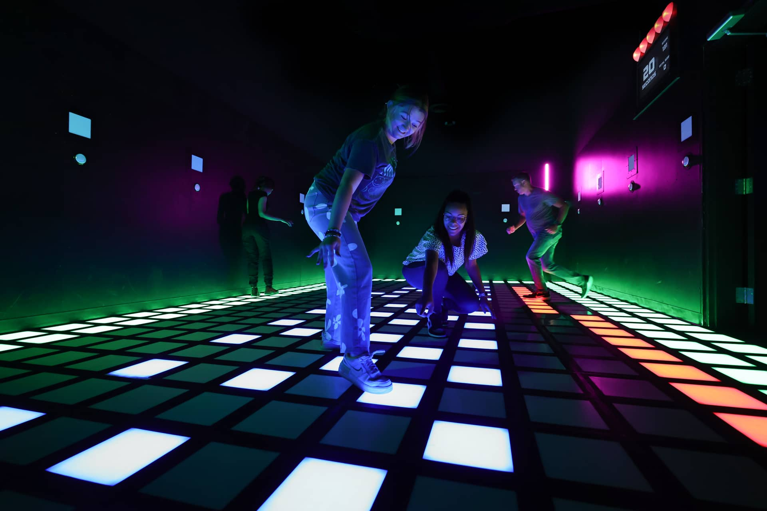


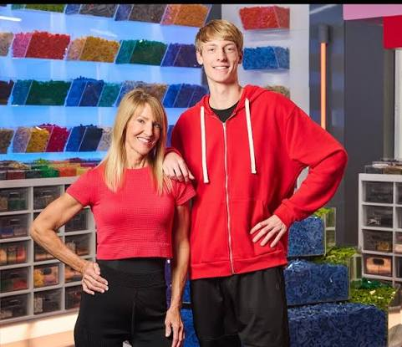




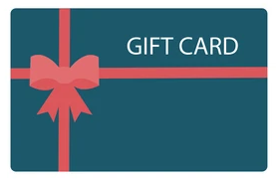



Adventures
Notes:
3 min

Slide 47
Resources

Slide 48
Unit Kick off
The Kick-off sets the tone for your popcorn sale. Motivated Scouts and, more importantly, motivated Parents are the key to a successful sale.
Make it FUN!
Explain WHY the money is needed
Give away prizes!
Have a Scout from last year talk about what they did
SPEND THE MONEY!
Notes:
1-2 min

Slide 49
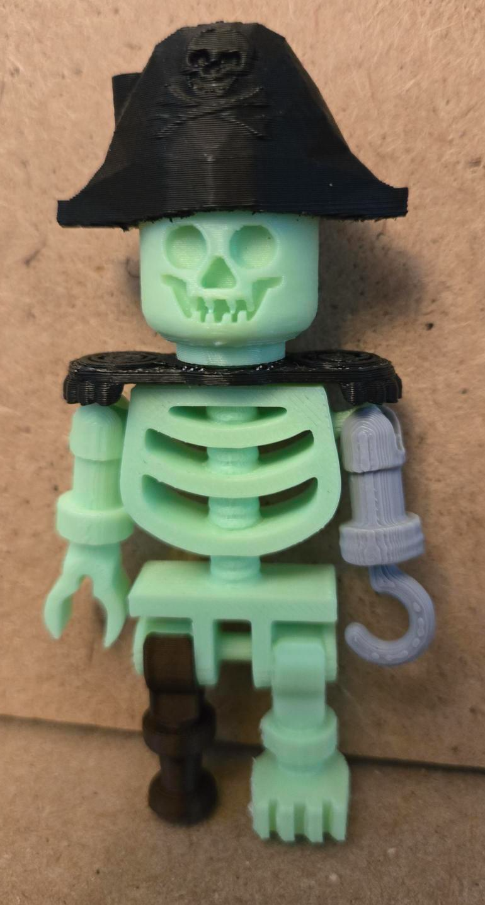
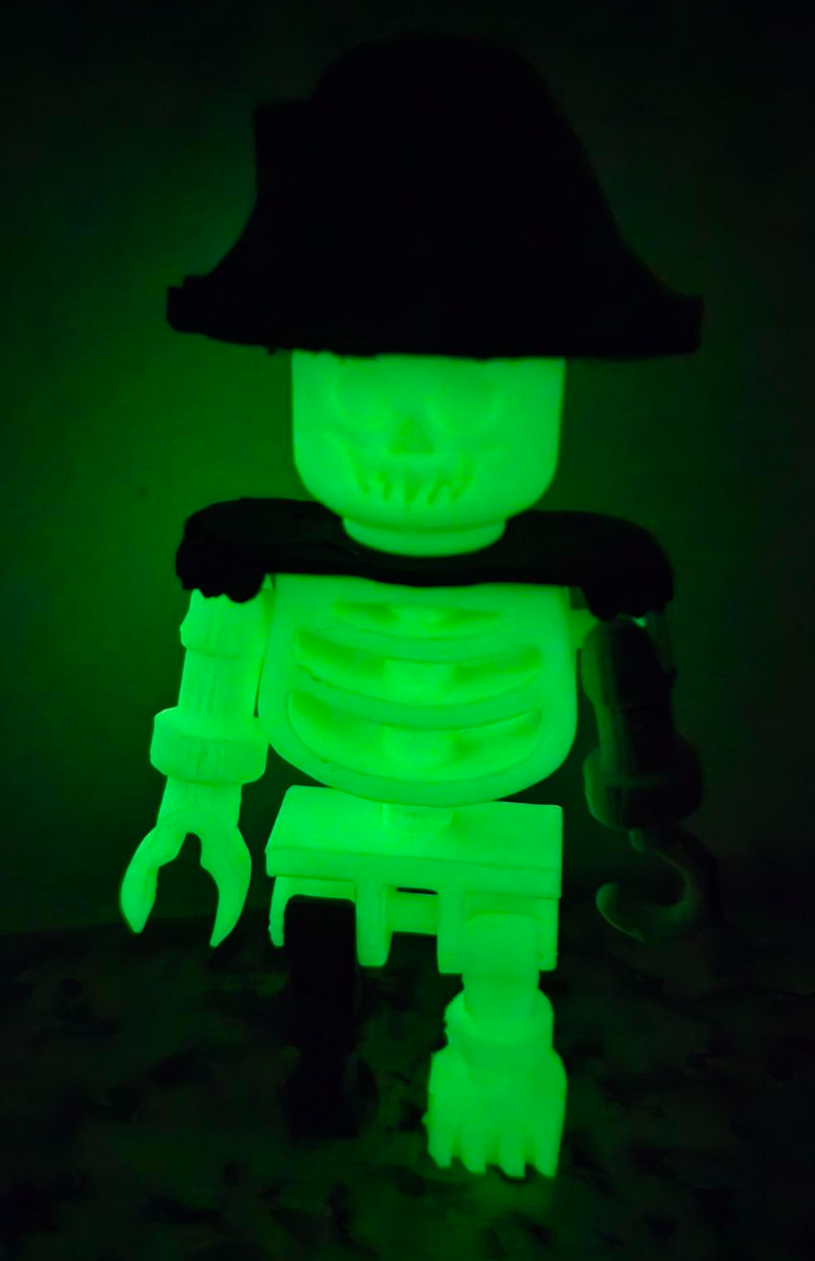
Popcorn kick off
The Kick-Off is for all Scouts selling popcorn and their families. Encourage all of your Scouts to attend this Open House style event! This year there are 3 locations to choose from, all on Friday Sept 18.
Date: Friday Sept. 18. 5-8pm
Hermantown/Duluth Service Center-3877 Stebner Road, Hermantown, MN
Base Camp—6202 Bloomington Road, Fort Snelling, MN 55111
Mankato Scout Office – 810 Madison Ave, Mankato, MN 56001
Stations: (subject to change)
Bonus Prizes/Adventures Storefront Success
Trail’s End App Practice Your Pitch
Meet a top seller
AND MORE!
.
All Scouts who preregister and attend will receive a 3D printed glow in the dark pirate skeleton and more!
Emails with the sign-up information will be sent out early August to all registered Scouts in the Trails End app, as well as unit chairs. Emails will be sent to popcorn chairs to forward to parents and Scouts.
Notes:
1-2 min

Slide 50
Payments
Payments are due Dec 15
1 Check from the Unit
No prepayments are needed
Check your Leader Portal for invoice, amount owed and if there are dollars in your payout section
Credit Card payments now have a 2.5% charge on them.

Slide 51
What should you do now?
Complete your Trail’s End Onboarding!
Attend a Trail’s End Webinar
Survey your Scout parents to get a feel if they will sell
Log into the leader portal at www.trails-end.com
Create a storefront plan
Start planning your order
If you don’t have a working login/password, email popcorn@northernstar.org, make sure to include your Unit and Name.

Slide 52
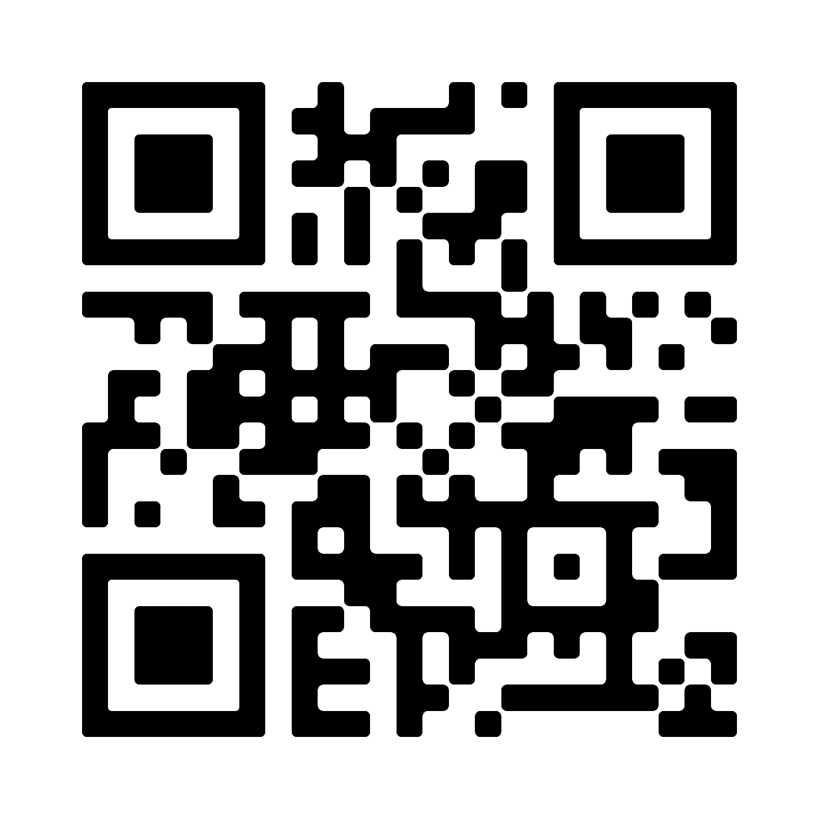
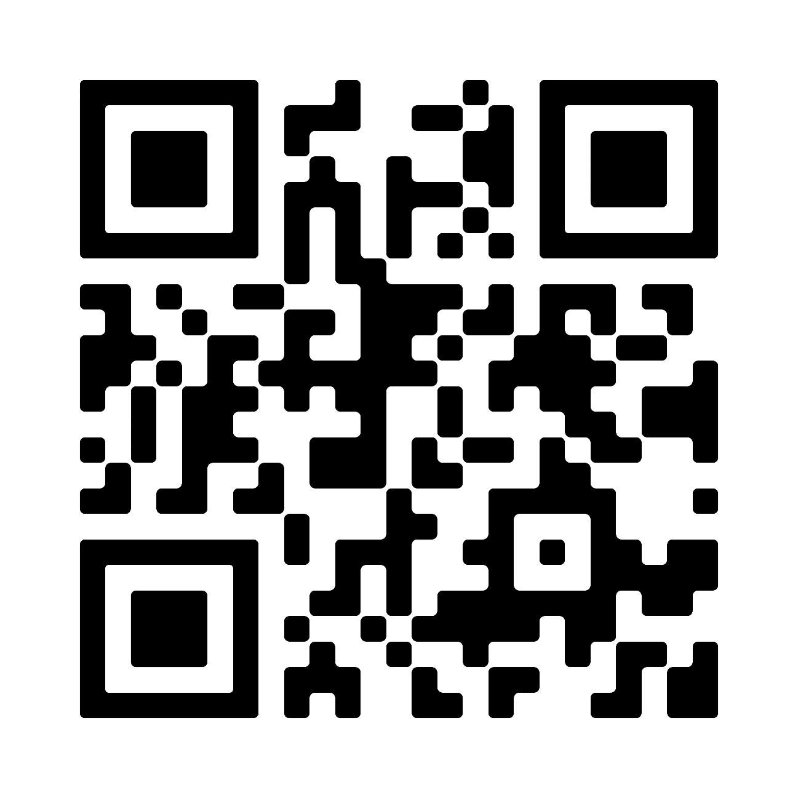
Support
Trail’s End Support
Visit our FAQ page for answers to commonly asked questions & to open a ticket.
Council Support
Bill Anderson-Horecka
Billa-h@northernstar.org
612-261-2405
Becki Whitaker
Bwhitaker@northernstar.org
612-261-2403
Popcorn Page:
www.buyscoutpopcorn.com
Facebook Group
Join Trail’s End Popcorn Community for best practices, support, news, and answers to questions.
Email: support@trails-end.com

Slide 53
Thank you!

