Slide 1
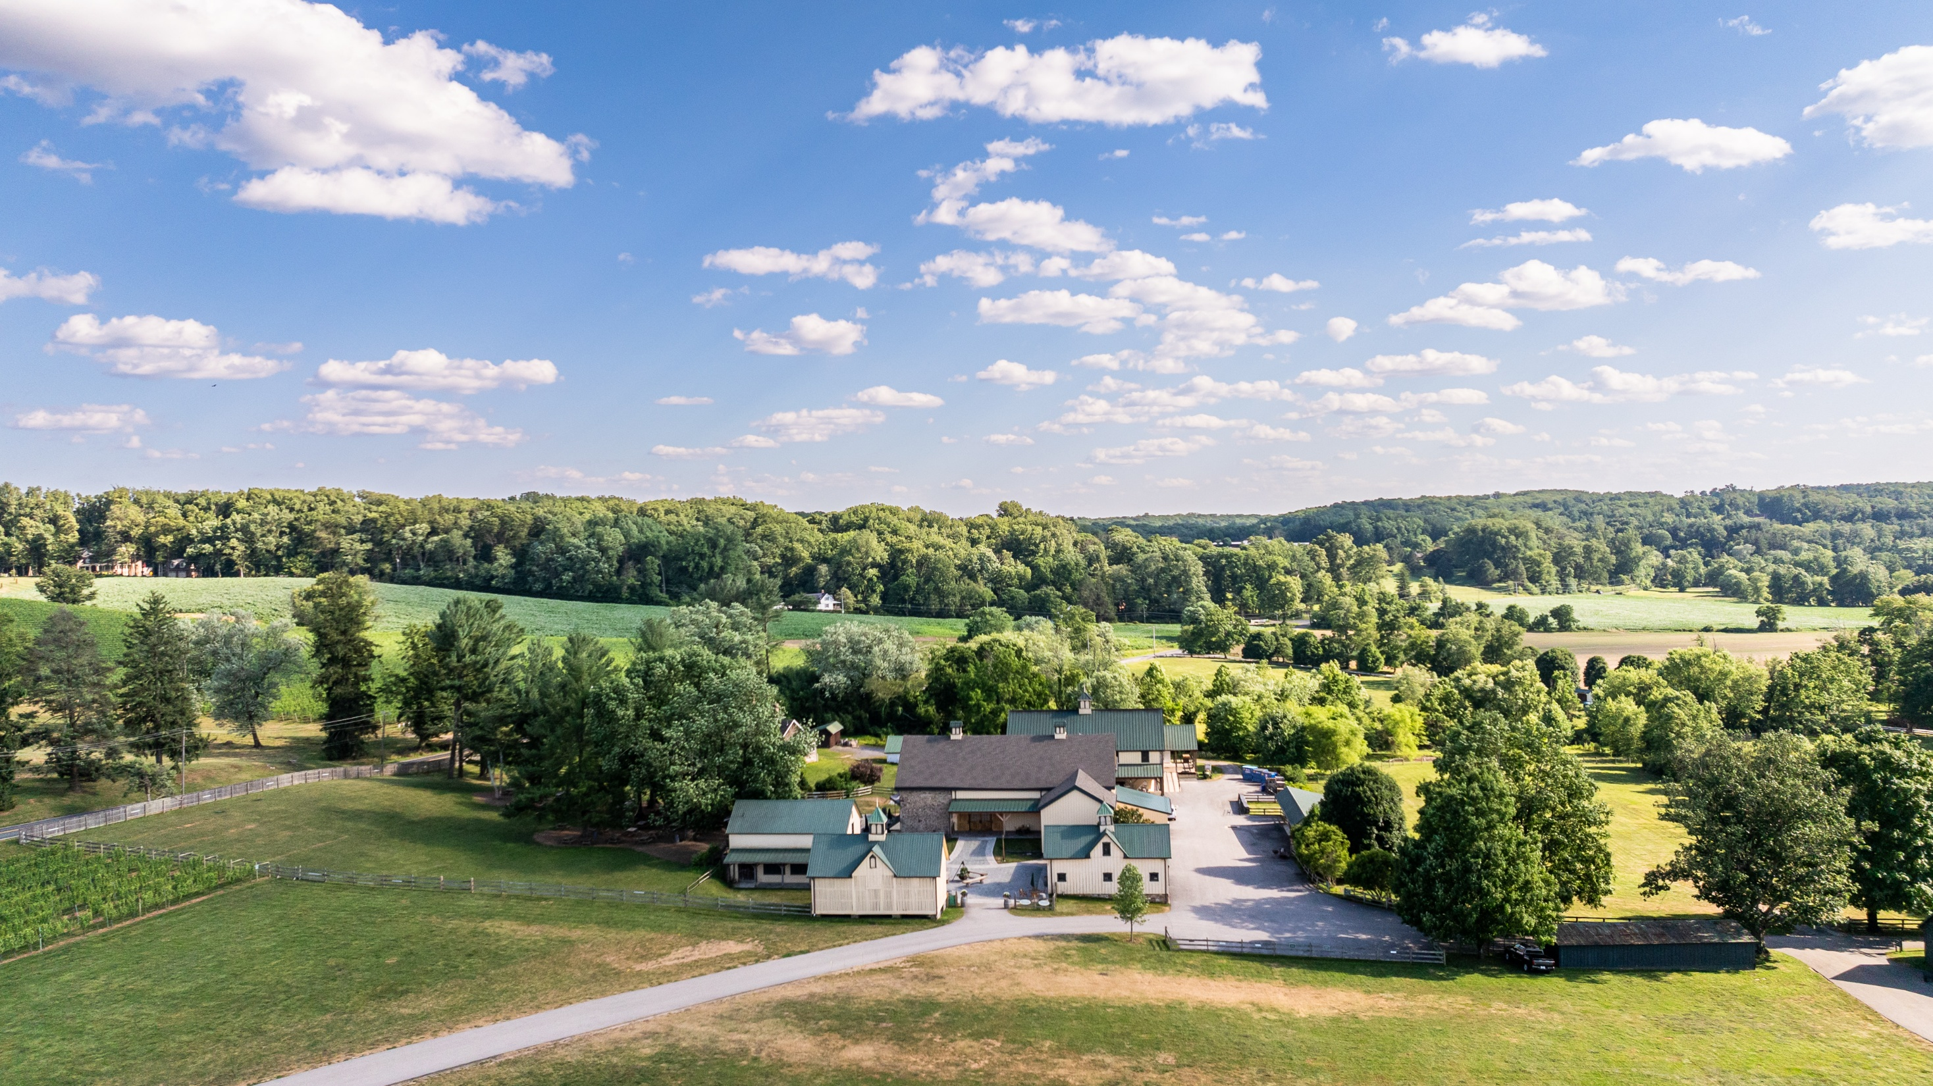
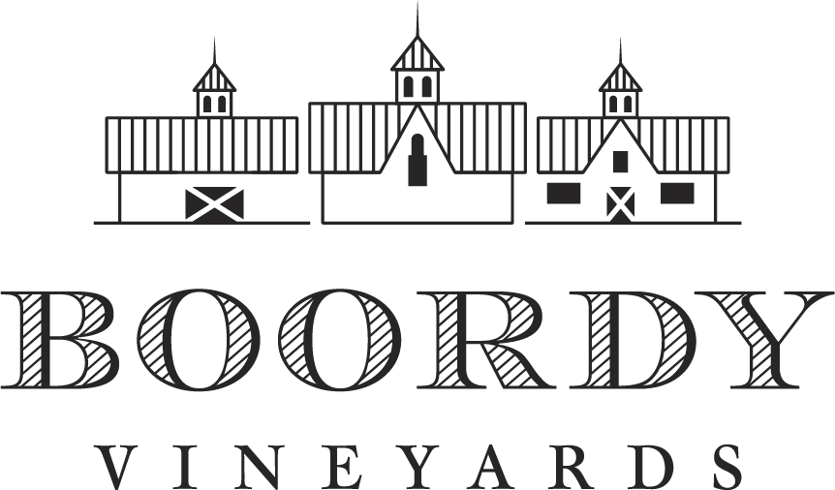
Established 1945 R.B. Deford Family, Props.

Slide 2
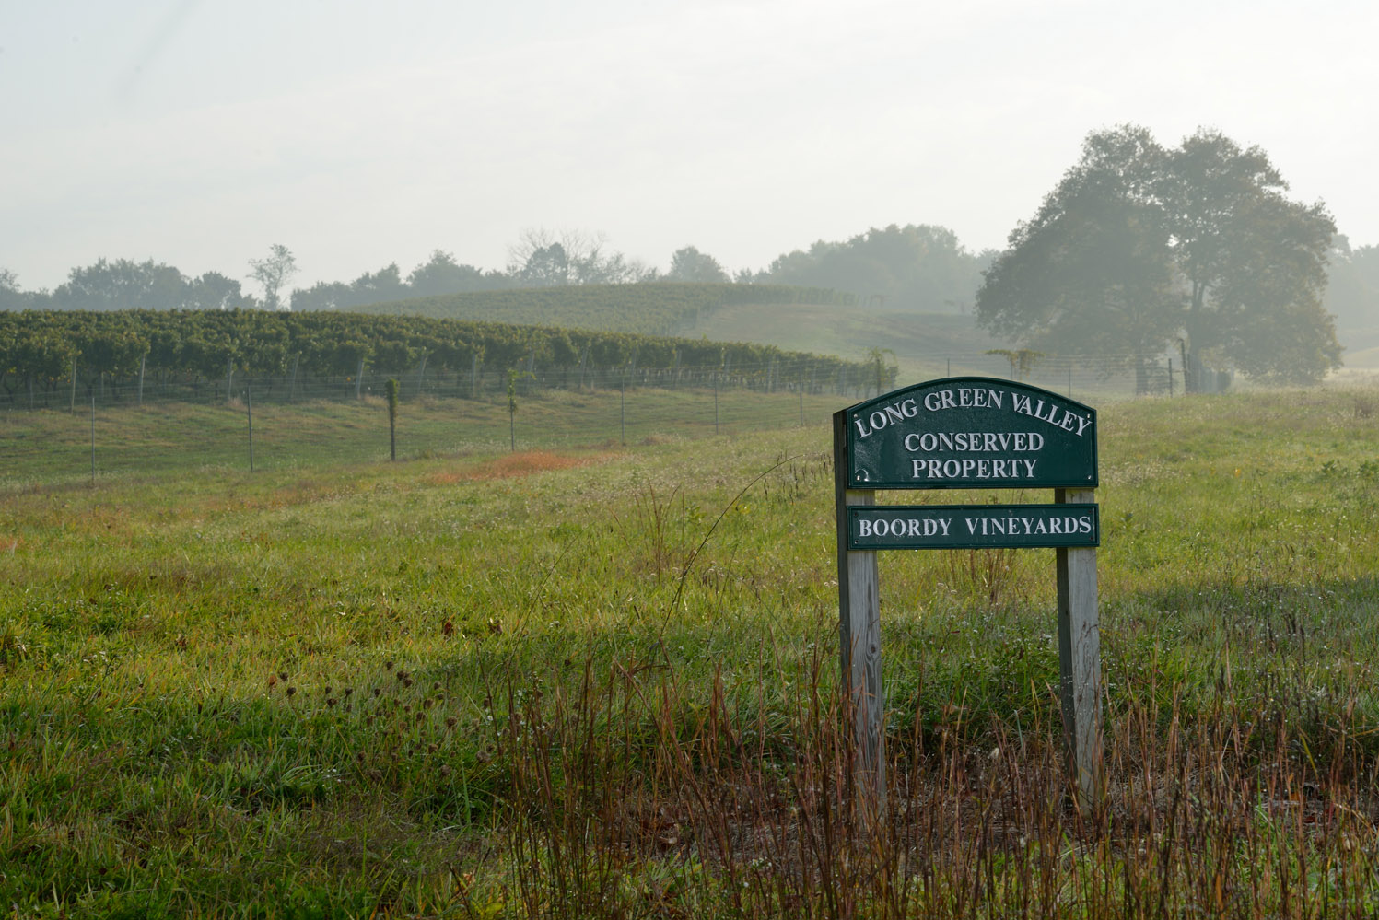
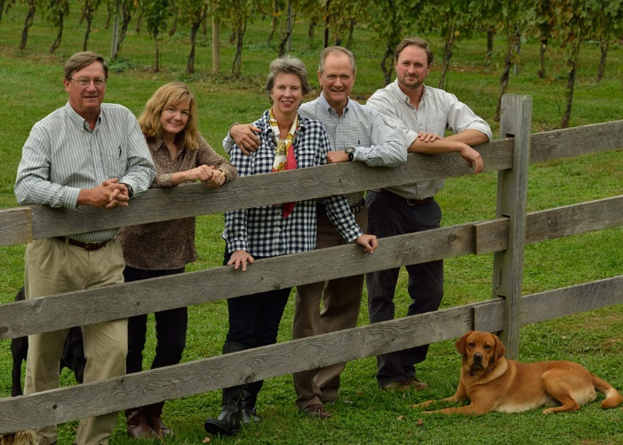
Boordy Vineyards is owned and operated by the R.B. Deford family who work with a talented team to farm grapes and produce wines,
guided by respect for the land.

Slide 3
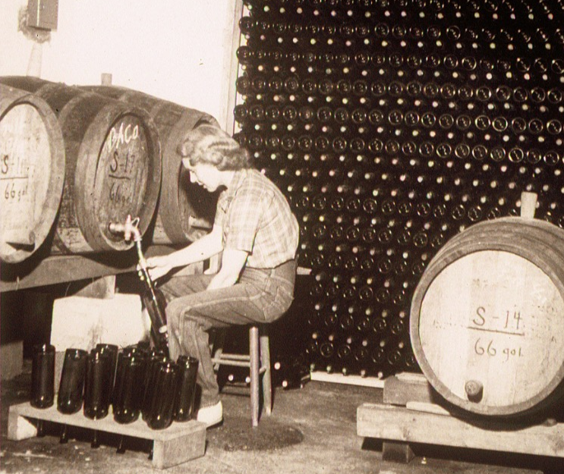
Boordy milestones
1930’s During Prohibition Philip & Jocelyn Wagner plant French grapevines on their farm in Riderwood, Maryland
1945 The Wagners found Maryland’s first winery in Riderwood, Baltimore City, MD
1965 R. B. Deford Family establishes a vineyard on their farm “Long Green” to supply grapes to Boordy
1980 The Defords purchase Boordy and move operations to “Long Green”
1996 Boordy acquires South Mountain Vineyard in Frederick County, initiates premium “Landmark” series
2008-2016 Replanting of all vineyards to better quality vines
2013 Construction of new winery at Boordy
2024 Historic Big Barn is restored by Amish craftsmen, ready for the next 200 years!
2024 Deford Family is inducted into Maryland Agricultural Hall of Fame
Jocelyn Wagner bottles Boordy’s first vintage 1945

Slide 4
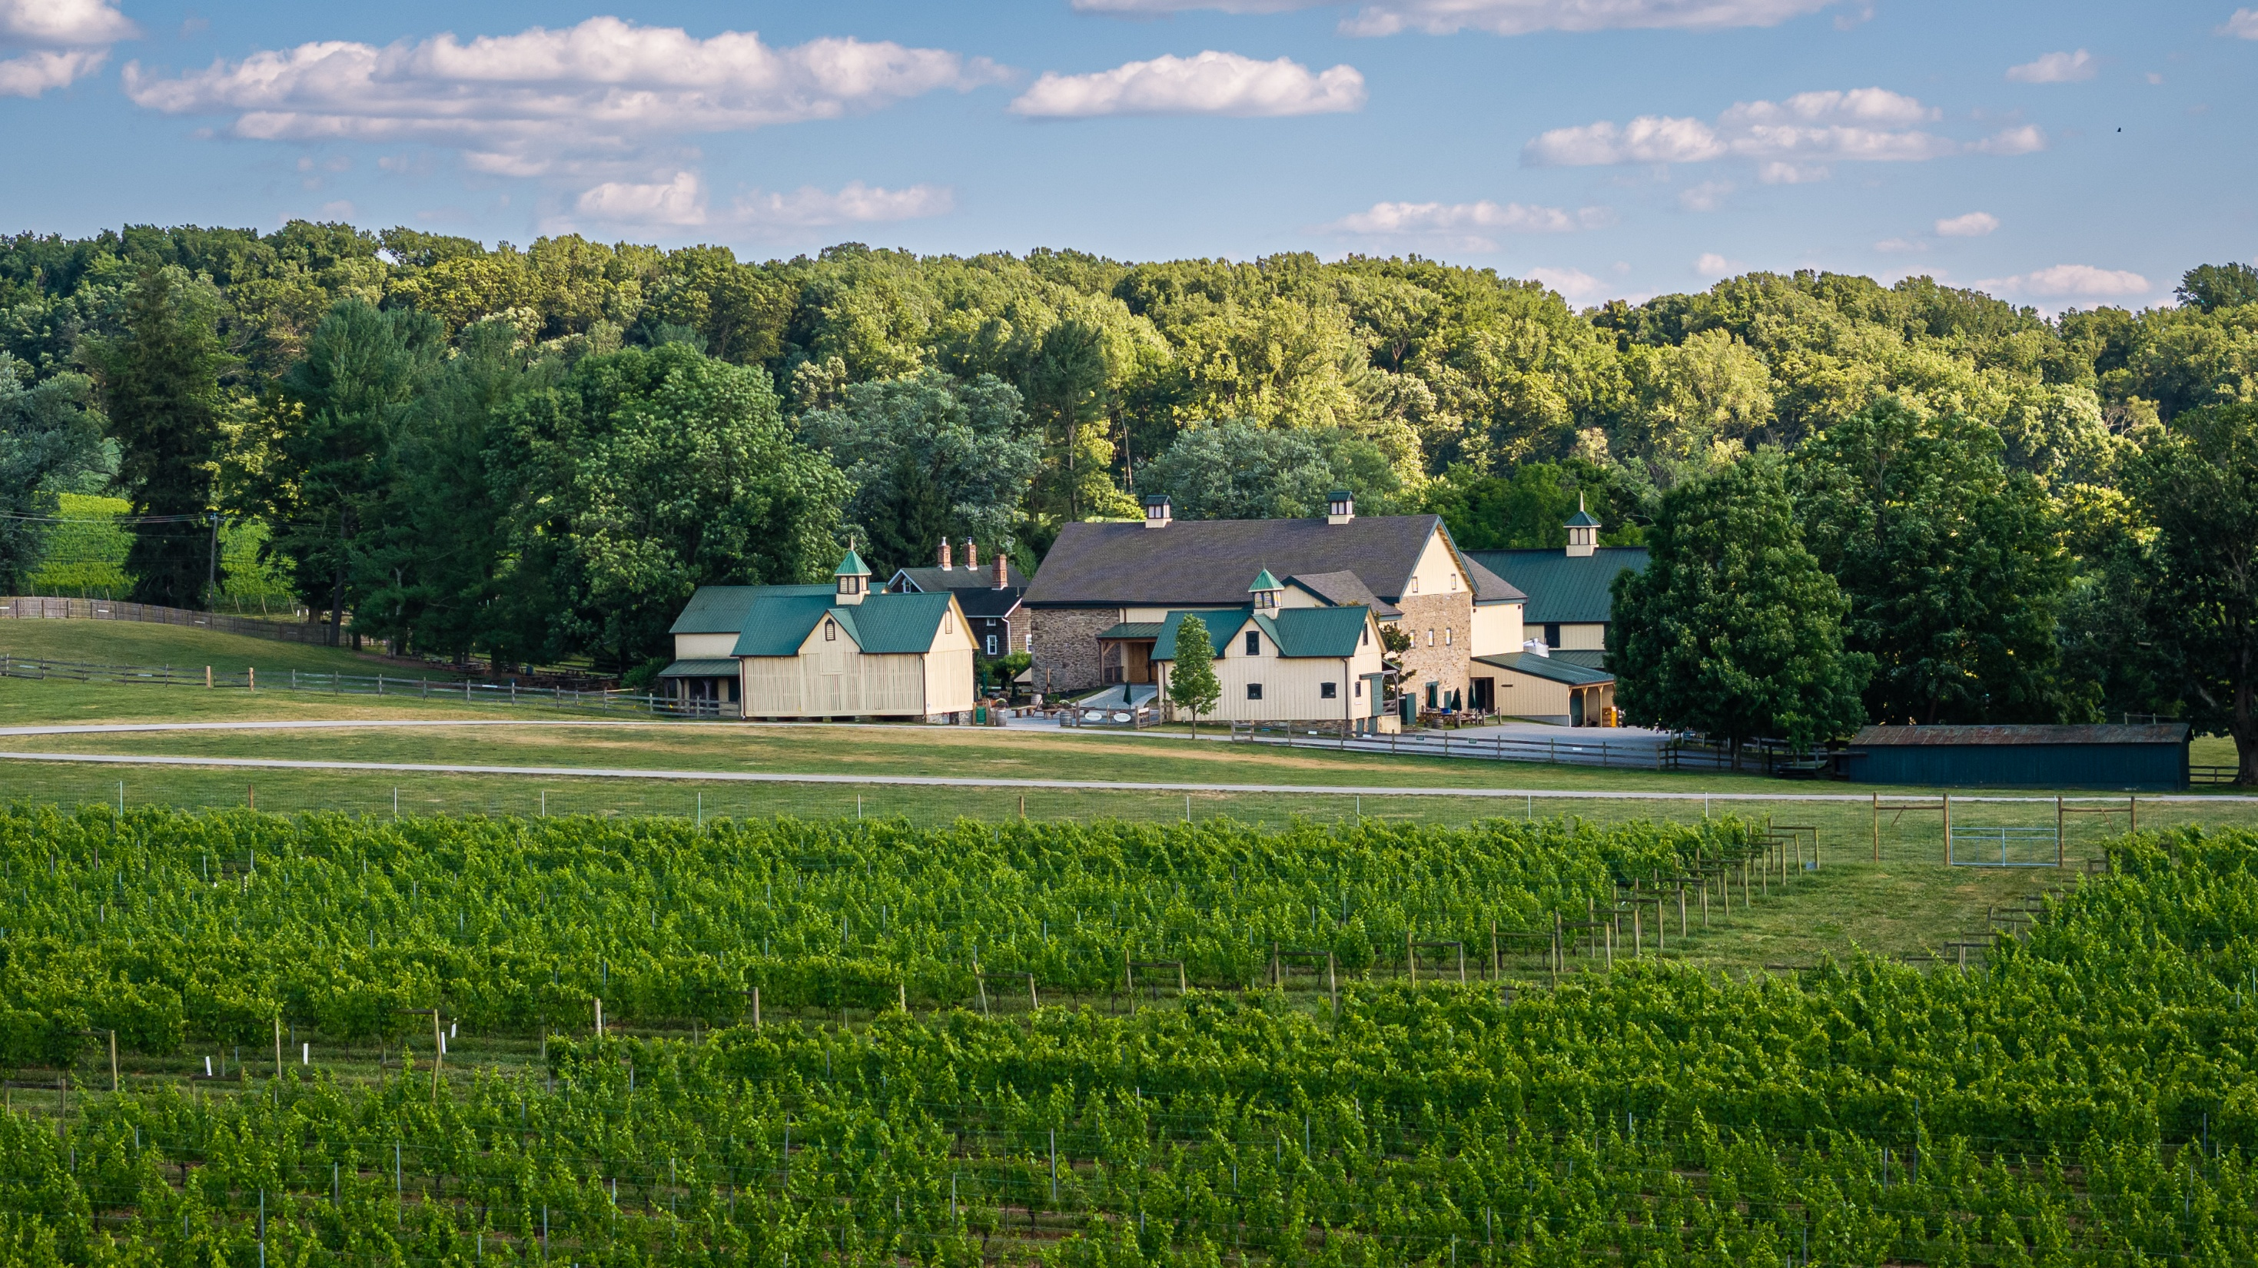
Boordy has brought vitality to the Deford’s Long Green Farm, which is listed on the National Register of Historic Places.

Slide 5
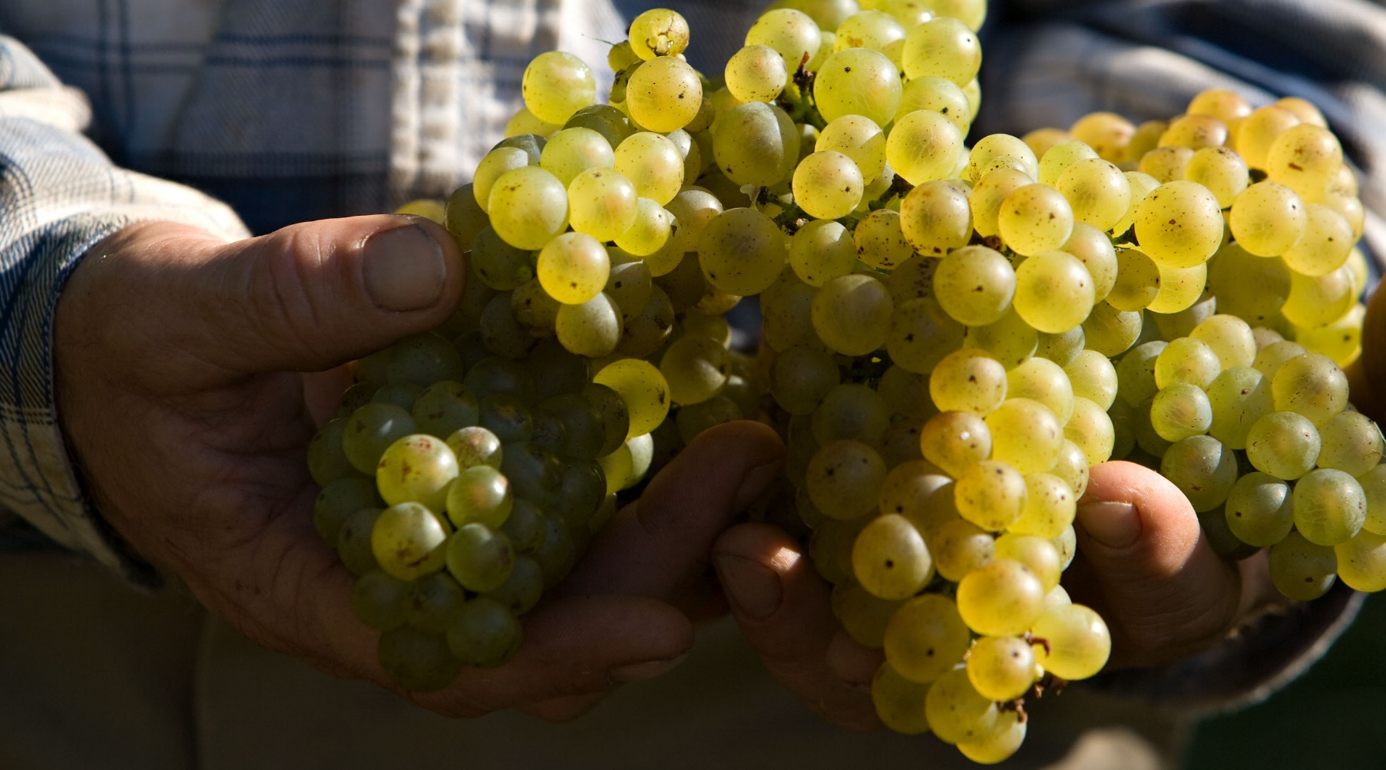
Good wines are made in the vineyard.
Boordy is fortunate to have two very favorable
vineyard sites.

Slide 6
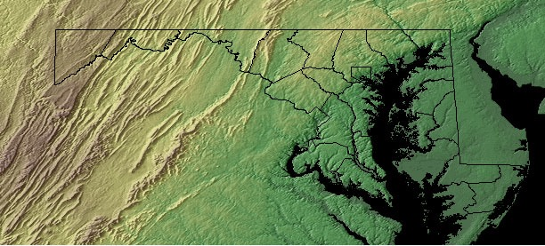
Boordy farms
two estate vineyards
in Maryland.
Long Green
Vineyard
Central Piedmont Region
Hydes, Maryland
__________
South Mountain Vineyard
Blue Ridge Province
Burkittsville, Maryland

Slide 7
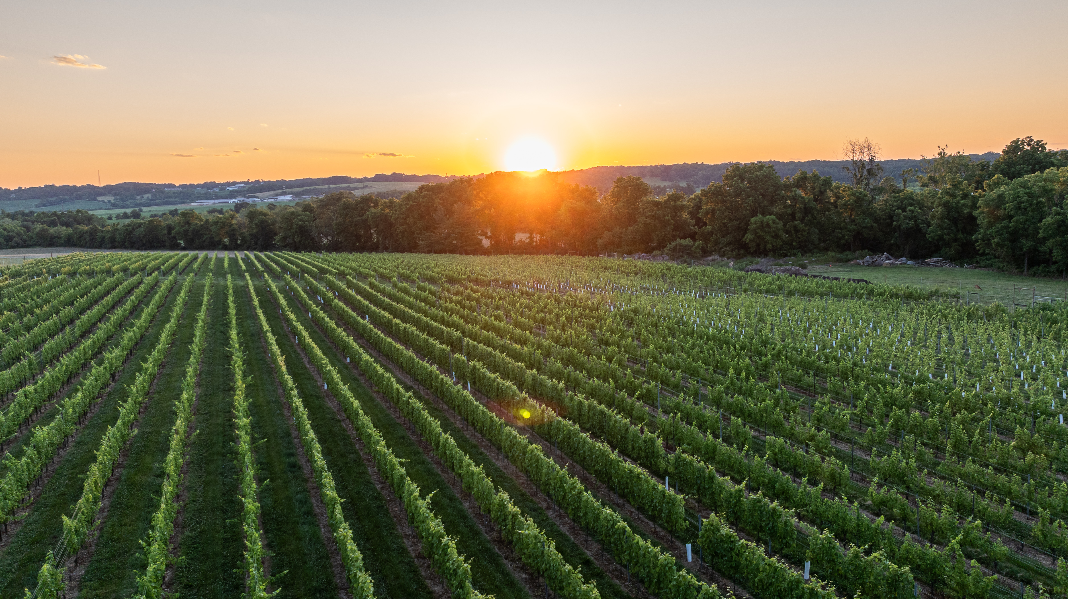
Long Green Vineyard
24 acres
Soils: clay loam,
granite schist
Elevation: 400 ft.
Region: Central Piedmont
Varieties planted:
Cabernet Franc Pinot Gris
Chambourcin Sauvignon Blanc
Chardonnay Seyval Blanc

Slide 8
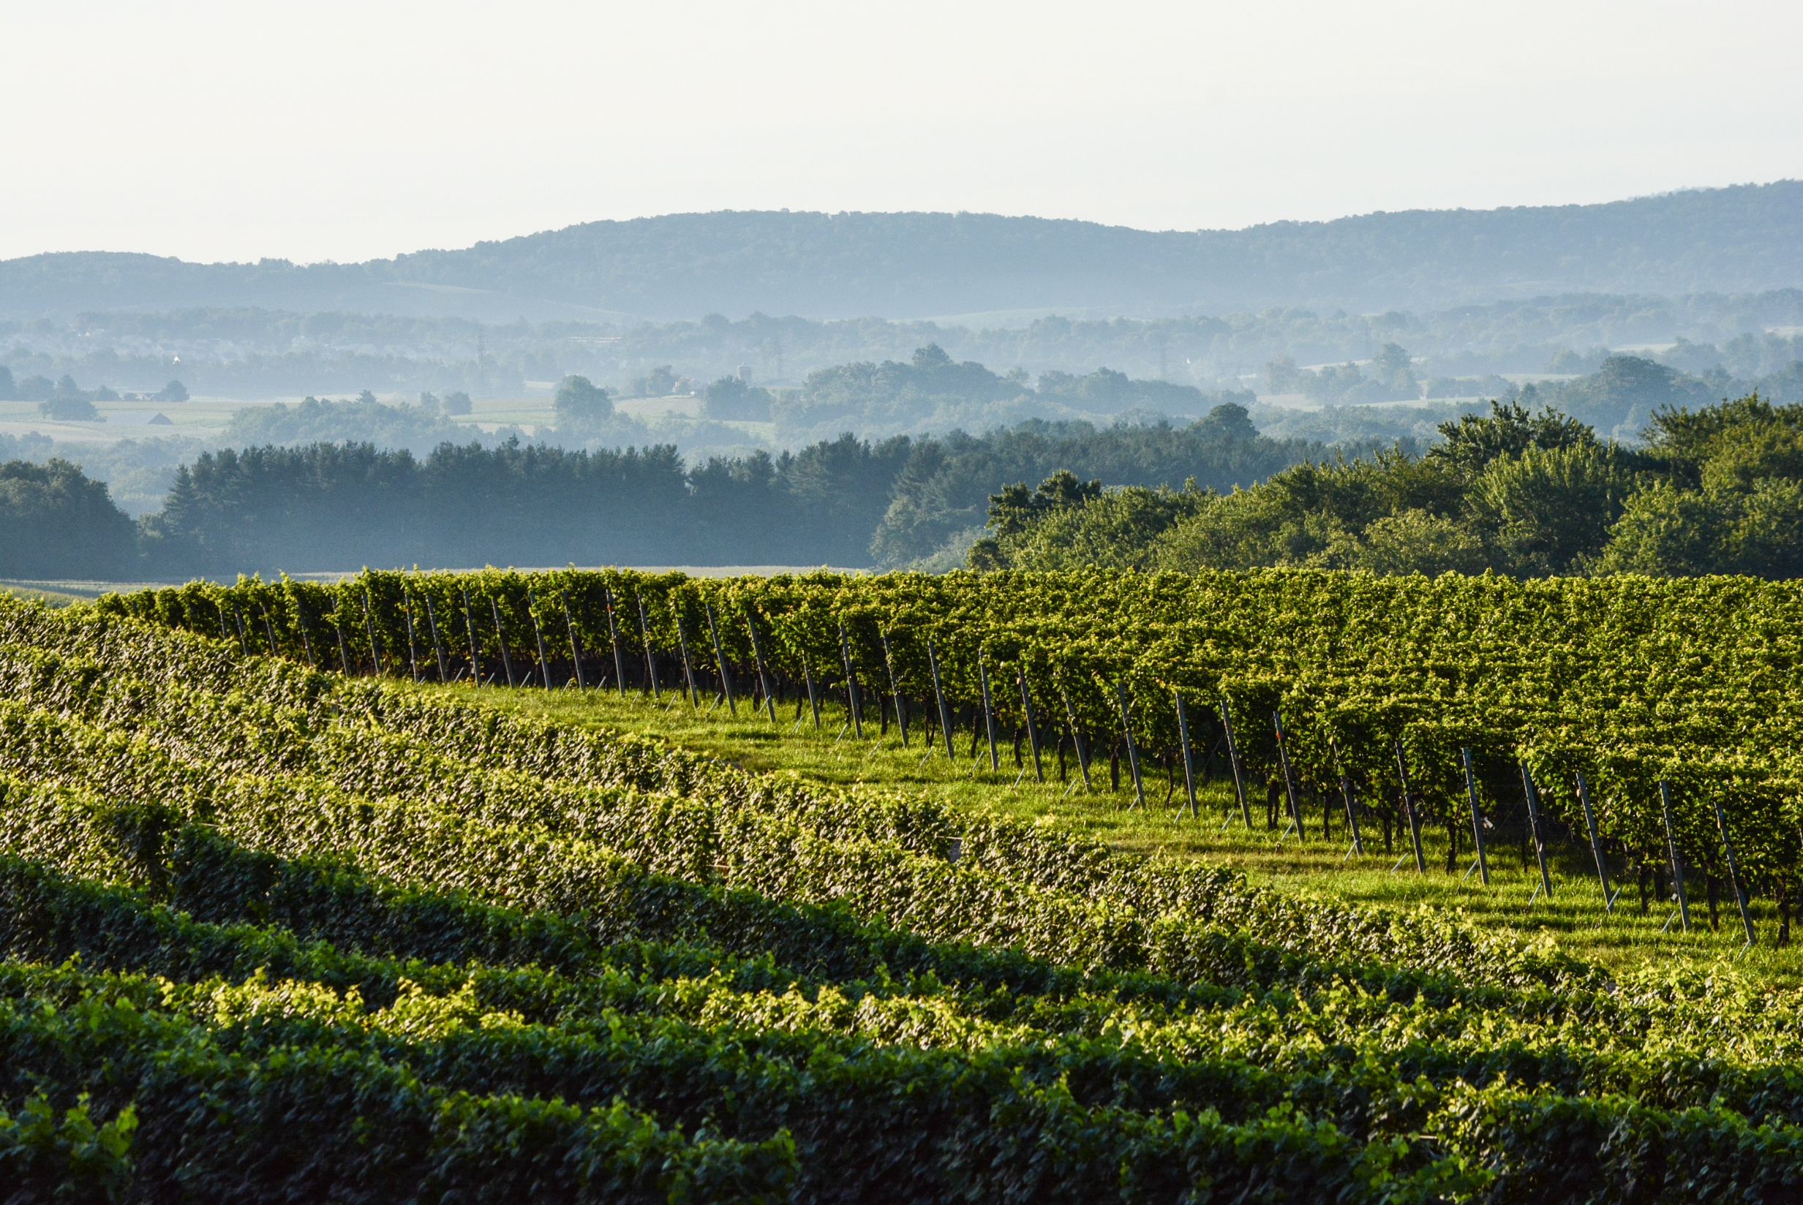
South Mountain Vineyard
26 acres
Soils: shale, greenstone
Elevation: 700 ft.
Region: Blue Ridge Province
Varieties planted:
Chardonnay
Albarino
Viognier
Cabernet Franc
Merlot
Cabernet Sauvignon
Petit Verdot

Slide 9
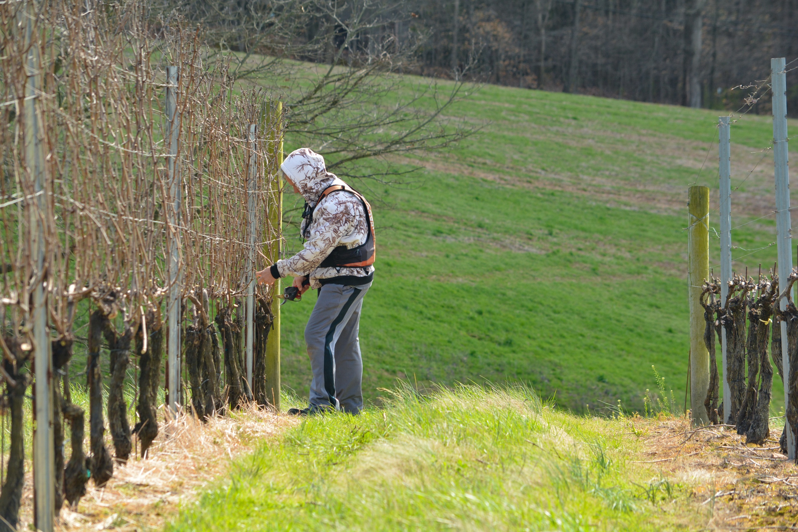
Experience matters.
Growing grapes of superior
quality is an exacting task.
We have gained intimate knowledge of our climate and soils by tending
vineyards for over
8 decades.

Slide 10
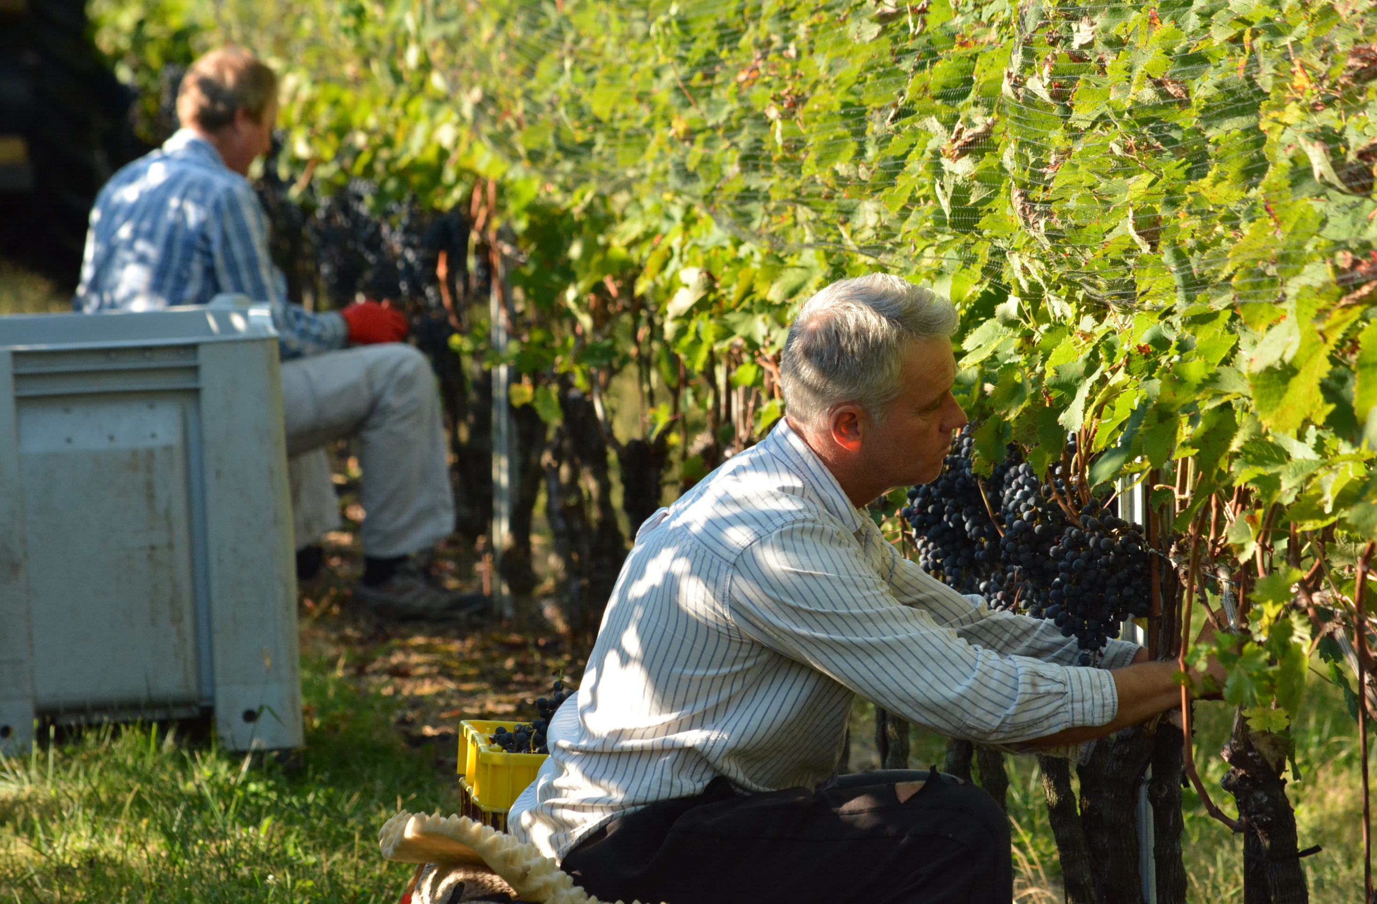
Many operations are done by hand, including harvesting, to ensure that we select only the best clusters
vineyard manager Ron Wates

Slide 11
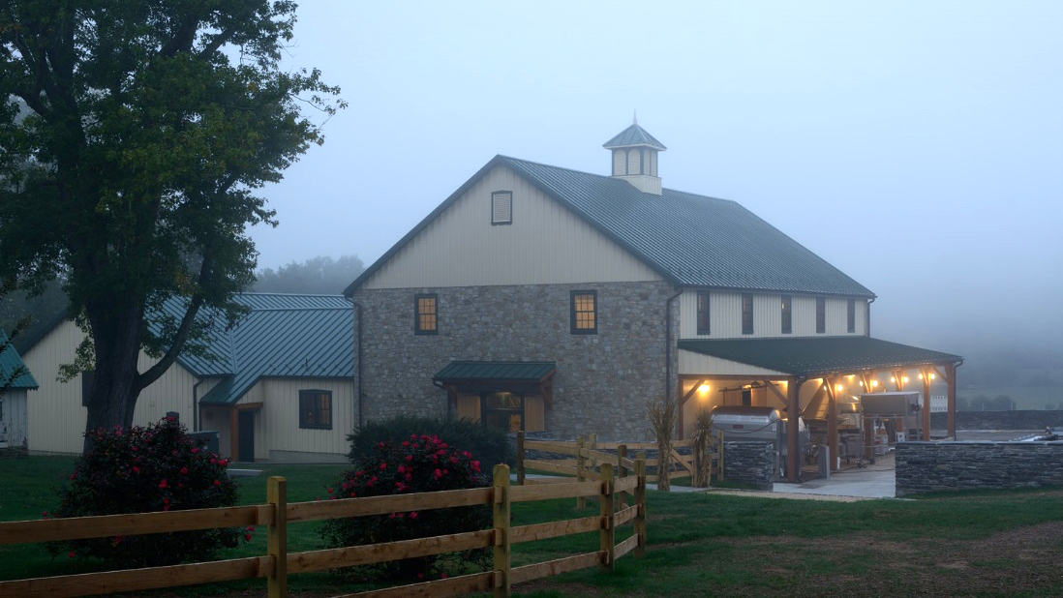
Boordy’s new winery honors the
traditional architecture of the Deford family farm

Slide 12
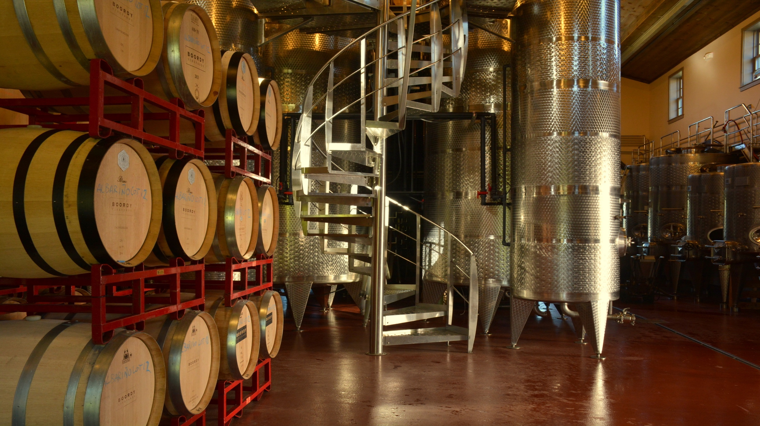
Inside, state of the art winemaking methods
are blended with time honored practices.

Slide 13
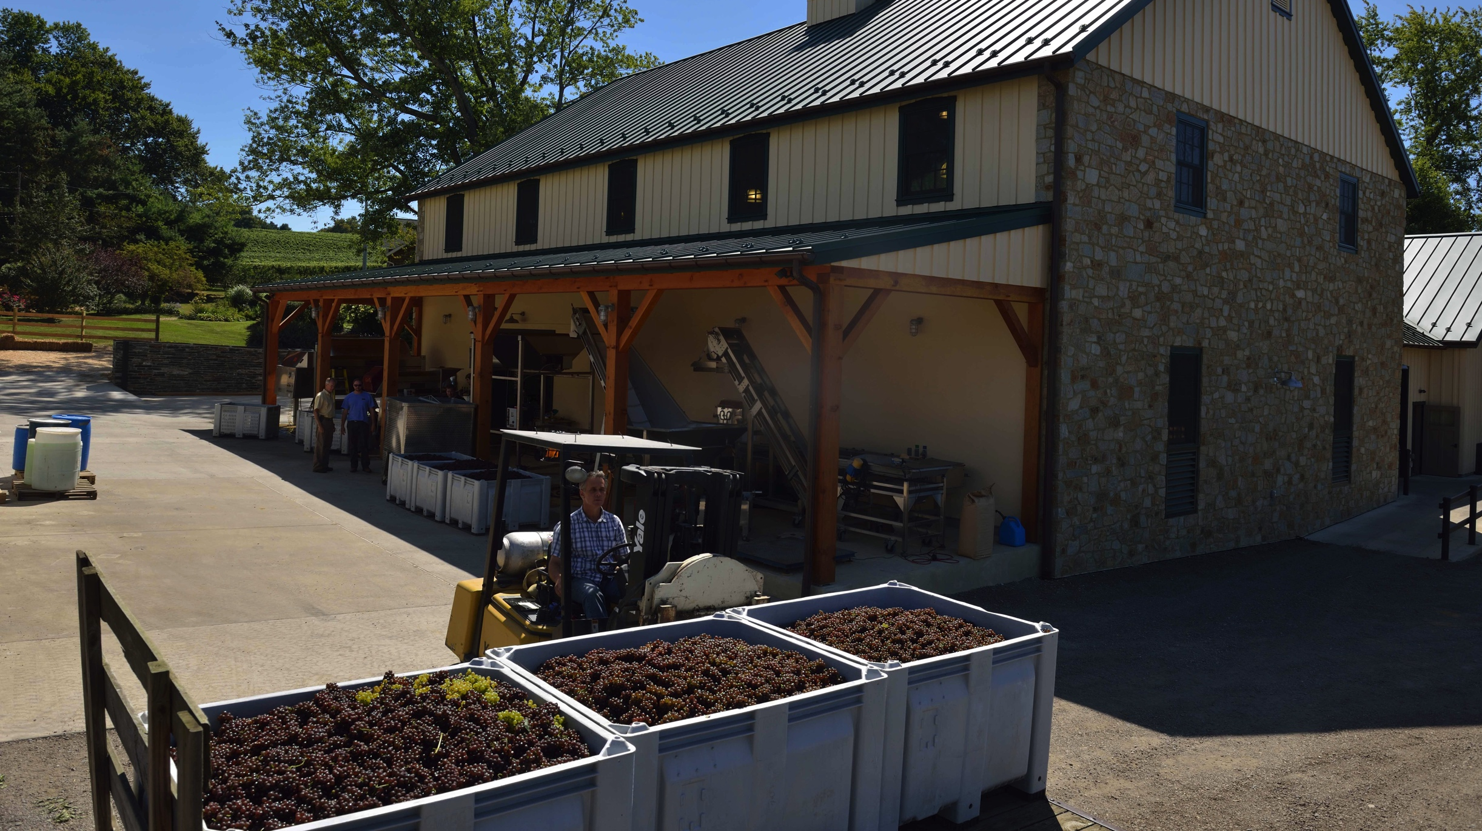
Freshly picked grapes
are delivered to Boordy’s crush pad where they are processed quickly
and gently.

Slide 14
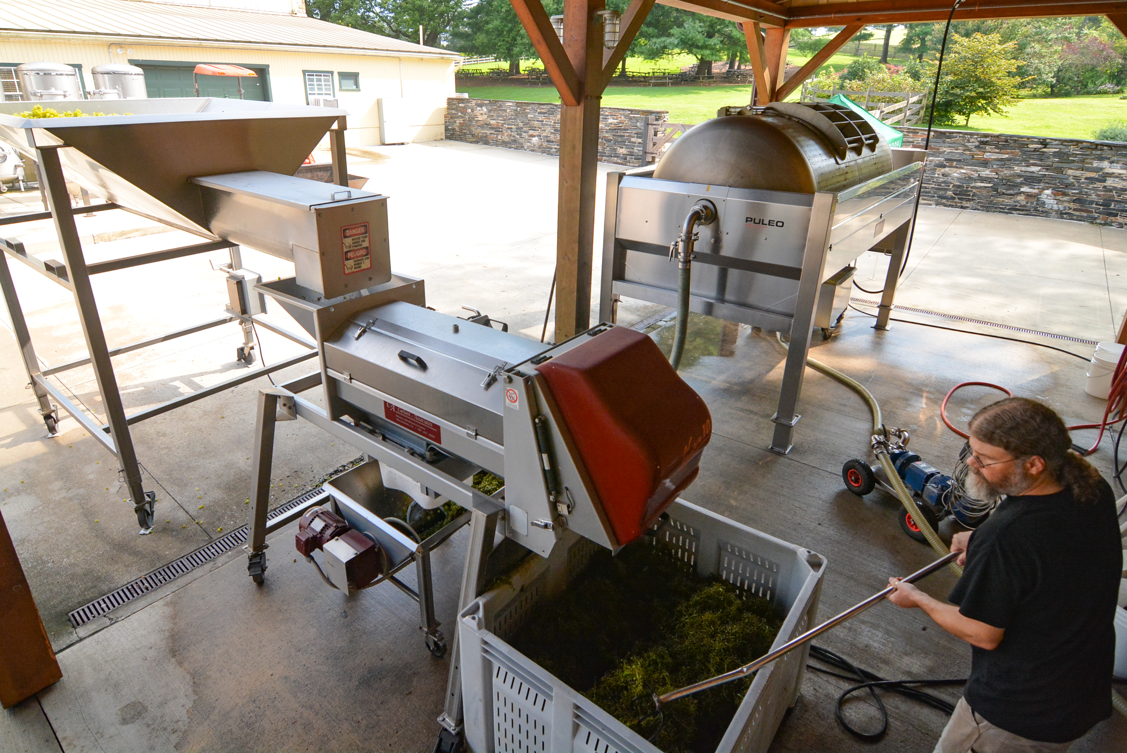
White grapes
are de-stemmed and pressed immediately to extract their juice.

Slide 15
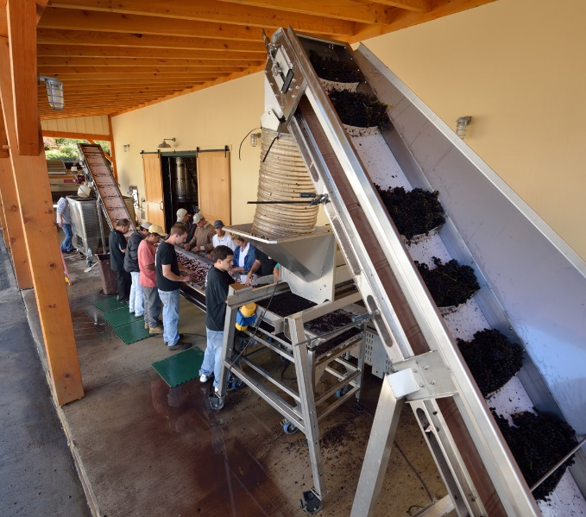
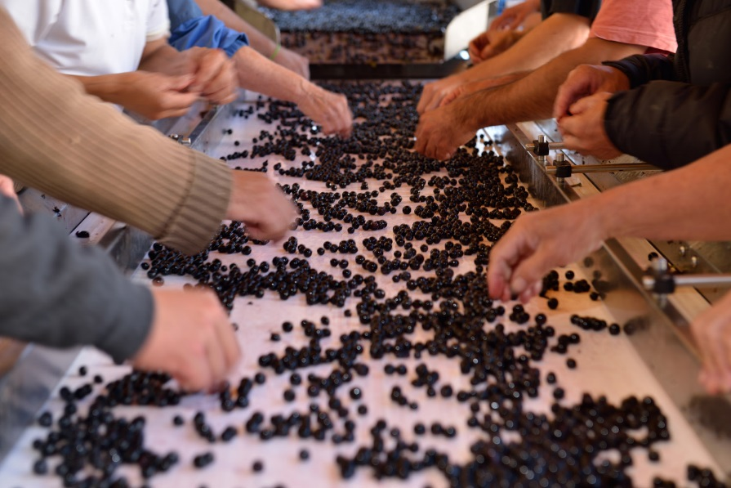
Red grapes
are de-stemmed and hand sorted prior to primary fermentation in stainless steel.

Slide 16
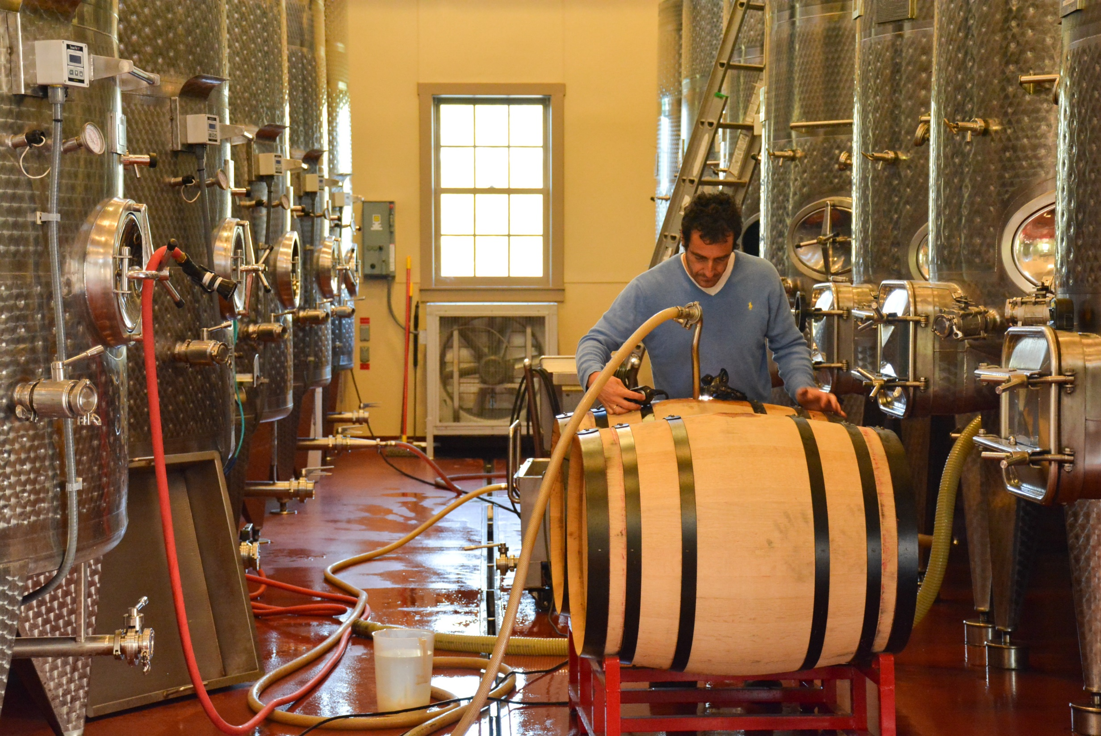
After primary fermentation is complete new red wines are transferred to French oak barrels head winemaker, Jose Real

Slide 17
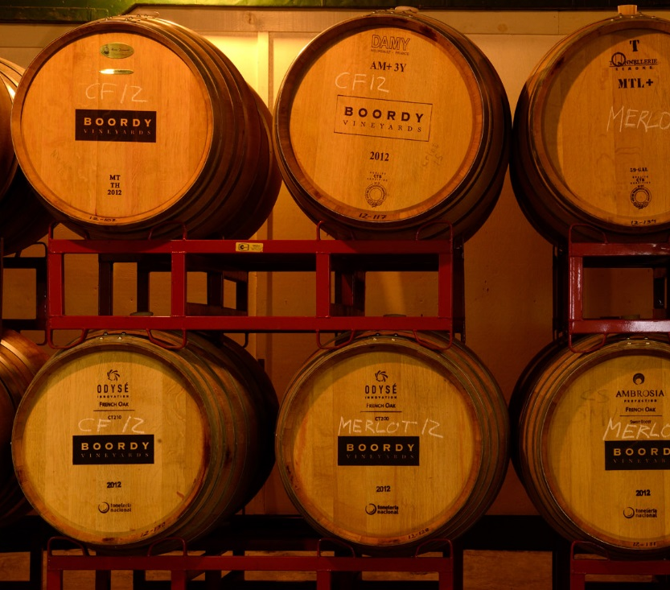
Patient aging brings out the best in each wine as it matures.
Barrel cellar
Holds 250 French oak barrels for aging red and white wines
Wines mature in barrels of various ages to control oak influence
Barrels are retired after five vintages

Slide 18
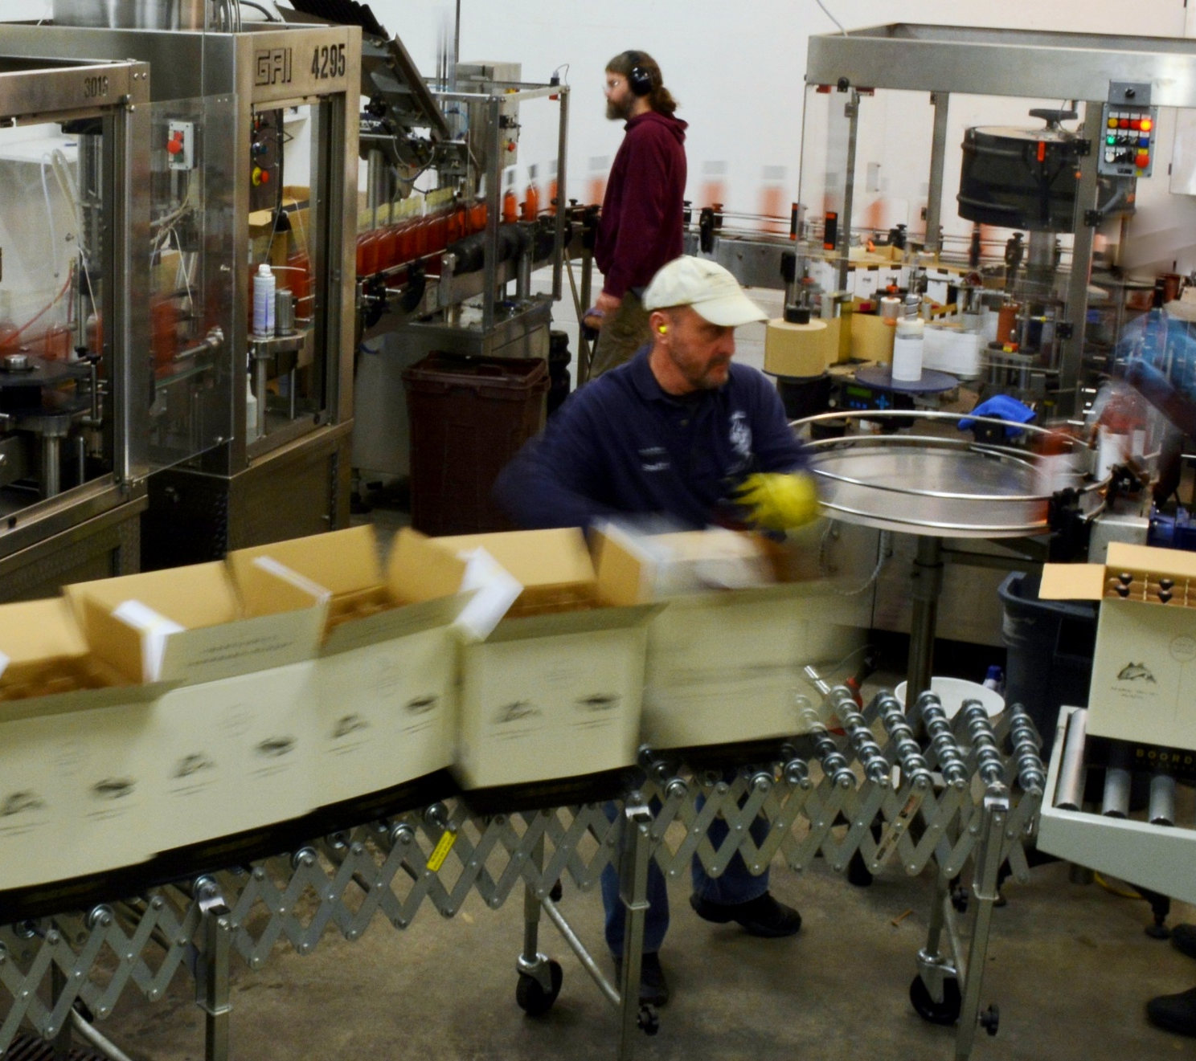
Wines are bottled between 5 and 18 months following their vintage.
Speed, cleanliness and minimal oxygen exposure are the keys to quality control.

Slide 19
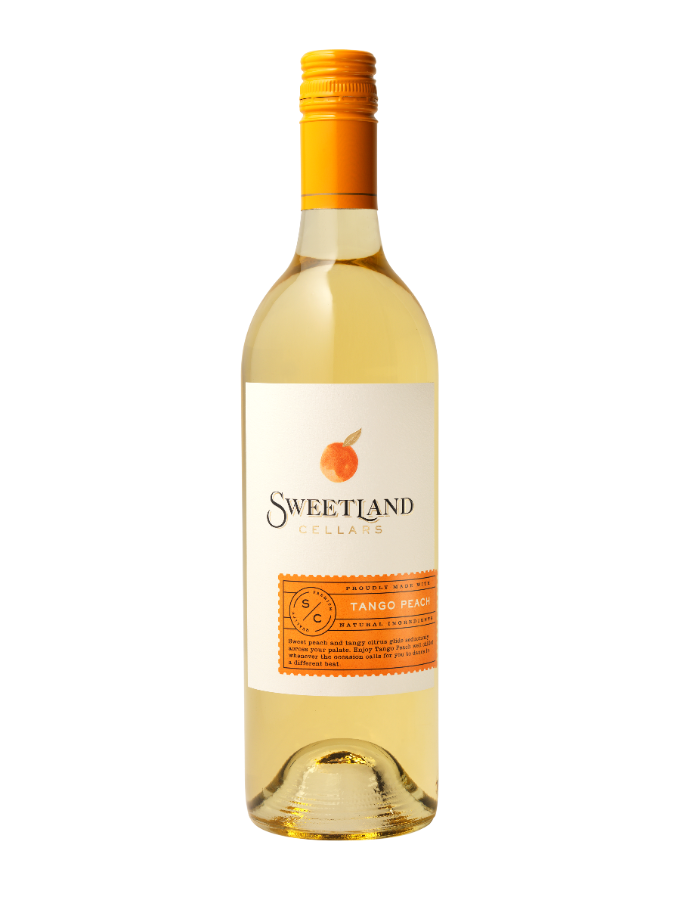
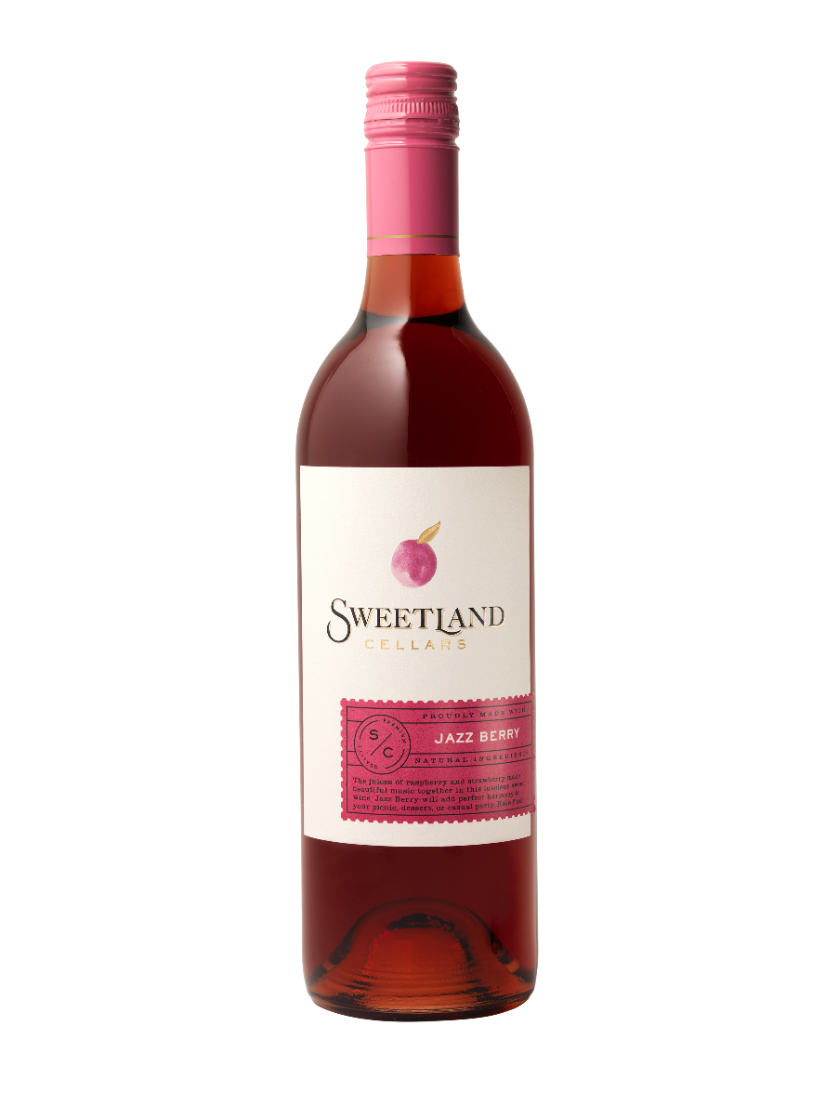
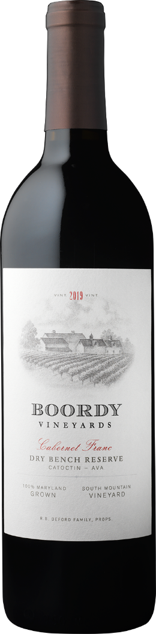
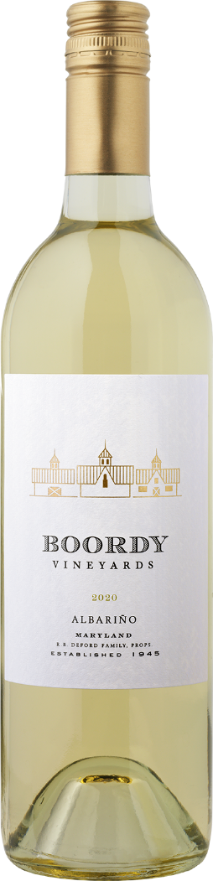
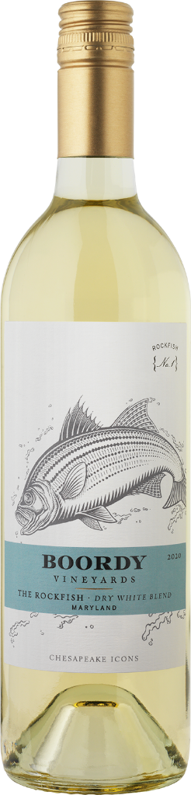
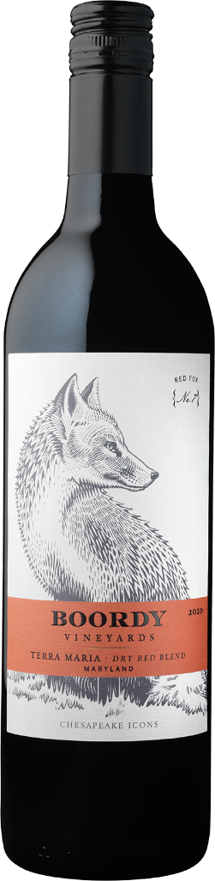
Boordy offers three series of wines
Selections that are as creative and diverse as your market
LANDMARK SERIES
ICON SERIES
SWEETLAND CELLARS

Slide 20
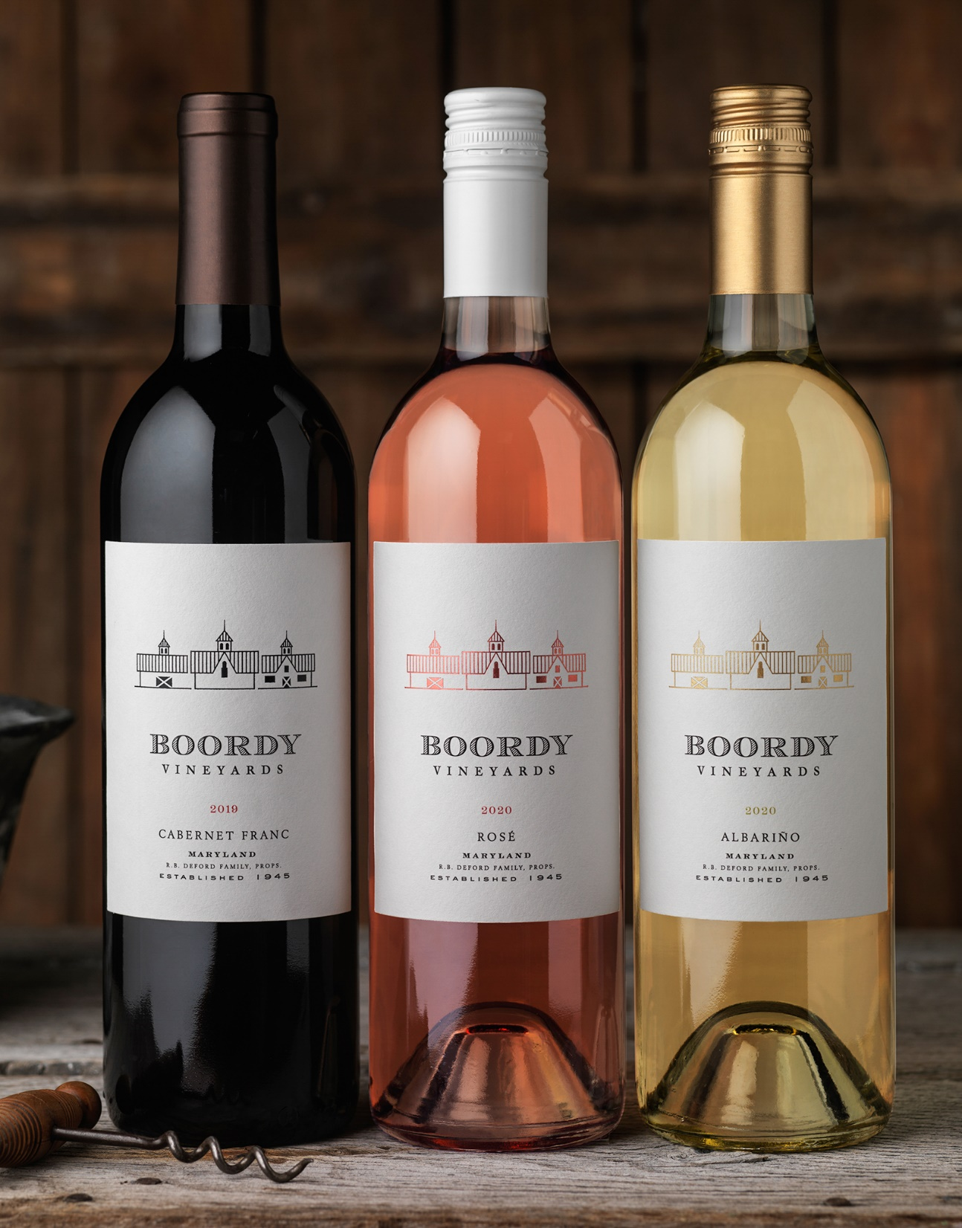
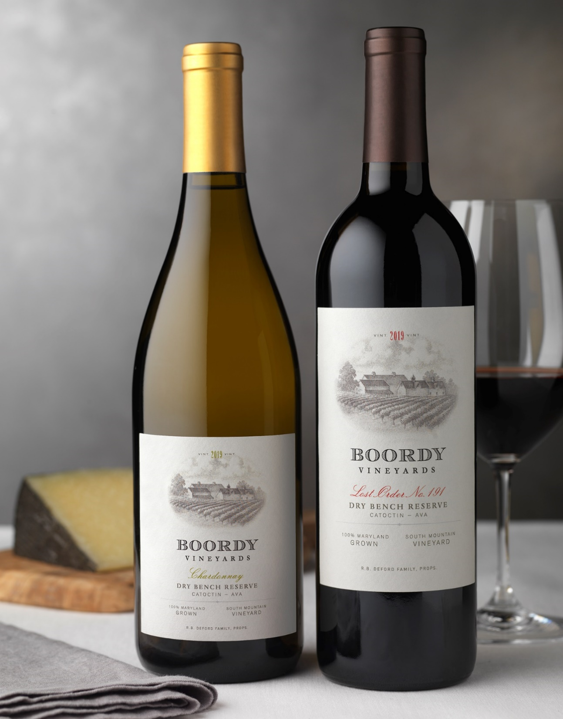
LANDMARK SERIES
The finest representations of vintage year, varietal character, and the geography of our region.
Made in limited quantities from 100% estate grown grapes.

Slide 21
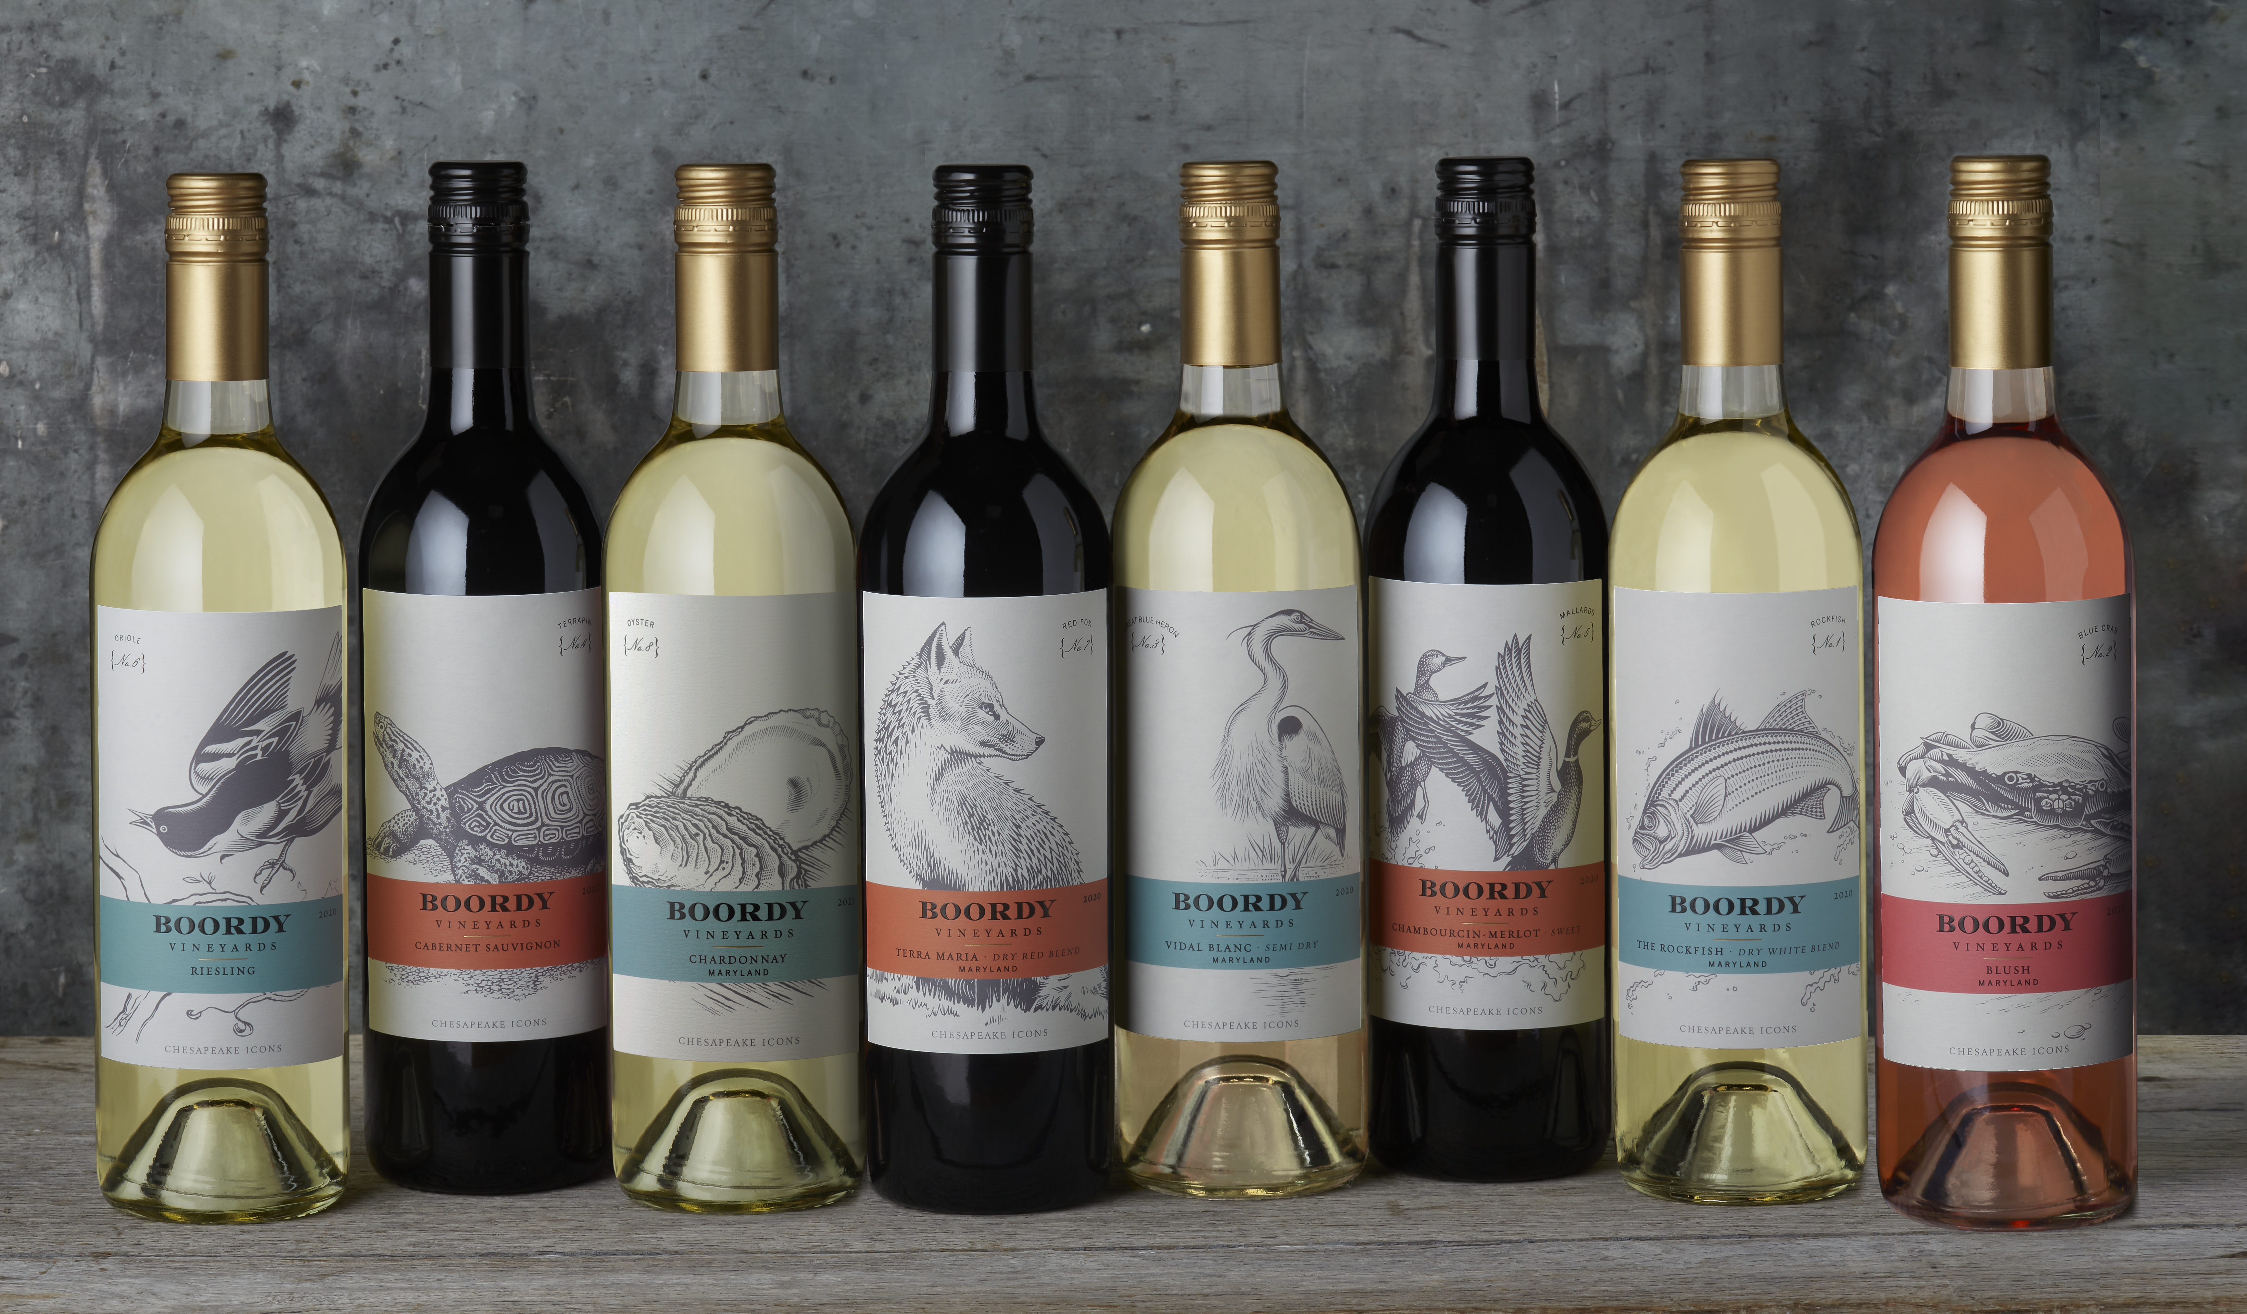
CHESAPEAKE ICONS
Boordy’s
most popular series offers well-balanced flavorful wines.
The engravings of iconic Chesapeake wildlife signify Boordy’s commitment to our environment.

Slide 22

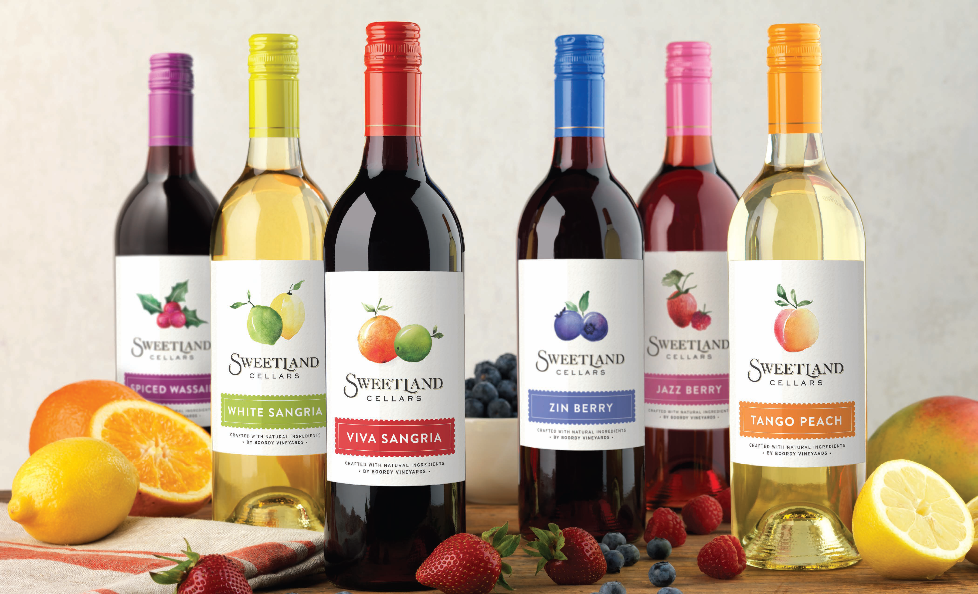
for the lighter
side of life
Natural, flavorful, & casual – enjoy Sweetland in a wine glass, over ice, or in a creative wine cocktail.

Slide 23
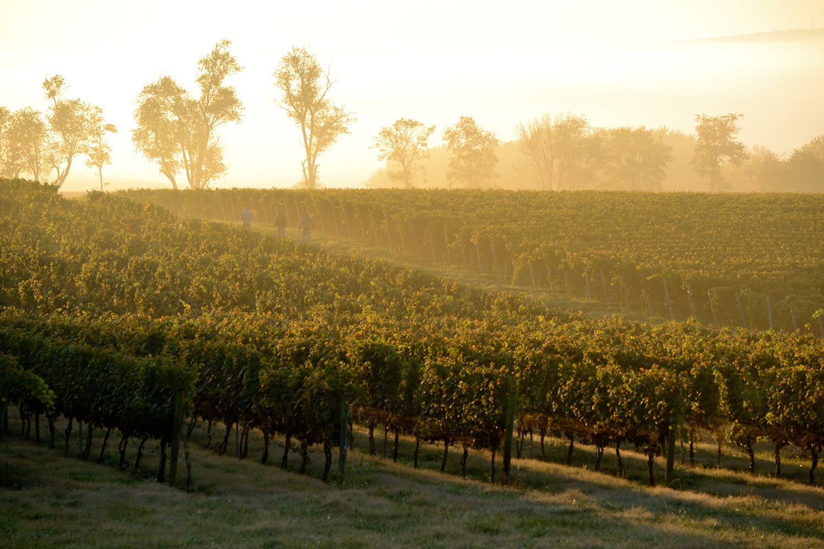
THE QUEST FOR EXCELLENCE
“Boordy Vineyards has become one of the most visible examples of the rapid rise in quality of East Coast wines.”
– International Wine Review
Five-time overall winner of Maryland Governor’s Cup Wine Competition
Voted Maryland’s Best Winery by readers of the Baltimore Sun five consecutive years
Double Gold medal, San Francisco International Wine Competition
Double Gold medal, Finger Lakes International Wine Competition
Top award, Atlantic Seaboard Wine Competition
Lifetime Achievement Award Eastern Winery Exposition 2020
Inducted into the Maryland Agricultural Hall of Fame 2024

Slide 24
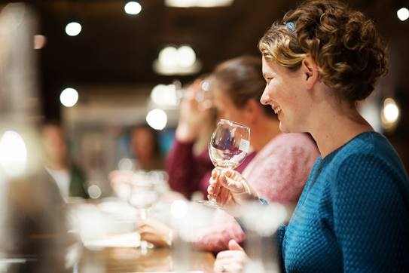
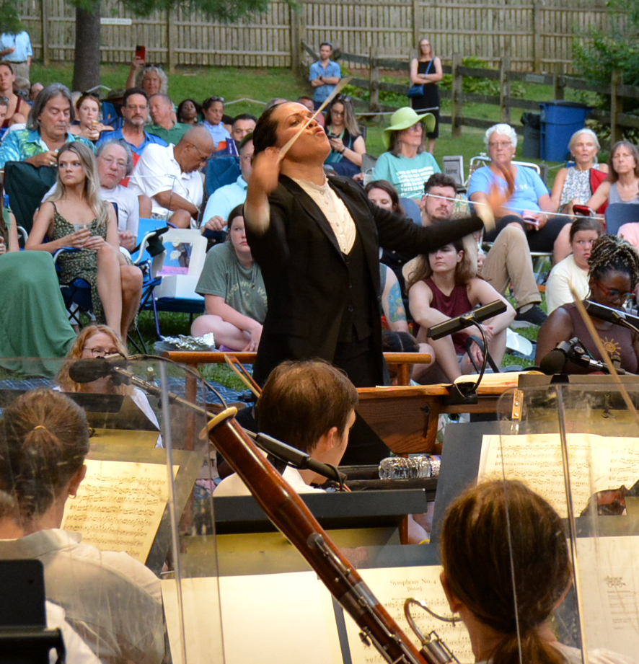
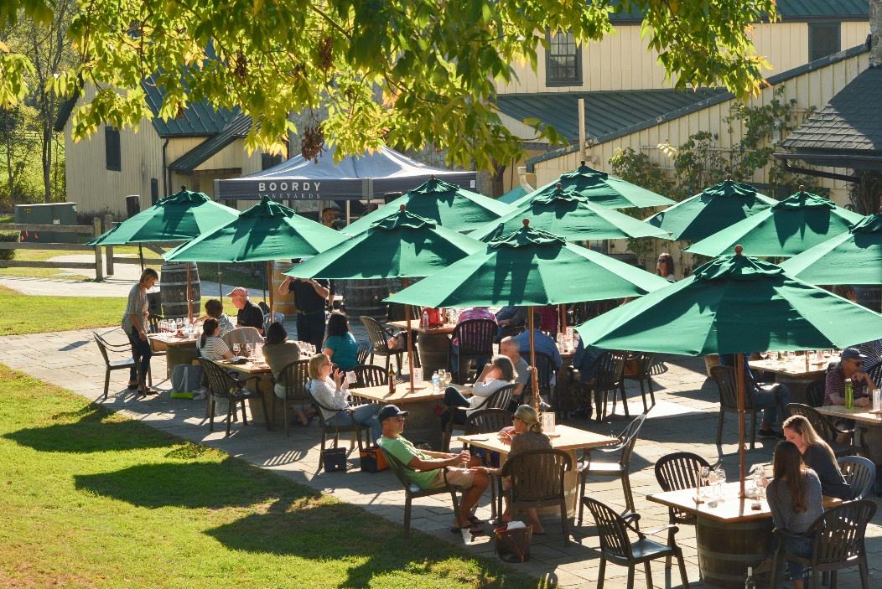
The Good Life at Boordy
Visitors to Boordy enjoy an afternoon in the country for
winetasting or a festive event.
Boordy is a Maryland landmark that
offers year-round hospitality.

Slide 25
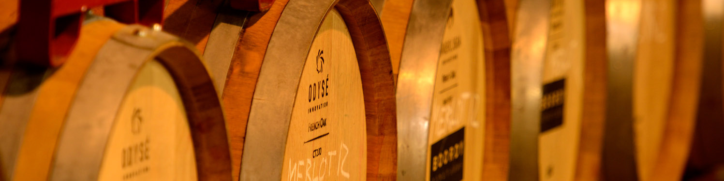
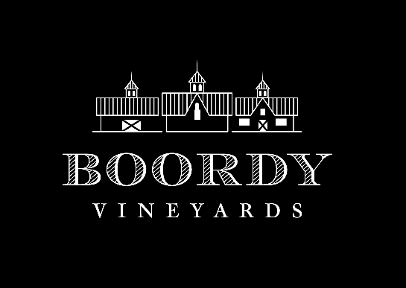
Why Boordy wines?
WHY BOORDY WINES?
A PERFECT MATCH ~ Delicious local foods deserve to be paired with fine locally-produced wines.
LOCAL OWNERSHIP ~ Boordy is owned by the R. B. Deford Family, 12th generation Marylanders.
INDUSTRY LEADER ~ Boordy is Maryland’s iconic winery, offering hospitality and events year ‘round.
EXPERIENCE ~ Boordy’s profound knowledge of our climate and soils is the foundation of quality.
PROFESSIONALISM ~ Boordy is represented by one of the region’s top distributor networks.
VALUE & AVAILABILITY ~ Boordy wines are competitively priced and are consistently available.
AWARD-WINNING QUALITY ~ Confirmed by awards and critical accolades.
www.boordy.com ~ Kate Cordell, sales & distribution manager ~kate@boordy.com ~ 410-456-3867

Slide 26
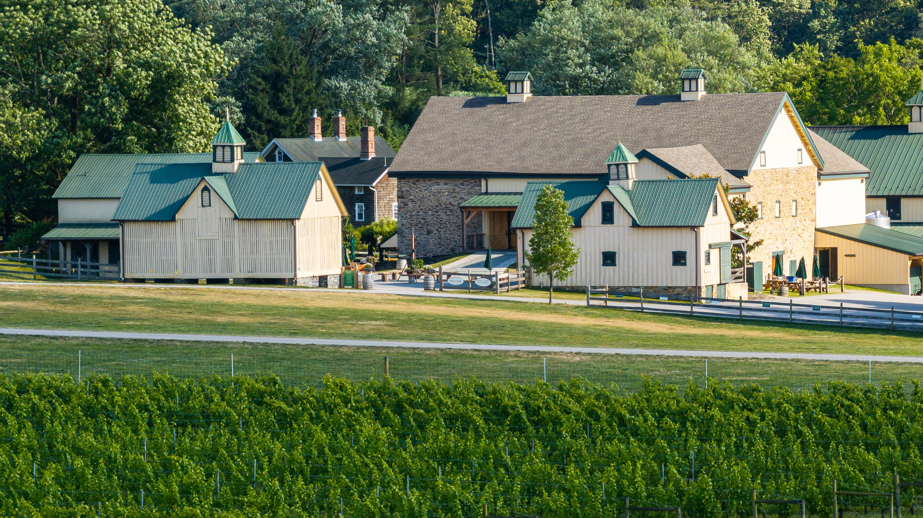
“Winemaking is our life and we are proud to share our wines with you.”
R.B. Deford Family

