Slide 1

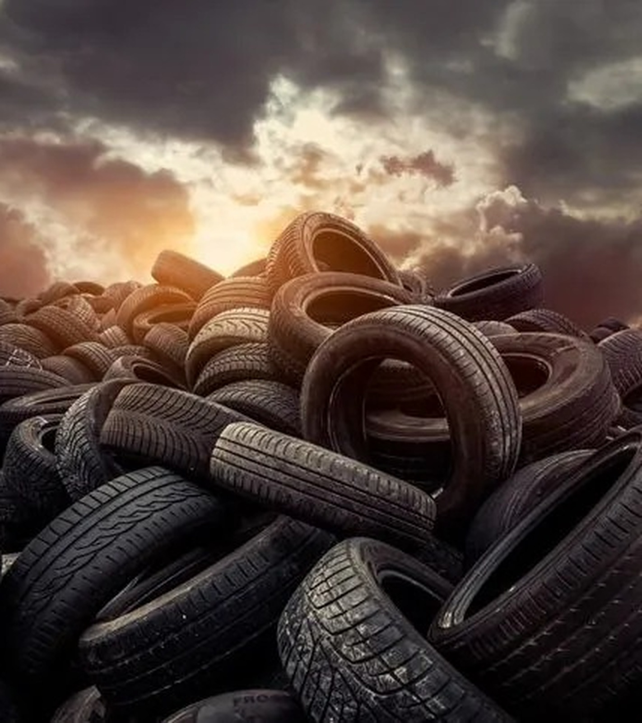
DOWNLOADABLE INVESTOR DECK
Turning the tire waste problem into a resource-recovery platform
Waste Energy Corp. is building a scalable platform designed to divert difficult waste streams from landfills and convert them into usable assets, recovered materials, and energy-related outputs.
OTC: WAST
wec.eco
Forward-looking information and risk disclaimers included.

Slide 2
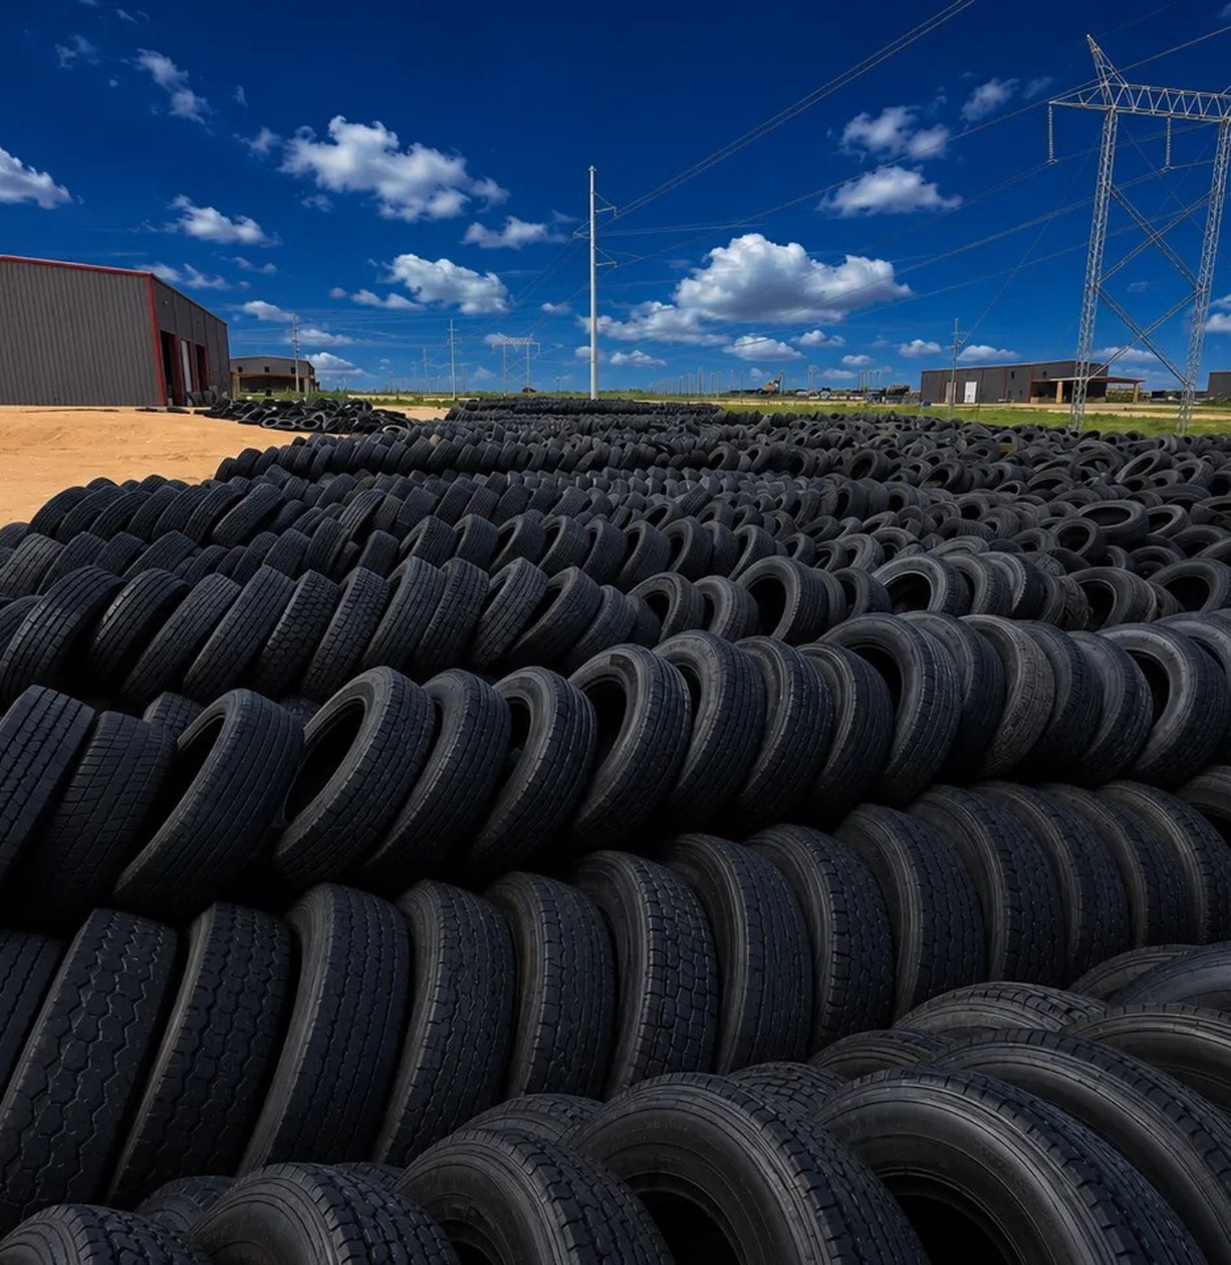
THE TIRE PROBLEM
Tires are a uniquely stubborn waste stream.
They are valuable engineered products, but once discarded they are difficult to compact, hard to process, and costly to move.
250M+
U.S. end-of-life tires generated annually
1B
Tires reach end of life globally each year
48M
Estimated U.S. tires still in stockpiles
21%
U.S. ELTs not consumed by end-use markets in 2023
Sources: USTMA 2023 ELT Management Report / Tire Recycling Markets; WBCSD Tire Industry Project.
WASTE ENERGY CORP. | OTC: WAST | 02

Slide 3
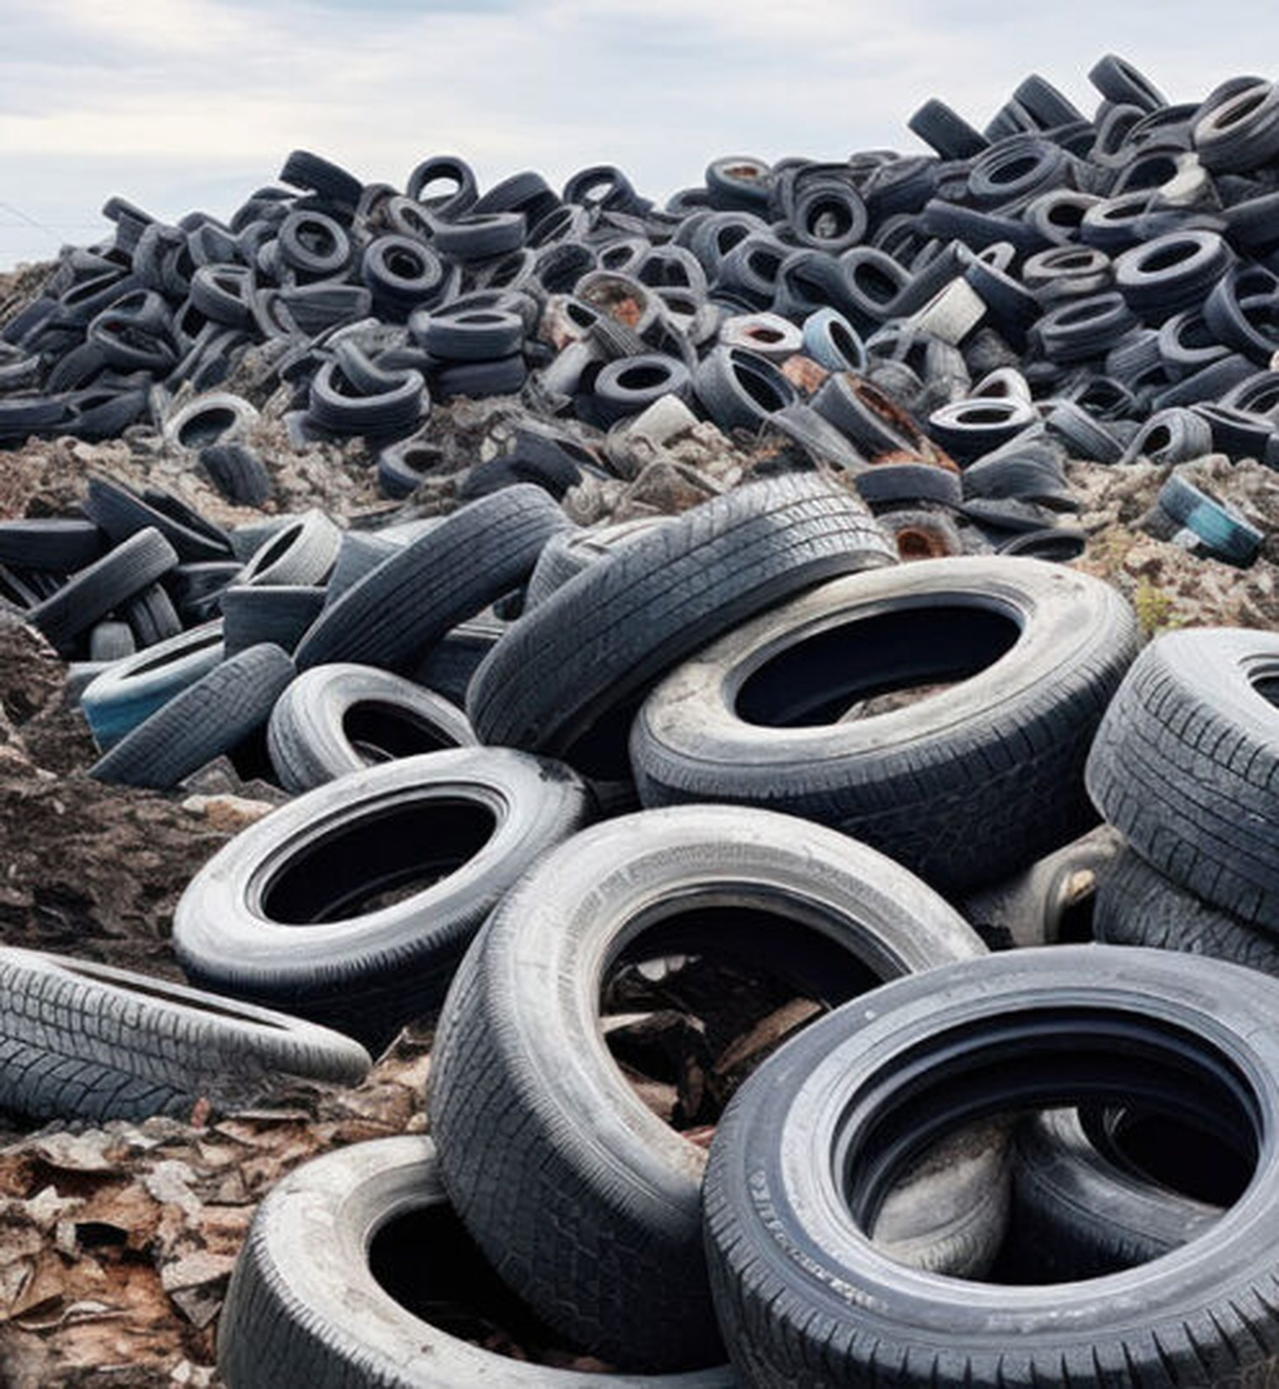
WHY LANDFILLS FAIL TIRES
The issue is not just volume. It is risk.
When tires are buried, dumped, or stockpiled, communities inherit a persistent environmental and public-health burden.
FIRE RISK
Stockpiles can create smoke plume and air-quality hazards.
WATER RISK
Tire rubber and ash contaminants can affect surface and groundwater.
PEST RISK
Stored tires can collect water and support mosquito breeding.
LONG-TERM COST
Improper storage becomes a cleanup and regulatory problem.
Sources: EPA Scrap Tires: Handbook on Recycling Applications and Management; USTMA.
WASTE ENERGY CORP. | OTC: WAST | 03

Slide 4
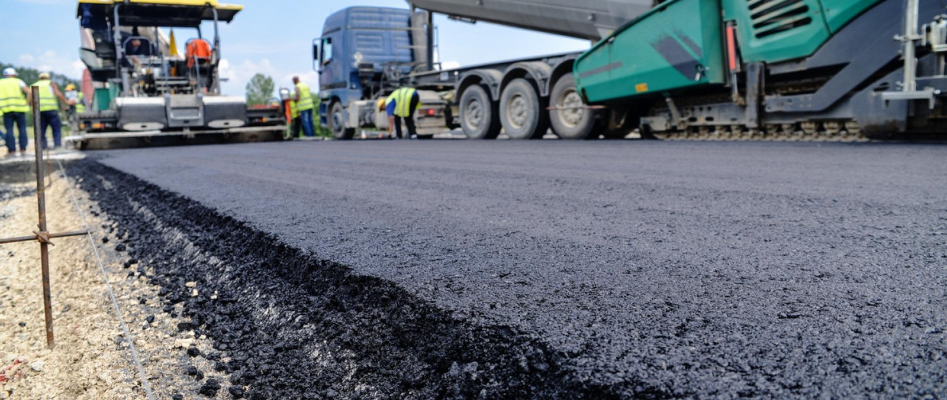
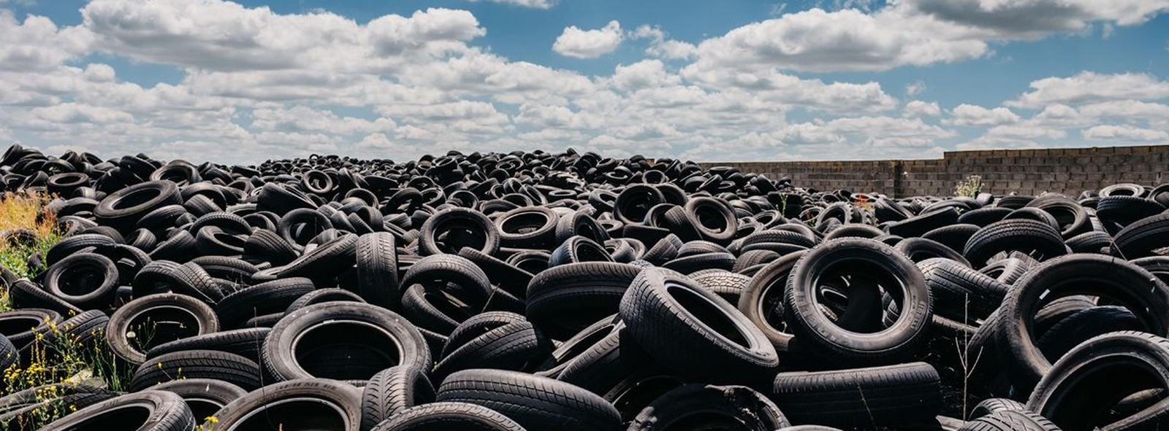
A STRUCTURAL MARKET GAP
Recycling is improving — but the gap still matters.
U.S. end-use markets consumed roughly 79% of annually generated end-of-life tires in 2023. WEC’s opportunity lives in the remaining difficult, fragmented, and underserved volumes.
Consumed by
end-use markets
79%
Remaining
gap
21%
The goal is not to compete only where traditional markets already work. It is to build infrastructure for streams others cannot or will not process at scale.
Sources: USTMA 2023 End-of-Life Tire Management Report; WBCSD/TIP ELT fact sheet.
WASTE ENERGY CORP. | OTC: WAST | 04

Slide 5
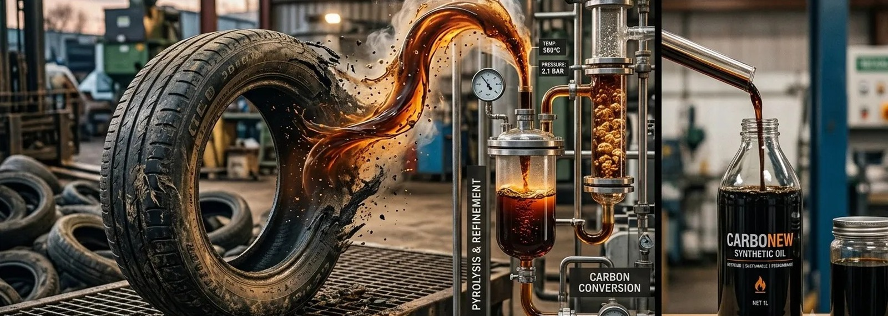
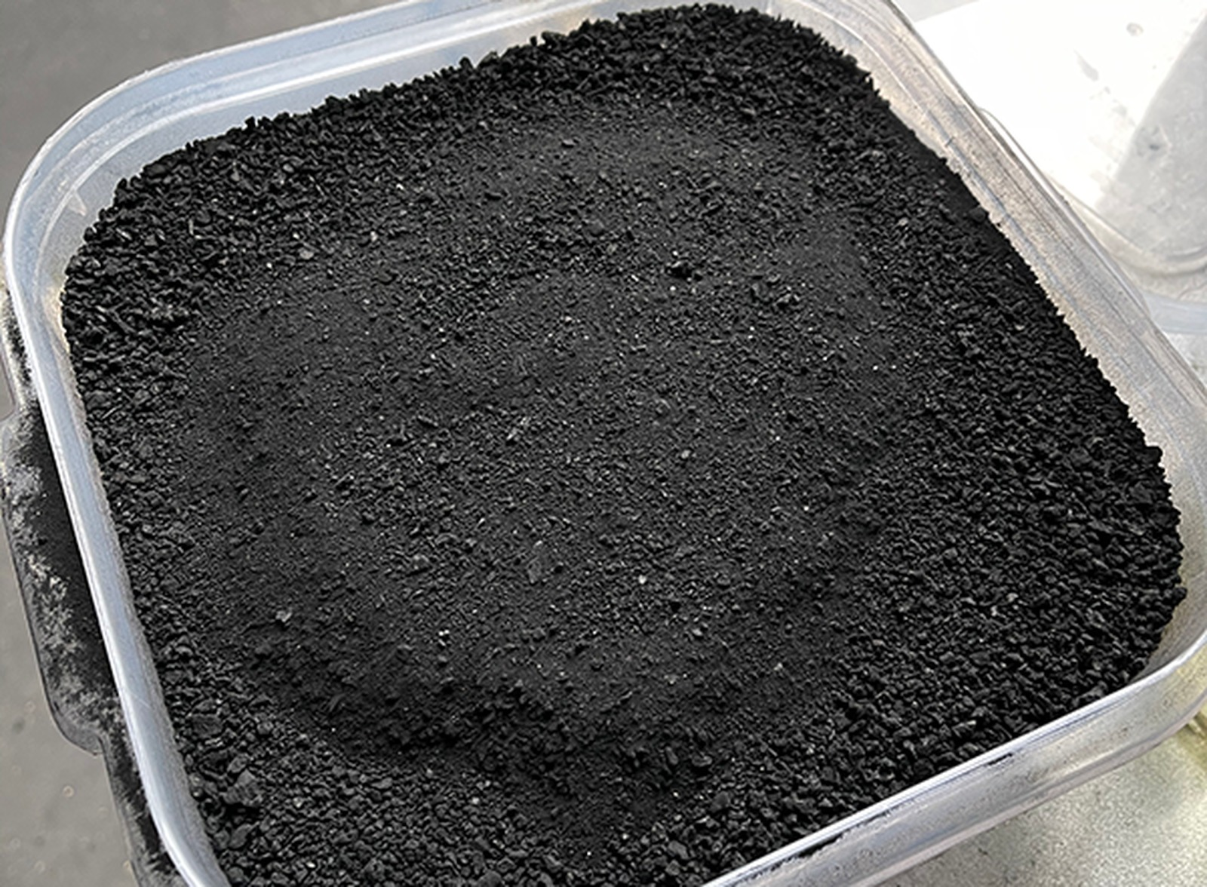
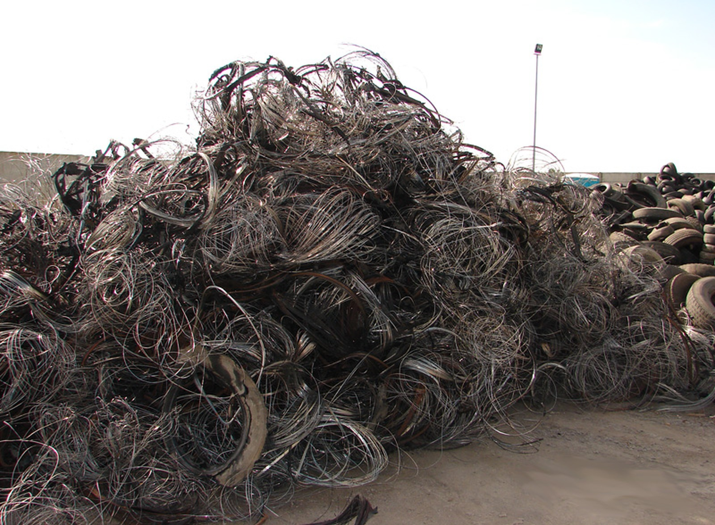

THE WEC ANSWER
Every tire WEC touches is intended to be diverted and converted.
WEC’s platform thesis: intercept tire waste before disposal, process it through controlled infrastructure, and recover useful outputs with measurable environmental value.
TIRE
WASTE
DIVERT
FROM LANDFILL
PROCESS &
CONVERT
RECOVER
OUTPUTS
MEASURE
IMPACT
→
→
→
→
The value stack begins at intake and compounds through recovered products, environmental attributes, data, and repeatable site economics.
WEC platform language based on public WEC website. Output examples are illustrative and subject to commissioning and commercial agreements.
WASTE ENERGY CORP. | OTC: WAST | 05

Slide 6
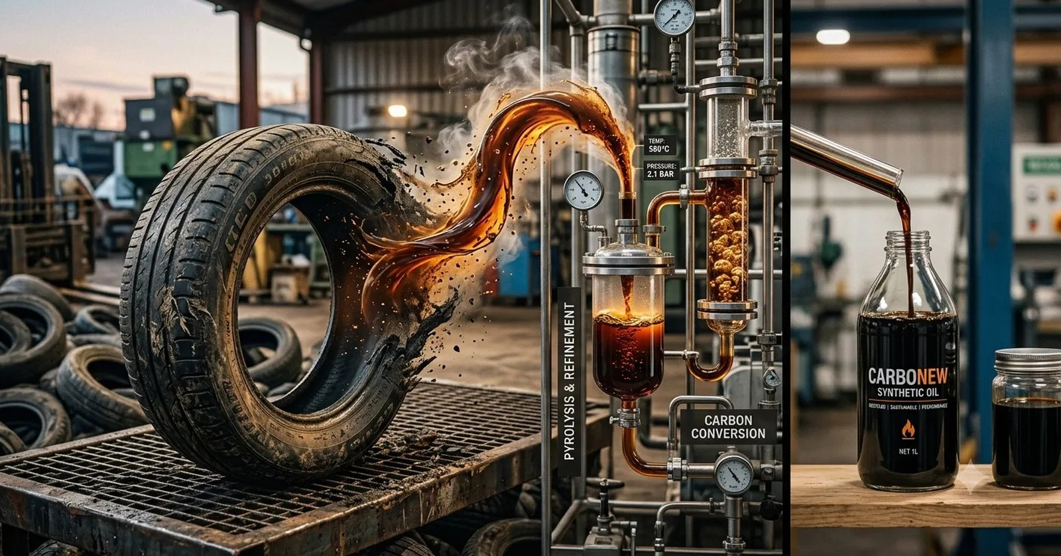
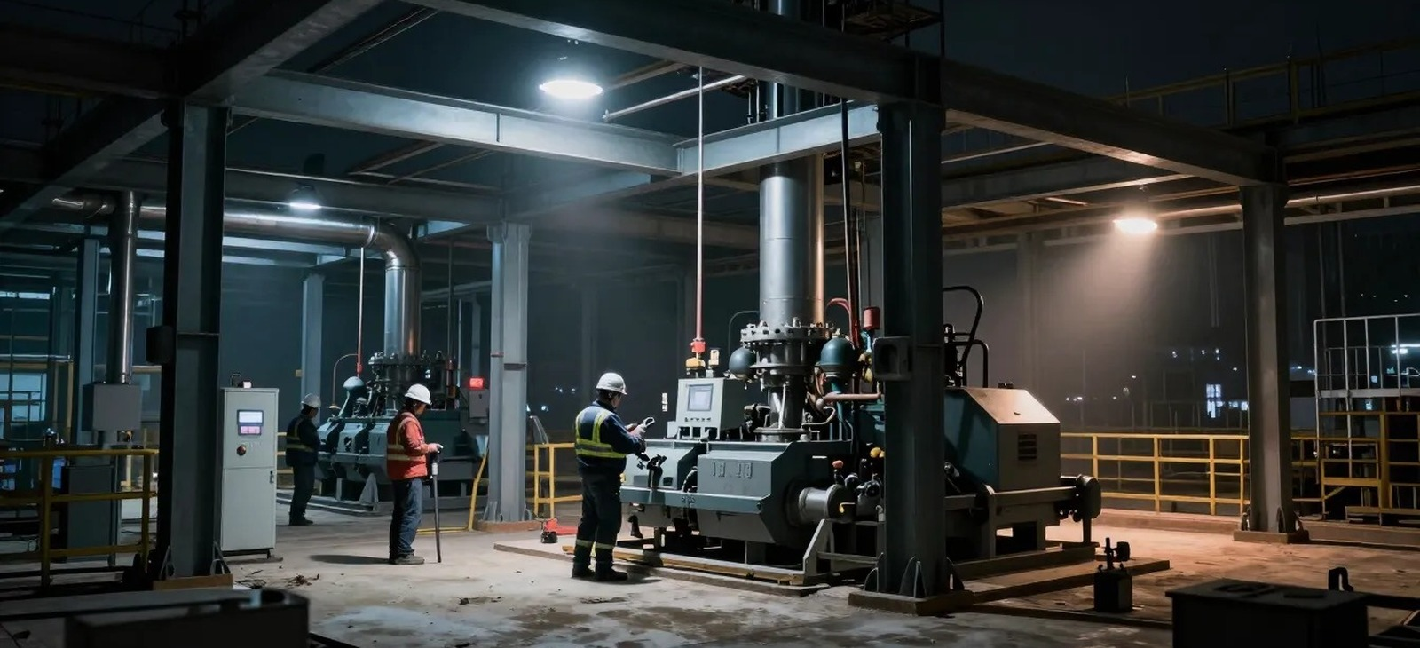
PLATFORM VALUE STACK
A tire is not one product. It is a bundle of recoverable value.
The WEC model is designed to avoid single-output dependency by participating across waste infrastructure, recovered materials, energy-related outputs, and environmental data.
• Intake & diversion revenue potential
• Recovered fuel or energy-related outputs
• Recovered carbon-rich materials
• Recovered metal content
• Environmental traceability and chain-of-custody data
• Replicable infrastructure model
Source: WEC website, Platform & Technology / Opportunity pages.
WASTE ENERGY CORP. | OTC: WAST | 06

Slide 7
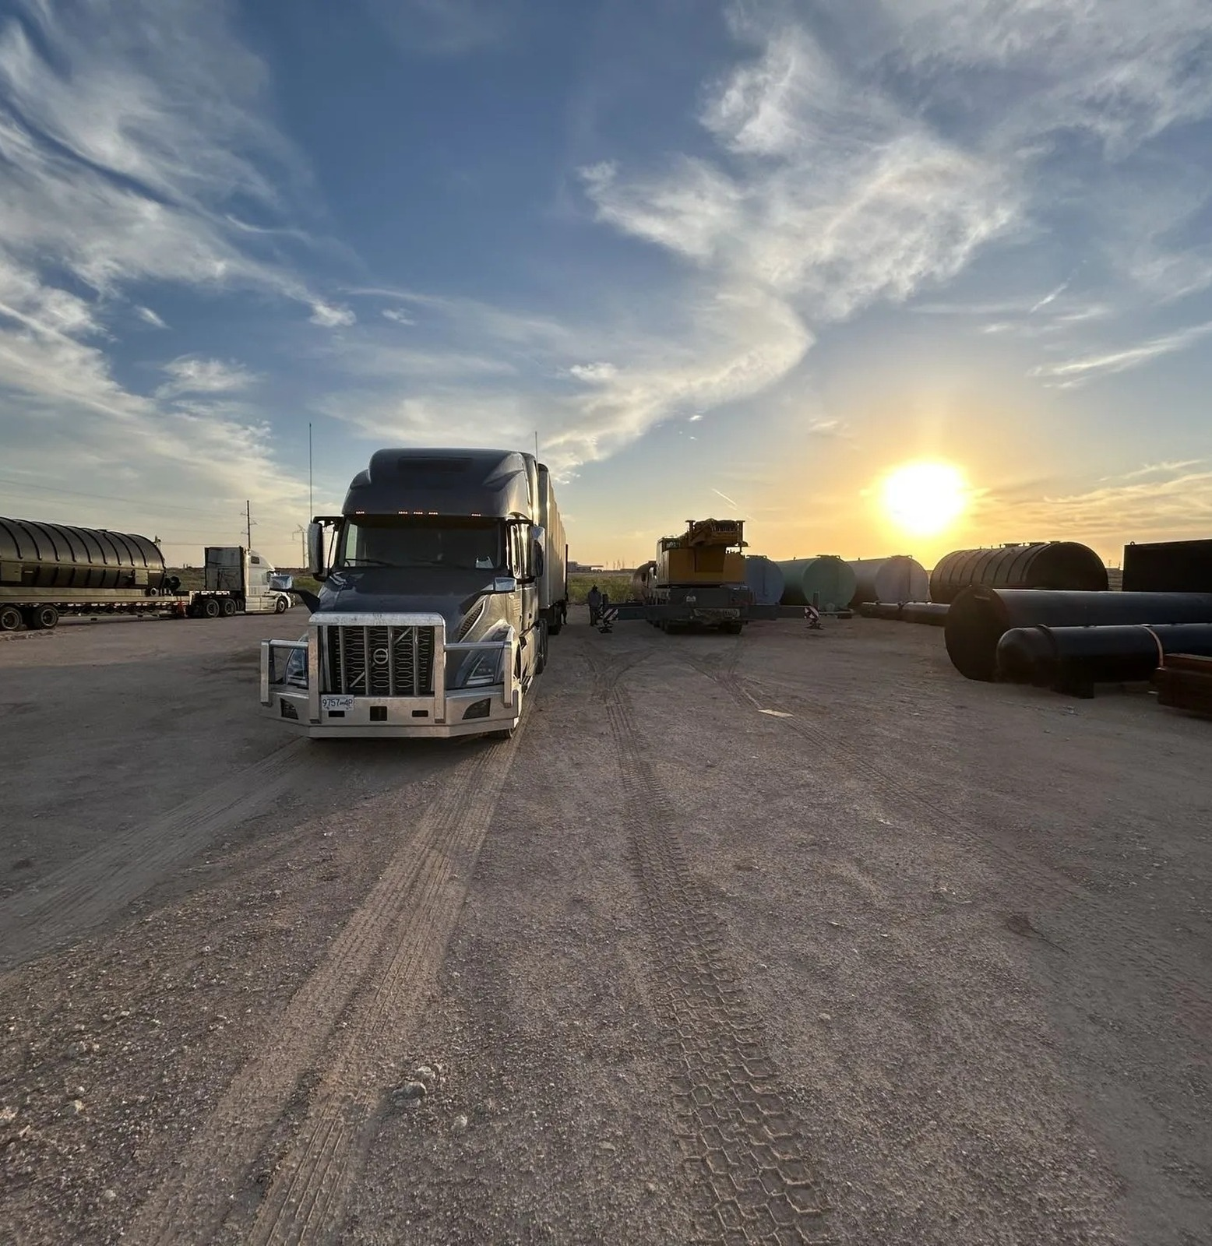
MIDLAND CAMPUS
The first mission: build the Midland waste-energy conversion campus.
Midland is intended to serve as WEC’s operating proof point — a controlled facility where feedstock intake, processing, output recovery, and environmental accountability can be validated.
1
Secure targeted feedstock
2
Commission conversion capacity
3
Develop offtake relationships
4
Measure diversion and outputs
Campus = feedstock + conversion + recovered outputs + data
Source: WEC public website expansion and platform strategy language.
WASTE ENERGY CORP. | OTC: WAST | 07

Slide 8
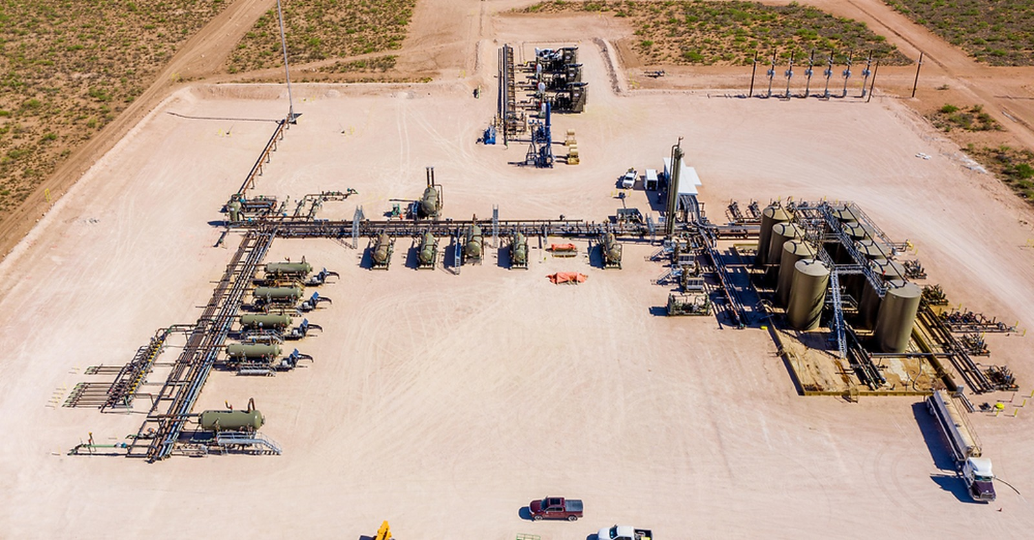
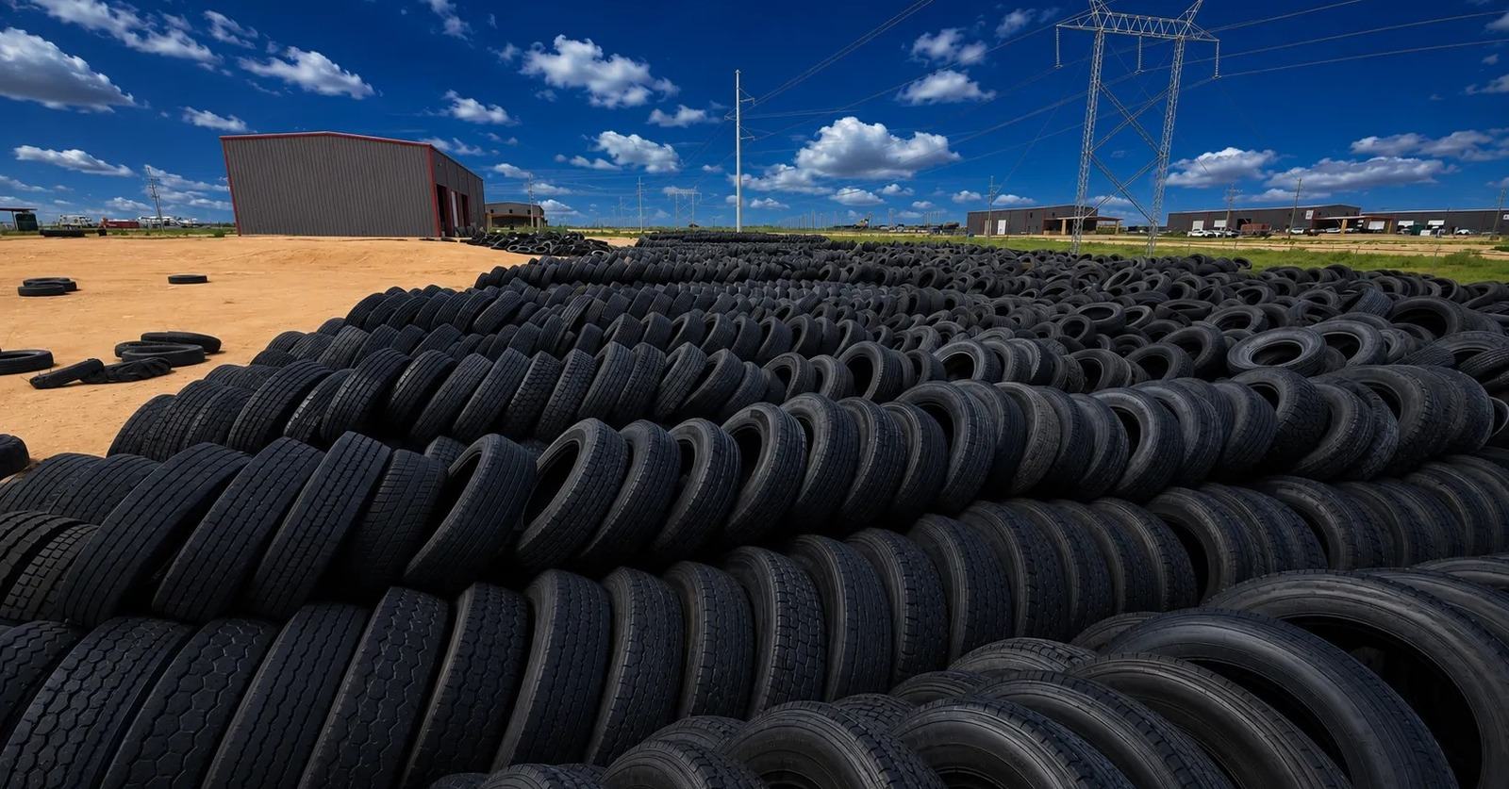
REPLICATION STRATEGY
Midland first. Texas next. Then a national platform.
The strategic goal is to replicate modular locations around recurring tire-waste corridors, bringing processing capacity closer to feedstock and customers.
PHASE 1
Midland campus proof point
PHASE 2
Texas modular rollout
PHASE 3
Regional U.S. network
PHASE 4
Data-enabled circular platform
Replicate the operating model — not just the machinery.
Source: WEC Platform & Technology page: phased expansion architecture and replication strategy.
WASTE ENERGY CORP. | OTC: WAST | 08

Slide 9
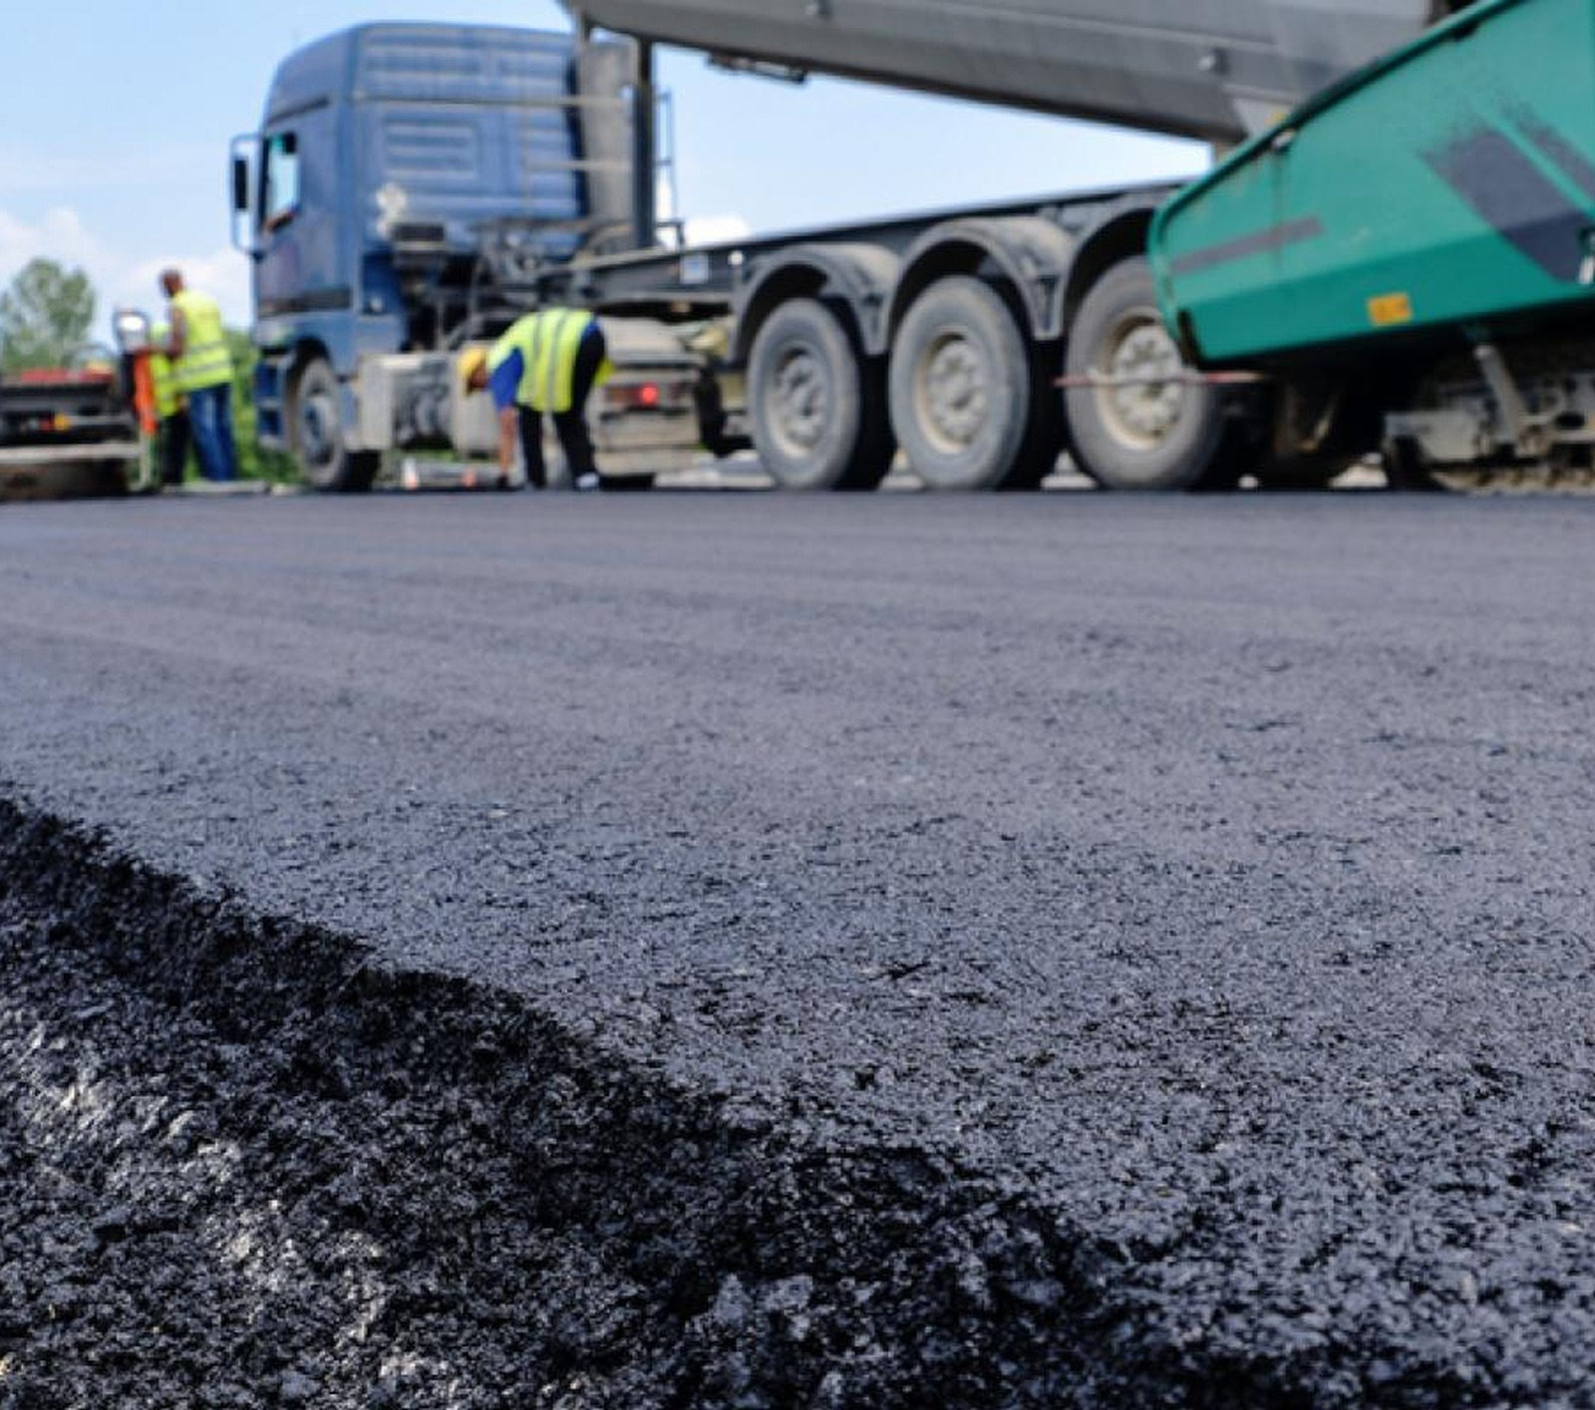
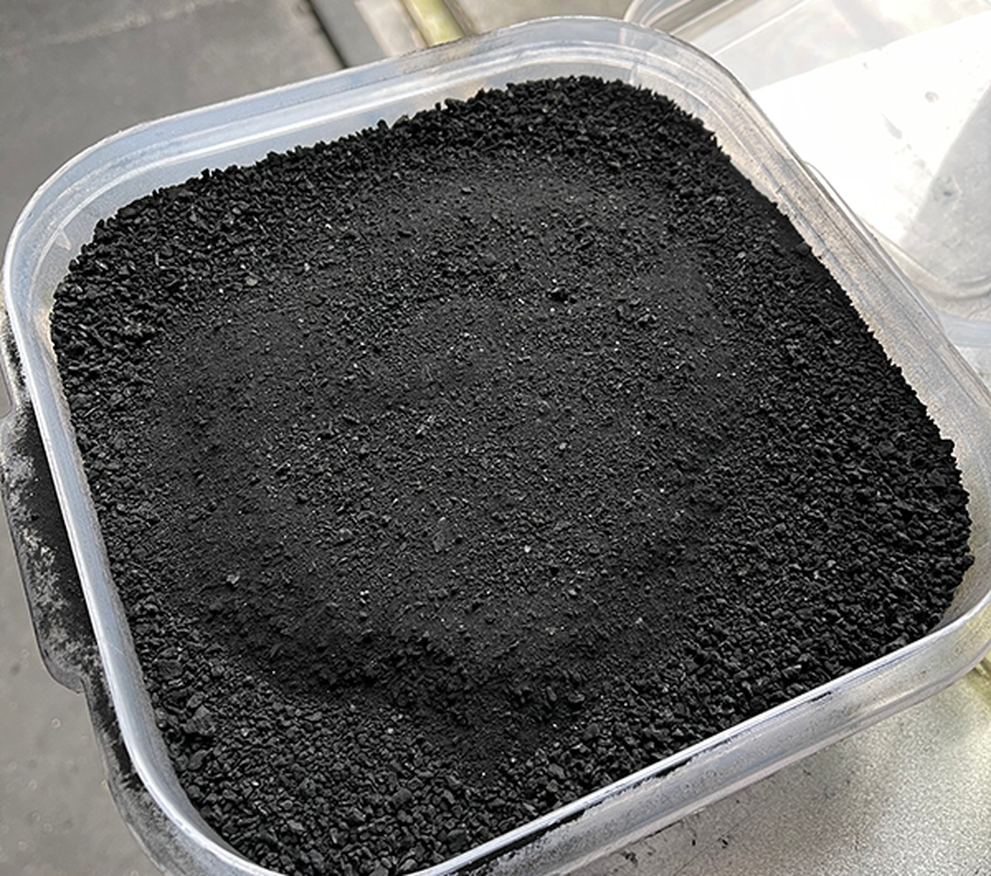
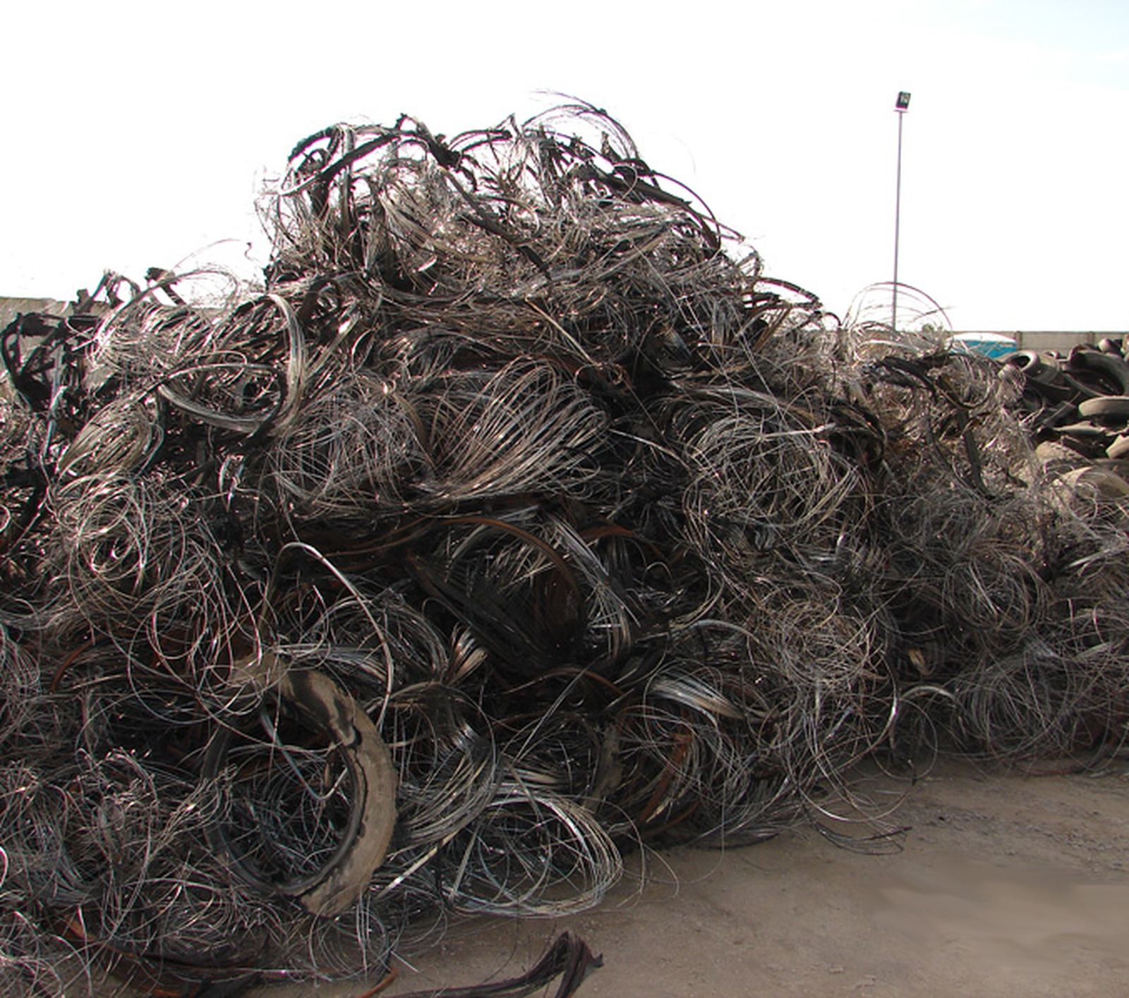
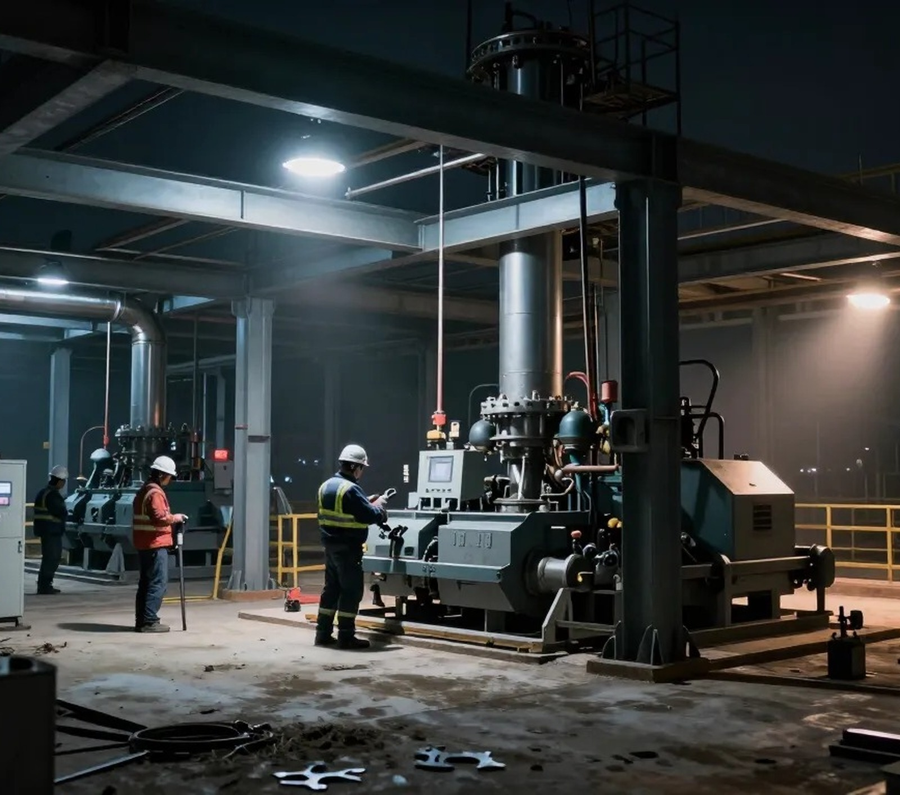
WHY NOW
The market is moving toward verified resource recovery.
Demand is being pulled by disposal pressure, circular-economy goals, domestic materials recovery, and the need for auditable environmental outcomes.
LANDFILL PRESSURE
Capacity constraints and permitting friction make disposal alternatives more valuable.
CIRCULAR DEMAND
Municipalities and industrial partners need verified diversion solutions.
DOMESTIC RESOURCES
Recovered materials support supply-chain resilience.
TRACEABILITY
Data-driven accountability may support ESG, compliance, and carbon-value infrastructure.
Sources: WEC Opportunity and Platform pages; USTMA Tire Recycling Markets.
WASTE ENERGY CORP. | OTC: WAST | 09

Slide 10
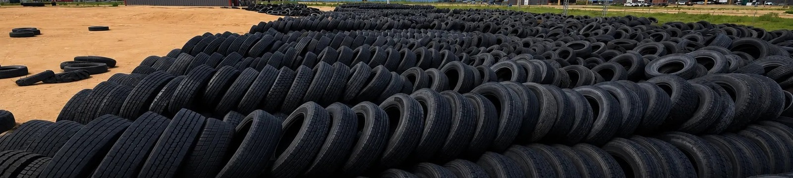
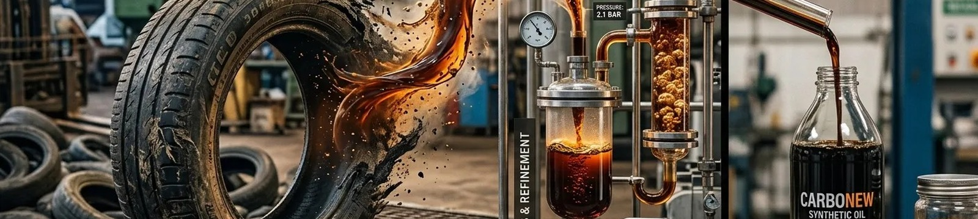
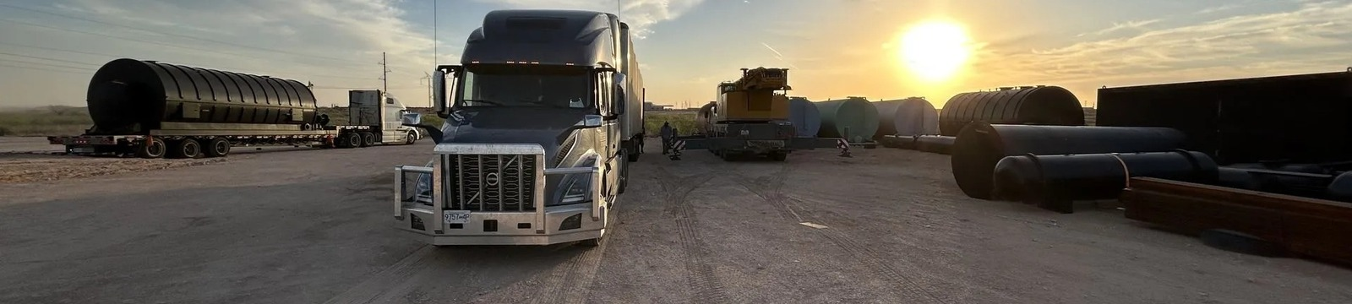
INVESTMENT THESIS
A resource-recovery infrastructure thesis, not a single-commodity bet.
WEC is positioned around recurring feedstock, multiple potential revenue streams, measurable impact, and a scalable campus-to-network expansion model.
Recurring waste feedstock
Difficult streams with fewer disposal alternatives
Multiple output channels
Environmental outcomes that can be measured
Designed for replication beyond one facility
Early-stage public company visibility
Source: WEC website Investment Thesis / Opportunity pages.
WASTE ENERGY CORP. | OTC: WAST | 10

Slide 11
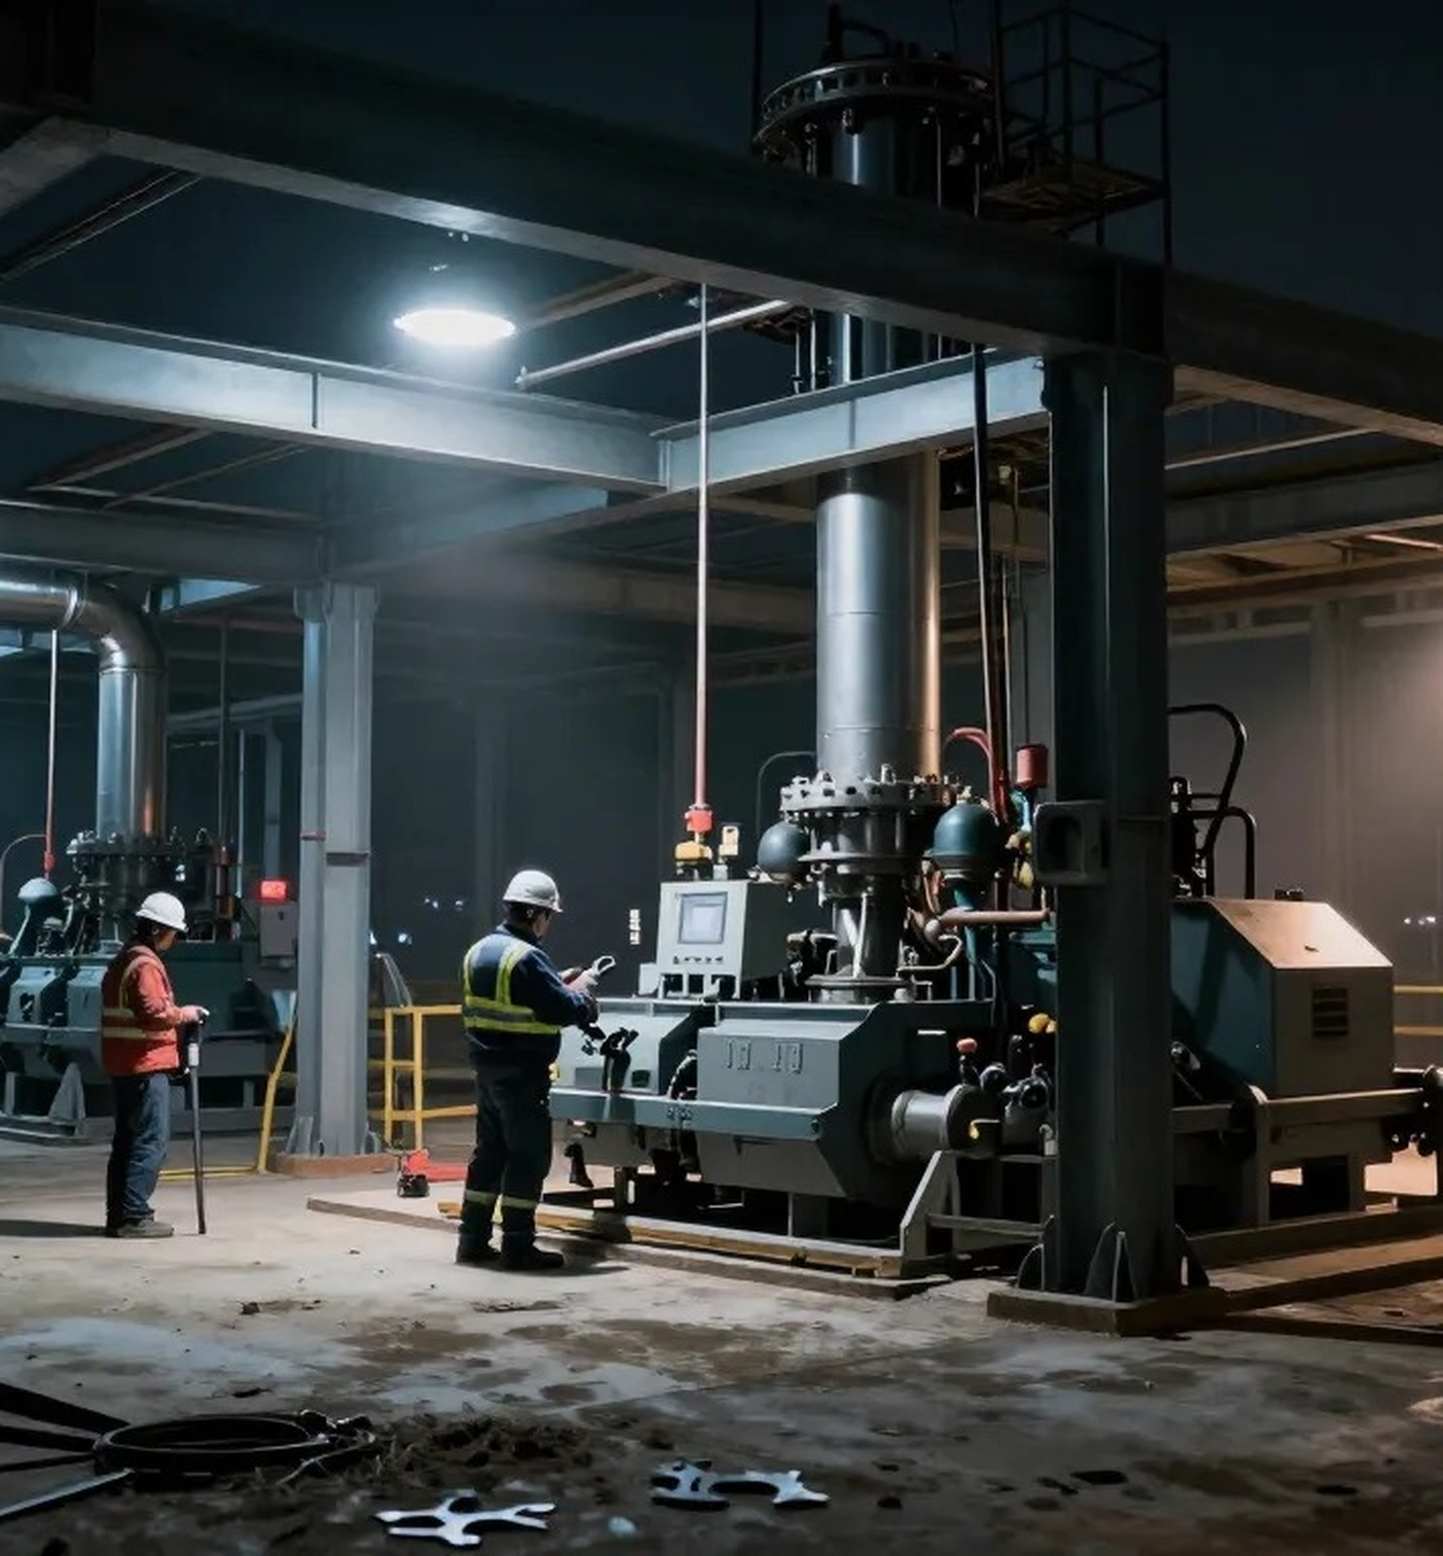
MEASURABLE OUTCOMES
The mission becomes more powerful when it is measurable.
The future platform value increases when every ton diverted can be tied to recovered outputs, chain-of-custody records, and environmental progress.
INPUTS
Tires received, source, weight, and chain of custody
PROCESS
Conversion status, operating data, and emissions visibility
OUTPUTS
Recovered materials, energy-related products, and market channels
WEC’s long-term opportunity is the operating system connecting waste intake to verified recovery.
Source: WEC Platform & Technology page: accountability, traceability, environmental measurement, and chain-of-custody data.
WASTE ENERGY CORP. | OTC: WAST | 11

Slide 12
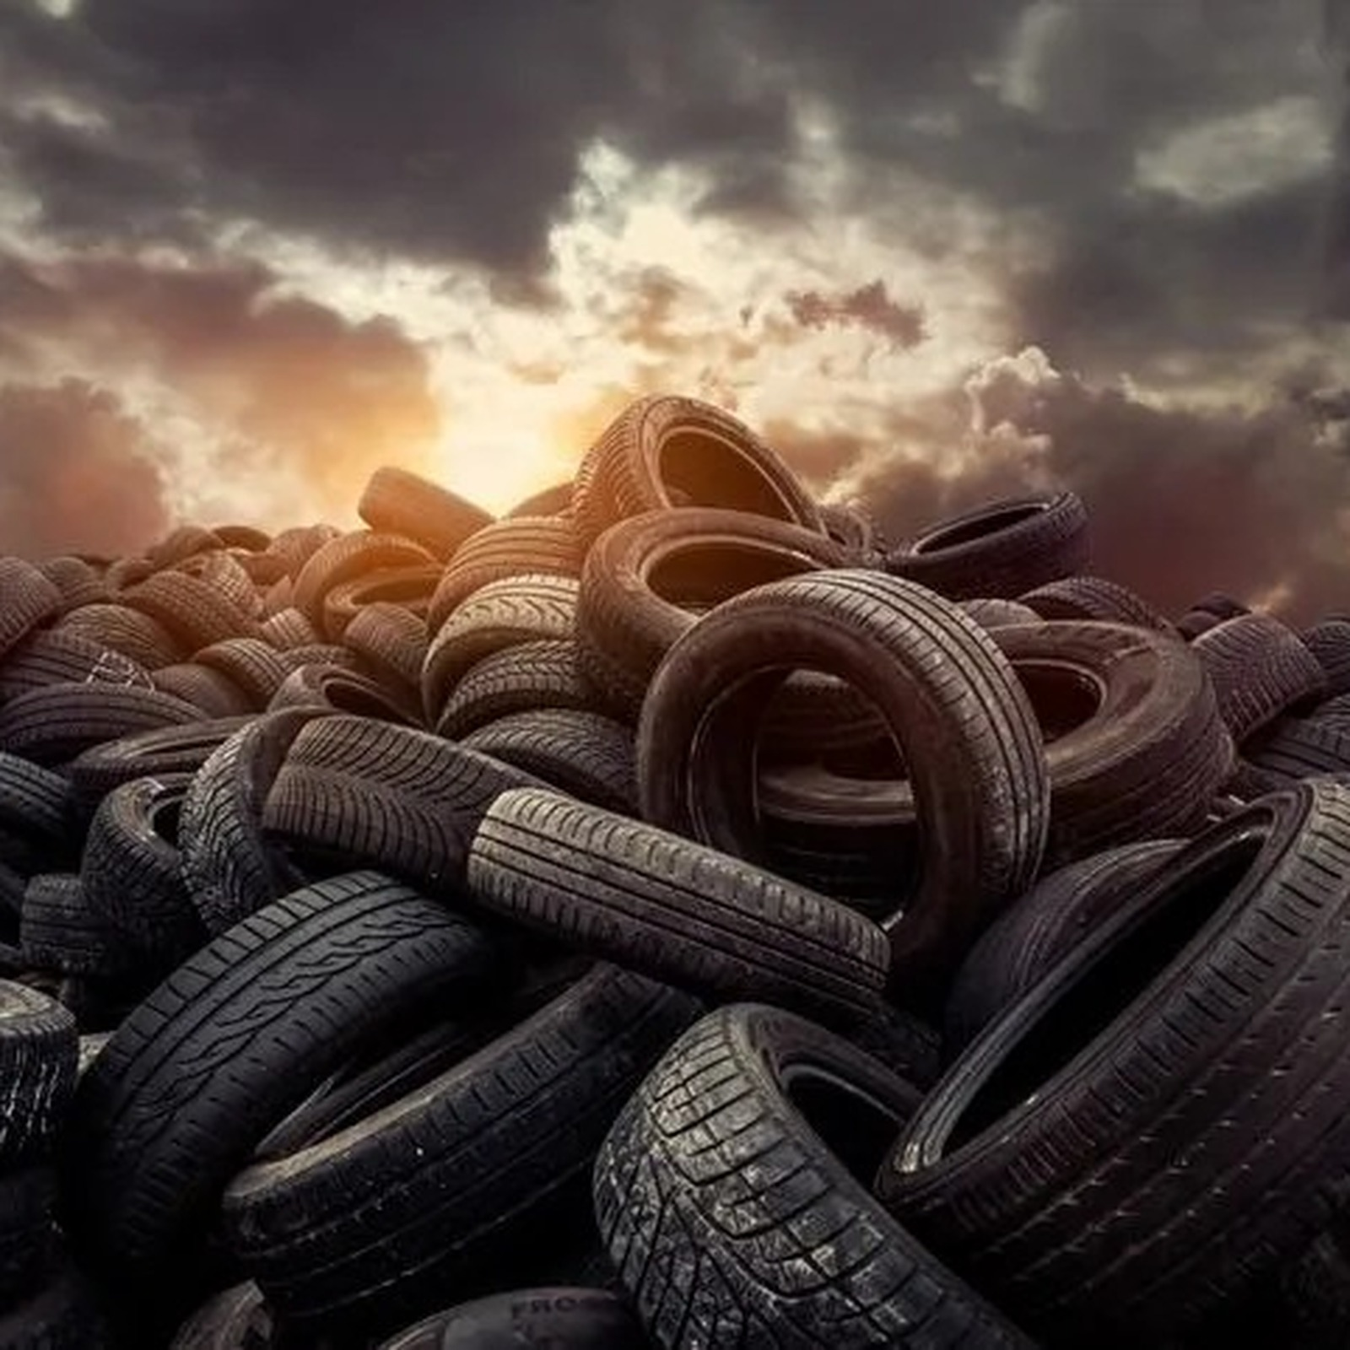
THE BIG IDEA
The world does not have a tire waste problem. It has a resource-recovery infrastructure opportunity.
WEC is building toward a platform where every tire it touches is diverted, converted, and transformed into something useful.
Follow WEC progress at wec.eco
This presentation contains forward-looking statements. See risk disclaimer and public filings.
WASTE ENERGY CORP. | OTC: WAST | 12

Slide 13
SOURCES & DISCLAIMERS
Sources & important notice
• Waste Energy Corp website: Opportunity, Platform & Technology, Environmental Impact pages; www.wec.eco.
• U.S. Tire Manufacturers Association: 2023 End-of-Life Tire Management Report and Tire Recycling Markets page.
• WBCSD Tire Industry Project: End-of-Life Tires fact sheet and Managing End-of-Life Tires report.
• EPA / USTMA Scrap Tires: Handbook on Recycling Applications and Management for stockpile risk factors.
• Images: WEC website assets and sourced illustrative images from USTMA and third-party image search results used for design context.
Forward-looking statements: This presentation contains forward-looking statements, including statements regarding targeted commissioning, commercial operations, product development, expansion, facility replication, revenue opportunities, environmental attributes, and future market participation. Forward-looking statements are subject to risks and uncertainties including successful commissioning, regulatory approvals, permitting, financing, equipment performance, feedstock availability, offtake agreements, customer adoption, commodity prices, market conditions, and risks described in WEC public filings. Nothing in this presentation constitutes an offer to sell or a solicitation to buy securities, investment advice, or a guarantee of future performance, revenue, profitability, environmental outcomes, or stock appreciation. Investors should review WEC public filings and consult their own advisors.
CONFIDENTIALITY / IP: WEC does not disclose proprietary engineering specifications, processing conditions, equipment configurations, operational recipes, or commercial terms in this public deck.
Waste Energy Corp. | OTC: WAST | ir@wec.eco
WASTE ENERGY CORP. | OTC: WAST | 13

